Slide 1
The Impact of Thrombus Aspiration on 1-year Mortality in Primary PCI for ST-Elevation Myocardial Infarction, ACSIS 2010 Experience
Mady Moriel, Shlomi Matetzky, Amit Segev,
Aharon Medina, Ran Kornowski, Haim Danenberg,
Natalie Gevrielov-Yusim, Ilan Goldenberg,
Dan Tzivoni, Shmuel Gottlieb
for ACSIS and ACSIS-PCI Investigators
60th International Conference of the Israel Heart Society
April 2013, Jerusalem

Slide 2
There are no financial relationships to disclose.

Slide 3
Background
Prior studies have suggested that thrombus aspiration (TA) in pts with STEMI undergoing PPCI may reduce 1-yr mortality.
Aim
To assess the impact of TA in consecutive STEMI pts undergoing PPCI on 1-yr mortality.
Methods
517 STEMI pts who underwent PPCI in 23 centers during ACSIS 2010 were included.
Results
Pts who underwent TA-PPCI vs. conventional (C)-PPCI were of similar age and had similar risk factors and history of coronary disease.

Slide 4
Angiographic and PPCI Results, Complications and 1-year Mortality
 | TA-PPCI (n=217) | C-PPCI (n=300) | P
Radial access (%) | 27 | 28 | 0.91
Multivessel disease (%) | 62 | 60 | 0.78
LAD-IRA (%) | 48 | 46 | 0.25
Culprit lesion ostial-proximal(%) | 47 | 42 | 0.26
Time from symptom onset to reperfusion (min; median,Q1,Q3) | 195 (130,317) | 188 (131,330) | 0.78
TIMI flow 0-1 before PPCI (%) | 80 | 56 | <0.0001
Restoration of flow after guidewire | 32 | 52 | <0.0001
IIb/IIIa inhibitors use (%) | 69 | 49 | <0.0001
TIMI flow 3, end of PPCI (%) | 90 | 92 | 0.38
Myocardial blush 3, end of PCI (%) | 60 | 64 | 0.35
ST segment resolution 1st ECG after PCI (%) | 78 | 65 | 0.003
Drug Eluting Stent (n,%) | 16 | 22 | 0.11
Hospital Complications, 1-y mortality (%)
No reflow | 5 | 3 | 0.46
Major bleeding | 1.84 | 2.67 | 0.53
Acute renal failure | 5.5 | 5 | 0.80
TIA/stroke | 0 | 1.33 | 0.037
1-year mortality (n, %) | (8/217) 3.7 | (20/299) 6.7 | 0.13

Slide 5
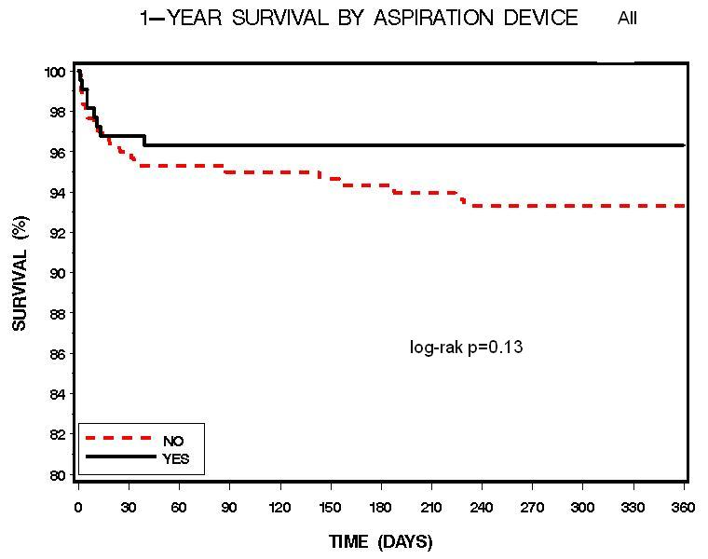
Variables Independently Associated with use of TA
3.7%7.7
 | OR | 95% CI | P
Center | 4.38 | 2.89-6.45 | <0.0001
TIMI 0,1 | 3.93 | 2.48-6.22 | <0.0001
Use of IIa/IIIb GP inhibitors | 1.76 | 1.16-2.68 | 0.008
Diabetes | 0.58 | 0.36-0.92 | 0.03
6.7%7.7
Predictors of 1-year mortality
p | Hazard Ratio (95% CI)
<0.0001 | 13.89 (4.52-42.71) | Killip Class >2
0.017 | 3.47 (1.25-9.65) | MBG<3
<0.0001 | 1.1 (1.05-1.155) | Age
0.042 | 0.31 (0.1-0.9) | Use of Aspiration
0.19 | 0.43 (0.12-1.55) | Use of IIb/IIIa

Slide 6
Conclusions
In the "real-world," practice use of TA in STEMI patients undergoing P-PPCI is associated with improved 1-year mortality

