Slide 1



אפיקסבאן למניעת stroke ודימום בחולי פרפור עליות
פרופ' דורון זגר
מנהל יחידת הביניים/ט.נ. לב, מ.מ. מנהל המערך הקרדיולוגי, מרכז רפואי סורוקה
הפקולטה למדעי הבריאות, אוניברסיטת בן גוריון בנגב

Slide 2
Conflicts of Interest:
Company Name Relationship
AstraZeneca honoraria, consultant
Eli Lilly honoraria, consultant
Iroko Honorarium
Bayer honoraria, consultant
Sanofi Aventis consultant
Rafa Laboratories honoraria, consultant
Pfizer honoraria, consultant

Slide 3
Warfarin for Atrial Fibrillation
Limitations Lead to Under-treatment
61%
55% Overall Use
58%
57%
44%
Warfarin Use in
Eligible Patients (%)
35%
<55
55-64
65-74
75-84
≥85
Age (years)
Go A et al. Ann Intern Med 1999;131:927.

Slide 4
The INR for VKAs is often outside the therapeutic range: international study of anticoagulation management
100
INR <2
INR 2–3
INR >3
80
60
Time in target range (%)
40
20
0
US
Canada
France
Italy
Spain
The predominant vitamin K antagonist (VKA) in use was warfarin in the US, Canada and Italy; acenocoumarol in Spain; and fluindione in France; INR = international normalized ratio
4
Ansell J et al. J Thromb Thrombolysis 2007;23:83–91

Slide 5
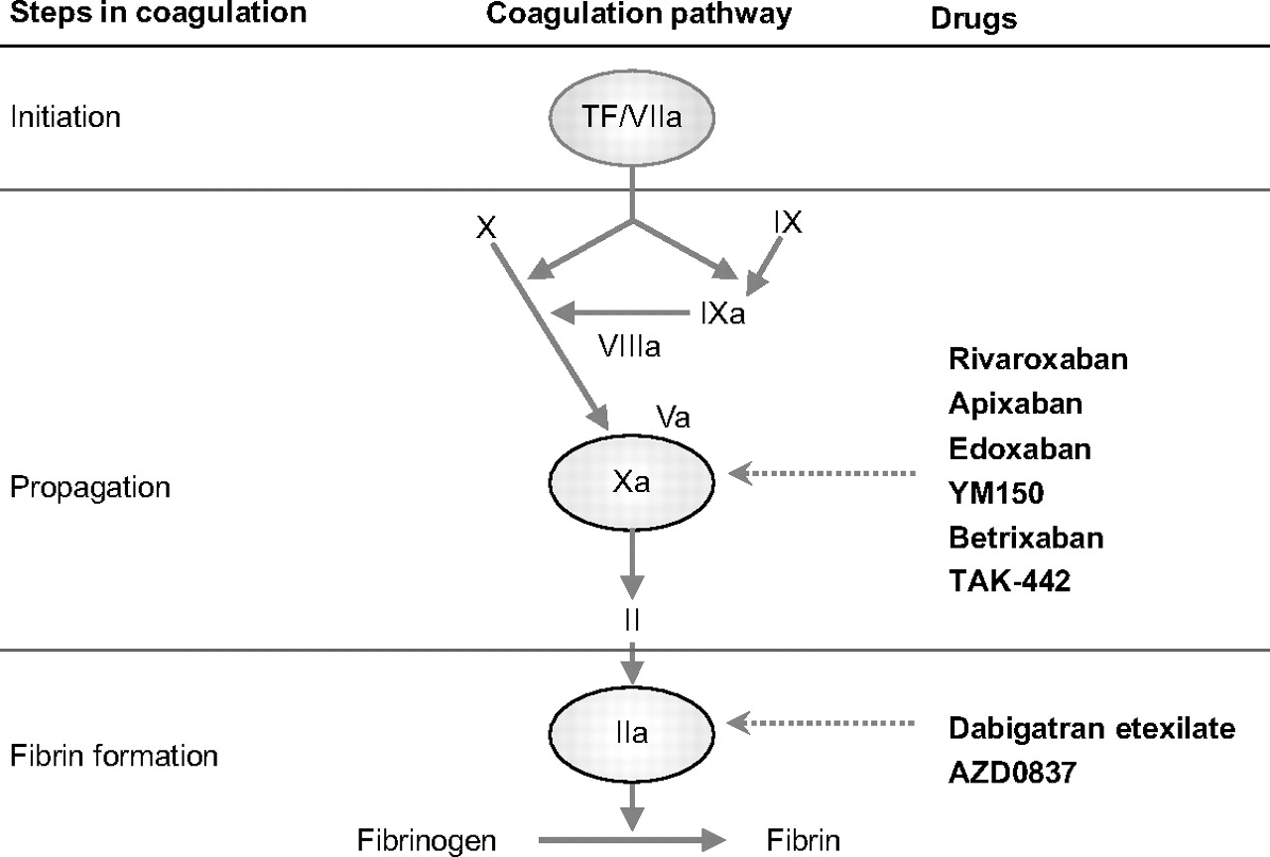


Illustration showing the sites of action of new anticoagulants in the coagulation cascade
Hankey, G. J. et al. Circulation 2011;123:1436-1450
Copyright ©2011 American Heart Association

Slide 6
Apixaban: a novel direct factor Xa inhibitor
O
Apixaban, a structurally novel and neutral bicyclic pyrazole, was rationally designed
and selected for the following qualities:
Not a prodrug
Oral bioavailability: ~50%
T_{max}: 3–4 h
~87% bound to plasma proteins
T_{1/2}: ~12 h
Multiple elimination/excretion pathways:
~27% renally excreted
No active circulating metabolites
N
NH₂
N
O
O
N
N
O
Apixaban
  Apixaban SmPC 2012.
  Pinto et al. J Med Chem. 2007;50(22):5339-56.
T_{1/2} = elimination half-life;
T_{max} = time to reach maximum plasma concentration
Notes:
References
1. Apixaban, SmPC 2012.
2. Pinto DJ, et al. Discovery of 1-(4-methoxyphenyl)-7-oxo-6-(4-(2-oxopiperidin-1-yl)phenyl)-4,5,6,7-tetrahydro-1H -pyrazolo[3,4-c]pyridine-3-carboxamide (apixaban, BMS-562247), a highly potent, selective, efficacious, and orally bioavailable inhibitor of blood coagulation factor Xa. J Med Chem 2007;50:5339-56.
6

Slide 7
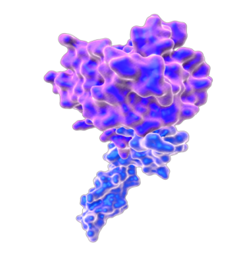
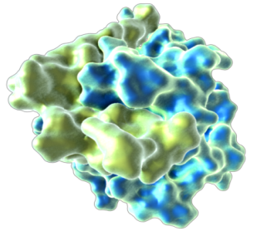
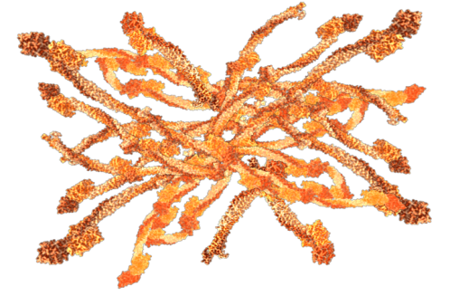
Direct factor Xa inhibition with apixaban
Apixaban can neutralise factor Xa regardless of whether
the target is clot bound or prothrombinase bound
Apixaban
factor Xa
Prothrombin
factor Xa
Fibrin clot
Ansell. J Thromb Haemost 2007;5(Suppl1):60-64.
Turpie AG. Arterioscler Thromb Vasc Biol. 2007 Jun;27(6):1238-47.
Notes:
References
1. Ansell J. Factor Xa or thrombin: is factor Xa a better target? J Thromb Haemost 2007;5(suppl1):60-4.
2. Turpie AGG. Oral, direct factor Xa inhibitors in development for the prevention and treatment of thromboembolic diseases. Arterioscler Thromb Vasc Biol 2007;27:1238-47.
7

Slide 8
המטבוליזם של אפיקסבאן אינו מושפע משמעותית מ:
אי ספיקת כבד קלה – בינונית
גיל
מין
מזון

Slide 9
Apixaban SmPC recommendations in AF patients requiring switch from VKA to apixaban or apixaban to VKA
Converting patients from VKA therapy to apixaban
Discontinue warfarin or other VKA therapy
Monitor INR at regular intervals until INR is < 2.0
Start apixaban BD
Converting patients from apixaban to VKA therapy
Continue apixaban for at least 2 days after beginning VKA
After 2 days, get an INR reading before next dose of apixaban
Continue both apixaban and VKA until INR is ≥ 2.0
Switching treatment from parenteral anticoagulants (and vice versa)
can be done at the next scheduled dose
Apixaban SmPC 2012.
Notes:
Abbreviations
AF: Atrial fibrillation
BD: Twice daily
INR: International normalised ratio
SmPC: Summary of product characteristics
VKA: Vitamin K antagonist
References
Apixaban, SmPC 2012.

Slide 10
How to use apixaban in patients with renal or hepatic impairment
Impaired renal function SmPC recommendation
 | Mild or moderate renal impairment | No dose adjustment required unless the patient fulfils criteria for dose reduction to 2.5 mg BD based on age, body weight and/or serum creatinine
 | Severe renal impairment (creatinine clearance 15-29 mL/min) | Dose reduction to 2.5 mg BD
 | Dialysis | Not recommended
 | Renal failure (creatinine clearance <15 mL/min) | Not recommended
Prior to initiating apixaban, liver function testing should be performed
 | Mild or moderate hepatic impairment (Child Pugh A or B) | Use with caution. No dose adjustment required
 | Severe hepatic impairment | Not recommended
 | Hepatic disease associated with coagulopathy and clinically relevant bleeding | Contraindicated
Patients with elevated liver enzymes (ALT/AST >2 x ULN) or total bilirubin ≥1.5 x ULN were excluded in clinical trials.
Therefore apixaban should be used with caution in this population.
Apixaban SmPC 2012.
Notes:
As there is no clinical experience in patients with creatinine clearance <15 mL/min, or in patients undergoing dialysis, apixaban is not recommended
in these patients.
No dose adjustment is necessary in patients with mild or moderate renal impairment.
Patients with serum creatinine ≥ 1.5 mg/dL (133 micromol/L) associated with
age ≥80 years or body weight ≤60 kg should receive the lower dose of apixaban
2.5 mg twice daily.
Patients with exclusive criteria of severe renal impairment (creatinine clearance 15-29 mL/min) should also receive the lower dose of apixaban 2.5 mg twice daily.
Prior to initiating apixaban, liver function testing should be performed.
Abbreviations
BD: Twice daily
ALT: Alanine aminotransferase
AST: Aspartate aminotransferase
ULN: Upper limit of normal
References
Apixaban, SmPC 2012.

Slide 11
Recommendations in other populations (with AF)
 | Patient characteristics | SmPC recommendation
 | Gender | No dose adjustment required.
 | Age – Elderly | No dose adjustment required in the elderly unless criteria for dose reduction are met. Caution when co-administered with aspirin.
 | Body weight | No dose adjustment required, unless criteria for dose reduction are met.
 | Age – Children | The safety and efficacy of apixaban in children and adolescents below age 18 have not been established. No data are available.
 | Pregnancy | Not recommended.
 | Breast-feeding | A risk to newborns and infants cannot be excluded. A decision must be made to either discontinue breast-feeding or to discontinue/abstain from apixaban therapy.
Apixaban SmPC 2012.
Notes:
Abbreviations
AF: Atrial fibrillation
SmPC: Summary of product characteristics
References
Apixaban, SmPC 2012.

Slide 12
Apixaban SmPC recommendations in AF patients with concomitant treatments
No dose adjustment* | Caution
Less potent inhibitors of CYP3A4 and/or P‑gp, such as: Diltiazem, naproxen, amiodarone, verapamil, quinidine Inducers of both CYP3A4 and P‑gp | Strong inducers of both CYP3A4 and P-gp, such as Rifampicin, phenytoin, carbamazepine, phenobarbital and St. John’s Wort NSAIDs including aspirin
Not recommended
Strong inhibitors of both CYP3A4 and P‑gp, such as: Azole-antimycotics (e.g., ketoconazole, itraconazole, voriconazole and posaconazole) HIV protease inhibitors (e.g., ritonavir) Agents associated with serious bleeding, such as: Thrombolytic agents, GPIIb/IIIa receptor antagonists, thienopyridines (e.g., clopidogrel), dipyridamole, dextran and sulfinpyrazone
*Unless other factors interfere
Apixaban SmPC 2012.
Notes:
Active substances which are not considered strong inhibitors of both CYP3A4 and P-gp, (e.g. diltiazem, naproxen, amiodarone, verapamil, quinidine)
are expected to increase apixaban plasma concentration to a lesser extent than strong inhibitors. Diltiazem (360 mg once a day), for instance, considered
a moderate CYP3A4 and a weak P‑gp inhibitor, led to a 1.4‑fold increase
in mean apixaban AUC and a 1.3‑fold increase in C_{max}. Naproxen (500 mg, single dose) an inhibitor of P‑gp but not an inhibitor of CYP3A4, led to a 1.5‑fold and 1.6‑fold increase in mean apixaban AUC and C_{max}, respectively. No dose adjustment for apixaban is required when co-administered with less potent inhibitors of CYP3A4 and/or P‑gp.
Co-administration of apixaban with rifampicin, a strong inducer of both CYP3A4 and P‑gp, led to an approximate 54% and 42% decrease in mean apixaban AUC and C_{max}, respectively. The concomitant use of apixaban with other strong CYP3A4 and P‑gp inducers (e.g., phenytoin, carbamazepine, phenobarbital or St. John’s Wort) may also lead to reduced apixaban plasma concentrations.
No dose adjustment for apixaban is required during concomitant therapy with such agents, however strong inducers of both CYP3A4 and P‑gp should be co-administered with caution.
Abbreviations
AF: Atrial fibrillation
AUC: Area under the curve
C_{max}: Maximum concentration
CYP3A4: Cytochrome P450 3A4
GPIIb/IIIa: Glycoprotein Iib/IIIa
HIV: Human immunodeficiency virus
NSAIDs: Nonsteroidal anti-inflammatory drugs
P-gp: P-glycoprotein
SmPC: Summary of product characteristics
References
Apixaban, SmPC 2012.

Slide 13
Concomitant use of apixaban with antiplatelet agents increases the risk of bleeding
Apixaban SmPC recommendations
In patients with AF and a condition that warrants mono or dual antiplatelet therapy,
a careful assessment of the potential benefits against the potential risks should be made before combining this therapy with apixaban.
Apixaban should be used with caution when co-administered with NSAIDs (including ASA) because these medicinal products typically increase the bleeding risk
ARISTOTLE | APPRAISE II
In a clinical trial of patients with AF, concomitant use of ASA increased the major bleeding risk: On apixaban from 1.8% to 3.4% per year On warfarin from 2.7% to 4.6% per year There was limited (2.1%) use of concomitant dual antiplatelet therapy | In a clinical trial of high-risk post ACS patients, characterised by multiple cardiac and non-cardiac comorbidities, who received ASA or the combination of ASA and clopidogrel: A significant increase in risk of ISTH major bleeding was reported: Apixaban: 5.13% per year Placebo: 2.04% per year
Apixaban SmPC 2012.
Notes:
Abbreviations
ACS: Acute coronary syndrome
AF: Atrial fibrillation
ISTH: International Society on Thrombosis and Haemostasis
NSAIDs: Non-steroidal anti-inflammatory drugs
SmPC: Summary of product characteristics
References
Apixaban, SmPC 2012.

Slide 14
Clinical pharmacology of various new oral anticoagulants
 | Apixaban^{1,2} | Rivaroxaban^{1,3} | Dabigatran^{1,4}
Mechanism of action | Direct factor Xa inhibitor | Direct factor Xa inhibitor | Direct thrombin inhibitor
Oral bioavailability | ~50% | 80-100% | ~6.5%
Pro-drug | No | No | Yes
Food effect | No | Yes (20 mg and 15 mg doses taken with food) | No
Renal clearance | ~27% | ~33 % * | 85%
Dialysis | Not recommended | Not dialysable | Dialysable
Mean half-life (t_{1/2}) | ~12 h | 5-13 h | 12-14 h
T_{max} | 3-4 h | 2-4 h | 0.5-2 h
direct renal excretion as unchanged active substance
The information in this table is based on the SmPC for apixaban, rivaroxaban and dabigatran. Please refer to the SmPC for further information.
1. Ansell J. Hematology Am Soc Hematol Educ Program 2010:221-8. 2. Apixaban SmPC 2012
3. Rivaroxaban SmPC 2012. 4. Dabigatran SmPC 2012.
Notes:
References
1. Ansell J. Warfarin versus new agents: interpreting the data. Hematology Am Soc Hematol Educ Program 2010:221-8.
2. Apixaban, SmPC 2012
3. Rivaroxaban, SmPC 2012.
4. Dabigatran, SmPC 2012.

Slide 15
Management of bleeding complications
First measures¹:
Treatment must be discontinued
The source of bleeding must be investigated
The initiation of appropriate treatment, e.g. surgical haemostasis or the transfusion of fresh frozen plasma, should be considered
Administration of activated charcoal may be useful in the management of apixaban overdose or accidental ingestion.
If life-threatening bleeding cannot be controlled by the above measures, administration of recombinant factor VIIa (rFVIIa) may be considered¹.
However, there is currently no experience with the use of rFVIIa in individuals receiving apixaban.
Re-dosing of rFVIIa could be considered and titrated depending on improvement of bleeding
An in vitro study suggests that PCC or activated PCC reverses the anticoagulant action of apixaban.²
1. Apixaban SmPC 2012
2. Escolar et al. Thromb Res 2012;130 (Suppl 1):S113, abstract no. C0122
PCC= Prothrombin Complex Concentrate
Notes:
Abbreviations
rFVIIa: Recombinant factor VIIa
References
Apixaban, SmPC 2012.

Slide 16
Management of bleeding complications:
Prothrombin Complex Concentrates
Prothrombin complex concentrates (PCC) contains
coagulation factors II, VII, IX, X.¹
An in vitro study suggests that PCC or activated PCC reverses
the anticoagulant action of apixaban.²
So far, there are no studies with apixaban with PCC or
activated PCC in humans.
Some animal studies suggest a beneficial effect of PCCs
for the reversal of bleeding with rivaroxaban.¹
PCC immediately and completely reversed the anticoagulant effect
of rivaroxaban in healthy subjects.¹
1. Eerenberg et al. Circulation 124:1573-9.
2. Escolar et al. Thromb Res 2012;130 (Suppl 1):S113, abstract no. C0122.
PCC= Prothrombin Complex Concentrate
Notes:
Abbreviations
PCC: Prothrombin complex concentrates.
References
Eerenberg ES et al. Reversal of rivaroxaban and dabigatran by prothrombin complex concentrate: a randomized, placebo-controlled, crossover study in healthy subjects. Circulation 2011;124:1573-9.
Escolar G et al. Effects of apixaban on hemostasis and reversal of its anticoagulant action by different coagulation factor concentrates: studies in vitro with circulating human blood. Thromb Res 2012;130 (Suppl 1):S113, abstract no. C0122.

Slide 17
Guidance on discontinuing apixaban before surgical or invasive procedures
Elective procedures |  | Urgent procedures
Low risk of bleeding* | Moderate or high risk of bleeding**
At least 24h prior to surgery or procedure* | At least 48h prior to surgery or procedure** | Appropriate caution should be exercised, taking into consideration an increased risk of bleeding. This risk of bleeding should be weighed against the urgency of intervention.
*Interventions for which any bleeding that occurs is expected to be minimal, non-critical in its location or easily controlled
**Interventions for which the probability of clinically significant bleeding cannot be excluded or for which the risk of bleeding would be unacceptable
Apixaban SmPC 2012.

Slide 18
Apixaban versus Warfarin in Patients with Atrial Fibrillation
Results of the ARISTOTLE Trial
Presented on behalf of the ARISTOTLE Investigators and Committees
Sponsored by Bristol-Myers Squibb and Pfizer

Slide 19
Atrial Fibrillation with at Least One Additional Risk Factor for Stroke
    Inclusion risk factors
    Age ≥ 75 years
    Prior stroke, TIA, or SE
    HF or LVEF ≤ 40%
    Diabetes mellitus
    Hypertension
Randomize
double blind, double dummy
(n = 18,201)
    Major exclusion criteria
    Mechanical prosthetic valve
    Severe renal insufficiency
    Need for aspirin plus thienopyridine
Apixaban 5 mg oral twice daily
(2.5 mg BID in selected patients)
Warfarin
(target INR 2-3)
Warfarin/warfarin placebo adjusted by INR/sham INR
based on encrypted point-of-care testing device
Primary outcome: stroke or systemic embolism
Hierarchical testing: non-inferiority for primary outcome, superiority for primary outcome, major bleeding, death

Slide 20
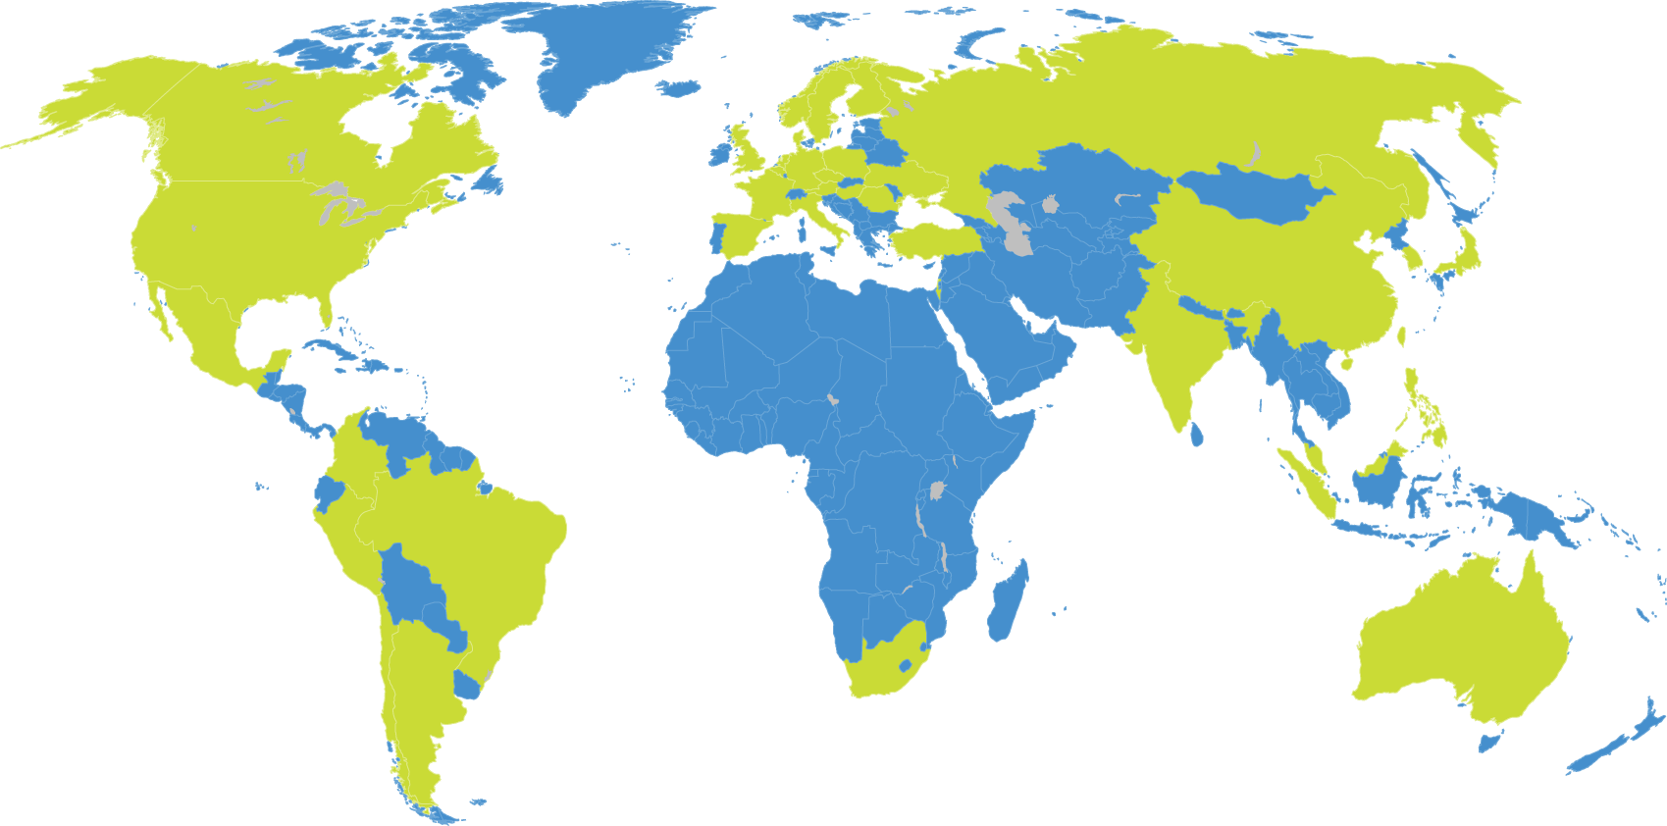
Enrollment
18,201 patients, 1034 sites, 39 countries
Poland: 314
Finland: 26
Norway: 90
Sweden: 217
Hungary: 455
Romania: 274
Russia: 1800
Canada:
1057
Denmark: 339
Ukraine: 956
U.K.: 434
Turkey: 6
United States:
3433
Netherlands: 309
Japan: 336
Belgium: 194
China: 843
Mexico:
609
Germany: 854
South Korea: 310
France: 35
India:
601
Spain: 230
Taiwan: 57
Czech Rep: 165
Hong Kong: 76
Colombia: 111
Austria: 34
Malaysia: 126
Philippines: 205
Italy: 178
Singapore: 40
Peru: 213
Brazil: 700
Israel: 344
Chile: 258
Australia: 322
South Africa: 89
Argentina: 1561

Slide 21
Objectives
Primary objective
To determine whether apixaban is non-inferior to warfarin at reducing stroke (ischemic or hemorrhagic) or systemic embolism in patients with atrial fibrillation and at least one additional risk factor for stroke.
Primary safety outcome
Major bleeding according to the International Society of Thrombosis and Hemostasis (ISTH) definition.

Slide 22
Objectives and Statistics
To control the overall type I error, a pre-specified hierarchical sequential testing was performed.
The primary outcome (stroke or systemic embolism) for non-inferiority (upper limit of 95% CI < 1.38 and upper limit of 99% CI < 1.44)
If met, then the primary outcome was tested for superiority
If met, then major bleeding was tested for superiority
If met, then all-cause mortality was tested for superiority

Slide 23
Apixaban and Warfarin Dosing
Apixaban (or matching placebo) was dosed at 5 mg twice daily, or 2.5 mg twice daily for a subset of patients with 2 or more of the following criteria: age ≥ 80 years, body weight ≤ 60 kg, serum creatinine ≥ 1.5 mg/dL (133 µmol/L).
Warfarin (or matching placebo) was dosed guided by blinded encrypted INR point-of-care device, with target INR of 2.0–3.0.

Slide 24
Baseline Characteristics
Characteristic | Apixaban (n=9120) | Warfarin (n=9081)
Age, years, median (25th, 75th %ile) | 70 (63, 76) | 70 (63, 76)
Women, % | 35 | 35
Region, %
North America | 25 | 25
Latin America | 19 | 19
Europe | 40 | 40
Asia/Pacific | 16 | 16
Warfarin naïve, % | 43 | 43
CHADS score, mean (+/- SD) | 2.1 (+/- 1.1) | 2.1 (+/- 1.1)
1, % | 34 | 34
2, % | 36 | 36
≥ 3, % | 30 | 30

Slide 25
Baseline Characteristics
Characteristic | Apixaban (n=9120) | Warfarin (n=9081)
Qualifying risk factors, %
Age ≥75 yrs | 31 | 31
Prior stroke, TIA, or SE | 19 | 20
Heart failure or reduced LV EF | 35 | 36
Diabetes | 25 | 25
Hypertension | 87 | 88
Renal function (Cl_{Cr} ml/min), %
Normal (>80) | 41 | 41
Mild impairment (>50 – 80) | 42 | 42
Moderate impairment (>30 – 50) | 15 | 15
Severe impairment (≤ 30) | 1.5 | 1.5

Slide 26
Trial Metrics
Patients enrolled from December 2006 to April 2010
Median duration of follow-up 1.8 years
Drug discontinuation in 25.3% of apixaban and 27.5% of warfarin patients (p=0.001)
Vital status at the end of the trial was missing in 380 (2.1%) patients
  Withdrawal of consent in 199 patients
  Loss to follow-up in 69 patients
Median (and mean) times in therapeutic INR range among warfarin- treated patients were 66.0 (and 62.2)%.
*Rosendaal FR et al. Throb Haemost 1993;69:236–39.

Slide 27
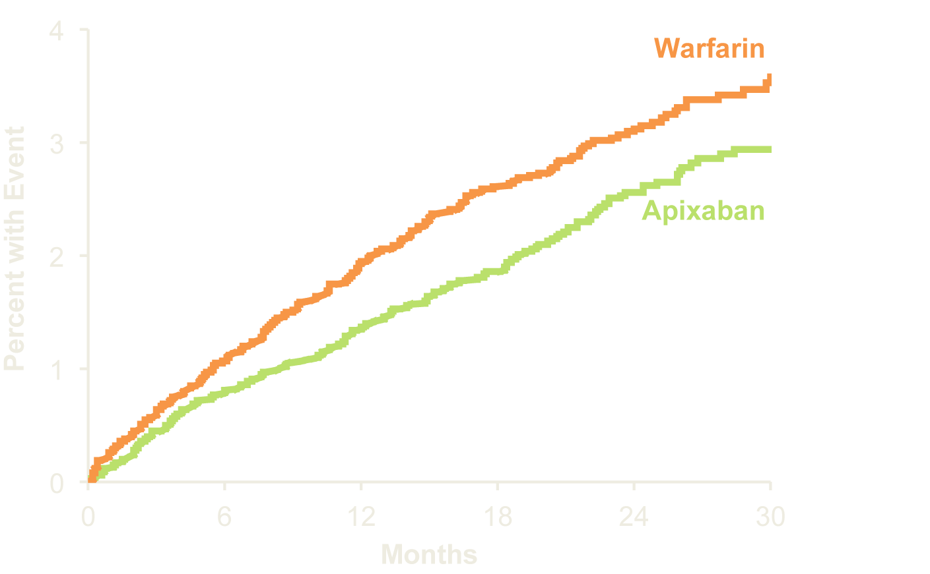
Primary Outcome
Stroke (ischemic or hemorrhagic) or systemic embolism
P (non-inferiority)<0.001
21% RRR
Apixaban 212 patients, 1.27% per year
Warfarin 265 patients, 1.60% per year
HR 0.79 (95% CI, 0.66–0.95); P (superiority)=0.011
No. at Risk
Apixaban 9120 8726 8440 6051 3464 1754
Warfarin 9081 8620 8301 5972 3405 1768

Slide 28
Efficacy Outcomes
Outcome | Apixaban (N=9120) | Warfarin (N=9081) | HR (95% CI) | P Value
 | Event Rate (%/yr) | Event Rate (%/yr)
Stroke or systemic embolism* | 1.27 | 1.60 | 0.79 (0.66, 0.95) | 0.011
Stroke | 1.19 | 1.51 | 0.79 (0.65, 0.95) | 0.012
Ischemic or uncertain | 0.97 | 1.05 | 0.92 (0.74, 1.13) | 0.42
Hemorrhagic | 0.24 | 0.47 | 0.51 (0.35, 0.75) | <0.001
Systemic embolism (SE) | 0.09 | 0.10 | 0.87 (0.44, 1.75) | 0.70
All-cause death* | 3.52 | 3.94 | 0.89 (0.80, 0.998) | 0.047
Stroke, SE, or all-cause death | 4.49 | 5.04 | 0.89 (0.81, 0.98) | 0.019
Myocardial infarction | 0.53 | 0.61 | 0.88 (0.66, 1.17) | 0.37
* Part of sequential testing sequence preserving the overall type I error

Slide 29
ARISTOTLE: Apixaban was superior to warfarin in reducing all-cause mortality
All-cause mortality*
11% RRR
HR: 0.89
95% CI: 0.80-0.998;
p=0.047
3.94%
669/9081
3.52%
603/9120
Event rate (% / year)
Warfarin
Apixaban
Figure created from data in Granger et al. N Engl J Med 2011;365:981-92.
*Key secondary efficacy endpoint
Notes:
The rate of death from any cause (key secondary outcome) was lower in
the apixaban group than in the warfarin group (3.52% per year vs. 3.94% per year; HR, 0.89; 95% CI, 0.80 to 0.99; P = 0.047).
Abbreviations
CI: Confidence interval
HR: Hazard ratio
RRR: Relative risk reduction
References
Granger CB et al; ARISTOTLE Committees and Investigators. Apixaban versus warfarin in patients with atrial fibrillation. N Engl J Med 2011;365:981-92.

Slide 30
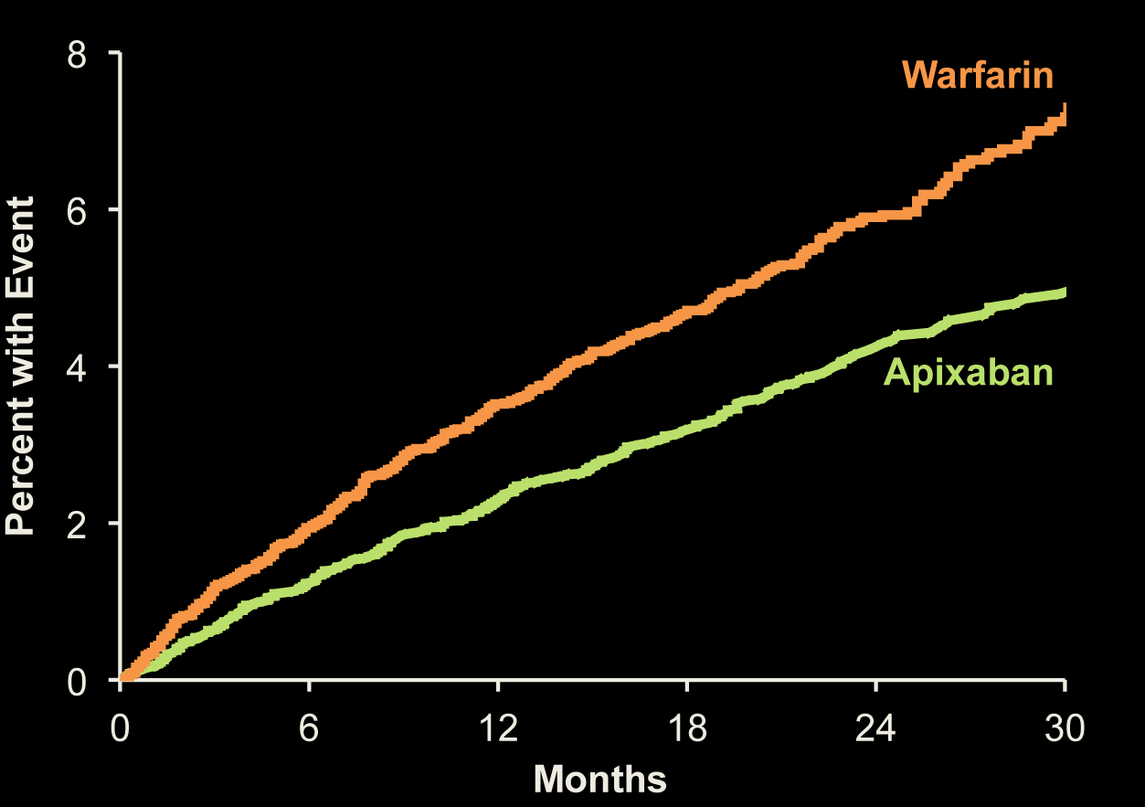
Major Bleeding
ISTH definition
31% RRR
Apixaban 327 patients, 2.13% per year
Warfarin 462 patients, 3.09% per year
HR 0.69 (95% CI, 0.60–0.80); P<0.001
No. at Risk
Apixaban 9088 8103 7564 5365 3048 1515
Warfarin 9052 7910 7335 5196 2956 1491

Slide 31
Bleeding Outcomes
Outcome | Apixaban (N=9088) | Warfarin (N=9052) | HR (95% CI) | P Value
 | Event Rate (%/yr) | Event Rate (%/yr)
Primary safety outcome: ISTH major bleeding* | 2.13 | 3.09 | 0.69 (0.60, 0.80) | <0.001
Intracranial | 0.33 | 0.80 | 0.42 (0.30, 0.58) | <0.001
Gastrointestinal | 0.76 | 0.86 | 0.89 (0.70, 1.15) | 0.37
Major or clinically relevant non-major bleeding | 4.07 | 6.01 | 0.68 (0.61, 0.75) | <0.001
GUSTO severe bleeding | 0.52 | 1.13 | 0.46 (0.35, 0.60) | <0.001
TIMI major bleeding | 0.96 | 1.69 | 0.57 (0.46, 0.70) | <0.001
Any bleeding | 18.1 | 25.8 | 0.71 (0.68, 0.75) | <0.001
* Part of sequential testing sequence preserving the overall type I error

Slide 32
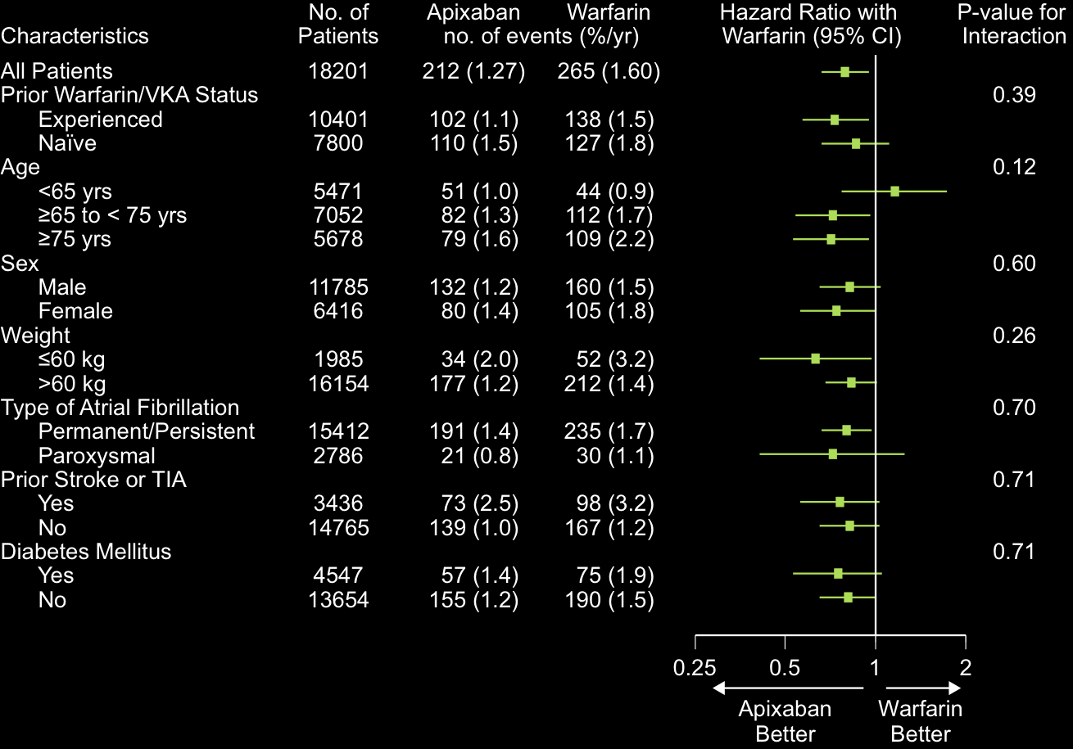
Subgroups for Stroke and Systemic Embolism
(1 of 2)

Slide 33
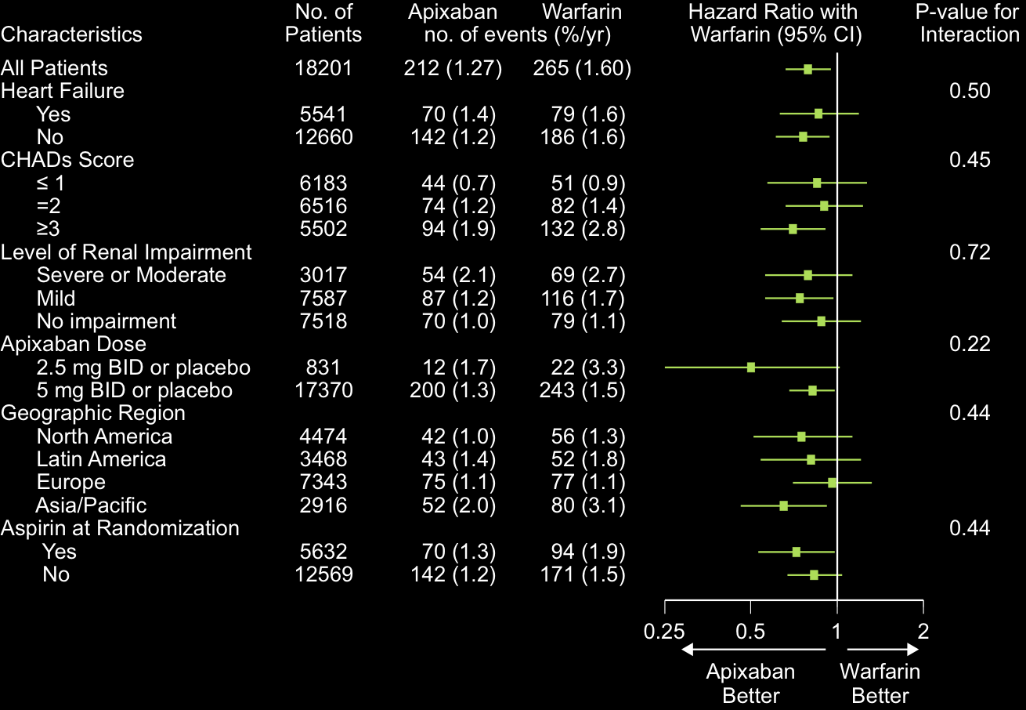
Subgroups for Stroke and Systemic Embolism
(2 of 2)

Slide 34
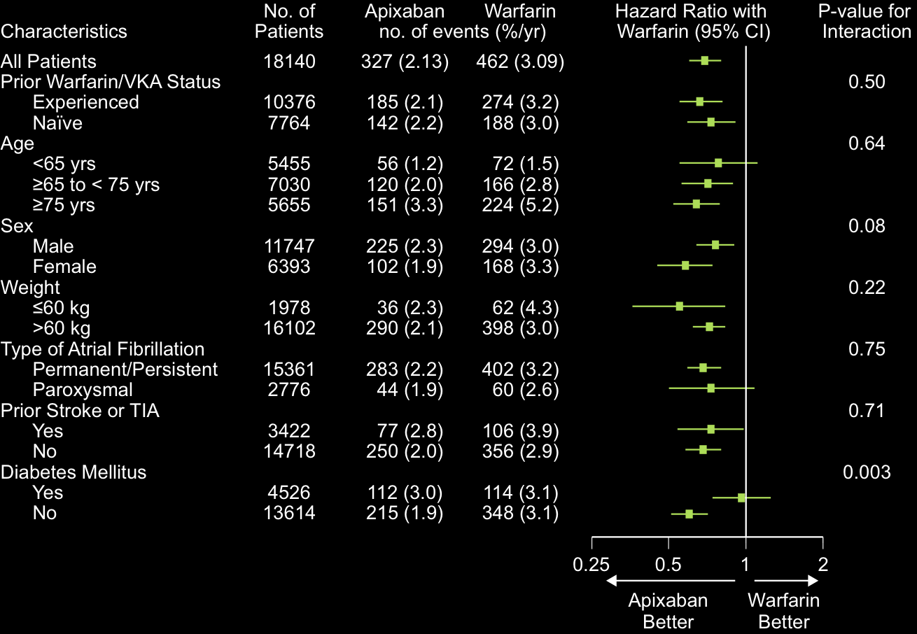
Subgroups for Major Bleeding
(1 of 2)

Slide 35

Subgroups for Major Bleeding
(2 of 2)

Slide 36
Adverse Events and Liver Function Tests
N (%) | Apixaban (N=9088) | Warfarin (N=9052)
Total patients with an adverse event | 7406 (81.5) | 7521 (83.1)
Total patients with a serious adverse event | 3182 (35.0) | 3302 (36.5)
Serious adverse events reported in ≥ 1% of patients in either treatment group
Atrial fibrillation | 301 (3.3) | 287 (3.2)
Pneumonia | 202 (2.2) | 231 (2.6)
Discontinuations due to an adverse event | 688 (7.6) | 758 (8.4)
ALT or AST > 3X ULN and total bilirubin > 2X ULN | 30/ 8788 (0.3) | 31/ 8756 (0.4)
ALT elevation
> 3X ULN | 100/ 8790 (1.1) | 89/ 8759 (1.0)
> 5X ULN | 45/ 8790 (0.5) | 47/ 8759 (0.5)
> 10X ULN | 16/ 8790 (0.2) | 20/ 8759 (0.2)
> 20X ULN | 8/ 8790 (<0.1) | 12/ 8759 (0.1)

Slide 37
Benefits of apixaban over warfarin in preventing stroke, reducing bleeding and
improving survival appear consistent regardless of centre quality of INR control
 | Apixaban | Warfarin |  | HR | CI 95%
 | No. of events (%/yr)
Stroke / Systemic embolism
Q1: TTR < 58.0% | 70 (1.75) | 88 (2.28) |  | 0.77 | 0.56 - 1.06
Q2: TTR 58.0% - 65.7% | 54 (1.30) | 68 (1.61) |  | 0.80 | 0.56 - 1.15
Q3: TTR 65.7% - 72.2% | 51 (1.21) | 65 (1.55) |  | 0.79 | 0.54 - 1.13
Q4: TTR > 72.2% | 36 (0.83) | 44 (1.02) |  | 0.81 | 0.52 - 1.26
 |  |  |  | Interaction p = 0.29
Major bleeding
Q1: TTR < 58.0% | 64 (1.75) | 115 (3.34) |  | 0.53 | 0.39 - 0.72
Q2: TTR 58.0% - 65.7% | 61 (1.60) | 102 (2.68) |  | 0.60 | 0.43 - 0.82
Q3: TTR 65.7% - 72.2% | 103 (2.68) | 109 (2.89) |  | 0.93 | 0.71 - 1.21
Q4: TTR > 72.2% | 98 (2.49) | 136 (3.46) |  | 0.72 | 0.55 - 0.93
 |  |  |  | Interaction p = 0.10
Death
Q1: TTR < 58.0% | 163 (3.95) | 191 (4.75) |  | 0.83 | 0.68 - 1.03
Q2: TTR 58.0% - 65.7% | 158 (3.71) | 177 (4.10) |  | 0.91 | 0.73 - 1.12
Q3: TTR 65.7% - 72.2% | 147 (3.44) | 174 (4.07) |  | 0.84 | 0.68 - 1.05
Q4: TTR > 72.2% | 133 (3.03) | 127 (2.91) |  | 1.04 | 0.82 - 1.33
 |  |  |  | Interaction p = 0.39
0.0
0.5
1.0
1.5
2.0
Favors apixaban
Favors warfarin
Wallentin L. European Society of Cardiology Congress, Paris, France, 28 August 2011.
http://www.escardio.org/congresses/esc-2011/congress-reports/Documents/28-8-CTU/ARISTOTLE-presenter-Wallentin-slides.pdf
Notes:
The efficacy and safety of apixaban vs. warfarin was maintained irrespective of INR control.
Abbreviations
TTR: Time in therapeutic range
INR= international normalized ratio
Yrs: years
References
Wallentin L. Efficacy and safety of apixaban compared with warfarin at different levels of INR control for stroke prevention in atrial fibrillation. European Society of Cardiology Congress, Paris, France, 28 August 2011. http://www.escardio.org/congresses/esc-2011/congress-reports/Documents/28-8-CTU/ARISTOTLE-presenter-Wallentin-slides.pdf

Slide 38
Compared with warfarin, apixaban (over 1.8 years) prevented
6 Strokes
15 Major bleeds
8 Deaths
    4 hemorrhagic
    2 ischemic/uncertain type
per 1000 patients treated.

Slide 39
New antithrombotic therapies compared to warfarin
Stroke or systemic embolism
Connolly S et al NEJM 2009; Patel M et al NEJM 2011; Granger C et al NEJM 2011

Slide 40
New antithrombotic therapies compared to warfarin
All-cause mortality
Connolly S et al NEJM 2009; Patel M et al NEJM 2011; Granger C et al NEJM 2011

Slide 41
New antithrombotic therapies compared to warfarin
Major bleeding
Connolly S et al NEJM 2009; Patel M et al NEJM 2011; Granger C et al NEJM 2011

Slide 42
New antithrombotic therapies compared to warfarin
Major + clinically relevant bleeding
Connolly S et al NEJM 2009; Patel M et al NEJM 2011; Granger C et al NEJM 2011

Slide 43
New antithrombotic therapies compared to warfarin
Intracranial hemorrhage
Connolly S et al NEJM 2009; Patel M et al NEJM 2011; Granger C et al NEJM 2011

Slide 44
New antithrombotic therapies compared to warfarin
Myocardial infarction
Connolly S et al NEJM 2009; Patel M et al NEJM 2011; Granger C et al NEJM 2011

Slide 45
New anticoagulants compared to warfarin in AF
Effect on outcome event | D150 | D110 | Riva | Apix
Noninferiority stroke | √ | √ | √ | √
Reduction hemorrhagic stroke | √ | √ | √ | √
Reduction ischemic stroke | √
Reduction mortality | (√) |  |  | √
Reduction major bleeding |  | √ |  | √
Increase gastrointestinal bleeding | √ |  | √
Increase myocardial infarction | (√) | (√)
Connolly S et al NEJM 2009; Patel M et al NEJM 2011; Granger C et al NEJM 2011

Slide 46

Apixaban is the only oral anticoagulant to demonstrate superiority vs. warfarin in all of the following 3 outcomes
Superior
stroke/systemic embolism
prevention
Superior
profile in reducing
major bleeding
Superior
reduction in
all-cause mortality
21% RRR
p=0.01
31% RRR
p<0.001
11% RRR
p=0.047
3.94%
669/9081
3.52%
603/9120
3.09%
462/9052
Event rate (% / year)
2.13%
327/9088
1.60%
265/9081
1.27%
212/9120
Primary efficacy endpoint
Primary safety endpoint
Key secondary endpoint
Median duration of follow-up 1.8 years
Apixaban
Warfarin (target INR 2.0-3.0)
Figure created from data in Granger et al. N Engl J Med 2011;365:981-92.
Notes:
Apixaban was superior to warfarin in reducing the rates of the three key outcomes of the ARISTOTLE study, i.e. stroke or systemic embolism, major bleeding and death from any cause.
Abbreviations
RRR: Relative risk reduction.
References
Granger CB et al; ARISTOTLE Committees and Investigators. Apixaban versus warfarin in patients with atrial fibrillation. N Engl J Med 2011;365:981-92.

Slide 47
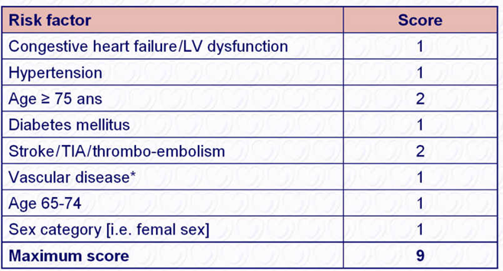
Risk factor-based point-based scoring system - CHA₂DS₂-VASc
*Prior myocardial infarction, peripheral artery disease, aortic plaque. Actual rates of stroke in contemporary
cohorts may vary from these estimates.
Notes:
47

Slide 48
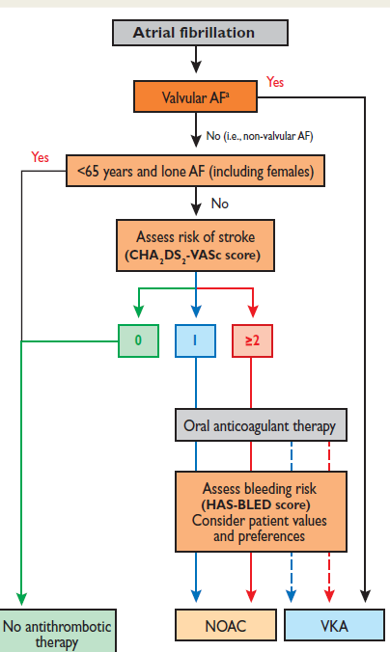
Anti thrombotic therapy in non valvular AF

Slide 49
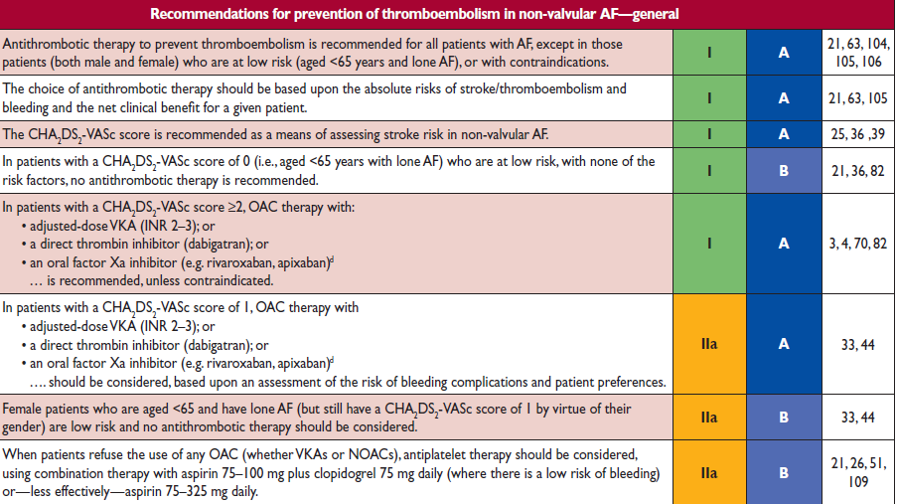
Anti thrombotic therapy in non valvular AF

Slide 50
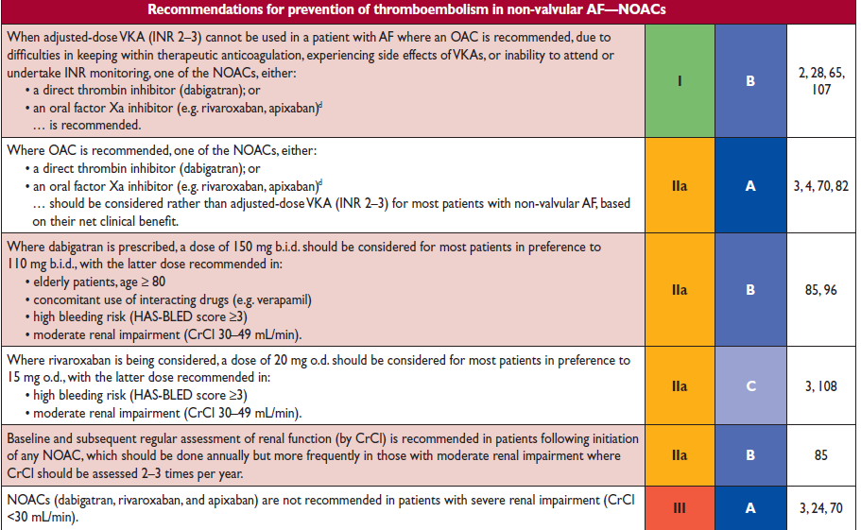
Anti thrombotic therapy in non valvular AF

Slide 51
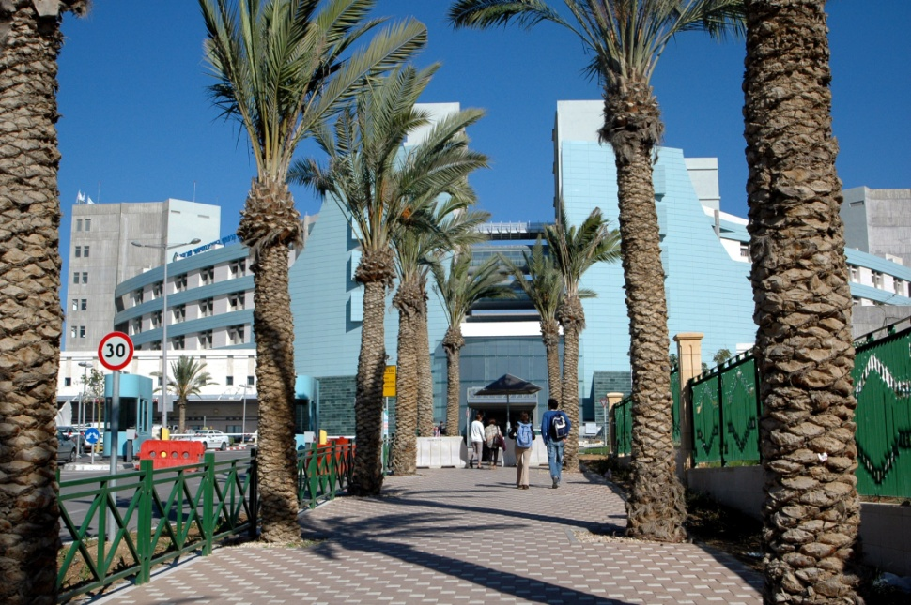
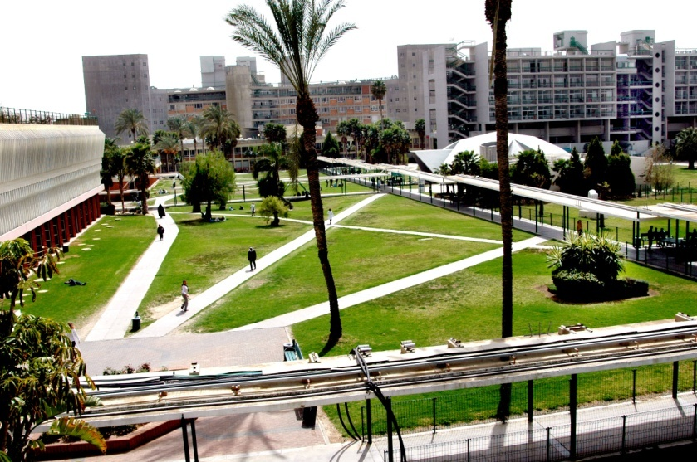
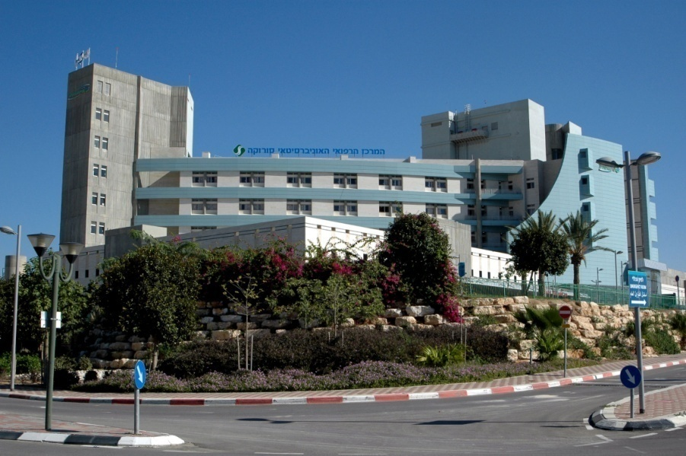
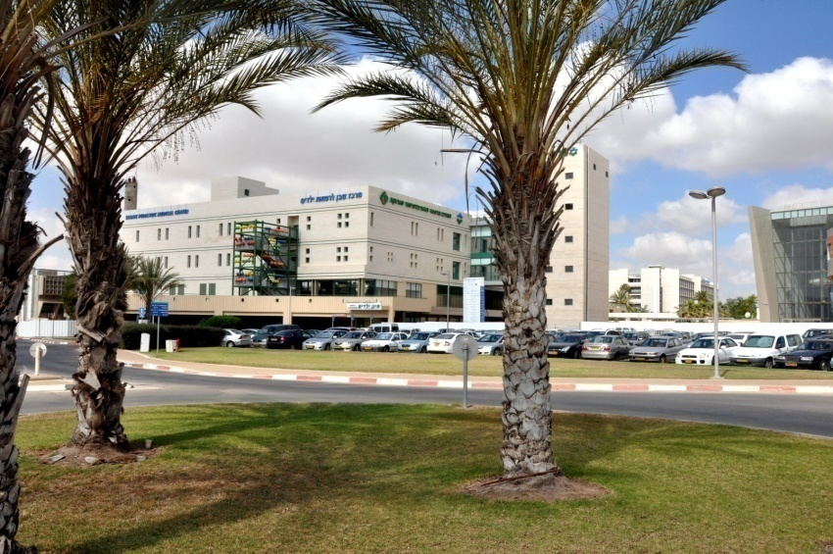
THANK YOU!

