Slide 1
Innovating Across an entire health care system:
Strategic Clinical Networks in Alberta, Canada
Blair J. O’Neill MD FRCPC
Senior Medical Director, CVH + Stroke SCN, Alberta Health Services
Immediate Past President, Canadian Cardiovascular Society
1

Slide 2
Alberta Health Services: Strategic Plan focused on Access, Quality and Sustainability
Quality
Learning and improving
Access
Enhancing quality and safety of care
How will we do this??
Responsive to consumers and communities
Decreasing wait times
Improving the overall patient experience
Client
Rebalancing demand / facilitating access to outpatient care
Patient
INNOVATE, INNOVATE, INNOVATE
Values:
Creativity
Risk Taking
Collaboration
Integrity
Respect
Resident
Building flexibility & adaptability
INNOVATE Structures
Optimizing health and wellness
Family
Community
Integrating knowledge & patient care
Fit for the future
Improving population
health
Collaborate Top to Bottom
Attracting, retaining and supporting staff
Increasing standardization and automation
Workplace of choice
Living within our means
Sustainability

Slide 3
The Landscape in 2013
3

Slide 4
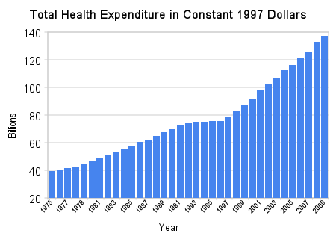
Non-sustainable cost increases in Canada
34.2 M people
23.4M people
1975 to 2010
Expenditure increases = 3.5 fold
Population increases = 1.5 fold
4

Slide 5
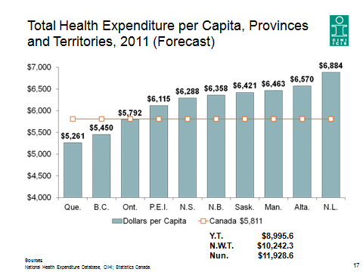
Expenditures per Province in Canada
5

Slide 6
Are we getting the results? Does Size of Expenditures Matter?
6

Slide 7
Changes are needed:
Alberta as an example
7

Slide 8
Innovation
Translating ideas or inventions into a goods or services that creates value for clients or customers
In the health care context, an innovation can be a device, a drug, a technique, a method, a system or a service.
Innovations can be 'procured' from outside or they can be developed 'within’.
8

Slide 9
Provincial Mandate of AHS/SCN’s
Improve population health
Eliminate health disparities
Ensure continuous quality improvement
Innovate health services
Discover and translate new knowledge
Focus on patient outcomes
Develop appropriate clinical practices
Make patient safety a priority
Ensure value for money + sustainability through evidence
9

Slide 10
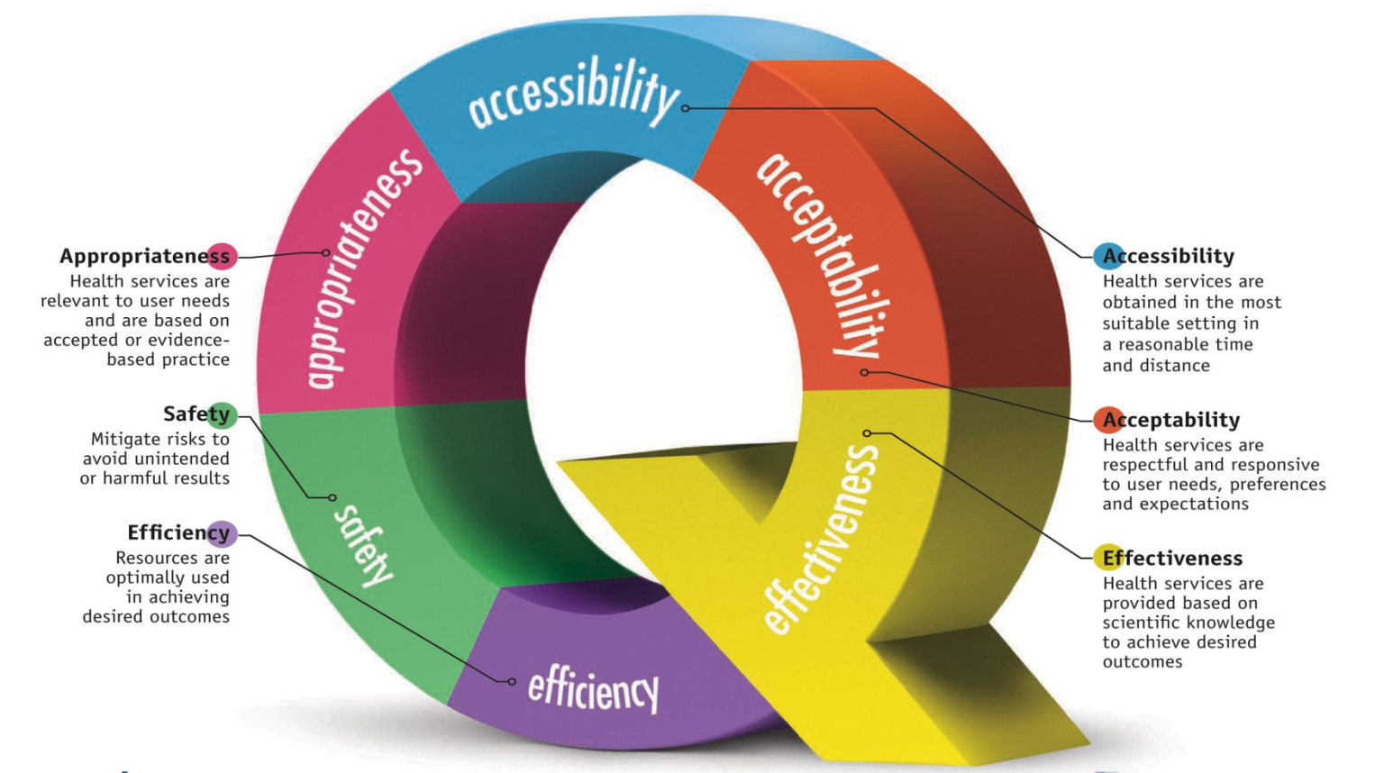
A Successful and Sustainable Formula for Quality Health Care
$$$$
Initial SCN Goal: Innovate, Eliminate ‘Waste’ and Reinvest Resources
To improve Quality and Create a Sustainable System
Notes:
Don and Tracy

Slide 11
Why Networks?
Facilitate collaboration, joint decision-making and shared learning
Promote the use/uptake of clinical experience, knowledge and research to reduce variation and improve care
Involve partners along a broad continuum in planning, improving and innovating healthcare services
"a crucial propellant for innovation is collaboration”
Fast Company.com
11

Slide 12
Strategic Clinical Networks Support Provincial Innovation, Improvement and Sustainability
Phase One (established June, 2012)
Obesity, Diabetes and Nutrition
Seniors’ Health
Bone & Joint
Cardiovascular Health and Stroke
Cancer
Addiction & Mental Health
Phase Two (TBA, 2013)
Population Health and Health Promotion*
Primary Care and Chronic Disease Management*
Maternal Health
Newborn, Child and Youth Health
Neurological Disease, ENT and Vision
Complex Medicine (current Respiratory Clinical Network + others TBD)
12

Slide 13
Composition of an SCN SMD-VP Dyad Co-leads Scientific Director/Associate SD Executive Director/Network Manager
Role of Core Committee
Engagement Bottom to Top
Determine priorities and strategic direction
Represent as broad a group as possible but especially their immediate constituency – rural/urban
Evidence Based Best Practices
Think Innovation; “Next” Practices; System redesign
Suggest things we can stop
Think Geographic Equity
Think Enhanced Quality
Core team
Clinicians+
Strategy+
Zones
Support teams
AHS + AHN + Zones
IDEAs
Front Line Teams
Wider public + patients, HAC’s,
community groups and other
external stakeholders
Notes:
We are not about projects. Projects are a means to an end. The end should determine the projects we propose in future and how we craft the current ones we have proposed.

Slide 14
SCN’s -an integral component of Alberta Innovation and Research & Development
Health is a global business:
Improving Prevention, Health, and Health Care Quality and Sustainability
Alberta has major competitive advantages
Our Provincial Approach is unique
Our Health system is unique
Our Universities are aligned
Our R and D structure is unique
Health/Energy/Environment/Food
Health generates major economic value
MANY industries related to health
Major Supply chains (drugs/lab /repairs)
Health Human Resources
Rapid and low cost access to high quality health data = a key
14

Slide 15
Health and Health Care Health is a Big Business: Comparison to the Oil Patch
OIL + GAS + MINING
>150,000 employed
~ 7% of workforce
$79B/yr to Alberta’s GDP
~ 27.6% of Alberta’s GDP
Oil sands
~21,000 jobs
>$3.7B/yr in royalties
$100B in provincial and municipal taxes over 25 years
R and D
~$1B/year on R and D (2010)
HEALTH + HEALTH CARE
>190,000 employed
~ 9% of workforce
$21B/yr to Alberta’s GDP
~ 7.6% of GDP (health care alone)
Health Care
100 hospitals ~100,000 public jobs
Every dollar spent on public health care generates 21.7 cents in taxes and import duties (Conf. Board – 2013)
~ $2.5B/year in Alberta in taxes/duties
R and D
~$ 478M/year (in 2008)
Included ~$75M/year in biotech
15

Slide 16
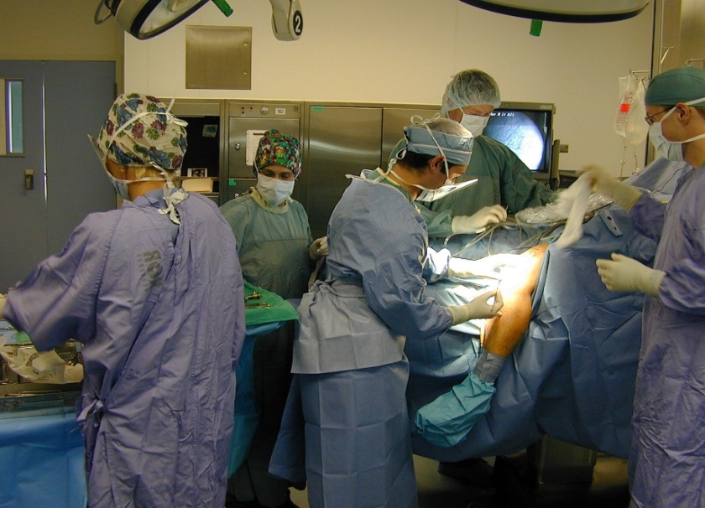
SCNs align ‘top to bottom’ SCN’s engage academics with Health Care System
Administrators
Providers
Patients
16
Policy Makers/Payers
Researchers

Slide 17
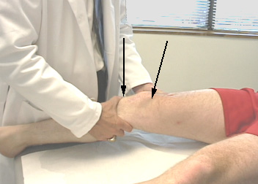
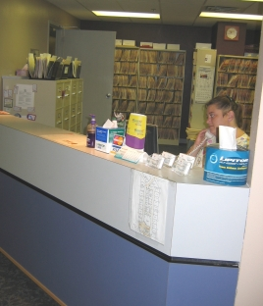
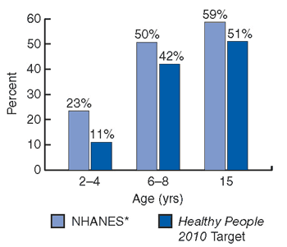
SCN’s For Researchers Integrating the four pillars of health research research networks connect, analyze, innovate and export
Basic research
Clinical research
Prevention, Population and Public Health research
Health systems research
17

Slide 18
The SCN’s can Address
Translational Gaps in Research Uptake
Gap 1….
Aka
“The Valley of Death”
Gap 2
Biomedical
Research
Gap 3
Clinical
Science &
Knowledge
Clinical
Practice &
Health Decision
Making
Community
Based
Practice
18

Slide 19
The Best ‘Knowledge Translation Networks’ with engaged end-users (clinical, policy, public, etc)
New Knowledge/
Innovations
Users of Knowledge
The Researcher
On the same team
19

Slide 20
Highly Qualified People = Key collecting and analyzing linked data
Biggest Research/Innovation Opportunities
Provincial Networking with Partners (leverage)
Easy and Rapid Data Access
Exceptionally High Quality Data
Linked and Analyzed Data
@ Low Cost
20

Slide 21
Opportunities
comparative effectiveness data will define value for $$
21

Slide 22
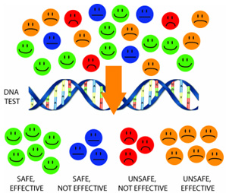
Other Opportunities data to inform personalized medicine
http://www.dh.gov.uk/prod_consum_dh/groups/dh_digitalassets/@dh/@en/
documents/digitalasset/dh_132382.pdf
22

Slide 23
Research and Innovation: Key enabler to achieving the highest performing health system
Alberta Health Services (AHS) partnered with the Universities in the Academic Health Network (AHN) enact Alberta's Health Research and Innovation Strategy (AHRIS) in order to achieve:
improved health for Albertans
evidence-informed health care across the province
a sustainable health care system from the direct and indirect economic benefits of these approaches
23

Slide 24
Research and Innovation Priorities for Alberta
Skilled People/Innovation Platform/Knowledge Translation
Test new ideas
Translate new strategies to improve acute care and CDM
Improved and completely linked Health Informatics Capability in order to mine data for innovations
Enhanced Clinical Trials Program
Provincial Biobanking and “Alberta Genomics for Health” Plan
Targeted technology and product development
Personalized Medicine
Support centers of excellence and networks in critical disciplines
24

Slide 25
Research and Innovation: Key enablers to achieving the highest performing health system
Align AHS within the Alberta Health Research Policy Framework
Map to Alberta's Health Research and Innovation Strategy
Measure impact of Research, Innovation and KT
Build Stronger Partnerships
Academic Health Network (AHN) and AIHS
Physicians and other clinicians
Attracting research and innovation partners to Alberta
Industry
Maximize Value of Health Care System Resources
Leverage AHS Resources with Partners
Further develop and link high quality data
25

Slide 26
Research and Innovation: Key enablers to achieving the highest performing health system
4. AHS Resources as an engine for research
QI and System Sustainability supported by excellent research
Prioritizing, Funding and Measuring Research in AHS
Start Small with High Impact Studies; seed capacity
5. Create a culture of research and innovation in AHS
Strategic Clinical Networks as Provincial Mechanisms
6. Incent Research of High Value to AHS
Incenting Strategic and Investigator Initiated Research of value
Sharing Gains of Research with those who did the work
Awards and Recognition
26

Slide 27
Strategic Clinical Networks: Bringing Science and Best Practices Together to Define Next Practices integrate to innovate

Slide 28
Stars are aligned - now
Thank You

