Slide 1
TICAGRELOR
The Best P2Y12 Platelet Antagonist Post ACS
Prof. Shaul Atar
Galilee Medical Center, Nahariya

Slide 2







Slide 3

PLATO established the efficacy and safety of ticagrelor 90 mg + aspirin in patients with ACS when compared to clopidogrel + aspirin
Primary Efficacy Endpoint¹
  In patients with ACS, ticagrelor 90 mg + aspirin significantly reduced major CV events and resulted in a 21% RRR in CV mortality at 12 months compared with clopidogrel + aspirin.¹
  There was an increase in PLATO-defined non-CABG-related major bleeding with ticagrelor (HR 1.19, 95% CI 1.02-1.38, p=0.03) but without a significant increase in overall major or fatal bleeding.¹
12
Clopidogrel 75 mg QD + Aspirin
(n=9291)
11.7%
10
9.8%
8
Ticagrelor 90 mg BID + Aspirin
(n=9333)
Composite of CV death, MI,
or stroke (K-M%)
6
4
2
HR | 95% CI | p-value | NNT²
0.84 | 0.77–0.92 | <0.001 | 54
0
0
60
120
180
240
300
360
Days after randomization
ACS = acute coronary syndromes; CABG = coronary artery bypass graft; CV = cardiovascular; HR = hazard ratio; K-M = Kaplan-Meier; MI = myocardial infarction; NNT = number needed to treat; PLATO = PLATelet inhibition and patient Outcomes.
1. Wallentin L et al. N Engl J Med. 2009;361:1045-1057; 2. AstraZeneca Pharmaceuticals LP. US Food and Drug Administration Web site. https://wayback.archive-it.org/7993/20170405212347/https://www.fda.gov/downloads/AdvisoryCommittees/CommitteesMeetingMaterials/Drugs/CardiovascularandRenalDrugsAdvisoryCommittee/UCM220197.pdf. Accessed April 1, 2019.
Notes:
References:
Wallentin L, Becker RC, Budaj A, et al. Ticagrelor versus clopidogrel in patients with acute coronary syndromes. N Engl J Med. 2009;361:1045-1057.
AstraZeneca Pharmaceuticals LP. Briefing document for July 28 Cardiovascular and Renal Advisory Committee meeting. US Food and Drug Administration website. https://wayback.archive-it.org/7993/20170405212347/https://www.fda.gov/downloads/AdvisoryCommittees/CommitteesMeetingMaterials/Drugs/CardiovascularandRenalDrugsAdvisoryCommittee/UCM220197.pdf. Accessed September 26, 2019.
PLATO: Wallentin pg 1053/Fig 1 & pg 1054
NNT: AZ BD, pg 154

Slide 4

Ticagrelor: The First and Only Oral Antiplatelet to Demonstrate Superior Reductions in CV Death vs Clopidogrel
Primary Endpoint
(CV death, MI, Stroke)
12
Clopidogrel
HR 0.84
(0.77–0.92)
p=0.0003
NNT = 54
11.7
11
10
N=18,624
9.8
9
8
Ticagrelor
CV death
7
Cumulative incidence (%)
6
5
Clopidogrel
HR 0.79
(0.69–0.91)
p=0.001
NNT = 90
5.1
4
4.0
3
Ticagrelor
2
1
0
0
60
120
180
360
Days after randomization
Wallentin L, et al. N Engl J Med. 2009;361:1045-57.
Notes:
Ticagrelor significantly reduced the rate of the composite endpoint of CV death, MI, and stroke v. clopidogrel (Relative Risk Reduction 16%, Absolute Risk Reduction 1.9%; p=0.0003), Number Needed to Treat (NNT)=54.
For every 54 ACS patients treated with ticagrelor for one year, one life will be saved, compared to patients treated with clopidogrel
These results support ticagrelor use to decrease the rate of clinically-important thrombotic events, those that represent major adverse cardiovascular events, in patients planned for invasive procedures and patients intended for medical management.
References
Wallentin L, et al.New Engl J Med. 2009;361.
3

Slide 5

Mortality reduction in invasive and non-invasive treatment strategies
Non-Invasive
10
N=5216
Non-invasive
HR, 0.75, 95% CI: (0.61–0.93)
8.2%
8
6
6.1%
All-cause mortality (%)
5.0%
4
3.9%
2
N=13408
Invasive
HR, 0.81, 95% CI: (0.68–0.95)
0
0
60
120
180
240
300
360
Number at risk
Invasive
Ticagrelor 6732 6439 6375 6241 5141 3951 3233
Clopidogrel 6676 6376 6331 6209 5114 3917 3164
Non-invasive
Ticagrelor 2601 2485 2447 2385 1978 1531 1186
Clopidogrel 2615 2488 2448 2380 1965 1524 1200
Days after randomization
James S et al. BMJ. 2011 Jun 17;342:d3527

Slide 6

Pretreatment with Ticagrelor in STEMI
ATLANTIC: 1862 patients with STEMI randomized to ticagrelor pretreatment or no pretreatment
Co-primary endpoints
Secondary endpoints
 | Pre-H | In-H | P
Definite ST ≤24 h | 0% | 0.8% | 0.008
30-d definite ST | 0.2% | 1.2% | 0.02
Death | 0.8% | 1.1% | 0.08
MI | 0.4% | 0.2% | 0.53
Stroke | 0% | 0.1% | 0.39
Bleeding ≤48 h | 2.6% | 2.5% | 0.87
Bleeding >48 h | 2.0% | 1.7% | 0.63
P=0.63
P=0.82
Montalescot G, et al. N Engl J Med. 2014;371:1016-27

Slide 7
Newer P2Y₁₂ Inhibitors in STEMI
STEMI Cohorts in PLATO (N=7544) and TRITON-TIMI 38 (N=3534)
TRITON
PLATO
Primary Efficacy Endpoint
Primary Efficacy Endpoint
15
N=3534
P=0.02
12
N=7544
P=0.07
10.8
12.4
10
p=0.02
9.4
10.0
RRR=21%
10
9.5
8
p=0.002
p=0.07
Proportion of patients (%)
RRR=32%
Cumulative incidence (%)
6
RRR=13%
6.5
5
4
Clopidogrel
Prasugrel
Clopidogrel
Ticagrelor
2
HR=0.79 (0.65–0.97) NNT=41
HR=0.87 (0.75 to 1.01) NNT=71
0
0
0
50
100
150
200
250
300
350
400
450
0
2
4
6
8
10
12
Time (Days)
Time (Months)
Montalescot G et al., Lancet. 2009;373:723-31
Steg PG et al. Circulation. 2010;122:2131-41

Slide 8
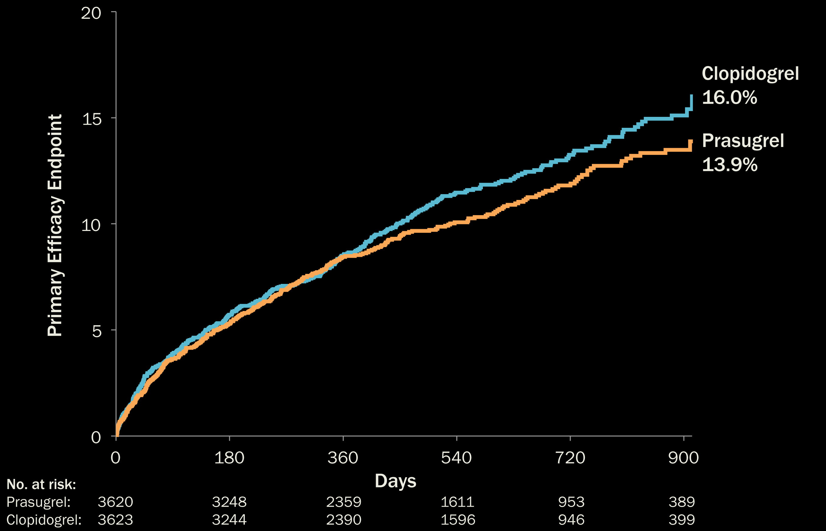
Primary Efficacy Endpoint to 30 Months
(Age < 75 years)
HR (95% CI) ≤ 1 Year:
0.99 (0.84, 1.16)
HR (95% CI) > 1 Year:
0.72 (0.54, 0.97)
HR (95% CI):
0.91 (0.79, 1.05)
P = 0.21
Interaction P = 0.07
Roe MT et al. N Engl J Med. 2012 ;367:1297-309

Slide 9
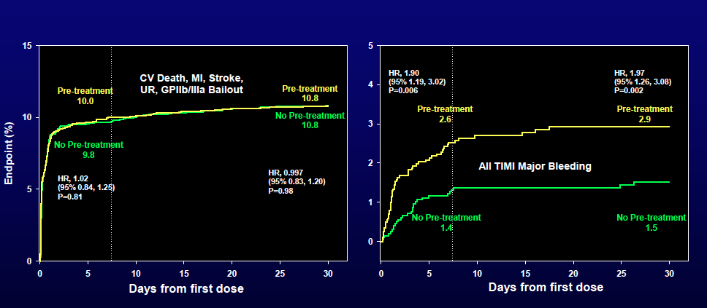
1° Efficacy End Point at 7 + 30 days
(All Patients)
ACCOAST - Primary Efficacy and Safety Endpoints
All TIMI (CABG or non-CABG)
Major Bleeding
(All Treated patients)
Montalescot et al. N Engl J Med. 2013;369:999-1010.

Slide 10
Net Clinical Benefit
Bleeding Risk Subgroups
Post-hoc analysis
Risk (%)
Yes
+ 54
Prior
Stroke / TIA
No
P_{int} = 0.006
-16
TICAGRELOR: Benefits Consistent Across All Subgroups and No Subgroup Altered the Relative Risk of Bleeding Complications.
>=75
-1
Age
< 75
P_{int} = 0.18
-16
< 60 kg
+3
Wgt
>=60 kg
P_{int} = 0.36
-14
-13
OVERALL
0.5
1
2
Prasugrel Better
HR
Clopidogrel Better
Wiviott SD et al. NEJM 2007
Notes:
9
As a result of the discordance between efficacy and safety with prasugrel –signficant reductions in events at the cost of a significant increase in bleeding we performed a series of post-hoc exploratory analyses to identify subgroups of patients that did not have a favorable net clinical benefit or who had net harm.
The group with a prior cerebrovascular event (shown in red) had more primary endpoint events and increased bleeding with prasugrel, resulting in a significant net clinical benefit favoring clopidogrel. Patients without a prior cerebrovascular event, shown in green, had a net clinical benefit favoring prasugrel. The P value for interaction was significant at 0.006.
Elderly patients and those with a low body weight (shown in yellow) tended to have better efficacy but more bleeding with prasugrel, resulting in a net clinical benefit near unity. The younger patients and those with higher body weights (shown in green) had siginificant net clinical benefit favoring prasugrel. The interaction P values for the elderly and low weight patients did not reach statistical significance.

Slide 11
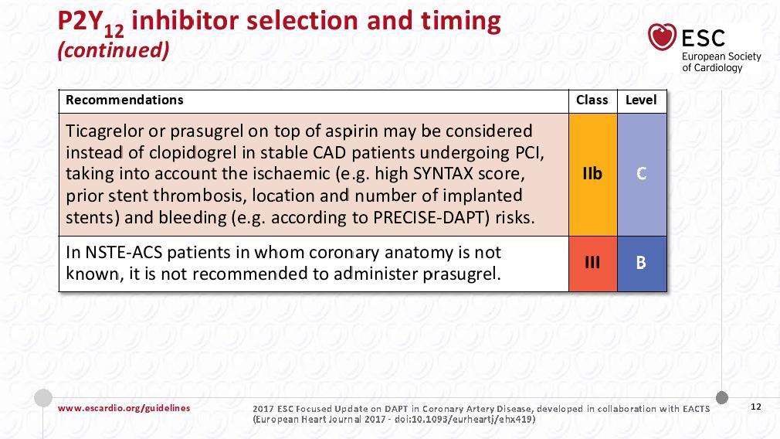

Slide 12
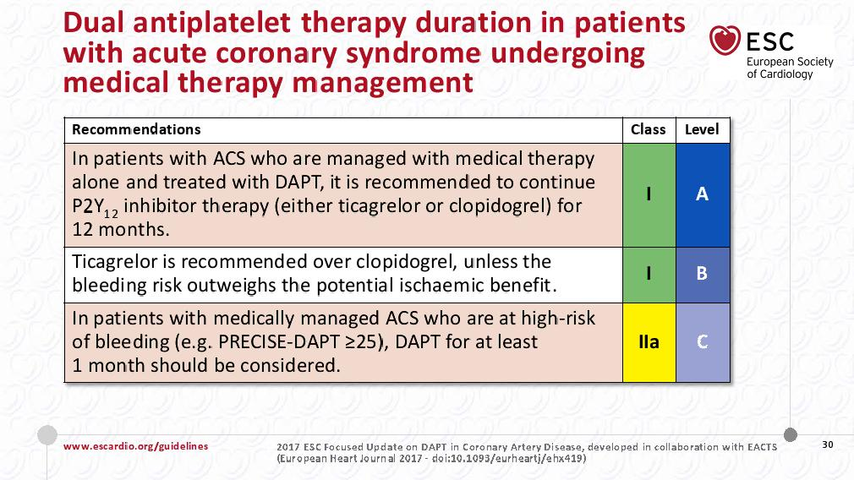

Slide 13
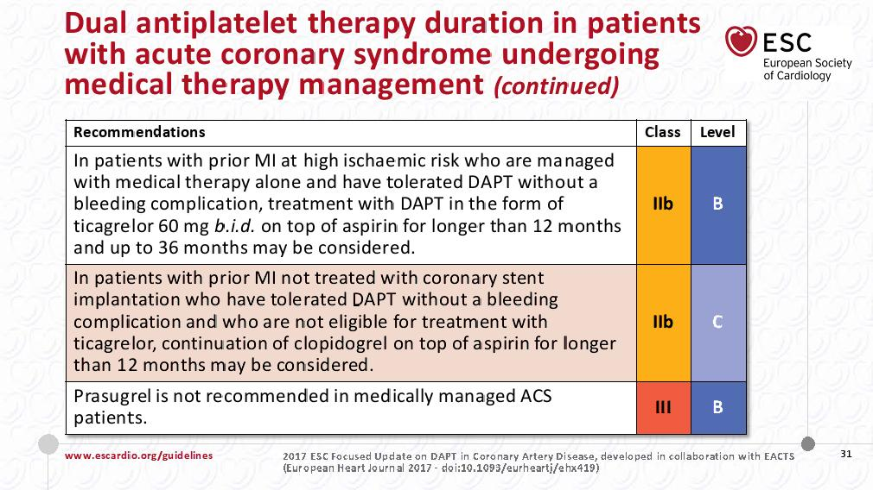

Slide 14
PEGASUS-TIMI 54 established the efficacy and safety of ticagrelor 60 mg + aspirin in high-risk patients post-MI when compared to aspirin alone
10
Primary Efficacy Endpoint
  In high-risk post-MI patients, ticagrelor 60 mg or 90 mg + aspirin significantly reduced major CV events compared with aspirin monotherapy at 3 years.
  The rate of the primary safety endpoint of TIMI major bleeding was significantly higher with both doses of ticagrelor
  (60 mg, HR 2.32, 95% CI 1.68-3.21, p<0.001; 90 mg, HR 2.69, 95% CI 1.96-3.70, p<0.001ª) compared with placebo.
  The rate of fatal bleeding or non-fatal intracranial hemorrhage was low
  (<1% at 3 years) and did not significantly differ between treatment arms.
9
9.04% Placebo
8
7.85% 90 mg BID
7
7.77% 60 mg BID
6
Placebo + Aspirin
Ticagrelor 90 mg BID + Aspirin
Ticagrelor 60 mg BID + Aspirin
Composite of CV death, MI,
or stroke (K-M%)
5
4
3
Ticagrelor 90 mg BID vs placebo
HR 0.85 (95% CI 0.75–0.96); p=0.008ª
2
Ticagrelor 60 mg BID vs placebo
HR 0.84 (95% CI 0.74–0.95); p=0.004ª
1
0
0
3
6
9
12
15
18
21
24
27
30
33
36
Months from randomization
No. at risk
Placebo
90 mg BID
60 mg BID
7067
7050
7045
6979
6973
6969
6892
6899
6905
6823
6827
6842
6761
6769
6784
6681
6719
6733
6508
6550
6557
6236
6272
6270
5876
5921
5904
5157
5243
5222
4343
4401
4424
3360
3368
3392
2028
2038
2055
ªp<0.026 indicates statistical significance.
CV = cardiovascular; HR = hazard ratio; K-M = Kaplan-Meier; MI = myocardial infarction; PEGASUS-TIMI 54 = PrEvention with ticaGrelor of secondAry thrombotic events in high-riSk patients with prior acUte coronary Syndrome - Thrombolysis In Myocardial Infarction 54; TIMI = Thrombolysis in Myocardial Infarction.
Bonaca MP et al. N Engl J Med. 2015;372:1791–1800.
Notes:
Reference:
Bonaca MP, Bhatt DL, Cohen M, et al, for the PEGASUS-TIMI 54 Steering Committee and Investigators. Long-term use of ticagrelor in patients with prior myocardial infarction. N Engl J Med. 2015; 372:1791-1800.
PEGASUS: Bonaca/Fig 1, Table 2, and Table 3

Slide 16
ISAR-REACT 5
Background & Rationale
Ticagrelor & prasugrel have never been compared in a well-designed prospective, double-blind, randomized trial
The ISAR-REACT 5 study investigators hypothesised that ticagrelor would be superior to prasugrel for the composite endpoint of all-cause death, MI or stroke at 1 year after randomization, based on 3 factors:⁵
  The ability to pre-treat with ticagrelor regardless of clinical presentation and coronary anatomy⁶
  Consistent positive results in the medically managed only patients in PLATO⁷
  Possible adenosine-mediated pleiotropic effects of ticagrelor⁸
ISAR-REACT 5
Eligibility Criteria
1. Wallentin L et al. N Engl J Med. 2009;361:1045-1057; 2. Wiviott SD et al. N Engl J Med. 2007;357:2001-2015; 3. Valgimigli M et al. Eur Heart J. 2018;39:213-260; 4. Levine GN et al. J Am Coll Cardiol. 2016;68:1082-1115; 5. Schulz S et al. J Cardiovasc Transl Res. 2014;7:91-100; 6. BRILIQUE Labelling Information; 7. James SK et al. BMJ. 2011;342:d3527. https://doi.org/10.1136/bmj.d3527. Accessed September 13, 2019; 8. Armstrong D et al. J Cardiovasc Pharmacol Ther. 2014;19:209-219; 9. Motovska Z et al. Circulation. 2016;134:1603-1612.
Notes:
Abbreviations:
ACS = acute coronary syndrome; MI = myocardial infarction; OR = odds ratio; PCI =percutaneous coronary intervention; PLATO = PLATelet inhibition and patient Outcomes; PRAGUE-18 = Comparison of prasugrel and ticagrelor in the treatment of acute myocardial infarction-18; STEMI = ST-segment elevation myocardial infarction.
References:
Wallentin L, Becker RC, Budaj A, et al. Ticagrelor versus clopidogrel in patients with acute coronary syndromes. N Engl J Med. 2009;361:1045–1057.
Wiviott SD, Braunwald E, McCabe CH, et al. Prasugrel versus clopidogrel in patients with acute coronary syndromes. N Engl J Med. 2007;357:2001–2015.
Valgimigli M, Bueno H, Byrne RA, et al. 2017 ESC focused update on dual antiplatelet therapy in coronary artery disease developed in collaboration with EACTS. Eur Heart J. 2018;39:213–260.
Levine GN, Bates ER, Bittl JA, et al. 2016 ACC/AHA guideline focused update on duration of dual antiplatelet therapy in patients with coronary artery disease: a report of the American College of Cardiology/American Heart Association Task Force on Clinical Practice Guidelines. J Am Coll Cardiol. 2016;68:1082-1115.
Schulz S, Angiolillo DJ, Antoniucci D, et al, for the Intracoronary Stenting and Antithrombotic Regimen: Rapid Early Action for Coronary Treatment (ISAR-REACT) 5 Trial Investigators. Randomized comparison of ticagrelor versus prasugrel in patients with acute coronary syndrome and planned invasive strategy--design and rationale of the iNtracoronary Stenting and Antithrombotic Regimen: Rapid Early Action for Coronary Treatment (ISAR-REACT) 5 trial. J Cardiovasc Transl Res. 2014;7:91-100.
Hamm CW, Bassand JP, Agewall S, et al. ESC guidelines for the management of acute coronary syndromes in patients presenting without persistent ST-segement elevation: the task force for the management of acute coronary syndromes in patients presenting without persistent ST-segment elevation of the ESC. Euro Heart J. 2011;32:2999-3054.
James SK, Roe MT, Cannon CP, et al. Ticagrelor versus clopidogrel in patients with acute coronary syndromes intended for non-invasive management: substudy from prospective randomised PLATelet inhibition and patient Outcomes (PLATO) trial. BMJ. 2011;342:d3527. https://doi.org/10.1136/bmj.d3527. Accessed September 13, 2019.
Armstrong D, Summers C, Ewart L, et al. Characterization of the Adenosine Pharmacology of Ticagrelor Reveals Therapeutically Relevant Inhibition of Equilibrative Nucleoside Transporter 1. J Cardiovasc Pharmacol Ther. 2014;19: 209-219.
Motovska Z, Hlinomaz O, Miklik R, et al. Prasugrel versus ticagrelor in patients with acute myocardial infarction treated with primary percutaneous coronary intervention: multicenter randomized PRAGUE-18 study. Circulation. 2016;134:1603-1612.
B1:
Ref 1:Wallentin 2009, p9, Fig 1 AND p 8 Table 3
Ref 2:Wiviott 2007, p9, Fig 1
Ref 3: Valgimigli 2018 p38, recommendations table
Ref 4: Levine 2016 pg 1091, Figure 1
B3: Schulz et al. pg 97, col 1, para 3, 7-10
SB1: Hamm 2011. p3018. Table. Row 5.
SB2:James 2011 p 1. conclusions. Col 2 para 2 line 3
SB3: Armstrong 2014. p 217. col 2 para 4 line 1
B4: Motovska et al. Pg 1604, col 1. clinical perspective

Slide 17





ISAR-REACT 5
Study Design
Investigator-initiated,
phase 4, multicentre, randomized, open-label trial,
conducted in 23 centres
(21 in Germany, 2 in Italy)
Patients were eligible for enrolment if they presented with ACS (STEMI, NSTEMI, UA) intended for invasive evaluation (angiography ± PCI/CABG)
Patients randomized to ticagrelor received a LD as soon as possible following enrolment
Patients randomized to prasugrel with STEMI received a LD as soon as possible, but patients randomized to prasugrel presenting with NSTEMI / UA could not receive a LD until
coronary anatomy was known
Randomisation was performed using sealed, opaque envelopes containing a computer-generated sequence
Based on the assumption of 10% incidence of the primary endpoint in the ticagrelor,
12.9% in the prasugrel group (22.5% relative risk reduction with ticagrelor), 2-sided α-level of 0.05 and power of 80%, 1895 patients in each group were needed. Compensation for censoring of missing endpoints required enrolment of 4000 patients
Primary and secondary endpoints were assessed by an event adjudication committee masked to the assigned study arm
ACS = acute coronary syndrome; CABG = coronary artery bypass graft; LD = loading dose; NSTEMI = non-ST-segment elevation myocardial infarction; PCI = percutaneous intervention; STEMI = ST-segment elevation myocardial infarction; UA = unstable angina.
Schüpke S et al. Online ahead of print. N Engl J Med. 2019.
Notes:
Reference:
Schüpke S, Neumann F-J, Menichelli M, et al for the ISAR-REACT 5 Trial Investigators. Ticagrelor or prasugrel in patients with acute coronary syndromes [published online ahead of print September, 1 2019]. N Engl J Med. 2019. http://dx.doi.org/10.1056/NEJMoa1908973. Accessed September 1, 2019.
Box 1: Schupke 2019/p5/col 1/par 3 + p2/col1/par4
Box 2: Schupke 2019/p2/col2/par2
Box 3:
B1: Schupke 2019/p2/col2/par4
B2: Schupke 2019/p3/col1/par2
Box 4:
B1: Schupke 2019/p2/col2/par3
B2: Schupke 2019/p3/col2/par2
B3: Schupke 2019/p3/col1/par3

Slide 18
ISAR-REACT 5
Study Design - Hypotheses tested in the open-label trial
STEMI
NSTEMI / UA
Clinical Presentation
Ticagrelor
180 mg LD + ASA LD²
Prasugrel
60 mg LD + ASA LD²
Randomization
Ticagrelor
180 mg LD + ASA LD²
Prasugrel
NA^{b} +
ASA LD²
Primary Efficacy Endpoint: Death, MI, or Stroke at 12 months from randomization
Primary Safety Endpoint: BARC 3-5 Bleeding
Follow-up: 30 days, 6 months, 12 months (outpatient clinic, phone, or letter)
Multiple Preloading
Strategies Tested
Angiographyª + PCI/CABG
Angiographyª
Ticagrelor
90 mg BID + ASA MD²
Prasugrel
10 mg QD^{b} + ASA MD²
Prasugrel
60 mg LD + ASA MD²
PCI/CABG
Ticagrelor
90 mg BID + ASA MD²
Prasugrel
10 mg QD^{c} + ASA MD²
Maintenance Drug
Strategy
ªIn patients with a coronary angiography confirmed ACS who were not candidates for PCI/CABG and were medically managed only, dual antiplatelet therapy (ASA and the randomly assigned trial medication) was recommended; ^{b}Prasugrel pretreatment was only allowed in patients with known coronary anatomy; ^{c}Prasugrel 5 mg QD MD was recommended in patients ≥75 years of age or <60 kg. Note: ASA LD = ASA 150-300 mg chewed or intravenous ASA. ASA MD = ASA 75-150 mg QD.²
1. Schüpke S et al. Online ahead of print. N Engl J Med. 2019; 2. Schulz S et al. J Cardiovasc Transl Res. 2014;7:91-100.
Notes:
Abbreviations:
ACS = acute coronary syndrome; ASA = aspirin; LD = loading dose; MD = maintenance dose; NSTE-ACS = non-ST-segment elevation myocardial infarction; PCI = percutaneous coronary syndrome; STEMI = ST-segment elevation myocardial infarction; UA = unstable angina.
References:
Schüpke S, Neumann F-J, Menichelli M, et al for the ISAR-REACT 5 Trial Investigators. Ticagrelor or prasugrel in patients with acute coronary syndromes [published online ahead of print September, 1 2019]. N Engl J Med. 2019. http://dx.doi.org/10.1056/NEJMoa1908973. Accessed September 1, 2019.
Schulz S, Angiolillo DJ, Antoniucci D, et al, for the Intracoronary Stenting and Antithrombotic Regimen: Rapid Early Action for Coronary Treatment (ISAR-REACT) 5 Trial Investigators. Randomized comparison of ticagrelor versus prasugrel in patients with acute coronary syndrome and planned invasive strategy--design and rationale of the iNtracoronary Stenting and Antithrombotic Regimen: Rapid Early Action for Coronary Treatment (ISAR-REACT) 5 trial. J Cardiovasc Transl Res. 2014;7:91-100.
Schupke 2019
p2/col2/par3 p3/col1/par2
p3/col1/par4
p7/col1/par2
P3/col1/par3
Schulz 2014
P95/col1/par3

Slide 19
ISAR-REACT 5
Consort Diagram - Screening, Randomization, Treatment, and Follow-up
8434 Patients were assessed for eligibility
4416 were excluded
4018 Underwent randomization
2012 Were assigned to ticagrelor-based strategy
1985 Received ticagrelor loading
27/2012 (1.3%) did not receive a ticagrelor LD
1602 Were discharged with ticagrelor
410 (20.4%) Were not discharged with trial medication
31 Died
6 Withdrew consent with no info on medication at discharge
172 (8.5%) Did not have confirmation of ACS diagnosis
69 Had indication for oral anticoagulation
61 Were withdrawn by physician
32 Underwent CABG
10 Had bleeding
7 Had dyspnoea
3 Had allergy
19 Had other reasons
2006 Were assigned to prasugrel-based strategy
1728 Received prasugrel loading
278/2006 (13.9%) did not receive prasugrel LD
1596 Were discharged with prasugrel
410 (20.4%) Were not discharged with trial medication
26 Died
2 Withdrew consent with no info on medication at discharge
184 (9.2%) Did not have confirmation of ACS diagnosis
65 Had indication for oral anticoagulation
67 Were withdrawn by physician
30 Underwent CABG
8 Had bleeding
28 Had other reasons
22 Withdrew consent
243 (15.2%) Discontinued ticagrelor after discharge
65 Were withdrawn by physician
44 Had bleeding
44 (2.7%) Had dyspnoea
40 Had indication for oral anticoagulation
13 Had unspecific side effects
9 Did not adhere to trial regimen
12 Had allergy
16 Had other reasons
19 Were lost to follow-up
31 Withdrew consent
199 (12.5%) Discontinued prasugrel after discharge
70 Were withdrawn by physician
35 Had bleeding
1 Had dyspnoea
43 Had indication for oral anticoagulation
5 Had unspecific side effects
18 Did not adhere to trial regimen
8 Had allergy
19 Had other reasons
18 Were lost to follow-up
2012 Were evaluated for primary endpoint
1989 Were evaluated for safety endpoint
    23 Were excluded from safety analysis (1.1%)
2006 Were evaluated for primary endpoint
1773 Were evaluated for safety endpoint
    233 Were excluded from safety analysis (11.6%)
ACS = acute coronary syndrome; CABG = coronary artery bypass graft; LD = loading dose.
Schüpke S et al. Online ahead of print. N Engl J Med. 2019.
Notes:
Notes:
4416 Were excluded
1312 Did not meet inclusion criteria or met exclusion criteria
584 Received oral anticoagulation
122 Had chronic renal insufficiency warranting dialysis
113 Received ticagrelor or prasugrel within 5 days before randomization
112 Had history of stroke, transient ischaemic attack, or intracranial bleeding
98 Were previously enrolled in the trial
51 Were participating in another trial
232 Had other reasons
1836 Declined to participate
1268 Had other reasons
Reference:
Schüpke S, Neumann F-J, Menichelli M, et al for the ISAR-REACT 5 Trial Investigators. Ticagrelor or prasugrel in patients with acute coronary syndromes [published online ahead of print September, 1 2019]. N Engl J Med. 2019. http://dx.doi.org/10.1056/NEJMoa1908973. Accessed September 1, 2019.
Schupke 2019:
p4/figure1
Calculations:
Loading dose percentage:
Ticagrelor: 1.3%=100-[(1985/2012)x100]
Prasugrel: 13.85%=100-[(1728/2006)x100]
Discharged on assigned therapy:
Ticagrelor: 410/2012 x 100% = 20.4%
Prasugrel: 410/2006 x 100% = 20.4%
Dyspnea: ticagrelor
(44/1602)x100%=2.7%
Excluded from safety analysis:
Ticagrelor: (23/2012)x100%=1.1%
Prasugrel: (233/2006)x100%=11.6%

Slide 20
האם ניתן לשנות את הפרדיגמה הטיפולית על סמך מחקר זה??
Criticism about study management
OPEN LABEL!!
A 10-fold greater proportion of patients in the prasugrel arm did not receive a study drug loading dose compared with ticagrelor: 13.9% (278/2006) randomized to prasugrel vs 1.3% (27/2012) randomized to ticagrelor
At discharge, only 81.1% of patients in the ticagrelor arm and 80.7% of patients in the prasugrel arm received the randomly assigned trial drug
High rate of discontinuation of the study drug in the trial (15.2% in the ticagrelor arm and 12.5% in the prasugrel arm)
High proportion of patients not receiving the randomly assigned study drug at 12 months, a total of 32.4% of patients in the ticagrelor group and 30.4% of patients in the prasugrel group- however, they were included in the outcomes analysis
Twelve-month follow-up data were not provided for 2.2% of patients- that is 90 pts! The difference in MACE was of 47 events!
Significant proportion of randomized patients did not have confirmation of ACS but were included in the ITT analysis: ticagrelor arm 8.5% (172/2012) vs prasugrel arm 9.2% (184/2006)

Slide 21
Specific criticism for TICAGRELOR
Median time to discontinuation in those patients that discontinued was very short and also differed significantly between the arms (84 days for ticagrelor vs 109 days for prasugrel; P=0.01)
Higher number of patients were excluded from the safety analysis (mITT) in the prasugrel arm (233/2006, 11.6%) compared with the ticagrelor arm (23/2012, 1.1%)
Number of MI/MACE events in prasugrel arm is lower than expected (MI: ISAR-REACT-5, 3.0% vs. TRITON-TIMI, 7.3%) (MACE: ISAR-REACT-5, 6.9% vs. TRITON-TIMI, 10.7%) )
‘On treatment’ analysis showed no difference between arms in MACE !!!
NSTEMI patients received prasugrel 61 minutes hours post randomization - this is NOT the practice in Israel! (they stay about 1-2 days without P2Y12. Therefore they MUST be preloaded)
High number of patients in the ticagrelor arm discontinued because of dyspnoea: 44/1602 (2.7%) vs prasugrel 1/1596 (0.06%), a much higher rate than observed in the ticagrelor arm of the PLATO study (0.9% vs clopidogrel 0.1%)²

Slide 22
ISAR-REACT 5
Angiographic Characteristics
Characteristic, n (%) | Ticagrelor (n=2003) | Prasugrel (n=2001)
Access site
Femoral | 1245 (62.2) | 1260 (63.0)
Radial | 748 (37.3) | 731 (36.5)
Other | 10 (0.5) | 10 (0.5)
No. of diseased coronary vessels
No obstructive CAD | 170 (8.5) | 164 (8.2)
One vessel | 601 (30.0) | 582 (29.1)
Two vessels | 521 (26.0) | 555 (27.7)
Three vessels | 711 (35.5) | 700 (35.0)
Procedural Characteristics
Note: Angiographic data were not available for 14 patients: four patients withdrew consent before angiography and ten patients did not undergo coronary angiography.
CAD = coronary artery disease.
Schüpke S, et al. Supplementary appendix online ahead of print. N Engl J Med. 2019.
Notes:
Reference:
Schüpke S, Neumann F-J, Menichelli M, et al for the ISAR-REACT 5 Trial Investigators. Ticagrelor or prasugrel in patients with acute coronary syndromes [supplementary appendix]. N Engl J Med. 2019. http://dx.doi.org/10.1056/NEJMoa1908973. Accessed September 1, 2019.
Schupke 2019 supplement, p15/table S1

Slide 23
ISAR-REACT 5
Medication after Discontinuation of Study Drug post-Discharge
Drug | Ticagrelor n/N (%) | Prasugrel n/N (%)
Discontinuation of assigned therapy¹ | 243/1602 (15.2) | 199/1596 (12.5)
Antithrombotic therapy following discontinuation of assigned treatment²
Ticagrelor | 0/243 (0.0) | 14/199 (7.0)
Prasugrel | 35/243 (14.4) | 0/199 (0.0)
Clopidogrel | 119/243 (49.0) | 106/199 (53.3)
Oral anticoagulant | 40/243 (16.5) | 44/199 (22.1)
None of the medications above | 78/243 (32.1) | 64/199 (32.2)
Approximately 50% of patients who discontinued study treatment after discharge were switched to clopidogrel²
  It is not known if the characteristics of patients switching / discontinuing the study drug remained balanced between the two arms in this open-label trial
Subsequent antithrombotic therapy was not reported in about 20% of patients who were not discharged on their assigned study drug¹
  These patients were however included in the ITT analysis
ITT = intention to treat.
1. Schüpke S et al. Online ahead of print. N Engl J Med. 2019; 2. Schüpke S et al. Supplementary appendix online ahead of print. N Engl J Med. 2019.
Notes:
References:
Schüpke S, Neumann F-J, Menichelli M, et al for the ISAR-REACT 5 Trial Investigators. Ticagrelor or prasugrel in patients with acute coronary syndromes [published online ahead of print September, 1 2019]. N Engl J Med. 2019. http://dx.doi.org/10.1056/NEJMoa1908973. Accessed September 1, 2019.
Schüpke S, Neumann F-J, Menichelli M, et al for the ISAR-REACT 5 Trial Investigators. Ticagrelor or prasugrel in patients with acute coronary syndromes [supplementary appendix]. N Engl J Med. 2019. http://dx.doi.org/10.1056/NEJMoa1908973. Accessed September 1, 2019.
Schüpke S, et al. Supplementary appendix Table S4
Schüpke S, et al. NEJM pg 5 col 2 para 4 line 5-6

Slide 24
ISAR-REACT 5
Primary Efficacy Endpoint (Composite of Death from any cause, MI, or Stroke)
10
Ticagrelor 9.3%
8
6
Prasugrel 6.9%
Cumulative Incidence (%)
4
2
Hazard ratio, 1.36; 95% CI, 1.09-1.70
p=0.006
0
0
2
4
6
8
10
12
Months since Randomization
No. at Risk
Schüpke S et al. Online ahead of print. N Engl J Med. 2019.
Ticagrelor
2012
1877
1857
1835
1815
1801
1722
Prasugrel
2006
1892
1877
1862
1839
1829
1803
Notes:
Reference:
Schüpke S, Neumann F-J, Menichelli M, et al for the ISAR-REACT 5 Trial Investigators. Ticagrelor or prasugrel in patients with acute coronary syndromes [published online ahead of print September, 1 2019]. N Engl J Med. 2019. http://dx.doi.org/10.1056/NEJMoa1908973. Accessed September 1, 2019.
Schüpke S, et al. NEJM 2019 Pub Figure 2.

Slide 25
ISAR-REACT 5
Clinical Endpoints
Endpoint, n (K-M %) | Ticagrelor (n=2012) | Prasugrel (n=2006) | HR (95% CI) | p-value
Primary endpoint (Death from any cause, MI, or stroke) | 184 (9.3) | 137 (6.9) | 1.36 (1.09-1.70) | 0.006
Death from any cause | 90 (4.5) | 73 (3.7) | 1.23 (0.91-1.68) | NR
MI | 96 (4.8) | 60 (3.0) | 1.63 (1.18-2.25) | NR
Stroke | 22 (1.1) | 19 (1.0) | 1.17 (0.63-2.15) | NR
Definite or probable stent thrombosis | 26 (1.3) | 20 (1.0) | 1.30 (0.72-2.33) | NR
Definite stent thrombosis | 22 (1.1) | 12 (0.6) | NR | NR
Secondary safety endpoint, (mITTª) BARC 3-5 bleeding, n/N (%) | 95/1989 (5.4) | 80/1773 (4.8) | 1.12 (0.83-1.51) | 0.46
Difference in primary endpoint events driven by reduction in non-fatal MI:
  Ticagrelor 4.8% (96/2012) vs. prasugrel 3.0% (60/2006)
Events recorded as death from any cause were predominantly non-cardiovascular deaths:
  Death from CV cause: ticagrelor 3.2% (63/2012) vs. prasugrel 3.0% (59/2006)
  Death from non-CV cause: ticagrelor 1.4% (27/2012 ) vs. prasugrel 0.7% (14/2006)
ªDefined as patients who received at least one dose of study medication and were assessed for bleeding events up to 7 days after discontinuation of the drug.
BARC = Bleeding Academic Research Consortium; CV = cardiovascular; HR = hazard ratio; K-M = Kaplan Meier; MI = myocardial infarction; mITT = modified intention-to-treat; NR = not reported.
Schüpke S et al. Online ahead of print. N Engl J Med. 2019.
Notes:
Reference:
Schüpke S, Neumann F-J, Menichelli M, et al for the ISAR-REACT 5 Trial Investigators. Ticagrelor or prasugrel in patients with acute coronary syndromes [published online ahead of print September, 1 2019]. N Engl J Med. 2019. http://dx.doi.org/10.1056/NEJMoa1908973. Accessed September 1, 2019.
Schüpke S, et al. NEJM 2019 Pub Table 2.

Slide 26
ISAR-REACT 5
Types of Myocardial Infarction
Endpoint, n/N (K-M%) | Ticagrelor | Prasugrel
Total MIs | 96/2012 (4.8) | 60/2006 (3.0)
Type 1 | 52/96 (54.2) | 35/60 (58.3)
Type 2 | 4/96 (4.2) | 3/60 (5.0)
Type 4a | 19/96 (19.8) | 11/60 (18.3)
Type 4b | 20/96 (20.8) | 11/60 (18.3)
Type 5 | 1/96 (1.0) | 0/60 (0.0)
STEMI | 31/96 (32.3) | 14/60 (23.3)
An unexpectedly high rate of type 4 MI was observed (~40%) in both groups
Note: Type 1 = spontaneous myocardial Infarction; Type 2 = myocardial infarction secondary to an ischemic imbalance; Type 4a = myocardial infarction related to percutaneous coronary intervention; Type 4b = myocardial infarction related to stent thrombosis; Type 5 = myocardial infarction related to coronary artery bypass grafting.
K-M = Kaplan Meier; MI = myocardial infarction; PCI = percutaneous coronary intervention; STEMI = ST-segment elevation myocardial infarction.
Schüpke S, et al. Online ahead of print. N Engl J Med. 2019.
Notes:
Reference:
Schüpke S, Neumann F-J, Menichelli M, et al for the ISAR-REACT 5 Trial Investigators. Ticagrelor or prasugrel in patients with acute coronary syndromes [published online ahead of print September, 1 2019]. N Engl J Med. 2019. http://dx.doi.org/10.1056/NEJMoa1908973. Accessed September 1, 2019.
Schüpke S, et al. NEJM 2019 Pub Table 2.

Slide 27
ISAR-REACT 5
Primary Safety Endpoint (BARC 3-5 Bleeding)
10
8
6
Ticagrelor 5.4%
Cumulative Incidence (%)
4
Prasugrel 4.8%
2
Hazard ratio, 1.12; 95% CI, 0.83-1.51
p=0.46
0
0
2
4
6
8
10
12
Months since Randomization
No. at Risk
Ticagrelor
1989
1441
1399
1356
1319
1296
1266
ISAR-REACT 5
Types of Bleeding
Schüpke S et al. Online ahead of print. N Engl J Med. 2019.
Prasugrel
1773
1465
1427
1397
1357
1333
1307
Notes:
Reference:
Schüpke S, Neumann F-J, Menichelli M, et al for the ISAR-REACT 5 Trial Investigators. Ticagrelor or prasugrel in patients with acute coronary syndromes [published online ahead of print September, 1 2019]. N Engl J Med. 2019. http://dx.doi.org/10.1056/NEJMoa1908973. Accessed September 1, 2019.
Schüpke S, et al. NEJM 2019 Pub Figure 3.

Slide 28

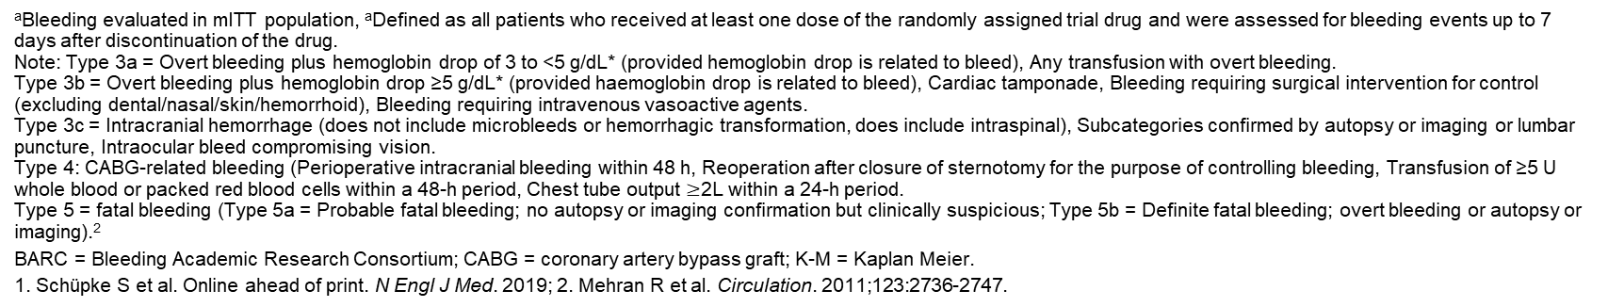
ISAR-REACT 5
Types of bleeding¹
Bleeding Criterionª | Ticagrelor n/N (K-M%) | Prasugrel n/N (K-M%)
BARC 3-5 | 95/1989 (5.4) | 80/1773 (4.8)
BARC 3a | 47/95 (49.5) | 41/80 (51.3)
BARC 3b | 32/95 (33.7) | 31/80 (38.8)
BARC 3c | 4/95 (4.2) | 2/80 (2.5)
BARC 4 | 8/95 (8.4) | 2/80 (2.5)
BARC 5a | 1/95 (1.1) | 0/80 (0.0)
BARC 5b | 3/95 (3.2) | 4/80 (5.0)
ªBleeding evaluated in mITT population, ªDefined as all patients who received at least one dose of the randomly assigned trial drug and were assessed for bleeding events up to 7 days after discontinuation of the drug.
Note: Type 3a = Overt bleeding plus hemoglobin drop of 3 to <5 g/dL* (provided hemoglobin drop is related to bleed), Any transfusion with overt bleeding.
Type 3b = Overt bleeding plus hemoglobin drop ≥5 g/dL* (provided haemoglobin drop is related to bleed), Cardiac tamponade, Bleeding requiring surgical intervention for control (excluding dental/nasal/skin/hemorrhoid), Bleeding requiring intravenous vasoactive agents.
Type 3c = Intracranial hemorrhage (does not include microbleeds or hemorrhagic transformation, does include intraspinal), Subcategories confirmed by autopsy or imaging or lumbar puncture, Intraocular bleed compromising vision.
Type 4: CABG-related bleeding (Perioperative intracranial bleeding within 48 h, Reoperation after closure of sternotomy for the purpose of controlling bleeding, Transfusion of ≥5 U whole blood or packed red blood cells within a 48-h period, Chest tube output $≥$2L within a 24-h period.
Type 5 = fatal bleeding (Type 5a = Probable fatal bleeding; no autopsy or imaging confirmation but clinically suspicious; Type 5b = Definite fatal bleeding; overt bleeding or autopsy or imaging).²
BARC = Bleeding Academic Research Consortium; CABG = coronary artery bypass graft; K-M = Kaplan Meier.
1. Schüpke S et al. Online ahead of print. N Engl J Med. 2019; 2. Mehran R et al. Circulation. 2011;123:2736-2747.
Notes:
Notes for Presenter:
To go back to the previous slide click “go back” button in upper right-hand corner
References:
Schüpke S, Neumann F-J, Menichelli M, et al for the ISAR-REACT 5 Trial Investigators. Ticagrelor or prasugrel in patients with acute coronary syndromes [published online ahead of print September, 1 2019]. N Engl J Med. 2019. http://dx.doi.org/10.1056/NEJMoa1908973. Accessed September 1, 2019.
Mehran R, Rao SV, Bhatt DL, et al. Standardized Bleeding Definitions for Cardiovascular Clinical Trials. A Consensus Report From the Bleeding Academic Research Consortium. Circulation. 2011;123:2736-2747.
Schüpke S, et al. NEJM 2019 Pub Table 2.

Slide 29
ISAR-REACT 5
Summary & Conclusions
The results in the prasugrel arm of ISAR-REACT 5 are not consistent with the large body of pre-existing data from pivotal randomized controlled trials^{2,3,4} which are supported by global clinical guidelines^{5,6}
  There is no clear explanation for the results of ISAR-REACT 5¹
  The inherent limitations of the study design and methodologies may offer an explanation for the unexpected results of this trial⁷
ACS = acute coronary syndrome; BARC = Bleeding academic research consortium.
1. Schüpke S et al. Online ahead of print. N Engl J Med. 2019; 2. Wiviott SD et al. N Engl J Med. 2007;357:2001-2015; 3. Roe MT et al. N Engl J Med. 2012;367:1297-1309; 4. Montalescot G et al. N Engl J Med. 2013;369:999-1010; 5. Roffi M et al. Eur Heart J. 2016;37:267-315; 6. Neumann FJ et al. Eur Heart J. 2019;40:87-165; 7. Levine GN et al. J Am Coll Cardiol. 2016;68:108201115; 8. Schulz S et al. J Cardiovasc Transl Res. 2014;7:91-100.
Notes:
References:
Schüpke S, Neumann F-J, Menichelli M, et al for the ISAR-REACT 5 Trial Investigators [published online ahead of print September, 1 2019]. N Engl J Med. 2019. http://dx.doi.org/10.1056/NEJMoa1908973. Accessed September 1, 2019.
Wiviott SD, Braunwald E, McCabe CH, et al. Prasugrel versus clopidogrel in patients with acute coronary syndromes. N Engl J Med. 2007;357:2001–2015.
Roe MT, Armstrong PW, Fox KAA, et al. Prasugrel versus clopidogrel for acute coronary syndromes without revascularization. N Engl J Med. 2012;367:1297–1309.
Montalescot G, Bolognese L, Dudek D, et al. Prehospital ticagrelor in ST-segment elevation myocardial infarction. N Engl J Med. 2013;369:999–1010.
Valgimigli M, Bueno H, Byrne RA, et al. 2017 ESC focused update on dual antiplatelet therapy in coronary artery disease developed in collaboration with EACTS. Eur Heart J. 2018;39:213–260.
Levine GN, Bates ER, Bittl JA, et al. 2016 ACC/AHA guideline focused update on duration of dual antiplatelet therapy in patients with coronary artery disease: a report of the American College of Cardiology/American Heart Association Task Force on Clinical Practice Guidelines. J Am Coll Cardiol. 2016;68:1082–1115.
Schulz S, Angiolillo DJ, Antoniucci D, et al, for the Intracoronary Stenting and Antithrombotic Regimen: Rapid Early Action for Coronary Treatment (ISAR-REACT) 5 Trial Investigators. Randomized comparison of ticagrelor versus prasugrel in patients with acute coronary syndrome and planned invasive strategy--design and rationale of the iNtracoronary Stenting and Antithrombotic Regimen: Rapid Early Action for Coronary Treatment (ISAR-REACT) 5 trial. J Cardiovasc Transl Res. 2014;7:91-100.
B1: Schupke 2019, p7/col1/par3 – p7/col2/par2
B2: Wallentin 2009: p1045/abstract; Wiviott 2007 p 2011/table 3; Montalescot 2013 p999/abstract; Roe 2012 p1298/col2/par2/line1-4; p1299/col1/par2/line1-4; p1302/table2; Schupke 2019 p8/table2
Valgimigli 2017 p16/figure 3 + p21/table and Levine 2016 p1091/figure1
SB1: Schupke 2019, p8-9, discussion
SB2: Schulz 2014, p95/figure 1 + p96/col1/par3-4

Slide 31

TWILIGHT: Study Design Overview¹
Enrollment
(N=9006)²
Randomized if event-free^{b} and adherent
(N=7119)²
Primary composite endpoint (ITT): Clinically relevant (BARC type 2, 3, or 5) bleeding during months 3-15
Key secondary endpoint
(per protocol):
Composite of all-cause death, non-fatal MI, stroke during months 3-15^{c}
High-riskª patients aged ≥18 years undergoing PCI with
≥1 DES placement
Ticagrelor DAPT
(Ticagrelor 90 mg BID
+ ASA 81-100 mg QD)
Ticagrelor 90 mg BID + ASA 81-100 mg QD
Standard of care therapy at the discretion of treating physician
Ticagrelor 90 mg BID + PBO
Ticagrelor Monotherapy
(Ticagrelor 90 mg BID
+ Placebo)
Open-label after index PCI
3 mo
Open-label ticagrelor;
double-blinded ASA or placebo
15 mo
Observation period
18 mo
ªHigh-risk patients must meet ≥1 criteria from both clinical and angiographic criteria (Inclusion criteria):
Clinical: ≥65 years of age, female, troponin positive ACS, established vascular disease (previous MI, documented PAD or CAD/PAD revascularization),
DM treated with medications, CKD (eGFR <60 mL/min/1.73 m² or CrCl <60 mLmin)
Angiographic: multivessel CAD, target lesion total stent length >30 mm, thrombotic target lesion, bifurcation lesions with Medina X, 1, 1 classification requiring ≥2 stents, left main ≥50% or proximal LAD ≥70% lesion, calcified target lesion requiring atherectomy
Exclusion Criteria
^{b}Event-free if none of the following:
Major bleeding (≥BARC type 3b); ischemic event after PCI (eg, non-fatal MI, definite or probable stent thrombosis, ischemic stroke, coronary revascularization with DES); no longer taking DAPT with ticagrelor + ASA; non physician-guided cessation of ASA or ticagrelor of ≥5 consecutive days; current indication for oral anticoagulation or high dose ASA; renal failure requiring dialysis; woman of child bearing potential; refusal of randomization by patient or treating physician; withdrawal of consent; lost to follow-up
^{c}Other secondary ischemic endpoints included time to first occurrence of: (i) CV death, non-fatal MI, ischemic stroke or clinically-driven revascularization; (ii) CV death, non-fatal MI or ischemic stroke; (iii) definite or probable stent thrombosis; (iv) CV death.
1. Baber U et al. Am Heart J. 2016;182:125-134; 2. Mehran R et al. Online ahead of print. N Engl J Med. 2019.
Notes:
Abbreviations:
ACS = acute coronary syndrome; ASA = aspirin; BARC = Bleeding Academic Research Consortium; CAD = coronary artery disease; CKD = chronic kidney disease; CrCl = creatinine clearance; CV = cardiovascular; DAPT = dual antiplatelet therapy; DES = drug eluting stent; DM = diabetes mellitus; eGFR = estimated glomerular filtration rate; ITT = intention-to-treat; LAD = left anterior descending; MI = myocardial infarction; PAD = peripheral artery disease; PCI = percutaneous coronary intervention.
References:
Baber U, Dangas G, Cohen DJ, et al. Ticagrelor with aspirin or alone in high-risk patients after coronary intervention: rationale and design of the TWILIGHT study. Am Heart J. 2016;182:125-134.
Mehran R, Baber U, Sharma SK, et al. Ticagrelor with or without aspirin in high-risk patients after PCI [published online ahead of print September 26, 2019]. N Engl J Med. 2019. http://dx.doi.org/10.1056/NEJMoa1908419. Accessed September 26, 2019.
Baber p126/col 2
Baber p128/Table2
Baber p127/Table1
Baber Study treatment: p127
Baber p126/Fig1 + p129/Fig2
Baber
Endpoints: p129/table III
ITT: p129/col2/para2
Per protocol: p130/col1/para2
Baber p128/col 2
Enrollment and Randomization #- Mehran results/patient characteristics/para1

Slide 32
TWILIGHT: Patient Distribution
Enrolled
N=9006
Lost to follow-up (n=106)
Adverse events (n=243)
Any revascularization (n=134)
Death, MI, or stroke (n=111)
BARC type 3B or higher bleeding (n=52)
Consent withdrawal/ randomization refusal (n=267)
Other reasons (n=123)
DAPT non-adherence (n=1148)
Shortness of breath (n=553)
Physician directed (n=221)
Non-compliance (n=95)
Bleed (n=92)
GI upset (n=64)
Rash/allergic reaction (n=58)
Oral anticoagulation (n=21)
Other (n=225)
Excluded from randomization (n=1887):
Randomized
n=7119
Ticagrelor Monotherapy n=3555
Ticagrelor DAPT
n=3564
18 withdrew consent
41 lost to follow-up
25 withdrew consent
27 lost to follow-up
1 physician withdrew
Includes 34 deaths
Month 15 Follow-up n=3496 (98.3%)
Month 15 Follow-up n=3511 (98.5%)
Includes 48 deaths
Month 15 Vital Status n=3546 (99.7%)
Month 15 Vital Status n=3554 (99.7%)
BARC = Bleeding Academic Research Consortium; DAPT = dual antiplatelet therapy; GI = gastrointestinal; MI = myocardial infarction.
Mehran R et al. Article and supplementary appendix online ahead of print. N Engl J Med. 2019.
Notes:
Reference:
Mehran R, Baber U, Sharma SK, et al. Ticagrelor with or without aspirin in high-risk patients after PCI [article and supplementary appendix published online ahead of print September 26, 2019]. N Engl J Med. 2019. http://dx.doi.org/10.1056/NEJMoa1908419. Accessed September 26, 2019.
Mehran Figure1
Mehran Table S5

Slide 33
TWILIGHT: Baseline Demographics of the Randomized Population
Characteristicª | Ticagrelor Monotherapy (n=3555) | Ticagrelor DAPT (n=3564)
Clinical parameters
Age, years (mean ± SD) | 65.2 ± 10.3 | 65.1 ± 10.4
Female | 846 (23.8) | 852 (23.9)
Nonwhite race | 1110 (31.2) | 1086 (30.5)
BMI, kg/m² (mean ± SD) | 28.6 ± 5.5 | 28.5 ± 5.6
Medical history
Diabetes mellitus | 1319 (37.1) | 1301 (36.5)
Chronic kidney disease (eGFR <60mL/1.73m²) | 572/3410 (16.8) | 573/3425 (16.7)
Anemia | 675/3405 (19.8) | 654/3423 (19.1)
Current smoker | 726/3553 (20.4) | 822/3562 (23.1)
Hypercholesterolemia | 2157 (60.7) | 2146 (60.2)
Hypertension | 2580/3555 (72.6) | 2574/3563 (72.2)
Peripheral arterial disease | 245 (6.9) | 244 (6.8)
Previous MI | 1020 (28.7) | 1020 (28.6)
Previous PCI | 1502 (42.3) | 1496 (42.0)
Previous CABG | 362/3554 (10.2) | 348/3564 (9.8)
Multivessel CAD | 2272 (63.9) | 2194 (61.6)
Previous major bleeding event | 31 (0.9) | 32 (0.9)
Indication for PCI
Asymptomatic | 234/3554 (6.6) | 223/3563 (6.3)
Stable angina | 1047/3554 (29.5) | 999/3563 (28.0)
Unstable angina | 1249/3554 (35.1) | 1245/3563 (34.9)
NSTEMI | 1024/3554 (28.8) | 1096/3563 (30.8)
ªData presented as number (%) or number/total number of patients (%) unless otherwise noted.
Mehran R et al. Online ahead of print. N Engl J Med. 2019.
Procedural Characteristics of the Randomized Population
Baseline Characteristics of the Enrolled Cohort
Notes:
Abbreviations:
BMI = body mass index; CABG = coronary artery bypass grafting; CAD = coronary artery disease; DAPT = dual antiplatelet therapy; eGFR = estimated glomerular filtration rate; MI = myocardial infarction; NSTEMI = non-ST-segment elevation myocardial infarction; PCI = percutaneous coronary intervention; SD = standard deviation.
Reference:
Mehran R, Baber U, Sharma SK, et al. Ticagrelor with or without aspirin in high-risk patients after PCI [published online ahead of print September 26, 2019]. N Engl J Med. 2019. http://dx.doi.org/10.1056/NEJMoa1908419. Accessed September 26, 2019.
Mehran Table 1

Slide 34
TWILIGHT: Primary Endpoint¹
10
BARC 2, 3 or 5 Bleeding
8
Monotherapy vs. DAPT
HR 0.56 (95% CI 0.45-0.68)
p<0.001
Ticagrelor DAPT 7.1%
6
Cumulative Incidence (%)
Ticagrelor Monotherapy 4.0%
4
2
0
0
3
6
9
12
Number at risk
Months Since Randomization
Ticagrelor DAPT
3564
3454
3357
3277
3213
Note: The primary endpoint analysis was performed in the ITT cohort, including those who were successfully randomized at the 3-month visit.²
1. Mehran R et al. Online ahead of print. N Engl J Med. 2019; 2. Baber U et al. Am Heart J. 2016;182:125-134.
Ticagrelor Monotherapy
3555
3474
3424
3366
3321
Definitions of BARC Bleeding
Notes:
Abbreviations:
BARC = Bleeding Academic Research Consortium; DAPT = dual antiplatelet therapy; HR = hazard ratio; ITT = intention-to-treat.
References:
Mehran R, Baber U, Sharma SK, et al. Ticagrelor with or without aspirin in high-risk patients after PCI [published online ahead of print September 26, 2019]. N Engl J Med. 2019. http://dx.doi.org/10.1056/NEJMoa1908419. Accessed September 26, 2019.
Baber U, Dangas G, Cohen DJ, et al. Ticagrelor with aspirin or alone in high-risk patients after coronary intervention: rationale and design of the TWILIGHT study. Am Heart J. 2016;182:125-134.
Mehran Figure 2
Note: Babar p129/col1/para1 + col2/para1

Slide 35
TWILIGHT: Key Secondary Endpoint¹
10
Composite of All-Cause Death, MI or Stroke
8
Monotherapy vs. DAPT
HR 0.99 (95% CI 0.78-1.25)
Non-inferiority p<0.001ª
6
Cumulative Incidence (%)
4
Ticagrelor Monotherapy: 3.9%
Ticagrelor DAPT: 3.9%
2
0
0
3
6
9
12
Number at risk
Months Since Randomization
Ticagrelor DAPT
3515
3466
3415
3361
3320
Note: The key secondary endpoint was performed in the per protocol cohort, including those who were randomized and completed all study-related contacts without any major protocol deviations.²
ªNon-inferiority was tested at a one-sided alpha level of 0.025 using 1.6% as the absolute upper limit of the 95% CI.²
1. Mehran R et al. Online ahead of print. N Engl J Med. 2019; 2. Baber U et al. Am Heart J. 2016;182:125-134.
Ticagrelor Monotherapy
3524
3457
3412
3365
3330
Notes:
Abbreviations:
DAPT = dual antiplatelet therapy; HR = hazard ratio; MI = myocardial infarction.
References:
Mehran R, Baber U, Sharma SK, et al. Ticagrelor with or without aspirin in high-risk patients after PCI [published online ahead of print September 26, 2019]. N Engl J Med. 2019. http://dx.doi.org/10.1056/NEJMoa1908419. Accessed September 26, 2019.
Baber U, Dangas G, Cohen DJ, et al. Ticagrelor with aspirin or alone in high-risk patients after coronary intervention: rationale and design of the TWILIGHT study. Am Heart J. 2016;182:125-134.
Mehran Fig 3
Note: Babar p129/col1/para1 + col2/para1 + p130/col1/para2
Footnote:Baber p130/col1/para2

Slide 37

GLOBAL LEADERS: Study Design
ASA ≤100 mg QD MD
Open-label study of all-comers with ACS and stable CAD with any clinical indication for PCI with Biolimus-eluting stent and bivalirudin
(N=15,991)^{1,2}
Stratified by indication - stable CAD/ACS and site
Experimental arm
Ticagrelor 180 mg LD and 90 mg BID MD
R
ASA ≤100 mg QD MD
Reference
arm
Ticagrelor 180 mg LD and 90 mg BID MD (ACS patients only)
OR
OR
Clopidogrel 600 mg LD and 75 mg QD MD (stable CAD patients only)ª
Clinic visits^{b}
0
1 mo
3 mo
6 mo
12 mo
18 mo
24 mo
Primary Efficacy Endpoint: Composite of all-cause death or non-fatal new Q-wave MI at 24 months
Key Secondary Endpoint: Composite of investigator-reported BARC type 3 or 5 bleeding events at 24 months
Note: A ticagrelor 180 mg LD was given irrespective of previous exposure to clopidogrel, if patients did not yet receive a LD for ticagrelor or prasugrel, or received a LD of prasugrel within 5 days of randomization but did not continue with maintenance therapy. Clopidogrel 600 mg LD was given to patients who have not received a LD of clopidogrel or have not received prasugrel for ≥5 days prior randomization. For patients not previously receiving ASA, a loading dose of 325 mg was preferred (160 mg-500 mg allowed).^{1,2}
ªStable CAD patients already on maintenance treatment with ticagrelor or prasugrel could continue with ticagrelor treatment.¹
^{b}Angiography data (Syntax Score) and ECGs were analyzed off-line by an independent Core Lab post-PCI and at 3 months and 2 years follow-up.²
1. Vranckx P et al. EuroIntervention. 2016;12:1239-1245; 2. Vranckx P et al. Supplementary appendix. Lancet. 2018;392:940-949.
Bivalirudin
Biolimus-
eluting stent
Notes:
Abbreviations:
ACS = acute coronary syndrome; ASA = aspirin; BARC = Bleeding Academic Research Consortium; CAD = coronary artery disease; DAPT = dual antiplatelet therapy; ECG = electrocardiogram; LD = loading dose; MD = maintenance dose; MI = myocardial infarction; PCI = percutaneous coronary intervention.
References:
Vranckx P, Valgimigli M, Windecker S, et al. Long-term ticagrelor monotherapy versus standard dual antiplatelet therapy followed by aspirin monotherapy in patients undergoing biolimus-eluting stent implantation: rationale and design of the GLOBAL LEADERS trial. EuroIntervention. 2016;12:1239-1245.
Vranckx P, Valgimigli M, Jüni P, et al, on behalf of the GLOBAL LEADERS Investigators. Ticagrelor plus aspirin for 1 month, followed by ticagrelor monotherapy for 23 months vs aspirin plus clopidogrel or ticagrelor for 12 months, followed by aspirin monotherapy for 12 months after implantation of a drug-eluting stent: a multicentre, open-label, randomised superiority trial [supplementary appendix]. Lancet. 2018;392:940-949. https://ars.els-cdn.com/content/image/1-s2.0-S0140673618318580-mmc1.pdf. Accessed September 26, 2019.
Vranckx 2018 abstract, p942/fig1, p942/col2/ procedures
Vranckx 2016 p1240 last sentence
Dosing: Vranckx 2016 fig1 + p1241 last para + 1242 first para
Clinic visits Vranckx 2016 p 1241 first para
Endpoints Vranckx 2016:
Table 3
Note: Vranckx 2016 p1241 last para + p1242 first para + Vranckx 2018 supp appendix p104 (info on clopidogrel LD)
Footnote a: Vranckx 2016 figure 1 note under the figure
Vranckx 2018 supp appendix p96 last para

Slide 38

GLOBAL LEADERS sub-analyses
ACS vs. SCAD Analysis
ACS = acute coronary syndrome; SCAD = stable coronary artery disease.

Slide 39
GLOBAL LEADERS ACS vs. SCAD Analysis: Primary Composite Endpoint and Safety Endpoint
All-Cause Mortality
or New Q-wave MIS
Overall population
Indication
ACS
SCAD
Experimental Arm
304/7980
147/3750
157/4230
Reference
Arm
349/7988
169/3737
180/4251
RR (95% CI)
Treatmen
0.87 (0.75-1.01)
0.86 (0.69-1.08)
0.87 (0.71-1.08)
p-value
Trea
0.073
0.19
0.22
Interaction p-value
Strategy
0.93
Experimental better
Reference better
BARC 3 or 5 Bleeding
Overall population
Indication
ACS
SCAD
Experimental
Arm
163/7980
73/3750
90/4230
Reference
Arm
169/7988
100/3737
69/4251
RR (95% CI)
Treatmen
0.97 (0.78-1.20)
0.73 (0.54-0.98)
1.32 (0.97-1.81)
p-value
Treatmen
0.77
0.037
0.081
Interaction p-value
Strategy
0.0068
ACS = acute coronary syndrome; BARC = Bleeding Academic Research Consortium; MI = myocardial infarction; RR = rate ratio; SCAD = stable coronary artery disease.
Vranckx P et al. Presented at: TCT Conference; September 21-25, 2018; San Diego, CA.
Experimental better
Reference better
Notes:
Reference:
Vranckx P, Valgimigli M, Serruys PW, et al. Ticagrelor monotherapy beyond one month vs. standard dual antiplatelet therapy following drug eluting stent implantation: a randomized multicenter superiority trial (GLOBAL LEADERS- stable vs ACS subanalysis) [presentation]. Presented at: Transcatheter Cardiovascular Therapeutics Conference; September 21-25, 2018; San Diego, CA. https://www.tctmd.com/slide/global-leaders-first-report-results-acs-and-non-acs-subgroups. Accessed September 26, 2019.
Vranckx presentation slides 5 and 6

Slide 40
GLOBAL LEADERS ACS vs. SCAD Analysis: All-Cause Mortality
Treatment by clinical presentation (ACS vs. SCAD) p-_{interaction}=0.88
10
ACS
10
SCAD
9
9
8
8
7
7
6
6
5
5
All-Cause Mortality (K-M%)
RR 0.87 (95% CI 0.68-1.12); p=0.29
All-Cause Mortality (K-M%)
RR 0.90 (95% CI 0.69-1.16); p=0.41
4
4
3
3
2
2
1
1
0
0
0
60
120
180
240
300
360
420
480
540
600
660
730
0
60
120
180
240
300
360
420
480
540
600
660
730
Number at risk
Days Since Index Procedure
Number at risk
Days Since Index Procedure
ACS - Reference
3737
3702
3690
3682
3676
3673
3662
3654
3641
3635
3624
3611
3584
SCAD - Reference
4251
4236
4227
4223
4216
4204
4196
4183
4174
4162
4156
4143
4103
ACS - Experimental
3750
3720
3711
3704
3700
3696
3691
3681
3674
3662
3653
3646
3604
SCAD - Experimental
4230
4211
4204
4197
4188
4183
4176
4170
4156
4146
4135
4125
4072
ACS = acute coronary syndrome; K-M = Kaplan-Meier; RR = rate ratio; SCAD = stable coronary artery disease.
Vranckx P et al. Presented at: TCT Conference; September 21-25, 2018; San Diego, CA.
Experimental treatment strategy
Reference treatment strategy
Notes:
Reference:
Vranckx P, Valgimigli M, Serruys PW, et al. Ticagrelor monotherapy beyond one month vs. standard dual antiplatelet therapy following drug eluting stent implantation: a randomized multicenter superiority trial (GLOBAL LEADERS- stable vs ACS subanalysis) [presentation]. Presented at: Transcatheter Cardiovascular Therapeutics Conference; September 21-25, 2018; San Diego, CA. https://www.tctmd.com/slide/global-leaders-first-report-results-acs-and-non-acs-subgroups. Accessed September 26, 2019.
Vranckx presentation slides 8 and 9

Slide 41
GLOBAL LEADERS ACS vs. SCAD Analysis: BARC 3 or 5 Bleeding
Treatment by clinical presentation (ACS vs. SCAD) p-_{interaction} =0.007
10
ACS
10
SCAD
9
9
8
8
7
7
6
6
5
5
BARC 3 or 5 Bleeding (K-M%)
RR 0.73 (95% CI 0.54-0.98); p=0.04
BARC 3 or 5 Bleeding (K-M%)
RR 1.32 (95% CI 0.97-1.81); p=0.08
4
4
3
3
2
2
1
1
0
0
0
60
120
180
240
300
360
420
480
540
600
660
730
0
60
120
180
240
300
360
420
480
540
600
660
730
Number at risk
Days Since Index Procedure
Number at risk
Days Since Index Procedure
ACS - Reference
3737
3648
3618
3596
3575
3564
3548
3539
3526
3519
3510
3496
3470
SCAD - Reference
4251
4199
4177
4165
4147
4134
4116
4091
4080
4064
4054
4042
3995
ACS - Experimental
3750
3654
3633
3622
3606
3602
3592
3577
3564
3553
3539
3531
3483
SCAD - Experimental
4230
4144
4122
4104
4086
4076
4063
4040
4023
4009
3987
3970
3903
ACS = acute coronary syndrome; BARC = Bleeding Academic Research Consortium; K-M = Kaplan-Meier; RR = rate ratio; SCAD = stable coronary artery disease.
Vranckx P et al. Presented at: TCT Conference; September 21-25, 2018; San Diego, CA.
Experimental treatment strategy
Reference treatment strategy
Notes:
Reference:
Vranckx P, Valgimigli M, Serruys PW, et al. Ticagrelor monotherapy beyond one month vs. standard dual antiplatelet therapy following drug eluting stent implantation: a randomized multicenter superiority trial (GLOBAL LEADERS- stable vs ACS subanalysis) [presentation]. Presented at: Transcatheter Cardiovascular Therapeutics Conference; September 21-25, 2018; San Diego, CA. https://www.tctmd.com/slide/global-leaders-first-report-results-acs-and-non-acs-subgroups. Accessed September 26, 2019.
Vranckx presentation slides 10 and 11

Slide 42
GLOBAL LEADERS ACS vs SCAD Analysis: Compositeª of All-Cause Mortality, MI and BARC 3 or 5 Bleeding
Treatment by clinical presentation (ACS vs. SCAD) p-_{interaction}=0.38
10
ACS
10
SCAD
9
9
8
8
7
7
6
6
Composite of All-Cause Mortality, Ml, and BARC 3 or 5 Bleeding (K-M%)
Composite of All-Cause Mortality, Ml, and BARC 3 or 5 Bleeding (K-M%)
5
5
4
4
3
3
2
2
1
RR 0.90 (95% CI 0.77-1.05); p=0.19
1
RR 1.00 (95% CI 0.85-1.17); p=0.96
0
0
0
60
120
180
240
300
360
420
480
540
600
660
730
0
60
120
180
240
300
360
420
480
540
600
660
730
Number at risk
Days Since Index Procedure
Number at risk
Days Since Index Procedure
ACS - Reference
3737
3597
3557
3528
3501
3483
3459
3440
3416
3400
3381
3362
3334
SCAD - Reference
4251
4156
4125
4104
4078
4058
4032
4004
3983
3955
3937
3917
3859
ACS - Experimental
3750
3605
3564
3545
3519
3506
3491
3467
3448
3433
3414
3399
3346
SCAD - Experimental
4230
4107
4076
4044
4021
4001
3979
3950
3926
3904
3875
3853
3785
ªNot a pre-specified analysis.
ACS = acute coronary syndrome; BARC = Bleeding Academic Research Consortium; K-M = Kaplan-Meier; MI = myocardial infarction; RR = rate ratio; SCAD = stable coronary artery disease.
Vranckx P et al. Presented at: TCT Conference; September 21-25, 2018; San Diego, CA.
Experimental treatment strategy
Reference treatment strategy
Notes:
Reference:
Vranckx P, Valgimigli M, Serruys PW, et al. Ticagrelor monotherapy beyond one month vs. standard dual antiplatelet therapy following drug eluting stent implantation: a randomized multicenter superiority trial (GLOBAL LEADERS- stable vs ACS subanalysis) [presentation]. Presented at: Transcatheter Cardiovascular Therapeutics Conference; September 21-25, 2018; San Diego, CA. https://www.tctmd.com/slide/global-leaders-first-report-results-acs-and-non-acs-subgroups. Accessed September 26, 2019.
Vranckx presentation slides 12 and 13

Slide 43


Slide 45
Ticagrelor has a broad applicability, whereas prasugrel can only be started after indication for PCI has been established, based on the absence of contraindications and known coronary anatomy
Protocol for ticagrelor¹
Protocol for prasugrel²
ACS^{3–5}
ACS^{3–5}
Contraindications?ª
Yes
Consider an alternative OAP
Yes
History of TIA/stroke?
No
Yes
No
Ticagrelor
LD: 2 x 90 mg
After: 90 mg BID
Need for CABG?
Yes
No
Treat non-invasively?
Yes
No
Consider an alternative OAP or reduce the dose
Weight <60 kg?
Yes
No
Age ≥75 years?
No
Not evaluated in TRITON-TIMI 38⁶
Yes
Pre-treatment with clopidogrel?
No
STEMI
Type of ACS?
NSTE-ACS
Consider an alternative OAP
Yes
Contraindications?ª
Yes
Is the coronary anatomy unknown?
No
No
ªContraindications common to both agents: previous ICH, ongoing bleeds.
ACS = acute coronary syndrome; CABG = coronary artery bypass graft; ICH = intracranial haemorrhage;
LD = loading dose; NSTE-ACS = non-ST-elevation acute coronary syndrome; OAP = oral antiplatelet;
PCI = percutaneous coronary intervention; STEMI = ST-elevation myocardial infarction; TIA = transient ischaemic attack;
TRITON-TIMI 38 = Trial to Assess Improvement in Therapeutic Outcomes by Optimizing Platelet Inhibition with Prasugrel –
Thrombolysis in Myocardial Infarction 38.
1. BRILIQUE Labelling information; 2. Efient Summary of Product Characteristics, Daiichi Sankyo EU GmbH,
December 2018; 3. Ibanez B et al. Eur Heart J. 2018;39:119–177; 4. Valgimigli M et al. Eur Heart J. 2018;39:213–260;
5. Roffi M et al. Eur Heart J. 2016;37:267–315; 6. Wiviott SD et al. N Engl J Med. 2007;357:2001–2015.
Prasugrel
LD: 6 x 10 mg
After: 10 mg QD
This was not examined in TRITON-TIMI 38 and is not recommended in
NSTE-ACS guidelines^{4–6}
Notes:
References:
BRILIQUE Labelling information.
Efient Summary of Product Characteristics, Daiichi Sankyo EU GmbH, December 2018.
Ibanez B, James S, Agewall S, et al. 2017 ESC Guidelines for the management of acute myocardial infarction in patients presenting with ST-segment elevation: The Task Force for the management of acute myocardial infarction in patients presenting with ST-segment elevation of the European Society of Cardiology (ESC). Eur Heart J. 2018;39:119–177.
Valgimigli M, Bueno H, Byrne RA, et al. 2017 ESC focused update on dual antiplatelet therapy in coronary artery disease developed in collaboration with EACTS: The Task Force for dual antiplatelet therapy in coronary artery disease of the European Society of Cardiology (ESC) and of the European Association for Cardio-Thoracic Surgery (EACTS). Eur Heart J. 2018;39:213–260.
Roffi M, Patrono C, Collet JP, et al. 2015 ESC Guidelines for the management of acute coronary syndromes in patients presenting without persistent ST-segment elevation: Task Force for the Management of Acute Coronary Syndromes in Patients Presenting without Persistent ST-Segment Elevation of the European Society of Cardiology (ESC). Eur Heart J. 2016;37:267–315.
Wiviott SD, Braunwald E, McCabe CH, et al. Prasugrel versus clopidogrel in patients with acute coronary syndromes. N Engl J Med. 2007;357:2001–2015.
Brilique SPC p2,4.2, Acute coronary syndrome
AND p3, 4.3
Efient SPC p3, 4.2, Patients >75 years old AND patients weight<60kg
Efient SPC p2, 4.1
Efient SPC p3, 4.3
Effient SPC p2, 4.2, Adults
Ibanez 2018 p32, recommendations table
Valgimigli 2018 p37, recommendations table
Valgimigli 2018 p38, recommendations table
Roffi 2016, p21, recommendations table
Wiviott 2007, p2, col 2, para 3
Efient SPC p4, last paragraph
Based on Ticagrelor – Confidence Based on Compelling Evidence Deck ML-1022-ALL-0106
slide 8.
Removed 1B (Chapter icon).
Changed colors of diagram

Slide 46
PEGASUS-TIMI 54 established the efficacy and safety of ticagrelor 60 mg + aspirin in high-risk patients post-MI when compared to aspirin alone
10
Primary Efficacy Endpoint
  In high-risk post-MI patients, ticagrelor 60 mg or 90 mg + aspirin significantly reduced major CV events compared with aspirin monotherapy at 3 years.
  The rate of the primary safety endpoint of TIMI major bleeding was significantly higher with both doses of ticagrelor
  (60 mg, HR 2.32, 95% CI 1.68-3.21, p<0.001; 90 mg, HR 2.69, 95% CI 1.96-3.70, p<0.001ª) compared with placebo.
  The rate of fatal bleeding or non-fatal intracranial hemorrhage was low
  (<1% at 3 years) and did not significantly differ between treatment arms.
9
9.04% Placebo
8
7.85% 90 mg BID
7
7.77% 60 mg BID
6
Placebo + Aspirin
Ticagrelor 90 mg BID + Aspirin
Ticagrelor 60 mg BID + Aspirin
Composite of CV death, MI,
or stroke (K-M%)
5
4
3
Ticagrelor 90 mg BID vs placebo
HR 0.85 (95% CI 0.75–0.96); p=0.008ª
2
Ticagrelor 60 mg BID vs placebo
HR 0.84 (95% CI 0.74–0.95); p=0.004ª
1
0
0
3
6
9
12
15
18
21
24
27
30
33
36
Months from randomization
No. at risk
Placebo
90 mg BID
60 mg BID
7067
7050
7045
6979
6973
6969
6892
6899
6905
6823
6827
6842
6761
6769
6784
6681
6719
6733
6508
6550
6557
6236
6272
6270
5876
5921
5904
5157
5243
5222
4343
4401
4424
3360
3368
3392
2028
2038
2055
ªp<0.026 indicates statistical significance.
CV = cardiovascular; HR = hazard ratio; K-M = Kaplan-Meier; MI = myocardial infarction; PEGASUS-TIMI 54 = PrEvention with ticaGrelor of secondAry thrombotic events in high-riSk patients with prior acUte coronary Syndrome - Thrombolysis In Myocardial Infarction 54; TIMI = Thrombolysis in Myocardial Infarction.
Bonaca MP et al. N Engl J Med. 2015;372:1791–1800.
Notes:
Reference:
Bonaca MP, Bhatt DL, Cohen M, et al, for the PEGASUS-TIMI 54 Steering Committee and Investigators. Long-term use of ticagrelor in patients with prior myocardial infarction. N Engl J Med. 2015; 372:1791-1800.
PEGASUS: Bonaca/Fig 1, Table 2, and Table 3

Slide 48

Thank You

