Slide 1






In Patients with CAD
PCSK9 Inhibitors Should be a Part of Routine Therapy to Any Patient in Whom LDL Goal is not Achieved
Michael Shechter, MD, MA, FACC, FAHA, FESC, FACN
Director, Clinical Research Unit,
Chairman, Israel Heart Society WG on Epidemiology & Cardiovascular Prevention,
Board Member, IMA, Society for Research, Prevention & Treatment of Atherosclerosis
ESC Nucleus Member WG on Atherosclerosis and Vascular Biology,
Leviev Heart Center, Chaim Sheba Medical Center,
Tel Hashomer and the Sackler Faculty of Medicine,
Tel Aviv University, Tel Aviv, Israel

Slide 2
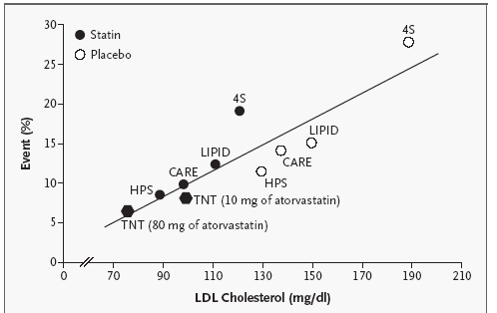
Event Rates Plotted against LDL-C
During Statin Therapy in
Secondary-Prevention Studies
IMPROVEIT
LaRosa JC, et al. NEJM 2005;352

Slide 3
CTT line - Linear Relationship Between LDL-C Levels and Major CV Events^{1,2}
  For every ~40mg/dL reduction in LDL-C, there was a 22% reduction in major
  CV events at 1 year²
50%
40%
30%
Proportional reduction in CV event rate (SE)
20%
The Cholesterol Treatment
Trialists’ (CTT) meta-analysis
of 26 studies suggest a linear
relationship between LDL-C
lowering with statins and CV
risk reduction²
10%
0%
(mmol/L)
(mg/dL)
0.5
19
1.0
39
1.5
58
2.0
77
-10%
Reduction in LDL cholesterol¹
Adapted from CTT Collaborators, Efficacy and safety of cholesterol-lowering treatment: prospective meta-analysis of data from 90 056 participants in 14 randomized trials of statins.
Major CV events included myocardial infarction, coronary death, and fatal or non-fatal stroke.
References: 1. Cholesterol Treatment Trialists’ (CTT) Collaborators. Lancet. 2005;366:1267-1278. 2. Cholesterol Treatment Trialists’ (CTT) Collaboration.
Lancet. 2010;376:1670–81.

Slide 4
LDL-C is a major contributor to atherosclerotic progression
LDL-C levels and atherosclerosis progression in coronary artery IVUS studies
1.8
REVERSAL
Statin
CAMELOT
1.2
Placebo
0.6
ACTIVATE
Median Change in
Atheroma Volume (%)
A-PLUS
REVERSAL
0
–0.6
r²=0.95
P<0.001
ASTEROID
–1.2
50
60
70
80
90
100
110
120
Mean LDL-C (mg/dL)
A-Plus, Avasimibe and Progression of Lesions on Ultrasound; ASTEROID, A Study to Evaluate the Effect of Rosuvastatin on Intravascular Ultrasound-Derived Coronary Atheroma Burden; CAMELOT, Comparison of Amlodipine vs Enalapril to Limit Occurrences of Thrombosis; LDL-C, low-density lipoprotein cholesterol; REVERSAL, Reversal of Atherosclerosis With Aggressive Lipid-Lowering; IVUS, intravascular ultrasound.
Sipahi I, et al. Cleve Clin J Med 2006;10:937–44; Nissen SE, et al. JAMA 2006;295:1556–65.
Notes:
The above slide depicts the linear relationship between mean LDL-C levels and atherosclerosis progression in some of the largest statin placebo-controlled trials
Linear regression analysis shows a high correlation between the mean LDL-C achieved in various statin trials and the mean progression rate for the most robust IVUS endpoint, PAV (r²=0.97; P<0.001), in various IVUS regression-progression trials
To convert: 100 mg/dL=2.59 mmol/L
Studies:
ACTIVATE, Acyl-CoA:Cholesterol Acyltransferase Intravascular Atherosclerosis Treatment Evaluation; A-PLUS, Avasimibe and Progression of Lesions on Ultrasound; ASTEROID, A Study to Evaluate the Effect of Rosuvastatin on Intravascular Ultrasound-Derived Coronary Atheroma Burden; CAMELOT, Comparison of Amlodipine vs Enalapril to Limit Occurrences of Thrombosis; REVERSAL, Reversal of Atherosclerosis With Aggressive Lipid-Lowering.
Abbreviations:
CV, cardiovascular; IVUS, intravascular ultrasound; LDL-C, low-density lipoprotein cholesterol; PAV, percent atheroma volume.
Reference:
Nissen SE, et al. JAMA 2006;295:1555–65.

Slide 5
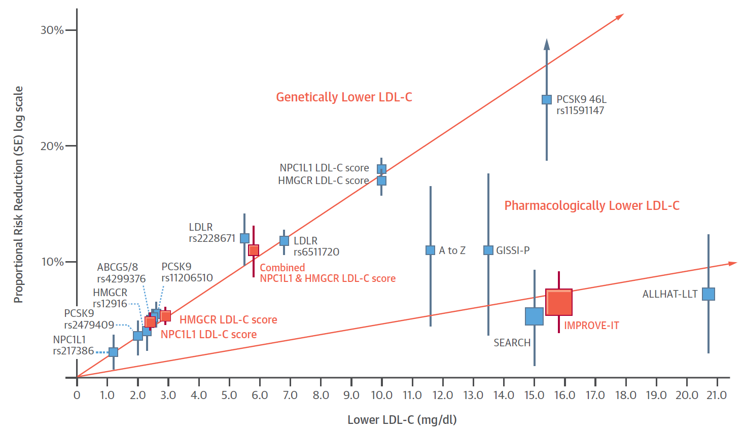
Clear genetic and epidemiological evidence for LDL-C as a risk factor
Meta-analysis of 312,321 participants: long-term exposure to lower LDL-C was associated with 54.5% reduction in risk of CHD for each 1 mmol/L (38.7 mg/dL) lower LDL-C¹
Mendelian randomization analysis²
[To convert, 100 mg/dL=2.59 mmol/L].
CHD, coronary heart disease; LDL-C, low-density lipoprotein cholesterol; LDLR, low-density lipoprotein receptor; LLT, lipid-lowering therapy; PCSK9, proprotein convertase subtilisin/kexin type 9; SE, standard error.
Ference BA, et al. J Am Coll Cardiol 2012;60:2631–9.
Ference BA, et al. J Am Coll Cardiol 2015;65:1552–61.
Notes:
Natural differences in LDL-C levels associated with genetic variants support the relationship between LDL-C and risk^{1,2}
Here are data from >300,000 individuals, plotted on an X–Y scatterplot, which show the impact of the variant on LDL on the X-axis and the reduction in CV events on the Y axis^{1,2}
Data show that relationship between lifelong exposure to lower LDL-C and risk of CHD is approx. log-linear and, importantly, is consistent regardless of the gene^{1,2}
Boxes represent proportional risk reduction (1–OR) of CHD for each exposure allele, genetic score, or randomized trial plotted against the absolute magnitude of lower LDL-C associated with that allele or genetic score; or the absolute difference in LDL-C between treatment groups for each trial. Vertical lines represent one SE above and below point estimate of proportional risk reduction. SNPs, genetic scores, and trials are plotted in order of increasing absolute magnitude of effect on lower LDL-C. In the top line, the red boxes represent results of the 2 × 2 factorial Mendelian randomization study and the blue boxes represent results derived from CARDIoGRAMplusC4D consortia data. In the lower line, the red box represents the results of the IMPROVE-IT trial and the blue boxes represent the results of prior statin trials¹
Abbreviations:
CHD, coronary heart disease; CV, cardiovascular; IMPROVE-IT, IMProved Reduction of Outcomes: Vytorin Efficacy International Trial; LDL-C, low-density lipoprotein cholesterol; OR, odds ratio; SE, standard error; SNP, single-nucleotide polymorphism.
References:
Ference BA, et al. J Am Coll Cardiol 2015;65:1552–61.
FDA Briefing Document (EMDAC) June 10 2015. http://www.fda.gov/downloads/AdvisoryCommittees/CommitteesMeetingMaterials/Drugs /EndocrinologicandMetabolicDrugsAdvisoryCommittee/UCM452354.pdf. [Accessed 9 July 2015].
Copyright:
Reprinted from J Am Coll Cardiol, Vol 65, Issue 15. Ference BA, et al. Effect of Naturally Random Allocation to Lower Low-Density Lipoprotein Cholesterol on the Risk of Coronary Heart Disease Mediated by Polymorphisms in NPC1L1, HMGCR, or Both. Pages 1554-61.Copyright 2015, with permission from Elsevier.

Slide 6
Clinical trial data support achieving lower levels of LDL-C, regardless of baseline LDL-C
ACS study
Stable CAD study
4S
pbo
PROVE-IT TIMI 22
P40
PROVE-IT TIMI 22
A80
4S
S40
IMPROVE-IT
S40
IMPROVE-IT
S40+EZE
CARE
P40
HPS
S40
CARE
pbo
LIPID
pbo
HPS
pbo
LIPID
P40
TNT
A10
TNT
A80
[To convert, 100 mg/dL=2.59 mmol/L].
ACS, acute coronary syndrome; CHD, coronary heart disease; LDL-C, low-density lipoprotein cholesterol.
Rosenson RS. Exp Opin Emerg Drugs 2004;9:269–79; LaRosa JC, et al. N Engl J Med 2005;352:1425–35; Cannon CP, et al. N Engl J Med 2015;372:2387–97.
Notes:
Although large-scale statin trials have demonstrated significant reductions in CV risk, there are many patients who have a CV event despite receiving statin therapy
There is increasing evidence that larger reductions in LDL-C are associated with greater improvements in CV morbidity and mortality
The studies shown here have demonstrated a generally linear relationship between event rates and on-treatment LDL values over a wide range of LDL from 194 down to 54 mg/dL [5.02 to 1.53 mmol/L]
The linear relationship between lower LDL-C levels and reduction in CV events was also observed in the IMPROVE-IT ezetimibe trial³
Importantly, there is no level of LDL that has been studied below which further LDL reduction has not shown benefit
Studies:
4S, Scandinavian Simvastatin Survival Study; CARE, Cholesterol and Recurrent Events Trial; HPS, Heart Protection Study; CV, cardiovascular; IMPROVE-IT, IMProved Reduction of Outcomes: Vytorin Efficacy International Trial; LIPID, Long-term Intervention with Pravastatin in ischemic Disease; PROVE IT-TIME 22, Pravastatin or Atorvastatin Evaluation and Infection Therapy –Thrombolysis in Myocardial Infarction 22; TNT, Treating to New Targets.
Abbreviations:
LDL, low-density lipoprotein; LDL-C, low-density lipoprotein cholesterol.
References:
Rosensen RS. Exp Opin Emerg Drugs 2004;9:269–79.
LaRosa JC, et al. N Engl J Med 2005;352:1425–35.
Cannon CP, et al. N Engl J Med 2015;372:2387–97.

Slide 7
Every 1 mmol/L reduction in LDL-C reduces annual CV risk by up to 28%, regardless of mechanism
50
More LDL lowering and risk reduction
40
Ezetimibe
Fibrate
30
Bile acid resin
Reduction in CV events (%)
Niacin
20
Diet/unsaturated fatty acid
Ileal bypass
10
CTTC trials (statin)
IMPROVE-IT
0
10
20
30
40
50
60
70
80
Reduction in LDL-C (mg/dL)
There is no evidence of any lower LDL-C threshold
Data from studies of non-statin lipid-lowering medications superimposed upon data from the Cholesterol Treatment Trialists Collaboration (CTTC) 2005 meta-analysis. The IMPROVE-IT trial was adequately powered to show the efficacy on incremental LDL-C lowering on CV outcomes. [To convert, 100 mg/dL=2.59 mmol/L].
CV, cardiovascular; IMPROVE-IT, IMProved Reduction of Outcomes: Vytorin Efficacy International Trial; LDL-C, low-density lipoprotein cholesterol.
CTT Collaboration. Lancet 2005:366;1267–78; CTT Collaboration. Lancet 2010;376:1670–81;
Cannon CP, et al. N Engl J Med 2015;372:2387–97.
Notes:
LDL-C has been validated as a modifiable risk factor through > 30 years of research
Trials with statins provided a large volume of data regarding the relationship between LDL-C reduction and reduction in CV events in a variety of patient populations and baseline LDL-C values
Very similar results were seen with studies over decades with non-statin interventions such as niacin, bile acid sequestrants, fibrates and even surgical approaches, all of which showed that, when LDL-C was appreciably lowered, and there were no off-target adverse effects on other lipid fractions or other parameters, then there was a corresponding reduction in risk
Some more recent trials had very small LDL-C reductions and non-significant reductions in CV events, but were inadequately powered to test the LDL-C hypothesis
In contrast, the IMPROVE-IT study was adequately powered for CV events and shows that further LDL-C reduction with a non-statin added to a statin further reduces CV events²
The data shown are from studies of non-statin lipid-lowering medications superimposed upon data from the Cholesterol Treatment Trialists Collaboration (CTTC) 2005 meta-analysis. Circle/square size is proportional to sample size
To convert: 100 mg/dL = 2.59 mmol/L
Abbreviations:
CV, cardiovascular; IMPROVE-IT, IMProved Reduction of Outcomes: Vytorin Efficacy International Trial; LDL-C, low-density lipoprotein cholesterol.
References:
FDA Briefing Document (EMDAC) June 10 2015. http://www.fda.gov/downloads/AdvisoryCommittees/CommitteesMeetingMaterials/Drugs /EndocrinologicandMetabolicDrugsAdvisoryCommittee/UCM452354.pdf. [Accessed 9 July 2015].
Cannon CP, et al. N Engl J Med 2015;372:2387–97.

Slide 8
Approximately half of patients do not achieve recommended LDL-C goals < 70 mg/dL
Patients on lipid-lowering drugs for >3 months (stable medication >6 weeks)
Asia¹
NCEP ATP III guidelines*
Europe²
JETF guidelines
% of patients at LDL-C goal
LDL-C, low-density lipoprotein cholesterol; JETF, Joint European Task Force;
NCEP ATP, National Cholesterol Educational Program Adult Treatment Panel.
Park JE et al. Eur J Prev Cardiol 2012;19:781–94.
Hermans MP et al. Curr Med Res Opin 2010;26:445–54.
Notes:
Pan-Asian CEPHEUS study:¹
Hypercholesterolemic patients aged ≥18 years who had been on lipid lowering treatment for ≥3 months (stable medication for ≥6 weeks) were recruited, and lipid concentrations were measured
7281 patients from eight Asian countries were included in the final analysis
Mean age: 61 years; 41% female; 82% on statin monotherapy
LDL-C goal attainment was reported in 49% of patients overall, including 51% of primary and 49% of secondary prevention patients, and 37% of patients with FH
The green bars in the graph show the proportion of patients attaining their NCEP ATP III guidelines LDL-C goals by country
Pan-European CEPHEUS study:²
Hypercholesterolemic patients aged ≥18 years who had been on lipid lowering treatment for ≥3 months (stable medication for ≥6 weeks) were recruited, and lipid concentrations were measured
14,478 patients from eight European countries were included in the final analysis
Mean age: 63 years; 45% female; 84% on statin monotherapy
Overall, 55% of patients achieved their LDL-C goal
The blue bars in the graph show the proportion of patients at the JETF guideline LDL-C goal level by country
Abbrevations:
CEPHEUS, Centralised Pan-European survey on tHE Under-treatment of hypercholeSterolemia; FH, familial hypercholesterolemia; JETF, Joint European Task Force; LDL-C, low-density lipoprotein cholesterol; NCEP ATP, National Cholesterol Educational Program Adult Treatment Panel.
References:
Park JE, et al. Eur J Prev Cardiol 2012;19:781–94.
Hermans MP, et al. Curr Med Res Opin 2010;26:445–54.

Slide 9
Only 1 in 5 MI patients achieve LDL-C target <70 mg/dL despite high statin prescription rate and good adherence
EUROASPIRE IV: 7998 patients <80 years old with established CHD*
*25% women, mean age 64 years, one third <60 years old, 2012–2013.
CHD, coronary heart disease; LDL-C, low-density lipoprotein cholesterol; MI, myocardial infarction.
http://www.escardio.org/about/press-releases/esc13-Amsterdam/Pages/euroaspire-iv-success-challenges-secondary-prevention-CVD-Europe.aspx. [Accessed 23 October 2015].
Notes:
The EUROASPIRE surveys are part of the ESC’s EORP programme1 and track lifestyle, risk factor control and cardioprotective drug use in Europe
Data were collected using standardised methods during May 2012 to April 2013 in 7,998 patients < 80 years with established coronary heart disease (25% women, mean age 64 years, one-third <60 years old). Patients had been hospitalised in the last years for coronary heart disease. They were interviewed and clinically examined for the study 6 months to 3 years (median 1.35 years) after the hospital episode
Some 87% of patients were taking lipid lowering drugs (almost exclusively statins) (range 75-95%)
Of these, 58% had a LDL-C level of < 2.5 mmol/L (100 mg/dL) but only 21% reached an LDL-C target of <1.8mmol/L (70mg/dL)
Abbreviations:
ESC, European Society of Cardiology; LDL-C, low-density lipoprotein cholesterol.
Reference:
http://www.escardio.org/about/press-releases/esc13-Amsterdam/Pages/euroaspire-iv-success-challenges-secondary-prevention-CVD-Europe.aspx. [Accessed 23 October 2015].

Slide 10
Despite the Risk of Recurrent Events after MI,
High-intensity Statin Use Decreases by~30%
Within 2 Years After MI
Retrospective, Cohort Study of Medicare Patients Following Hospitalization for MI in 6 Month Post-discharge Cohort
Patients:
N = 57,898
≥ 66 years with
MI hospitalization*
Cohort of Medicare beneficiaries 66 to 75 years at
6 months post-discharge for MI
(N = 29,932)
Follow-up: 6, 12, 18, and 24 months
100
Remain taking high-intensity statins with high adherence
80
Down-titrate to low-/moderate-intensity statins with high adherence
60
Statin use with low adherence
Population (%)
Discontinuation of statins
40
Other patterns of statin use
The group “other patterns of statin use” includes beneficiaries who do not meet the definition for continuing to take high-intensity statins with high adherence, down-titrating to low-/moderate-intensity statins with high adherence, using statins with low adherence, or discontinuing statins.
20
0
6
(n = 29,932)
12
(n = 28,131)
18
(n = 26,393)
24
(n = 24,768)
Follow-up (Months)
*Defined by an inpatient claim with a code of 410.x0/410.x1 in any diagnosis position between January 1, 2007, and December 31, 2012, whose initial statin fill within 30 days of hospital discharge was for a high-intensity dosage.
Colantonio LD, et al. JAMA Cardiol. 2017;2:890-895.

Slide 11
Only ~30% of Patients Post-ACS Achieve LDL-C < 70 Mg/dL and 90% Did Not Receive Up-titration of Statins
National, Prospective Swedish Registry of Patients Post-ACS (N = 17,236) SWEDEHEART
Patients:
Subgroup of SWEDEHEART
N = 4,327
Patients with ACS who had LDL-C values at admission, 2 months and 12 months post-ACS
Age: < 75 years
Follow-up: 2 and 12 months
LDL-C levels
2 months post-AMI
LDL-C ≤ 70 mg/dL (≤ 1.8 mmol/L)
70 mg/dL (1.8 mmol/L) < LDL-C
≤ 77 mg/dL (≤ 2.0 mmol/L)
12 months post-AMI
77 mg/dL (2.0 mmol/L) < LDL-C
≤ 97 mg/dL (≤ 2.5 mmol/L)
0%
20%
40%
60%
80%
100%
LDL-C > 97 mg/dL (> 2.5 mmol/L)
Titration after follow-up
12 months post-AMI
No titration after follow-up
The majority of patients did not have LLT up-titration despite LDL-C ≥ 97 mg/dL
(≥ 2.5 mmol/L)
2 months post-AMI
0%
20%
40%
60%
80%
100%
AMI = acute myocardial infarction; LLT = lipid-lowering therapy.
Hambraeus K, et al. Am J Cardiol. 2014;113:17-22.

Slide 12
< 30% of Patients Overall and < 40% of Patients Even on High-Intensity statins post-Acs, PCI, or CABG Achieved LDL-C < 70 mg/dL (< 1.8 mmol/L)
Cross-sectional Survey Across 27 European Countries
ESC-EORP EUROASPIRE V
Proportion of Patients With LDL-C < 70 mg/dL
at 6–24 Months Post-Event
Patients:
N = 7,824
Patient with history of ACS, PCI, or CABG
Age: > 18 – < 80 years
Follow up: 6–24 months post-event
% of Patients
Overall
Men
Women
None
Low/
Mod
High
<50
50-59
60-69
>70
LLT Intensity
Age (years)
De Backer G, et al. Atherosclerosis. 2019;285:135-146.

Slide 13
The lower the LDL-C achieved, the lower the risk of CV events
TNT^{1,a}
Rate of major CV events
JUPITER^{2,b}
Time to occurrence of major CV events
PROVE-IT^{3,c}
Hazard ratio of primary endpoint
14
0.08
Placebo
>80–100
Referent
P<0.0001*
≥106
12
90–<106
LDL-C >50 rosuvastatin
10
77–<90
0.06
LDL-C <50 rosuvastatin
0.80 (0.59, 1.07)
64–<77
>60–80
8
<64
P for trend <0.0001
Achieved LDL-C (mg/dL)
% of Patients With Major CV Events
0.04
Cumulative Incidence
0.67 (0.50, 0.92)
6
>40–60
4
0.02
2
≤40
0.61 (0.40, 0.91)
0
0.00
0
1
2
3
4
0
1
2
LDL-C (mg/dL)
Follow-up (Years)
Lower Better
Higher Better
*P value for trend across LDL-C
ªRCT in patients with stable coronary disease. Major CV Events = death from CHD, nonfatal non-procedure-related MI, resuscitation after cardiac arrest, or fatal or nonfatal stroke. ^{b}RCT of patients with LDL-C <130 mg/dL, high-sensitivity C-reactive protein ≥2.0 mg/L, and no history of CVD or diabetes mellitus. Major CV events = CV death, MI, stroke, arterial revascularization, or hospitalized UA. ‡post randomization LDL-C. ^{c}RCT in patients with stabilized ACS. Primary composite endpoint of death, MI, stroke, revascularization, and UA requiring hospitalization.
ACS, acute coronary syndrome; CHD, coronary heart disease; CV, cardiovascular; CVD, cardiovascular disease; LDL-C, low-density lipoprotein cholesterol; MI, myocardial infarction; RCT, randomized controlled trial; UA, unstable angina.
LaRosa JC, et al. J Am Coll Cardiol 2007;100:747–52.
Hsia J, et al. J Am Coll Cardiol 2011;57:1666–75.
Wiviott SD, et al. J Am Coll Cardiol 2005;46:1411–6.
Notes:
TNT¹
4995 patients with coronary heart disease and LDL-C <130 mg/dL were randomized to atorvastatin 10 mg/day or 80 mg/day
Patients were divided into quintiles according to LDL-C levels after 3 months of treatment: <64, 64–<77, 77–<90, 90–<106 and ≥106 mg/dL
The figure plots the % of patients with major CV events according to LDL-C level
JUPITER²
17,802 apparently healthy adults with high-sensitivity C-reactive protein ≥2 mg/L and LDL-C <130 mg/dL were randomized to rosuvastatin 20 mg/day or placebo
The figure shows the Kaplan-Meier curves for the time to first occurrence of major CV events (CV death, MI, stroke, arterial revascularization or hospitalized UA) for subjects allocated to placebo vs rosuvastatin with LDL-C >50 mg/dL or <50 mg/dL
PROVE-IT TIMI 22³
19,825 patients were randomized to receive atorvastatin 80 mg. LDL-C levels were assessed 4 months after the start of treatment
The hazard ratio of the primary endpoint (death, MI, stroke, revascularization and UA requiring hospital admission) was compared with achieved LDL-C (adjusted for age, gender, baseline calculated LDL-C, diabetes mellitus and prior MI)
Patients who achieved a lower LDL-C level (≤80 mg/dL) had a lower risk of any primary endpoint events compared with patients with LDL-C >80–100 mg/dL
Abbreviations:
CV, cardiovascular; JUPITER, Justification for the Use of Statins in Prevention: an Intervention Trial Evaluating Rosuvastatin; LDL-C, low-density lipoprotein cholesterol; MI, myocardial infarction; PROVE-IT TIMI 22, Pravastatin or Atorvastatin Evaluation and Infection Therapy –Thrombolysis In Myocardial Infarction; TNT, Treating to New Targets; UA, unstable angina.
References:
LaRosa JC, et al. J Am Coll Cardiol 2007;100:747–52.
Hsia J, et al. J Am Coll Cardiol 2011;57:1666–75.
Wiviott SD, et al. J Am Coll Cardiol 2005;46:1411–6.

Slide 14
Glagov Study: Exploratory Subgroup: LDL-C Change from Baseline in Patients with LDL-C < 70 mg/dL at Baseline
Patients with LDL-C < 70 mg/dL at Baseline (n = 144)
Statin monotherapy
Statin + evolocumab
Mean LDL-C 70.6 mg/dL
Change from baseline 16.4%
65.5 mg/dL
Mean LDL-C 24.0 mg/dL
Change from baseline -58.3%
15.0 mg/dL
Nissen SE, et al. American Heart Association Scientific Sessions, Nov 12 - 16, 2016,
New Orleans, Louisiana. Oral Presentation
Notes:
Nissen AHA 2016-
Oral Presentation
< 70 Subgroup

Slide 15
Exploratory Subgroup: Change in PAV & Regression in Patients with LDL-C < 70 mg/dL at Baseline
Patients with LDL-C < 70 mg/dL at Baseline (n = 144)
Percent Atheroma Volume
Fraction Showing Regression
P < 0.001*
Change in PAV (%)
% of Patients with Regression in PAV
P < 0.001*
*Between-treatment group comparison
PAV = percentage atheroma volume
Nicholls SJ, et al. JAMA. [published online ahead of print November 15, 2016]. doi: 10.1001/jama.2016.16951.
Notes:
Nicholls SJ, et al. JAMA. 2016:
E7-A-2

Slide 16
Exploratory Analysis: Achieved LDL-C and Change in PAV in All Patients- GLAGOV Study
1.0
0.5
0
Change Percent Atheroma Volume (%)
-0.5
-1.0
-1.5
10
20
30
40
50
60
70
80
90
100
110
On-Treatment LDL-C (mg/dL)
Local regression (LOESS) curve illustrating the association (with 95% CI) between achieved LDL-C levels and change in PAV in all patients undergoing serial IVUS evaluation. PAV = percentage atheroma volume;
LDL-C = low-density lipoprotein cholesterol
Nicholls SJ, et al. JAMA. [published online ahead of print November 15, 2016]. doi: 10.1001/jama.2016.16951.
Notes:
Nicholls SJ, et al. JAMA. 2016:
E9-A-1 (Fig 4)

Slide 17

FOURIER
Further cardiovascular OUtcomes Research with PCSK9 Inhibition in subjects with Elevated Risk
MS Sabatine, RP Giugliano, AC Keech, N Honarpour,
SM Wasserman, PS Sever, and TR Pedersen,
for the FOURIER Steering Committee & Investigators
American College of Cardiology – 66th Annual Scientific Session
Late-Breaking Clinical Trial
March 17, 2017

Slide 18
42% of patients ≤ 25 mg/dl

Slide 19
RRR 15%
ARR 1.5%

Slide 20
evolocumab Provides 24% RRR in CV Death, MI, or Stroke in Patients Within 2 Years Post-MI
Post hoc Analysis of the 81% (N = 22,351) of Patients in FOURIER With MI as
Their Qualifying Event
Qualifying MI < 2 years ago (N = 8,402)
12
HR 0.76
(95% CI, 0.64–0.89)
10.8%
10
8
7.9%
Placebo + statin
6
CV Death, MI, or Stroke (%)
2.9% ARR
4
Evolocumab + statin
24% RRR
2
0
0
6
12
18
24
30
36
Months
ARR = absolute risk reduction. RRR = relative risk reduction.
Sabatine MS, et al. Circulation. 2018;138:756-766.

Slide 21

Lower LDL-C Is Better
Patients divided by quartile of baseline LDL-C and by treatment arm
P<0.0001
Q4
Q3
Q2
Q4
Q3
Q1
Q1
Q2
Placebo
Evolocumab

Slide 22
20 mg/dL
20-50 mg/dL
50-70 mg/dL
70-100 mg/dL
100 mg/dL
30 mg/dL 85 mg/dL

Slide 23
20 mg/dL
20-50 mg/dL
50-70 mg/dL
70-100 mg/dL
100 mg/dL

Slide 24
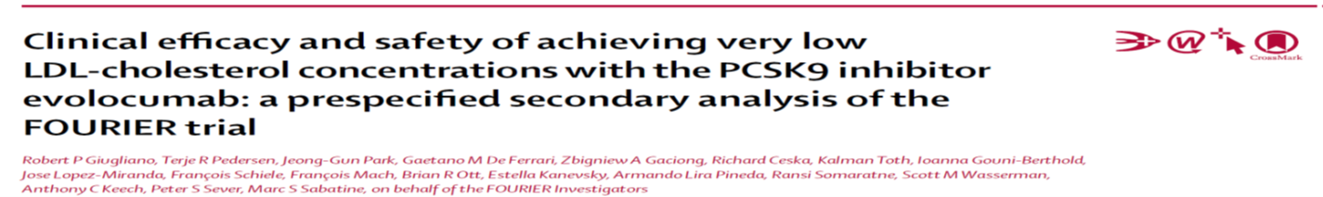
20 40 50 80 100 115 130 155 180 mg/dL
Lancet 2017

Slide 25
20 20-50 50-70 70-100 100 mg/dL

Slide 27
Guidelines for Treatment of Dyslipidemia in ACS STEMI and NSTEMI patients emphasize LDL-C Lowering
ACC/AHA¹ | ESC/EAS²
Age ≤ 75 and no safety concerns: High-intensity statins to lower LDL-C by ≥ 50% Age > 75 or safety concerns: Moderate- or high-intensity statin therapy after evaluation for ASCVD risk reduction² On maximal LDL-C lowering therapy with LDL-C ≥ 70 mg/dL (≥ 1.8 mmol/L): reasonable to add PCSK9i | LDL-C ↓ ≥ 50% from baseline AND < 55 mg/dL Initiate high-intensity statin therapy during first 1–4 days of ACS hospitalization For planned PCI: consider high-intensity statin pretreatment (or loading dose if on statin) LDL-C levels not at goal despite maximally tolerated statin + ezetimibe: consider PCSK9i early after event (during hospitalization for ACS event, if possible) LDL-C goal not achieved after 4–6 weeks despite maximally tolerated statin + ezetimibe: recommend initiation of PCSK9i
Additionally, for ASCVD patients on maximally tolerated statin
experiencing a second vascular event within 2 years, a lower
LDL-C goal of < 40 mg/dL may be considered
ACC = American College of Cardiology; AHA = American Heart Association; ESC = European Society of Cardiology; EAS = European Atherosclerosis Society; PCSK9i = PCSK9 inhibitor
1. Grundy SM, et al. J Am Coll Cardiol. 2018;73:e285-e350. 2. Mach F, et al. Eur J Heart. 2019 [epub ahead of print August 31, 2019]. doi.org/10.1093/eurheartj/ehz455.

Slide 28
LDL Levels in Populations
With and Without CHD
Frequency (%)
LDL Cholesterol (mg/dL)
Kannel W. Am J Cardiol 1995;76:69C-77C
LDL ממוצע אצל חולה לב:
140-160 מ"ג/ד"ל
לפי ההנחיות האירופאיות החדשות כדי להוריד לפחות 50% ולהגיע לרמה של פחות מ 55 מ"ג/ד"ל
צריך להפחית 75-105 מ"ג/ד"ל מהערך ההתחלתי
דהיינו 53-67%
ובמידה ויש אירוע נוסף בשנתיים אחרונות להוריד LDL מתחת ל 40 מ"ג/ד"ל, דהיינו 71%-75%

Slide 29
EVOlocumab for Early Reduction of LDL-cholesterol Levels in Patients with Acute Coronary Syndromes^{1,2}
EVOPACS
In-hospital
(72 hours)
ACS
(NSTEMI/UA, STEMI)
Placebo SC QM + atorvastatin 40 mg QD
N = 308
Randomized 1:1
1 country, 7 sites
Evolocumab SC 420 mg QM + atorvastatin 40 mg QD
8 weeks
Assessments conducted day 1, weeks 4 and 8
Primary Endpoint
Secondary endpoint
  LDL-C change from baseline at week 8
  Safety and tolerability (S)AE
INCLUSION CRITERIA
  ACS (NSTEMI/UA) < 72 hours, STEMI < 24 hours
LDL-C levels
  ≥ 70 mg/dl (≥ 1.8 mmol/L)in patient previously on stable treatment with high-intensity statin OR
  ≥ 90 mg/dl (≥ 2.3 mmol/L) in patients previously on stable treatment with low- or moderate-intensity statin OR
  ≥ 125 mg/dL (≥ 3.2 mmol/L) in statin-naive patients or patients not on stable statin treatment
ACS = acute coronary syndrome; SC = subcutaneous; QM = monthly; QD = daily;
LDL-C = low-density lipoprotein cholesterol; NSTEMI = Non-ST-elevation myocardial infarction;
STEMI = ST-elevation myocardial infarction; UA = unstable angina; AE = adverse event
1. Koskinas KC, et al. Clin Cardiol. 2018;41:1513-1520. 2. Koskinas KC, et al. J Am Coll Cardiol. 2019. [epub ahead of print]. doi.org/10.1016/j.jacc.2019.08.010.

Slide 30
evopacs primary Endpoint showed Significant Reduction in LDL-C at 8 Weeks
Mean Values (±SD)
The reduction in LDL-C levels was evident at 4 weeks and maintained at 8 weeks
There were no differences observed for any of the exploratory endpoints
3.61 mmol/L
(139 mg/dL)
3.42 mmol/L
(132 mg/dL)
Calculated LDL-cholesterol (mmol/L)
2.00 mmol/L
(77 mg/dL)
2.06 mmol/L
(80 mg/dL)
0.79 mmol/L
(31 mg/dL)
No. of patients
Placebo
148
144
149
Evolocumab
146
136
141
Absolute difference,
LS means (mmol/L)
Percentage difference
1.34
1.43
38.4%
40.7%
P value
<0.001
<0.001
AE = adverse event; LS = least-squares; LDL-C = low-density lipoprotein cholesterol; SD = standard deviation .
Koskinas KC, et al. J Am Coll Cardiol. 2019. [epub ahead of print August 31, 2019]. doi.org/10.1016/j.jacc.2019.08.010.

Slide 31
In EVOPACS, 90% of Evolocumab Patients Achieved ESC/EAS LDL-C Guideline Goal of < 55 mg/dL¹⁻³
Achieved LDL-C in EVOPACS
 | Placebo
 | Evolocumab
LDL-C <70 mg/dL
LDL-C <55 mg/dL
Compared with placebo, substantially more patients receiving evolocumab were able to achieve LDL-C levels
< 1.4 mmol/L
(90% vs 11%)
Proportion of Patients
Proportion of Patients
(70 mg/dL)
(55 mg/dL)
LDL-C = low-density lipoprotein cholesterol.
1. Koskinas KC, et al. J Am Coll Cardiol. 2019. [epub ahead of print August 31, 2019]. doi.org/10.1016/j.jacc.2019.08.010. 2. Mach F. et al. Eur Heart J. [epub ahead of print August 31, 2019]. https://doi.org/10.1093/eurheartj/ehz455. 3. Koskinas KC, et al. ESC 2019, Paris Aug 31-Sept 4.

Slide 32
EVOPACS Secondary Endpoint: No New Safety Findings
There were no new safety findings. The percentage of patients who experienced AEs, SAEs, and AEs resulting in study
discontinuation were similar between groups
 | Evolocumab (n = 155) | Placebo (n = 152)* | P value
Any AE | 78 (50.3) | 77 (50.7) | 0.72
SAE | 12 (7.7) | 11 (7.2) | 0.84
AE resulting in study drug discontinuation | 2 (1.3) | 3 (2.0) | 0.65
Number (proportion) of patients with each event type are reported, not counting multiple events of the same type. Fisher's exact tests in case of zero events in one group.
*Excluded is one patient randomly allocated to placebo who withdrew consent early and refused study drug injection and any study intervention.
AE = adverse event; SAE = serious adverse event.
Koskinas KC, et al. J Am Coll Cardiol. 2019. [epub ahead of print August 31, 2019]. doi.org/10.1016/j.jacc.2019.08.010.

Slide 33
The VCU-ALIROCRT Trial: Alirocumab in Patients With Acute NSTEMI
Placebo SC + atorvastatin 80 mg
Type 1 acute NSTEMI
N = 20
Randomized
Alirocumab 150 mg SC + atorvastatin 80 mg
14 days
Primary Endpoint
Secondary endpoint
  Percent change in LDL-C from baseline to day 14
  Percent change in inflammatory markers (hsCRP) from baseline to 3 and 14 days
INCLUSION CRITERIA
  Type 1 acute NSTEMI
  High-intensity statin use
  No prior PCSK9i use
  LDL-C ≥ 70 mg/dL (≥ 1.8 mmol/L)
hsCRP = high-sensitivity C-reactive protein..
Trankle CR, et al. J Cardiovasc Pharmacol. 2019. [In press].

Slide 34
In Patients with Acute NSTEMI, Alirocumab Use Provided Significant Reductions in LDL-C but Neutral Effects on Measured Inflammatory Biomarkers
LDL-C
P < 0.001
No significant differences were seen between the alirocumab and placebo groups in the inflammatory biomarkers
hsCRP, IL-6,
IL-10, or TNF-α
200
P = 0.020
Placebo
150
-30 mg/dL
(-0.8 mmol/L)
Alirocumab
LDL-C (mg/dL)
100
-64 mg/dL
(-1.7 mmol/L)
50
0
Baseline
≤ 72 hours
14 days
Baseline
≤ 72 hours
14 days
Trankle CR, et al. J Cardiovasc Pharmacol. 2019. [In press].

Slide 35
In patients with CAD PCSK9 inhibitors should be a part of routine therapy to any patient in whom LDL goal is not achieved
Conclusion

Slide 36
In patients with CAD PCSK9 inhibitors should be a part of routine therapy to any patient )in whom LDL goal is not achieved(
Conclusion

Slide 37
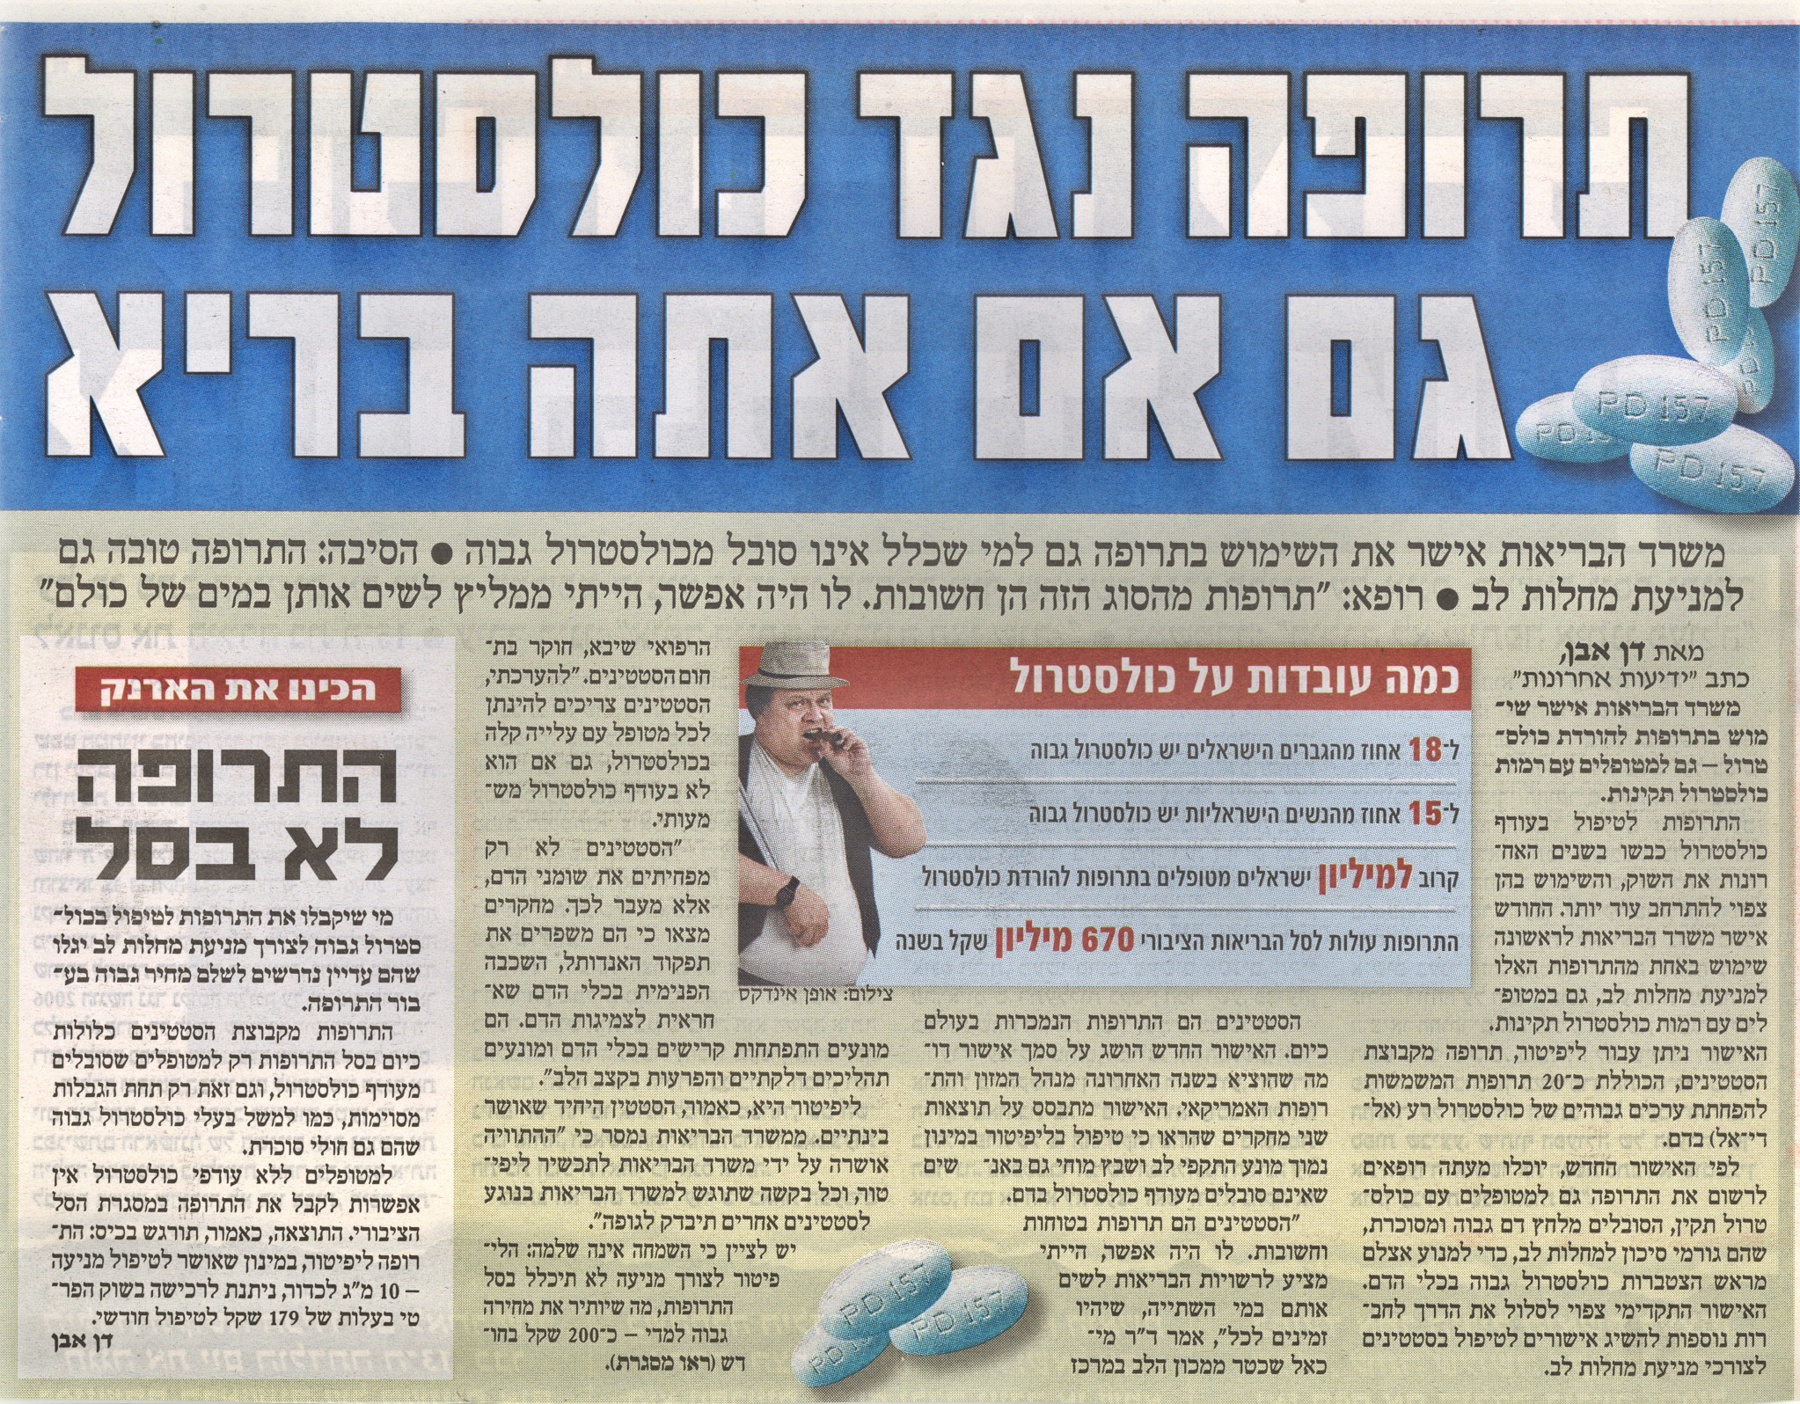
מאי 2008

Slide 38




The Clinical Research Unit
Leviev Heart Center, Sheba Medical Center

Slide 39
PCSK9 Levels Predict MACE Following ACS
PCSK9-REACT
Prospective, Single-Center, Observational Study in Austria
50
Patients:
N = 333
hospitalized for ACS
Median age: 57
Follow-up: 1 year
MACE = CV death, MI, UA, stent thrombosis, repeat revascularization and ischemic stroke
Lower tertile
Upper tertile
40
30
MACEs at One Year (%)
Log rank 8.73
P = 0.003
22%
20
10
3.4%
0
0
100
200
300
400
Follow-up (Days)
No. at risk
Lower tertile | 59 | 57 | 57 | 52 | 0
Upper tertile | 59 | 56 | 53 | 49 | 0
Upper tertile = higher PCSK9 concentration
Lower tertile = lower PCSK9 concentration
Association of PCSK9 with platelet reactivity in patients with acute coronary syndrome treated with prasugrel or ticagrelor.
Navarese EP, et al. Int J Cardiol. 2017;227:644-649.

Slide 40
PCSK9 Levels Are Associated with Increased
Platelet Reactivity and MACE in Patients with ACS
PCSK9-REACT Study
Prospective, Single-Center, Observational Study in Austria
P = 0.02
P = 0.47
P = 0.08
Lower tertile
Upper tertile
25
50
Log rank 8.73
P = 0.003
20
40
15
30
ADP-induced Platelet Aggregation (U)
MACEs at One Year (%)
22%
10
20
5
10
3.4%
0
0
1st tertile
2nd tertile
3rd tertile
0
100
200
300
400
PSCK9 Level
Follow-up (Days)
ADP = adenosine diphosphate.
Navarese EP, et al. Int J Cardiol. 2017;227:644-649.

Slide 41
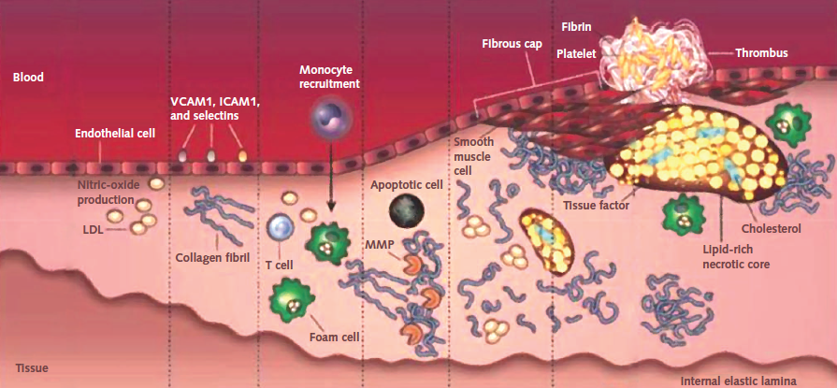
PCSK9 Upregulation Following an ACS Event
Results in Stimulation of Deleterious Lipid and Inflammatory Regulation
VULNERABLE PLAQUE WITH INCREASED NECROTIC CORE IN ACS
Statin Therapy
ACS
PCSK9 upregulation
PCSK9 Antibody
PCSK9 Inhibition
NF-κβ pathway activation
Reduced
apolipoprotein E receptor-2
NF-κβ pathway activation
Reduced LDL receptor expression in macrophages
NF-κβ pathway activation
PATHOLOGICAL PROCESS
Endothelial cell activation
Lipid core & fibrous cap formation
inflammation
Proteolysis apoptosis
THROMBOSIS
MMP= matrix metalloproteinase;
NF-κβ= nuclear factor-κβ.
Navarese EP, et al. Ann Intern Med. 2016;164:600-607.

Slide 42





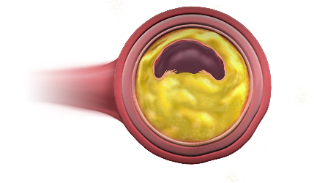


PCSK9 Increases Coronary
Plaque Vulnerability
ACS
PCSK9
oxLDL
oxLDL
LDL receptor degradation
PCSK9 increases coronary plaque vulnerability through several pathways, including proinflammatory LDL oxidation and direct modification of plaque composition
ADP
Collagen
Thrombin
CD36
SRA
Native LDL
Receptor
Native
LDL
ApoER2
p38^{MAPK}
cPLA₂
mPLAs
AA
COX-1/
Tx synthase
TxA₂
GPIIb/IIIaReceptor
ApoER2 = apolipoprotein E receptor 2; cPLA₂= cytosolic 85-kDa phospholipase A₂; COX-1 = cyclooxygenase 1; GPIIb/IIIa = glycoprotein IIb/IIIa; mPLA= monophosphoryl lipid A; oxLDL oxidized LDL; P38^{MAPK} = p38 mitogen-activated protein kinases; SRA = scavenger receptor class A; Tx = thromboxane.
Gencer B, et al. Atherosclerosis. 2018;275:368-375.
Thrombosis
Platelet
aggregation

Slide 43
The Clinical Research Unit
Leviev Heart Center, Sheba Medical Center

