Slide 1

The routine anti-thrombotic therapy in patients with ccs - dapt
Prof. Eli I. Lev
Director, Cardiology Department
Assuta Ashdod Medical Center
Ben Gurion University

Slide 2
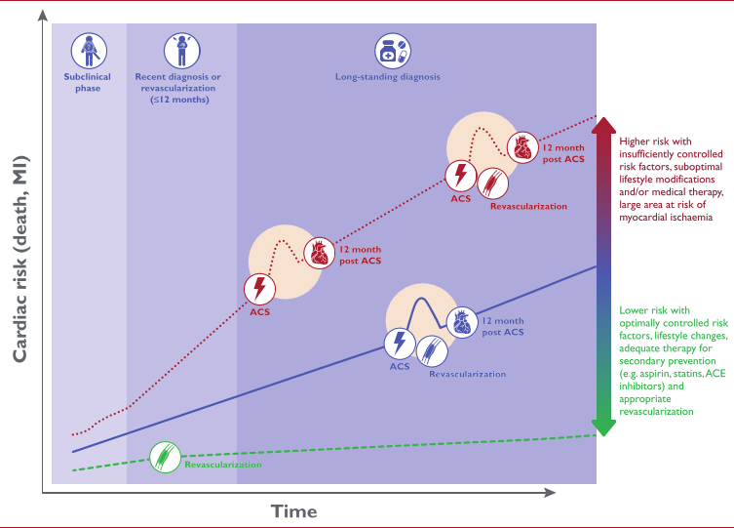
The routine long-term anti-thrombotic therapy in patients with ccs
No argument that post PCI (or post ACS) the recommended therapy is DAPT for at least 6-12 mo.
CCS ESC guidelines 2019

Slide 3
Main points
The concept of anti-platelet vs. “dual pathway” anti-platelet + anti-coagulant approach
The weight of the evidence
Where is the benefit of COMPASS vs. DAPT studies derived from?
Consequences of long-term treatment with anti-coagulant meds in patients wit CAD

Slide 4
Main points
The concept of anti-platelet vs. “dual pathway” anti-platelet + anti-coagulant approach
The weight of the evidence
Where is the benefit of COMPASS vs. DAPT studies derived from?
Consequences of long-term treatment with anti-coagulant meds in patients wit CAD

Slide 5
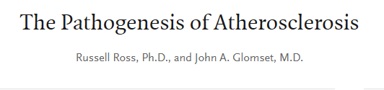


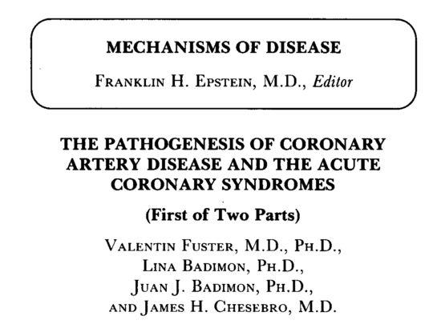
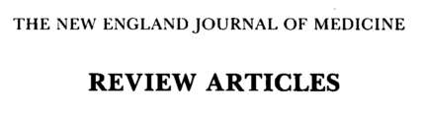

Role of platelets and coagulation in cad and acs

Slide 6
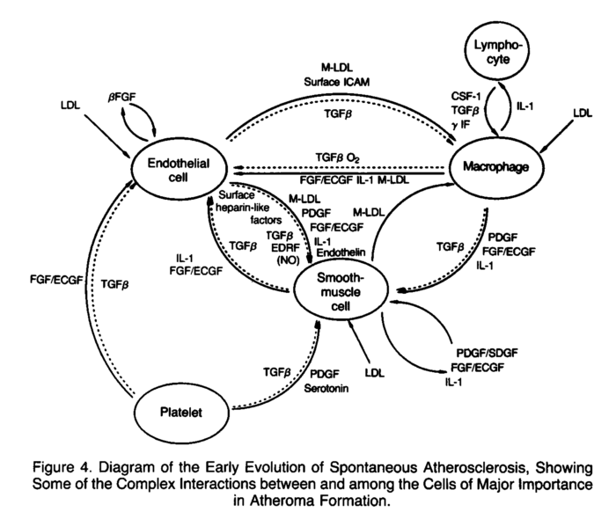
Role of platelets and coagulation in cad and acs
Fuster V, et al, NEJM 1992

Slide 7
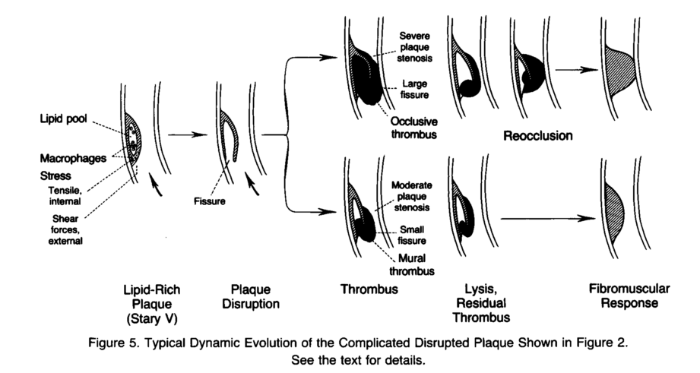
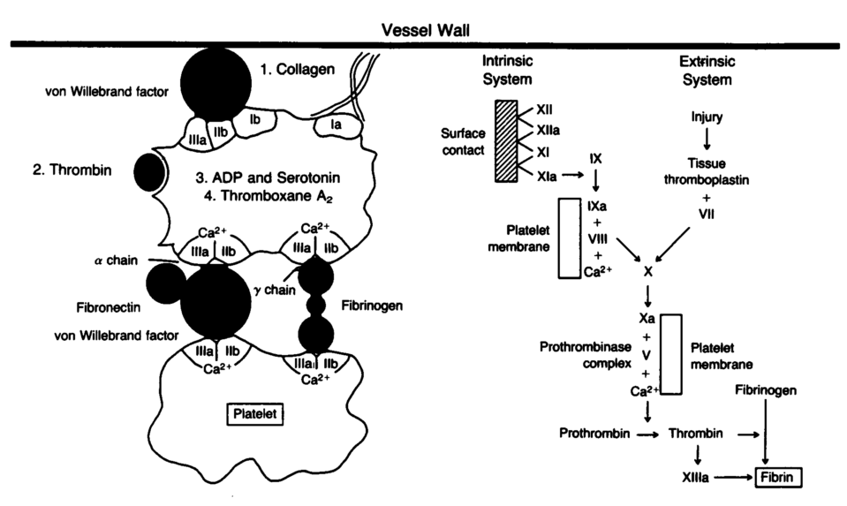
Role of platelets and coagulation in cad and acs
Fuster V, et al, NEJM 1992

Slide 8

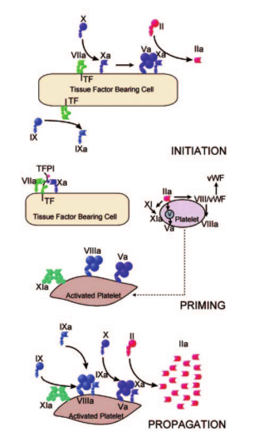
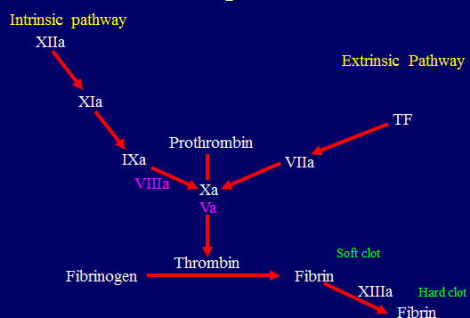
Role of platelets and coagulation in cad and acs
“Traditional - classic
coagulation cascade”
Updated framework of the coagulation system
and current view of arterial thrombus formation
Schneider D, Circulation 2007

Slide 9

There is no dual pathway !!!
There is one pathway of arterial thrombosis in which platelets are the main mediator

Slide 10
The Platelet as a Mediator of Coagulation
Phosphatidyl Serine
P-Selectin
PSGL-1
ACTIVATED
PLATELET
Coagulation
Factors
WBC
CD40L
CD40
Amplification
Cycle
Tissue Factor
Expression
Thrombin Generation
Courtesy of Dr. P. Gurbel

Slide 11
The Platelet as a Mediator of Inflammation
GP IIb/IIIa
sCD40L
sCD40L
CD40L
ENDOTHELIUM
Activation
CD40
PLATELET
Activation
CD40
P-selectin
PSGL-1
WBC
CD40L
Inflammatory Mediator/MMP Release
Proliferative Mediator Release
CD40
WBC
Activation
Courtesy of Dr. P. Gurbel

Slide 12
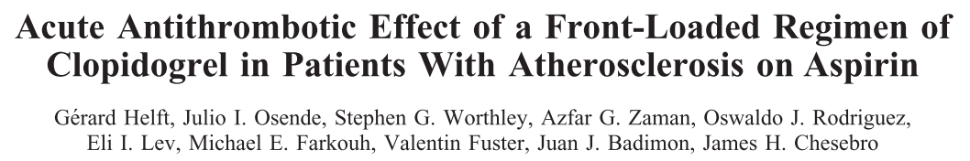
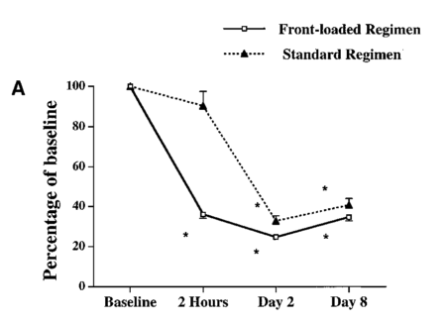
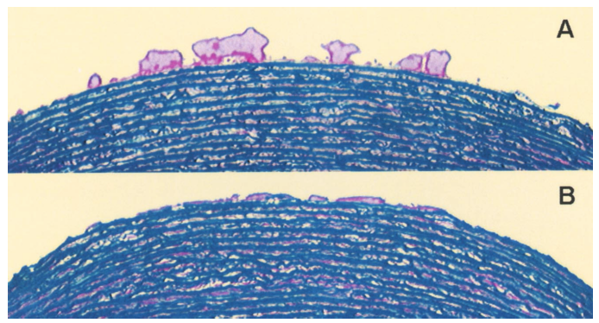
% Thrombus formation
Standard regimen
Front loaded
clopidogrell
Total thrombus formation
at high shear rate
Arterioscler Thromb Vasc Biol 2000

Slide 13
Main points
The concept of anti-platelet vs. “combined” anti-platelet + anti-coagulant approach
The weight of the evidence
Who is COMPASS applicable for and where does the benefit come from?
Rebound effect when discontinuing anti-thrombin meds

Slide 14
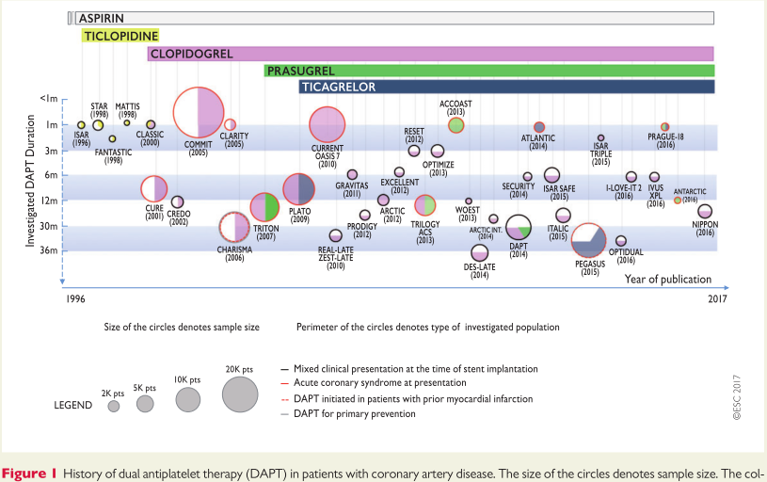
The weight of the evidence
“Based on over 35 randomized clinical trials, including more than 225000 patients, DAPT is among the most intensively investigated treatment options in the field of CV medicine”.
ESC DAPT guidelines 2017

Slide 15

Studies of antithrombotic strategies in patients with ccs
12 studies of
long-term DAPT
COMPASS

Slide 16

Combined long-term antiplatelet + anticoagulant treatment in stable CV dis
Contemporary studies: COMPASS trial
Evaluated one NOAC (rivaroxaban), at a specific dose (2.5 mg bid + ASA vs. ASA alone vs. 5 mg bid alone)
Did not compare rivaroxaban + ASA to DAPT, but to ASA alone
Eikelboom et al, NEJM 2017

Slide 17
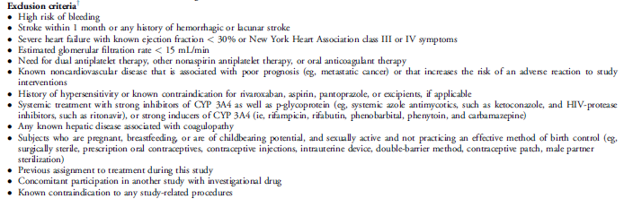
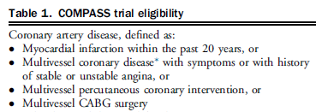
Combined long-term antiplatelet + anticoagulant treatment in stable CV dis
Who was included in the COMPASS trial ?
≈90% patients with CAD, ≈27% patients with PAD
≈62% patients with prior MI, ≈38% patients with diabetes
Eikelboom et al, NEJM 2017; Bosch et al, Can J Cardiol 2017

Slide 18
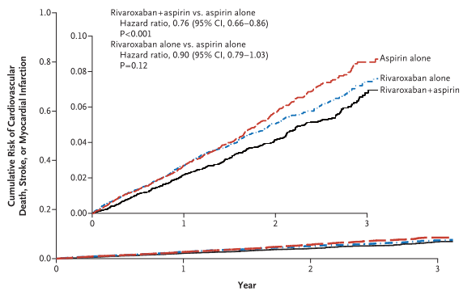
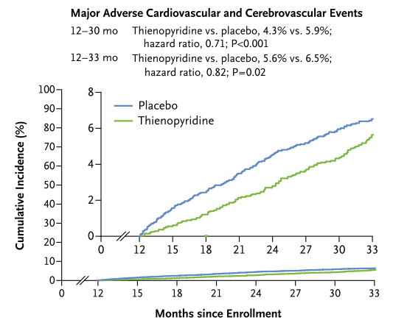
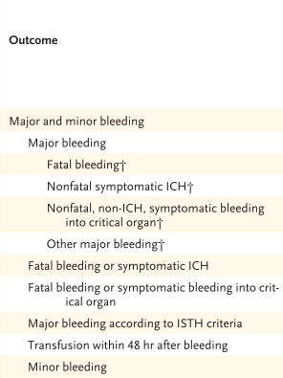
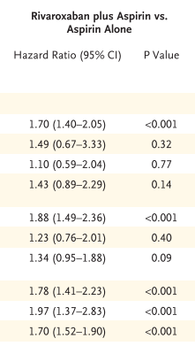
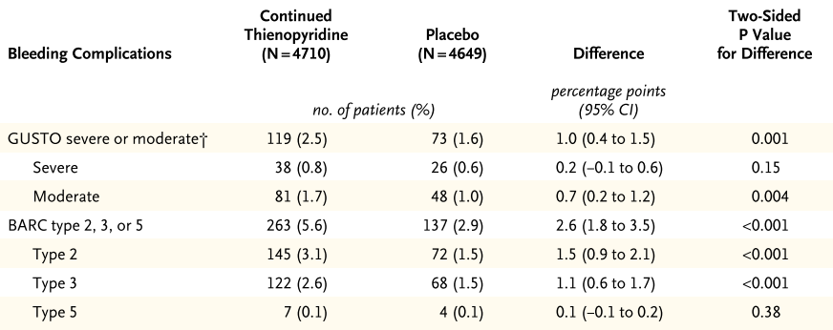
Compass vs long term dapt studies in cad pts
COMPASS
DAPT
CV death, stroke, MI
death, stroke, MI
Bleeding
NNT=76, NNH=83
NNT=62, NNH=111
NEJM 2017, NEJM 2014

Slide 19
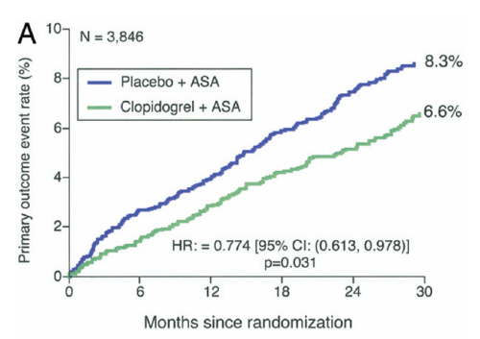
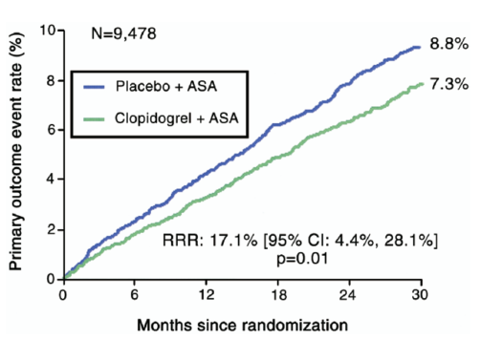
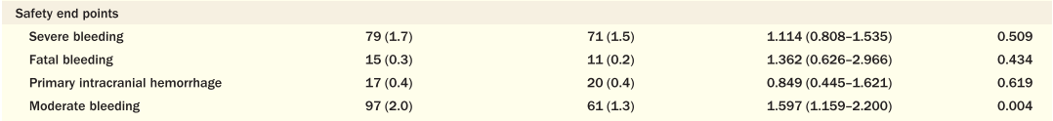
Compass vs long term dapt studies in cad pts
COMPASS
CHARISMA - CVD
CV death, stroke, MI
Patients with prior MI
CV death, stroke, MI
Bleeding
NNT=76, NNH=83
NNT=67, NNH=111
Eikelboom et al NEJM 2017, Bhatt et al JACC 2007

Slide 20
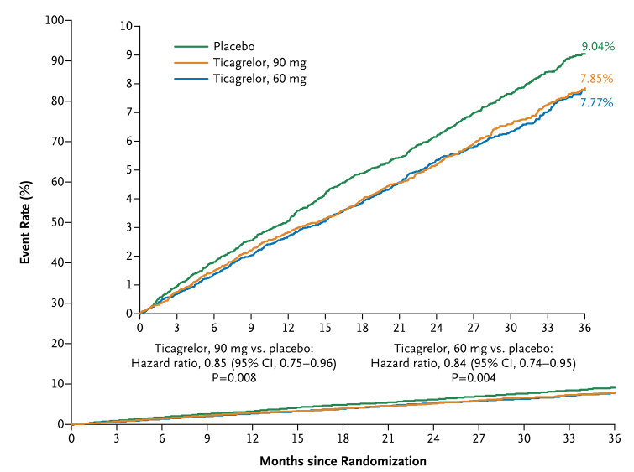
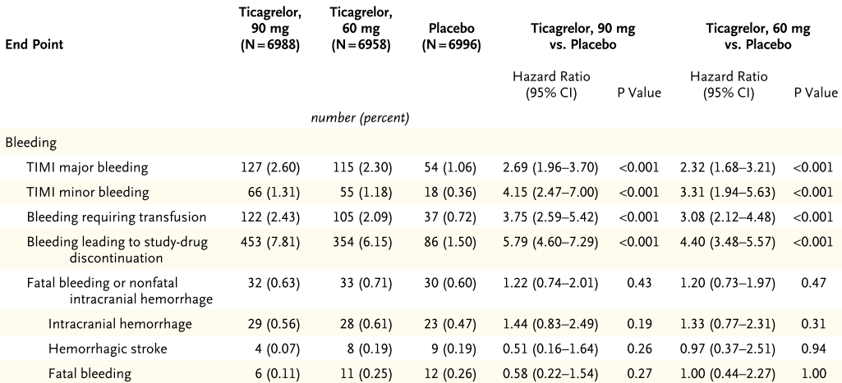
Compass vs long term dapt studies in cad pts
COMPASS
PEGASUS
CV death, stroke, MI
CV death, stroke, MI
Bleeding
NNT=76, NNH=83
NNT=77, NNH=83
NEJM 2017, NEJM 2015

Slide 21
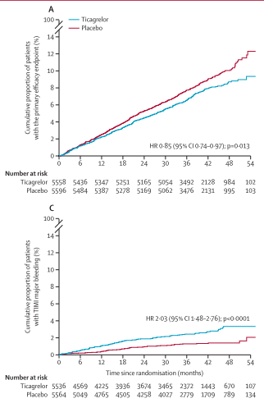
Compass vs long term dapt studies in cad pts
COMPASS
THEMIS - PCI
CV death, stroke, MI
CV death, stroke, MI
Bleeding
NNT=77, NNH=111
NNT=76, NNH=83
TIMI major bleeding
Eikelboom et al NEJM 2017, Steg et al Lancet 2019

Slide 22
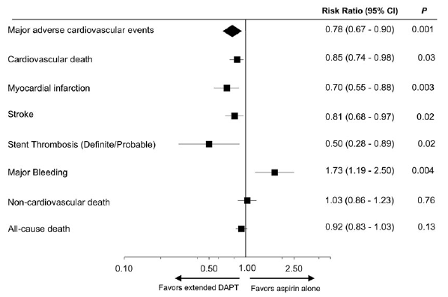
Compass vs long term dapt studies in cad pts
COMPASS
Post-MI DAPT Meta-analysis
(5 trials, 33,435 patients)
CV death, stroke, MI
Bleeding
Eikelboom et al NEJM 2017, Udell et al EHJ 2016

Slide 23
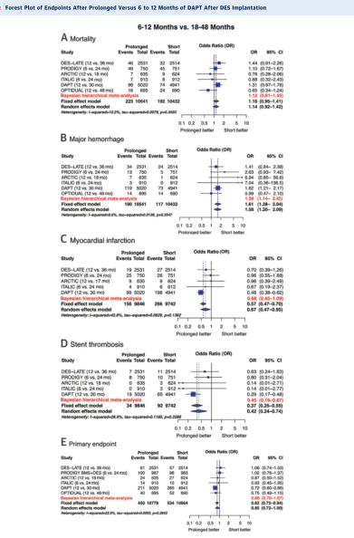
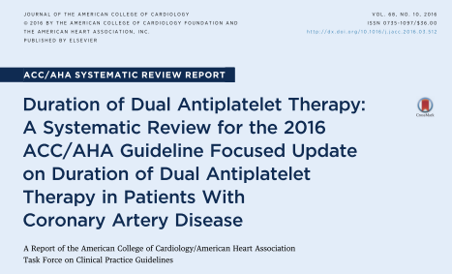
The weight of the evidence

Slide 24
Main points
The concept of anti-platelet vs. “combined” anti-platelet + anti-coagulant approach
The weight of the evidence
Where is the benefit of COMPASS vs. DAPT studies derived from?
Consequences of long-term treatment with anti-coagulant meds in patients wit CAD

Slide 25
DAPT meta-analysis
Post-MI DAPT Meta-analysis, EHJ 2016
(5 trials, 33,435 patients)

Slide 26
Efficacy of various anti-thrombotic combinations in reducing thrombotic coronary events after stenting
Cumulative event rate (%)

Slide 27
COMPASS BENEFIT
Total mortality: “There were 313 deaths (3.4%) in the riva + ASA group vs. 378 (4.1%) in the ASA-alone group (HR 0.82; 95% CI, 0.71-0.96; P = 0.01; threshold P value for significance, 0.0025)”.
MI – no sig. difference between the groups
Stroke - 83 strokes (0.9%) in the riva + ASA group vs. 142 (1.6%) HR = 0.58 (0.44–0.76) P<0.001
Eikelboom et al, NEJM 2017

Slide 28
Main points
The concept of anti-platelet vs. “combined” anti-platelet + anti-coagulant approach
The weight of the evidence
Where is the benefit of COMPASS vs. DAPT studies derived from?
Consequences of long-term treatment with anti-coagulant meds in patients wit CAD

Slide 29
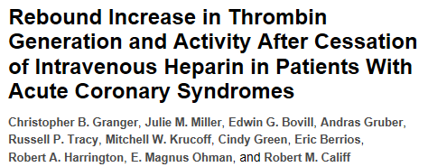
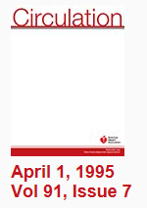
Possible rebound effect when discontinuing short-term anti-thrombin meds
Clear rebound effect upon discontinuation of unfractionated heparin (less degree of rebound effect with LMWH)
Preliminary data of rebound effect when discontinuing rivaroxaban
Mild rebound effect with clopidogrel and prasugrel, none with ticagrelor (Witberg G, et al , JTT 2018)

Slide 30
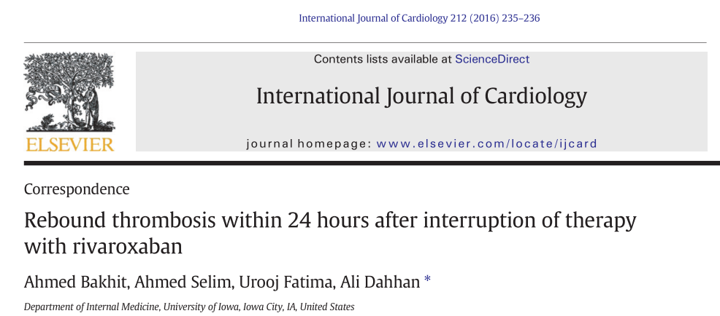
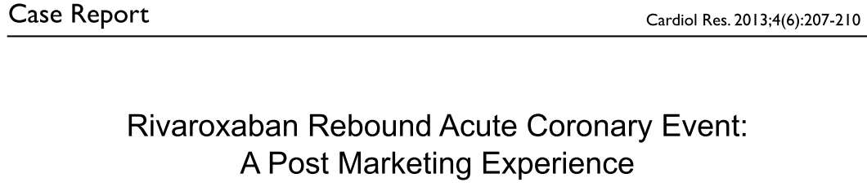
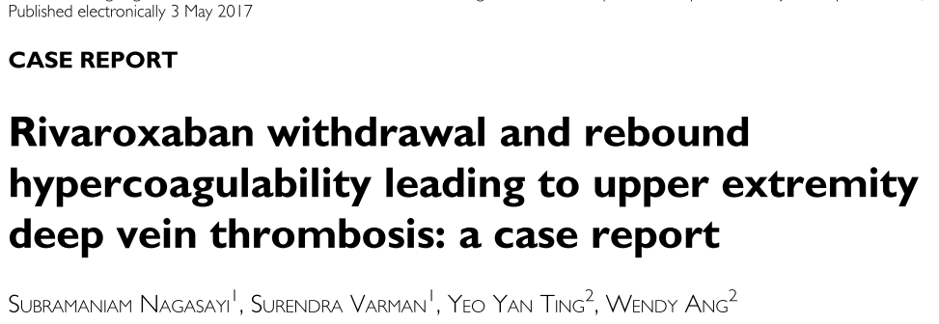
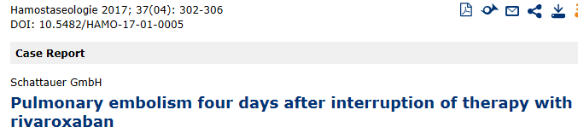
Possible rebound effect when discontinuing short-term anti-thrombin meds

Slide 31
Acs events or need for pci during asa + rivaroxaban treatment
Need to discontinue rivaroxaban and switch to DAPT → bleeding
Continuing rivaroxaban (low dose) during and after ACS associated with high bleeding risk (ATLAS trial)

Slide 32
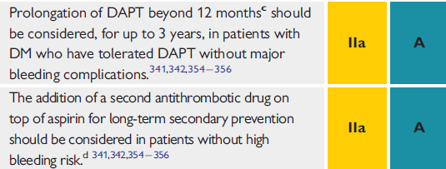
GUIDELINES
ESC Diabetes 2019
ESC Chronic coronary syndromes 2019

Slide 33
conclusions
Platelets play a central and major role in the pathogenesis of CAD and arterial thrombus formation (as part of ACS).
Very robust evidence from multiple RCTs regarding the benefit of extended DAPT treatment in patients with CCS (compared with one trial – COMPASS)
Consistent reductions in MI, stent thrombosis, and in certain subpopulations (e.g. post-MI) also stroke and CV mortality with DAPT
Possible adverse consequences of long-term rivaroxaban therapy in CCS patients: rebound effect with discont., bleeding risk with switching to DAPT

Slide 34
The routine long-term anti-thrombotic therapy in patients with ccs
DAPT

Slide 35

THANK YOU

