Slide 1


Old Argument New Data – The Best P₂Y₁₂ Antagonist Strategy in ACS Patients: Ticagrelor vs. Prasugrel
ד"ר רואי בייגל
המערך הקרדיולוגי
המרכז הרפואי ע"ש ח. שיבא

Slide 2
Old Argument New Data – The Best P₂Y₁₂ Antagonist Strategy in ACS Patients: Ticagrelor vs. Prasugrel
ד"ר רואי בייגל
המערך הקרדיולוגי
המרכז הרפואי ע"ש ח. שיבא

Slide 3
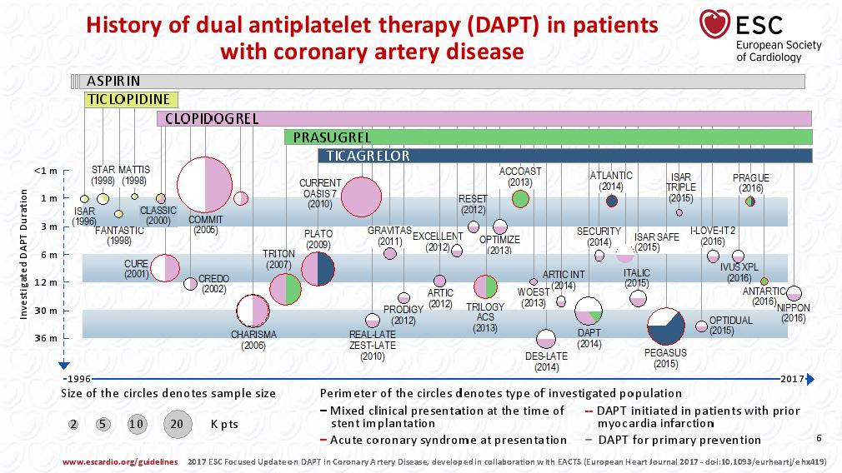

Slide 4
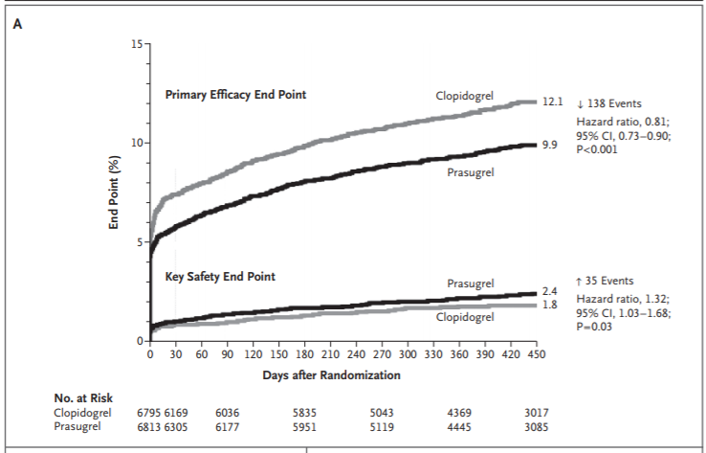
TRITON- TIMI 38 (2007)
In patients with ACS and scheduled PCI, prasugrel reduces CV morbidity and mortality but increases bleeding when compared to clopidogrel.
There was no apparent net clinical benefit in patients ≥75 years of age and in patients with low body weight (<60 kg).
Worse outcomes seen in patients with prior CVA/TIA
Wiviott, SD, et al. N Engl J Med 2007;357:2001-15.

Slide 5
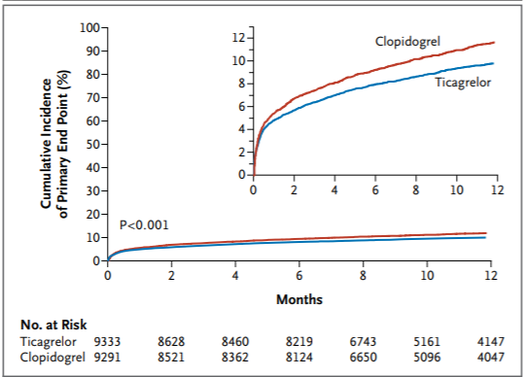
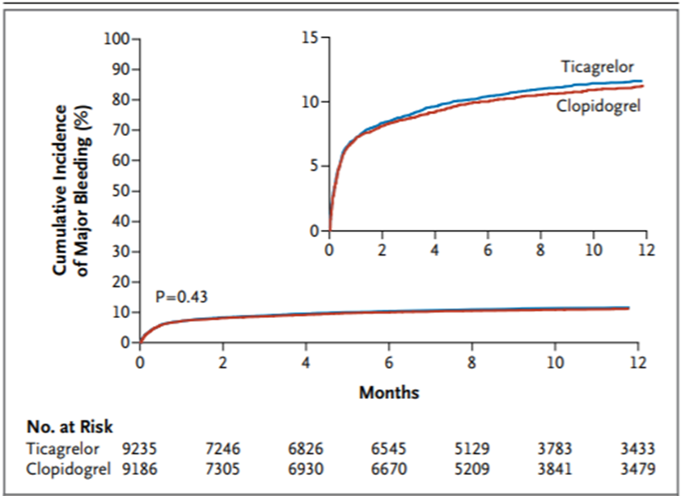
PLATO (2009)
Compared to clopidogrel, ticagrelor significantly reduced the rate of CV death, MI, or stroke without an increase in the rate of overall major bleeding.
The superiority of ticagrelor over clopidogrel was consistent across management strategies (PCI, conservative, CABG)
Wallentin L, et al. N Engl J Med. 2009;361:1045–1057.
Notes:
Given the remarkable reduction in the incidences of recurrent myocardial infarction and death in PLATO, the application of the trial results in medically and invasively treated patients with acute coronary syndromes, and the reversible action and faster offset of ticagrelor over prasugrel, the clinical community promptly adopted ticagrelor for use in patients with acute coronary syndromes

Slide 6
TRILOGY ACS (2012) (Prasugrel)
  Medically managed ACS patients
  Death from cardiovascular causes, MI, or stroke among patients under the age of 75 years occurred in 13.9% of the prasugrel group and 16.0% of the clopidogrel group (p = 0.21), at a median follow-up of 17 months
  Similar results were observed in the overall population (i.e. also including elderly patients)
  Prasugrel is not indicated in medically managed ACS patients
ACCOAST (2013) (Prasugrel)
  NSTEMI patients
  Pre-treatment did not reduce the rate of the primary outcome among patients undergoing PCI (69% of the patients) but increased the rate of TIMI major bleeding at 7 days
ATLANTIC (2014) (Ticagrelor)
  STEMI patients
  Did not differ significantly between the pre-hospital and in-hospital groups
  The rates of definite stent thrombosis were lower in the prehospital group than in the in-hospital group

Slide 7
ESC Recommendations for P₂Y₁₂ Rx in ACS:
Start as soon as possible: Clopidogrel and Ticagrelor
Start after the indication for PCI is established: Prasugrel
In STEMI planned for PPCI: All indicated
Prasugrel not recommended for those with:
  Prior CVA/TIA
  Age > 75 years
  Weight < 60 Kg

Slide 8
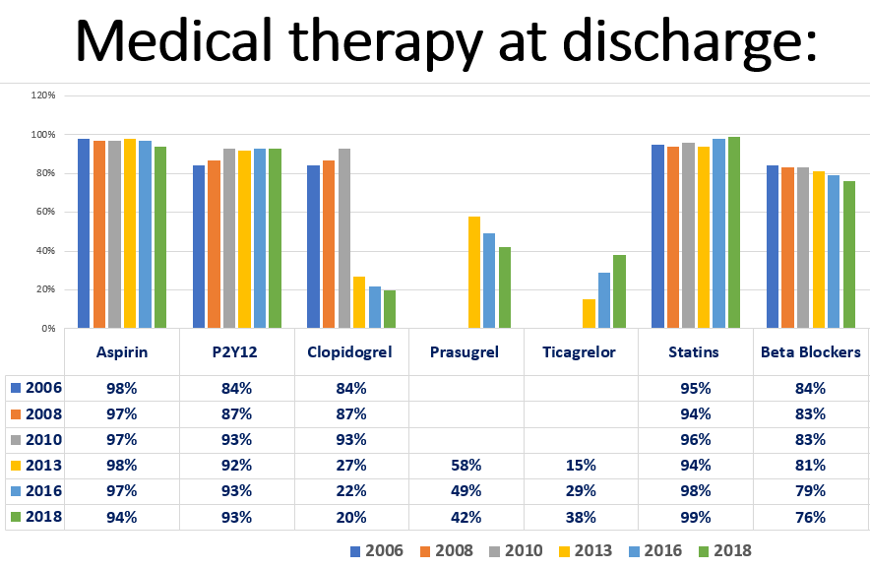
P2Y12 in ACS

Slide 9
“If we all worked on the assumption that what is accepted as true is really true, there would be little hope of advance.”

Slide 11
The hypothesis:
Ticagrelor would be superior to prasugrel for the composite endpoint of all-cause death, MI or stroke at 1 year after randomization, based on 3 factors:
  The ability to pre-treat with ticagrelor regardless of clinical presentation and coronary anatomy
  Consistent positive results in the medically managed only patients in PLATO
  Possible adenosine-mediated pleiotropic effects of ticagrelor

Slide 12
ISAR-REACT 5:
Multicenter, randomized, open-label trial
23 centers in Germany and Italy (21+2)
September 2013 - February 2018
Duration of follow-up: 1 year
ACS patients planned for angiography
Overall 4,018 pts. Of which 41% were STEMI

Slide 13
Trial Protocol
Ticagrelor
  Loading dose 180mg as soon as possible after randomization
  Maintenance dose - 90mg x 2/d
Prasugrel
  Loading dose 60mg
    STEMI as soon as possible after randomization
    NSTEMI after PTCA, before PCI
  Maintenance dose – 10mg (5mg if >75yrs or <60kg)
In patients with a coronary angiography – confirmed ACS who were considered to be candidates for conservative therapy, dual antiplatelet therapy (aspirin and the randomly assigned trial medication) was recommended.

Slide 14
ISAR-REACT 5 Consort Diagram - Screening, Randomization, Treatment, and Follow-up
8434 Patients were assessed for eligibility
4416 were excluded
4018 Underwent randomization
2012 Were assigned to ticagrelor-based strategy
1985 Received ticagrelor loading
27/2012 (1.3%) did not receive a ticagrelor LD
1602 Were discharged with ticagrelor
410 (20.4%) Were not discharged with trial medication
31 Died
6 Withdrew consent with no info on medication at discharge
172 (8.5%) Did not have confirmation of ACS diagnosis
69 Had indication for oral anticoagulation
61 Were withdrawn by physician
32 Underwent CABG
10 Had bleeding
7 Had dyspnoea
3 Had allergy
19 Had other reasons
2006 Were assigned to prasugrel-based strategy
1728 Received prasugrel loading
278/2006 (13.9%) did not receive prasugrel LD
1596 Were discharged with prasugrel
410 (20.4%) Were not discharged with trial medication
26 Died
2 Withdrew consent with no info on medication at discharge
184 (9.2%) Did not have confirmation of ACS diagnosis
65 Had indication for oral anticoagulation
67 Were withdrawn by physician
30 Underwent CABG
8 Had bleeding
28 Had other reasons
22 Withdrew consent
243 (15.2%) Discontinued ticagrelor after discharge
65 Were withdrawn by physician
44 Had bleeding
44 (2.7%) Had dyspnoea
40 Had indication for oral anticoagulation
13 Had unspecific side effects
9 Did not adhere to trial regimen
12 Had allergy
16 Had other reasons
19 Were lost to follow-up
31 Withdrew consent
199 (12.5%) Discontinued prasugrel after discharge
70 Were withdrawn by physician
35 Had bleeding
1 Had dyspnoea
43 Had indication for oral anticoagulation
5 Had unspecific side effects
18 Did not adhere to trial regimen
8 Had allergy
19 Had other reasons
18 Were lost to follow-up
2012 Were evaluated for primary endpoint
1989 Were evaluated for safety endpoint
    23 Were excluded from safety analysis (1.1%)
2006 Were evaluated for primary endpoint
1773 Were evaluated for safety endpoint
    233 Were excluded from safety analysis (11.6%)
ACS = acute coronary syndrome; CABG = coronary artery bypass graft; LD = loading dose.
Schüpke S et al. Online ahead of print. N Engl J Med. 2019.
Notes:
Notes:
4416 Were excluded
1312 Did not meet inclusion criteria or met exclusion criteria
584 Received oral anticoagulation
122 Had chronic renal insufficiency warranting dialysis
113 Received ticagrelor or prasugrel within 5 days before randomization
112 Had history of stroke, transient ischaemic attack, or intracranial bleeding
98 Were previously enrolled in the trial
51 Were participating in another trial
232 Had other reasons
1836 Declined to participate
1268 Had other reasons
Reference:
Schüpke S, Neumann F-J, Menichelli M, et al for the ISAR-REACT 5 Trial Investigators. Ticagrelor or prasugrel in patients with acute coronary syndromes [published online ahead of print September, 1 2019]. N Engl J Med. 2019. http://dx.doi.org/10.1056/NEJMoa1908973. Accessed September 1, 2019.
Schupke 2019:
p4/figure1
Calculations:
Loading dose percentage:
Ticagrelor: 1.3%=100-[(1985/2012)x100]
Prasugrel: 13.85%=100-[(1728/2006)x100]
Discharged on assigned therapy:
Ticagrelor: 410/2012 x 100% = 20.4%
Prasugrel: 410/2006 x 100% = 20.4%
Dyspnea: ticagrelor
(44/1602)x100%=2.7%
Excluded from safety analysis:
Ticagrelor: (23/2012)x100%=1.1%
Prasugrel: (233/2006)x100%=11.6%

Slide 15
ISAR-REACT 5, PLATO & TRITON-TIMI 38
Comparison of Baseline Characteristics
 | ISAR-REACT 5¹ |  | PLATO² Overall (n=18,624) | TRITON-TIMI 38³ Overall (n=13,608)
Characteristicª | Ticagrelor (n=2012) | Prasugrel (n=2006)
Age (years, mean) | 64.5 | 64.6 | 62.0 | 61.0^{b}
Female sex | 478/2012 (23.8) | 478/2006 (23.8) | 28.4% | 26%
Diabetes | 463/2011 (23.0) | 429/2005 (21.4) | 25.0% | 23%
Hypertension | 1432/2008 (71.3) | 1384/2003 (69.1) | 65.4% | 64%
Hypercholesterolemia | 1178/2007 (58.7) | 1163/2003 (58.1) | 46.7% | 56%
Current Smoker | 682/2002 (34.1) | 667/1999 (33.4) | 35.9% | 38%
Prior Myocardial infarction | 311/2010 (15.5) | 320/2005 (16.0) | 20.5% | 18%
Prior PCI | 453/2011 (22.5) | 463/2004 (23.1) | 13.4% | NR
Prior CABG | 115/2011 (5.7) | 130/2005 (6.5) | 5.9% | 7.5%
Weight <60 kg | 108/2003 (5.4) | 94/1988 (4.7) | 7.0% | NR
Creatinine level (µmol/L) | 88±27 | 88±31
Admission Diagnosis
Unstable angina | 249 (12.4) | 261 (13.0) | 16.7% | 74%^{c}
NSTEMI | 930 (46.2) | 925 (46.1) | 42.7%
STEMI | 833 (41.4) | 820 (40.9) | 37.7% | 26%
Treatment Strategy
Underwent coronary angiography | 2003 (99.6) | 2001 (99.8) | 81.5% | 100%^{d}
Underwent PCI | 1676/2009 (83.4) | 1701/2005 (84.8) | 61.0% | 99%
Underwent CABG surgery | 47/2009 (2.3) | 36/2005 (1.8) | 4.5% | 1%
Underwent conservative strategy | 285/2009 (14.2) | 268/2005 (13.4) | 28%%⁴ | 1%
Please note that it is inappropriate to make direct comparisons as the study design, demographics and other criteria may be different as these trials were not head-to-head.
ªData presented as number (%) unless otherwise stated; ^{b}Presented as a median value; ^{c}Unstable angina and NSTEMI were not reported individually in the trial; ^{d}ACS with planned PCI was an enrolment requirement.³
1. Schüpke S et al. Online ahead of print. N Engl J Med. 2019; 2. Wallentin L et al. N Engl J Med. 2009;361:1045-1057; 3. Wiviott SD et al. N Engl J Med. 2007;357:2001-2015; 4. James SK et al. BMJ. 2011;342:d3527. https://doi.org/10.1136/bmj.d3527. Accessed September 16, 2019.
Notes:
Abbreviations:
ACS = acute coronary syndrome; CABG = coronary artery bypass graft; NR = not reported; NSTEMI = non-ST-segment elevation myocardial infarction; PCI = percutaneous coronary intervention; PLATO = PLATelet inhibition and patient Outcomes; SD = standard deviation; STEMI = ST-segment elevation myocardial infarction; TRITON-TIMI 38 = Trial to Assess Improvement in Therapeutic Outcomes by Optimizing Platelet Inhibition with Prasugrel – Thrombolysis in Myocardial Infarction 38.
References:
Schüpke S, Neumann F-J, Menichelli M, et al for the ISAR-REACT 5 Trial Investigators. Ticagrelor or prasugrel in patients with acute coronary syndromes [published online ahead of print September, 1 2019]. N Engl J Med. 2019. http://dx.doi.org/10.1056/NEJMoa1908973. Accessed September 1, 2019.
Wallentin L, Becker RC, Budaj A, et al. Ticagrelor versus clopidogrel in patients with acute coronary syndromes. N Engl J Med. 2009;361:1045–1057.
Wiviott SD, Antman EM, Gibson CM, et al. Evaluation of prasugrel compared with clopidogrel in patients with acute coronary syndromes: design and rationale for the TRial to assess Improvement in Therapeutic Outcomes by optimizing platelet InhibitioN with prasugrel Thrombolysis In Myocardial Infarction 38 (TRITON-TIMI 38). Am Heart J. 2006;152:627-635.
James SK, Roe MT, Cannon CP, et al, for the PLATO Study Group. Ticagrelor versus clopidogrel in patients with acute coronary syndromes intended for non-invasive management: substudy from prospective randomized PLATelet inhibition and patient Outcomes (PLATO) trial. BMJ. 2011. https://dx.doi.org/10.1136/bmj.d3527. Accessed September 1, 2019.
Schupke 2019/p6/table 1
Wallentin 2009/p1048/table1
Wiviott 2007/p2006/table1
James 2011/p2/col2/par6/line3-6
Calculations from Wallentin 2009: p1048/table1
Female: (2655+2633)/(9333+9291)x100=28.4
Diabetes: (2326+2336)/(9333+9291)x100=25.0
Smoker: (3360/3318)/(9333+9291)x100=35.9
HTN: (6139+6044)/(9333/9291)x100=65.4
Hypercholesterolemia: (4347+4342)x100=46.7
MI: (1900+1924)/(9333+9291)x100=20.5
CABG: (532+574)/(9333+9291)x100=5.9
PCI: (1272+1220)/(9333+9291)x100=13.4
Wt <60 kg: (652+660)/(933+9291)x100=7.0
UA: (1549+1563)/(9333+9291)x100=16.7
NSTEMI: (4005+3950)/(9333+9291)x100=42.7
STEMI: (3496+3530)/(933+9291)x100=37.7%
Coronary Angiography: (7599+7571)/(9333+9291)x100=81.4
PCI: (5687+5676)/(9333+9291)x100=61.0
CABG: (398+434)/(9333+9291)x100=4.5
Calculations from Wiviott 2007: p2006 table 1
Female: (25%+27%)/2=26%
Prior CABG: (8%+7%)/2=7.5%

Slide 16
End points
Primary:
  Death, myocardial infarction, or stroke at 1 year after randomization
Secondary:
  Bleeding at 1 year (type 3, 4, or 5 on the Bleeding Academic Research Consortium [BARC] scale, which ranges from 0 to 5, with higher values indicating more severe bleeding)
  Definite or probable stent thrombosis at 1 year.

Slide 17
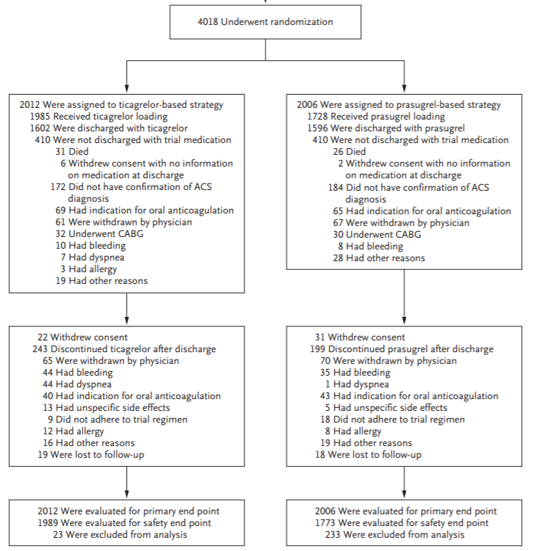
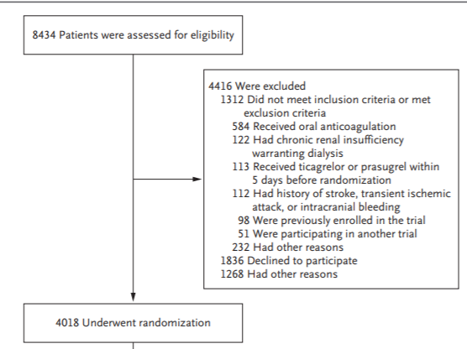

Slide 18
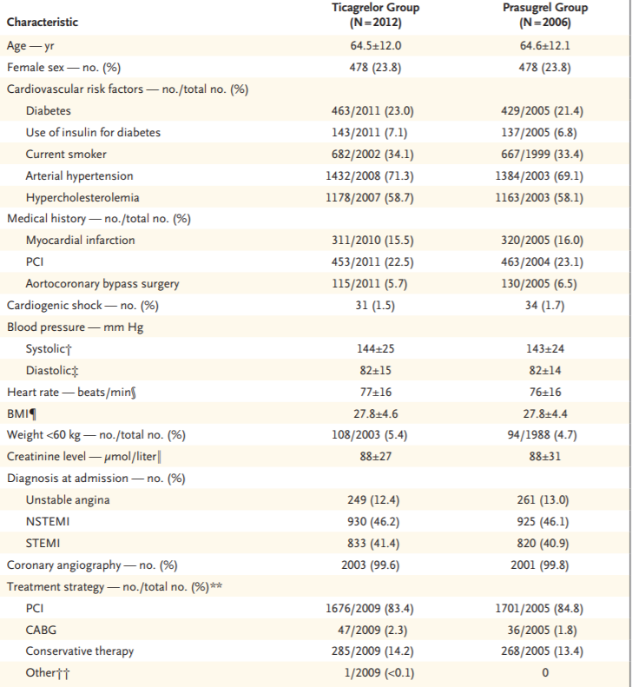
Characteristics
Age 64.5
Gender (male to female ration 3:1)
DM, HTN, Dyslipidemia, Smoking
Previous MI, PCI, CABG
Aspirin (~35%) and Clopidogrel (~5%) treatment
BP, HR, BMI, Creatinine levels
STEMI (41.1%), NSTEMI (46.2%), UA (12.7%)
Cardiogenic shock
PCI, CABG, Conservative therapy

Slide 19
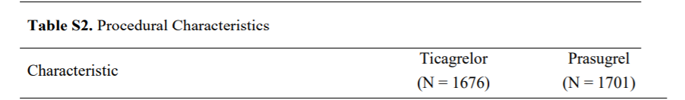
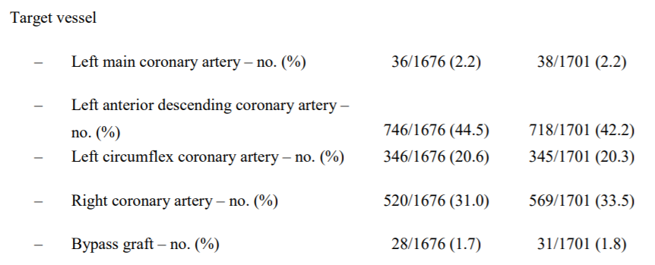
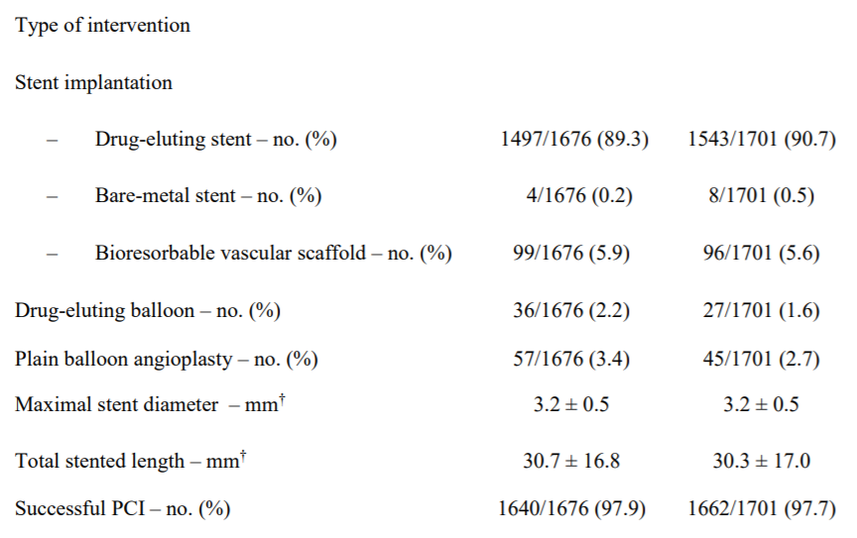
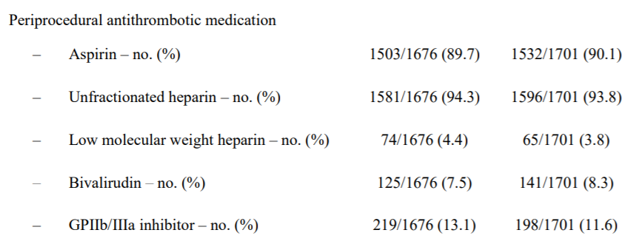
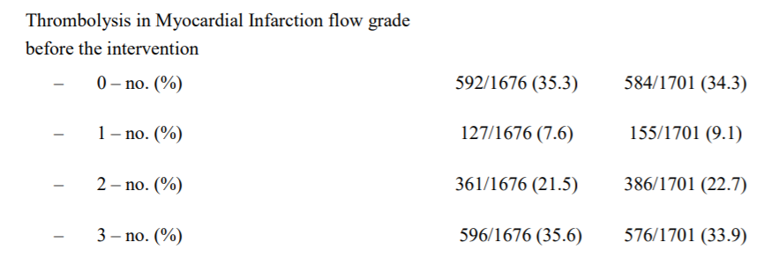

Slide 20
Intervention and follow-up
A total of 84.1% of the patients underwent PCI, and 2.1% underwent CABG
In patients presenting with STEMI, the interval from symptom onset to randomization was 3.2 hours in the ticagrelor group and 3.0 hours in the prasugrel group
In patients undergoing PCI for NSTEMI, the interval from randomization to receipt of the loading dose was 6 minutes in the ticagrelor group and 61 minutes in the prasugrel group

Slide 21
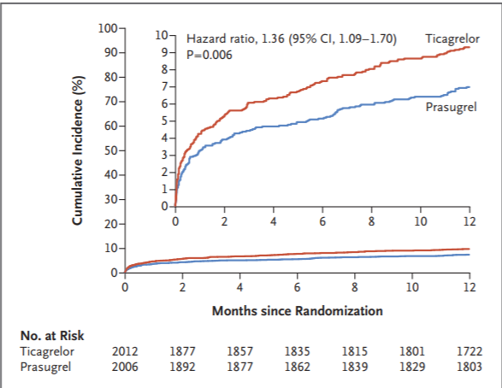
Primary end point
A primary end-point event — death from any cause, myocardial infarction, or stroke at 1 year after randomization — occurred in 9.1% in the ticagrelor group and in 6.8% in the prasugrel group (P=0.006)
The lower incidence was primarily driven by fewer myocardial infarctions in the prasugrel group than in the ticagrelor group.
The benefit of fewer ischemic events with prasugrel did not occur at the expense of an increased risk of bleeding.
The results were consistent across the whole spectrum of presentation of acute coronary syndromes.
NNT = 42

Slide 22
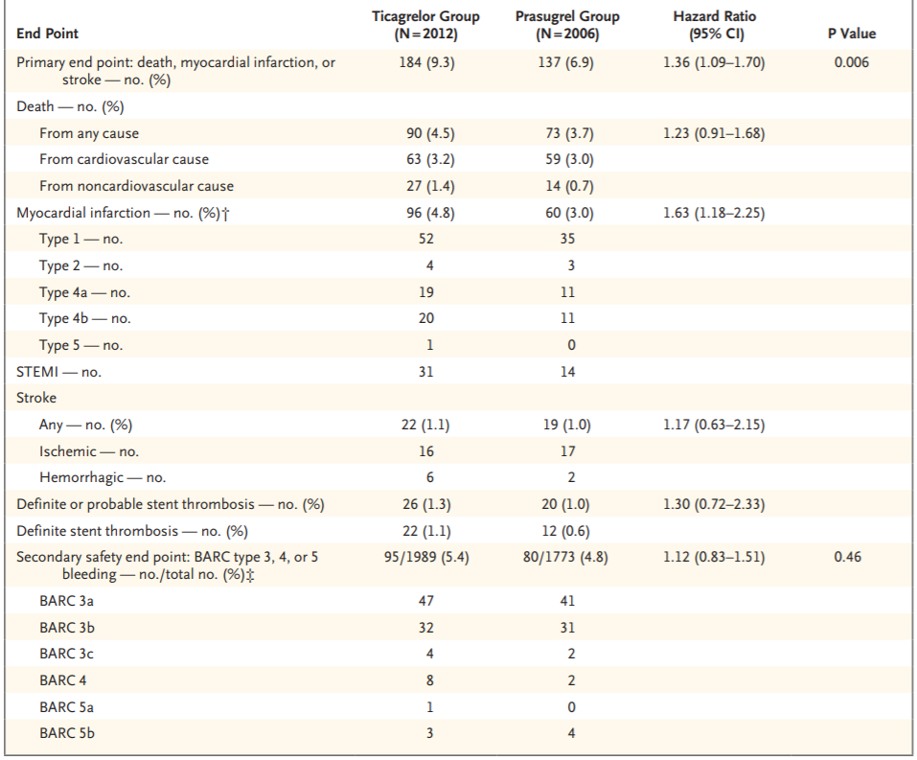

Slide 23
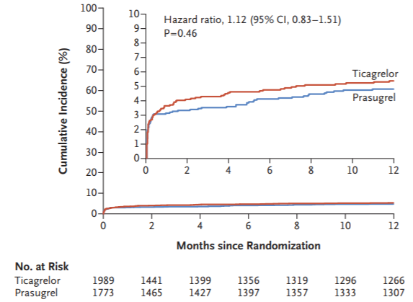
Safety end point
Major bleeding rates were similar in both groups — occurred in 5.4% in the ticagrelor group and in 4.8% in the prasugrel group (P=0.46).
Stent thrombosis was rare and did not significantly differ between groups.

Slide 24
ISAR-REACT 5
Primary Efficacy Endpoint (Composite of Death, MI, or Stroke) by Subgroup
Subgroup | Ticagrelor n/N (%) | Prasugrel n/N (%) |  | Hazard Ratio (95% CI)
Overall | 184/2012 (9.3) | 137/2006 (6.9) |  | 1.36 (1.09–1.70)
Age
≥ 75 years | 74/490 (15.3) | 66/492 (13.7) |  | 1.19 (0.85–1.66)
< 75 years | 110/1522 (7.3) | 71/1514 (4.8) |  | 1.55 (1.15–2.09)
Sex
Female | 42/478 (8.9) | 39/478 (8.3) |  | 1.10 (0.71–1.70)
Male | 142/1534 (9.4) | 98/1528 (6.5) |  | 1.47 (1.13–1.90)
Smoking Status
Active | 47/682 (7) | 41/667 (6.2) |  | 1.15 (0.76–1.75)
Non-active | 133/1320 (10.2) | 94/1332 (7.2) |  | 1.44 (1.10–1.87)
Weight
< 60 kg | 13/108 (12.2) | 10/94 (10.7) |  | 1.18 (0.52–2.71)
≥ 60 kg | 171/1895 (9.1) | 124/1894 (6.4) |  | 1.40 (1.11–1.77)
Diabetes mellitus
Yes | 51/463 (11.2) | 55/429(13) |  | 0.84 (0.58–1.24)
No | 132/1548 (8.6) | 81/1576 (5.2) |  | 1.70 (1.29–2.24)
Creatinine
≥ 83.1 µmol/L | 125/1005 (12.6) | 88/1009 (8.8) |  | 1.46 (1.11–1.92)
< 83.1 µmol/L | 59/1002 (6) | 49/996 (5) |  | 1.21 (0.83–1.76)
Current smoker
Yes | 19/31 (62.6) | 18/34 (52.9) |  | 1.29 (0.67–2.47)
No | 165/1981 (8.4) | 119/1972 (6.1) |  | 1.40 (1.11–1.78)
Clinical presentation
STEMI | 83/833 (10.1) | 64/820 (7.9) |  | 1.31 (0.94–1.81)
NSTEMI | 81/930 (8.8) | 60/925 (6.6) |  | 1.36 (0.97–1.90)
Unstable angina | 20/249 (8.2) | 13/261 (5.1) |  | 1.62 (0.81–3.26)
Treatment strategy
PCI | 162/1676 (9.8) | 120/1701 (7.1) |  | 1.41 (1.11–1.78)
Conservative | 17/285 (6.1) | 12/268 (4.6) |  | 1.29 (0.62–2.70)
CABG | 5/47 (10.6) | 5/36 (13.9) |  | 0.66 (0.19–2.30)
CABG = coronary artery bypass graft; NSTEMI = non-ST-segment elevation myocardial infarction;
PCI = percutaneous coronary intervention; STEMI = ST-segment elevation myocardial infarction.
Schüpke S et al. Supplementary appendix online ahead of print. N Engl J Med. 2019.
0
0.5
1.0
1.5
2.0
2.5
3.0
3.5
4.0
Ticagrelor better
Prasugrel better
Notes:
Reference:
Schüpke S, Neumann F-J, Menichelli M, et al for the ISAR-REACT 5 Trial Investigators. Ticagrelor or prasugrel in patients with acute coronary syndromes [supplementary appendix]. N Engl J Med. 2019. http://dx.doi.org/10.1056/NEJMoa1908973. Accessed September 1, 2019.
Schüpke S, et al. NEJM 2019 Supplementary Appendix
Figure S1.

Slide 25
Summary:
Although direct head-to-head comparisons of pretreatment with no pretreatment with ticagrelor in patients who have acute coronary syndromes without ST-segment elevation are lacking, pretreatment with ticagrelor was associated with an early benefit over clopidogrel in the PLATO Study.
In contrast, in ACCOAST trial, pretreatment with prasugrel was not beneficial in patients who had ACS without ST-segment elevation, and it was associated with an increased incidence of major bleeding complications.
On the basis of the rationale that a stronger platelet inhibition at the time of PCI reduces periprocedural thrombotic risk, the pretreatment strategy with ticagrelor was considered to be advantageous.
However, this trial shows that a prasugrel-based strategy with deferred loading after knowledge of coronary anatomy in patients with ACS without ST-segment elevation was superior to a ticagrelor-based strategy with routine pretreatment.

Slide 26
Discussion
Previous findings suggest a consistent benefit of ticagrelor but not a consistent benefit of prasugrel in patients with acute coronary syndromes who receive conservative therapy.
In PLATO, ticagrelor was superior to clopidogrel not only in patients who underwent PCI but also in those who received conservative treatment.
Conversely, in TRILOGY ACS trial, prasugrel was not superior to clopidogrel in patients who had acute coronary syndromes without ST-segment elevation and who did not undergo revascularization.
Whereas in PLATO only 61% of the patients underwent PCI during the index hospitalization, PCI was performed much more frequently in the present trial (84%).
Therefore, the contribution of patients who did not undergo PCI to the overall results was relatively small.

Slide 27
Limitations
Open-label design allows for potential bias in ascertainment of outcomes, although this is mitigated somewhat by blinded outcomes adjudication
There was a slight asymmetry in the proportion of individuals who stopped assigned therapy (15% in ticagrelor group, 12% in prasugrel group), which may overestimated the benefit of prasugrel (14% switched from ticagrelor to prasugrel, 7% from prasugrel to ticagrelor)
Greater than 80% of individuals underwent PCI, limiting ability to extend findings reliably to those undergoing medical therapy for ACS

Slide 28
STEMI patients:
Patients received the same treatment strategy involving a loading dose of the assigned P2Y12 inhibitor prior to angiography
This allowed for a direct head-to-head comparison of the clinical efficacy of the two antiplatelet agents in STEMI
The composite event rate was 10.1% in the ticagrelor group, compared with 7.9% in the prasugrel group

Slide 29
Summary ISAR-REACT 5:
Despite:
  A sizable percentage of patients who received conservative therapy (14.2%)
  A 1-hour delay in administration of prasugrel in the group of patients with acute coronary syndromes who did not have STEMI
  Inclusion of patients >75 years old, and/or < 60kg body weight
The one-size-fits-all strategy - with ticagrelor – was inferior to an individualized strategy, with prasugrel
No significant difference in the incidence of major bleeding

Slide 30
Prasugrel – Not without limitations
TRITON – NSTEMI SUB GROUP
ACCOAST
TRILOGY ACS

Slide 31
ISAR-REACT 5: Not without limitations
Sample size and Power, type I error
ITT analysis
Not Blinded

Slide 32
There is a slight asymmetry in the proportion of individuals who stopped assigned therapy (15% in ticagrelor group, 12% in prasugrel group, p=0.03), may overestimated the benefit of prasugrel
This is real life!

Slide 33
ISAR-REACT 5: Not without limitations
Sample size and Power, type I error
ITT analysis
Not Blinded
Event rate for Prasugrel lower than expected

Slide 34
ACSIS: MACE in ACS throughout the years

Slide 35
Taking all of these into account:
The Prasugrel strategy is the preferred strategy for ACS patients planned for interventions
 | The Prasugrel Strategy | The Ticagrelor Strategy
Proven superiority over clopidogrel | Yes | Yes
 | The Prasugrel Strategy | The Ticagrelor Strategy
Proven superiority over clopidogrel | Yes | Yes
Pretreatment in STEMI | Yes | Yes
 | The Prasugrel Strategy | The Ticagrelor Strategy
Proven superiority over clopidogrel | Yes | Yes
Pretreatment in STEMI | Yes | Yes
Pretreatment in NSTEMI planned for angiography | No | Yes
 | The Prasugrel Strategy | The Ticagrelor Strategy
Proven superiority over clopidogrel | Yes | Yes
Pretreatment in STEMI | Yes | Yes
Pretreatment in NSTEMI planned for angiography | No | Yes
Proven for conservative Rx after angiography | No | Yes
 | The Prasugrel Strategy | The Ticagrelor Strategy
Proven superiority over clopidogrel | Yes | Yes
Pretreatment in STEMI | Yes | Yes
Pretreatment in NSTEMI planned for angiography | No | Yes
Proven for conservative Rx after angiography | No | Yes
Increased risk of bleeding over the comparator | No | No
 | The Prasugrel Strategy | The Ticagrelor Strategy
Proven superiority over clopidogrel | Yes | Yes
Pretreatment in STEMI | Yes | Yes
Pretreatment in NSTEMI planned for angiography | No | Yes
Proven for conservative Rx after angiography | No | Yes
Increased risk of bleeding over the comparator | No | No
Proven superiority over the comparator | Probably | No

Slide 36
“It is a definitive head-to-head outcome trial of the new P2Y12 receptor inhibitors and a stark reminder of the importance of clinical trials to generating evidence — rather than extrapolating it from indirect comparisons and surrogate studies. “
“…prasugrel has now become the P2Y12 receptor inhibitor of choice in patients with acute coronary syndromes. It should be used instead of ticagrelor in appropriately selected patients with this condition.”
Jneid H. New Engld J Med 2019;381(16): 1582-5.
“Until new similar randomized trials come to light, we should prioritize this trial rather than network meta-analysis and ¨logic¨ which are limited with indirectness of the comparison in question.”
"ISAR-REACT 5 is a landmark study, which is going to impact our practice and probably the next set of guidelines to come.”

Slide 37
ISAR-REACT 5 meets the highest quality evidence describing the direct relative efficacy and safety of both interventions.
Until new similar randomized trials come to light, we should prioritize this trial rather than network meta-analysis and ¨logic¨ which are limited with indirectness of the comparison in question.
In this situation in my case for ACS patients: The Prasugrel strategy is superior in the detailed setting until proven otherwise!
ISAR-REACT 5 is a landmark study, which is going to impact our practice and probably the next set of guidelines to come.

Slide 38
ואם נחזור למטופל שלנו...
בחולה עם NSTEMI (העומד בהתוויות) העובר צנתור התערבותי תרופת הבחירה תהיה: Prasugrel
בחולה STEMI (העומד בהתוויות) המיועד לצנתור ראשוני תרופת הבחירה תהיה: Prasugrel
בחולה ACS שצונתר ללא התערבות, חולה מעל גיל 75, חולה השוקל מתחת ל-60 ק"ג או חולה עם אhרוע מוחי איסכמי בעברו תרופת הבחירה תהיה: Ticagrelor

Slide 39

beigelr@yahoo.com
Notes:
Prague 18
Twilight

Slide 40
On-treatment analysis:
We analyzed the composite end point of all-cause death, myocardial infarction, or stroke among patients discharged on study drug (1602 patients in the ticagrelor group and 1596 in the prasugrel group) from discharge to the time of discontinuation or end of follow-up ("on treatment" analysis).
There were 163 events, 92 in the ticagrelor group and 71 in the prasugrel group (hazard ratio 1.34 [95% confidence interval 0.98-1.82]).
In a similar analysis, there were 107 myocardial infarctions, 64 in the ticagrelor group and 43 in the prasugrel group (hazard ratio 1.54 [95% confidence interval 1.04-2.26]).

Slide 41
ISAR-REACT 5
Medication after Discontinuation of Study Drug post-Discharge
Drug | Ticagrelor n/N (%) | Prasugrel n/N (%)
Discontinuation of assigned therapy¹ | 243/1602 (15.2) | 199/1596 (12.5)
Antithrombotic therapy following discontinuation of assigned treatment²
Ticagrelor | 0/243 (0.0) | 14/199 (7.0)
Prasugrel | 35/243 (14.4) | 0/199 (0.0)
Clopidogrel | 119/243 (49.0) | 106/199 (53.3)
Oral anticoagulant | 40/243 (16.5) | 44/199 (22.1)
None of the medications above | 78/243 (32.1) | 64/199 (32.2)
Approximately 50% of patients who discontinued study treatment after discharge were switched to clopidogrel²
  It is not known if the characteristics of patients switching / discontinuing the study drug remained balanced between the two arms in this open-label trial
Subsequent antithrombotic therapy was not reported in about 20% of patients who were not discharged on their assigned study drug¹
  These patients were however included in the ITT analysis
ITT = intention to treat.
1. Schüpke S et al. Online ahead of print. N Engl J Med. 2019; 2. Schüpke S et al. Supplementary appendix online ahead of print. N Engl J Med. 2019.
Notes:
References:
Schüpke S, Neumann F-J, Menichelli M, et al for the ISAR-REACT 5 Trial Investigators. Ticagrelor or prasugrel in patients with acute coronary syndromes [published online ahead of print September, 1 2019]. N Engl J Med. 2019. http://dx.doi.org/10.1056/NEJMoa1908973. Accessed September 1, 2019.
Schüpke S, Neumann F-J, Menichelli M, et al for the ISAR-REACT 5 Trial Investigators. Ticagrelor or prasugrel in patients with acute coronary syndromes [supplementary appendix]. N Engl J Med. 2019. http://dx.doi.org/10.1056/NEJMoa1908973. Accessed September 1, 2019.
Schüpke S, et al. Supplementary appendix Table S4
Schüpke S, et al. NEJM pg 5 col 2 para 4 line 5-6

Slide 42
Single or Dual antiplatelet? Can we really rely on that?
TWILIGHT:
  STEMI patients excluded
  No Aspirin control arm
Similar findings were noted with clopidogrel in the SMART-CHOICE and STOPDAPT-2 trials
These trials are thus likely to influence future guidelines regarding DAPT duration post-PCI
However, in GLOBAL LEADERS, ticagrelor monotherapy after 1 month of DAPT was not associated with any benefit compared with continued DAPT over 2 years
And wait… what about aspirin monotherapy in the current era???
More question than answers

Slide 43
PLATO trial as it was designed was not a pure PCI trial. PLATO had a significant number of patients undergoing conservative treatment and a significant number of patients undergoing coronary artery bypass graft surgery. This is in contrast to TRITON-TIMI 38, which really was a PCI trial, as was the case for ISAR-REACT 5, which was designed to have PCI as the first-line treatment strategy. In looking at PLATO results, I agree that in the overall trial there was a mortality benefit; the results were really convincing and they still are. But if you dive a little bit deeper and look at the PCI-treated patients, you can see that most of the benefit, or at least a significant amount, was seen in the conservatively managed patients. We have to reflect on this when we compare all of these trials, apart from the fact that there are 15 years in between now.

Slide 44
Discontinuation rate in ISAR-REACT 5 was comparatively low. If you look at THEMIS,^{[6]} for example, you have about a 20% discontinuation rate. If you look at GLOBAL LEADERS,^{[7]} for ticagrelor there was a discontinuation rate of about 20%. In ISAR-REACT 5 [the discontinuation rate] is slightly above 10%.
We have to reflect it in our practice. I am not saying that all ACS patients should now be on prasugrel and none should be prescribed ticagrelor. But specifically for the PCI cohort, if you have good reason to [prescribe] prasugrel, I think the ISAR-REACT 5 trial results support your strategy.
The one-size-fits-all strategy – here, with ticagrelor – was inferior to an individualized strategy, here with prasugrel

Slide 45
This study is a great example why studies should consider two-tailed hypothesis, especially in trials with an active comparator. Authors powered the study to show superiority of Ticagrelor when actually ended being inferior for efficacy. If authors specified a single-tailed superiority analysis (2.5% type I error risk) study power (sample size) calculations would have been the same but, strictly talking, cannot claim that prasugrel was superior at the end of the study.
But do we care about this when applying evidence-based medicine? Not much in my opinion. Evidence-based medicine means to integrate the best available evidence to guide clinical decisions. The actual data of this evidence does not come from a single study, but a critically appraised summary of the body of the evidence (all the evidence available about a specific topic). Then, when summarizing the evidence we don’t really care if the primary study used a single-tailed, two-tailed, 5%, 2.5% type I error, but we care about the point estimate and its precision (95% CI). Then, if this was (hypothetically talking) the only study comparing these two drugs directly in a randomized trial, Ticagrelor would look harmful vs Prasugrel, regardless of primary study plan.

Slide 46
Is important to highlight that this was not just a head-to-head comparison of Ticagrelor vs Prasugrel, since interventions were delivered differently. Ticagrelor was delivered as PLATO, allowing pre-treatment in NSTEACS. Prasugrel was delivered as TRITON, which loading dose was given once anatomy was known in NSTEACS. Then, the observed differences can be partially explained by the way the drug was delivered, rather than just the drug effect.
Against a significant impact of timing for loading dose in the results, 46% of the population were STEMI, in which Ticagrelor and Prasugrel loading doses were administered as soon as possible after randomization. STEMI patients also belong to the highest risk subgroup, accounting of more than half of both ischemic and bleeding events.
https://cardiomics.club/2019/09/07/ticagrelor-vs-prasugrel-isar-react-5-a-lesson-learned/
https://www.medscape.com/viewarticle/917980#vp_3

