Slide 1
What should the First Choice be in Patients with CAD and Newly Diagnosed DM: SGLT2 Inhibitors Vs. GLP-1?
Zaza Iakobishvili, MD, PhD
Department of Community Cardiology
Tel Aviv Jaffa District, Clalit Health Services

Slide 2
Answers:
A. SGLT2-inhibitors
B. GLP-1 receptor agonists

Slide 5
SGLT2 inhibitors
SGLT2i have their greatest and most consistent effect on reducing the relative risk of hospitalization for heart failure (31%) and of progression of renal disease (45%).
Their effect on the composite atherosclerotic outcome of MI, stroke, or cardiovascular death more modest but still significant (11%).
Reduction in MACE is is apparent only for patients with established CVD but no effect for patients without atherosclerotic CVD.
The reduction in hospitalization for heart failure was robust and of similar magnitude regardless of the presence of established atherosclerotic cardiovascular disease or a history of heart failure.
The reduction in progression of renal disease was also equally robust in patients with and without atherosclerotic cardiovascular disease. However, an interaction between baseline renal function and the clinical benefit of SGLT2 inhibition was seen.
Zelniker et al, Lancet, 2019

Slide 6
An ideal combination of antidiabetes drugs should have complementary effects that correct the many pathophysiological effects of type 2 diabetes and be safe, durable, well tolerated, easy to administer, and cost-effective.

Slide 15
Ledwidge et al, STOP-HF trial, JAMA 2013; Huelsmann et al, PONTIAC trial, JACC 2013

Slide 19
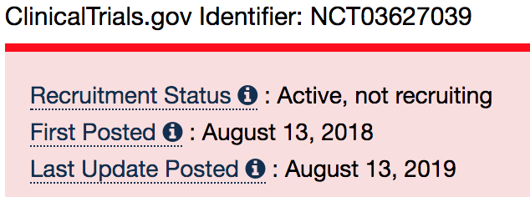
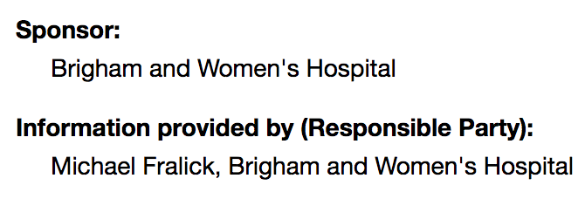

Slide 20
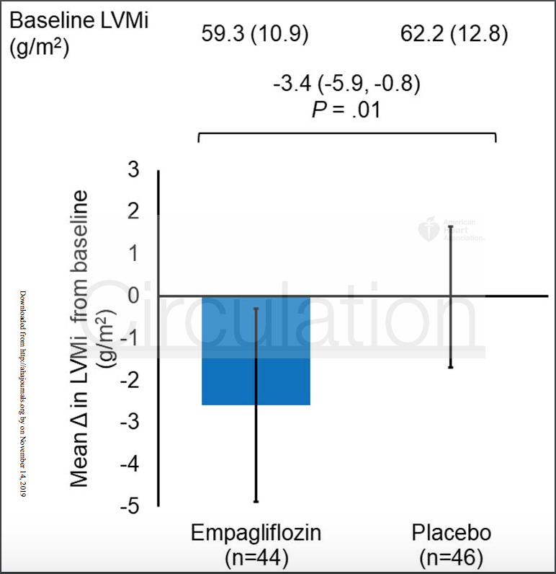
https://www.ahajournals.org/doi/pdf/10.1161/CIRCULATIONAHA.119.042375

Slide 21
My approach to Diabetes Type II Management by Cardiologist
Be sure you have the stable (chronic) patient with type II DM;
Any prior cardiovascular disease?
Risk factors for cardiovascular disease?
What kind of patient do you have:
Recent ACS? High ischemic risk?
Long standing ischemic heart disease with no recent exacerbations?
What is the ejection fraction?
Additional co-morbidities (renal function, albuminuria)?
Cancer (active/survivor)?
Osteoporosis?
Be in close contact with diabetologist/primary practitioner
Listen, what is important for your patient

Slide 22
Consider to begin with SGLT2-inhibitors:
convenience of administration (oral vs injection), semaglutide may change this;
Huge benefit in prevention of heart failure development and hospitalization for heart failure;
Renal benefits are prominent for SGLT2i

