Slide 1
What should be the first choice in patients with CAD and newly diagnosed DM SGLT2 vs GLP-1?
ד"ר אלעד אשר
מנהל היחידה לטיפול נמרץ לב
המרכז הרפואי שערי צדק

Slide 3
Cardiovascular disease is the leading cause of death in people with diabetes
Cause of death among people with T2D¹
  People with type 2 diabetes are 2 to 4 times more likely to have CVD^{2,3}
CVD
52–80%
Renal disease
10–20%
Cerebrovascular
15%
  Among people with diabetes aged 65 and older,
  heart disease accounts for two-thirds of deaths⁴
1. Nwaneri et al. Br J Diabetes Vasc Dis 2013;13(4):192-207.; 2. Fowler M. Microvascular and macrovascular complications of diabetes. Clinical Diabetes. 2008;26(2):77-82.; 3. Almdal T, et al. The independent effect of type 2 diabetes mellitus on ischemic heart disease, stroke, and death: a population-based study of 13,000 men and women with 20 years of follow-up. Arch Intern Med. 2004;164(13):1422-6.; 4. Centers for Disease Control and Prevention. National Diabetes Fact Sheet 2011. Available at: http://www.cdc.gov/diabetes/pubs/pdf/ndfs_2011.pdf.
Notes:
Mortality in type 2 diabetes mellitus: magnitude of the evidence from a systematic review and meta-analysis

Slide 4
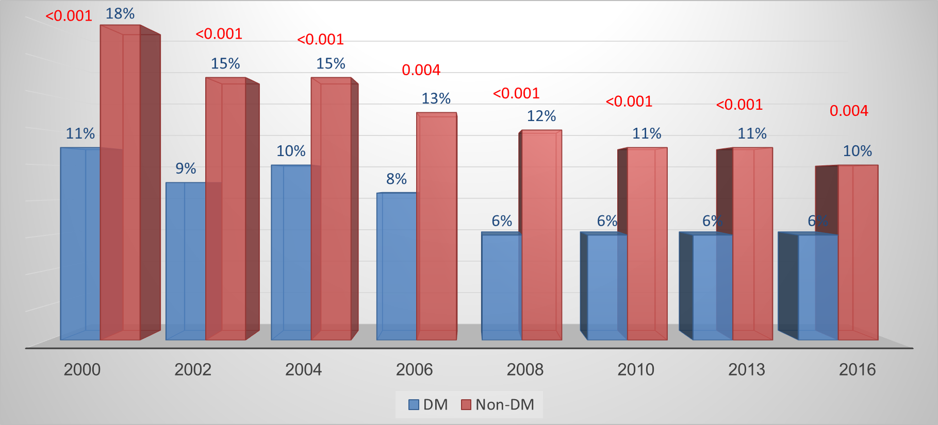
ACSIS 2000-2016: 1 year Mortality in ACS Patients
Non DM
DM

Slide 5
The history of anti-diabetes medications and CV outcomes
Up to 2008 approval decisions for such medications focused largely on short-term glycemic efficacy (i.e., A1C reduction), along with safety data from 6- to 12-month phase 2 and 3 randomized clinical trials
Individuals with established CVD were usually excluded
In 2008 the FDA issues its guidance for approval of anti-diabetic drugs

Slide 6
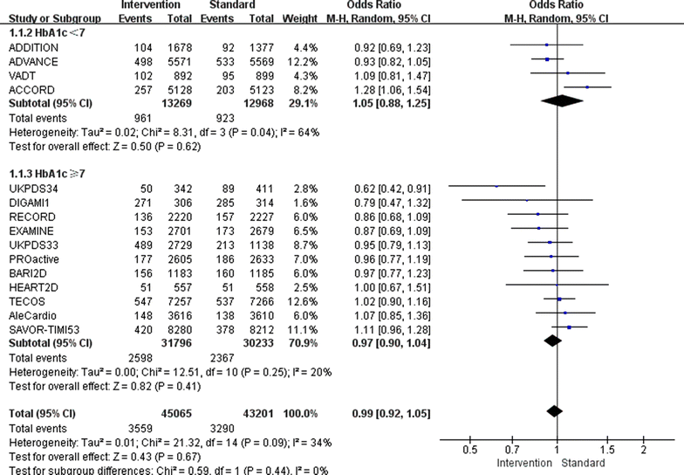
HbA1c below 7 % as the goal of glucose control fails to maximize the cardiovascular benefits: a meta-analysis
Cardiovascular Diabetology volume 14, Article number: 124 (2015)

Slide 7
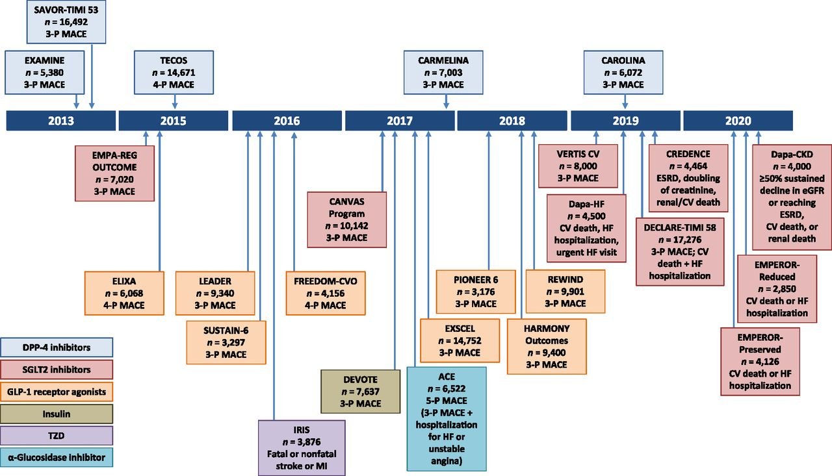
Completed and ongoing
cardiovascular outcome trials (CVOT)

Slide 8
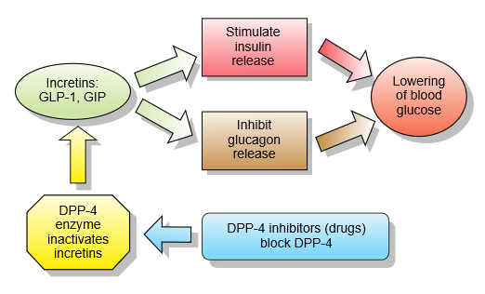
Glucagon-like peptide-1 receptor agonist/analogue (Victoza)

Slide 9
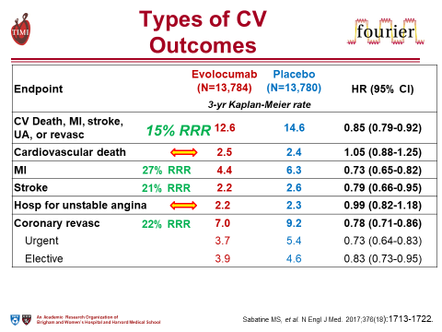

Types of CV Outcomes
Endpoint | Evolocumab (N=13,784) | Placebo (N=13,780) | HR (95% CI)
 | 3-yr Kaplan-Meier rate
CV Death, MI, stroke, UA, or revasc | 12.6 | 14.6 | 0.85 (0.79-0.92)
Cardiovascular death | 2.5 | 2.4 | 1.05 (0.88-1.25)
MI | 4.4 | 6.3 | 0.73 (0.65-0.82)
Stroke | 2.2 | 2.6 | 0.79 (0.66-0.95)
15% RRR
27% RRR
21% RRR
Hosp for unstable angina | 2.2 | 2.3 | 0.99 (0.82-1.18)
Coronary revasc | 7.0 | 9.2 | 0.78 (0.71-0.86)
Urgent | 3.7 | 5.4 | 0.73 (0.64-0.83)
Elective | 3.9 | 4.6 | 0.83 (0.73-0.95)
22% RRR
Sabatine MS, et al. N Engl J Med. 2017;376(18):1713-1722.
Notes:
לא נצפתה השפעה של הטיפול ב-evolocumab על תמותה קרדיווסקולרית. ייתכן שזה נובע ממשך המחקר שהיה קצר יחסית (חציון של 26 חודשים) וייתכן שמשך זמן מעקב ממושך יותר יראה השפעה של הטיפול גם על תמותה, מקווים לראות השפעה במחקר הodyssey outcomes- מאחר ומשך זמן המעקב בו ארוך יותר משמעותית (5 שנים מקסימום זמן מעקב לעומת 3 שנים ב-fourier).

Slide 10

Primary Efficacy and Components
Endpoint, n (%) | Alirocumab (N=9462) | Placebo (N=9462) | HR (95% CI) |  | Log-rank P-value
MACE | 903 (9.5) | 1052 (11.1) | 0.85 (0.78, 0.93) | 15% | 0.0003
CHD death | 205 (2.2) | 222 (2.3) | 0.92 (0.76, 1.11) | 8% | 0.38
Non-fatal MI | 626 (6.6) | 722 (7.6) | 0.86 (0.77, 0.96) | 14% | 0.006
Ischemic stroke | 111 (1.2) | 152 (1.6) | 0.73 (0.57, 0.93) | 27% | 0.01
Unstable angina | 37 (0.4) | 60 (0.6) | 0.61 (0.41, 0.92) | 39% | 0.02

Slide 11

CV risk needs to be actively managed¹⁻³
Lifestyle modification
(including weight)
Glycaemic control
Multifactorial approach
Blood pressure control (including ACE and ARB)
Management of dyslipidaemia
(Statin treatment)
Platelet inhibition
(aspirin and other anti-thrombotics)
CV: cardiovascular; ACE: Angiotensin Converting Enzyme Inhibitors; ARB: Angiotensin Receptor Blockers
1. Rydén L et al. Eur Heart J 2013;34:3035–3087.; 2. Fox CS et al. Diabetes Care 2015;38:1777–1803.; 3. Piepoli MF et al. Eur Heart J 2016; May 23 [Epub ahead of print]: pii ehw106.
Notes:
NOTE: In their 2016 update, the ESC guidelines recommend the use of ACE inhibitors or angiotensin receptor blockers in patients with hypertension and microalbuminuria
All guidelines emphasise the importance of a multifactorial approach to reducing cardiovascular risk in patients with T2DM by addressing all modifiable risk factors,
This approach is evidence based and the STENO-2 study¹ in particular established the benefits of a multi-factorial approach to the management of patients with type 2 diabetes.
STENO-2 study investigated the effect of intensive treatment, on death from any cause and from CV causes, in T2DM patients with persistent microalbuminuria. The study showed that at-risk T2DM patients receiving intensive intervention with multiple drug combinations and behaviour modification had sustained beneficial effects with respect to vascular complications and on rates of death from any cause and from cardiovascular causes.
STENO-2 study details:
160 white Danish patients with type 2 diabetes (defined according to the criteria of the World Health Organization)
All had persistent microalbuminuria
Patients randomly assigned to receive either conventional multifactorial treatment or intensified, target-driven therapy
Treatment targets: Hb_{A1c} <6.5%; fasting serum total cholesterol level <4.5 mmol/L; fasting serum triglyceride <1.7 mmol/L; systolic blood pressure <130 mm Hg; diastolic blood pressure <80 mm Hg
1. Gæde P et. al. N Engl J Med 2008; 358:580-591

Slide 12
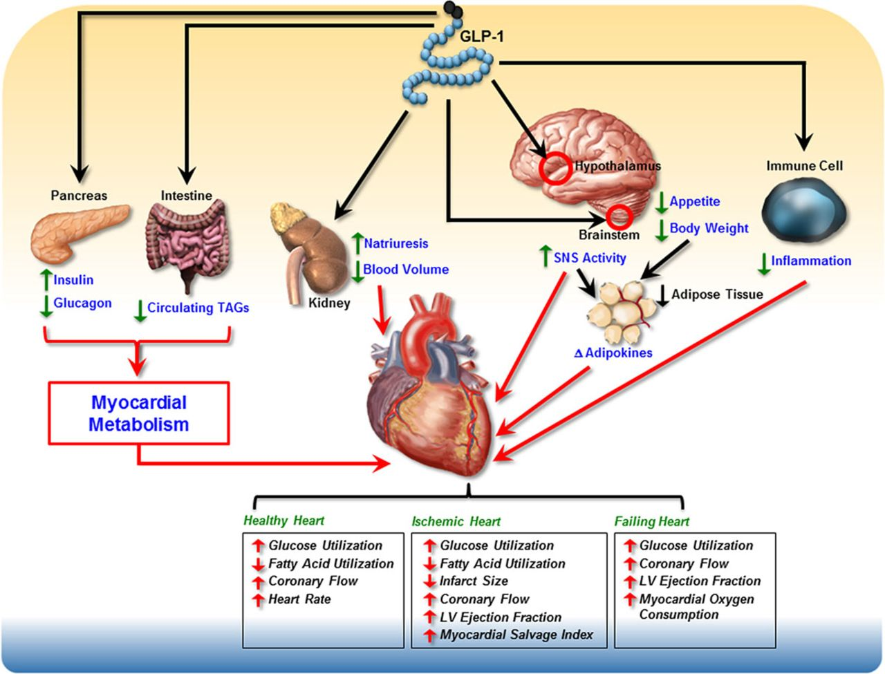
INCRETIN BASED THERAPY
Ussher JR, Drucker DJ. Circ Res 2014;114:1788–803.
Presented at the American Diabetes Association 76th Scientific Sessions, Session 3-CT-SY24. June 13 2016, New Orleans, LA, USA.
Notes:
מפחית תהליכי דלקת, מוריד במשקל על ידי העלאת תחושת שובע, מוריד את נפח הדם ואת לחץ הדם, כמו גם משפיע על רמות הסוכר בדם
Triacylglycerol - TAG

Slide 13
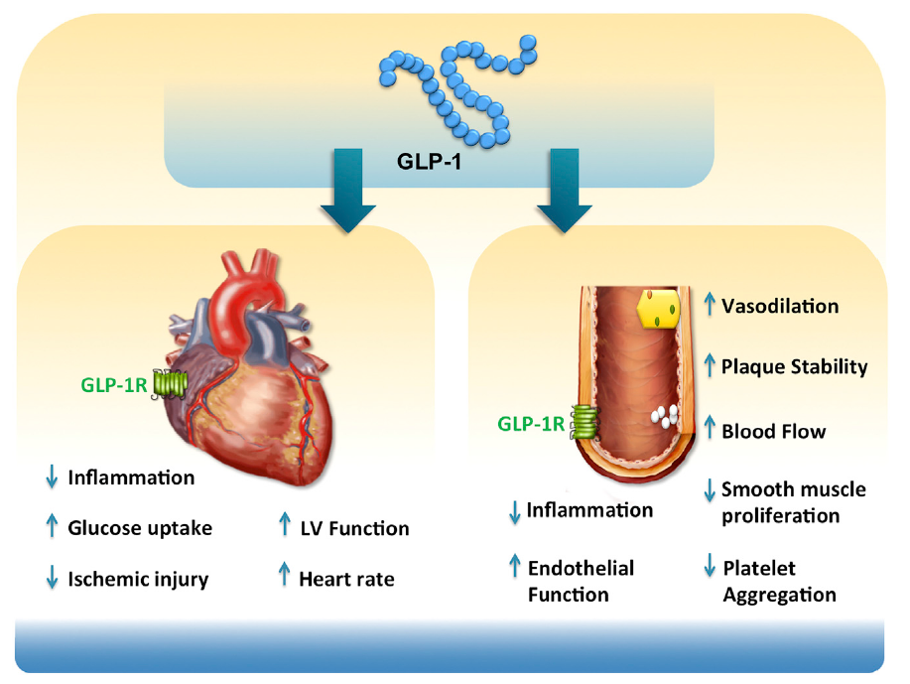
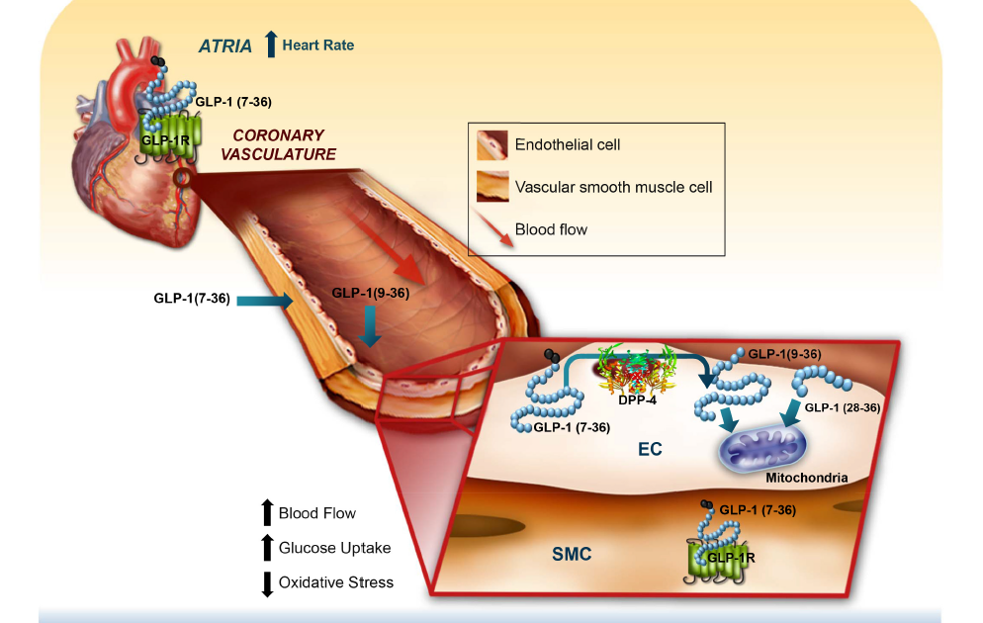
Potential mode of action for GLP-1 to impact CVD
Anti-atherosclerotic
Reduced plt aggregation
Anti-inflammatory effects
CVD, cardiovascular disease; GLP-1, glucagon-like peptide-1; LV, left ventricular
Drucker DJ. Cell Metab. 2016;24:15–30
Ussher & Drucker 2018
Notes:
Unique and safe mechanism of action
A lot of research has been conducted regarding the CV effects of GLP-1. The recent quite extensive review from Drucker highlights both the direct and indirect effects of GLP-1 on the heart and vessels.
The potential effects on the vessel depicting both a reduction in inflammation and plaque stability are aligned with the LEADER primary publication on the potential of liraglutide to impact atherosclerotic progression
Figure 2. Actions of glucagon-like peptide-1 (GLP-1) and GLP-1 receptor (GLP-1R) agonists on the atria and vasculature. GLP-
1R is localized to atrial cardiomyocytes and coronary vascular smooth muscle cells (VSMCs) in the heart. Furthermore, GLP-1–mediated
increases in heart rate are consistent with functional atrial GLP-1R expression in pacemaker cells. The presence of GLP-1R on VSMCs,
and dipeptidyl peptidase-4 (DPP-4) expressed in the endothelial cells (ECs) of coronary vasculature, suggests that a combination of GLP-
1 and GLP-1(9–36) action on VSMCs and endothelial cells, respectively, may be responsible for GLP-1–mediated increases in coronary
flow and subsequent myocardial glucose uptake.

Slide 14
The cardio protective effect of GLP-1RA
GLP1 demonstrated in-vitro ability to increase the survival of cardio-myocytes exposed to hypoxia.
GLP1 improved myocardial contractility in post ischemic rat hearts.
In humans, 72 hour infusion of GLP1 was shown to improve LVEF, global and regional wall motion scores and decrease the hospital stay and mortality.
GLP1 and its metabolite were found to have a glucose independent vaso-relaxant effects on phenylephrine- preconstricted rat mesenteric arteries.
Notes:
The cardio protective effect of GLP-1RA

Slide 15
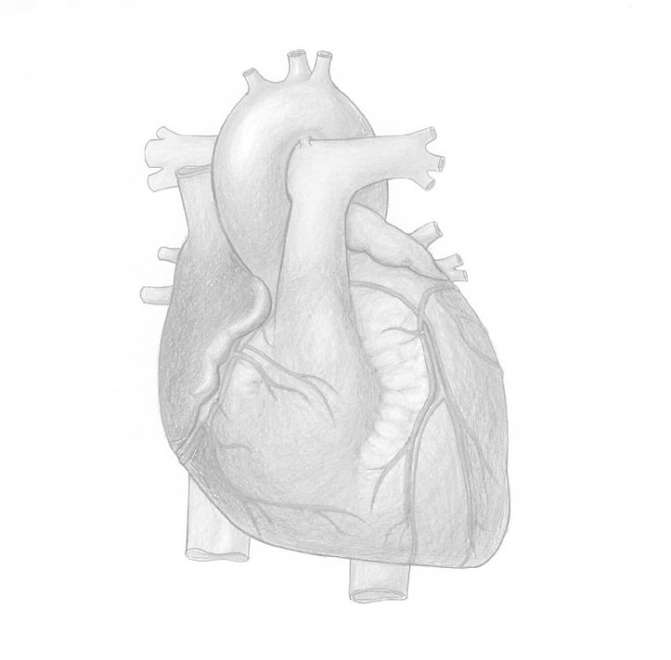
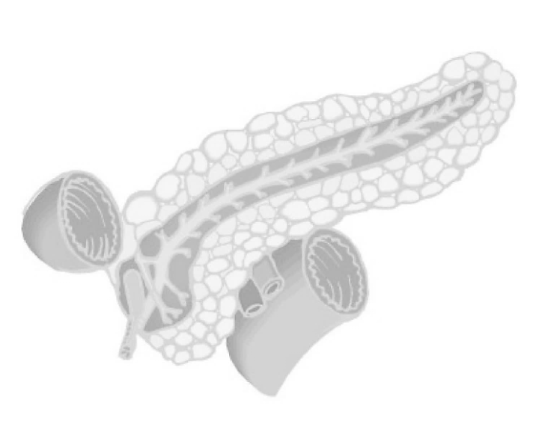
T2D and CVD: More than hyperglycaemia
Dysglycaemia
Beta-cell dysfunction
Insulin resistance
Dyslipidaemia
Small dense LDL
HDL
FFAs
Triglycerides
ApoB, ApoA-1
Oxidative stress
AGEs
oxLDL
PAF-acetylhydrolase
Endothelial dysfunction
vWF
tPA-antigen
adhesion mol.
ET-1, NO
Inflammation
hsCRP
IL-1
IL-6
TNF-α
MMPs
CD40-lig
PAI-1
Adipokines
Hypercoagulability
PAI-1
Fibrinogen
Antithrombin activity
AGE, advanced glycation end products; CVD, cardiovascular disease; FFA, free fatty acids; HDL, high-density lipoprotein; LDL, low-density lipoprotein; oxLDL, oxidized low-density lipoprotiein.

Slide 16
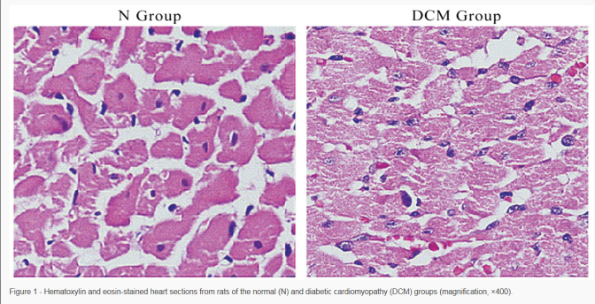
The Diabetic Heart
Morphological abnormalities
LV concentric remodeling & hypertrophy
Alteration of LV remodeling with advanced age
*Functional alteration
Longitudinal & radial systolic impairment
Diastolic dysfunction
Notes:
functional abnormalities that exist during LV relaxation and filling. When such abnormalities cause or contribute to the clinical syndrome of heart failure with a normal LV ejection fraction, it is appropriate to describe the condition as diastolic heart failure

Slide 17
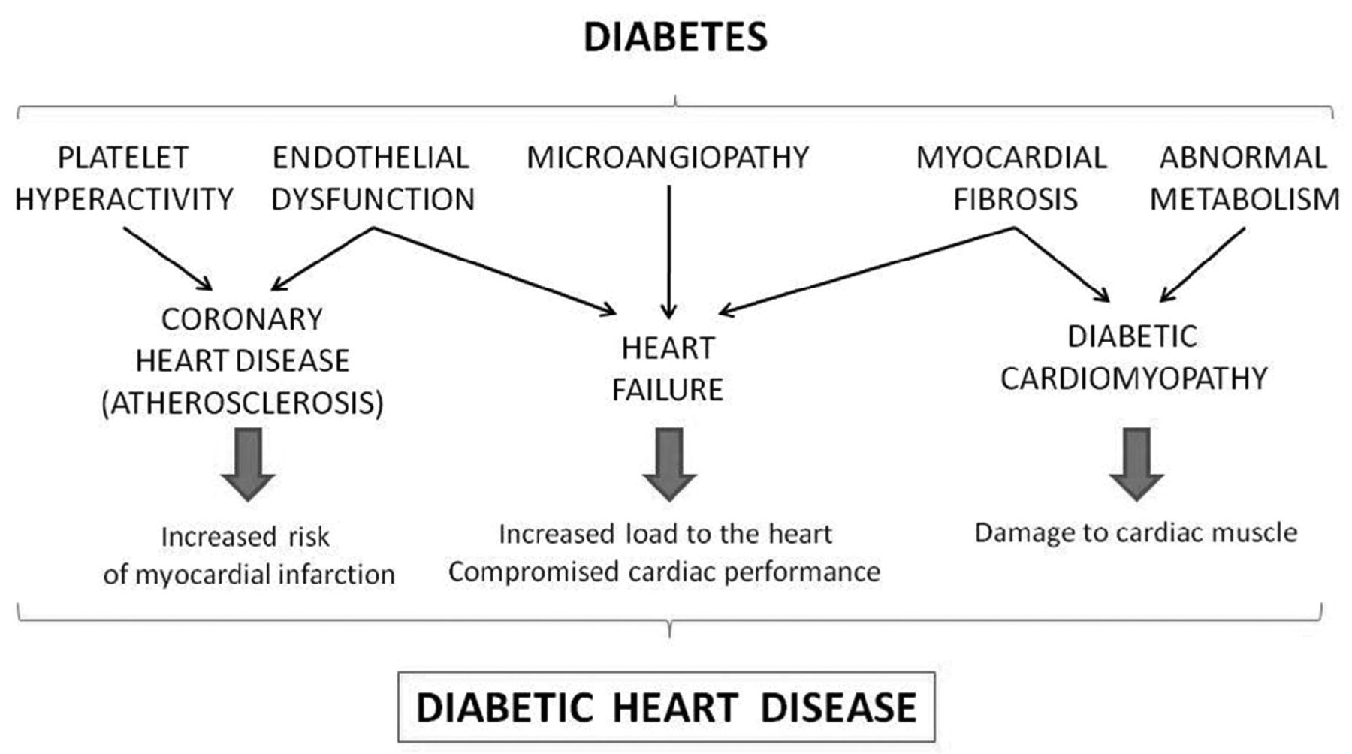
Diabetic heart disease
S. Gross ET AL J. Exp. Med., 2007, 204, 311–320

Slide 18

Liraglutide is a once-daily, human GLP-1 analogue
Human endogenous GLP-1
His
Ala
Glu
Gly
Thr
Phe
Thr
Ser
Asp
Val
Ser
Lys
Ala
Ala
Gln
Gly
Glu
Leu
Tyr
Ser
Glu
Phe
Ile
Ala
Trp
Leu
Val
Lys
Gly
Arg
Gly
Liraglutide
C-16 fatty acid
(palmitoyl)
His
Ala
Glu
Gly
Thr
Phe
Thr
Ser
Asp
Val
Glu
Ser
T1/2-13hr
Lys
Ala
Ala
Gln
Gly
Glu
Leu
Tyr
Ser
Glu
Phe
Ile
Ala
Trp
Leu
Val
Arg
Gly
Arg
Gly
DPP-4, dipeptidyl peptidase-4; GLP-1, glucagon-like peptide-1; PK, pharmacokinetics
Knudsen et al. J Med Chem 2000;43:1664–9; Degn et al. Diabetes 2004;53:1187–94
Notes:
Knudsen et al. J Med Chem 2000;43:1664–9.
Abstract
A series of very potent derivatives of the 30-amino acid peptide hormone glucagon-like peptide-1 (GLP-1) is described. The compounds were all derivatized with fatty acids in order to protract their action by facilitating binding to serum albumin. GLP-1 had a potency (EC(50)) of 55 pM for the cloned human GLP-1 receptor. Many of the compounds had similar or even higher potencies, despite quite large substituents. All compounds derivatized with fatty acids equal to or longer than 12 carbon atoms were very protracted compared to GLP-1 and thus seem suitable for once daily administration to type 2 diabetic patients. A structure-activity relationship was obtained. GLP-1 could be derivatized with linear fatty acids up to the length of 16 carbon atoms, sometimes longer, almost anywhere in the C-terminal part without considerable loss of potency. Derivatization with two fatty acid substituents led to a considerable loss of potency. A structure-activity relationship on derivatization of specific amino acids generally was obtained. It was found that the longer the fatty acid, the more potency was lost. Simultaneous modification of the N-terminus (in order to obtain better metabolic stability) interfered with fatty acid derivatization and led to loss of potency.
Degn et al. Diabetes 2004;53:1187–94.
Abstract
Glucagon-like peptide 1 (GLP-1) is potentially a very attractive agent for treating type 2 diabetes. We explored the effect of short-term (1 week) treatment with a GLP-1 derivative, liraglutide (NN2211), on 24-h dynamics in glycemia and circulating free fatty acids, islet cell hormone profiles, and gastric emptying during meals using acetaminophen. Furthermore, fasting endogenous glucose release and gluconeogenesis (3-(3)H-glucose infusion and (2)H(2)O ingestion, respectively) were determined, and aspects of pancreatic islet cell function were elucidated on the subsequent day using homeostasis model assessment and first- and second-phase insulin response during a hyperglycemic clamp (plasma glucose approximately 16 mmol/l), and, finally, on top of hyperglycemia, an arginine stimulation test was performed. For accomplishing this, 13 patients with type 2 diabetes were examined in a double-blind, placebo-controlled crossover design. Liraglutide (6 micro g/kg) was administered subcutaneously once daily. Liraglutide significantly reduced the 24-h area under the curve for glucose (P = 0.01) and glucagon (P = 0.04), whereas the area under the curve for circulating free fatty acids was unaltered. Twenty-four-hour insulin secretion rates as assessed by deconvolution of serum C-peptide concentrations were unchanged, indicating a relative increase. Gastric emptying was not influenced at the dose of liraglutide used. Fasting endogenous glucose release was decreased (P = 0.04) as a result of a reduced glycogenolysis (P = 0.01), whereas gluconeogenesis was unaltered. First-phase insulin response and the insulin response to an arginine stimulation test with the presence of hyperglycemia were markedly increased (P < 0.001), whereas the proinsulin/insulin ratio fell (P = 0.001). The disposition index (peak insulin concentration after intravenous bolus of glucose multiplied by insulin sensitivity as assessed by homeostasis model assessment) almost doubled during liraglutide treatment (P < 0.01). Both during hyperglycemia per se and after arginine exposure, the glucagon responses were reduced during liraglutide administration (P < 0.01 and P = 0.01). Thus, 1 week's treatment with a single daily dose of the GLP-1 derivative liraglutide, operating through several different mechanisms including an ameliorated pancreatic islet cell function in individuals with type 2 diabetes, improves glycemic control throughout 24 h of daily living, i.e., prandial and nocturnal periods. This study further emphasizes GLP-1 and its derivatives as a promising novel concept for treatment of type 2 diabetes.

Slide 19
Liraglutide and Cardiovascular
Outcomes in Type 2 Diabetes (LEADER)
LEADER®
9,340 Patients
32 Countries
3.5-5 Years Follow up
Presented at the American Diabetes Association 76th Scientific Sessions, Session 3-CT-SY24. June 13 2016, New Orleans, LA, USA.

Slide 20
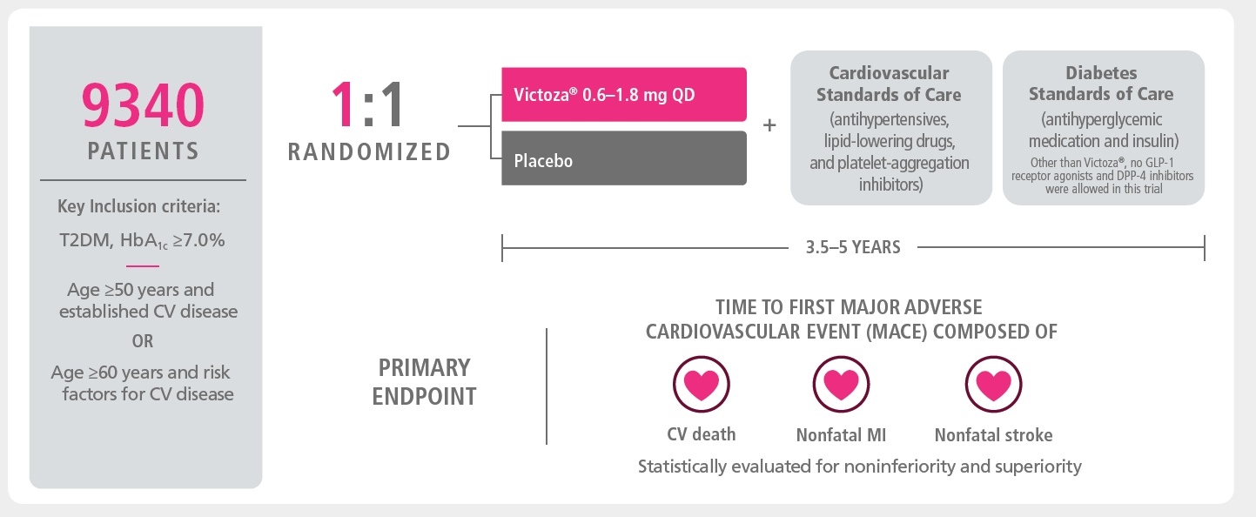



LEADER: A large scale cardiovascular outcomes trial¹
Standard of care treatments
9340
PATIENTS
1:1
RANDOMISED
Oral antidiabetic treatments
Insulin
CV treatments
(antihypertensives, lipid-lowering drugs, platelet-aggregation inhibitors)
Key inclusion criteria
T2D, HbA_{1c} ≥7.0%
Baseline characteristics
3.5-5 YEARS
Time to first major adverse CV event (MACE) composed of:
High study completion rate of
97%
PRIMARY ENDPOINT
87%
Patients with prior CVD
8.7%
Mean HbA_{1c}
92 kg
Mean weight
12.8 years
Mean diabetes duration
CV death
Nonfatal MI
Nonfatal stroke
Statistically evaluated for noninferiority and superiority
1. Marso et al. N Engl J Med 2016;375:311–22.
Notes:
LEADER is a cardiovascular outcomes trial (CVOT) in diabetes designed to evaluate the CV safety of Victoza®
The LEADER trial enrolled 9,340 people globally, with progressed T2D and at high CV risk*, who were followed for up to 5 years¹
*Age >50 and prior CVD or renal impairment or age >60 and one or more CVD risk factor

Slide 21

In patients with type 2 diabetes and high cardiovascular risk*
Victoza® prevented major adverse CV events vs placebo¹
20
20
13%
RRR
OVERALL
MACE
15
Placebo
Liraglutide
15
10
10
Patients with
an event (%)
HR=0.87
5
95% CI (0.78;0.97)
5
p<0.001 for non
-
inferiority
p=0.01 for superiority
0
0
0
6
6
12
12
18
18
24
24
30
30
36
36
42
42
48
48
54
54
Patients at risk
Time from randomisation (months)
Liraglutide
4668
4641
4599
4558
4505
4445
4382
4322
1723
484
Placebo
4672
4648
4601
4546
4479
4407
4338
4267
1709
465
*High cardiovascular risk was defined as ≥50 years with at least 1coexisting cardiovascular condition or ≥60 years with at least 1 cardiovascular risk factor as determined by the investigator.
1. Marso et al. N Engl J Med 2016;375:311–22.
Notes:
The primary outcome was the time from randomization to a composite outcome consisting of the first occurrence of cardiovascular death, nonfatal (including silent) myocardial infarction (MI), or nonfatal stroke.
Primary composite outcome in time-to-event analysis was first occurrence of death from cardiovascular causes, non-fatal myocardial infarction or non-fatal stroke. Cumulative incidences estimated using the Kaplan–Meier method, and hazard ratios using the Cox proportional-hazard regression model. Data analyses are truncated at 54 months, as <10% of patients had an observation time >54 months
CI, confidence interval; CV, cardiovascular; HR, hazard ratio
Reference: Primary manuscript Figure 1
Source: KM plot: EOT Figure 14.2.45 / ID14201320
HR: EOT Table 14.2.43/ID14201300_primary_analysis_fas.txt
p-value: EOT Table 14.2.44/ID14201310_primary_analysis_pvalues_fas.txt

Slide 22
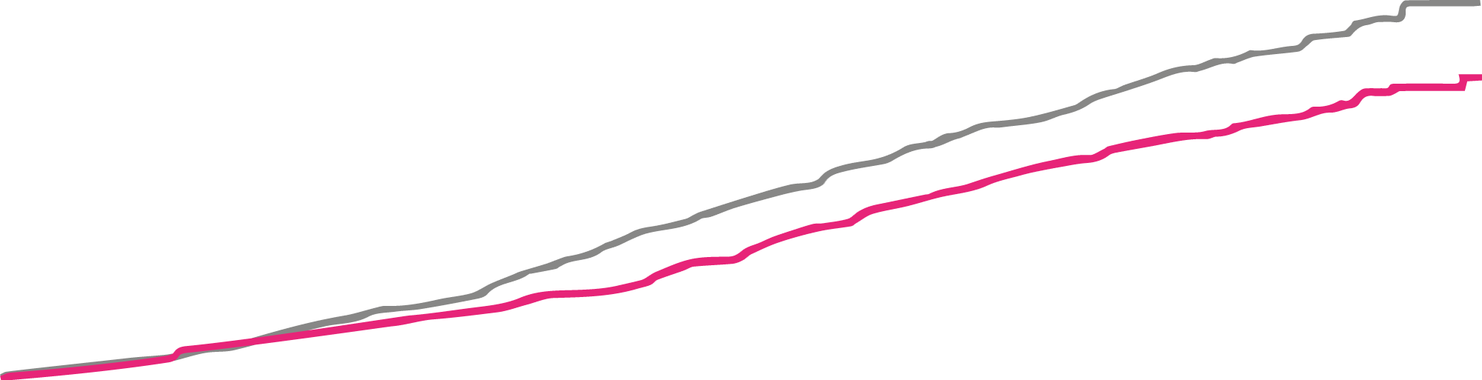
In patients with type 2 diabetes and high cardiovascular risk*
Victoza® provided a significant life-saving CV benefit¹
20
20
15
22%
RRR
CV death
15
Placebo
Liraglutide
Patients with
an event (%)
10
10
5
HR=0.78
95% CI (0.66 ; 0.93)
p=0.007
5
0
0
0
0
6
6
12
12
18
18
24
24
30
30
36
36
42
42
48
48
54
54
Patients at risk
Time from randomisation (months)
Liraglutide
4668
4641
4599
4558
4505
4445
4382
4322
1723
484
Placebo
4672
4648
4601
4546
4479
4407
4338
4267
1709
465
*High cardiovascular risk was defined as ≥50 years with at least 1coexisting cardiovascular condition or ≥60 years with at least 1 cardiovascular risk factor as determined by the investigator.
1. Marso et al. N Engl J Med 2016;375:311–22.

Slide 23
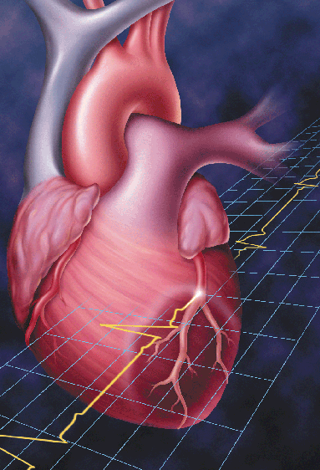
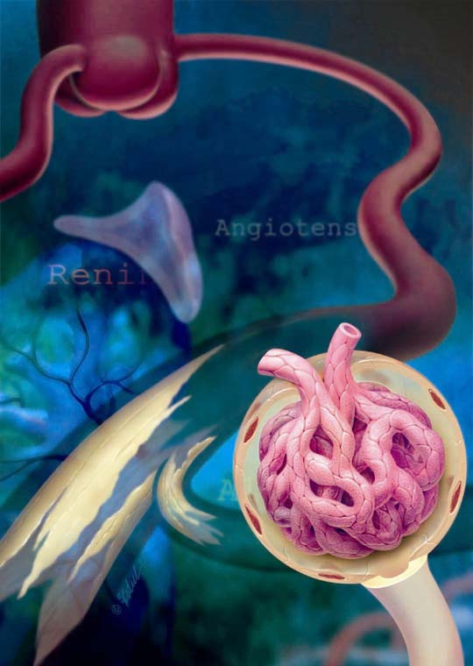
DM – CVD – Renal Disease = Deadly Triad

Slide 24
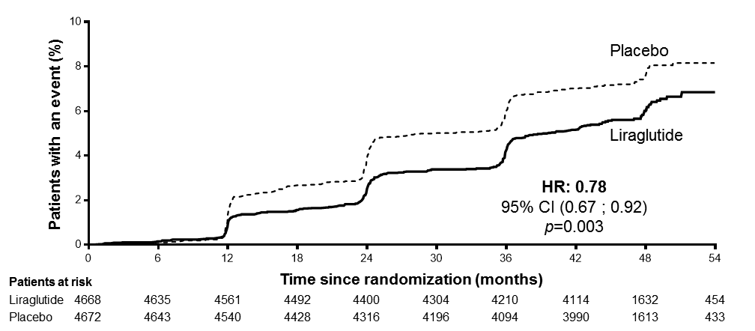
Time to first renal outcome
Macroalbuminuria, doubling of serum creatinine*, ESRD, renal death
22%
*and eGFR ≤45 mL/min/1.73 m² per MDRD
The cumulative incidences were estimated using the Kaplan–Meier method, and the HRs using the Cox proportional-hazards regression model. The data analyses are truncated at 54 months because less than 10% of the patients had an observation time beyond 54 months
CI: confidence interval; eGFR: estimated glomerular filtration rate; ESRD: end-stage renal disease;
HR: hazard ratio; MDRD: modification of diet in renal disease
Presented at 52nd EASD Annual Meeting, 14 September 2016, Munich, Germany

Slide 25
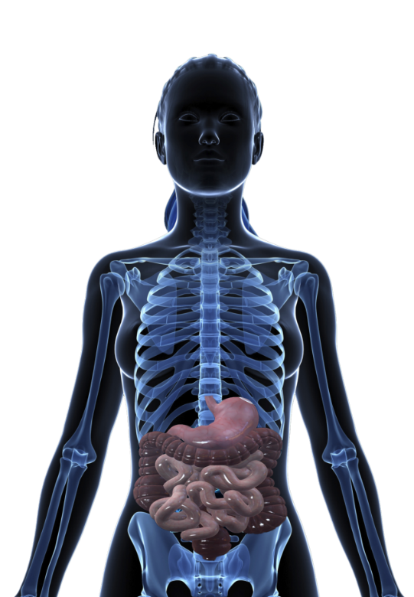

Safety profile of GLP-1RAs
GLP-1
GLP-1
All cause mortality
CV death
Nausea
Vomiting
Myocardial infarction
Microvascular disease
Non-alcoholic steatohepatitis
Diarrhoea
Acute gallstone disease
Diabetes
Obesity
Glucose
Body weight
CV, cardiovascular; GLP-1, glucagon-like peptide-1; GLP-1RA, glucagon-like peptide-1 receptor agonist; LEADER, Liraglutide Effect and Action in Diabetes: Evaluation of cardiovascular outcome Results
Drucker DJ. Cell Metab 2016;24(1):15-30.
Notes:
Based on results from the LEADER trial, sustained GLP-1R agonism in subjects with T2D at high risk for CV events produced a reduction in MACE events and CV mortality, balanced by gastrointestinal side effects, and lingering uncertainty about any possible associated increased risk of cancer. The CV benefit of GLP-1RAs in obese nondiabetic subjects has not been established.

Slide 26
CVS risk in T2D&recent outcomes trials: How will they influence clinical decision making?

Slide 27
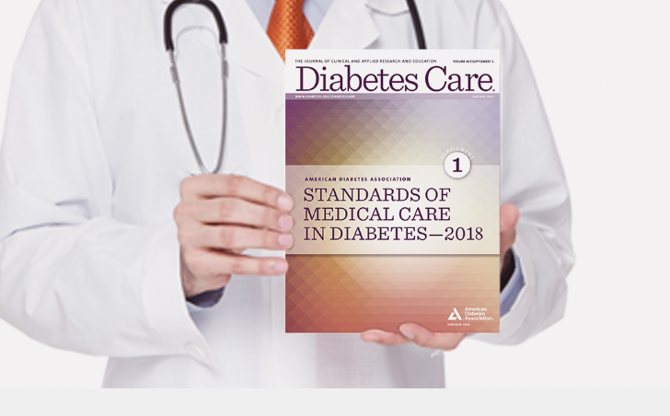
Notes:
עידכונים מהגיידליינס של 2018 של שני האיגודים – ADA ו AACE

Slide 28
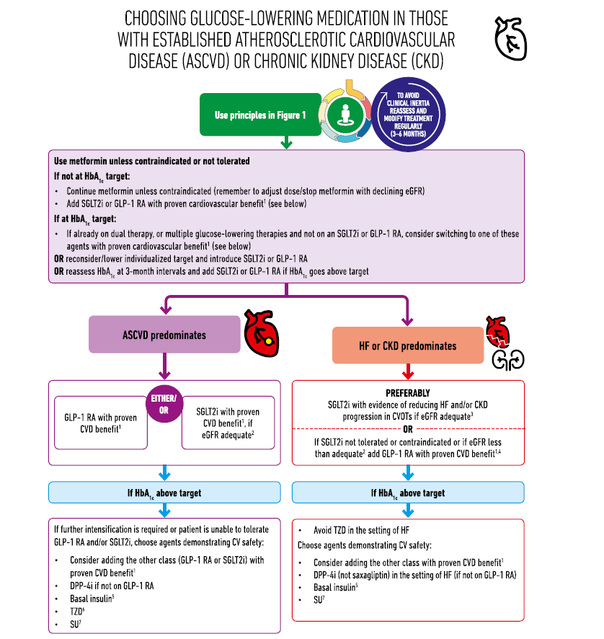

Slide 31
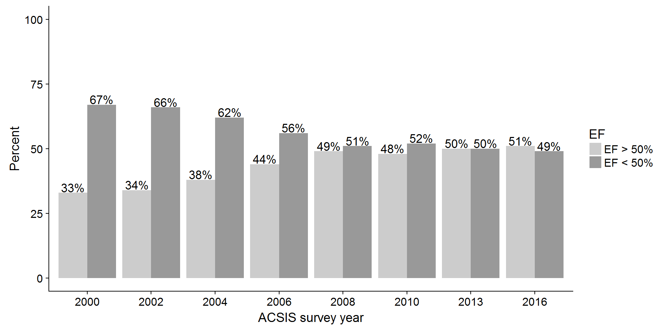

Slide 32
Very high risk / High risk
Individuals with DM and CVD, or DM with target organ damage, such as proteinuria or kidney failure [estimated glomerular filtration rate (eGFR) <30 mL/min/1.73 m2] are at very high risk (10 year risk of CVD death >10%).
Patients with DM with three or more major risk factors, or with a DM duration of >20 years, are also at very high risk.

Slide 33
ESC/EASD guidelines on DM 2019

Slide 34
Israeli Health Basket Criteria:
SGLT2 inh.: DM type II patients with an HbA1c of >7%, GFR >45 ml/min, with previous therapy and one of the following:
  Ischemic heart disease
  CABG
  S/P MI
GLP-1 RA: DM type II patients with an HbA1c 7.5-9% and BMI 28-30 after therapy with at least 2 oral anti-diabetic medications and one of the following:
  Ischemic heart disease
  Cerebrovascular disease
  Chronic renal failure

Slide 35
A practical guide
Reduces CV and total mortality
Atherosclerosis/ischemic benefits > heart failure benefits
Renal benefits
Can use in patients with CKD
No risk of DKA
No risk of genital infections, hypovolemia
No hypotension
No titration of diuretics
No risk of ARF

Slide 36
Thank you
easher@szmc.org.il
052-5046080

