Slide 1
AF+PCI: Dual Therapy is the Treatment of Choice!
המחלוקות הגדולות בתחום
הטיפול התרופתי בחולה הלב
15.11.2019
ד"ר אלון אייזן
המערך הקרדיולוגי, מרכז רפואי רבין

Slide 2
Disclosures
Consultant- Bayer
Honoraria for lectures- AstraZeneca, Daiichi Sankyo, Pfizer, Sanofi, Bayer
Grant- Bayer, Amgen, Bohringer Ingelheim

Slide 3
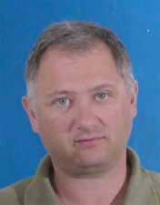
So you’ve heard that…
High ischemic
risk….
Stent thrombosis!
Not powered for
efficacy…
For years…

Slide 4
We have enough controversies…

Slide 5
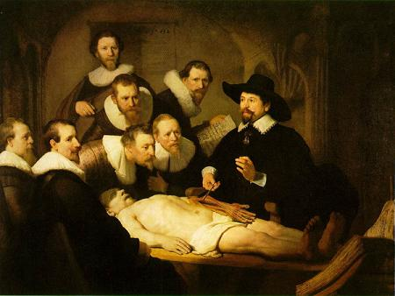
Let’s move on…

Slide 6
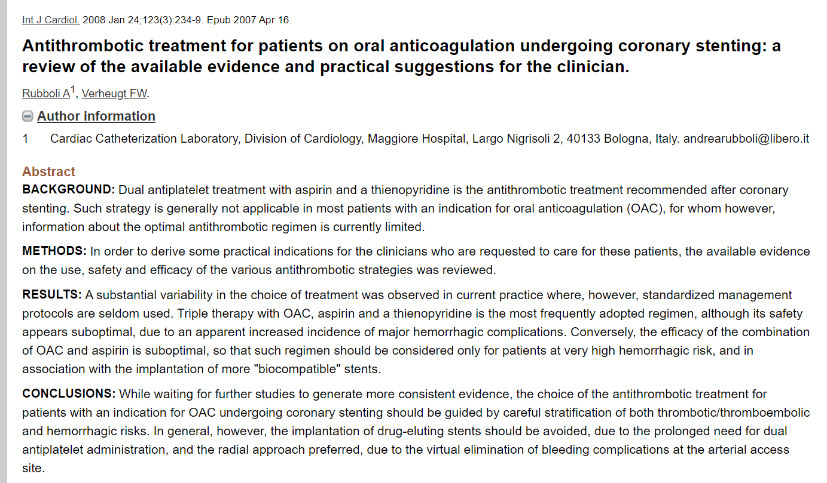
Triple Therapy- the past…

Slide 7
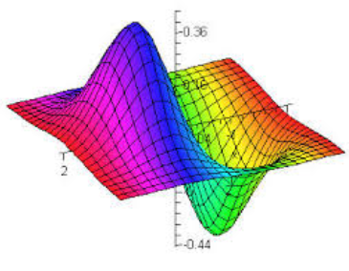
How does it add up?
Stroke Prevention
Full dose NOAC
OR
Low dose NOAC
OR
Warfarin
Clopidogrel
OR
Ticagrelor
OR
Prasugrel
Aspirin
The Calculus is complex
MACE reduction
Bleeding
+
±

Slide 8
D U A L T H E R A P Y

Slide 9
Bleeding

Slide 10
Triple Therapy with a VKA Reduces Thromboembolic Events but Increases Bleeding after PCI in AF Patients
Danish registry data (2000–2009; N=11,480 patients)
Crude incidence rates (events per 100 person-years ± SE)
CV death, MI,
Ischemic stroke
Fatal and non fatal bleeding
CV death plus MI plus ischemic stroke
Fatal and non-fatal bleeding
Lamberts M et al, Circulation 2012;126:1185–1193
Notes:
Abbreviations
AF, atrial fibrillation; ASA, acetylsalicylic acid (aspirin); CV, cardiovascular; DAPT, dual antiplatelet therapy; PCI, percutaneous coronary intervention; VKA, vitamin K antagonist

Slide 11
Triple therapy is associated with the greatest increase in bleeding risk with all OAC/antiplatelet combinations
Antiplatelet therapy
None (n=3478)
2.8
Warfarin
Single (n=2312)
4.6
Dual (n=232)
6.3
None (n=3613)
2.6
Dabigatran 150 mg BID
Single (n=2251)
4.3
Dual (n=212)
5.5
None (n=3510)
2.2
Dabigatran 110 mg BID
Single (n=2288)
3.8
Dual (n=217)
5.4
Major bleeding (%/year)
1. Dans et al. Circulation 2013; 2. Dewilde et al. Lancet 2013; 3. Lip et al. Thromb Haemost 2010; 4. Nikolsky et al. Am J Cardiol 2012; 5. Lamberts et al. Circulation 2014
Notes:
References
1. Dans AL et al. Circulation 2013;127:634–40
2. Dewilde WJ et al. Lancet 2013;381:1107–15 3. Lip GY et al. Thromb Haemost 2010;103:13–28
4. Nikolsky E et al. Am J Cardiol 2012;109:831–8 5. Lamberts M et al. Circulation 2014;129:1577–85

Slide 13
Primary Endpoint: Bleeding events TIMI classification
WOEST
44.9
p<0.001
p<0.001
27.2
Event rate (%)
p<0.001
19.5
16.7
11.2
p=0.16
6.5
5.8
3.3
Dewilde WJ et al. Lancet 2013;381:1107–1115

Slide 14
WOEST
Forest plot of primary endpoint Hazard Ratios
Triple
Double
P-value for interaction
age
age75
<75 years
FALSE
79
200
194
82
TRUE
>75 years
79
200
82
194
0.9157
0.9157
gender
male
no
female
50
50
65
65
yes
male
234
234
214
214
0.8217
0.8217
ACS
t0acs
no
no
195
195
207
207
yes
yes
86
86
69
0.721
69
0.7210
indication
OAC
AF/AFlut
162
164
oacind3cat
AF/AFlut
162
164
Mechanical
valve
25
24
0.1116
Mechanical valve
25
24
0.1116
Other
47
48
0.7761
Other
47
48
0.7761
Stent
type
des
No
BMS
90
90
94
94
DES
DES
194
194
184
184
0.7894
0.7894
Overall
Overall
284
284
279
279
0.1
0.4
1
double therapy better <=> triple therapy better
Dewilde WJ et al. Lancet 2013;381:1107–1115

Slide 15
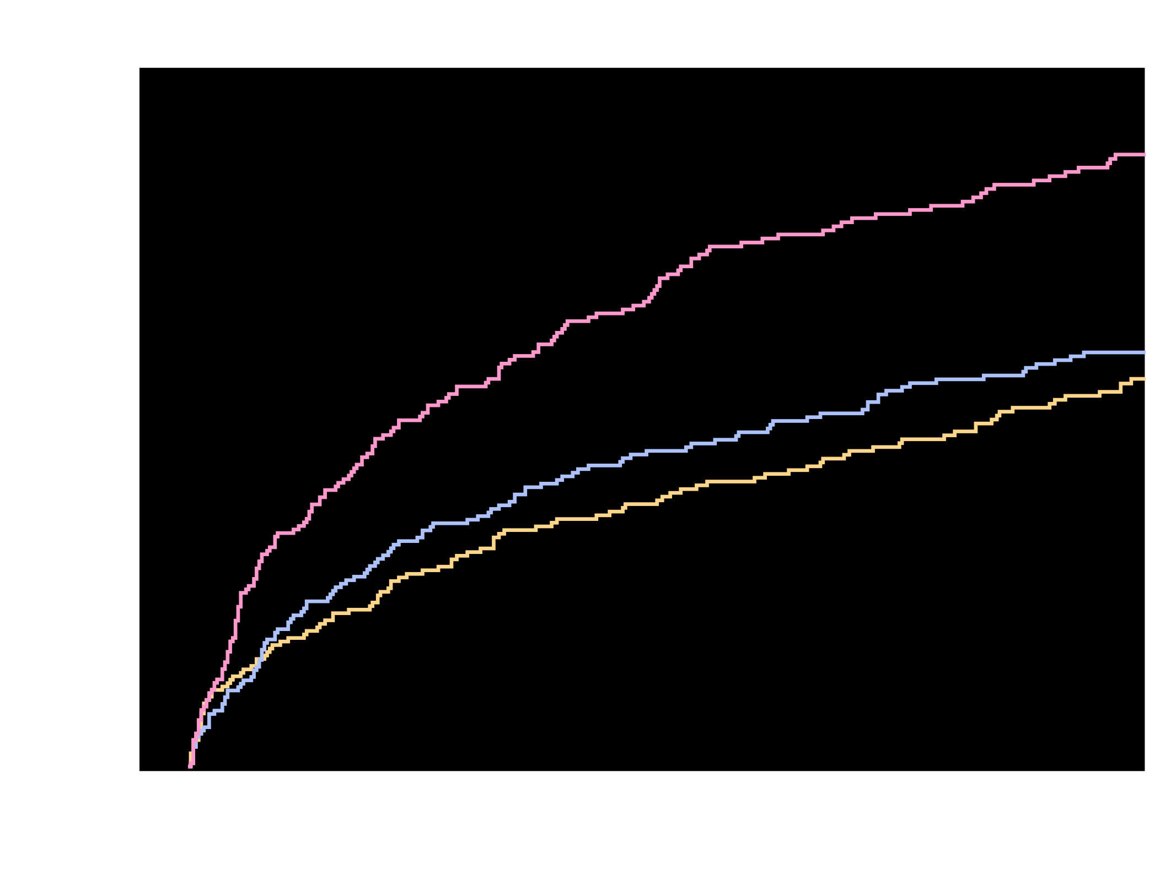
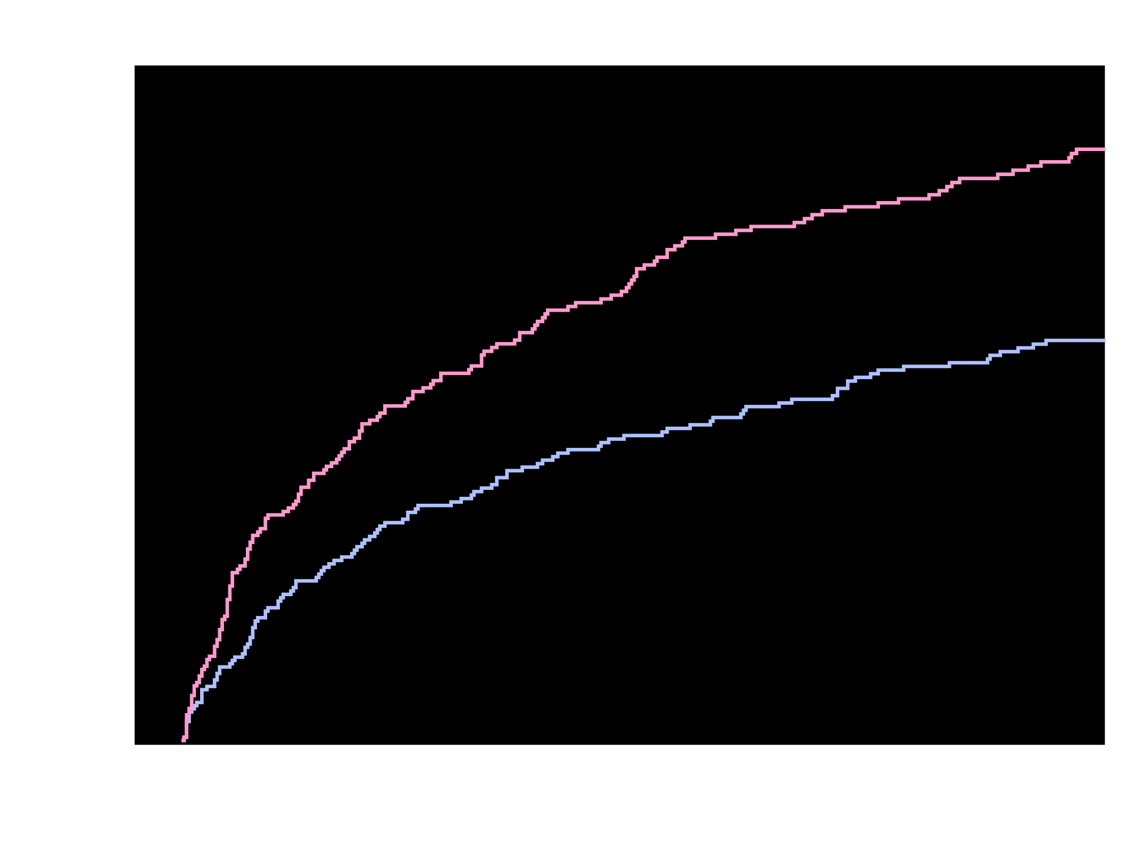
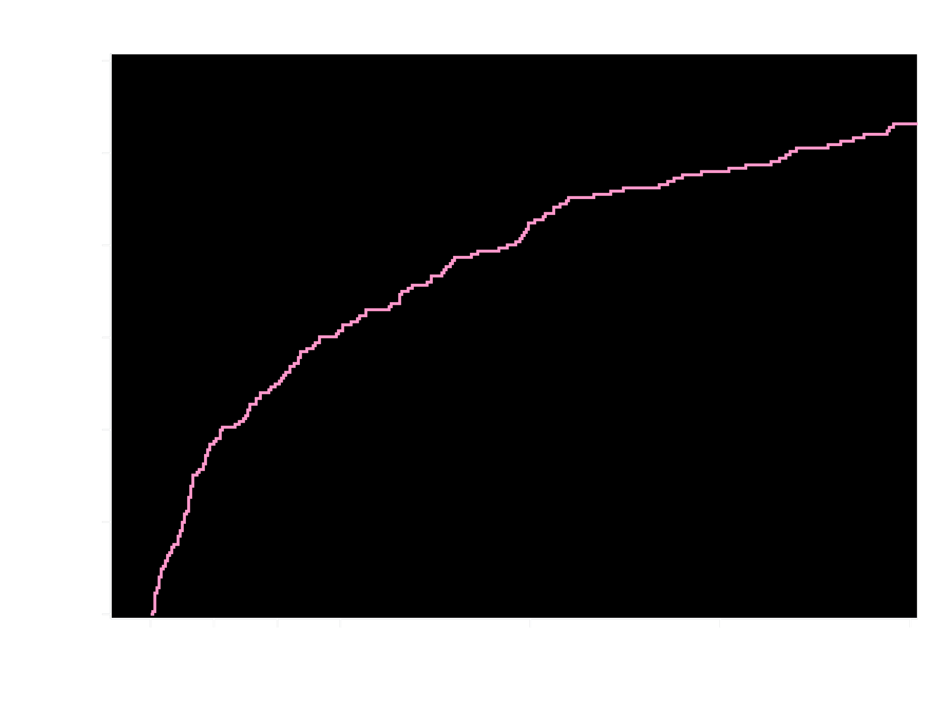
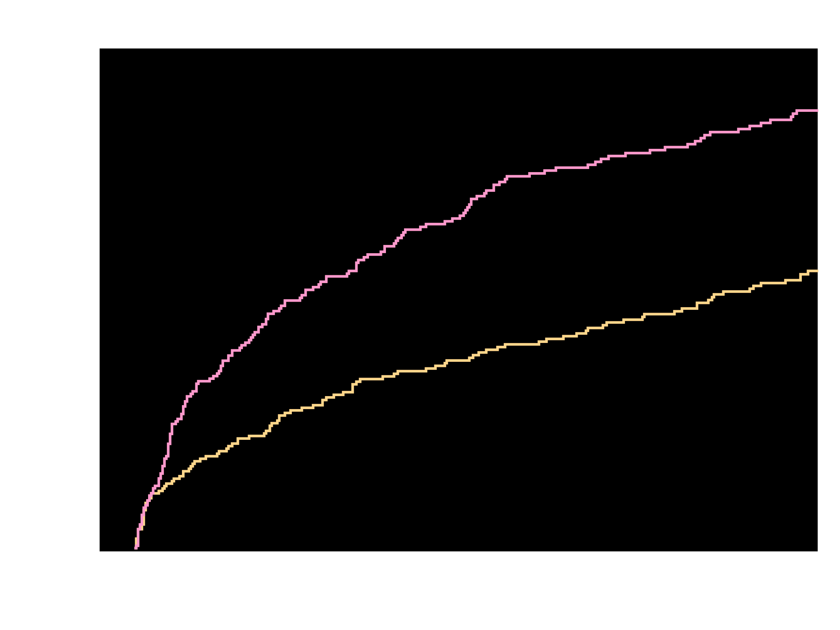
Kaplan-Meier Estimates of First Occurrence
of Clinically Significant Bleeding Events
TIMI Major, TIMI Minor, or Bleeding Requiring Medical Attention (%)
26.7%
p<0.00018
p<0.000013
18.0%
VKA + DAPT
16.8%
VKA + DAPT
VKA + DAPT (group 3)
VKA + DAPT
Riva + DAPT (group 2)
Riva + DAPT
Riva + P2Y_{12 (group 1)}
Riva + P2Y₁₂
HR = 0.63 (95% CI 0.50-0.80)
ARR = 8.7
NNT = 12
HR = 0.59 (95% CI 0.47-0.76)
ARR = 9.9
NNT = 11
Riva + P2Y₁₂ v. VKA + DAPT
HR=0.59 (95% CI: 0.47-0.76)
p <0.000013
ARR=9.9
NNT=11
Riva + DAPT v. VKA + DAPT
HR=0.63 (95% CI: 0.50-0.80)
p <0.00018
ARR=8.7
NNT=12
Days
No. at risk
VKA + DAPT
Riva + DAPT
VKA + DAPT
Riva + P2Y₁₂
VKA + DAPT
Riva + P2Y₁₂
Riva + DAPT
VKA + DAPT
697
706
697
696
697
696
706
697
593
636
593
628
593
628
636
593
329
409
329
383
409
329
600
555
383
329
606
555
606
600
555
579
521
585
521
585
579
521
543
461
543
461
543
543
461
509
426
510
426
555
521
461
510
509
426
426
Gibson et al. NEJM 2016

Slide 16
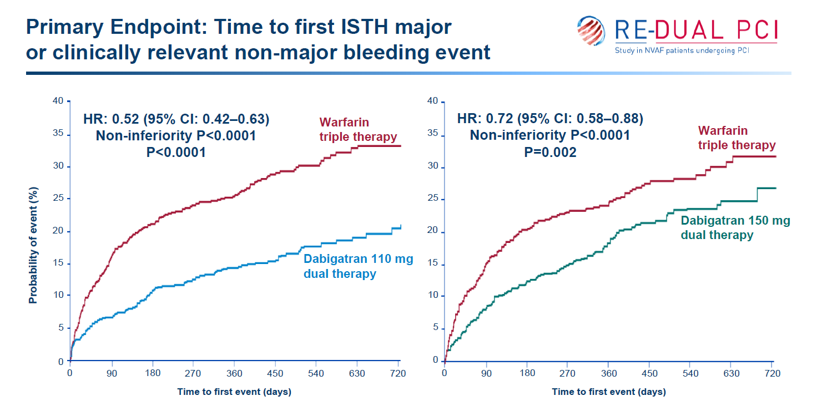
NEJM 2017

Slide 17
EHJ 2019

Slide 18
Apixaban Versus Warfarin in Patients with AF and ACS or PCI: The AUGUSTUS Trial
Inclusion
AF (prior, persistent, and/or >6 hours duration)
CHADS ≥ 1
Physician decision that oral anticoag is indicated
ACS or PCI with planned P2Y12 inhibitor for 6 months
Randomize
n =4,600
Patients
Exclusion
Contraindication to DAPT
Other reason for warfarin (prosthetic valve, moderate/severe MS)
Apixaban
Warfarin
P2Y12 inhibitor for all patients x 6 months
Aspirin for all on the day of ACS or PCI
Aspirin versus placebo after randomization
ASA
placebo
ASA
placebo
Primary outcome: major/clinically relevant bleeding (through 6 months)
Secondary objective: Death, MI, stroke, stent thrombosis

Slide 19
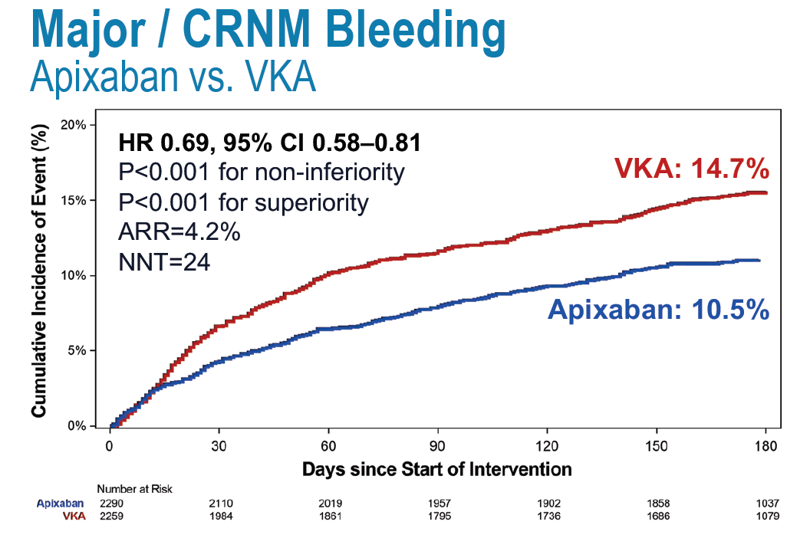
NEJM 2019

Slide 20
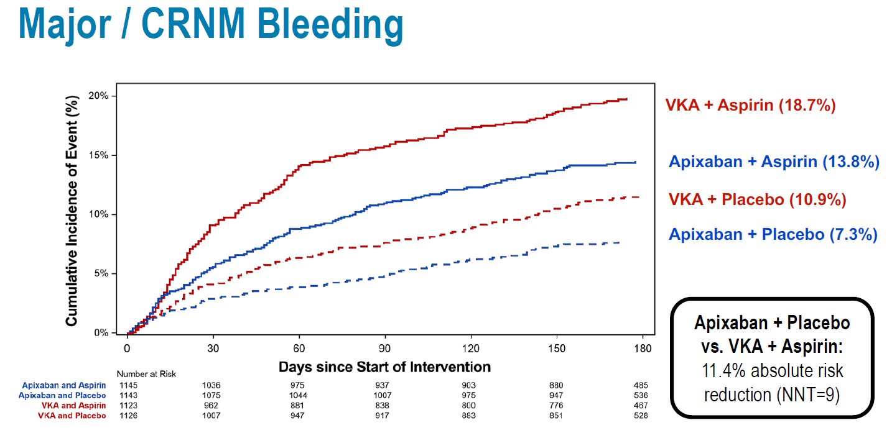
NEJM 2019

Slide 21
Less Bleeding with dual compared with triple therapy…

Slide 22
Less Bleeding with dual
compared with triple
therapy !!!

Slide 23
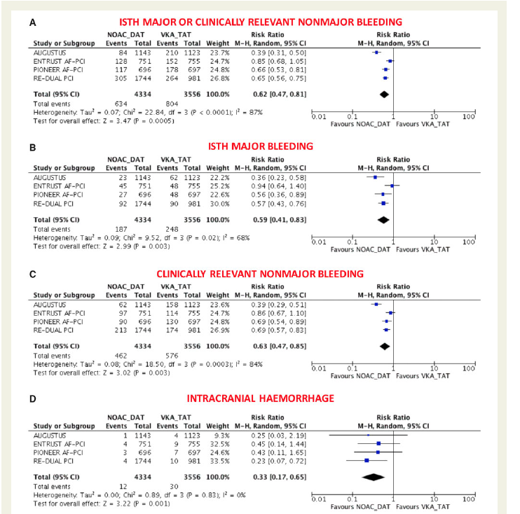
EHJ 2019

Slide 24
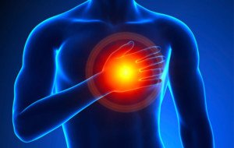
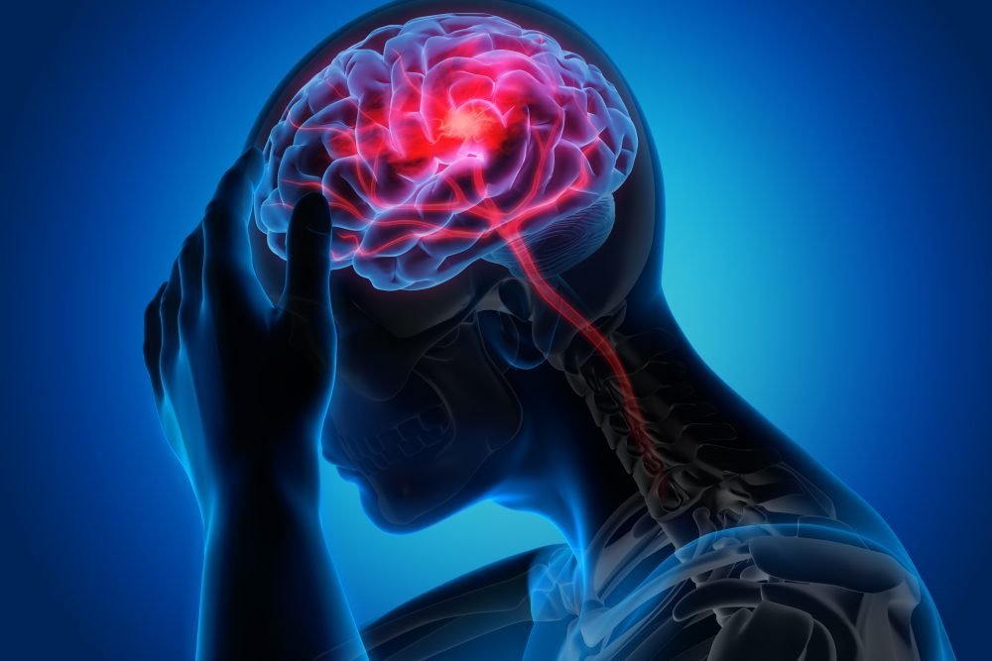
Ischemic events?

Slide 25
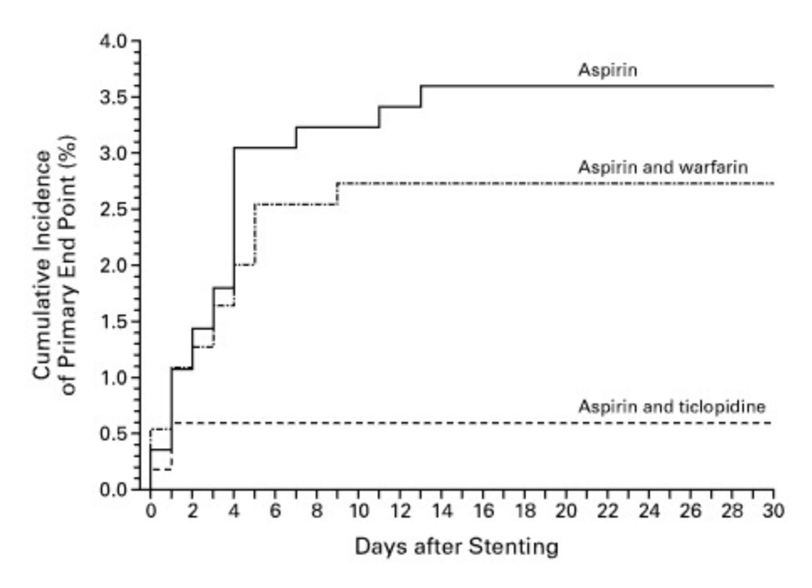
What is the role of aspirin?
P2Y12 inhibition is probably the most important target to prevent stent thrombosis, rather than inhibition of the cycloxygenase pathway with aspirin.
1653 patients s/p PCI randomized to:
ASA
ASA+ Warfarin
ASA + ticlopidine
Primary endpoint: death, revasc, 30d ST
N Engl J Med 1998;339:1665-1671

Slide 27
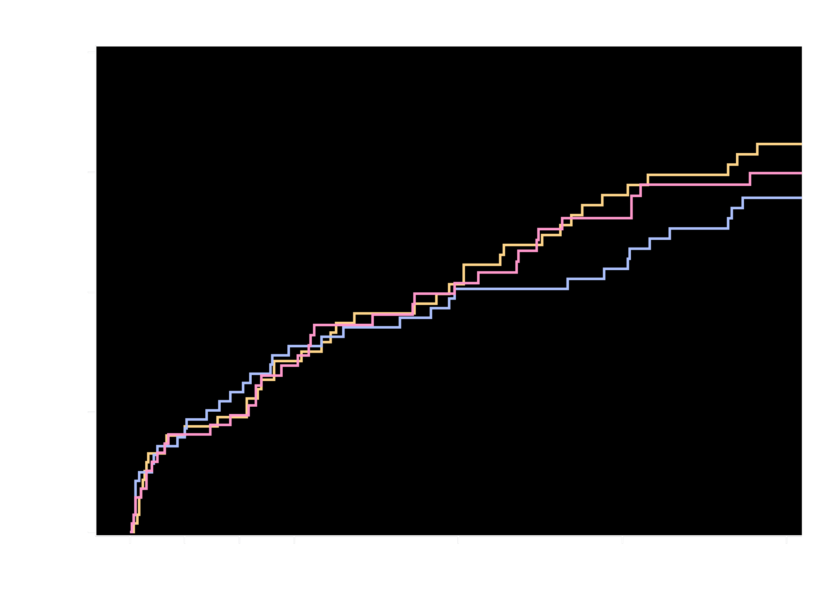
Kaplan-Meier Estimates of First
Occurrence of CV Death, MI or Stroke
Cardiovascular Death, Myocardial Infarction, or Stroke (%)
6.5%
Riva + P2Y₁₂
6.0%
5.6%
Riva + DAPT
VKA + DAPT
Riva + P2Y₁₂ v. VKA + DAPT
HR=1.08 (95% CI: 0.69-1.68)
p=0.750
Riva + DAPT v. VKA + DAPT
HR=0.93 (95% CI: 0.59-1.48)
p=0.765
No. at risk
Days
Riva + P2Y₁₂
Riva + DAPT
VKA + DAPT
694
704
695
648
662
635
633
640
607
621
628
579
590
596
543
562
570
514
430
457
408
Gibson et al. NEJM 2016

Slide 28
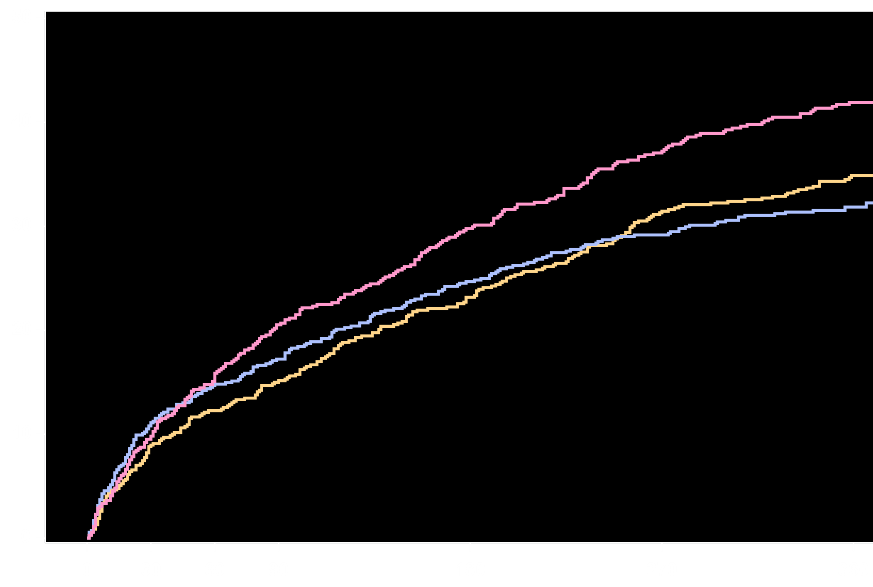
All Cause Death or All Cause Hospitalization for an Adverse Event
All Cause Death or All Cause Rehospitalization (%)
41.9%
VKA + DAPT
Riva + P2Y₁₂
34.9%
31.9%
Riva + DAPT
Riva + P2Y₁₂ v. VKA + DAPT
HR=0.79 (95% CI: 0.66-0.94)
p=0.008
ARR=7.0
NNT=15
Riva + DAPT v. VKA + DAPT
HR=0.75 (95% CI: 0.62-0.90)
p=0.002
ARR=10.0
NNT=10
No. at risk
Days
Riva + P2Y₁₂
Riva + DAPT
VKA + DAPT
696
706
697
609
607
592
582
570
540
559
548
490
496
493
422
437
454
369
322
367
272
Gibson et al. Circulation 2016

Slide 29
NEJM 2017

Slide 30
AUGUSTUS trial
NEJM 2019

Slide 31
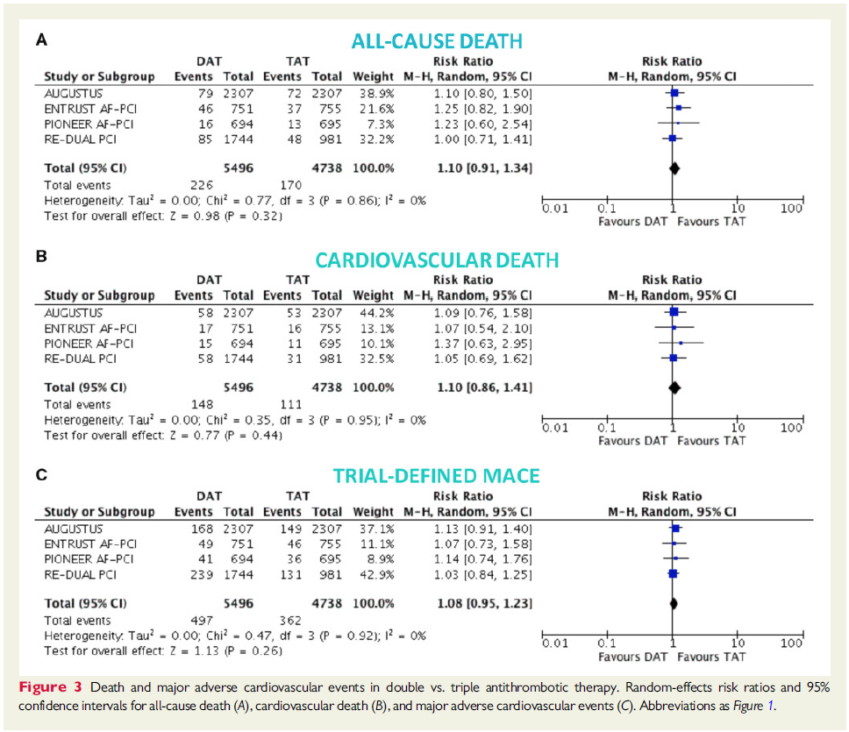
EHJ 2019

Slide 32
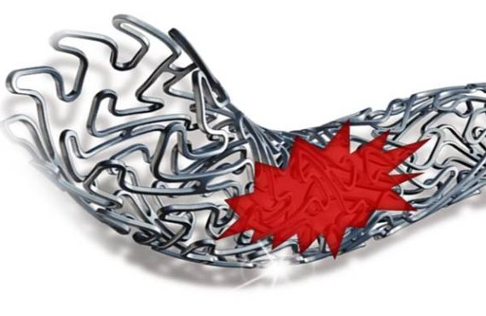
Stent thrombosis?

Slide 33
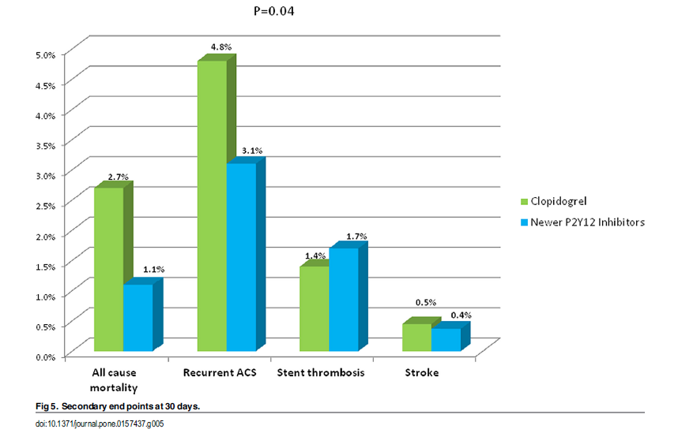
Stent thrombosis- ACSIS
pLOS one 2016

Slide 34
Prespecified Ischemic Endpoints
HR [95%CI]:
0.97 [0.76 - 1.24]
p = 0.80
HR [95%CI]:
1.00 [0.75 - 1.33]
p = 0.99
HR [95%CI]:
0.75 [0.48 - 1.18]
p = 0.21
HR [95%CI]:
1.80 [0.83 - 3.90]
p = 0.13
HR [95%CI]:
0.74 [0.37 – 1.47]
p = 0.38

Slide 36
Comparable Efficacy with Rivaroxaban Strategies vs VKA Plus DAPT
Endpoints | HR | 95% CI | HR (95% CI) |  | p-value
Rivaroxaban 15 mg OD plus single antiplatelet vs VKA plus DAPT
Major adverse CV events* | 1.08 | 0.69–1.68 |  |  | 0.75
CV death | 1.29 | 0.59–2.80 |  |  | 0.52
MI | 0.86 | 0.46–1.59 |  |  | 0.62
Stroke | 1.07 | 0.39–2.96 |  |  | 0.89
Stent thrombosis | 1.20 | 0.32–4.45 |  |  | 0.79
Rivaroxaban 2.5 mg BID plus DAPT vs VKA plus DAPT
Major adverse CV events* | 0.93 | 0.59–1.48 |  |  | 0.77
CV death | 1.19 | 0.54–2.62 |  |  | 0.66
MI | 0.75 | 0.40–1.42 |  |  | 0.37
Stroke | 1.36 | 0.52–3.58 |  |  | 0.53
Stent thrombosis | 1.44 | 0.40–5.09 |  |  | 0.57
Favours rivaroxaban
Favours VKA
Incidence of major adverse CV events was comparable between all three treatment strategies; however the trial was not powered for efficacy
*Composite of CV death, MI and stroke
Gibson CM et al, New Engl J Med 2016; doi: 10.1056/NEJMoa1611594
Notes:
Abbreviations
CV, cardiovascular; DAPT, dual antiplatelet therapy; BID, twice daily; CI, confidence interval; HR, hazard ratio; OD, once daily; VKA, vitamin K antagonist

Slide 37
NEJM 2017

Slide 38
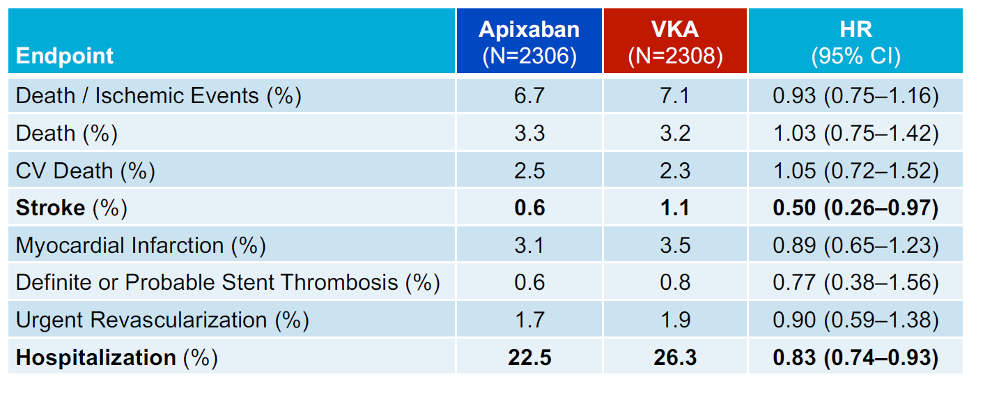
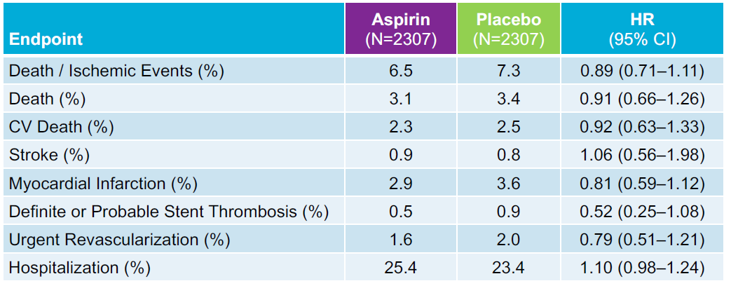
AUGUSTUS trial
NEJM
2019

Slide 39
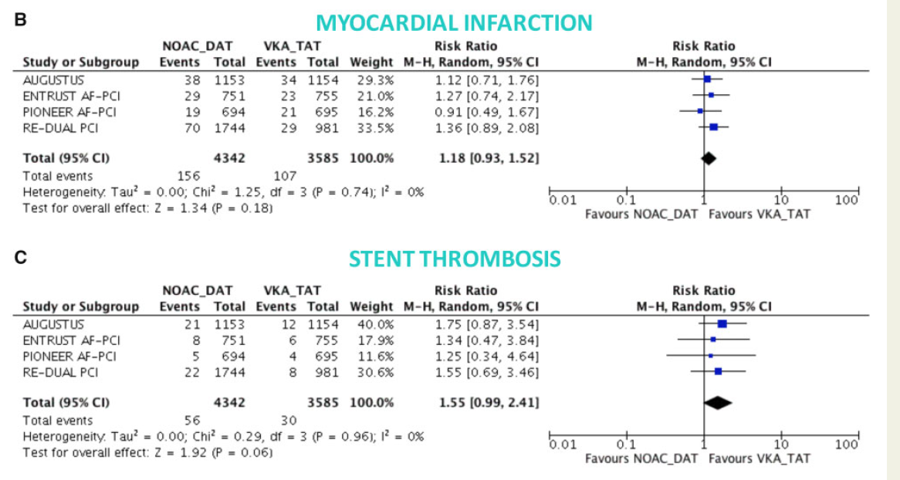
EHJ 2019

Slide 40
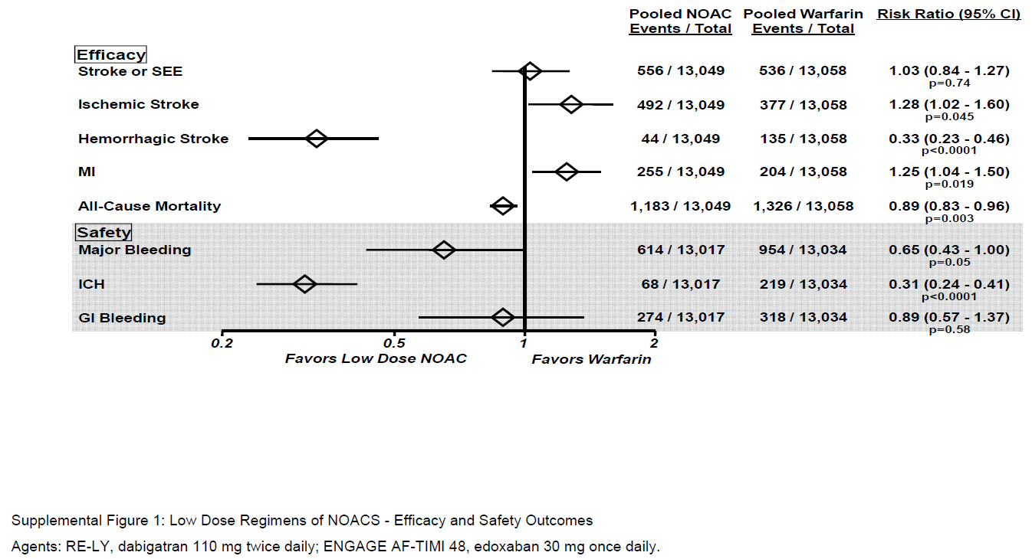
Low dose NOACs
Ruff CT, et al. Lancet 2014;383:955-962

Slide 41
The guidelines

Slide 42
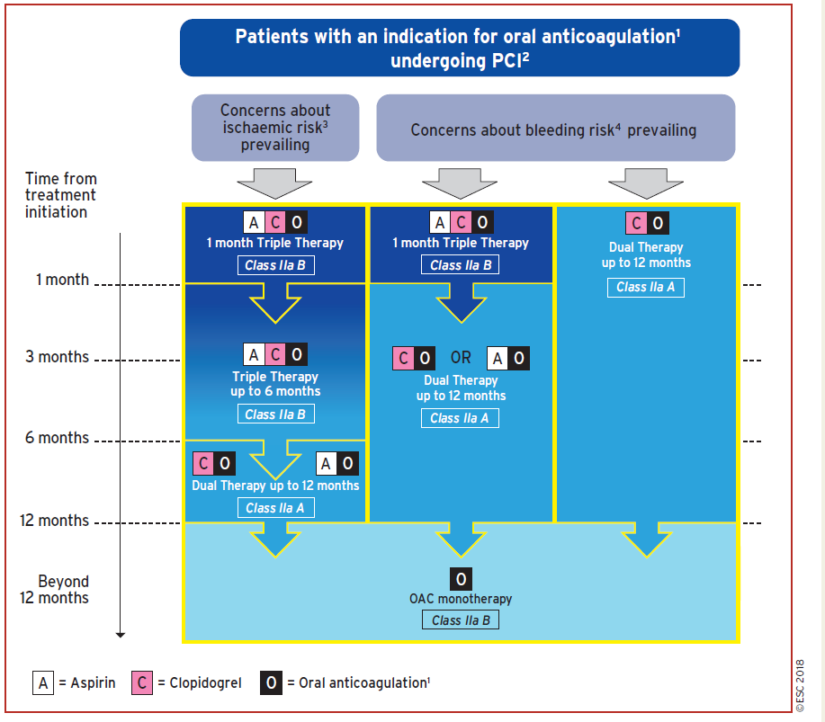
ESC revascularization guidelines 2018

Slide 43
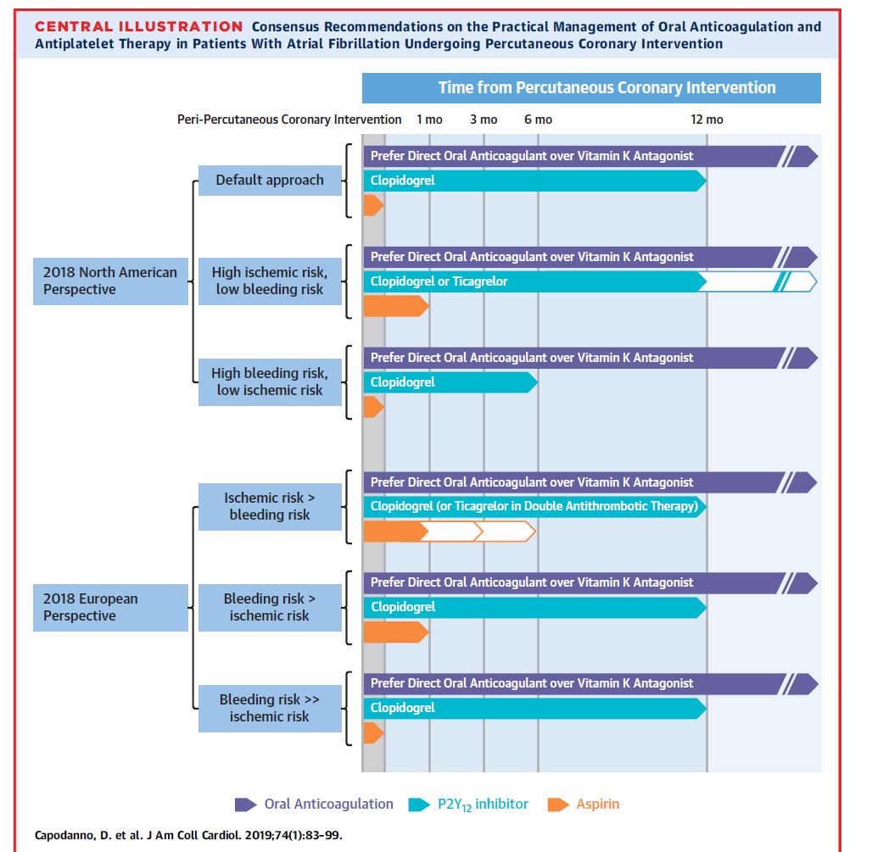

Slide 46
JACC 2019

Slide 47
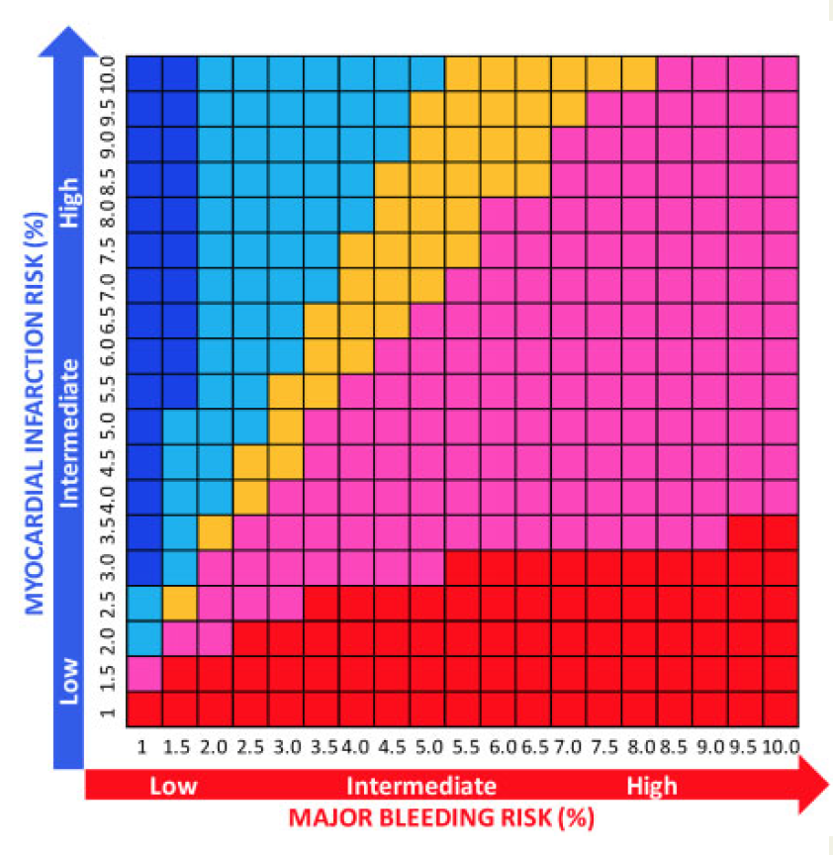
Net benefit and net harm
EHJ 2019

Slide 48
In Summary…
NOAC should be the anticoagulant of choice.
NOAC should be used at a dose shown to be effective
in AF trials.
A VKA based triple therapy should be avoided.
Clopidogrel should be the P2Y12 inh. Of choice since it was the most used.
Dual therapy is the best approach. This strategy does not imply abandoning aspirin in the peri-PCI period.

Slide 49
Dual Therapy should be the default strategy because…
Triple therapy is associated with increased risk of major bleeding (including intracranial).
Rate of stent thrombosis is low nowadays.
The AUGUSTUS trial has demonstrated that the benefit from aspirin is low…
Potent P2Y12 inh. (eg. Ticagrelor) can be used.
The guidelines recommend triple therapy for only high-risk specific cases for a short period of time…

Slide 50
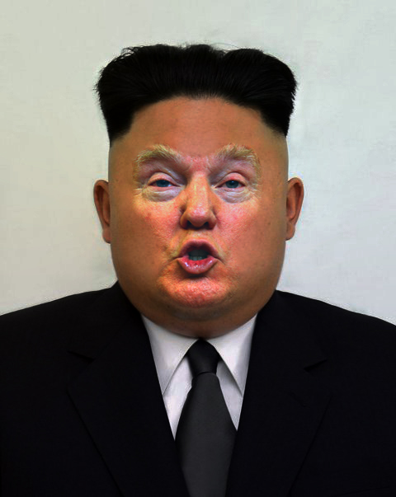

Slide 51
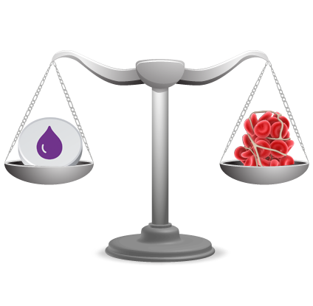
One size does not fit all…
Thank you

