Slide 1
Challenges in Prevention of Sudden Cardiac Death in 2020
Mahmoud Suleiman MD
Haifa, IL
Notes:
I will mainly talk about prevention of SCD in ischemic CM

Slide 2
SCD Prevention= ICD
Notes:
My focus will be on prevention of SCD in Post MI patients

Slide 3
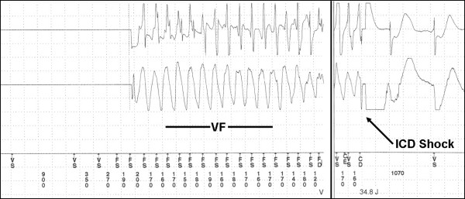

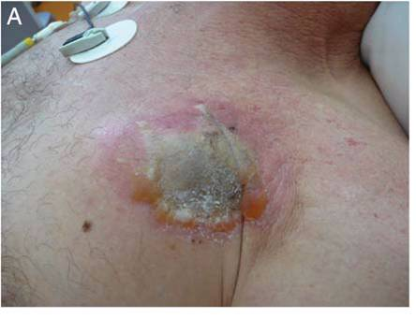
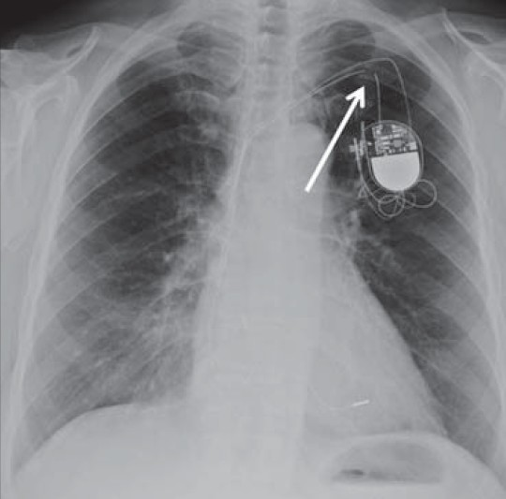
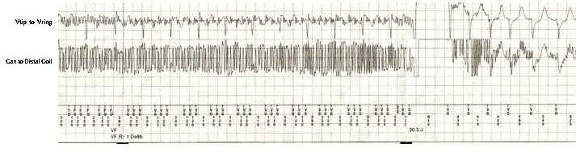
Notes:
There is strong evidence supporting the mortality beneﬁt of ICD in primary prevention of SCD in ischemic cardiomyopathy.

Slide 4
What Are The Challenges in 2020
The Need for Better Risk Stratification Tool(s)
Notes:
The big challenge is how to determine what is the patient’s risk for SCD

Slide 5
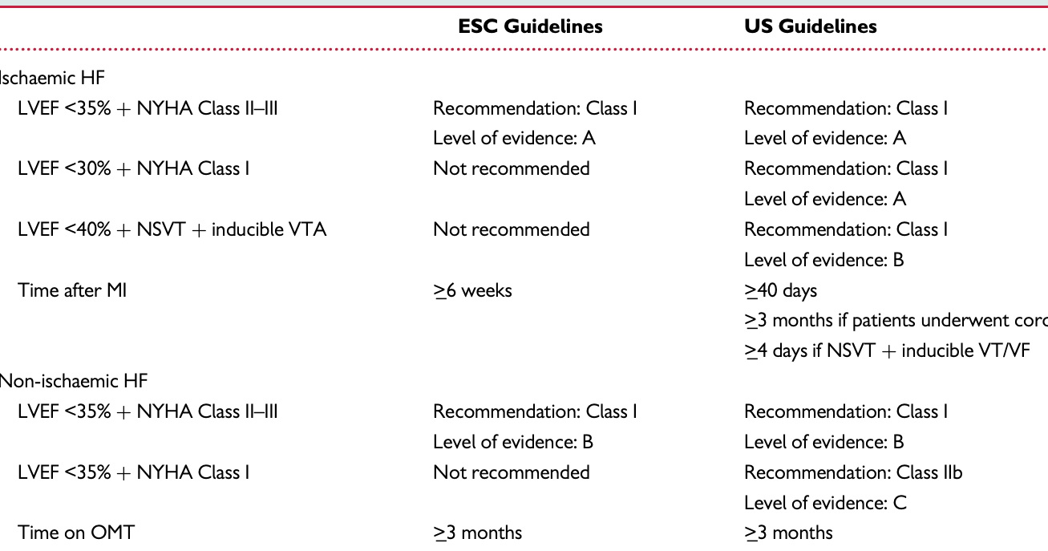
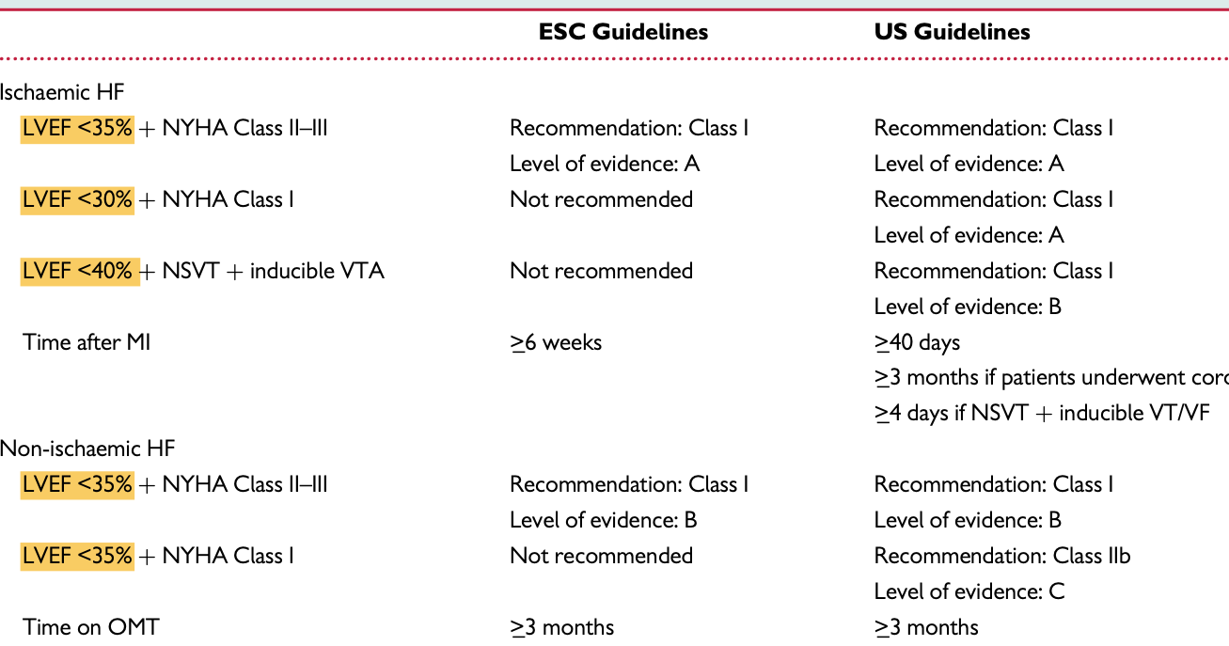
ICD for primary prevention of SCD
It is all about LVEF
Is LVEF the Optimal Risk Stratification Variable in Post MI?
Notes:
It is all about LVEF and I'm asking my self and you: How come that in 2020 we still rely on one single parameter for risk stratification?

Slide 6
Is LVEF the Optimal Risk Stratification Variable in Post MI?
  LVEF is a good predictor of all-cause mortality, cardiac mortality, and SCD
  Only ~20% of SCD patients had LVEF ≤35%
  Appropriate therapy occurs in less than a third of ICD recipients with LVEF ≤35%
  Many patients that could benefit from the ICD are missed (not covered by the guidelines), and many patients that will never benefit from the ICD are exposed to its risks and costs.
ATRAMI: La Rovere et al. Lancet 1998;.
ISAR-Risk: Bauer et al. Eur Heart J 2009;
Notes:
relying on LVEF alone for guiding selection of ICD candidates for primary prevention, may not be the ideal strategy.
In the Oregon Sudden Unexpected Death Study (2093 patients with SCD and 448 with echocardiographic data) only 20.5% of patients had LVEF ≤35%.
Furthermore, a number of studies have demonstrated that appropriate therapy occurs in less than a third of ICD recipients with LVEF ≤35% (while still exposing them to potential complications of the device). Accordingly, relying on LVEF alone for guiding selection of ICD candi- dates for primary prevention, may not be the ideal strategy.
many patients that could benefit from the ICD are missed (not covered by the guidelines), and many patients that will never benefit from the ICD are exposed to its risks and costs.
The problem with promoting trials that solely determine whether a broad-based population (identified by one parameter such as ejection fraction that bears no direct relation to the pathogenesis of arrhythmias) derives a survival benefit from a therapy such as the ICD, is that many patients that could benefit from the ICD are missed (not covered by the guidelines), and many patients that will never benefit from the ICD are exposed to its risks and costs.

Slide 7
Use of LVEF to risk stratify patients for sudden death has significant limitations
LVEF<35%
High risk for VF/VT SCD
High risk for non VF/VT SCD
Low risk for VF/VT SCD
ICD
Notes:
Our guidelines recommend ICD implantation for all patients with LVEF below 35%.
Beyond ensuring that patient characteristics qualify them for an ICD for primary prevention, it would be important to understand
how case mix in the real world compares with case mix in the randomized trials that provide the data supporting the guidelines. In particular, are patients who stand to benefit the most receiving the majority of devices, or is it patients for whom the benefit is more questionable?

Slide 8
Use of LVEF to risk stratify patients for sudden death has significant limitations
LVEF<35%
High risk for VF/VT SCD
High risk for non VF/VT SCD
Low risk for VF/VT SCD
ICD
Notes:
Our guidelines recommend ICD implantation for all patients with LVEF below 35%.
Beyond ensuring that patient characteristics qualify them for an ICD for primary prevention, it would be important to understand
how case mix in the real world compares with case mix in the randomized trials that provide the data supporting the guidelines. In particular, are patients who stand to benefit the most receiving the majority of devices, or is it patients for whom the benefit is more questionable?

Slide 9
Use of LVEF to risk stratify patients for sudden death has significant limitations
LVEF<35%
High risk for VF/VT SCD
High risk for non VF/VT SCD
Low risk for VF/VT SCD
ICD
Notes:
Our guidelines recommend ICD implantation for all patients with LVEF below 35%.
Beyond ensuring that patient characteristics qualify them for an ICD for primary prevention, it would be important to understand
how case mix in the real world compares with case mix in the randomized trials that provide the data supporting the guidelines. In particular, are patients who stand to benefit the most receiving the majority of devices, or is it patients for whom the benefit is more questionable?

Slide 10
Need for improved risk stratification models
Low risk for VF/VT SCD
LVEF<35%
High risk for VF/VT SCD
High risk for non VF/VT SCD
Novel risk markers
ICD
competing risk factors

Slide 12
Contemporary HF Patients
Current indications for implanting ICDs are based on trials conducted 15–20 years ago.
Patient characteristics have changed over decades.
Today, prognosis in HF patients is markedly better with longer survival and lower risk of SCD

Slide 13
Our whole treatment has changed…
Beta-blockers
Mineralocorticoid antagonists
ARNI
Statins
Primary revascularization at myocardial infarction
…
Effect not only on mortality but… specifically on sudden cardiac death

Slide 14
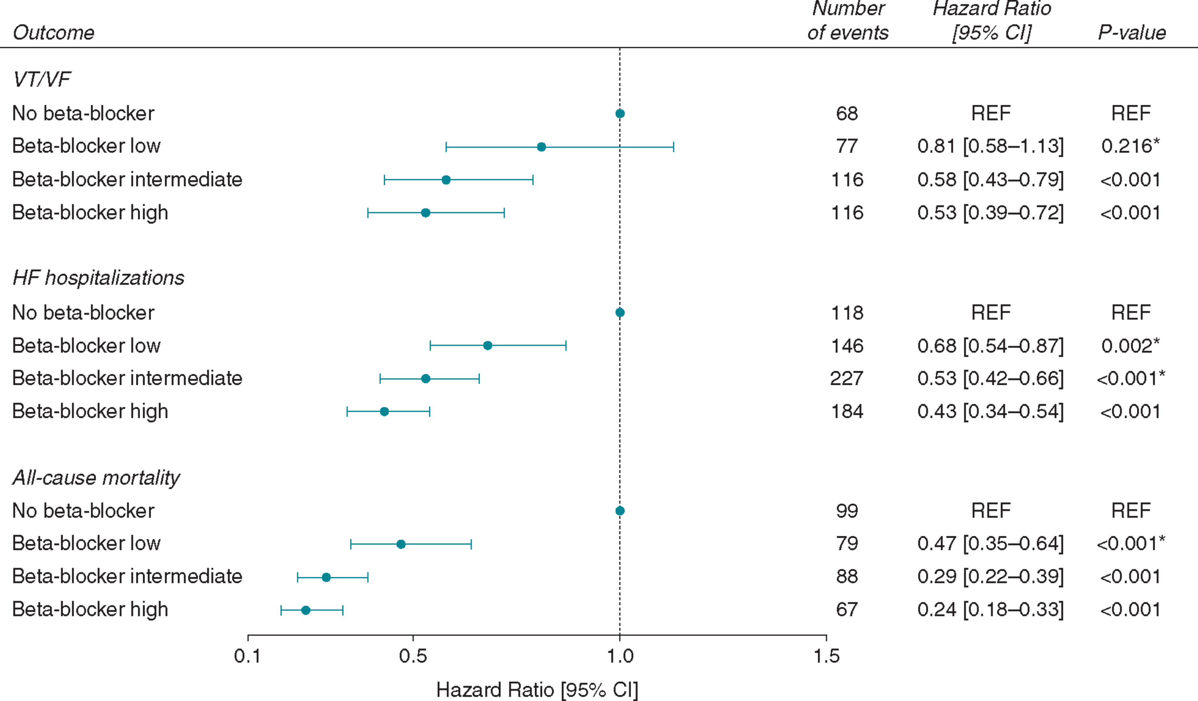
Beta blocker dosage and sudden death

Slide 15
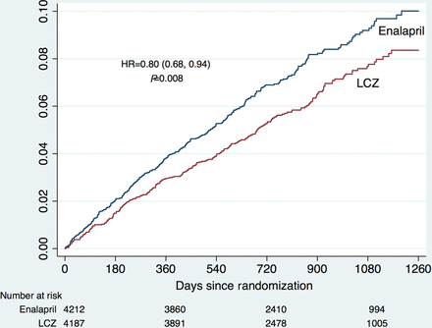
Angiotensin-Receptor-Neprilysin Inhibitor (ARNI) and SCD
PARADIGM-HF. Desai AS et al. Eur Heart J 2015

Slide 16
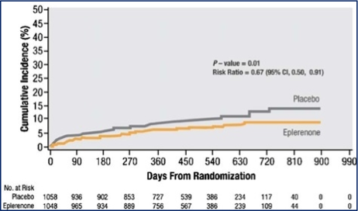
Eplerenone and SCD
EPHESUS Trial. Pitt B et al. Eur J Heart Fail 2006;8:295-301

Slide 17
NEJM 2017

Slide 18
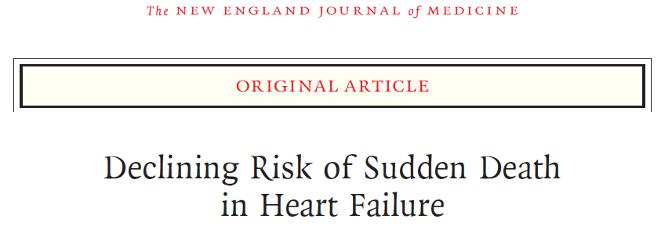
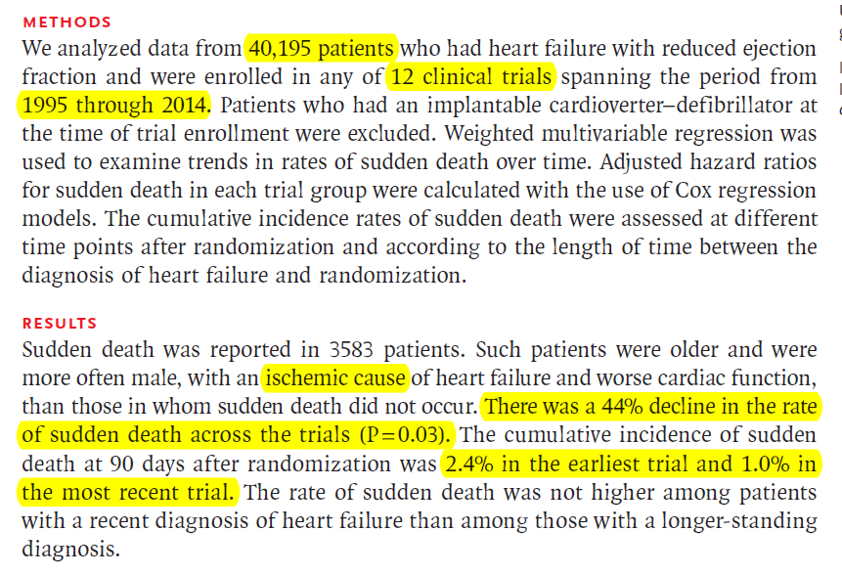
Notes:
In an analysis of over 40 000 patients with HFrEF enrolled in 12 non-ICD clinical trials, a significant 44% decline in the rate of SCD across these trials was observed

Slide 19
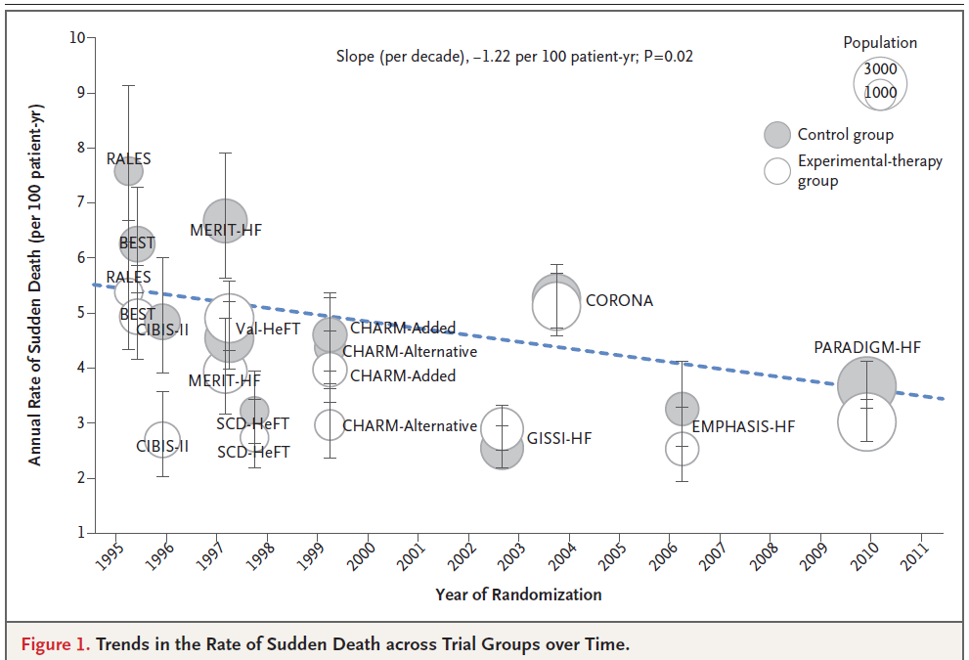
MADIT II
SCD-HeFT
44% decline in the rate of SCD

Slide 20
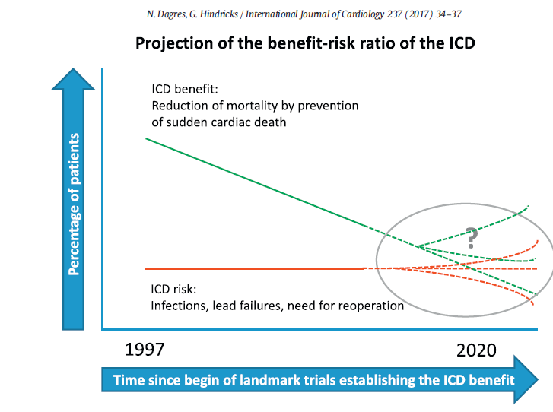
MADIT II
SCD-HeFT
Notes:
The decreased risk of sudden death in contemporary trials involving patients with a high use of guideline-recommended therapies, coupled with data from previous trials and registries on the likely benefits and complications of ICDs, suggests that it may be difficult to show a significant benefit of ICD implantation for primary prevention in most patients with heart failure with reduced ejection fraction in the current era.
new efforts are needed to find a high-risk subgroup of patients who benefit from ICD implantation and in whom it is cost effective, particularly in patients with nonischemic cardiomyopathies

Slide 21
CRTD or CRTP?

Slide 22
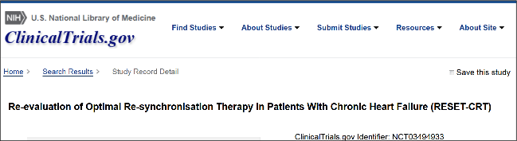
RESET-CRT randomized trial
2.030 patients with CRT indication randomized 1:1 CRT-D vs CRT-P
Primary endpoint: total mortality
Recruitment ongoing

Slide 23
RISK in LVEF>35%

Slide 24
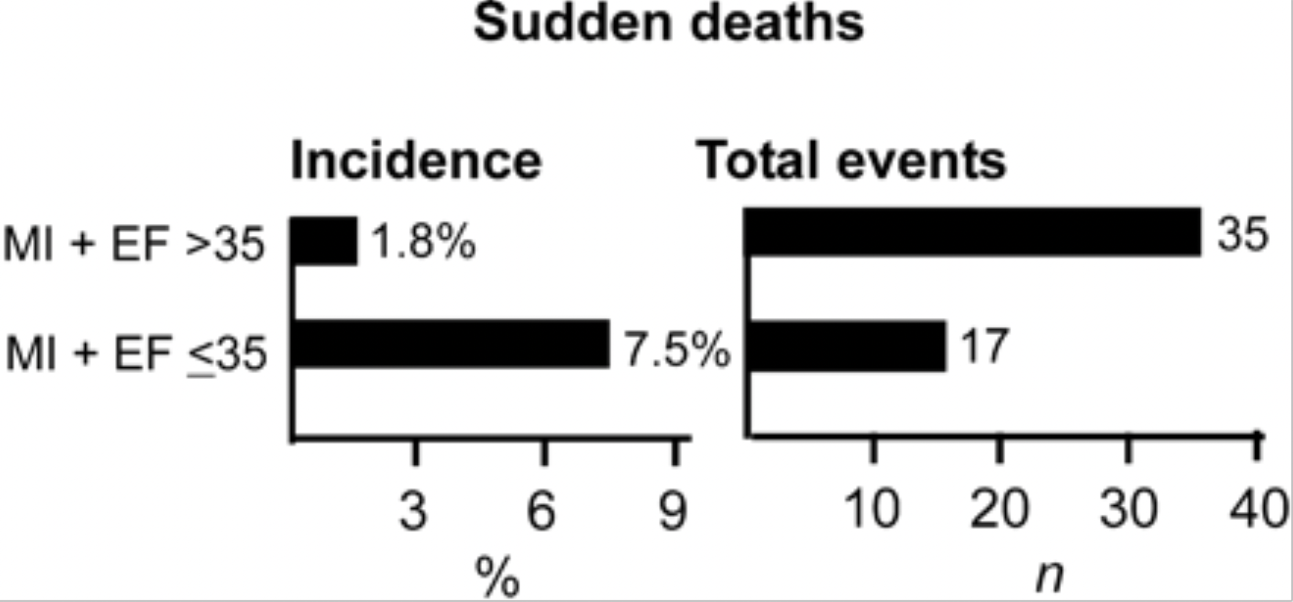
Risk in patients with ejection fraction > 35%
How can we prevent SCD in patients with moderately reduced or preserved ejection fraction?
Makikallio TH et al.
Eur Heart J. 2005;26(8):762-769

Slide 25
These findings, together with the negative results of the DANISH trial, bring into question whether primary prevention ICD therapy would have the same mortality benefit as was observed in earlier ICD trials, and stress the need for more contemporary risk stratification approaches to ICD therapy

Slide 26
Machine Learning in Sudden Cardiac Death Research
PROFID

Slide 27
What is our Intention?
To personalize the prediction of risk for SCD in post-infarction patients
Based on this, to personalize the prevention of SCD by ICD implantation

Slide 29
PROFID
First part
Analysis of existing data in postinfarct patients
Second part
Development of clinical prediction model for prediction of the individualized risk for SCD
Third part
Two randomized trials, 4000 patients:
EF <35% - low risk
Non-inferiority design: defibrillator versus optimal medical treatment
EF>35% - high risk:
Superiority design: defibrillator versus optimal medical treatment

Slide 30
Analysis of existing data
Registries of consecutive post-infarct patients
Registries of patients with primary prevention ICD
Electronic health records
Claims data
Previous randomized trials (MADIT series)
> 1.000.000 patients

Slide 31
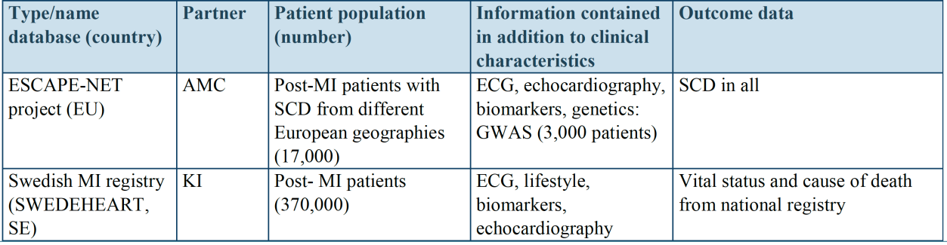

Slide 32
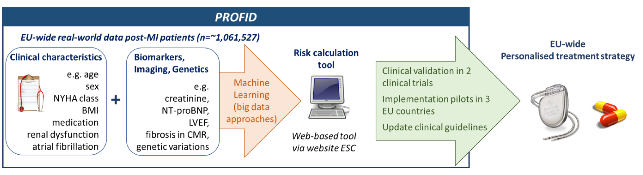

Slide 34
Future directions for combined risk assessment for sudden cardiac death

Slide 35
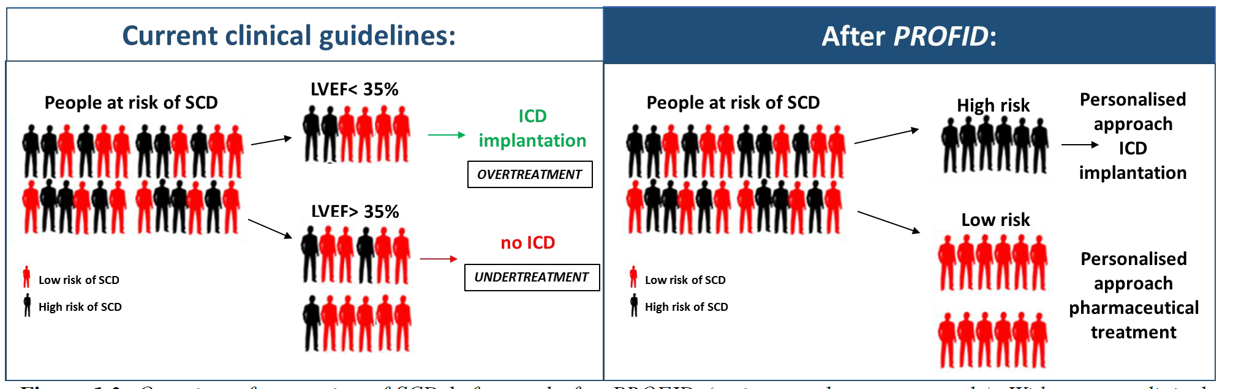
Ambition

Slide 36
Challenges in Prevention of Sudden Cardiac Death in 2020
Mahmoud Suleiman MD
Haifa, IL

Slide 37
No single test alone is likely to provide adequate risk strati cation
New Approaches to Risk Stratification
Electric properties
Sympathetic Innervation,
anatomy, structure
Clinical markers
Genetic markers
Biomarkers
Autonomic effects
Notes:
Cardiac anatomy/structure
imaging infarct size and characteristics or assessing sympathetic innervation
Electric properties—depolarization and repolarization
QT interval, QT variability, T wave alternans, QRS durution and fragmentation
Several reports20,21 suggest that no single test alone is likely to provide adequate risk strati cation

