Slide 1
Real World ICD Practice :
An Overview of The Results of The Israeli ICD Registry
Prof Michael Glikson, MD, FACC, FESC
Past President of Israel Heart Society
Director of Jesselson Heart Center
Shaare Zedek Medical Center
Jerusalem, Israel
11-2019
Notes:
Thank Dr Chinitz and staff and Biotronik for the invitation to come back …
I will present to you a seven year continuous registry of ICDS in Israel as a mean to learn about contemporary real world practice , and how we used it to answer several ongoing debates in ICD practice .

Slide 2
Presented On Behalf of the IWGPE Registry Scientific Committee ¹
and
Israeli Center Cardiovascular Research ²
M Sulleiman , M Haim, J Schliamser, R Rosso ¹
Ilan Goldenberg , Shlomit Ben Tzvi , Lizy Kimron , Robert Klempfner ²

Slide 3
Israeli ICD Registry
Launched in July 2010 , data locked in June 2017
Voluntary registry organized by IWGPEP with technical assistance of device companies
Online reporting at the end of each high power device procedure on site
Web-based secured database
No data collected on complications, commercial information kept confidential , medical centers de-identified in the report
Support by the IWGPEP , device companies, Israeli CDC and the major HMO
Yearly follow up started 7-2011
Notes:
Good will of centers and companies , reps are present in all high power implantations in Israel
Aimed to get real life data on pertinent issues in the world of ICDS
All ICD implantations are pre authorized so you cannot bypass the guidelines

Slide 4
Follow-Up
The registry headquarters issued a quarterly request of follow up data (in 17/24 hospitals) starting one year following the implantation
Sources of follow up data vary between centers and include real time data entry during ICD clinic visits (67%), chart review (64% ) and phone interview (14% ) .

Slide 5
Statistics 7/10-6/17
N = 9256 new implants in 24 hospitals
Median age = 64.7 , 83% male
4.5% upgrades from pacemakers
77% primary prevention (72.6% 80.3%)
Total no. of pts with follow-up = 5839 from 17 hospitals
Median follow up time = 25.4 months
Notes:
ICD Implantations are preauthorized so we have to stick to guidelines

Slide 6
Implantation by Medical Centers

Slide 7
NYHA Class
7/2010-6/2011
7/2016 -6/2017

Slide 8
LVEF
7/2016-6/17

Slide 9
Etiology
38% IVF, 26% LQT, 13% Brugada
Among CAD pts 8% received the ICD within less than 40 days from MI , 17% within 3 m from last PCI , 10% within 3 m from last CABG

Slide 10
Atrial Fibrillation
Overall incidence = 20%
PAF = 53%
Persistent = 15%
Permanent = 30%
Undocumented 2%

Slide 11
Published Studies from Israeli ICD Registry
2014
2014
2014
2014

Slide 12
Published Studies from Israeli ICD Registry
2015
2015
2015
2015

Slide 13

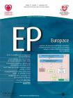
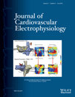
Characteristics and outcomes of diabetic patients with an implantable cardioverter defibrillator in a real world setting: results from the Israeli ICD registryin a real world setting: results from the Israeli ICD registry
2016
2016
Contemporary rates and outcomes of single- vs. dual-coil implantable cardioverter defibrillator lead implantation: data from the Israeli ICD Registry.
2016
Morbidity and mortality with cardiac resynchronization therapy with pacing vs. with defibrillation in octogenarian patients in a real-world setting
2016
Clinical Outcomes of Single- versus Dual-Chamber Implantable Cardioverter Defibrillators: Lessons from the Israeli ICD Registry.
Arrhythmic burden among asymptomatic patients with
ischemic cardiomyopathy and an implantable
cardioverter-defibrillator
2019
2018
Developing a risk score to predict mortality in the first year after implantable cardioverter defibrillator implantation:
Data from the Israeli ICD Registry

Slide 14
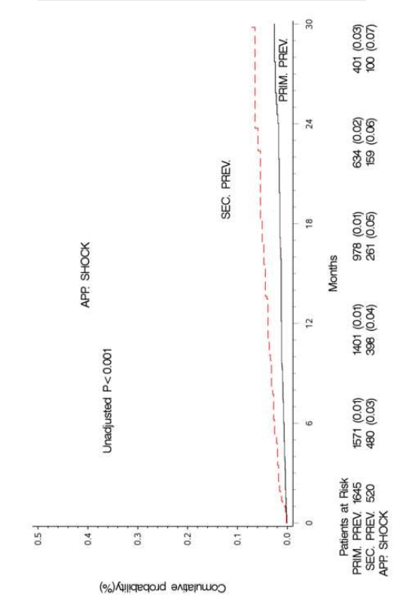
Appropriate
Inappropriate
HRJ 2015 , n = 2400
Notes:
Appropriate ICD shock: 1.1 % per year (primary prevention) 3.8% per year sec prevention
If we look at shocks as true salvage there will be 95% of patients of the primary prevention group that will reach EOL without life saving therapies
Rates of “life saving” shocks in our study is significantly lower than reported in the literature

Slide 15
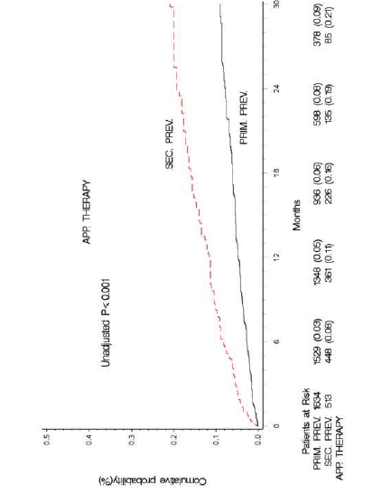
Low Rate of Therapies over Time
(n=2600 pts )
Sabbag et al , HRJ 2015
Notes:
2600 pts

Slide 16
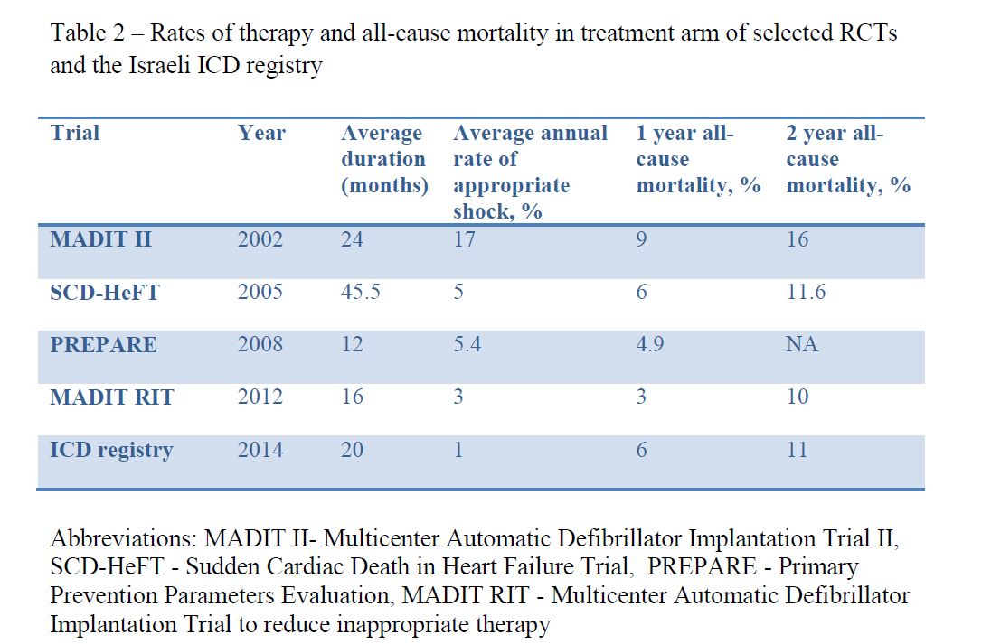
Results in Comparison to Other Studies
Sabbag 2015

Slide 17
Explaining Low Shock Rates
Long detection times
High rate cutoffs
Optimal medical therapy
> 40% CRTD
Overtreatment - need to reassess contemporary indications and selection criteria for primary prevention
Notes:
Cannot exclude underreporting

Slide 18
How Can we Improve Efficacy of Primary Prevention ICDs ?
Change the guidelines to exclude borderline indications
New studies to test classic indications based on EF and NYHA only (Danish trial in NICMP, other new trials in ICMP patients )
Use combined risk scores for selection

Slide 19
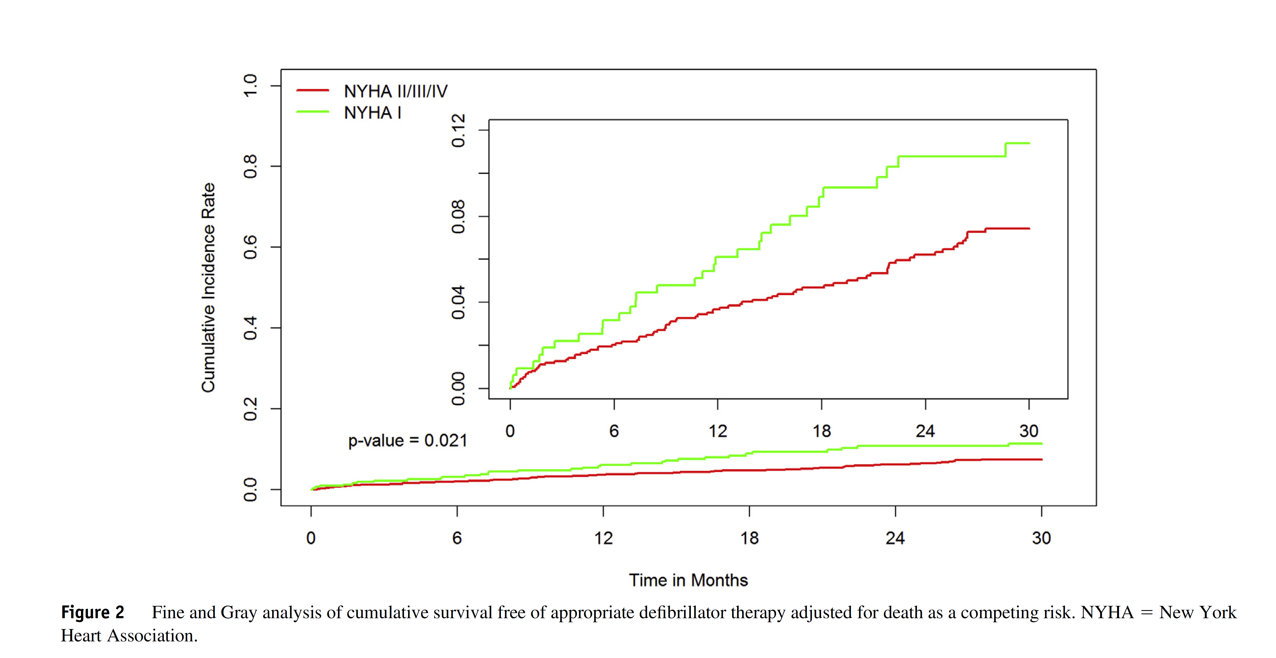
Notes:
Our data support ICDS in Ischemic CMP at NYHA I

Slide 20
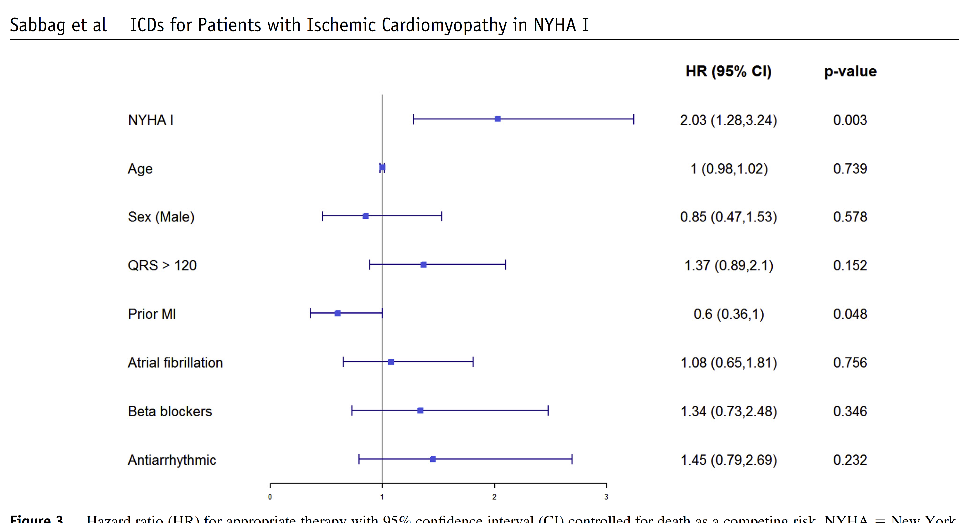
Risk Factors for Appropriate Therapies

Slide 21
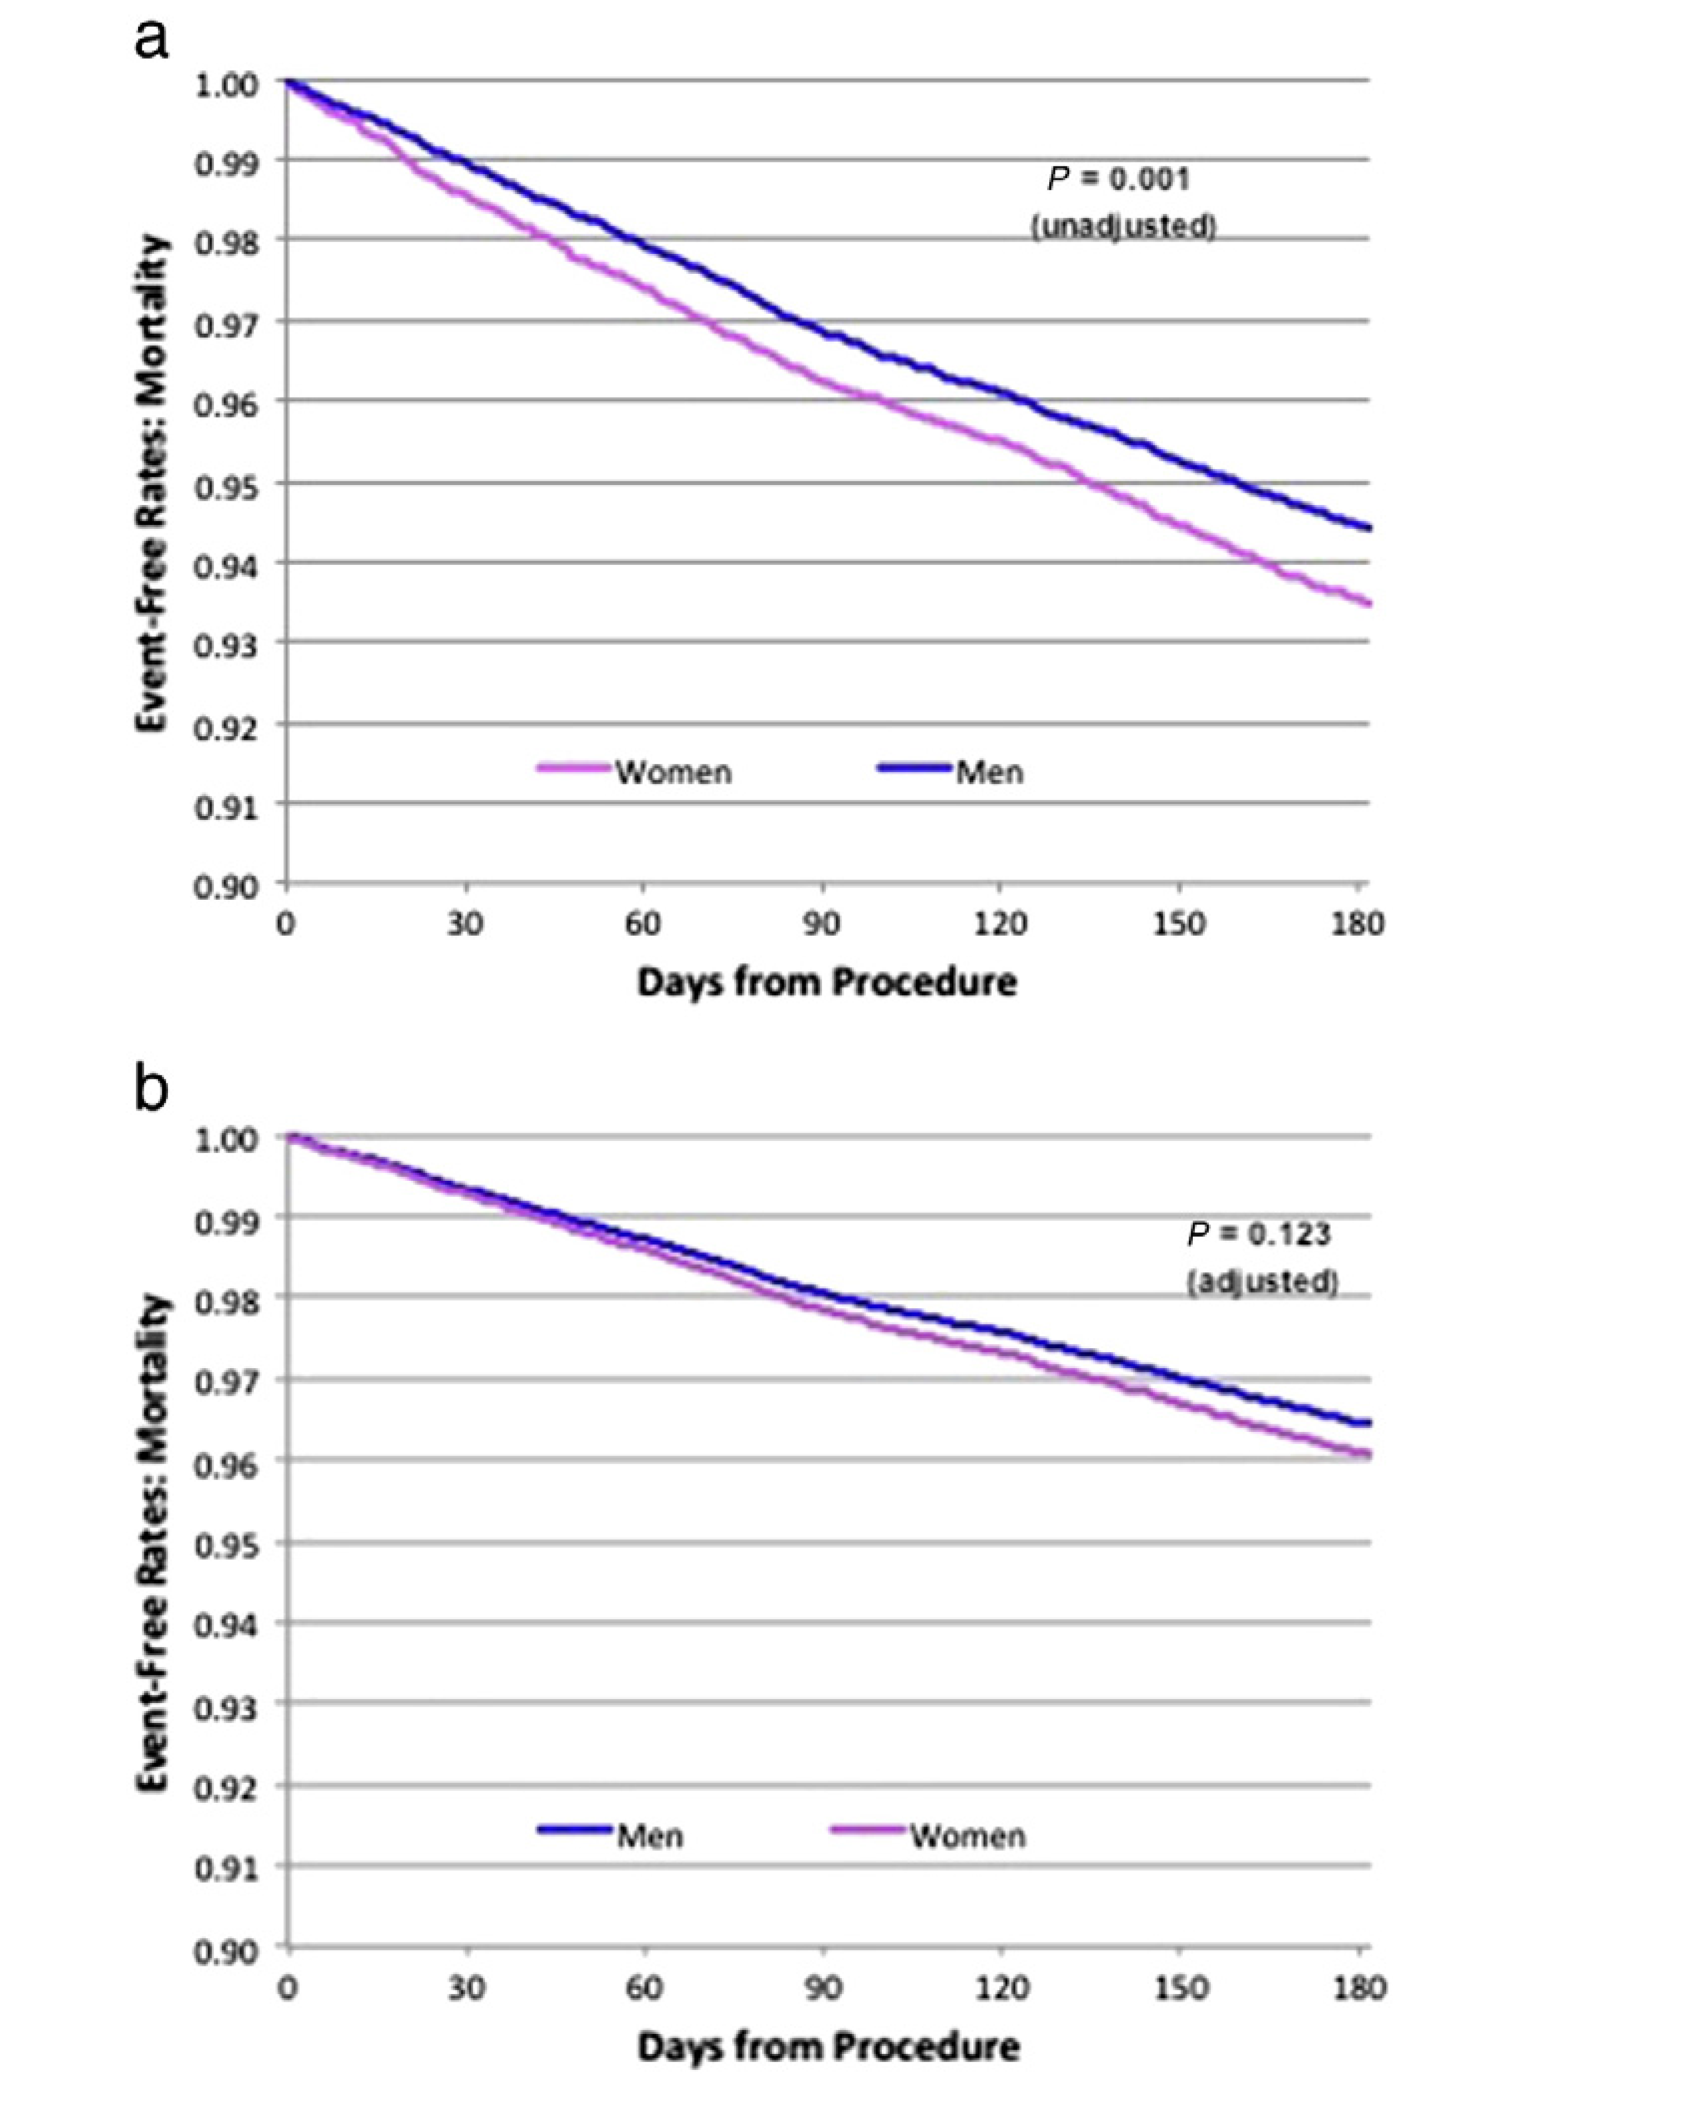
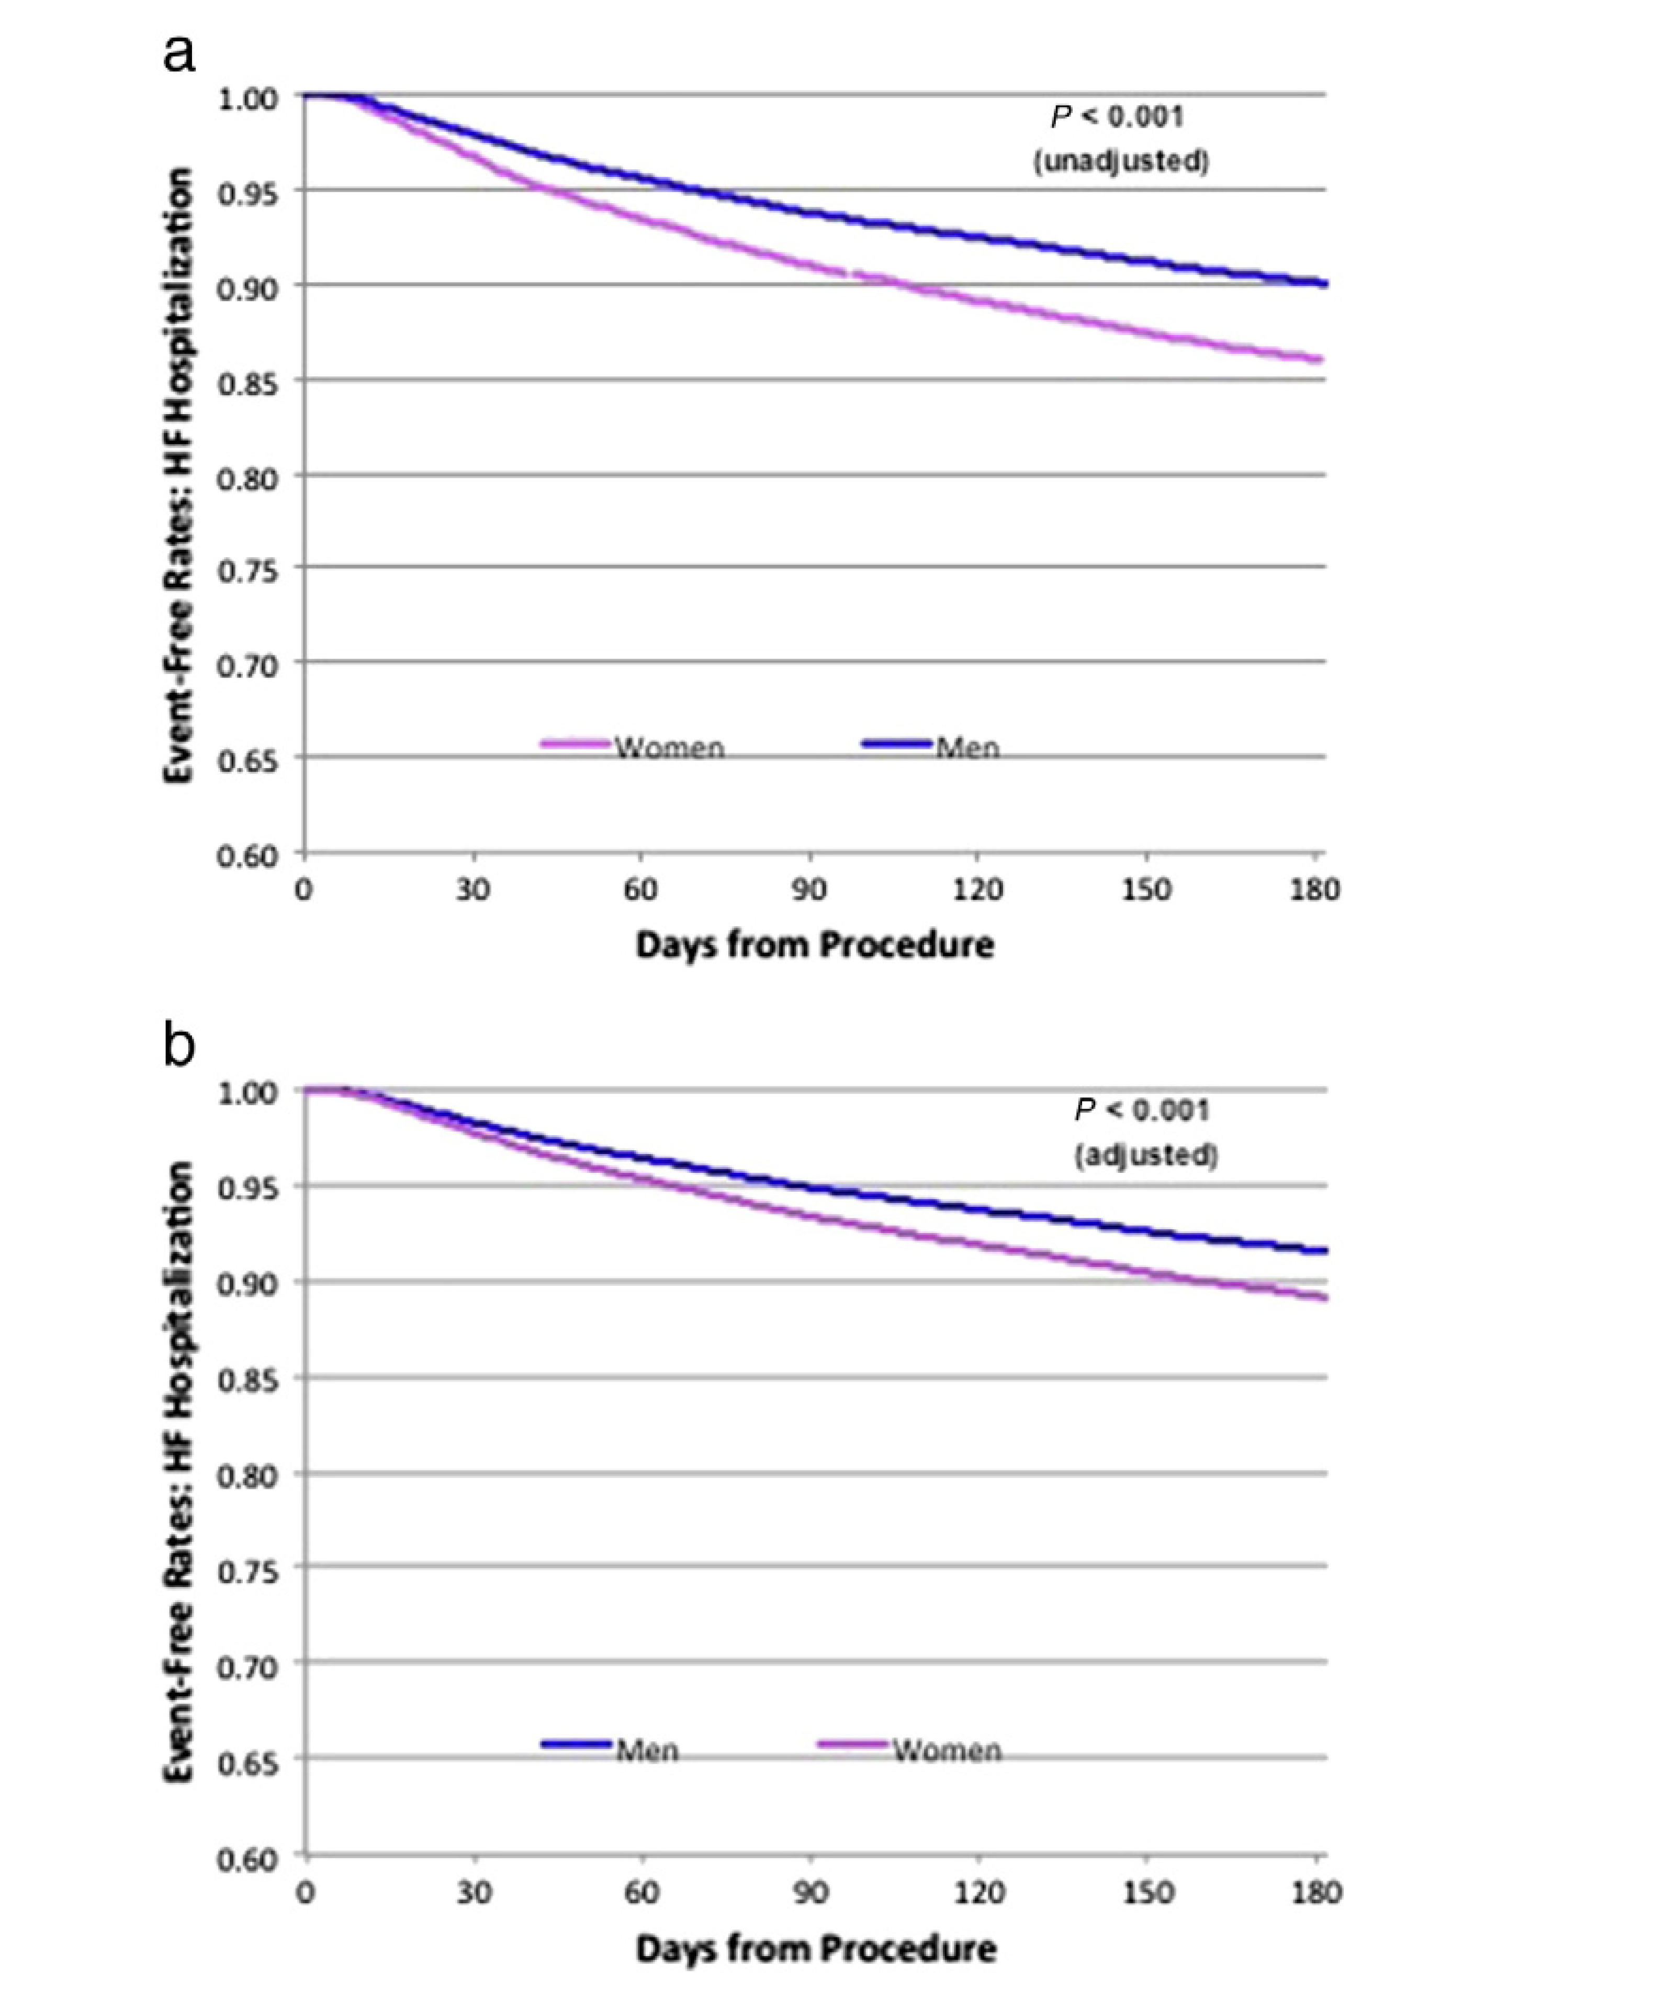
Gender and Outcomes in US NCDR
Russo 2015
Notes:
38000 initial implant for prim prevention (25% women ) NCDR database
Same age
It has been shown in several studies as well as metaanalyses that ICD benefit is lower in women )
less likely to die of SCD or device treatable conditions
Complication rate is higher

Slide 22
Europace 2014

Slide 23
Follow up Male vs Females
Notes:
In real-world setting,womenimplanted with anICDdiffer significantly frommenin their baseline characteristics and in the
use of CRTD devices. These, however, did not translate into outcome differences

Slide 24
AHA ACC HRS GL 2017
Prevention of SCD in CKD
Writing committee concluded there was not enough data to inform a recommendation on ICD implantation in patients with ESRD on dialysis.
Decisions regarding ICDs in patients with CKD, especially those with ESRD, should be individualized and take into consideration the patient’s functional status, number of comorbidities, and preferences, among other
factors.

Slide 25
Why Primary Prevention by ICDs may not Benefit Severe CKD patients ?
Competing risks :
  Non cardiac death
  Cardiac non arrhythmic death
  EMD and asystole as frequent causes of death
  Device complications?
Wrong risk stratification schemes ?

Slide 26
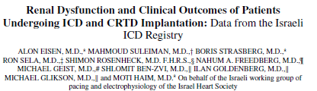
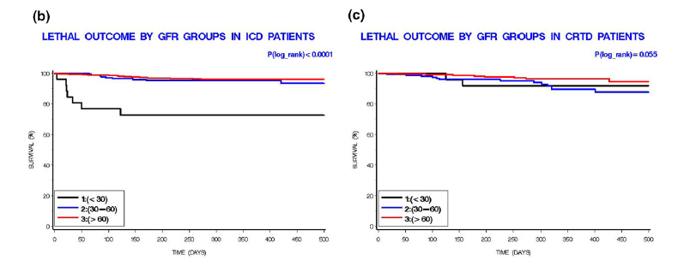
N = 711 pts , 54 with GFR<30
JCE 2014
Notes:
CKD is associated with adverse prognosis after ICD implantation with several series reporting no benefit
We demonstrated lower benefit of ICD in the presence of severe CKD, but not after CRTD implantation. GFR decreased in patients with ICD, but not in CRTD

Slide 27
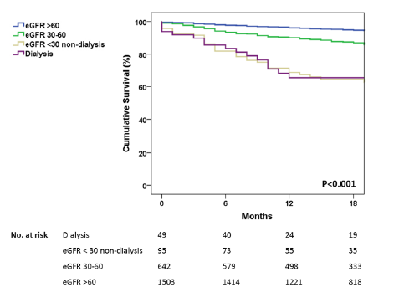
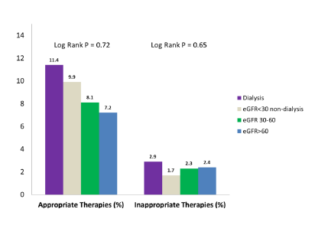
N = 2289 AM J Nephrol 2015
Notes:
95 pts with severe CKD (GFR< 30)
49 pts on dialysis
There was no difference between severe CKD and dialysis pts as far as survival or therapies

Slide 28
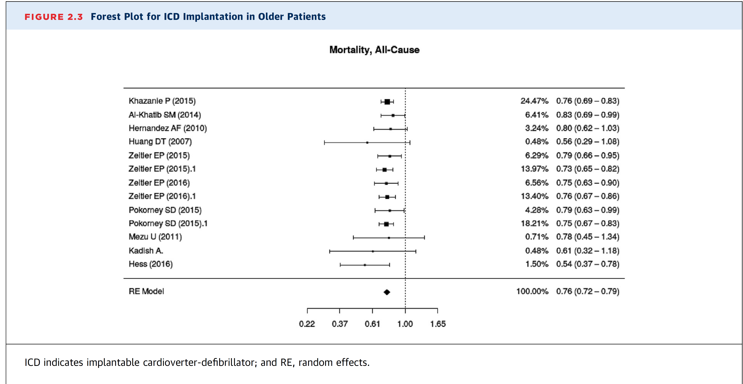
ICD in the Elderly
Conflicting results of meta-analyses of primary prevention ICDS in the elderly
Notes:
The role of the evidence review committee of the 2017 guideline group

Slide 29
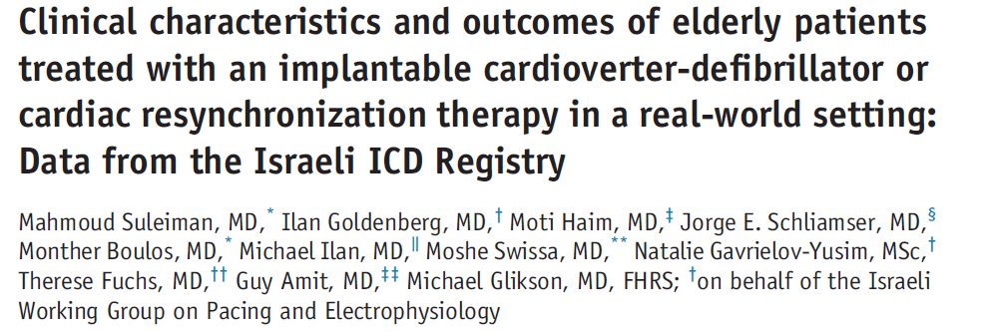
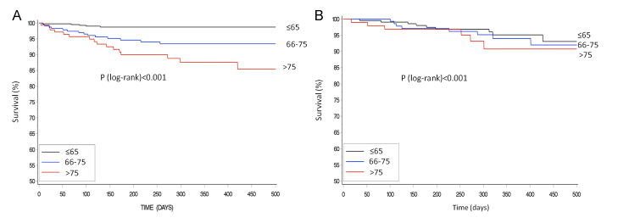
ICD recipients
CRTD recipients
N=2807 , 20% > 75 yo
HRJ 2014
Notes:
75 yo
CRT attenuated the difference in mortality between the aged and the others

Slide 30
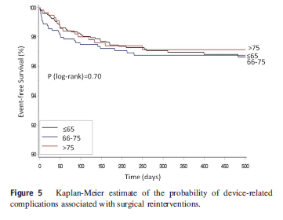
Elderly – Device Related Complications
Notes:
Complication rate was similar

Slide 31
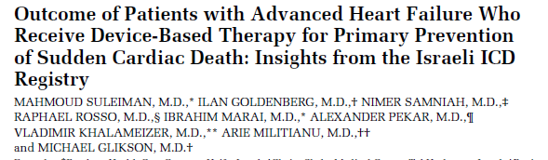
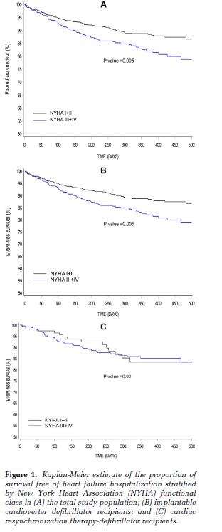
N=913 , PACE 2015

Slide 32
VF Testing During Implantation ?
Notes:
Very hottopic in the past after several early series that showed increased mortality with high DFTS
Followed by many registries and small studies that questioned the value and safety of VF testing

Slide 33
VF testing over the years
YEARS
Notes:
Practice of VF testing has been questions due to lack of relevance with contemporary devices ans the risk of testing
The Simple and the Nordic ICD trials buried the practice of DFT testing .
Overall rate of VF testing in replacements 3% is an issue for concern .
We are conducting the Simpler trial for replacements

Slide 34
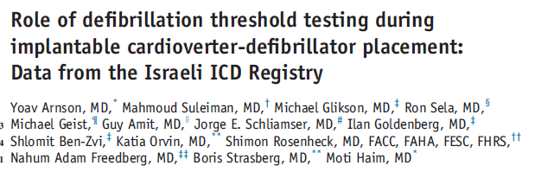
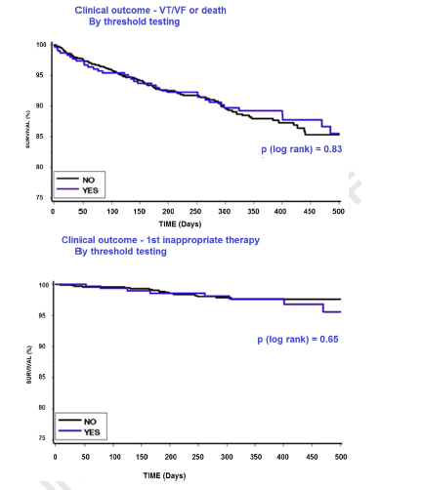
Total No = 3596
No VF testing = 614 (17%)
HRJ 2014

Slide 35
Device Types Over the Years
2011
2017
Notes:
Change into device type over the years

Slide 36
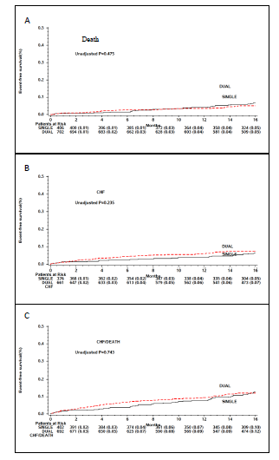
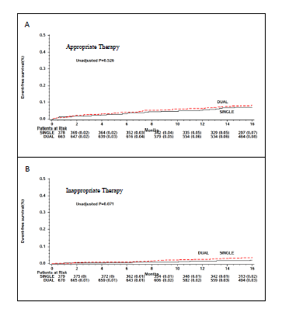
N = 1125 , JCE 2016

Slide 37
N=6343
Europace 2016
Notes:
Dual coil commonly used for allegedly lower DFTS
We came to realize that it affects extraction

Slide 38
Long term Follow up (n=2285)
Notes:
The use of single coil ICD leads is increasing despite decreasing use of DFT testing .
This trend does not increase the long term risk

Slide 39
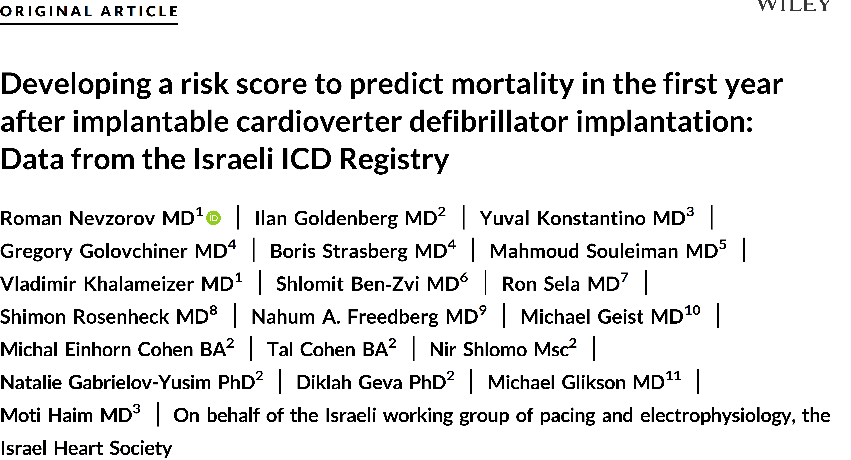
This study sought to construct a risk score for one year mortality following ICD implantation
2600 patients with one year follow up were used (half for initial cohort , half for validation)
4.8 % of patients died within one year
They were compared with patients who survived one year looking at risk factors for one year mortality

Slide 42
The SHOCKED Risk Score
>75 years
heart failure (NYHA FC III)
AF
COPD
CKD
LVEF ≤20%
Diabetes mellitus
Highest risk group:
1 y mortality = 30%
2y mortality = 47%
3y mortality = 68%
Bilchick JACC 2012

Slide 43
Conclusions I
Using registry information we were able to show:
  Very low rate of delivered ICD therapies
  Benefit of ICD in ICMP in NYHA I
  CRTD usefulness in CKD patients
  No difference between dialysis patients and non dialysis patients with severe CKD
  Advantage of CRTD in the elderly
  Advantage of CRTD in advanced CHF
  Lack of effect of VF testing as well as the use of dual chamber/dual coil ICDs

Slide 44
Conclusions II
Primary prevention indications should be reassessed in view of the very low rate of appropriate therapies in contemporary series
The emerging role of SCICDs and their long term outcomes remain to be established

Slide 45


Slide 46
Thank You !!
mglikson@szmc.org.il

