Slide 1

Hemodynamic Support During VT Ablation: When and How?
Eyal Nof M.D
Director of Invasive Electrophysiology Service
Davidai Arrhythmia Center, Leviev Heart Center, Sheba Medical Center, Tel-Hashomer, Israel

Slide 3
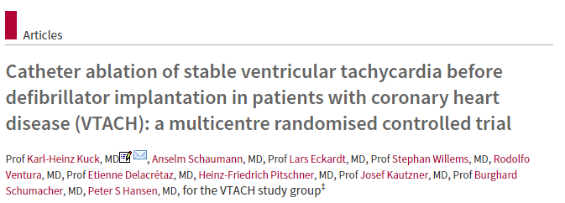


Slide 4
How at perform VTA?
Options:
Avoid GA
Substrate only
Mechanical support
OR..
1+2+3

Slide 5
Prospective study:
Retro study:
90% of the pts under GA
needed inotropic support vs.
50% under IVCS (p=0.03)!!

Slide 6
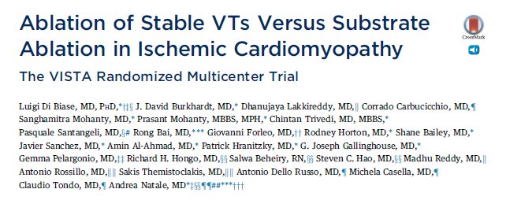
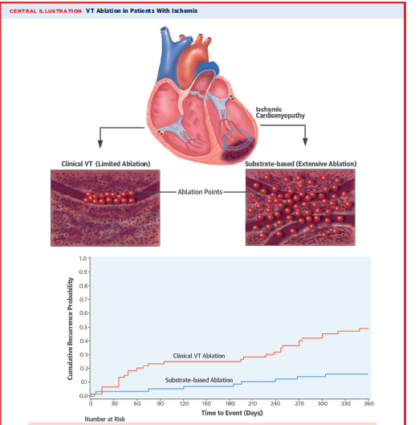

Slide 7
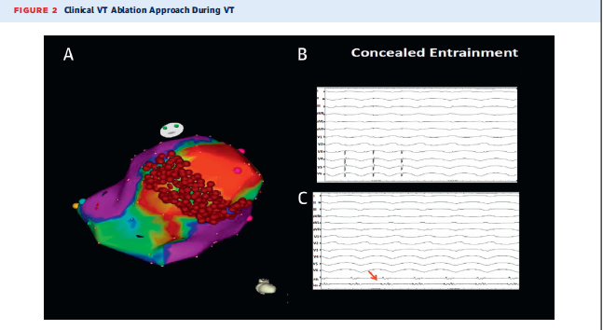
Which approach was used here?

Slide 8
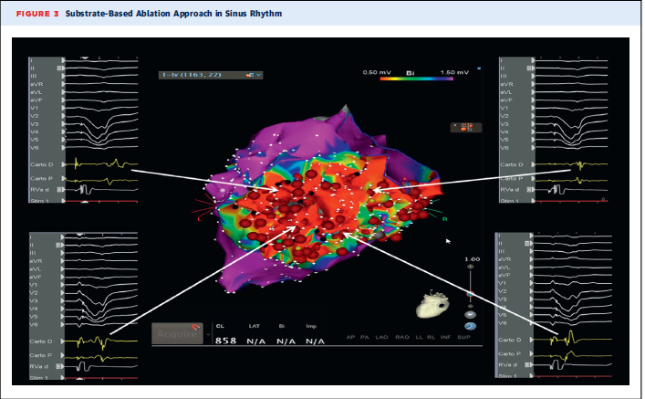

Slide 9
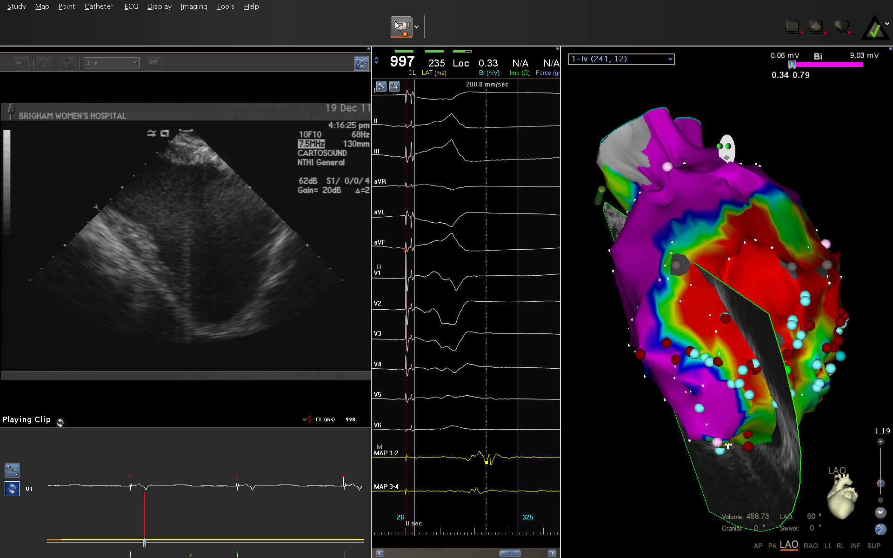
1. What about this scar???

Slide 11
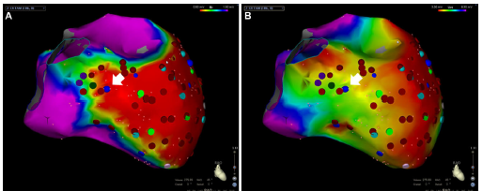

Slide 12
DCMP

Slide 13
Sy
End
Point
Substrate
Activation

Slide 14
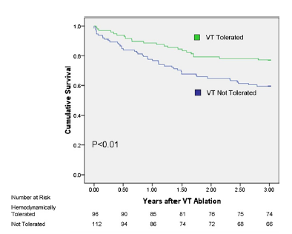
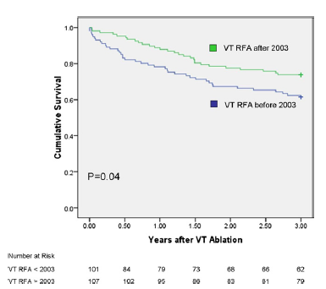
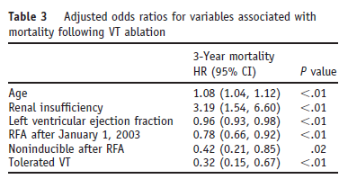
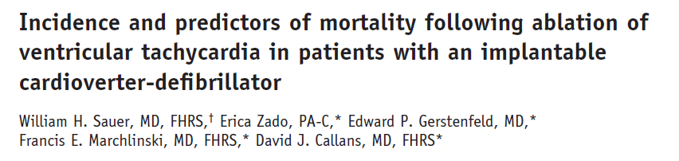
2. You will need to induce VT to check inducibility

Slide 15
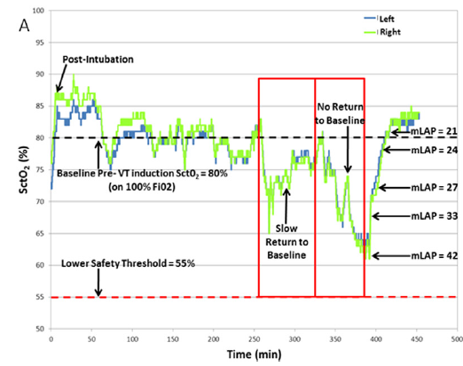
Bilateral SctO2 curves correlated with mean left atrial pressure
3. You can’t always avoid VT and need for shocks
Notes:
Bilateral cerebral tissue oxygen saturation (SctO) curves of the case, and correlation between comparatively low SctO values during sinus rhythm and elevated mean left atrial pressures at the end of the case—in the context of extensive entrainment and activation mapping. Note that the return of SctO2 to baseline values, following each episode of VT, is comparatively slower as the case progresses. After the last episode of VT, the full performance level of the pLVAD was maintained for approximately 30 minutes prior to explant, which permitted the return of both the SctO2 and mean left atrial pressures to their baseline values. The patient was successfully extubated at the end of the procedure.

Slide 17
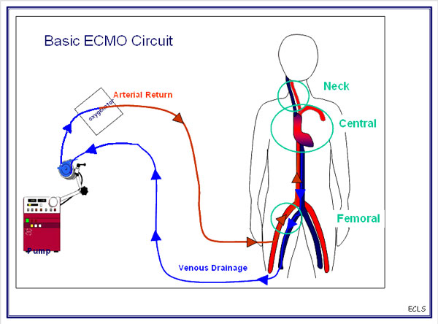
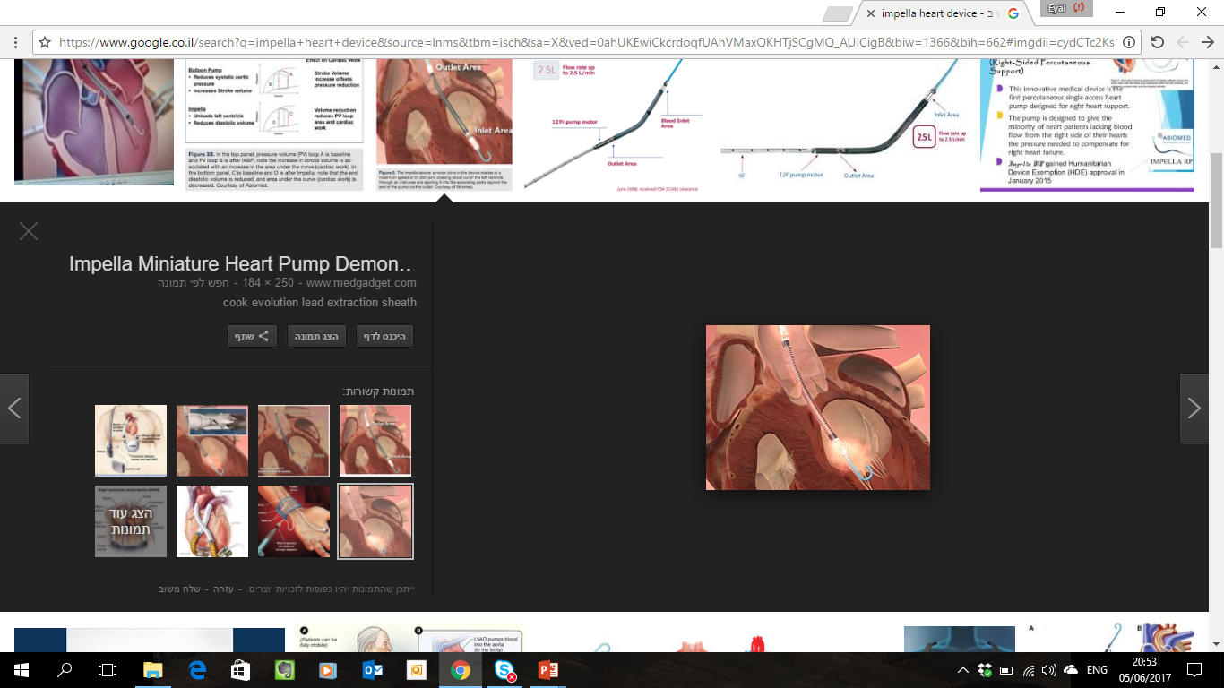
ECMO:
Impella:

Slide 18
Mechanical support may:
Facilitate extensive activation mapping of unstable ventricular tachycardia (VT)
Provide hemodynamic support
Eliminate the need for rescue shocks during RFA

Slide 19
Despite the worse clinical status
of the patients selected for pLVAD
support, clinical outcomes were
better than expected and were
similar to healthier patients not
receiving hemodynamic support.

Slide 20
pLVAD was implanted prophylactically
for VT ablation only.
However, this did not translate to improved long- term freedom from VT!

Slide 21
22% underwent ECMO implantation 2/2 hemodynamic stabilization of cardiogenic shock.
Others were considered high risk for procedure (unstable VTs during EPS in setting of high risk clinical profile or previous failed RFA).
VT mapping and at least one termination of VT during CA was achieved in 48 out of 61 patients (79%)
Prevention of the inducibility of any VT was achieved in 51 procedures (69%).
ECMO was removed after a median time of 24.0 hours (24.0– 48.0)

Slide 22
Without ECMO
With ECMO

Slide 23
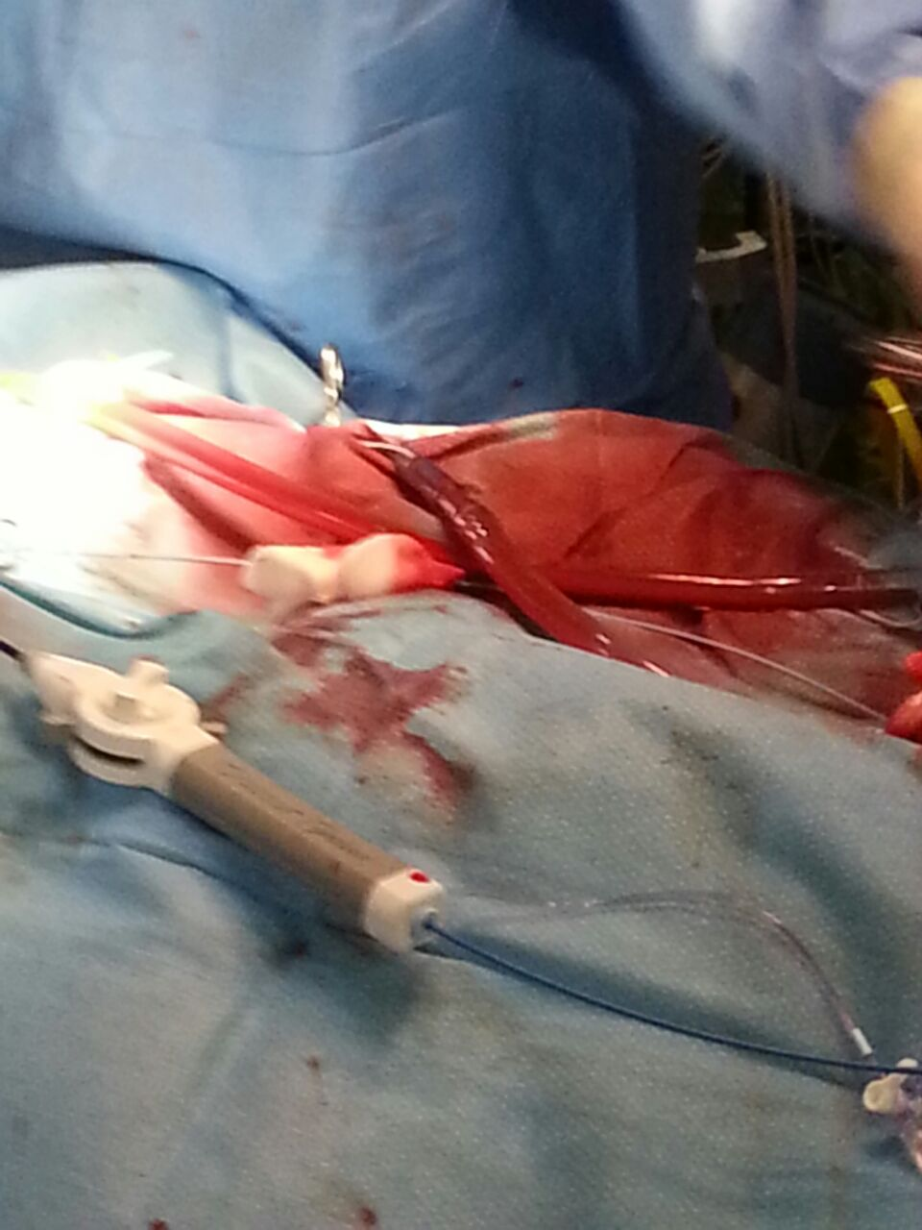
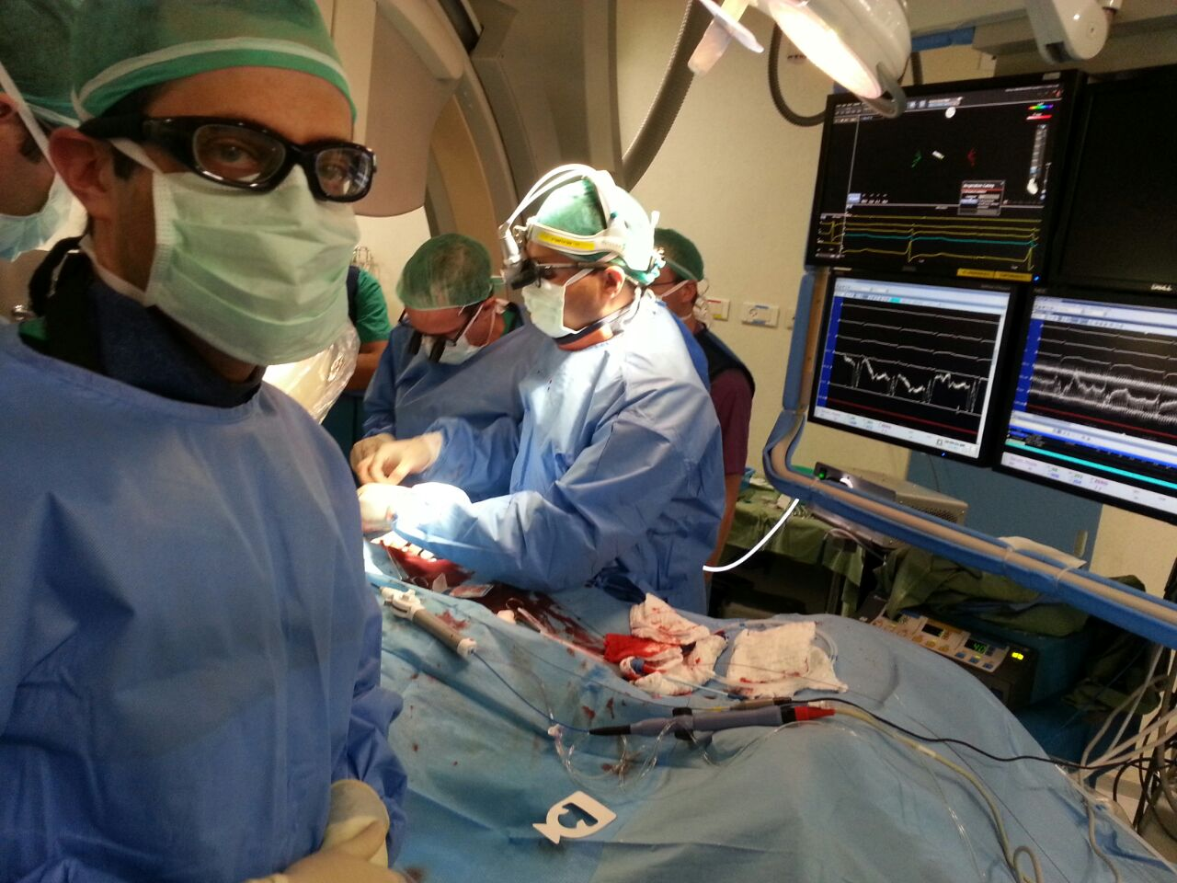

Slide 24
All underwent RFCA under general anesthesia and were connected to an ECMO circuit maintained at 1.5 L /min output.
In case of VT or VF the blood flow on the ECMO machine was increased to 3 L/min to allow hemodynamic stability.
In all cases ECMO didn’t prevent VT inducibility.
ECMO permitted sufficient activation mapping for ablation of all inducible VTs.

Slide 25
Results
45 pts(22%), 43 men
Median Age 63
31 Ischemic CM, 14 Dilated CM
Mean left ventricular EF~25%
Comorbidities: HTN 57%, IHD 77%, CRF 20%, PVD 8.5%, , DM 28%
28 pts (62%) presented with VT Storm
For 16 pts (35%) it was a redo procedure
Notes:
implantable cardioverter defibril
All men
Age 63.7
8 dilated
12 redo
EF 19.3
20 VT STORM

Slide 26
Ablation procedure
In 34 pts (75%) the clinical VT was induced
95 VTs were induced in 45 procedures, 82 were ablated.
percutaneous epicardial approach was performed in 11 procedures
Cannulation type: 6 cut down, 39 percutaneous
Mean ECMO time was 3.5 hours
Flow was 1.5 L/min, while during VT induction the flow was increased to 4 L/min
44 were put on ECMO in EP lab
40 patients (86%) were de-cannulated by the end of the procedure, 5 patient required an overnight further support
Inotropes were administered in 23 out of 45 patients (51%)
Notes:
Epicardial 10
מוקדי VT הושרו
18 מטופלים נזקקו לתמיכת אמינים
5 מטופלים עברו דה-קנולציה מאוחרת

Slide 27
DEFINITIONS
Success - Non inducibility of any VT
Partial success - Non inducibility of clinical VT
No success - Failure to ablate clinical VT

Slide 28
Ablation Results
VT wasn’t inducible: 14%
In those that VT was inducible:
Full Success 81% (vs. 62% in non ECMO)
Partial 15% (vs. 22%)
Failure 5% (vs. 10% in non ECMO)
Inducibility wasn’t checked: 2% (vs 6% in non ECMO)
ECMO permitted full VT activation maps in most pts (80%)
Notes:
תוצאות בסיום הפרוצדורה
Activation 61%
Full success 74%, partial 16%, failed 10%
REDO - in the first procedure without ECMO 4 failed, 3 partial.

Slide 29
Postoperative Complications
4 patients died within a week after the procedure (Ischemic leg-> sepsis, 2 cardiogenic shock with second ECMO run, CVA + pneumonia)
2 patient (5.6%) – vascular complications
7 patients (20%) - transient renal failure
1 patient (2.8%) - CVA

Slide 30
Follow-up
Only 1/45 (2%) vs. 9/155 (6%) pts required redo VTA
3 patients required permanent LVAD implantation
1 patient required heart transplant
3 patient died (late mortality)
Notes:
2 מתוך 31 ללא אירועים

Slide 31
Discussion
Our experience demonstrate the safety and efficacy of hemodynamic support in unstable and clinically challenging patients
Most patients do not required longer time with mechanical support
Percutaneous cannulation was not associated with vascular complications
IABP and Impella (alternative mechanical support)
*don’t provide right ventricular assistance nor respiratory support
*need for synchronization (IABP)
*Impella- expensive, electromagnetic interferences

Slide 32
Mechanical support for VT ablation
Pros:
  Maintenance of hemodynamic stability and end-organ perfusion during ongoing VT to facilitate activation and entrainment mapping
  LV unloading during periods of sinus rhythm to minimize peri- and postprocedure worsening of heart failure

Slide 33
Mechanical support for VT ablation
Cons:
  Time consuming
  Bleeding complications
  Longer hospitalizations
  Expertise
  Vascular complications
  Cost

Slide 34
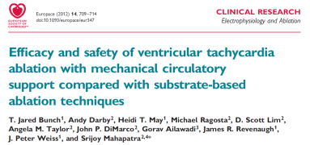
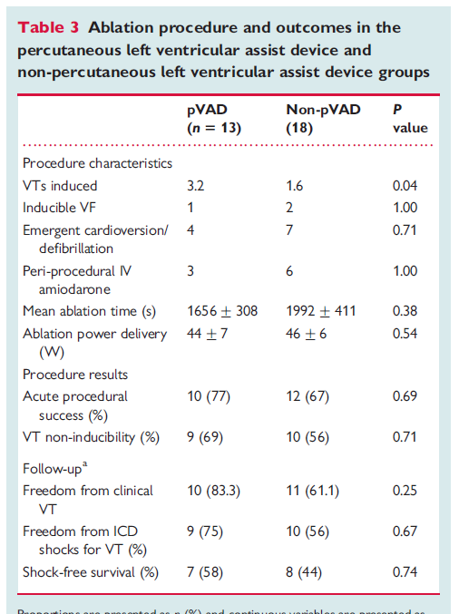
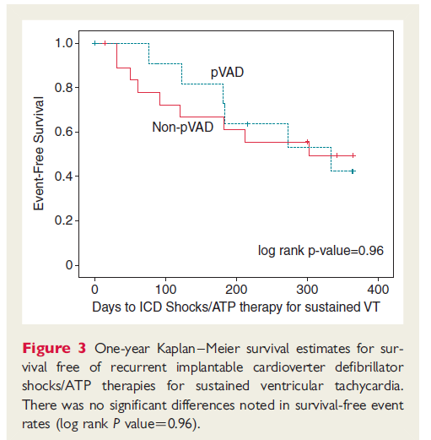
Is outcome really better?

Slide 35
Patient, electrophysiological, and procedural-speciﬁc variables to consider during pLVAD-assisted scar-VT ablation
1. Severe AS
2. Severe PHT
3. Overt heart failure
4. Unstable arrhythmias – usually when previous substrate modification failed.
5 .Redo procedures
6. DCMP

Slide 37
Conclusions:
Pts with VT and advanced HF present a significant challenge.
A strong co-operation between electrophysiologists and multiple disciplines is pivotal to achieve satisfactory results.
Most pts will benefit from CA intervention.
Consider 2 stage procedure or mechanical support when needed.
The best treatment for difficult situations is to prevent them!

Slide 38
Thank you

