Slide 1
State of the Art in Remote Monitoring of Implantable Devices
Prof. Dr. THOMAS DENEKE
Heart Center Bad Neustadt
Bad Neustadt, GER

Slide 2
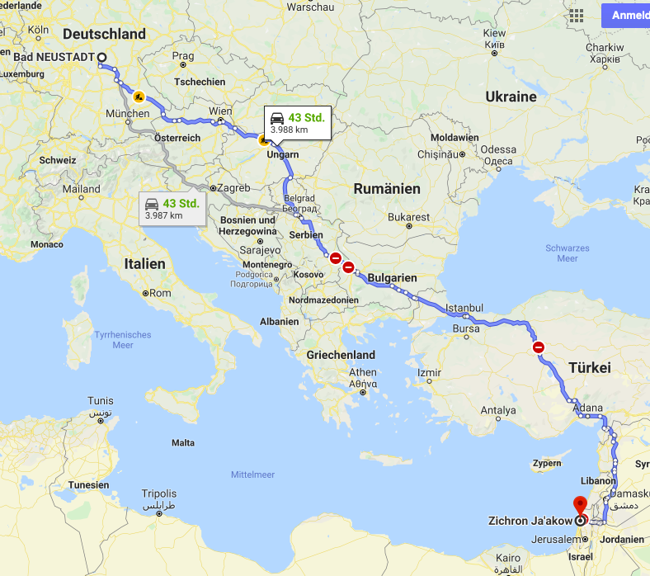
Heart Center Bad Neustadt (NES)

Slide 3
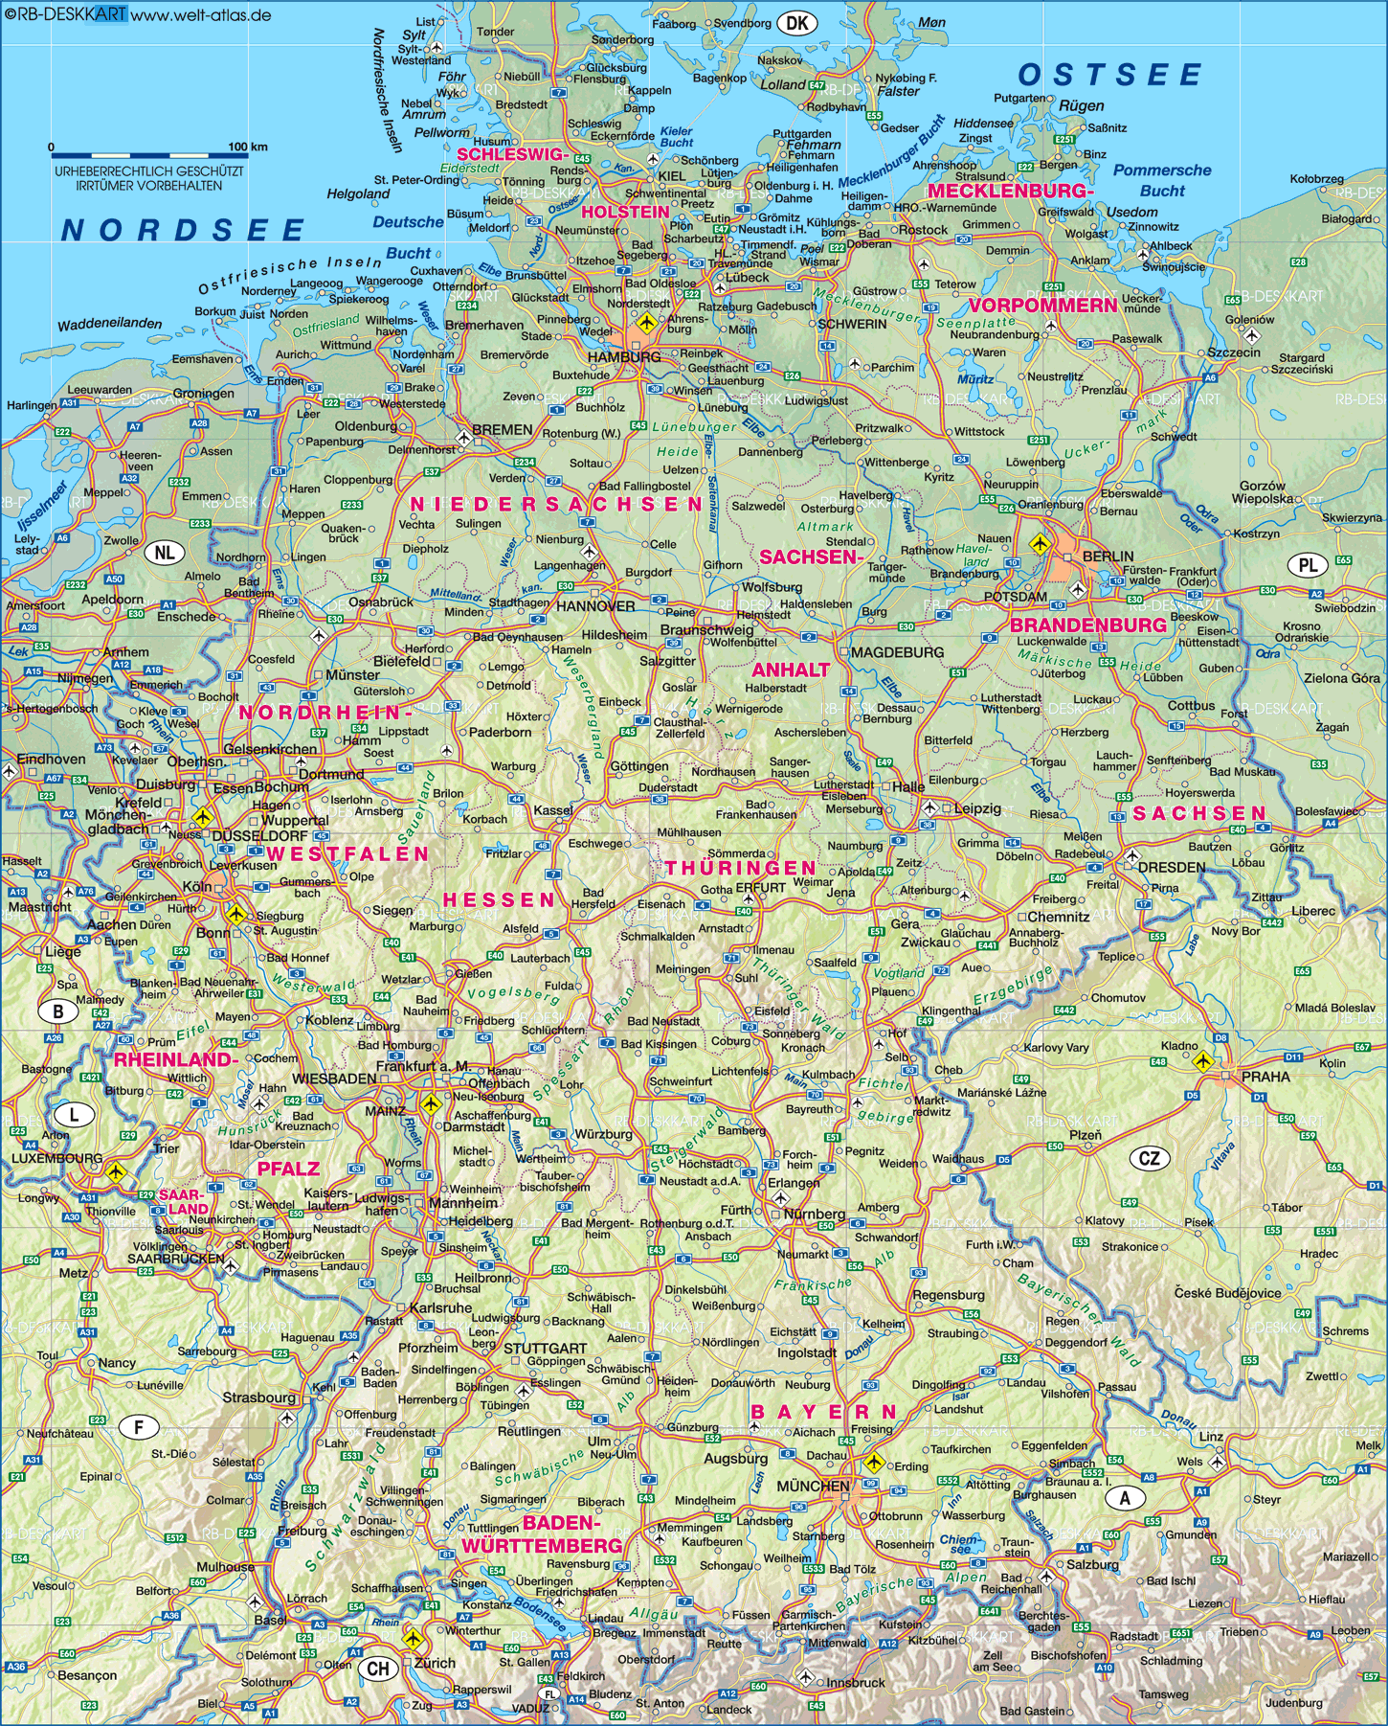
NES
Bad Neustadt

Slide 4

Rhoen: UNESCO biosphere reserve

Slide 5
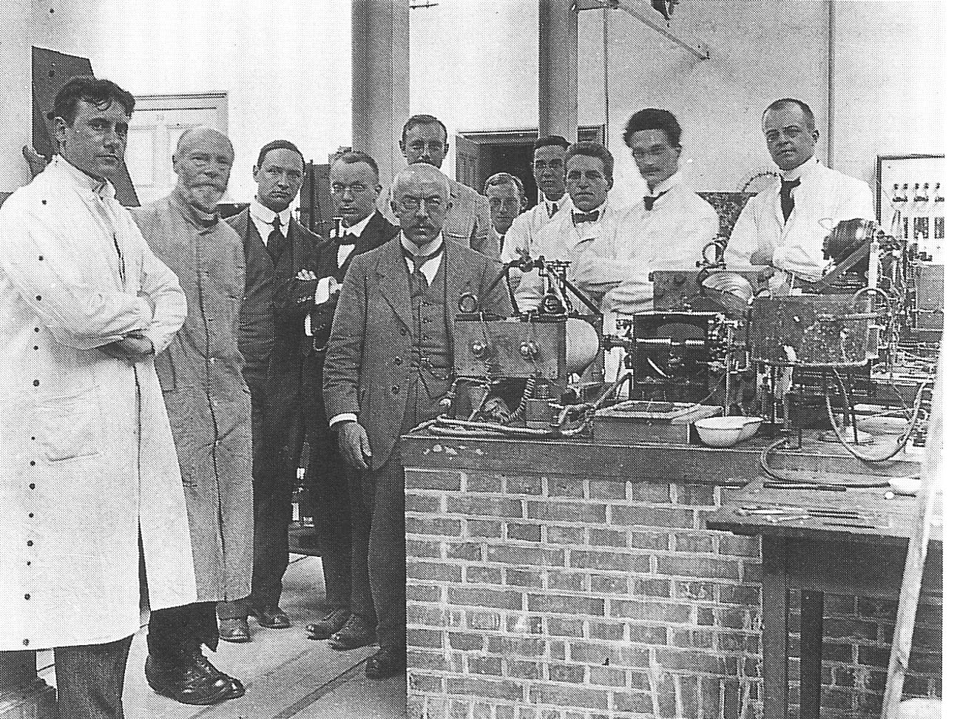
Le telecardiogramme, 1906
1st ECG transmitted via telephone line by
W. Einthoven
Einthoven; Arch Internat Physiol 1906

Slide 6
Introduction: Remote monitoring
Capability of devices to connect wirelessly and distribute data has revolutionized cardiac device care
Remote monitoring (RM) - as a non-active act of continuous monitoring of cardiovascular health-related parameters - very helpful in rural/remote areas with long patient travel distances
RM-capable devices in cardiovascular health:
Implantable active cardiac devices (PM, ICD, CRT)
Implantable cardiac monitors (ILR, implantable hemodynamic sensors)
Wearable cardiovascular monitors (watches, wristbands, textiles)

Slide 7
AGENDA: State of the Art Remote Monitoring
How does it work?
Effects on in-patient visits and time-to-event detection
Detection of atrial fibrillation (AF)
Effects on ICD-shocks
Effects on mortality?

Slide 8
Remote monitoring (RM)
automated transmission of data provided by the device including daily self-testing and event notification for out-of-bound parameters and patient specific events: device- and biological/disease-monitoring
no interaction from patient needed, easy to install
Notes:
Embedded technology has createdthe ability of the device to monitor their own funciton, record arrythmias and other physiological paramters and communicate this information to health care providers

Slide 9
Remote monitoring in CIEDs
Aprox 20% of CIED pts not in person seen for follow-up within first 12 months after implant
Need for structured regular follow-up but in-person evaluations (IPE) has failed to engage many pts (specifically those with long travel distances and need to take off time from work)
Remote monitoring technology developed as complementary to IPE and to replace some of routine follow-up
Up to 80% of implanted PM, ICDs and CRTs have availability of RM, actively used in aprox. 40% of these pts
RM may document same data as IPE – 2 different sets of events:
technical events / device related – technical device integrity
patient events / disease affected – biological/disease parameters

Slide 10
RM of active CIEDs (PM, ICD, CRTs)
Incidence of device events increases with complexity of device
Overall complications in ICD pts during FU: 9.1% (6.4 to 12.6%)
Lead related: 5.8% including displacement (3.1%)
Generator related: 2.7%
CRT-D patients:
Lead related: 9.2% - mostly related to LV-lead
→ all detectable via remote monitoring/remote interrogation
Ezzat et al. Open Heart 2005; Schuchert et al., Europace 2013

Slide 11
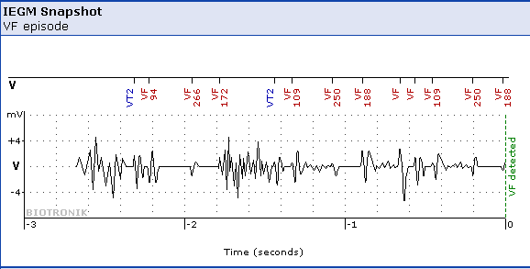
Case # 1: Device surveillance
67 year old male patient
remote myocardial infarction
- EF 23%
- QRS 80 ms, SR
ICD Implantation - single chamber ICD (MADIT II)
16 months of uneventful follow-up
then: alert by telemonitoring due to frequent non-sustained VF-episodes
→ ICD-lead dysfunction

Slide 12
Remote monitoring: proven effects
> 400 published manuscripts incl. 7 RCTs on effects of RM
Proven early detection of relevant clinical events, reduces time from event to clinical action (TRUST, CONNECT, ECOST)
High reliability of transmissions (TRUST)
Reduction of follow-up burden (TRUST, COMPAS, REFORM) compared w/ standard of care
Proven reduction of hospitalization due to AF and of related strokes
Proven reduction of inappropriate ICD-Shocks (ECOST)
Varma et al., Circ 2010; Mabo et al., Eur Heart J 2012; Guedon-Moreau et al, Eur Heart J 2012; Hindricks et al., Eur Heart J 2014

Slide 13
Remote monitoring: proven effects
> 400 published manuscripts incl. 7 RCTs on effects of RM
Proven early detection of relevant clinical events, reduces time from event to clinical action (TRUST, CONNECT, ECOST)
Proven reduction of ICD-Shocks (ECOST)
Proven reduction of hospitalization due to AF and of related strokes
Reduction of follow-up burden (TRUST, COMPAS, REFORM) compared w/ standard of care
High reliability of transmissions (TRUST)
the twin epidemics: AF and chronic HF
→ in these pts RM must be considered gold standard
Varma et al., Circ 2010; Mabo et al., Eur Heart J 2012; Guedon-Moreau et al, Eur Heart J 2012; Hindricks et al., Eur Heart J 2014

Slide 14
Remote monitoring: proven effects
1339 pts with Lumos-T
102 US centers
2005 to 2008
R
automatic daily RM surveillance
3-mo IPE
Follow-Up 12 mo
 | RM | conventional
Primary prophylaxis ICD | 72.2% | 73.8%
CAD | 64.8% | 71.7%
Dual-chamber ICD | 57.8% | 56.6%
Varma et al., Circulation 2010

Slide 15
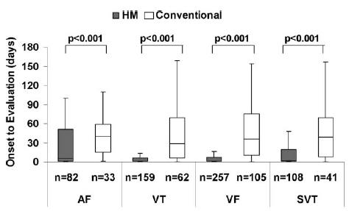
RM: Effect on time to event identification
 | RM | Conventional | p
3-mo IPE visits adherence | 93.5% | 88.7% | <0.001
Mean IPEs | 2.1 | 3.8 | <0.001
Unscheduled visits | 0.78 | 0.50 | 0.009
12-mo survival | 96.4% | 94.2% | 0.174
Time from event-onset to evaluation (AF, VT, VF) | 1 day | 35.5 days

Slide 16
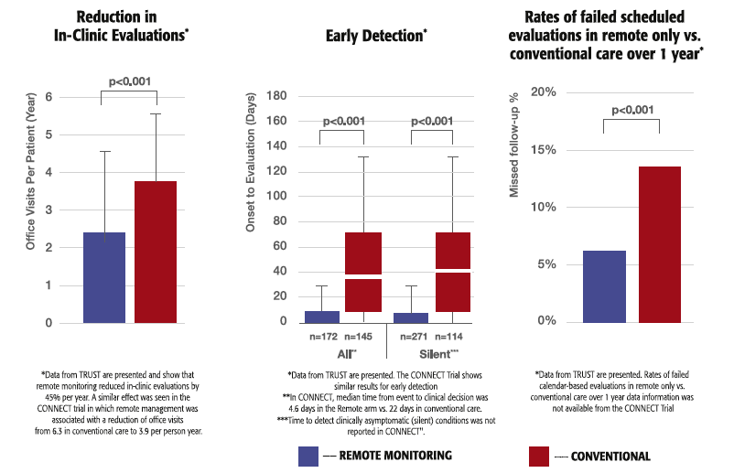
RM: Effect on follow-up burden
Comparing RM to conventional IPE at 3 to 6mo (ICD pts)
RM allows to reduce IPEs by 45%
RM reduces time-from-clinical-event-to-clinical-decision/action
Varma et al., Circulation 2010; Crossley et al., JACC 2011
Notes:
12 mo Follow-up (TRUST, CONNECT) or even 24mo (ECOST)

Slide 17
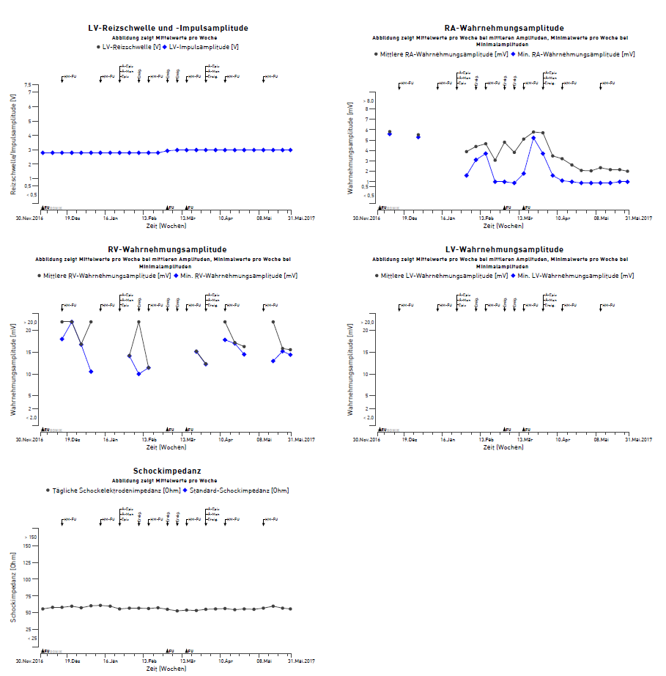
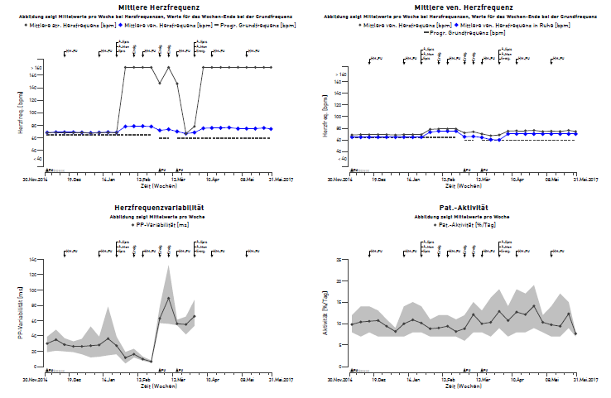
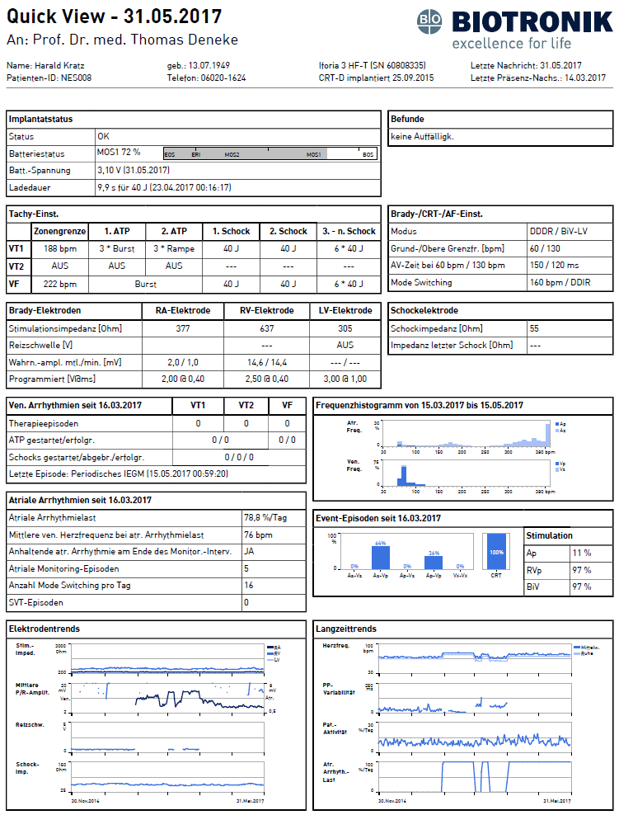
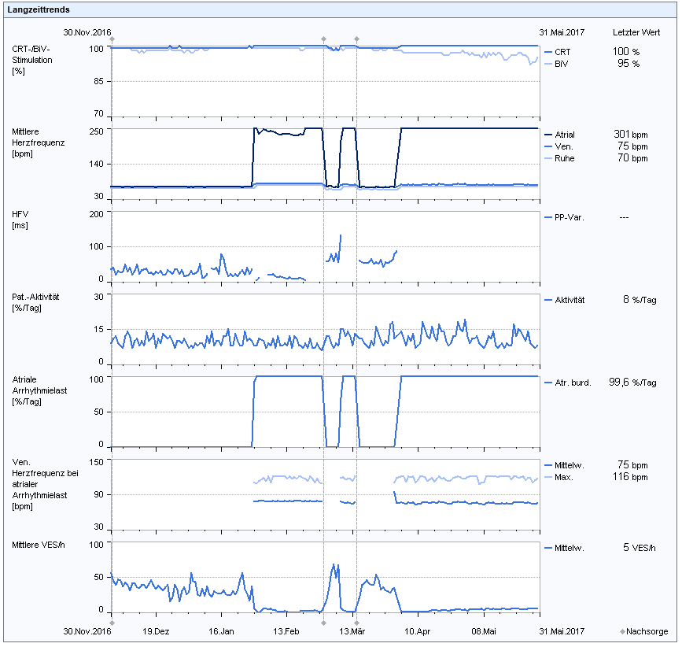
Today: technical & physiological data
physiological parameters
<<<<<<<<
Notes:
Comprehensive reporting of technical and physiological/disease specific parameters

Slide 18
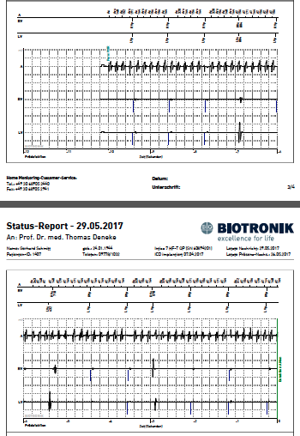
The Twin Epidemics: AF and HF
Previosly unrecognized AF in between 30 to 60% of ICD pts
risk of thrombembolic complications significantly increased in episodes > 24hrs
90% of AF episodes triggering device alerts asymptomatic
RM detects AF 1 to 5 mo earlier compared to standard protocol
early AF/AHRE detection → may avoid inappropriate ICD-interventions, heart failure, loss of biventricular pacing, enables early onset of OAC
Eur Heart J 2017; Orlov et al., PACE 2007; Bunch Heart Rhythm 2009

Slide 19
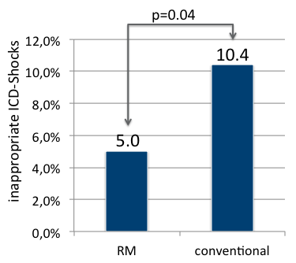
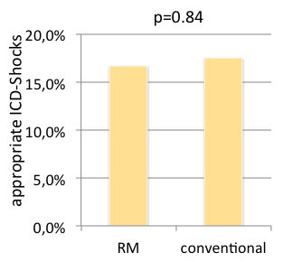
RM: Effect on inappropriate shocks
early detection of AF with rapid V-conduction, T-wave oversensing, device malfunction may help to reduce unnecessary ICD shocks
ECOST study: randomized, prospective, multicenter ICD-trial
RM reduces inappropriate but not appropriate ICD-shocks
Guedon-Moreau et al.; Eur Heart J 2012

Slide 20
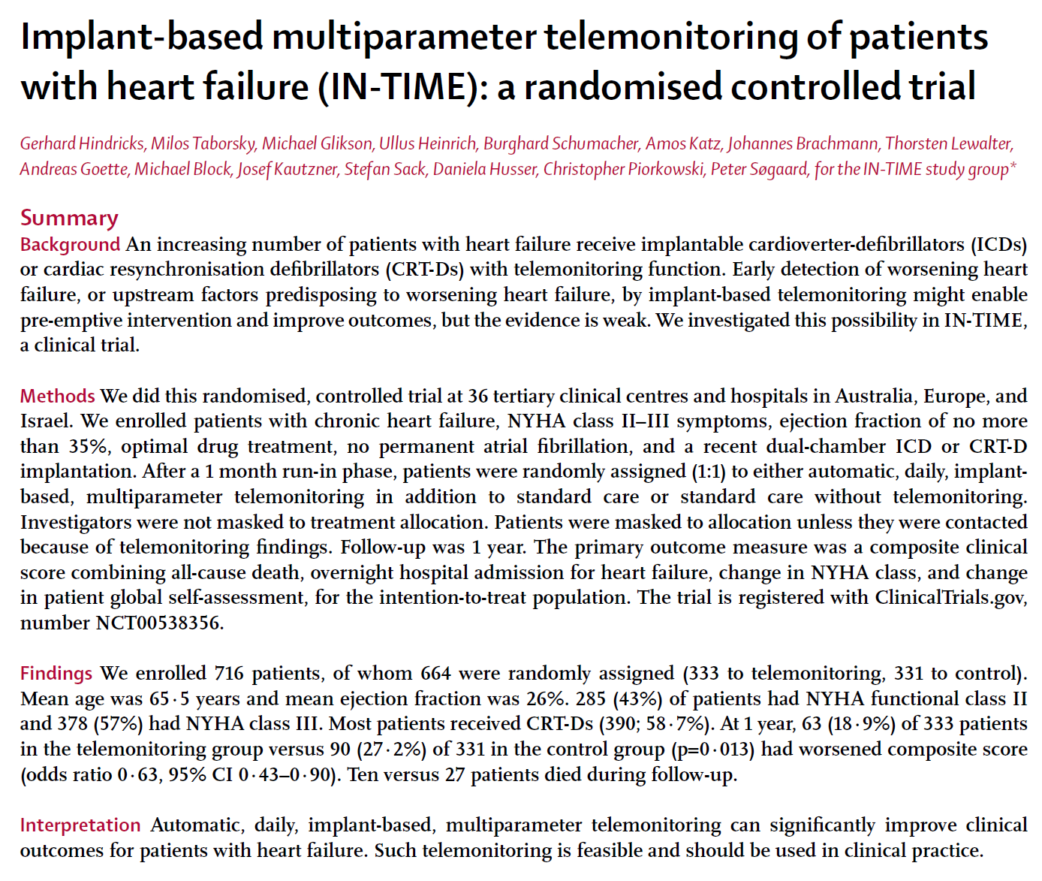
RM: Effect on mortality
664 pts with DDD-ICD or CRT-D
NYHA II or III
R
333 RM
331 control
12-mo: worsened clinical status
63 pts (18.9%)
90 pts (27.2%)
p = 0.013
Hindricks et al., Lancet 2013
Notes:
BIOTRONIK Home Monitoring enabled >30% reduction of worsening of clinical status.
Modified Packer Score
Patients are classified as “worsened” in case of:
Death
Overnight hospitalization for worsening heart failure
Worsening in NYHA Class
Deterioration in patient’s global self assessment

Slide 21
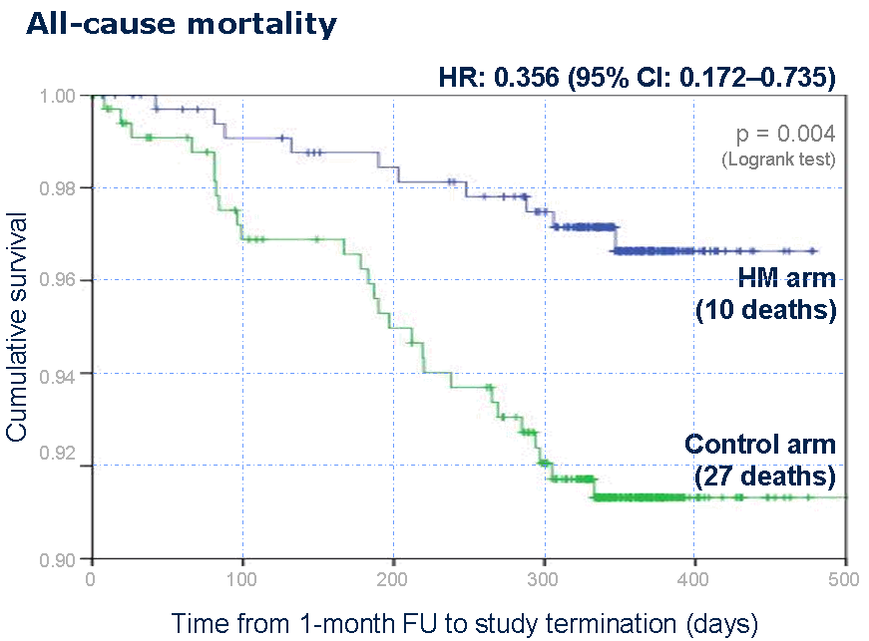
RM: Effect on mortality
Hindricks et al., Lancet 2013

Slide 22
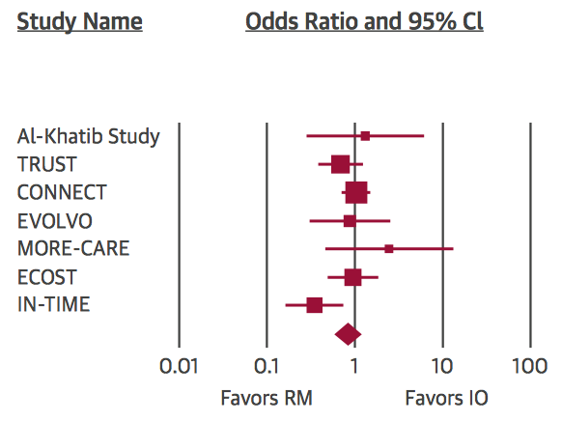
RM: Effect on mortality
7 Randomized Controlled Trials (RCTs) report on mortality comparing remote monitoring to conventional follow-up (4.932 pts total)
OR for mortality with RM was not different from in-office follow-up (control) (OR: 0.83; 95%-CI: 0.58 – 1.17; p=0.285)
only IN-TIME reported significant reduction in overall mortality
Parthiban et al., JACC 2015
Notes:
Reasons for differences: 1. daily transmission, 2. complete set of HF data evaluated, 3. predefined set of action-events

Slide 23
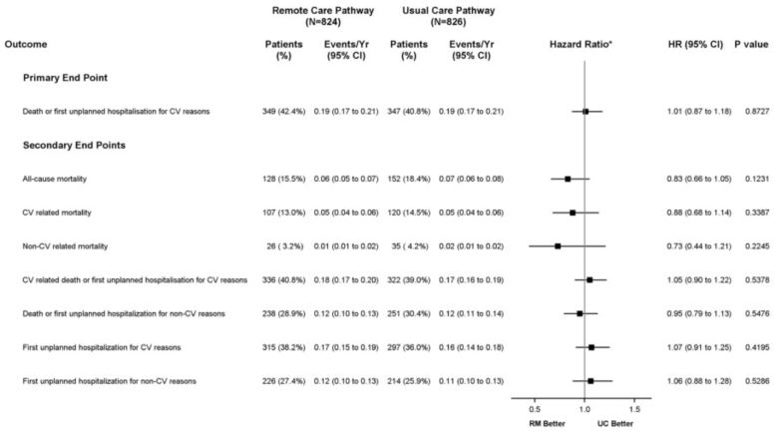
RM: Effect on mortality
8 Randomized Controlled Trials (RCTs) report on mortality comparing remote monitoring to conventional follow-up (6.582 pts total)
OR for mortality with RM was not different from in-office follow-up (control) (OR: 0.83; 95%-CI: 0.58 – 1.17; p=0.285) in 7 RCTs
only IN-TIME reported significant reduction in overall mortality
1 recent RCT including 1650 pts showed no benefit of weekly RM using single parameter HF monitoring
Primary Endpoint (death or CV hospitalization) occurred in 42.4 vs. 40.8%
Parthiban et al., JACC 2015; Morgan et al., Eur H J 2017
Notes:
Reasons for differences: 1. daily transmission, 2. complete set of HF data evaluated, 3. predefined set of action-events

Slide 24
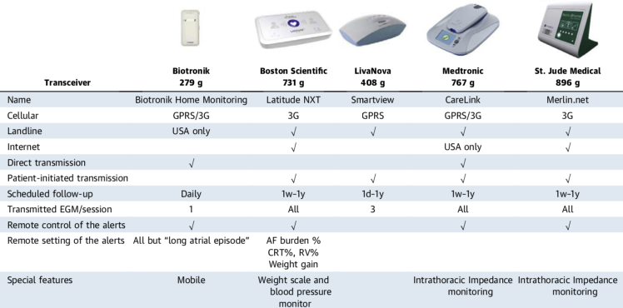
Differences in RM systems
Differences in RM portals: daily transmission, multiparameter set of HF-data vs vs. single parameter, pre-defined set of action-events

Slide 25
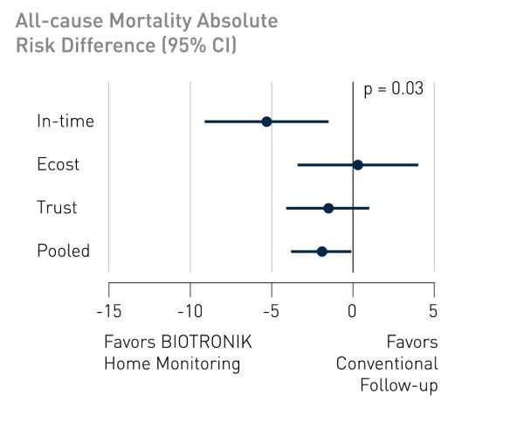
Mortality reduction and mode of RM
in Biotronik remote monitoring trials: 1.9% absolute reduction of all-cause mortality (p=0.037)
 | IN-TIME | ECOST | TRUST
Site selection | 26 sites in Germany + 10 other sites | 43 sites in France | 102 sites in USA
Patients included | 664 | 414 | 1327
Dual-chamber ICD | 274 (41.3) | 123 (29.7) | 765 (57.6)
CRT-D | 390 (58.7) | 0 (0.0) | 0 (0.0)
-5.3
0.3
-1.5
daily RM reduces mortality in a broad spectrum of ICD-pts
-1.9

Slide 26
RM: disease specific events - HF Monitor
Biological monitoring/monitoring of disease state:
Multiparameter Heart Failure Monitor - overview of clinical HF parameters
Parameter | Worsening HF
Pt activity | ⬇
AF burden | ⬆
V-rate during AT | ⬆
% BiV pacing | ⬇
HR variability | ⬇
Mean HR | ⬆
% BiV pacing
Set of RM parameters relates to disease state

Slide 27
RCT and mortality – daily RM
Daily transmitting RM is associated with a significant reduction of all cause mortality and combined endpoints
Clinical benefit mainly driven by prevention of heart failure exacerbation
Clinical endpoint
(at 12 months)
relative
risk reduction
absolute
risk reduction
All-cause mortality
38%
1.9%
p<0.05
All-cause mortality or
WHF hospitalization
36%
5.6%
p<0.01

Slide 28
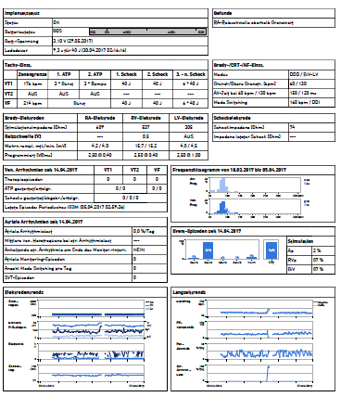
Case # 2: Heart Failure Worsening
Male Pts, ICM, EF 28%, LBBB-QRS = 170ms
no hx of atrial arrhythmia
primary prophylaxis ICD
12/2016 CRT-D (Iforia 5 HF-T)

Slide 29
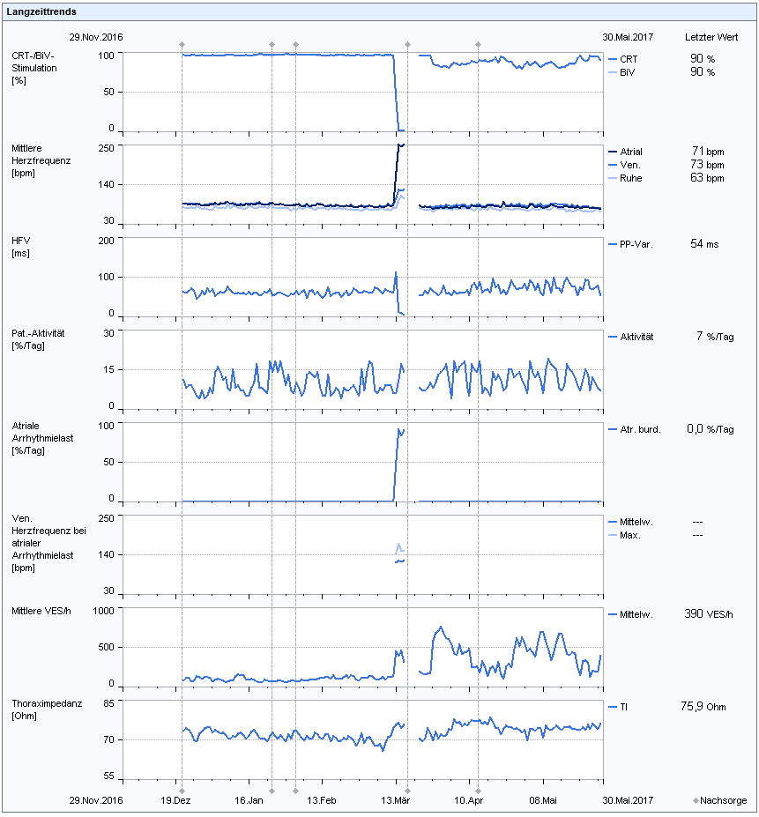
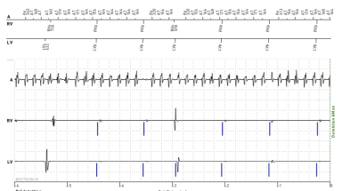
Case # 2: Heart Failure Worsening
% biv pacing
Pt increased dyspnea, specifically on exertion
daily RM indicated onset of AF (first diagnosis)
OAC was initiated
Cardioversion with early relapse
AF ablation was performed
mean heart rate
pt activity/d
atrial arrhythmia
burden
thorax impedance

Slide 30
Case # 2: Heart Failure Worsening
% biv pacing
mean heart rate
pt activity/d
atrial arrhythmia
burden
thorax impedance

Slide 31
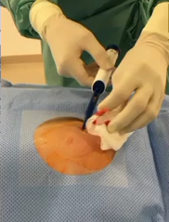
Implantable Loop Recorders
Cryptogenic stroke
15% of strokes attributed to AF, 20 to 30% of ischemic strokes are cryptogenic (no detected aetiology)
Implantable Cardiac Monitors (ILR = implantable loop recorders) have identified AF in 17 to 27.3% of these patients
new biomonitor III
AF may have several clinical presentation: > 60% of patients have asymptomatic episodes
Camm, Arr&Electrophys 2014; Savelieva et al., JICE 2013; Cotter et al., Neurology 2013; Etgen et al., Stroke 2013; Ritter et al., Stroke 2013; Seet et al., Circulation 2011

Slide 32
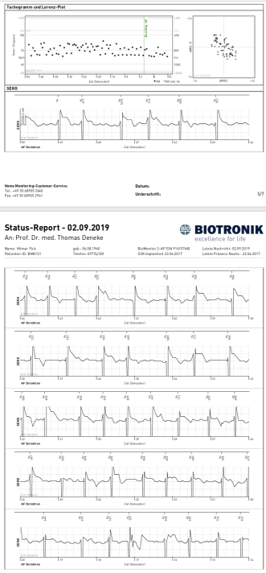
Case # 3: ILR in cryptogenic stroke
7 months later:
AF-episode based on ILR for 2h13m
initiation of OAC
Longer episodes are more likely to be AF
Episode PPV for any detected AF episode > 1h is > 90%
Remains subclinical AF per definition as no EKG document

Slide 33
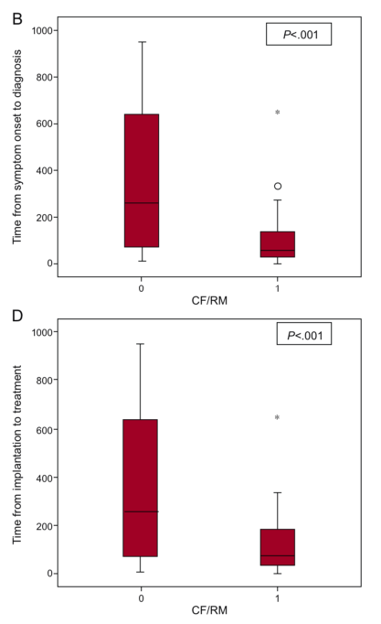
RM in ILRs
In ILR: RM for early detection of relevant events is critical but data is scarce
104 pts with ILR (mostly for syncope evaluation)
– retrospective observation
In RM vs. IPE (every 3 mo):
mean time from implant to diagnosis: 56 vs. 260d
targeted treatment in RM 186 days earlier
Drak-Hernàndez et al., Rev Esp Cardiol 2013

Slide 34
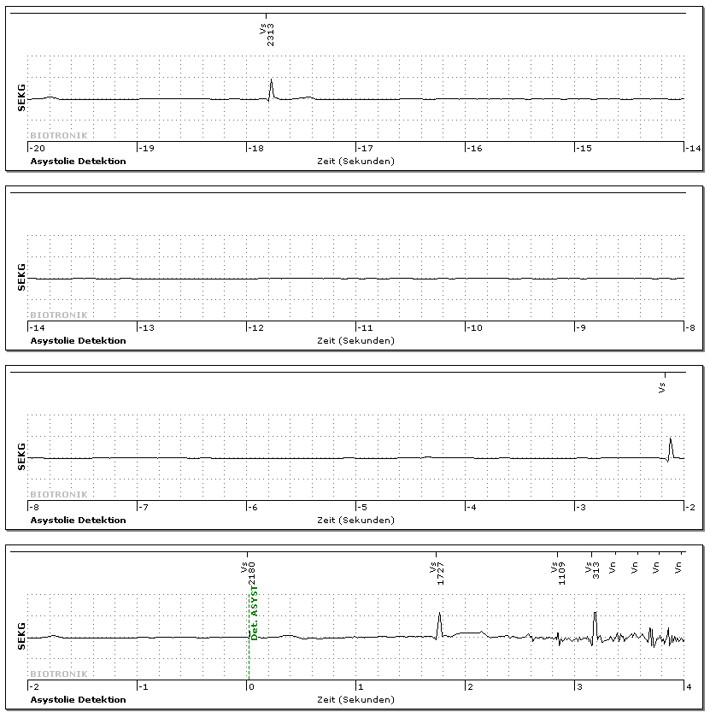
Case # 4
54y, cryptogenic stroke

Slide 35
Conclusions 1
1
Remote Monitoring has converged CIED follow-up to an even-based paradigm: reduces time from event to action, IPEs and follow-up burden, reduces health-care cost
2
RM is helpful in closely monitoring disease progression and occurrence of relevant arrythmias in HF pts
3
RM may reduce mortality in ICD-pts with symptomatic HF including CRT-D-patients if daily transmission, multiparameter monitoring and defined set of clinical actions
Multiparameter monitoring based on ICD (IN-TIME appraoch) may be considered in symptomatic HFrEF in order to improve clinical outcomes | IIb | B
Ponikowski et al., ESC guidelines on HF 2016

Slide 36
Conclusions 2
4
A strategy of Remote Monitoring of CIEDs combined with at least annual IPE is recommended (Class I, LoE A)
5
All pts with CIEDs should be offered RM as part of standard follow-up (Class I, LoE A)
6
RM should be performed for surveillance of battery and lead function, reduces incidence of inappropriate shocks and allows early detection and quantification of AF
7
All ILRs should be monitored with daily automated RM
Slotwiner et al.: HRS Expert Consensus on Remote Monitoring, 2016

Slide 37
Conclusions 2
4
A strategy of Remote Monitoring of CIEDs combined with at least annual IPE is recommended (Class I, LoE A)
5
All pts with CIEDs should be offered RM as part of standard follow-up (Class I, LoE A)
6
RM should be performed for surveillance of battery and lead function, reduces incidence of inappropriate shocks and allows early detection and quantification of AF
7
All ILRs should be monitored with daily automated RM
Slotwiner et al.: HRS Expert Consensus on Remote Monitoring, 2016

