Slide 1

PVC induced Cardiomyopathy
An Update
Antonio Berruezo, MD, PhD
Heart Institute, Teknon Medical Center, Barcelona
29 November 2019

Slide 2
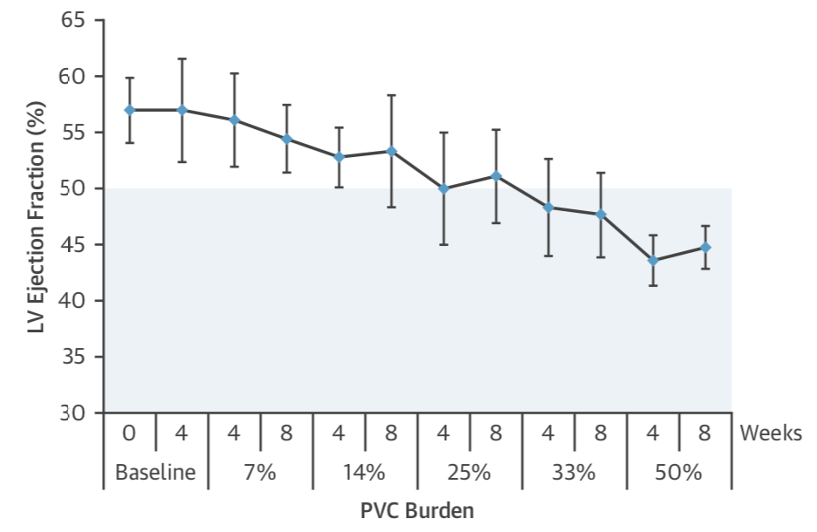
PVC induced cardiomyopathy
Experimental Model - Decrease of LVEF with sequential increase in PVC burden
10%
20%
Huizar FJ, et al. JACC 2019

Slide 3
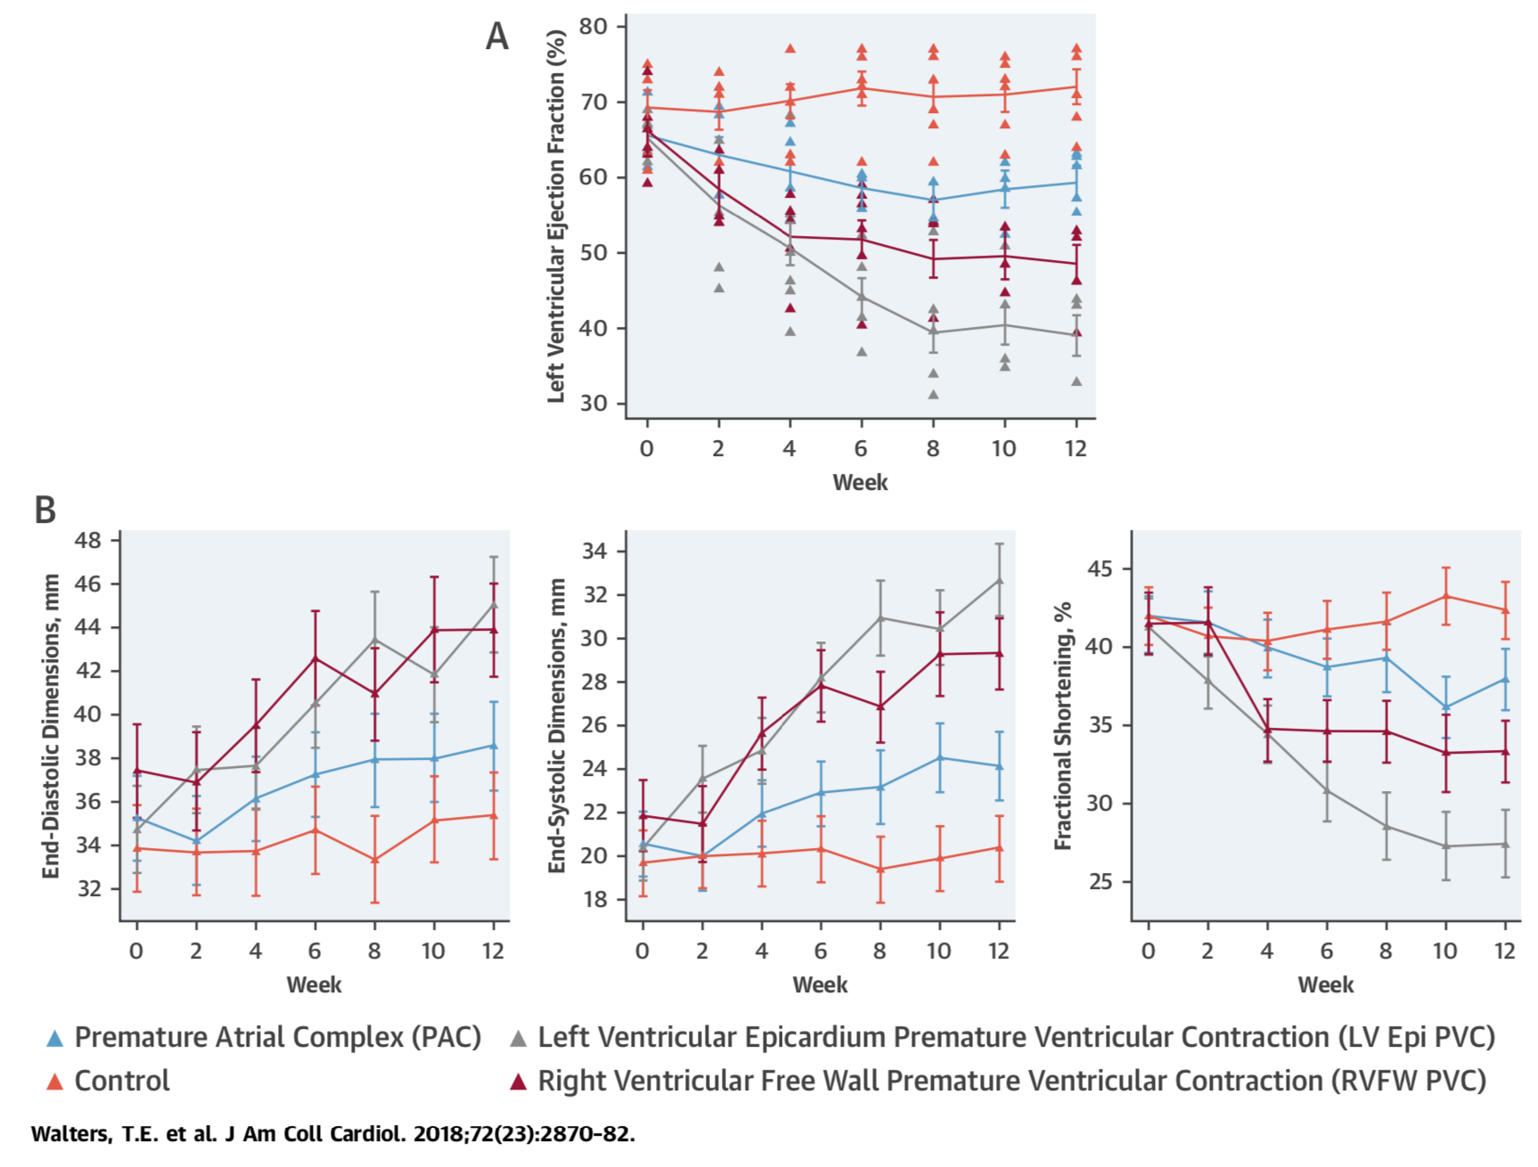
PVC induced cardiomyopathy
PVC-induced cardiomyopathy is phenotypically distinct from a tachycardia-induced cardiomyopathy
Walter et al. JACC 2018

Slide 4
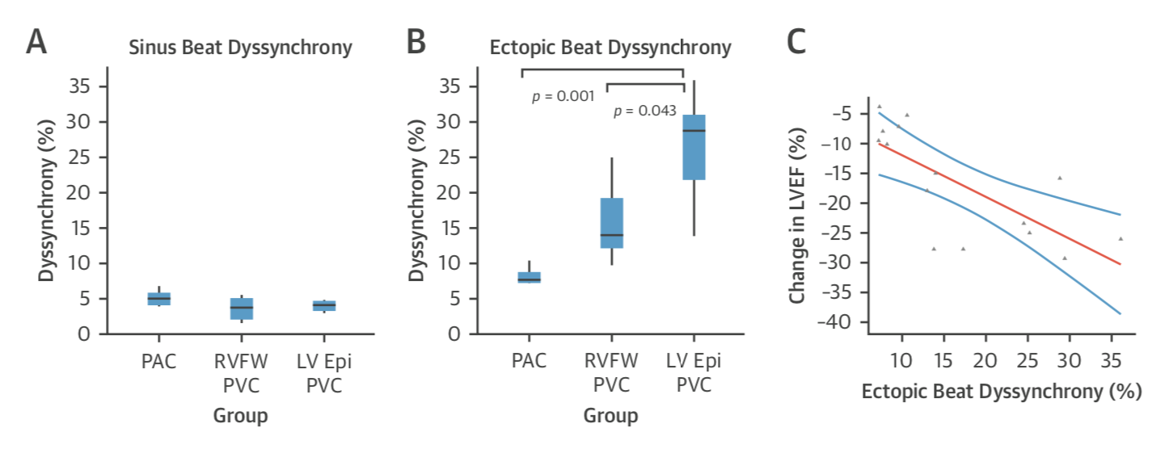
PVC induced cardiomyopathy
Cardiomyopathy severity is associated with the extent of LV dyssynchrony
Walter et al. JACC 2018

Slide 5
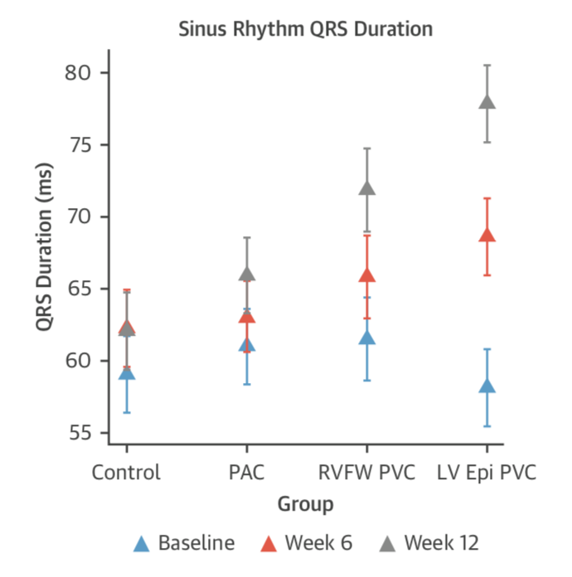
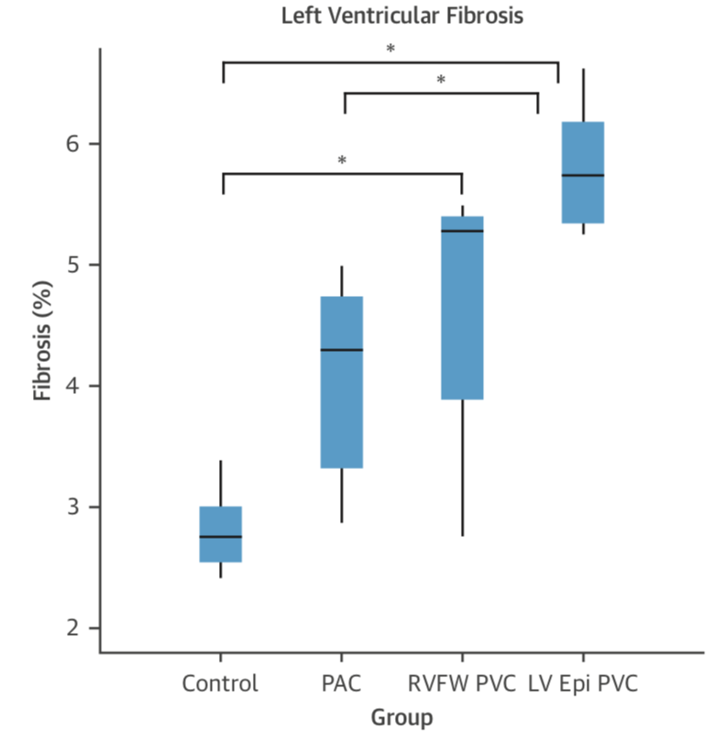
PVC induced cardiomyopathy
There was an increase in sinus rhythm QRS duration and in diffuse fibrosis
Walter et al. JACC 2018

Slide 6
Can we modify the prognosis with catheter ablation?

Slide 7
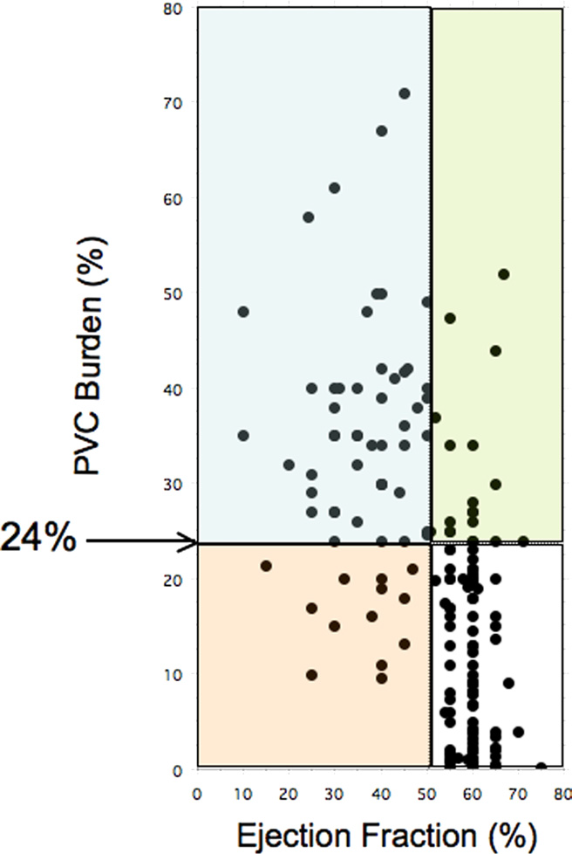
Role of the Baseline PVC burden
There is an association between the baseline PVC burden and the probability of developing LV dysfunction
10%
Baman et al. HR 2010
Notes:
A PVC burden of >24% best separated the patient population with impaired as compared with preserved left ventricular function (sensitivity 79%, specificity 78%, area under curve 0.89) The lowest PVC burden resulting in a reversible cardiomyopathy was 10%.

Slide 8
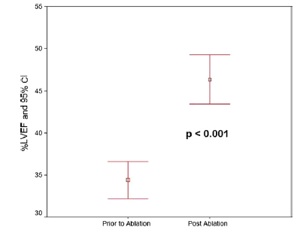
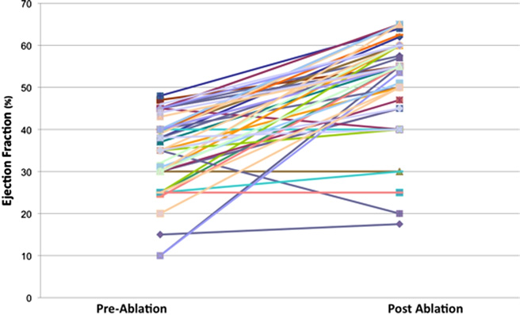
PVC induced cardiomyopathy
PVC ablation improve LVEF in patients with a PVC induced cardiomyiopathy
Yarlagadda RK et al. Circulation 2005; Takemoto M et al. JACC 2005

Slide 9
Role of the Baseline PVC burden
No benefit after ablation with a baseline PVC burden <13%
Penela D; Berruezo A et al. JACC 2013

Slide 10
Role of the Baseline PVC burden
Best cut-off for predicting Response?
22% Lakkireddy et al
26% Ban JE et al
24% Baman et al
28% Yokokama et al
13% Penela et al
0%
Baseline PVC burden (%)
30%
Notes:
There is variability in the cut-off suggested to be used to expect to obtain a benefit. Each one of them with different Sen and Sp.

Slide 11
Relevance of the Baseline PVC burden
Linear association between the absolute reduction of the baseline PVC burden and the
improvement in the LVEF
LVEF increase by 0.68 points for each absolute point of PVC burden abolished.
Penela D, Berruezo A, et al. HR 2015
Penela D et al. HR 2015

Slide 12
Could we modify the prognosis with catheter ablation?
Yes, in patients with a PVC induced cardiomyopathy and a baseline PVC burden >13%
But in every patient?

Slide 13
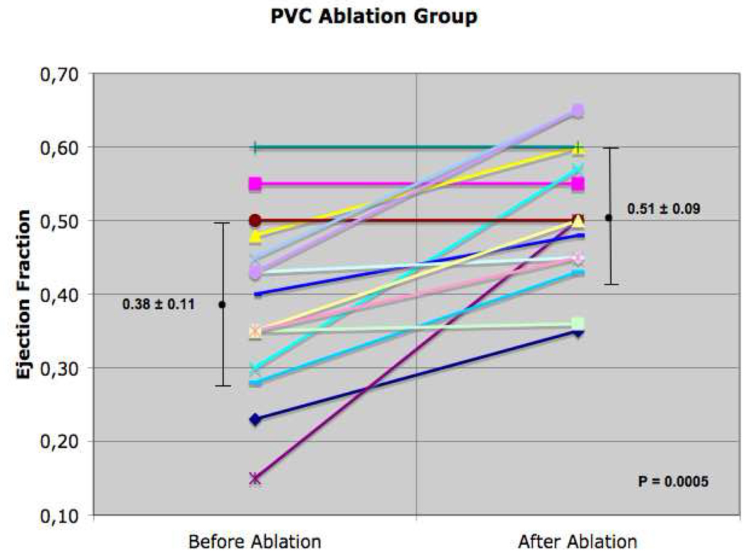
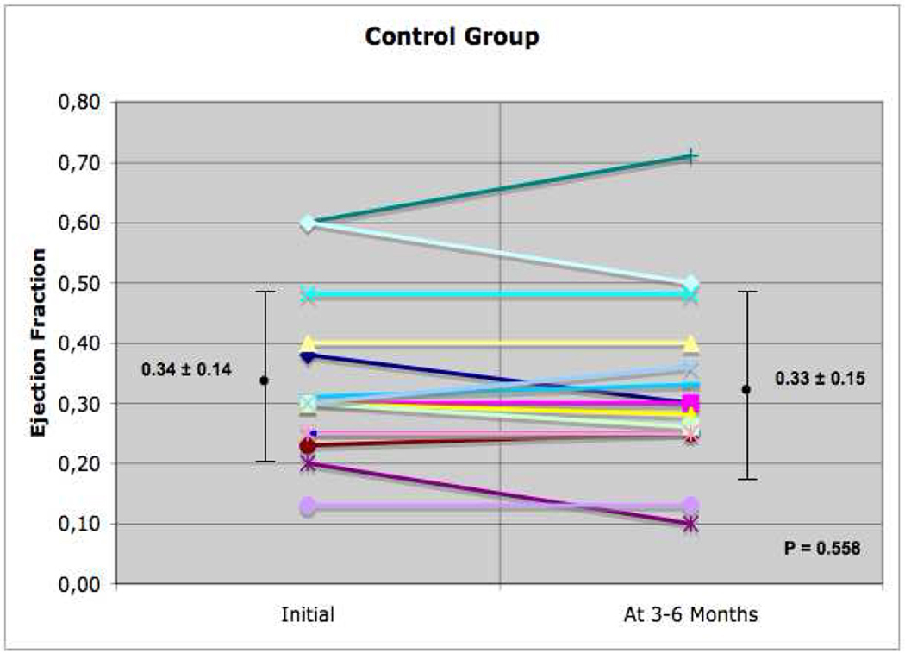
PVC ablation in patients with a Prior MI
Impact of post-infarction PVC ablation in patients with a high PVC burden
Sarrazin JF et al. HR 2009
Notes:
So, here you can see the initial description of sarrazin….

Slide 14
International multicenter prospective study on PVC ablation
55 consecutive Post-MI patients with LV dysfunction and high PVC burden
PVC ablation in patients with a Prior MI
P<0.001
P<0.001
Unpublished data

Slide 15
International multicenter prospective study on PVC ablation
55 consecutive Post-MI patients with LV dysfunction and high PVC burden
PVC ablation in patients with a Prior MI
P<0.001
P=0.005
P<0.001
Unpublished data

Slide 16
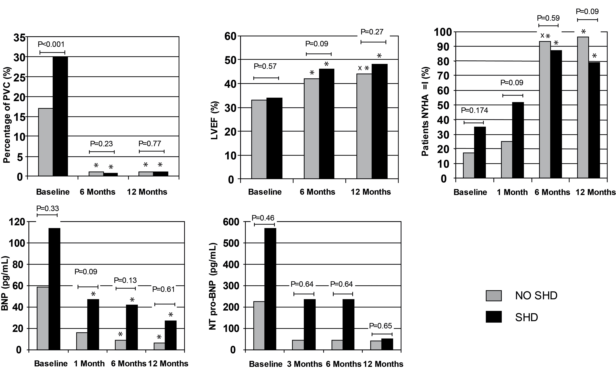
PVC-worsened Cardiomyopathy
Equivalent benefit in patients with PVC-worsened cardiomyopathy and the rest of patients
Penela D, Berruezo A et al. JACC 2013

Slide 17
PVC-worsened Cardiomyopathy
Equivalent benefit in patients with PVC-worsened cardiomyopathy and the rest of patients
Penela D, Berruezo A, et al. JACC 2013

Slide 18
Could we modify the prognosis with catheter ablation?
Yes, in patients with a PVC induced cardiomyopathy and a baseline PVC burden >13%
Patients with any SHD worsened by PVC
Including patients with a previous myocardial infarction

Slide 19
The amount of myocardial scar in inversely related with the probability of response
Patients with Myocardial Scar
Penela D, Berruezo A, et al. Heart 2018

Slide 20
However, presence of scar does NOT preclude response
Patients with Myocardial Scar
Penela D, Berruezo A, et al. Heart 2018

Slide 21
Could we modify the prognosis with catheter ablation?
Yes, in patients with a PVC induced cardiomyopathy and a baseline PVC burden >13%
Patients with any SHD worsened by PVC
Including patients with a previous myocardial infarction
Including patients with myocardial scar, if they have a high PVC burden

Slide 22
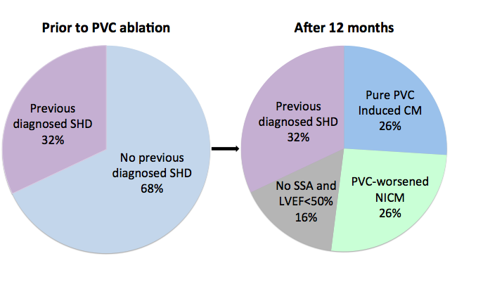
Patient classification based on changes in LVEF during follow-up
Patients with a NICM worsened by PVCs
Penela D, Berruezo A, et al. HR 2017

Slide 23
Baseline identification of patients with a “Pure” PVC-induced CM
How to identify Pure PVC-induced CM
Penela D, Berruezo A, et al. HR 2017

Slide 24
Evolution after PVC ablation: Pure PVC-induced CM (red) and patients with a NICM- worsened (green)
PVC-worsened NICM
Penela D, Berruezo A, et al. HR 2017

Slide 25
Can we modify the prognosis with catheter ablation?
Yes, in patients with a PVC induced cardiomyopathy and a baseline PVC burden >13%
Patients with any SHD worsened by PVC
Including patients with a previous myocardial infarction
Including patients with myocardial scar, if they have a high PVC burden
Patients with a NIHD worsened by frequent PVC

Slide 26
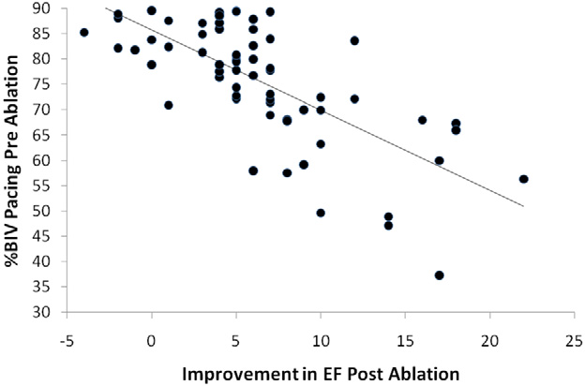
CRT Patients
Linear association between biventricular pacing and improvement after PVC ablation in CRT non-responders
Lakkireddy et al. JACC 2012

Slide 27
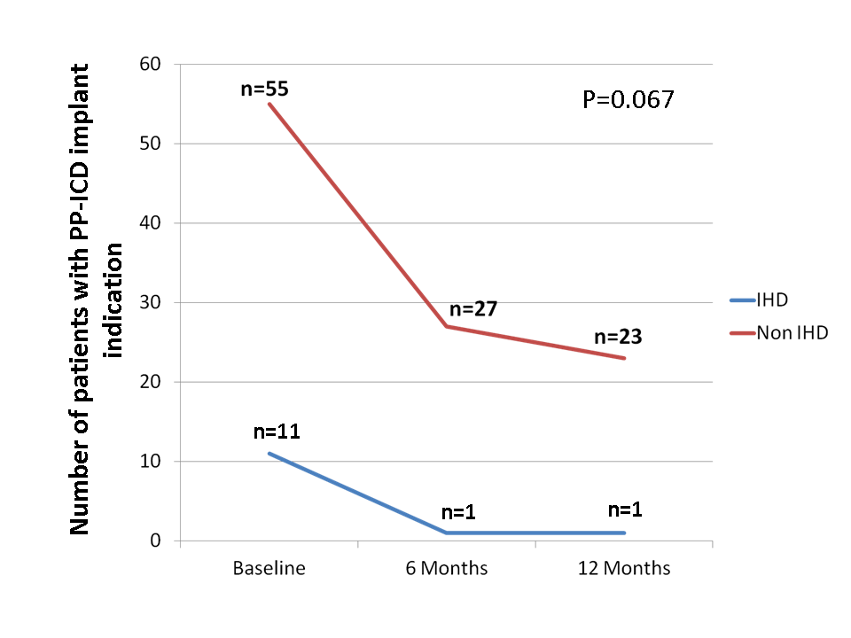
Primary Prevention ICD Implant Indication
PVC ablation can also withdraw the indication for primary prevention ICD implant in patients with
severe LV dysfunction
Penela D, Berruezo, et al. HR 2016

Slide 28
Can we modify the prognosis with catheter ablation?
Yes, in patients with a PVC induced cardiomyopathy and a baseline PVC burden >13%
Patients with a PVC worsened cardiomyopathy
Including patients with a previous myocardial infarction
Including patients with myocardial scar, if they have a high PVC burden
Patients with a NIHD worsened by frequents PVC
CRT patients and patients with a PP ICD indication

Slide 29
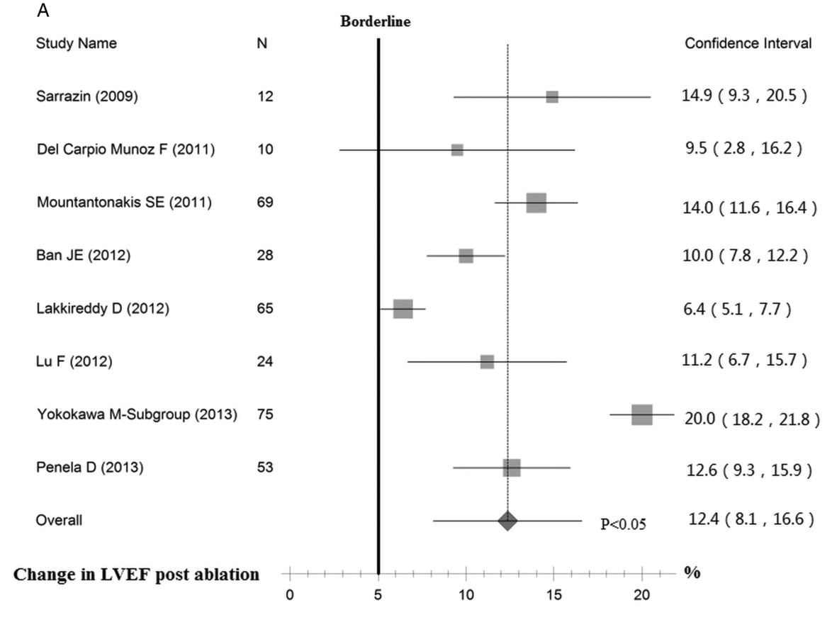
Mean LVEF Improvement
CRT non responders
Any role of QRS and dyssynchrony?
Zang et al. Heart 2014

Slide 30
Role of baseline QRS
QRS morphology is not related with the ablation success
Penela D, Berruezo A, et al Europace 2019

Slide 31
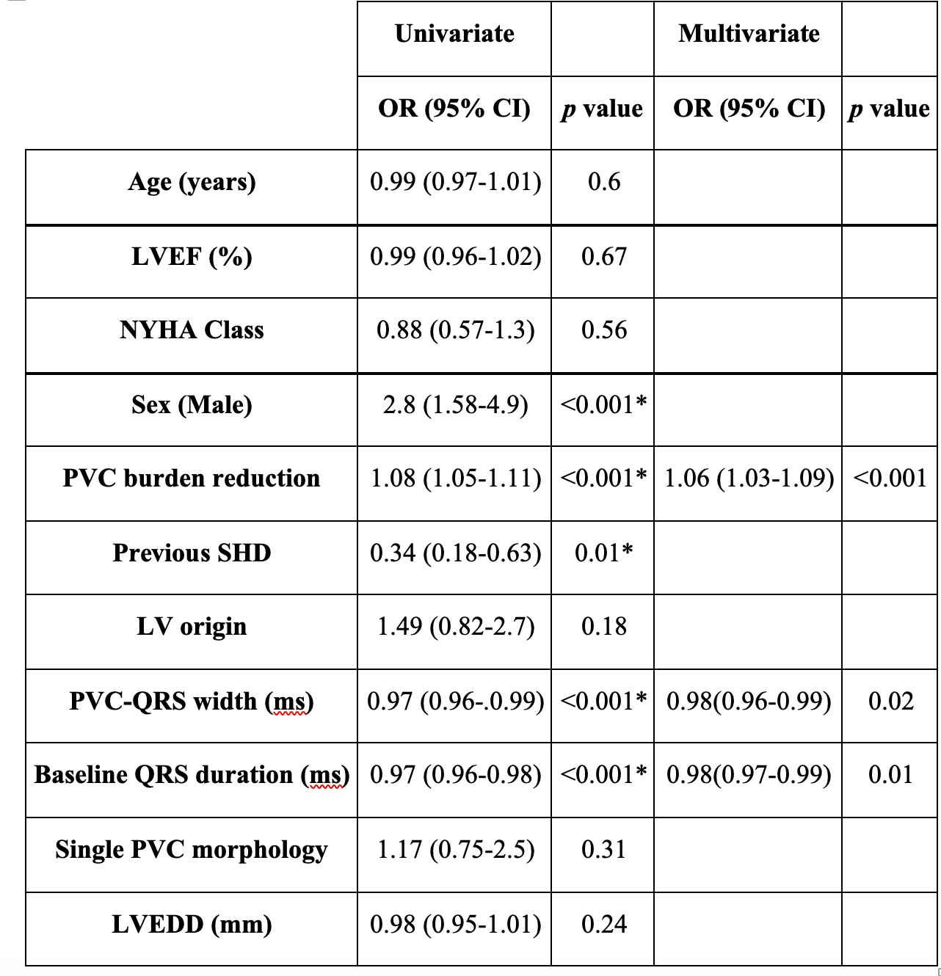
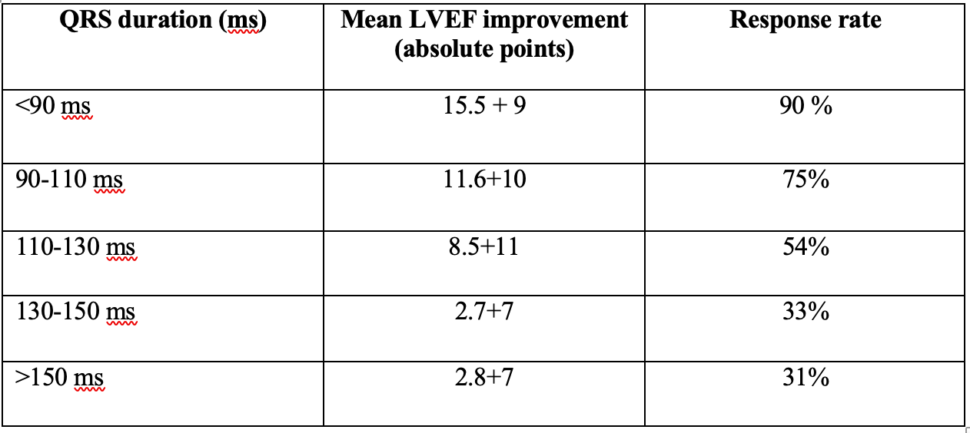
Role of baseline QRS
Baseline QRS witdh is an independent predictor of response after PVC ablation
Penela D, Berruezo A, et al Europace (in press)

Slide 32
Role of baseline QRS
Both, baseline QRS morphology and duration, are related with the magnitude of response
Penela D, Berruezo A, et al Europace

Slide 33
Role of baseline QRS
Predictors of response in 215 consecutive patients with LV dysfunction
Penela D, Berruezo A, et al Europace 2019

Slide 34
Can we expect to improve hard outcomes?
Mean improvement of 12 points in LVEF after ablation
Zang et al. Heart 2014
Salomon et al.Circulation 2005
De Groote et al. Am Heart J 2007
MIRACLE trial. Ciruclation 2003
Zang et al. Heart 2014

Slide 35
Long-term Follow-up after PVC
International multicenter prospective study on PVC ablation
Ablation of frequent PVCs induces a significant improvement in NYHA, BNP and LVEF, which is maintained at long term
(mean FU: 34 months)
Berruezo A et al. Europace 2019

Slide 36
Long-term Follow-up after PVC
PVC burden reduction was related with the improvement of LVEF
Berruezo A et al. Europace 2019
Notes:
Therefore, the CAST PVC buden was not enough to achive an improvement in the LVEF

Slide 37
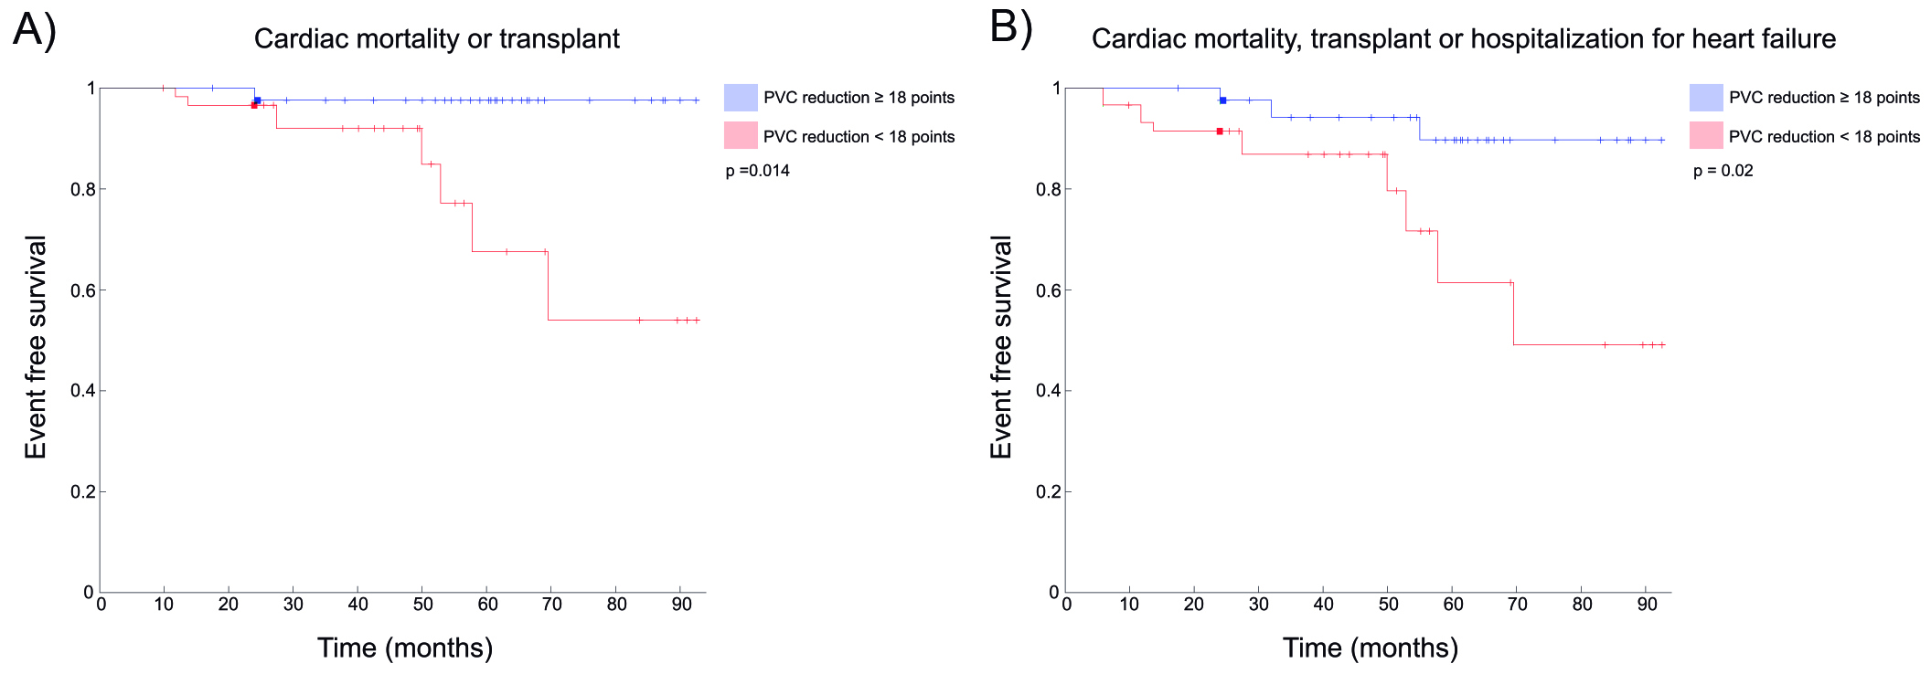
Long-term Follow-up after PVC
The abolition of 18 points of the PVC burden was related with Mortality or Heart Failure
Berruezo A et al. Europace 2019

Slide 38
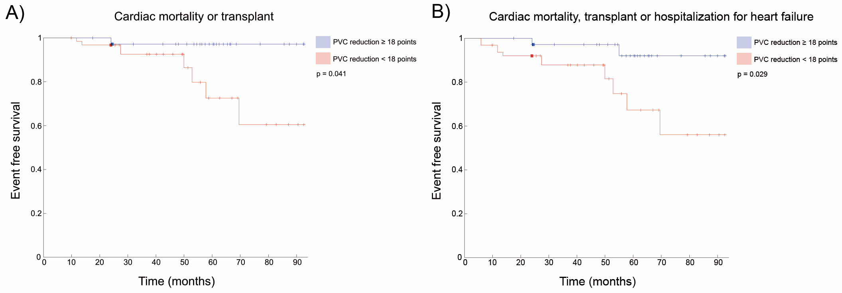
Long-term Follow-up after PVC
The long term follow-up outcomes can be predicted with the 6-month Holter monitoring
Berruezo A et al. Europace 2019

Slide 39
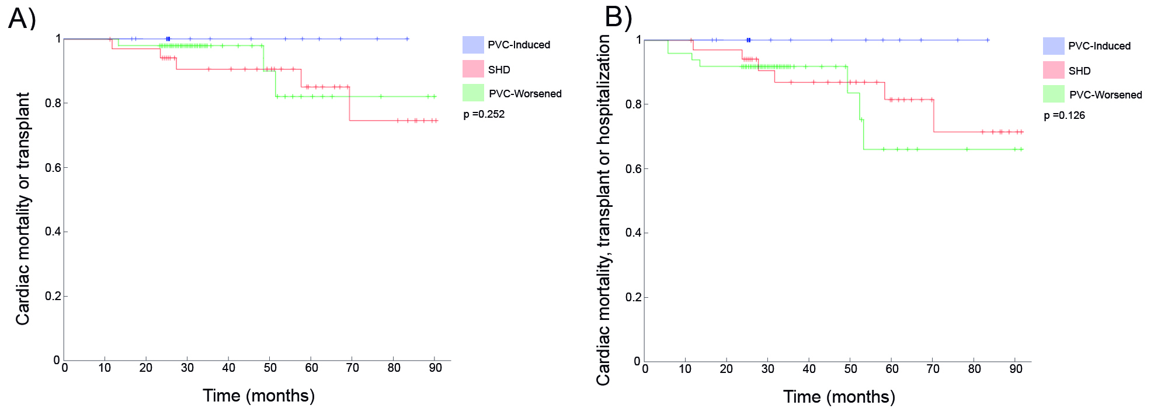
Long-term Follow-up after PVC
Excellent prognosis in patients with a PVC-induced CM
Berruezo A et al. Europace 2019

Slide 40
Conclusions I
Baseline PVC burden and the persistent successful ablation (PVC burden reduction) are the main predictors of outcomes
Patients with a “Pure” PVC-induced cardiomyopathy can be accurately identified prior to the ablation procedure
Patients with a previous SHD can also improve after frequent PVC ablation

Slide 41
Conclusions II
Amount of myocardial scar is inversely related with the improvement in cardiac function after ablation, but do not preclude response
Patients with a baseline QRS duration >130 ms have low benefit from frequent PVC ablation
  Any role of CRT?
A PVC burden reduction of 18% after ablation is associated to lower mortality and cardiac trasplant and also to less hospitalizations for HF
  But lower PVC burden reduction also obtain benefit!!

Slide 42
Thank you!!

