Slide 1
Device Detected Atrial High-Rate Episodes: Management and Clinical Gaps in Evidence
Roy Beinart, MD, FESC
Davidai Arrhythmia Center
Sheba Medical Center

Slide 2
67 year old woman w/h/o HTN
s/p DDD PPM for SSS
Current meds:
  Atenolol 50 mg/day
  Aspirin 100 mg/day
  Lisinopril 10mg/day

Slide 3
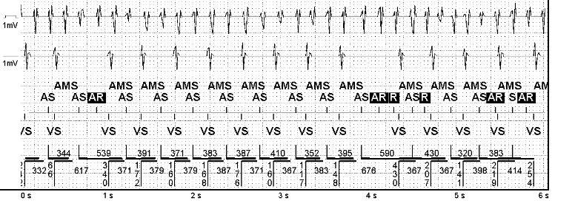
On device interrogation, the arrhythmia below is found (duration: 11 minutes)
She has no arrhythmia symptoms

Slide 4
What would you recommend?
  Continue current medications
  Start OAC

Slide 5
67 year old woman w/h/o HTN and TIA
s/p DDD PPM for SSS
Current meds:
  Atenolol 50 mg/day
  Aspirin 100 mg/day
  Lisinopril 10mg/day

Slide 6
What would you recommend?
  Continue current medications
  Start OAC

Slide 7
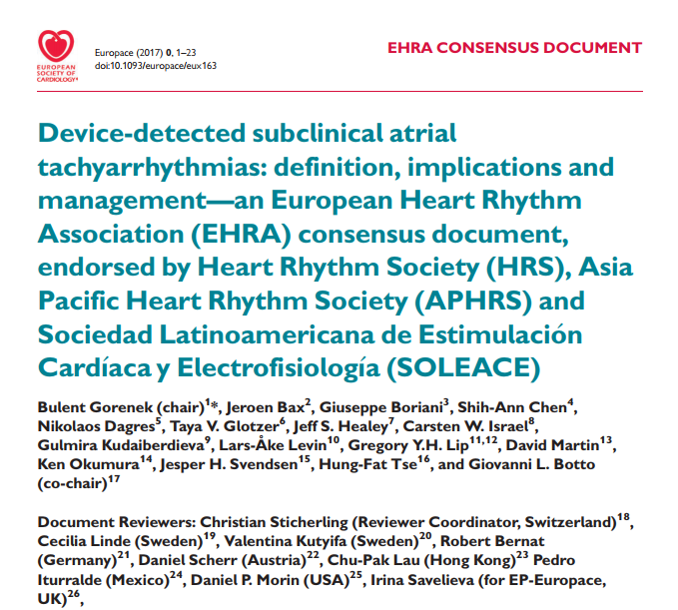
Notes:
Assert >65 HTN
Lowres ECG screening

Slide 8
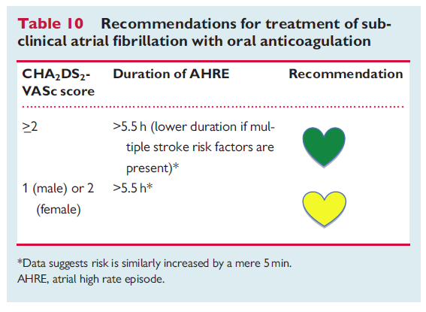
Recommendations

Slide 11
Introduction
Atrial high-rate episodes (AHREs) are detected in patients with pacemakers or ICDs.
The definition of AHREs refers to episodes with atrial tachy-arrhythmias including atrial tachycardia, atrial flutter, and atrial fibrillation (AF).
AHRE duration usually >6 min.

Slide 12
Introduction
AHREs must be distinguished from Sub clinical AF (SCAF/SCAT).
All data supporting the use of OAC for stroke prevention in AF have been obtained from patients with ECG documented AF.
The effectiveness and safety of NOACs in patients with AHRE/subclinical AF (SCAF) but without ECG documented AF is unknown.

Slide 13
% of AHRE

Slide 14
SCAF and Subsequent AF
Pooled analysis of TRENDS, PANORAMA, SOS AF; Boriani et al, Heart Rhythm. 2018;15:376–383;

Slide 16
↑ Mortality (HR 2.48 95% CI 1.25–4.91, p=0.0092),
Death or non-fatal stroke (HR 2.79; 95% CI 1.51–5.15, p=0.0011)
↑ TE: HR 2.20; 95% CI 0.96–5.05, p=0.06
↑ ischemic stroke or SE (HR 2.49; 95% CI 1.28–4.85; p=0.007).
↑ Stroke (OR=4.33. 95% CI 1.19–23.7, p<0.05)
↑ Ischemic stroke risk (log-rank test ¼ 6.2, P=0.013)
↑ ischemic stroke (HR 2.11, 95% CI 1.22–3.64, p=0.008)

Slide 17
ASSERT Trial
Van Gelder et al.

Slide 18
Hazard ratio for thromboembolism reported in previous studies
Noseworthy et al. Circulation. 2019;140

Slide 19
Strokes and AHRE
* Retrospective analysis – patients with h/o AF
Botto et al. J Cardiovasc Electrophysiol, Vol. 20, pp. 241-248, March 2009

Slide 20
Relationship of Atrial Tachy-arrhythmias, cerebrovascular events, and systemic emboli
Brambatti et al; Circulation. 2014;129:2094–2099

Slide 21
Noseworthy et al. Circulation. 2019;140

Slide 22
Perino et al. Circulation. 2019;139:2502–2512
* Retrospective analysis – patients w/o AF or OAC

Slide 23
Perino et al. Circulation. 2019;139:2502–2512
* Retrospective analysis – patients w/o AF or OAC

Slide 24
Perino et al. Circulation. 2019;139:2502–2512
* Retrospective analysis – patients w/o AF or OAC

Slide 25


Summary
Silent AF/AHRE is fairly common in CIED patients.
It increases risk of TE events, but less than clinical AF
Duration of AF is correlated with TE risk.
The duration threshold for TE risk is unclear, and is related to comorbidities.

Slide 26
Summary
There is lack of temporal relationship between AF episodes and TE events.
A strategy of starting and stopping OAC based on monitoring cannot be supported.

Slide 27
Noseworthy et al. Circulation. 2019;140

Slide 29
Noseworthy et al. Circulation. 2019;140

Slide 30

Thank you roy.beinart@sheba.health.gov.il

