Slide 1

Arrhythmia Management in Patients With Left Ventricular Assist Devices
Rabea Asleh MD PhD MHA FACC
Director, Heart Failure Unit
Hadassah University Medical Center
Jerusalem, Israel
28.11.2019

Slide 2

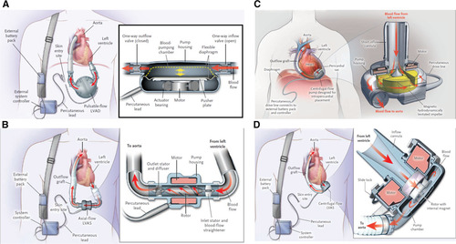
LVAD Support for Advanced Heart Failure
LVADs improve survival and minimize morbidity in patients with end-stage HF
LVADs clinical use has markedly increased over the past several years
DT and BTT indications
Notes:
2

Slide 3
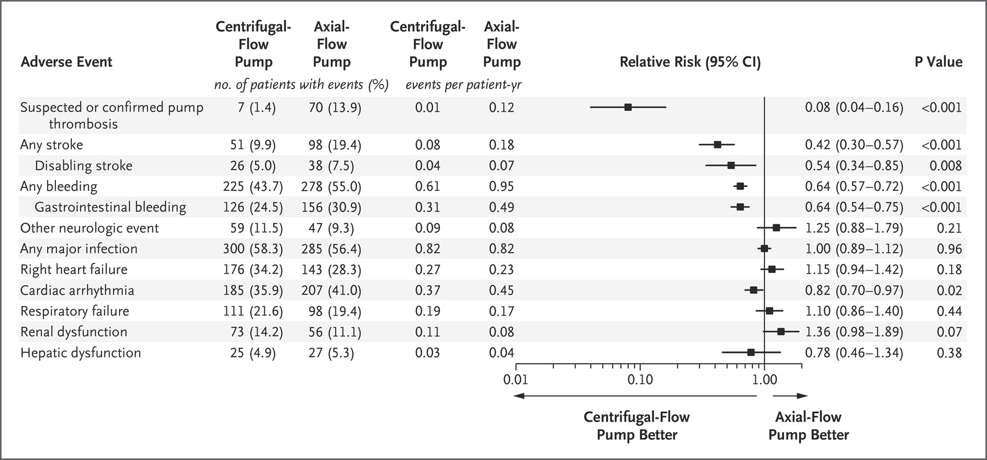
LVADs and Arrhythmias
Atrial arrhythmias (AFib) and ventricular arrhythmias (VT/VF) are common in LVAD recipients
Mechanisms: Combination of preexisting abnormal myocardial substrate and complex electrical remodeling after LVAD implantation
Patient with an LVAD presents a very different physiological state and optimal management strategies in this growing population is unclear
Mehra M et al. NEJM 2019
Notes:
3

Slide 4
LVAD and Atrial Arrhythmias
Atrial Arrhythmias are diagnosed in 20%-50% of patients before LVAD implantation
The strongest predictor of post-LVAD AF is pre-LVAD AF
Postoperative AF not strongly associated with stroke or mortality
A high burden of AF may portend a worse outcome
Notes:
4

Slide 5
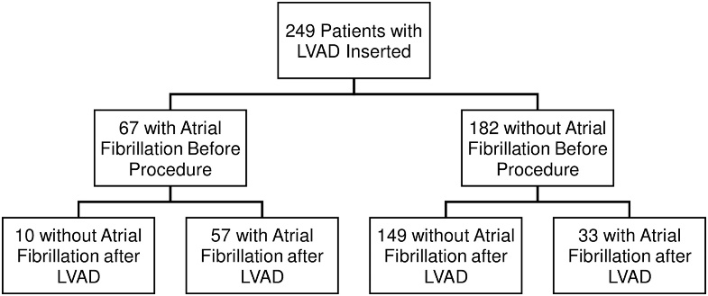
LVADs and Atrial Arrhythmias
HMII (88%)
32% developed post-LAVD AF
84% recurrence of AF after LVAD
16% de novo AF
No increased risk of stroke or death
Hickey KT et al. JACC Clin Electrophysiol 2016
Mirza et al. ISHLT 2019
Notes:
5

Slide 6
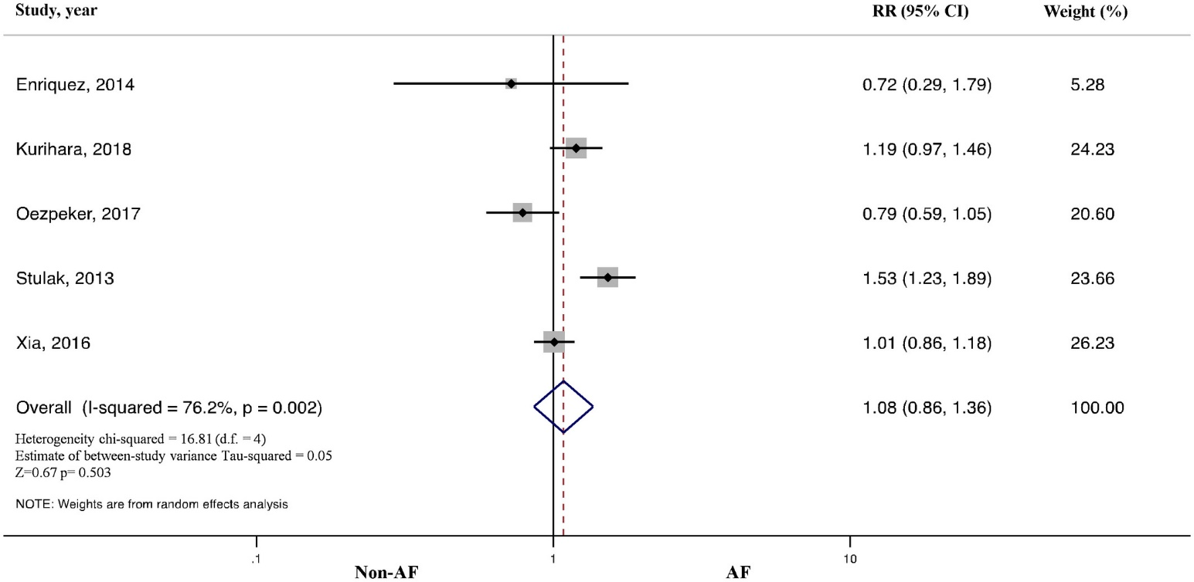
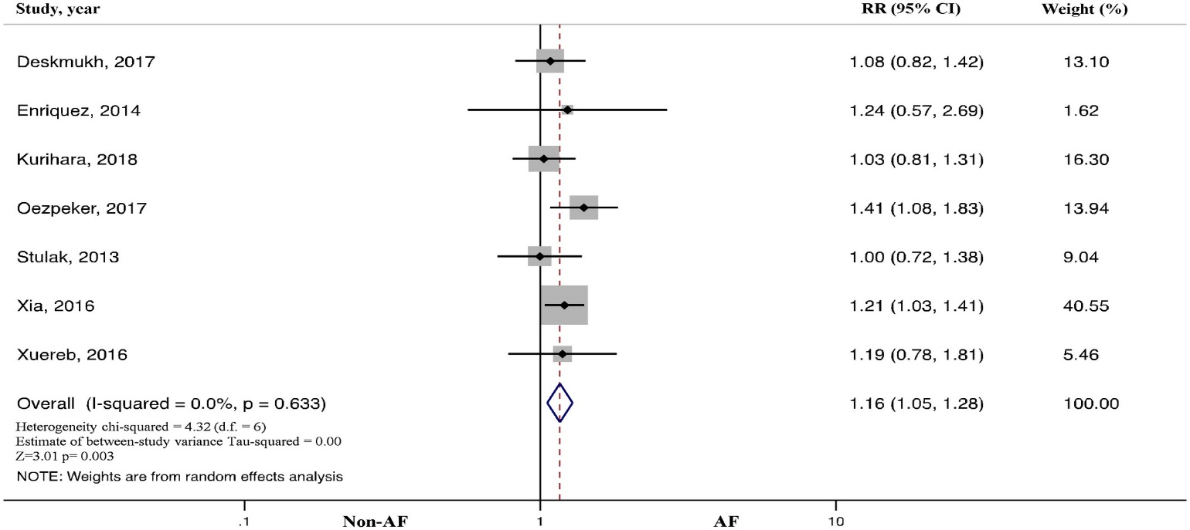
LVAD and Atrial Arrhythmias
Impact of preoperative atrial fibrillation in patients with left ventricular assist device: A systematic review and meta‐analysis
All-Cause Mortality
Thromboembolic Events
Tantrachoti P et al. J Artif Organs 2019
Notes:
6

Slide 7
Management of Atrial Arrhythmias
Importance:
  Lower physical capacity
  Atrial thrombus formation
  Retrospective studies showed more admissions for HF
  Inconsistency regarding risk of death and stroke
Management:
  Rate control: BB +/- Digoxin (avoid verapamil/diltiazem)- Ideal HR?
  If symptomatic or RV failure: Antiarrythmic treatment (amiodarone)/cardioversion?
  Ablation: Described, but rarely indicated
  Anticoagulation: Given already (no influence on INR target)
  LAA occlusion or exclusion at surgery: Not discussed
Notes:
7

Slide 8
LVAD and Ventricular Arrhythmias
Common (20-40% of pts.), more monomorphic VTs and in the early period post LVAD implantation
Mechanisms: Ischemia, fibrosis, inotropic/pressor therapies, inflow cannula, suction events, others
The majority of mapped VTs during longer-term LVAD support are related to intrinsic scar rather than the inflow cannula
Beta blocker treatment is associated with decreased risk
Notes:
8

Slide 9
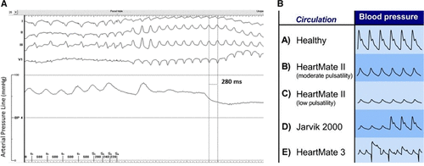
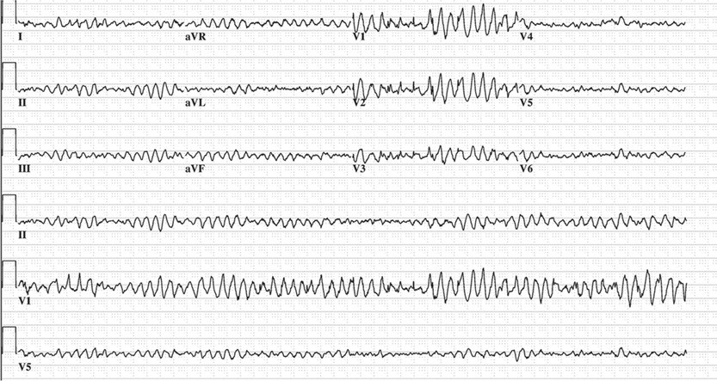
LVAD and Ventricular Arrhythmias
VAs can be tolerated for hours/days (maintained cardiac output by LVAD)
May result in low preload and adverse RV effects (failure/thrombosis)
Notes:
9

Slide 10
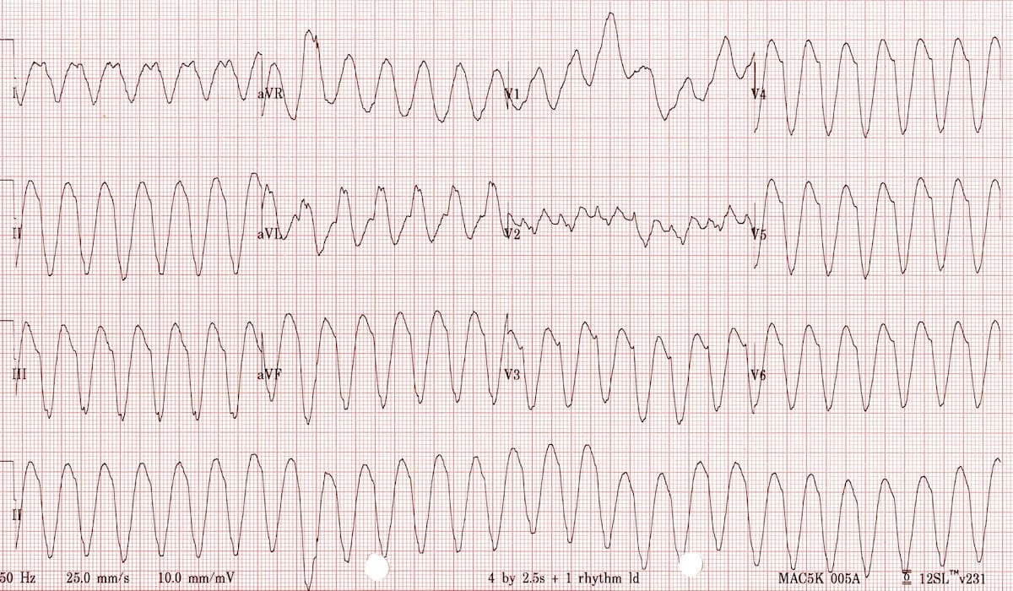
LVAD and Ventricular Arrhythmias
Pulmonary blood flow ~ CVP/PVR
Lungs
PVR
RV
LV
LVAD
CVP
Body /organs

Slide 11
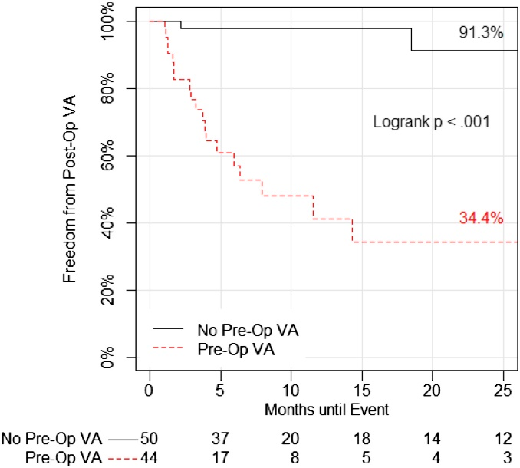
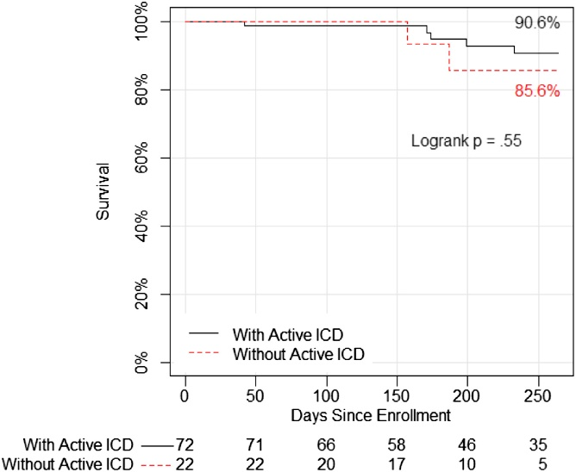
LVAD and Ventricular Arrhythmias
The most powerful predictor is having VT/VF before LVAD support
The association with mortality is not consistent
Many observational studies showed association with worse survival (causative versus a serogate marker of sicker patients ??)
VA Events
Survival
Garan AR et al. JACC 2013
Notes:
11

Slide 12
ICD in Patients With LVAD
Problem: VT/VF in most patients will lead to shock in awake patients
Should patients with ICDs have their shock therapy turned on?
  If yes, how should it be programmed?
Should patients without ICD have an ICD implanted?
Notes:
12

Slide 13
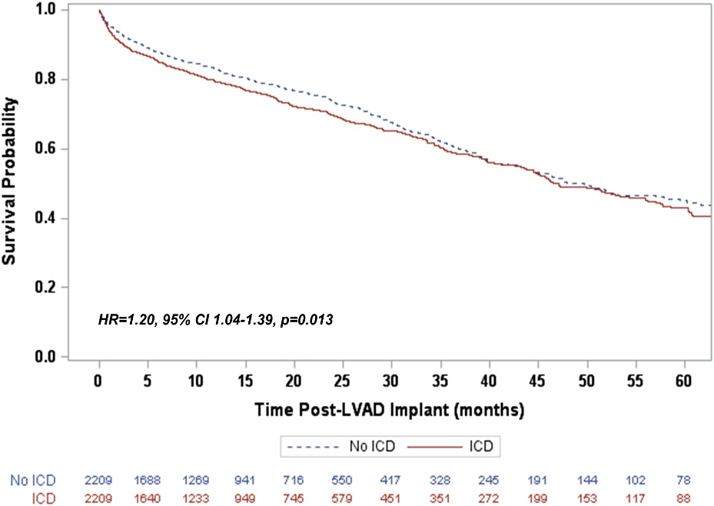
ICD in Patients With LVAD
A propensity score–matched comparison of 2209 patients with a CF-LVAD from the INTERMACS registry with and without an active ICD
ICD was associated with an increased mortality risk (HR, 1.20; P=0.013) and an increased risk of unexpected death during LVAD support (HR, 1.33; P=0.03).
Clerkin KJ et al. JACC HF 2017
Notes:
13

Slide 14
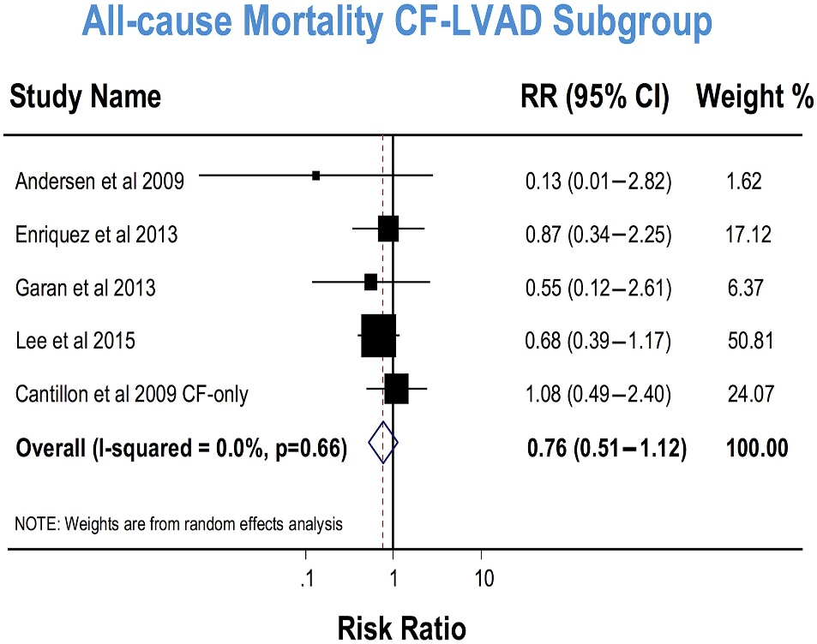
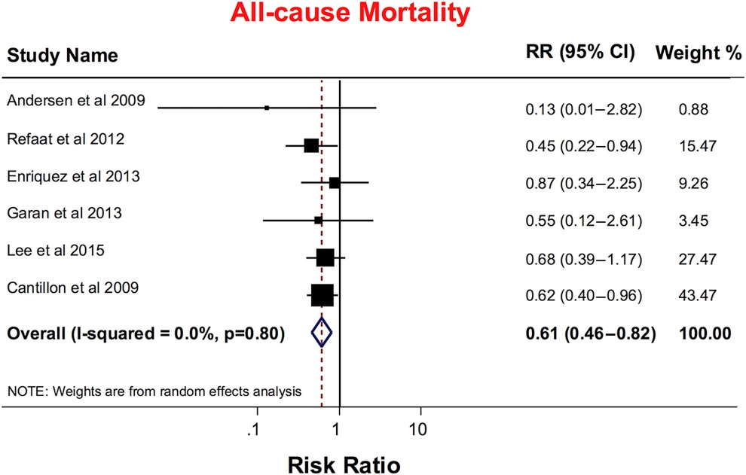
ICD in Patients With LVAD
A retrospective analysis of 937 patients with P-LVAD (60%) or CF-LVAD (40%) with and without an active ICD
ICD use was associated with a significant reduction in mortality in LVAD patients, however, this effect was not significant in patients with CF-LVADs
Kairav V. et al. JACC HF 2016
Notes:
14

Slide 15
ICD in Patients With LVAD
Meta-analysis: ICD use was NOT associated with a significant reduction in mortality in CF-LVAD patients and those implanted an ICD post CF-LVADs.
All-cause mortality in >6400 patients supported by CF-LVADs
All-cause mortality
ICD implanted post CF-LVADs
Elkaryoni A. et al. Europace. 2019
Notes:
15

Slide 16
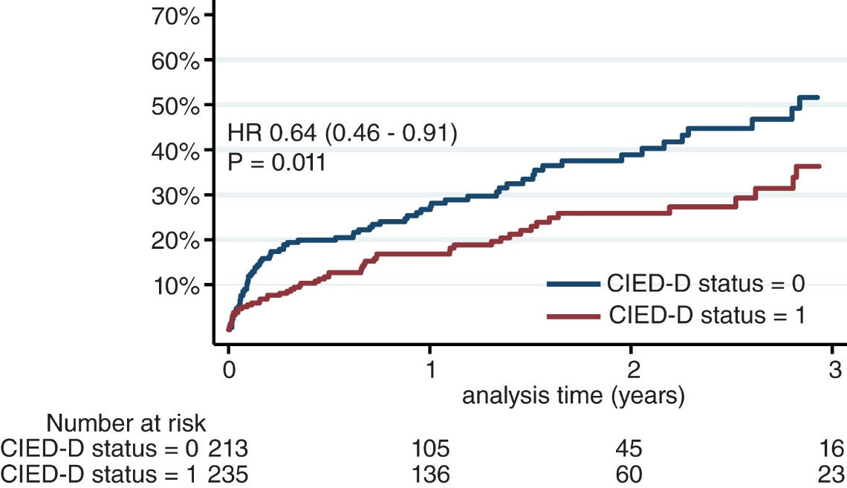
ICD in Patients With LVAD
A propensity-Score analysis of 448 patients with CF-LVAD (European PCHF-VAD registry)
Incident VAs post‐LVAD was a strong predictor of all‐cause and CV mortality
ICD use was associated with a significant improvement in survival
Cikes M et al. Eur J Heart Fail. 2019
Notes:
16

Slide 17
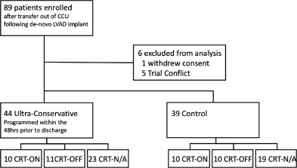
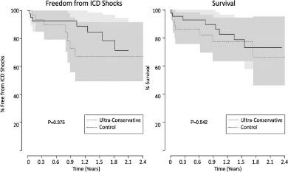
What about leaving the ICD shock therapy ON but programing it very conservatively
Patients randomized to standard ICD programming versus Ultra-conservative ICD programming strategy utilizing maximal allowable intervals to detection in the VF and VT zones with use of ATP
Richardson TD et al. JAHA. 2018
Notes:
17

Slide 18
ICD in Patients With LVAD
Recommendations
In patients with ICD: Leave shock function on/ Discuss with patient
In patients without ICD and pre-LVAD burden of VT/VF: Consider ICD
In patients without ICD and hemodynamic destabilizing VT: Amiodarone/ablation and ICD after discussion with patient
Notes:
18

Slide 19
The Impact of CRT on Clinical Outcomes in CF-LVAD Patients
Main question: Leave CRT function on?
Battery use
Does it improve HF symptoms / exercise capacity ?
Does it improve survival and other outcomes ?
Notes:
19

Slide 20
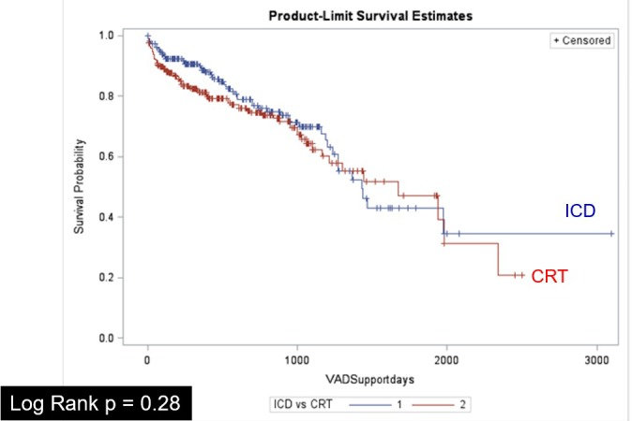
The Impact of CRT on Clinical Outcomes in CF-LVAD Patients
Continued CRT was NOT associated with improved survival, hospitalizations, incidence of VAs and ICD therapies
There were significantly higher number of pulse generator changes with CRT-D
Gopinathannair R et al. JAHA. 2018
Notes:
20

Slide 21
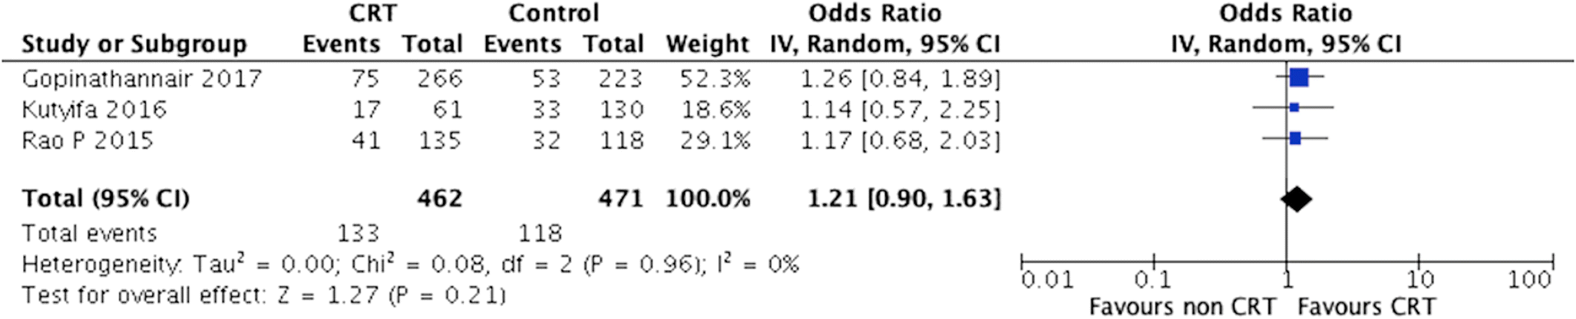
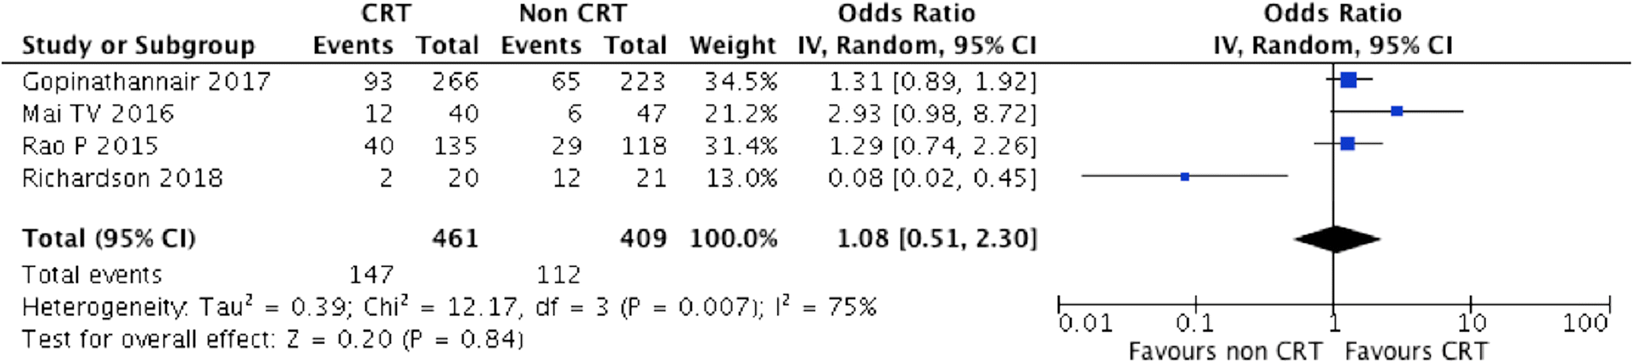
The Impact of CRT on Clinical Outcomes in CF-LVAD Patients
All-Cause Mortality
ICD Therapies
Voruganti DC et al. Heart Fail Rev. 2019

Slide 22
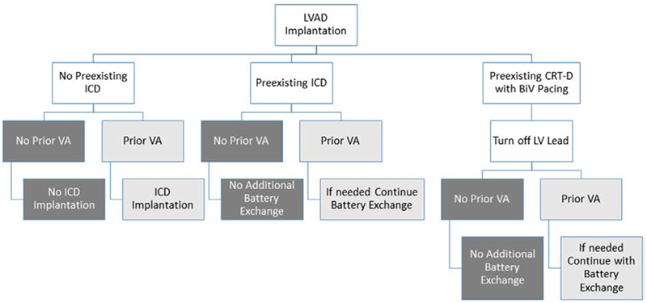
CRT in Patients With LVAD
Conclusions
Despite absence of large RCTs the available evidence favors turning OFF CRT in general
Must be decided on an individual patient basis
Notes:
22

Slide 23
Management of Arrhythmias in LVAD Patients
Tachyarrhythmia | Clinical Presentation | Acute Management | Further Management
AF | Associated with RHF, hospital admission, lower exercise capacity | Rate control, ensure adequate anticoagulation, rule out hyperthyroidism | If symptomatic: antiarrhythmic therapy and cardioversion
VT | Low PVR and adequate CVP: Awake, may have RHF, but can hemodynamically stable for hours or days, pump flow often reduced | TTE, if suction, reduce pump speed, amiodarone, sedation and cardioversion | Optimize pump speed, amiodarone, ablation ? ICD?
 | High PVR or low CVP: often awake, hemodynamically unstable, low flow alarms | Sedation and cardioversion | Optimize pump speed, amiodarone, ablation ? ICD?
VF | Low PVR and adequate CVP: often awake, may have RHF, hemodynamically stable for hours/days, pump flow often reduced | Sedation and cardioversion | Optimize pump speed, amiodarone, ICD?
 | Low PVR and adequate CVP: often awake, hemodynamically unstable, low flow alarms | Sedation and cardioversion | Optimize pump speed, amiodarone, ICD?

Slide 24
Conclusions
Observational data show no survival benefit for ICD therapy in patients with CF-LVADs
Patients who do not have an ICD before LVAD implantation may be considered for ICD implantation on a case-by-case basis
In patients with primary prevention ICDs and no sustained VAs, the benefit of generator replacement should be balanced against the procedural risks
Notes:
24

Slide 25
Conclusions
A conservative programming strategy should be used with the aim of minimizing ICD shocks
  A high-rate cutoff VF zone (240–250 bpm) with the longest programmable detection time available on the device.
  A second zone can be added for patients at risk of or with a known history of VAs with the highest detection cutoff allowed by the device unless the tachycardia is known to result in hemodynamic instability
If ATP is unsuccessful at terminating a VT episode, elective cardioversion or defibrillation under sedation is advised
Notes:
25

Slide 26
Conclusions
Certain patients with an LVAD may prefer to have their ICD therapies programmed off to minimize painful ICD shocks
An alternative option would be to give the patient a magnet to disable ICD therapies when needed
In patients with an existing CRT-D device who receive a CF-LVAD, consideration can be given to programming LV pacing off after LVAD implantation
Notes:
26

Slide 27
Conclusions
Antiarrhythmic drugs: Guideline recommendations to treat AAs and VAs in the non-LVAD population can be followed in these patients
Ablation therapy: Should be considered as a first-line therapy for typical atrial flutter in patients with an LVAD if there is a clear hemodynamic and functional compromise from the atrial flutter
VT ablation should be considered in patients with an LVAD with recurrent, drug-resistant VAs resulting in hemodynamic compromise or recurrent ICD shocks
For patients with significant VAs before LVAD implantation, intraoperative VT ablation during LVAD implantation may be effective at reducing postoperative VAs
Notes:
27

Slide 28
Thank You

