Slide 1
His bundle pacing
& Heart Failure
Daniel Keene
d.keene@imperial.ac.uk

Slide 2
His bundle pacing
& Heart Failure
Daniel Keene
d.keene@imperial.ac.uk
Notes:
I have been asked to talk about his bundle apcing as a treatment in heart failure focusing on when dyssynchrony is present

Slide 3
Notes:
im going to start in a controversial manner, this gets peoples attention

Slide 4
His bundle pacing (is probably) a BETTER solution than BiV
Notes:
Ill put it out there his bundle pacing is better than biv pacin

Slide 5
Not everyone BENEFITS from BiV
Notes:
Only highly selected patients benefit from CRT

Slide 6
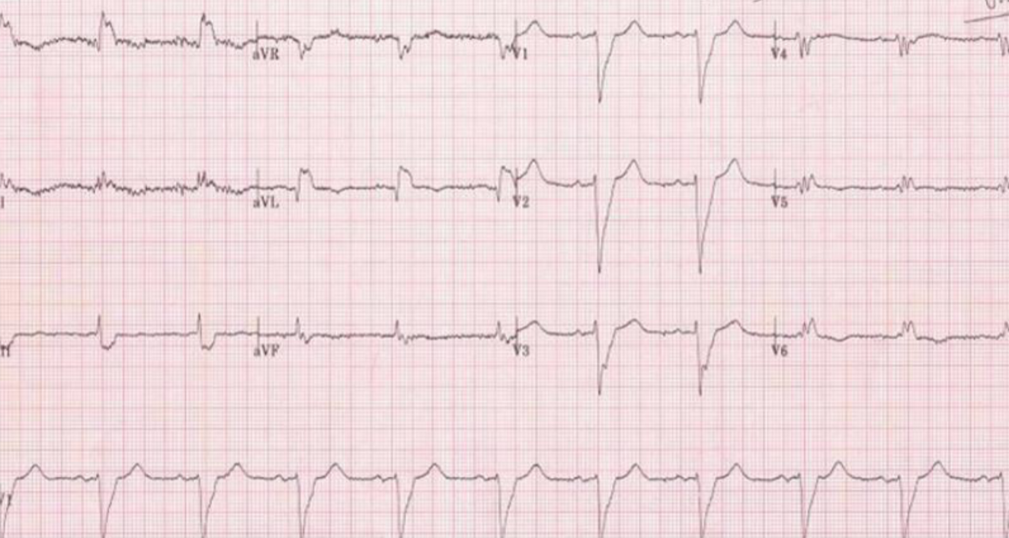
Notes:
If you are getting biventricular pacing you better pray the ecg looks like
Very broad and with LBBB

Slide 7
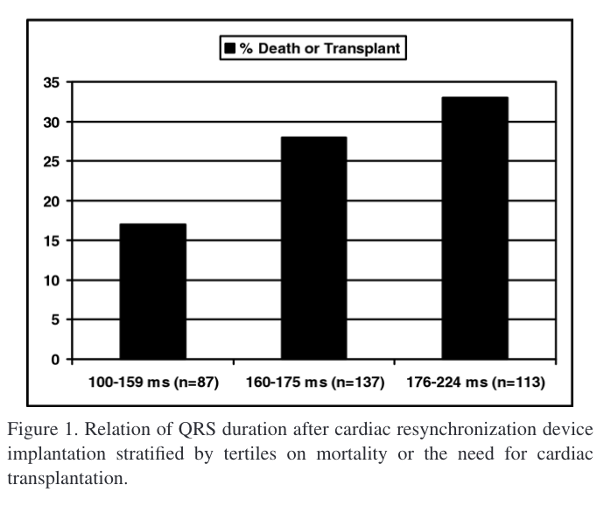
%
Dead
Or
Transplant
BiV paced QRSd
Iler et al 2008 Am J Card
Notes:
And that when you pace you get the narrowest QRS duration possible, because the broader the paced qrs the higher your likelihood of death

Slide 8
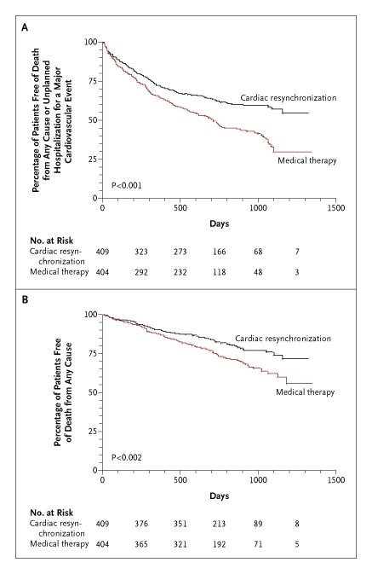
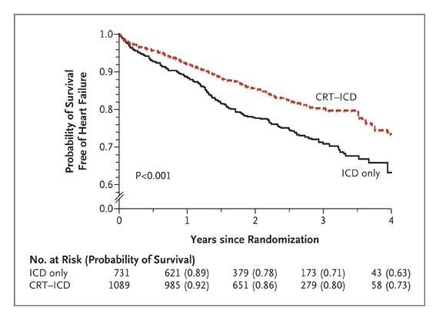
BiV is better than LBBB…
Percentage of Patients Free of Death From Any Cause
CARE HF - Cleland JG et al. N Engl J Med 2005;352:1539-1549.
MADIT CRT Moss AJ et al. N Engl J Med 2009;361:1329-1338.
Notes:
That said, for patients with LBBB
in these patients there is benefit

Slide 9
WHY?
Notes:
why

Slide 10
WHY?
Activation pattern matters
Notes:
Because the biventricular paced complex is an improvement on broad LBBB

Slide 11
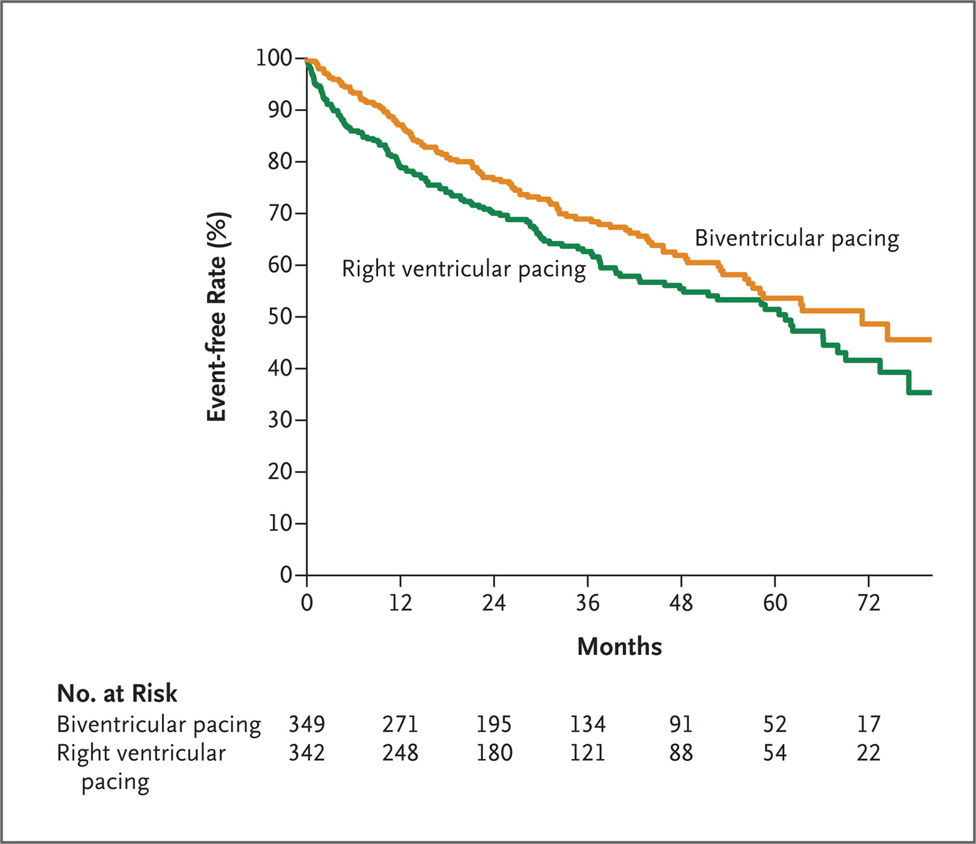
RV vs BiV
Event free rate from the Clinical Components of the Primary Outcome
Block HF - Curtis AB et al. N Engl J Med 2013;368:1585-1593.
Notes:
And it’s just about a similar story actually when we compare biv pacing to RV pacing even

Slide 12
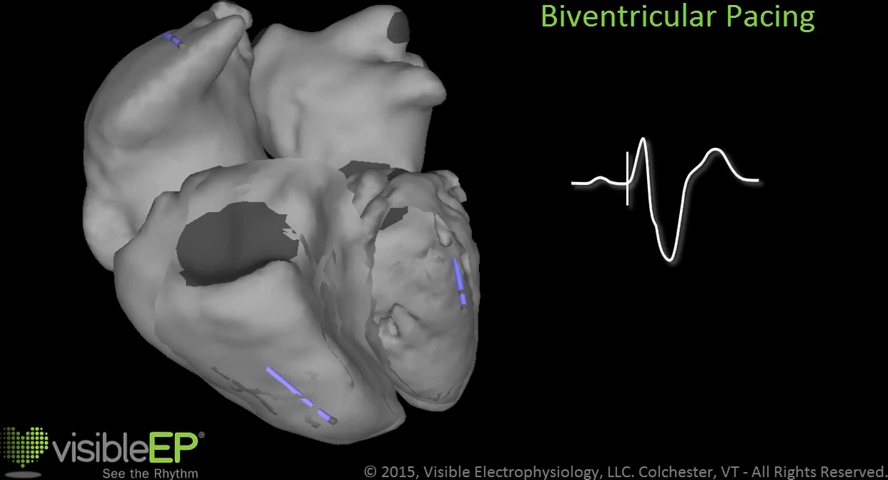
BiV is better than LBBB…
BiV is better than RV Pacing…
Event free rate from the Clinical Components of the Primary Outcome
Percentage of Patients Free of Death From Any Cause
CARE HF - Cleland JG et al. N Engl J Med 2005;352:1539-1549.
Block HF - Curtis AB et al. N Engl J Med 2013;368:1585-1593.
Notes:
if the alternative qrs is really wide, causing catatstrophic inccordination
then biventricular apcing improves the coordination just enough to to improve symptoms and survival

Slide 13
Notes:
But stop there

Slide 14
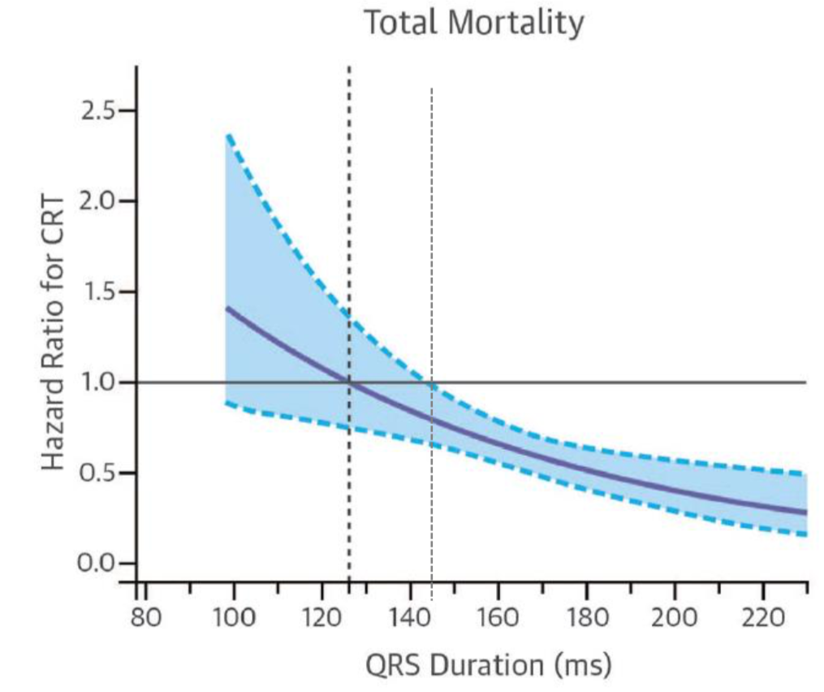
META ANALYSIS
(CARE HF, MIRACLE, REVERSE, MIRACLE ICD, RAFT)
BIV is only beneficial if
QRS >140ms
(OR the alternative is RV pacing)
Cleland JG et al. Eur Heart J 2013, 34: 3547-56.
Notes:
The benefit of biventricular pacing only exists if your qrs is more than 140ms or the alternative is an RV paced complex

Slide 15
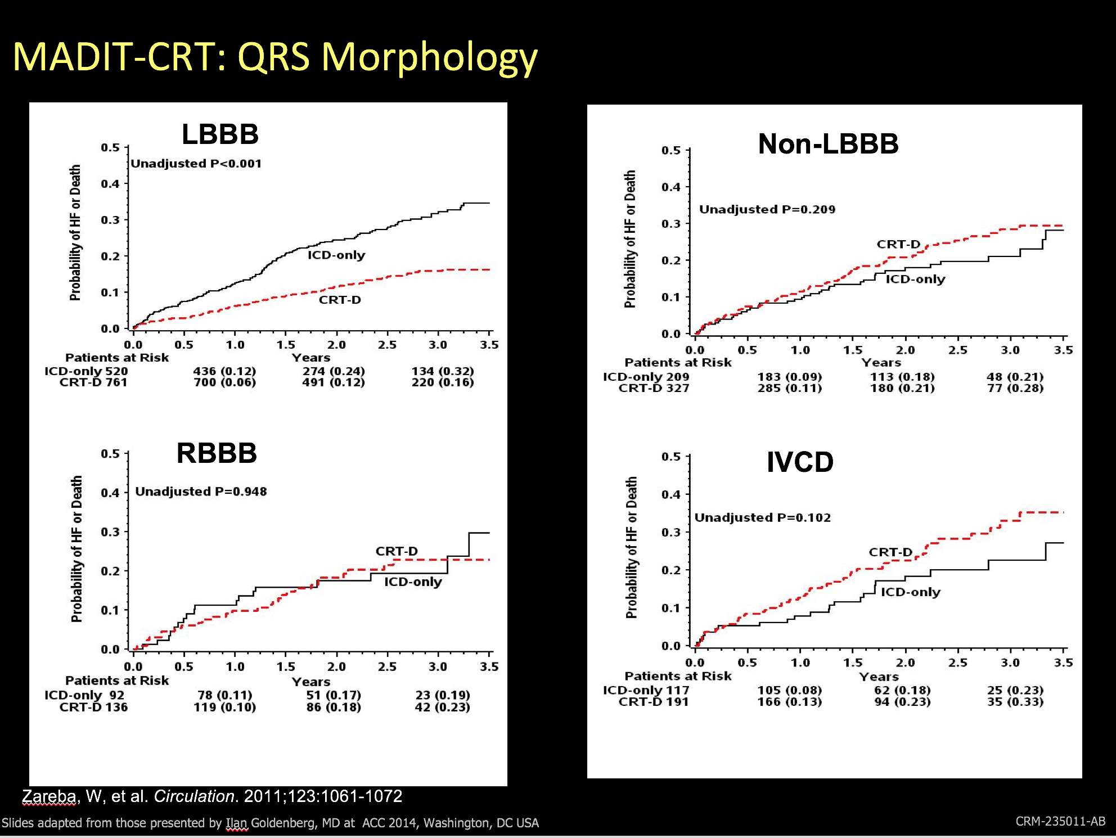
Who benefits?
MADIT CRT ANALYSIS Zareba et al Circulation 2011, 123: 1061-72.
Notes:
You got to have lbbb

Slide 16
Who benefits?
MADIT CRT ANALYSIS Zareba et al Circulation 2011, 123: 1061-72.
Notes:
It is of no benefit if you have RBBB

Slide 17
Who benefits?
MADIT CRT ANALYSIS Zareba et al Circulation 2011, 123: 1061-72.
Notes:
Or non specific intra ventricular conduction delay

Slide 18
Who benefits?
MADIT CRT ANALYSIS Zareba et al Circulation 2011, 123: 1061-72.
Notes:
In essence if you don’t have lbbb it’s a bad idea

Slide 19
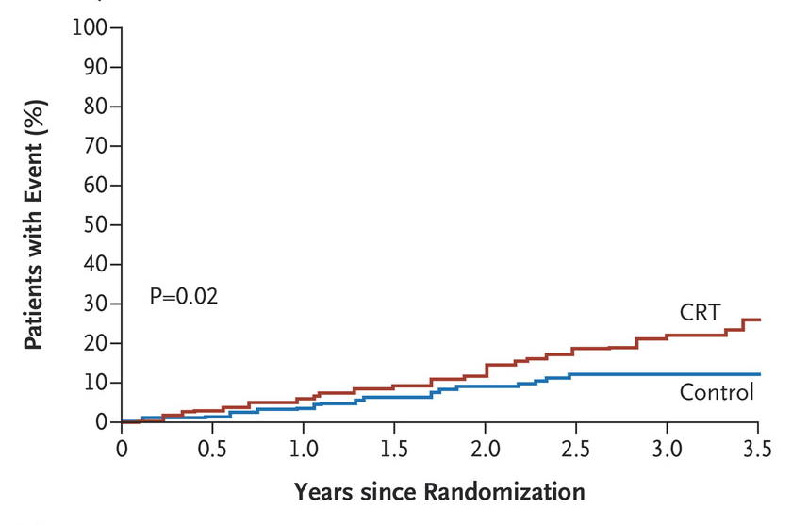
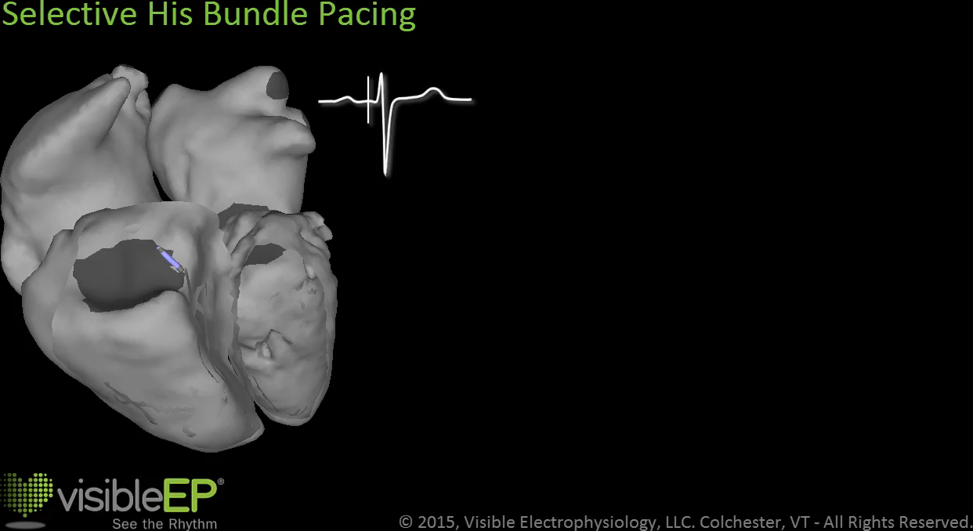
Worsening Ventricular Activation is Bad
Death From Any Cause
BiV Pacing
P = 0.02
Minimal Pacing
ECHO CRT Ruschitzka F et al. N Engl J Med 2013;369:1395-1405.
Notes:
and scarily when given to patients with narrow QRS even when carefully selected to have “mechanical dyyscyncrhonry”

Slide 20
Worsening Ventricular Activation is Bad
Death From Any Cause
BiV Pacing
P = 0.02
Minimal Pacing
ECHO CRT Ruschitzka F et al. N Engl J Med 2013;369:1395-1405.
Notes:
It kills you!

Slide 21
WHY?
BiV is not normal
Notes:
Biventricular pacing is not normal and

Slide 22
Thank to Peter Spector and Dan Lusgarten
Notes:
has four fundamental problems
activation is unnatural - it is backwards - epicardial to endocardial
second it relys on cell to cell conduction rather than the high speed native conduction system
third - we are limited in lead placement to the few locations nature offers
fourth unfrotunately lv activation time is rarely returned to normal with biv pacing

Slide 23
BiV is better than LBBB…
Percentage of Patients Free of Death From Any Cause
CARE HF - Cleland JG et al. N Engl J Med 2005;352:1539-1549.
MADIT CRT Moss AJ et al. N Engl J Med 2009;361:1329-1338.
Notes:
And when we acknowledge these limitations
look at these studies again where we said Biv is good…if we take off the rose tinted glasses

Slide 24
It still leaves a lot to be desired….
Probability of Survival Free
of Heart Failure
Percentage of Patients Free of Death From Any Cause
CARE HF - Cleland JG et al. N Engl J Med 2005;352:1539-1549.
MADIT CRT Moss AJ et al. N Engl J Med 2009;361:1329-1338.
Notes:
EVEN where we improve on LBBB,
look at the area above the curve
There is scope to improve things even for those with LBBB

Slide 25
Notes:
but certainly we ALSO have to do better for
Heart failure patients with RBBB, with long PR intervals and pathological av dyssynchrony, and those that need lots of anti-bradycardia pacing

Slide 26
Intrinsic Rhythm LBBB
Notes:
So lets start with a patient
Here we have Straight forward left bundle branch block
We have the option of crt, which might help a little, but could never deliver this (new slide)

Slide 27
Intrinsic Rhythm LBBB
Selective His Pacing with LBBB reversal
Notes:
Reversal of that horrible looking qrs pattern to something far improved
This is the solution his bundle pacin gives us
improving cardiac activation pattern in this way will be massive

Slide 28
Thank to Peter Spector and Dan Lusgarten
Notes:
his apcing provides physiological activation of the ventricule just like in health
once The pacing lead fires
activation spreads down the native specialised his purkinjee conduction system
this is then followed by rapid depolarisation and activatin of the ventricle giving a normal and narrow qrs complex

Slide 29
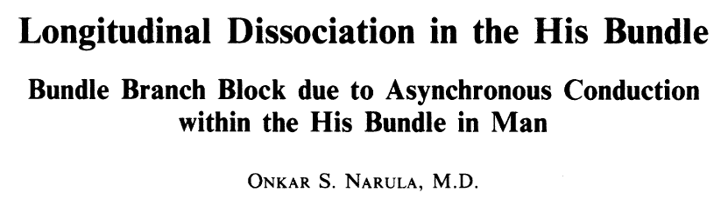
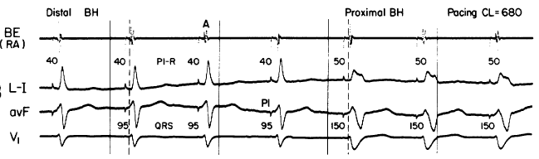
Reversing Bundle Branch Block
Notes:
And knowing that his pacing could reverse bundle branch block is not new
in 1977 narula
paced the his bundle in 25 patients with bbb
he started proximaly and edged his pacing catheter distally
He found changes in the qrs duration
as he moved more distal he achieved a narrower qrs
What might explain this is pacing beyond the site of block….

Slide 30
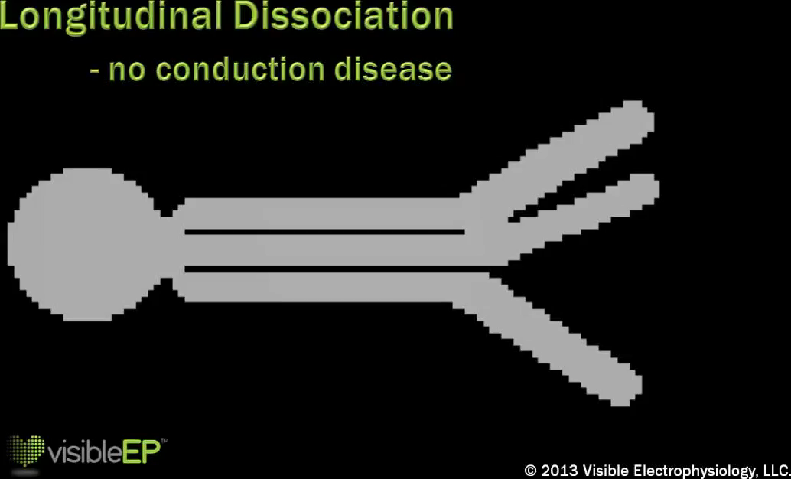
Bundle Branch Block Reversal
Notes:
And that can nicely be seen here- in health conduction travels down longitudianlly dissociated fibres to each bundle of the conduction system
These may be obstructed in someone with bundle branch block
But can be bypassed by pacing at a site distal to the site of the block

Slide 31
I
II
III
aVR
aVL
aVF
V1
V2
V3
V4
V5
V6
Intrinsic
Sharma et al. Heart Rhythm 2018
Notes:
Id like to show you a case example of his pacing in action in someone with intrinsic LBBB

Slide 32
I
II
III
aVR
aVL
aVF
V1
V2
V3
V4
V5
V6
Intrinsic
2 Volts
Sharma et al. Heart Rhythm 2018
Notes:
His pacing at 2v is applied
the LBBB is reversed, however you may notice a pseudo delta wave at the time of the pacing impulse (v3), this is because inaddition to capturing the his bundle there is also capture of some of the surrounding muscle, this would be non selective capture

Slide 33
Sharma et al. Heart Rhythm 2018
Notes:
You can appreciate from the schematic what is occuring, the red squiggle depicts the site of block in the lbb, in addition to supplying sufficient energy at this site to activate this part of the bundle branch there is also capture of the surrounding muscle

Slide 34
I
II
III
aVR
aVL
aVF
V1
V2
V3
V4
V5
V6
Intrinsic
2 Volts
Sharma et al. Heart Rhythm 2018
Notes:
so

Slide 35
I
II
III
aVR
aVL
aVF
V1
V2
V3
V4
V5
V6
Intrinsic
2 Volts
1.5 Volts
Sharma et al. Heart Rhythm 2018
Notes:
As we come down on the output to 1.5 v you will notice that that local myocardial capture represented by a pseudo delta wave is no longer present just selective reversal of the lbbb

Slide 36
Sharma et al. Heart Rhythm 2018
Notes:
Only enough energy is given to activate the bundle and this time not the surrounding tissue - this just emphasizes the point that his bundle pacing responses can be output dependednt

Slide 37
I
II
III
aVR
aVL
aVF
V1
V2
V3
V4
V5
V6
Intrinsic
2 Volts
1.5 Volts
Sharma et al. Heart Rhythm 2018
Notes:
But then

Slide 38
I
II
III
aVR
aVL
aVF
V1
V2
V3
V4
V5
V6
Intrinsic
2 Volts
1.5 Volts
1 Volts
Sharma et al. Heart Rhythm 2018
Notes:
As we come down further you will notice we still have his capture (point the pacing spikes) but we are no longer providing

Slide 39
Sharma et al. Heart Rhythm 2018
Notes:
Sufficient energy to engage the diseased part of the left bundle branch

Slide 40
I
II
III
aVR
aVL
aVF
V1
V2
V3
V4
V5
V6
Intrinsic
2 Volts
1.5 Volts
1 Volts
Sharma et al. Heart Rhythm 2018
Notes:
So we are left with a paced lbbb
Similar responses with right bundle branch block are seen too

Slide 41
Bundle Branch Block
Notes:
Now interestingly We know
even in patients with left bundle branch block and gross left axis deviation i.e where the block may theoretically involve the Left anterior fasicle these blocks can still be narrowed or reversed even though our pacing lead can not physically get to this lcoation anatomically as more than likely this part of the conduction system is already deep within the muscular septum

Slide 42
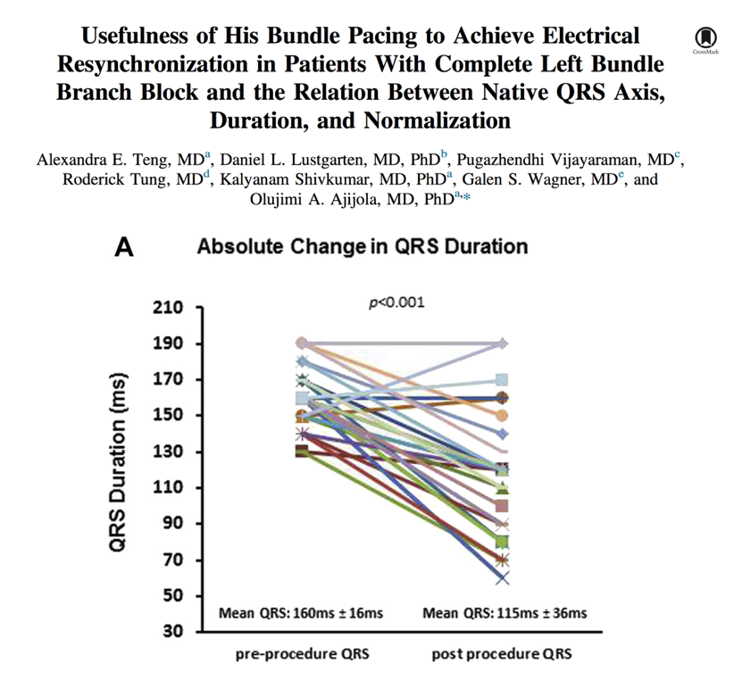
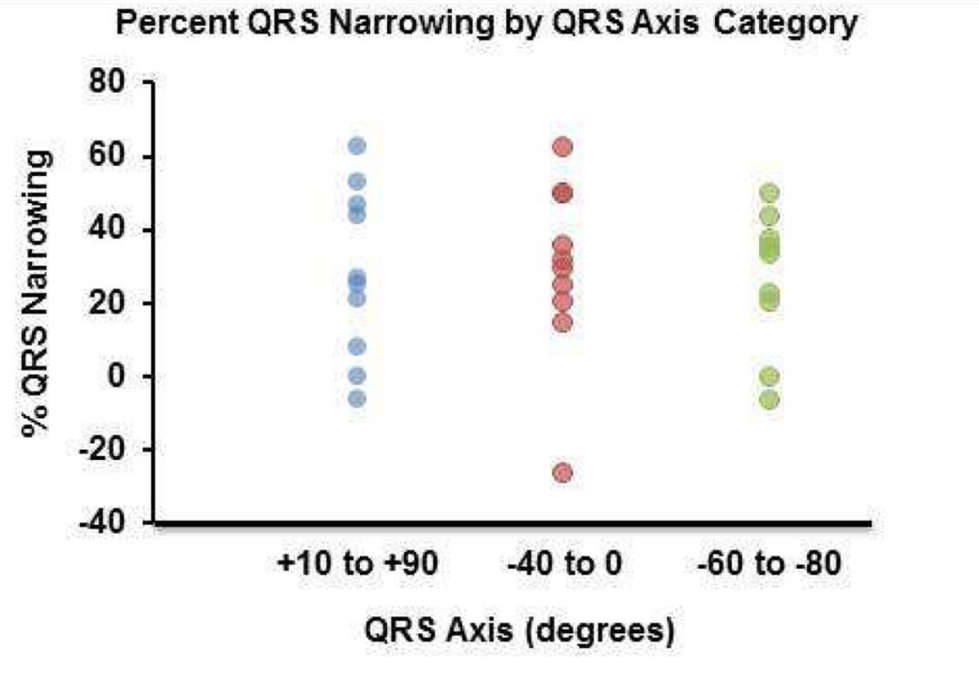
Notes:
Yet we see
there has been no proven obvious correlation between qrs duration and axis and narrowing and it has been shown approx 80% of patients will narrow or reverse and this is irrespective of their starting qrs duration or exact bundle branch block morphology and
So even those with potentially distal block display reversal or correction patterns
So we have to ask how might this occur?

Slide 43
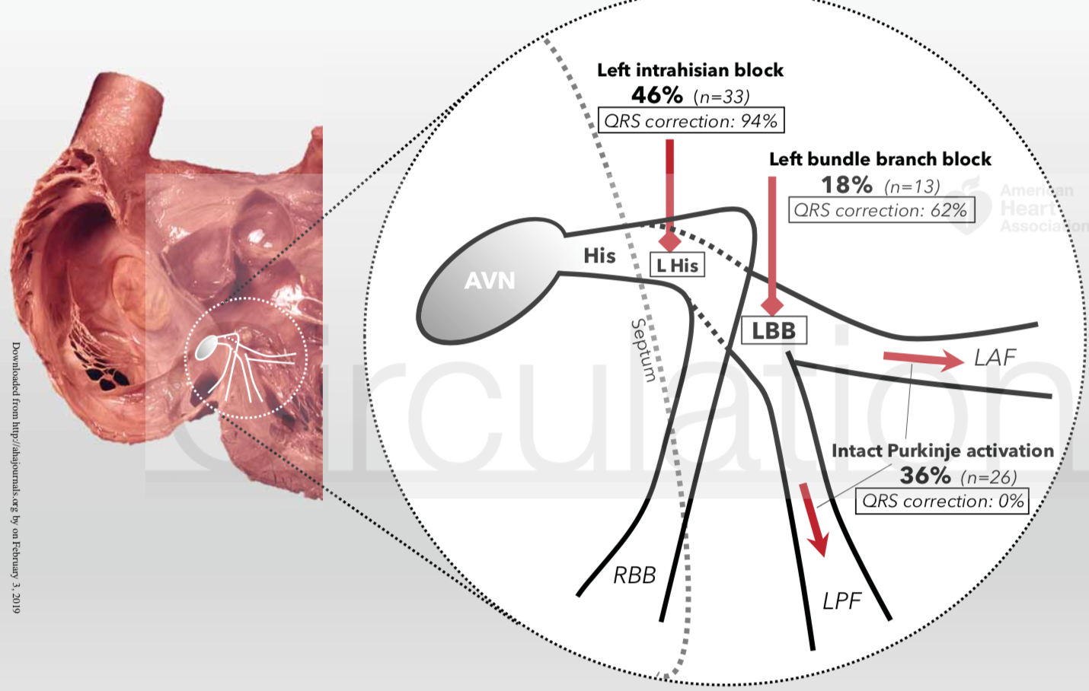
Upadhyay et al.; Intracardiac Delineation of LBBB Patterns Circ 2019
Notes:
And I think one realisiation may be that the majority of conduction system disease that causes bundle branch block may actually be located in the longitudinally dissociated fasicles in more proximal locations than we imagine
and the cases that we cant narrow might be those where the block is in the myocardium rather than within the conduction tissue or
if the block although in the conduction system is really far far away from our pacing sites

Slide 44
Upadhyay et al.; Intracardiac Delineation of LBBB Patterns Circ 2019
Notes:
so if we look here, left septal activation was plotted
we see in the control patient with narrow qrs on the left we can see his purkinjee activation present at all levels along the left septum,
however in the far right patient we see lbbb with intrahisian block from a proximal location, his, purkinje and then nothing - this seemingly is the majority of patients with true LBBB
however the middle panel shows a broad QRS but not caused by his purkinjee disease and in these patients correction is much harder

Slide 45
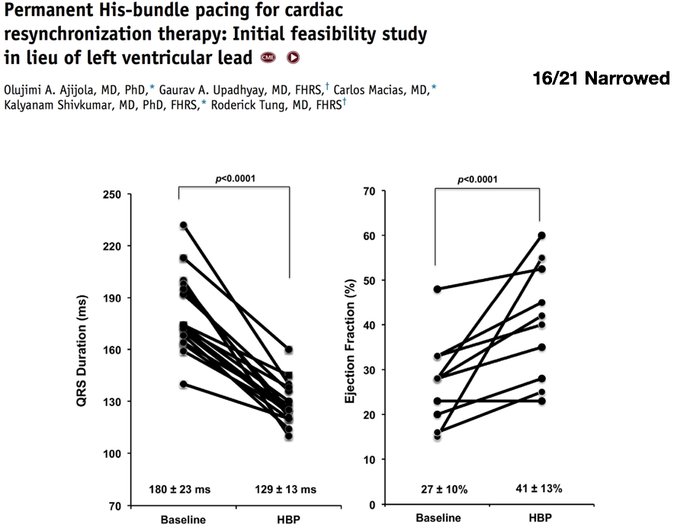
QRS narrowing
EF improving
Notes:
but what we see is
when QRS duration is shortened
after following these patients for 12 months

Slide 46
QRS narrowing
EF improving
Notes:
That This normalisation of ventricualr activation improves lv ejection fraction and also patient symptoms

Slide 47
Within Patient Comparison: His vs BIV
Arnold, Shun-Shin, Keene et al. JACC, 2018;72(24):3112-22
Notes:
And if we compare the within patient effects of his pacing versus biventricular pacing in those with LBBB

Slide 48
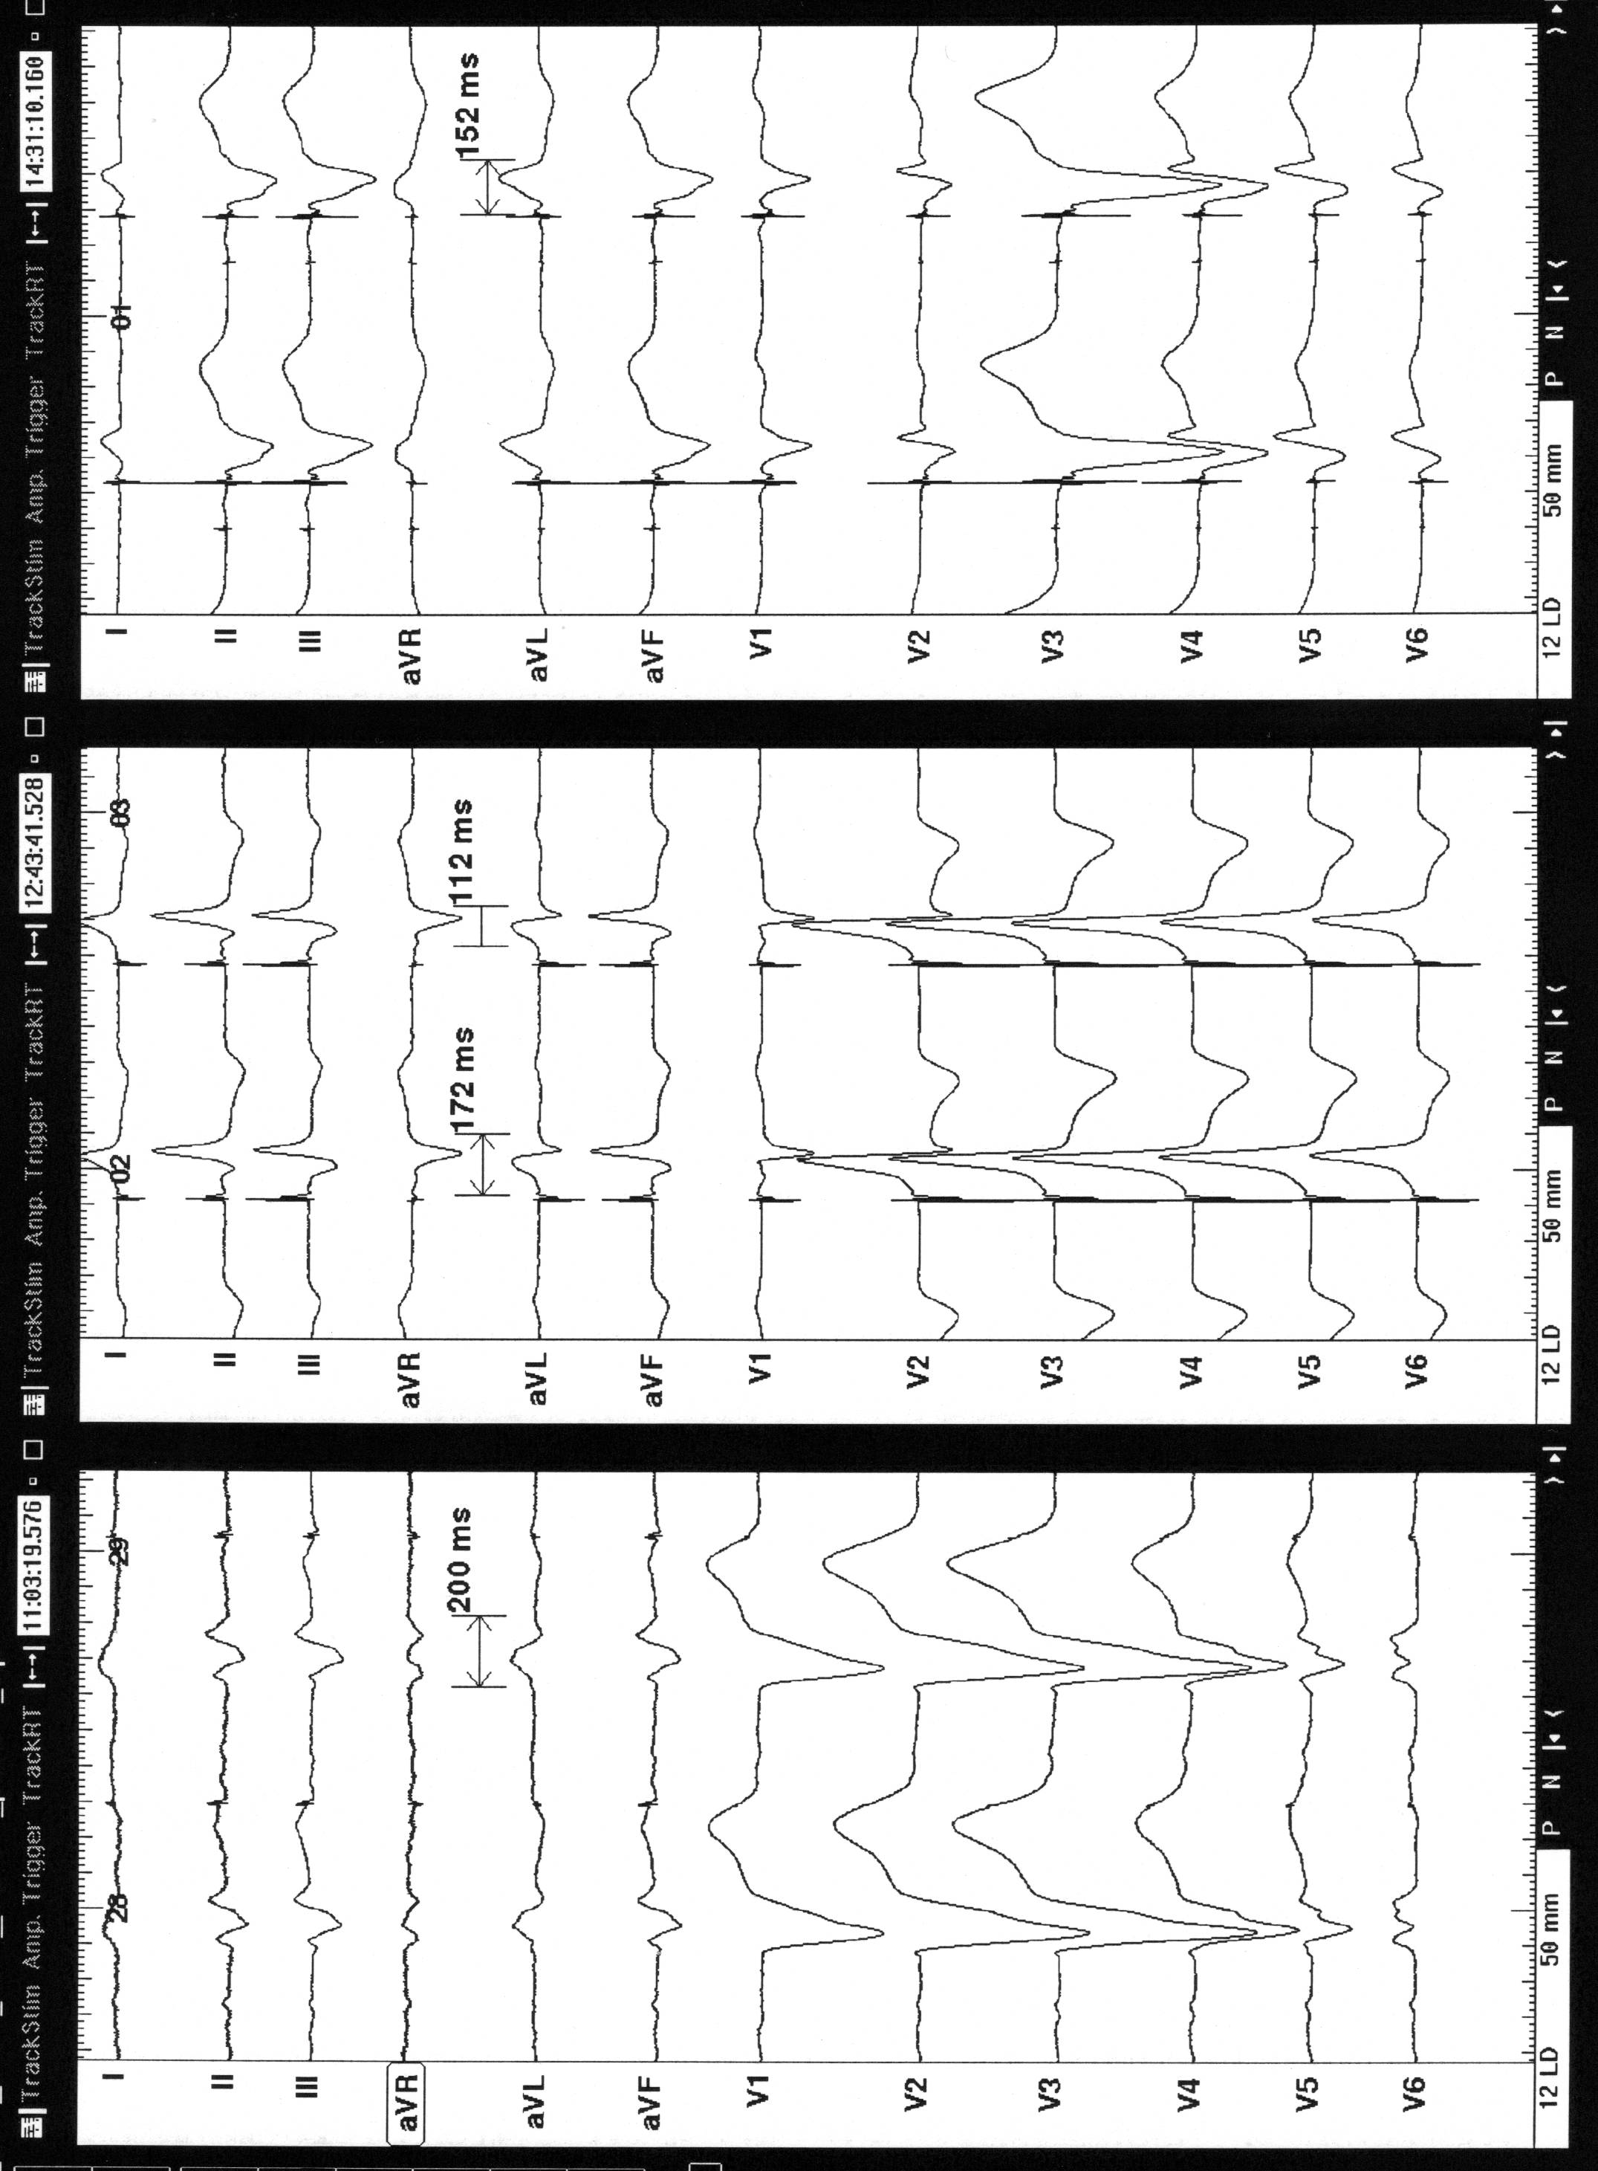
Native LBBB QRS 200ms
Notes:
We know in LBBB that
The ventricular activation is long
Its Early in the rv and very late in the lv–

Slide 49
Native LBBB QRS 200ms
BiV Pacing QRS 152ms
Notes:
And biv pacing can improve this a little,
And although not at all back to normal
Can be a life saving intervention

Slide 50
Native LBBB QRS 200ms
BiV Pacing QRS 152ms
His Bundle Pacing QRS 112ms
His Bundle pacing
Notes:
But
now this never gets less astounding
with his bundle pacing we can reduce that activation time even further, allowing normal healthy rapid ventricular activation

Slide 51
Intrinsic LBBB activation
His bundle
Pacing
Biventricular Pacing
Notes:
And when we measure high precision haemodynamics and plot av delay optimsiation curves for both of these pacing modes within the same patient

Slide 52
Intrinsic LBBB activation
His bundle
Pacing
Biventricular Pacing
Notes:
We see that his pacing gives superior hamedynamics
far greater than with biv pacing

Slide 53
Intrinsic LBBB activation
His bundle
Pacing
Biventricular Pacing
Notes:
And at the optimal av delay

Slide 54
Benefit at OPT AVD
Intrinsic LBBB activation
His bundle
Pacing
3mmHg
Biventricular Pacing
Notes:
We see that biv gives us 3mmhg of benefit , extra cardiac output, over a control state in this example patient

Slide 55
Benefit at OPT AVD
His bundle
Pacing
8mmHg
Intrinsic LBBB activation
3mmHg
Biventricular Pacing
Notes:
Whereas his gives us over double and gives us 8mmhg

Slide 56
Improvement in ventricular activation time
Arnold, Shun-Shin, Keene et al. JACC, 2018;72(24):3112-22
Notes:
This was just one case but when we look across the whole 18 patient cohort who we performed this acute protocol on we see

Slide 57
Improvement in ventricular activation time
Arnold, Shun-Shin, Keene et al. JACC, 2018;72(24):3112-22
Notes:
That biv pacing reduces activation time… a little

Slide 58
Improvement in ventricular activation time
Arnold, Shun-Shin, Keene et al. JACC, 2018;72(24):3112-22
Notes:
But his pacing pacing reduces activation time dramatically – giving far more normal looking qrs complexes

Slide 59
Haemodynamic improvement
Arnold, Shun-Shin, Keene et al. JACC, 2018;72(24):3112-22
Notes:
The haemodynamic changes are so exciting too

Slide 60
Haemodynamic improvement
Arnold, Shun-Shin, Keene et al. JACC, 2018;72(24):3112-22
Notes:
Unsurprisingly there is a significant difference from baseline with biv pacing – and lets not forget that this difference was what led to a survival difference in rcts

Slide 61
Haemodynamic improvement
Arnold, Shun-Shin, Keene et al. JACC, 2018;72(24):3112-22
Notes:
But is massively overshadowed by the whopping benefit seen with his pacing with a masive difference in haemodynamics.

Slide 62
Arnold, Shun-Shin, Keene et al. JACC, 2018;72(24):3112-22
Notes:
Now I do not have a crystal ball but if you recall back t

Slide 63
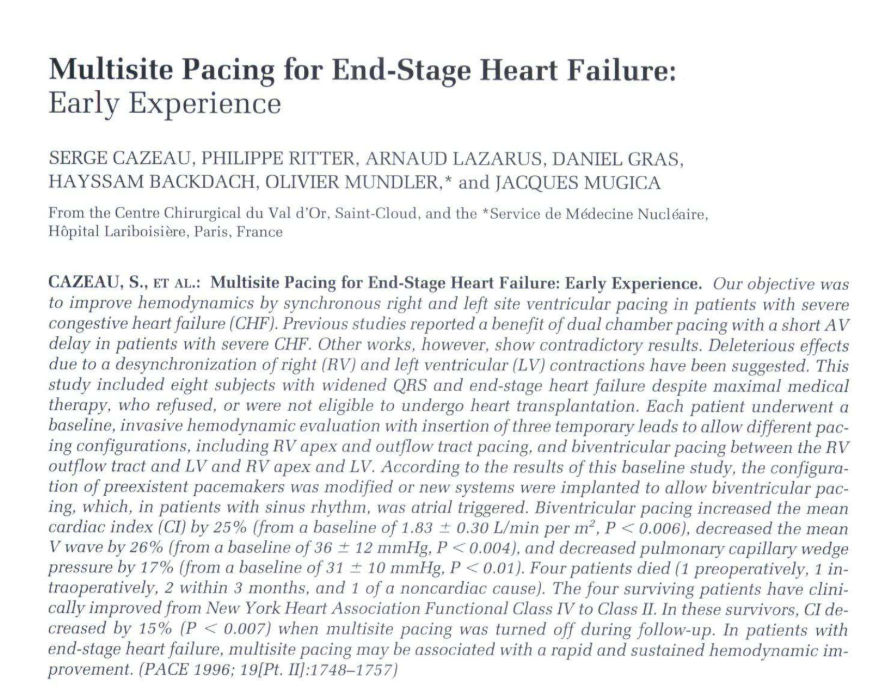
Cazeau – BIV improves acute haemodynamics
Arnold, Shun-Shin, Keene et al. JACC, 2018;72(24):3112-22
Cleland JG et al. N Engl J Med 2005;352:1539-1549
Cazeau et al. PACE 1996;19:1748-1757
Notes:
to the early days of crt developments
where the initial studies showed haemodynamic improvements

Slide 64
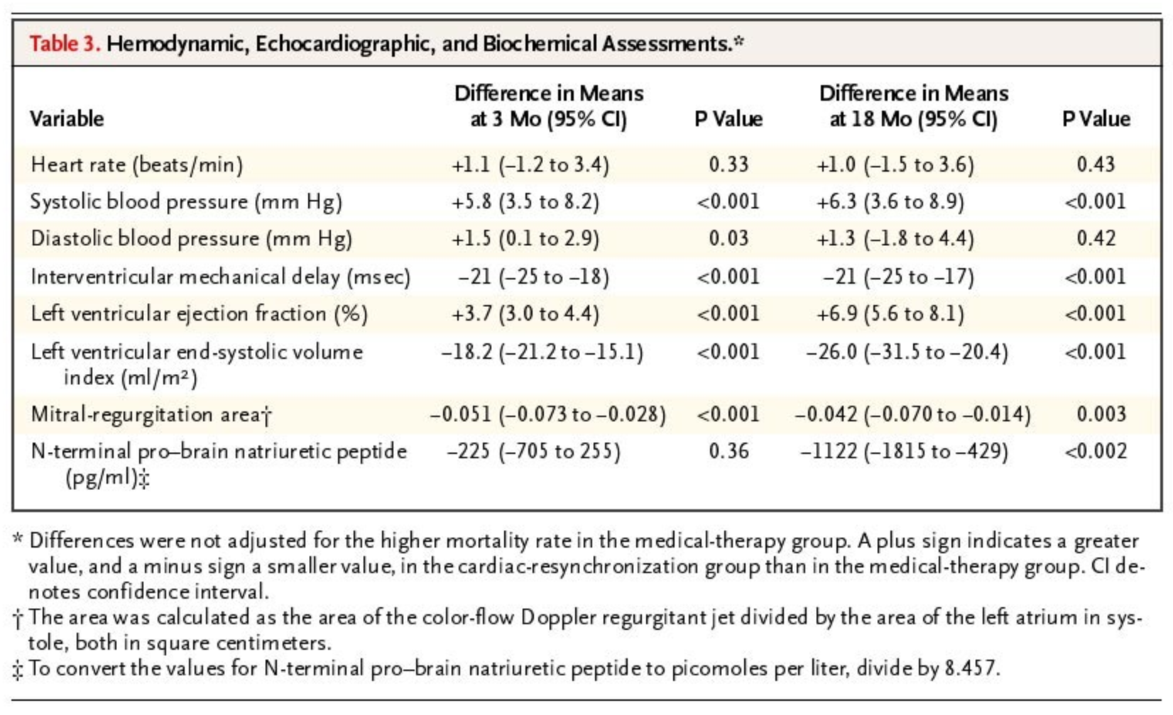
Cazeau – BIV improves acute haemodynamics
CARE-HF
Increase in haemodynamics = mortality benefit
Arnold, Shun-Shin, Keene et al. JACC, 2018;72(24):3112-22
Cleland JG et al. N Engl J Med 2005;352:1539-1549
Cazeau et al. PACE 1996;19:1748-1757
Notes:
and these improvements in cardiac function where shown to lead to mortality benefit
this may well be the path his apcing follows too

Slide 65
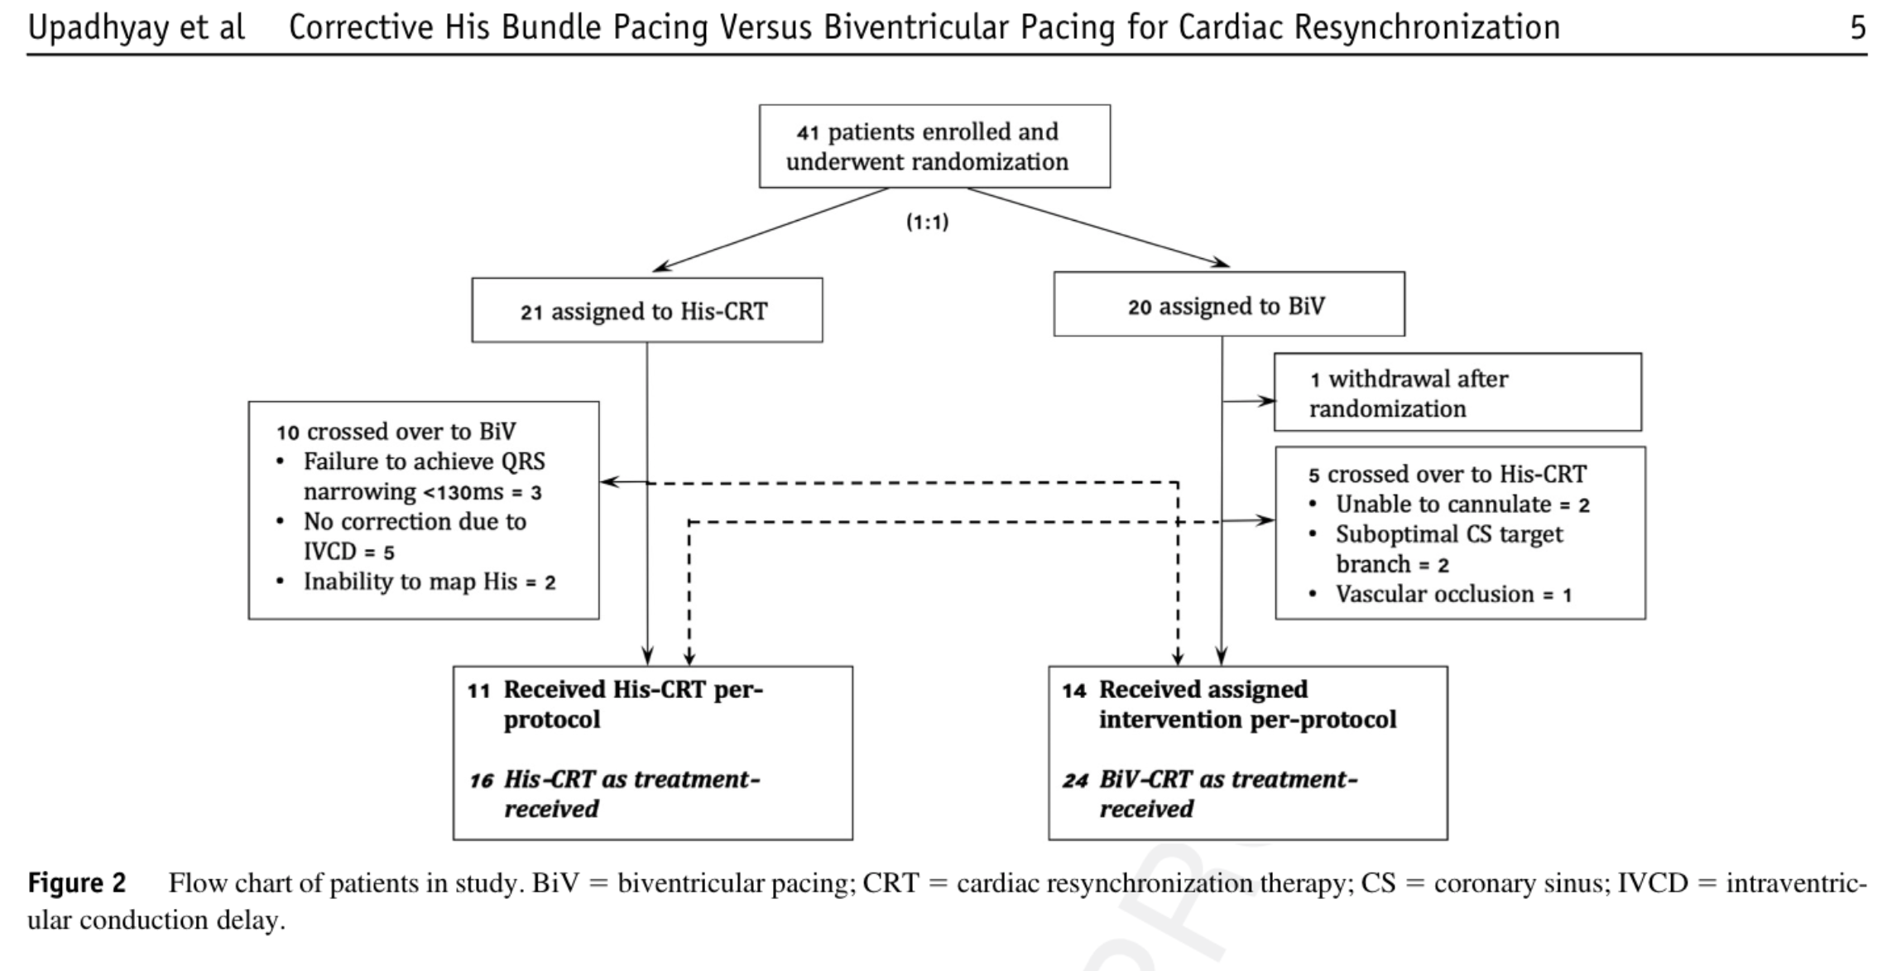
His-SYNC RCT Pilot Study
Notes:
may have heard from HRS this year
So the His sync trial aimed to begin investigating this and took 41 patients eligible for CRT and randomised them to either BIV or His

Slide 66
His-SYNC RCT Pilot Study
HIS
BiV
Notes:
The trial was interesting and a little curious it took over 2.5 years to only recruit 41 patients and the trial was plagued with high crossover rates.

Slide 67
His-SYNC RCT Pilot Study
HIS
BiV
25% x over
Notes:
25% of patients intented for CRT crossed over to His – im not sure that would be normal crt expectations in any of your labs here
So consider that when I then tell you a whopping

Slide 68
His-SYNC RCT Pilot Study
HIS
BiV
47% x over
25% x over
Notes:
47% of patients intended for His crossed over to BiV

Slide 69
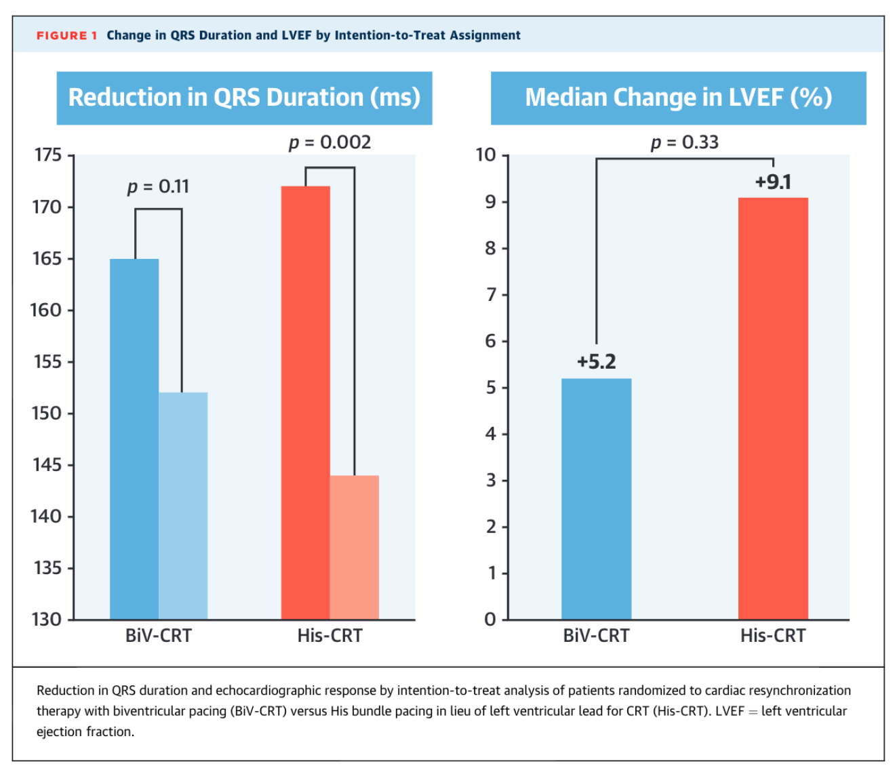
Upadahay et al JACC 2019
Notes:
Now when we look at the interntion to treat analysis
So disregarding the x overs
Biv pacing did reduce qrs duration but not signficiantly

Slide 70
Upadahay et al JACC 2019
Notes:
And like so much of the data I have shown you already the his approach did reduce QRS duration significantly

Slide 71
Upadahay et al JACC 2019
Notes:
Now the his pacing approach did result in a numerically higher average change in LVEF but in this study this was not shown to be signfiantly different from biv but this could be limited by the small sample size and also remember that
almost 50% of this group received Biv and not his pacing – the potential one could argue if it weren’t for this contamination could be even greater

Slide 72
His-SYNC RCT Pilot Study
HIS
BiV
47% x over
25% x over
Notes:
Now one of the most frequent reasons for x over was the apparent failure to reverse the conduction delay due to what they describe as intraventricular conduction delay rather than true LBBB

Slide 73
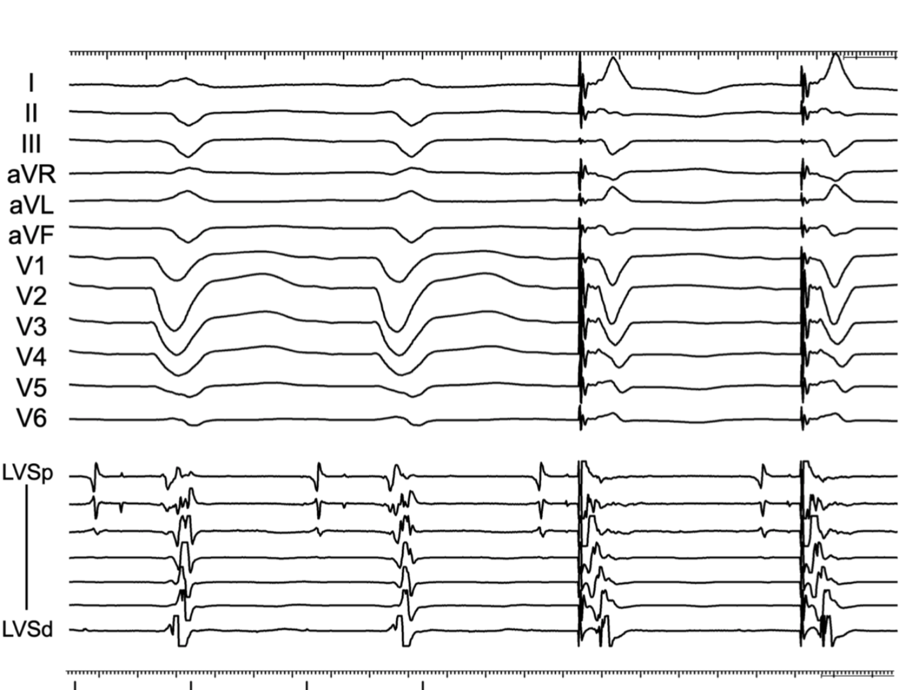
Notes:
Here you can see true LBBB which shows
(POINT)
Conduction block proximal to the left bundle at the level of the left his fibres
Which is able to correct with non selective hbp but reversal wasn’t frequently observed in this study if the block was not true LBBB and the authors here recommend the strauss criteria for defining LBBB

Slide 74
Upadahay et al JACC 2019
Notes:
Now if we contextulise the values observed here that Biv improved EF by 5.2% and his by 9.1%

Slide 75
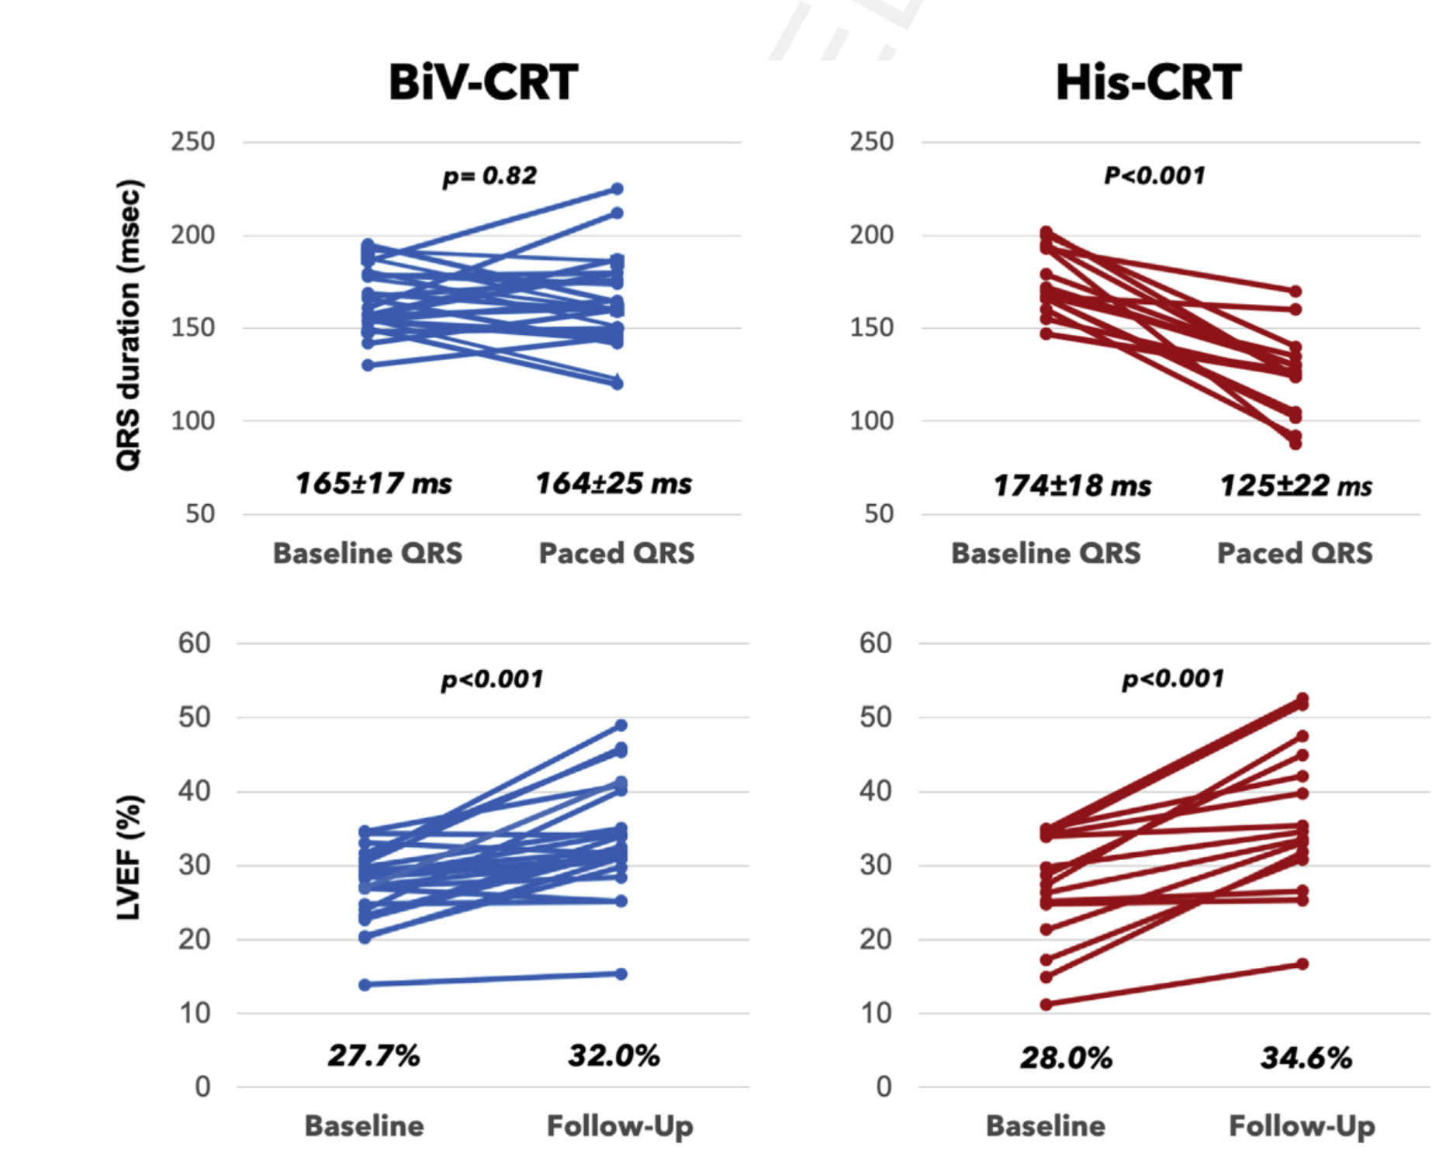

Slide 76
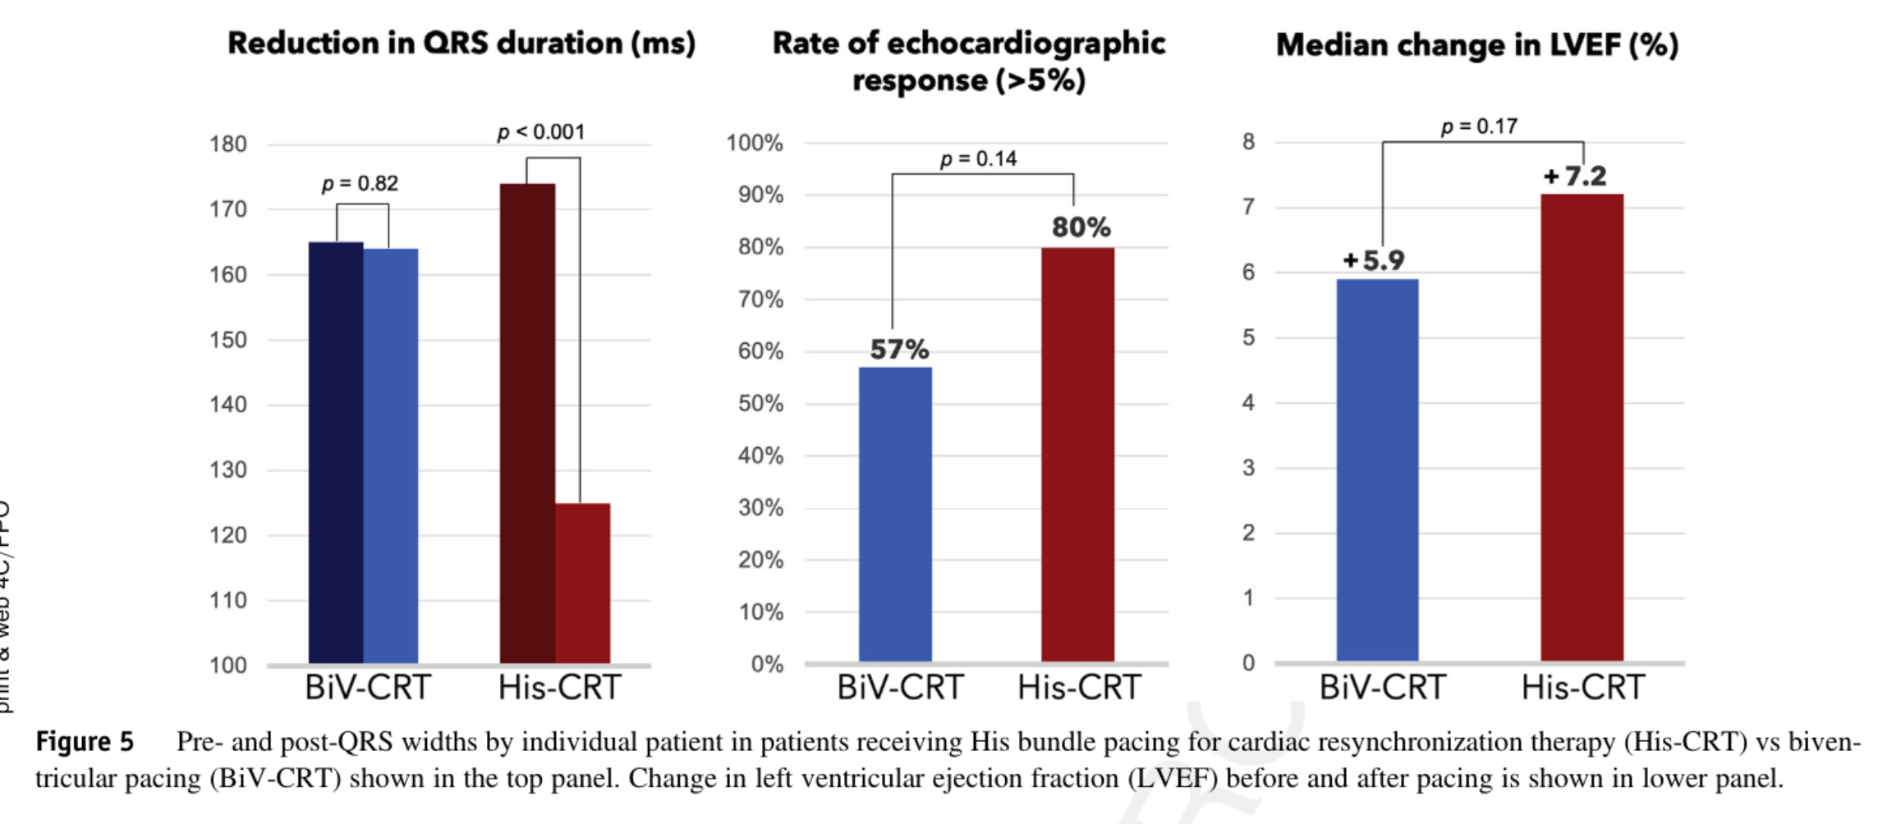

Slide 77
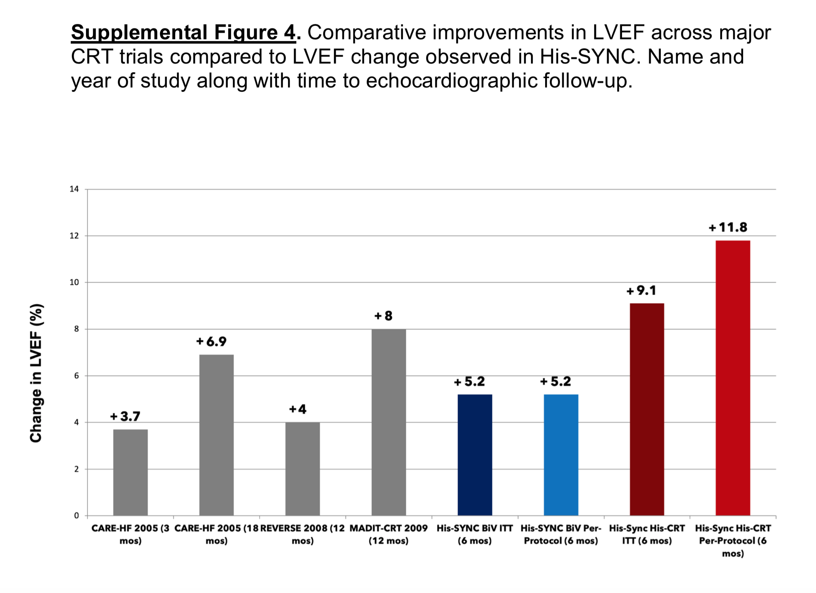
Notes:
And we look at historical studies that have shown mortality benefit with only modest improvements in EF for example in care hf and madit crt

Slide 78
Notes:
We see improvement s in EF Similar to these in EF with both our intention to treat and per protocol assessment of Biv pacing in the his sync trial
- so doing the right thing

Slide 79
Notes:
And with the ITT the improvement and potential magnitude with his pacing is even greater

Slide 80
Notes:
And the potential even greater still when his pacing is considered in the per protocol when it is actually delivered. Imagine the potential benefit here for hard outcomes if this is the mechanism underpinning the improvements already observed…

Slide 81
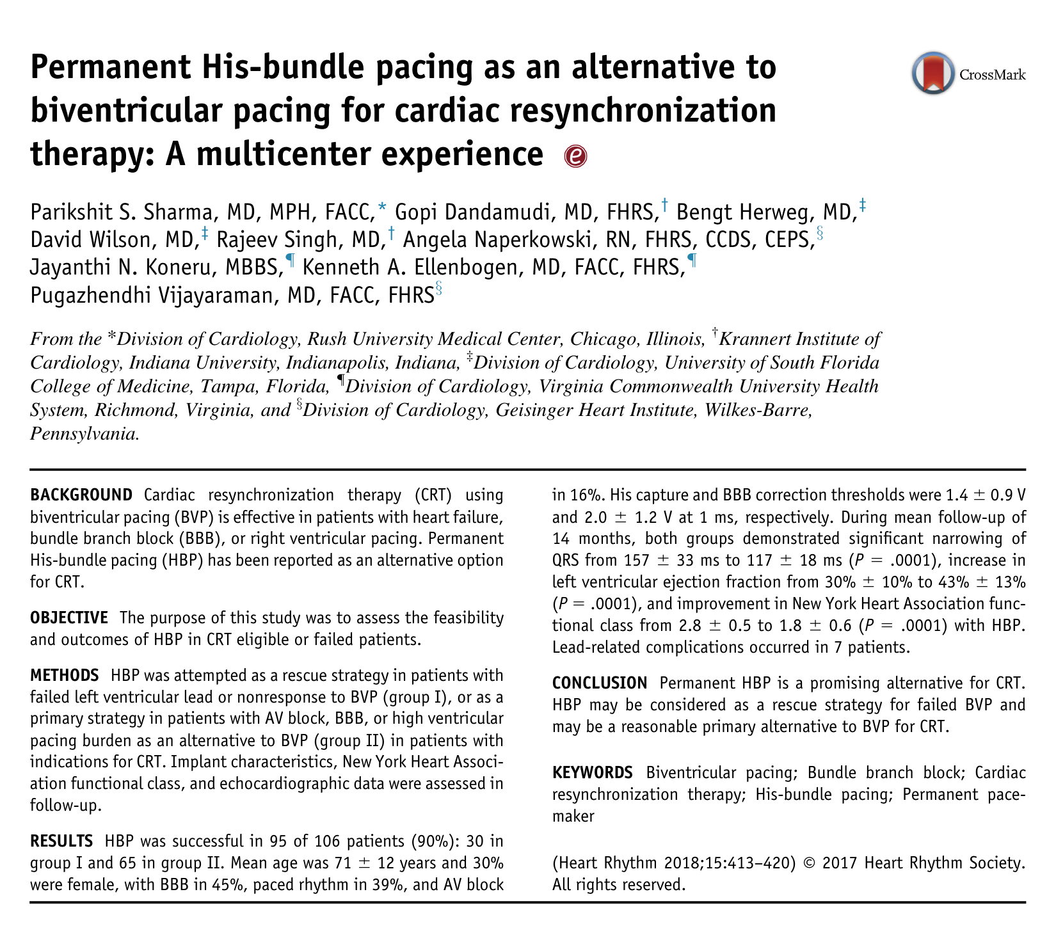
Notes:
and if we look at longer term published outcomes of his pacing in crt eligible or crt failed patients we see exciting results too

Slide 82
Sharma et al. Heart Rhythm 2018
Notes:
they had 1 group where his bundle pacing was used as a bailout because of failed lv lead placement or clinical non-response

Slide 83
Sharma et al. Heart Rhythm 2018
Notes:
and a second where his pacing was used for patients with bradycardia and a predicted high ventricular apcing burden

Slide 84
Sharma et al. Heart Rhythm 2018

Slide 85
Sharma et al. Heart Rhythm 2018
Notes:
Most patients had a broad QRS due to bundle branch block or rv pacing and

Slide 86
Sharma et al. Heart Rhythm 2018
Notes:
And most had signigant ventricular impairment

Slide 87
Sharma et al. Heart Rhythm 2018
Notes:
Success levels of implant were high at 90%
And QRS duration -

Slide 88
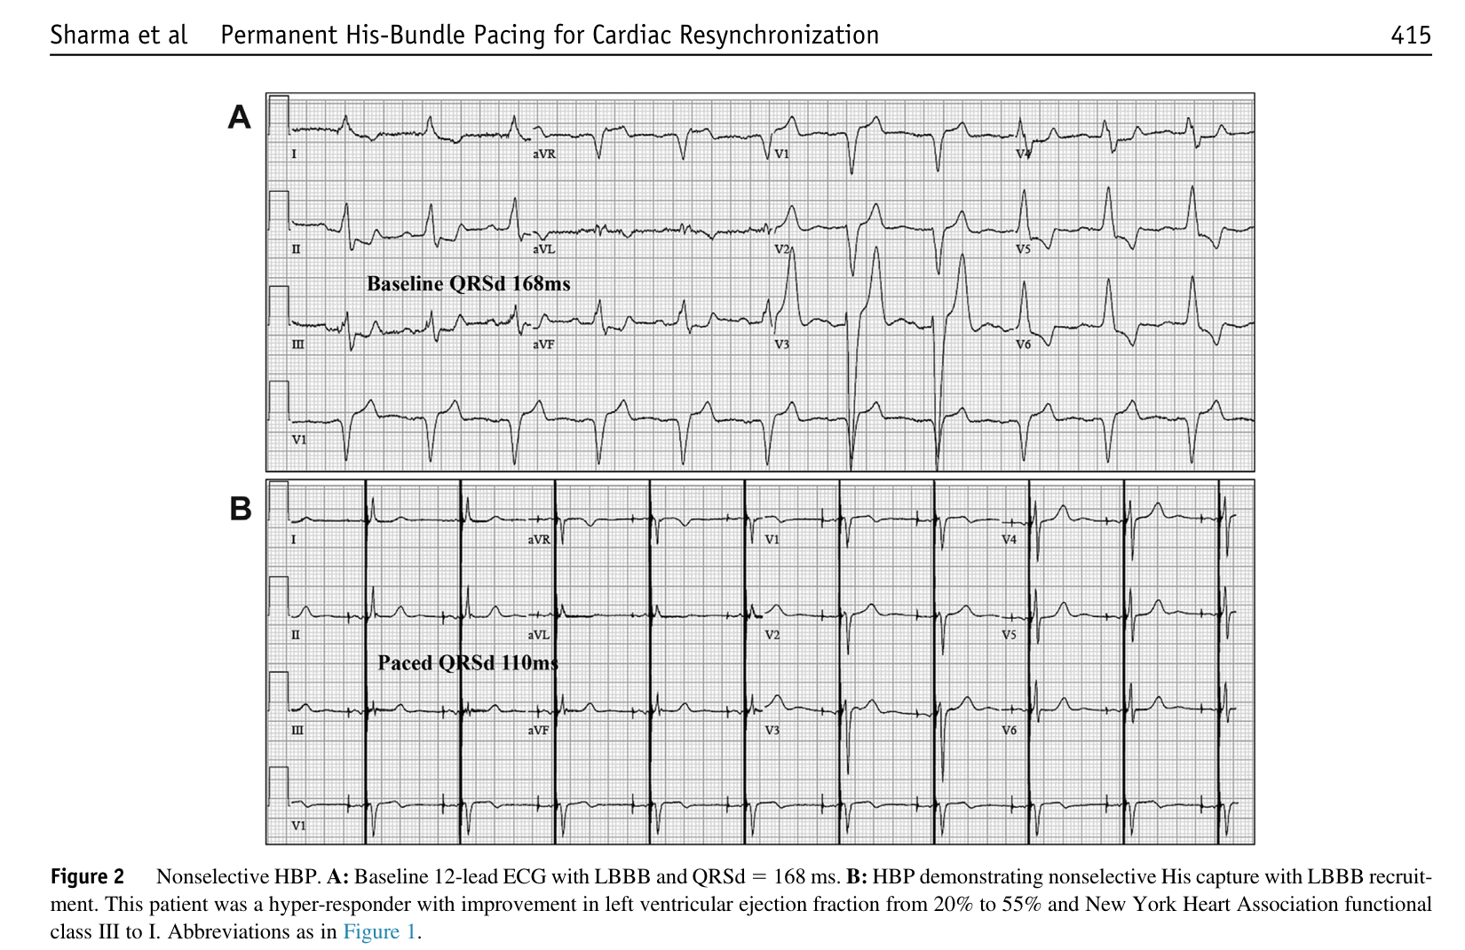
Notes:
ventricular activatiom was noted to improve with his pacing from a mean of 157 to 118 ms and

Slide 89
Sharma et al. Heart Rhythm 2018
Notes:
And In those with intrinsic narrow qrs this was preserved with his pacing

Slide 90
Sharma et al. Heart Rhythm 2018
Notes:
And after 12 months his bundle pacing increased LVEF from 30 to 44%

Slide 91
Sharma et al. Heart Rhythm 2018
Notes:
and improves NYHA functional class

Slide 92
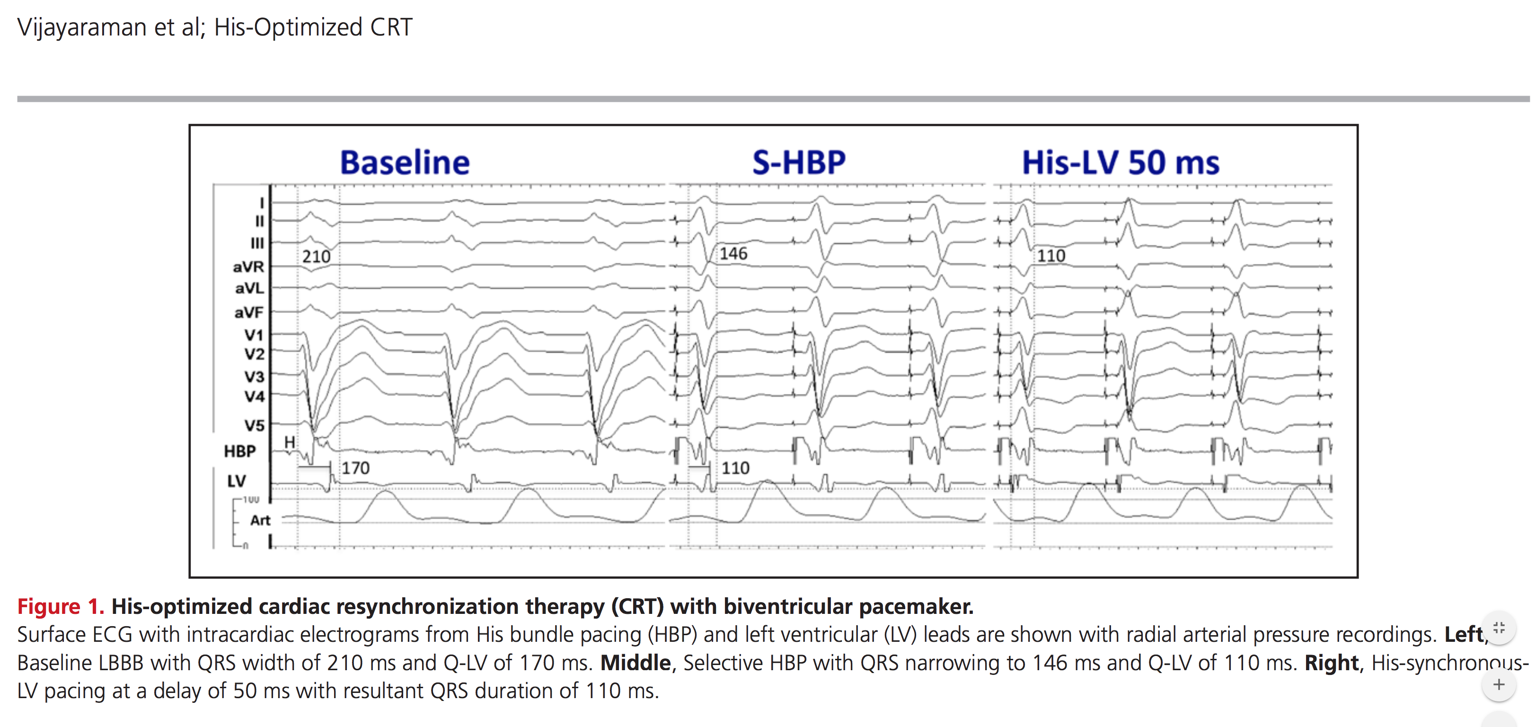
Not always complete correction…
Notes:
Now sometimes his pacing can improve things a little but maybe we could do better
Here is a patient with LBBB, QRS duration 210 ms
QLV 170ms

Slide 93
Not always complete correction…
Notes:
Here his pacing could reverse partially the LBBB and reduce the ventricular activation time, our QRS here is 146 and QLV reduced to 110ms but to improve activation further we can create fusion by using an LV lead with our his lead to activate the LV in two ways to better optimise QRS duration

Slide 94
Not always complete correction…
Notes:
And here you can see with this approach our QRS duration is now reduced to 110ms – a fantastic improvement

Slide 95
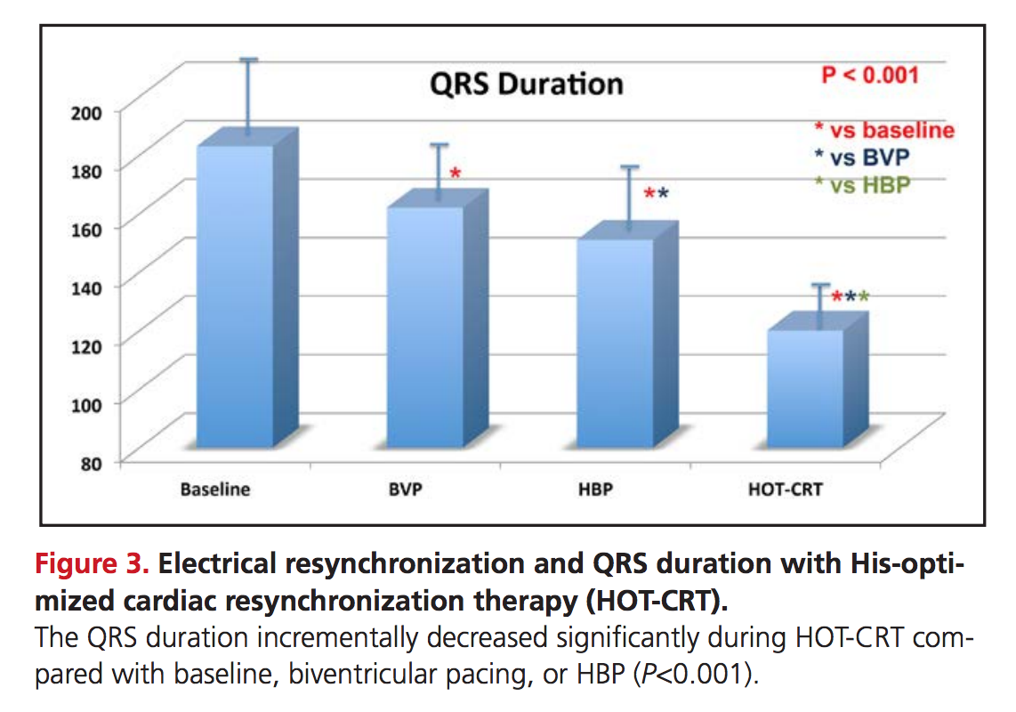
Vijayaraman et al 2017
Notes:
And you can see here in a cohort of 27 patients with LBBB or IVCD with starting QRS >140ms that although His was overall a better approach than BiV
That hot crt did offer an alternate solution

Slide 96
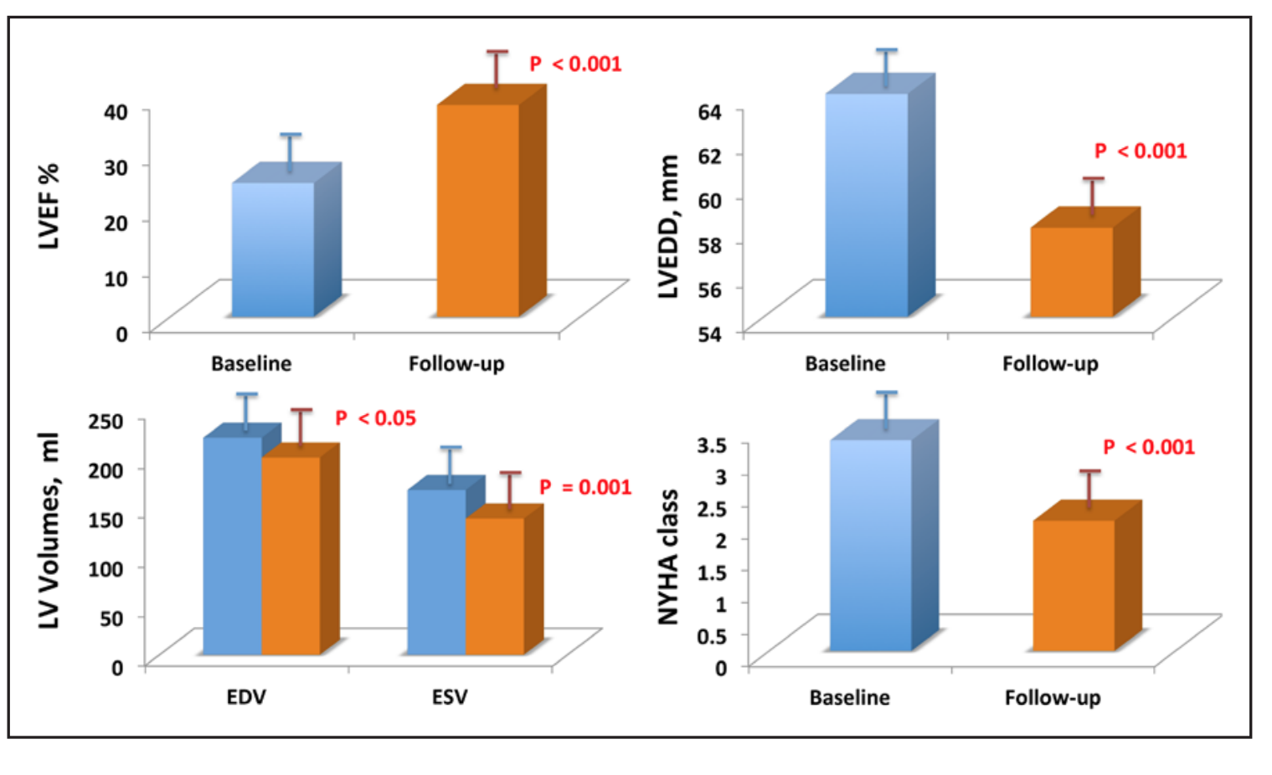
Notes:
Which in this cohort compared to the baseline improved EF and nyha symptom class

Slide 97
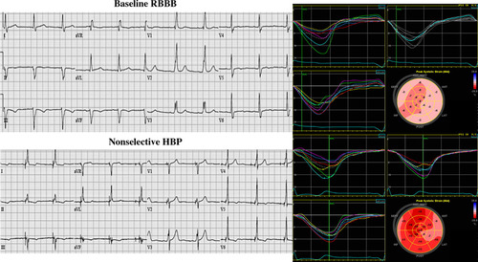
RBBB too…
Permanent His Bundle Pacing for Cardiac Resynchronization Therapy in Patients With Heart Failure and Right Bundle Branch Block
CIRC EP 2018
Notes:
And it’s a similar story of improvements for for RBBB too

Slide 98
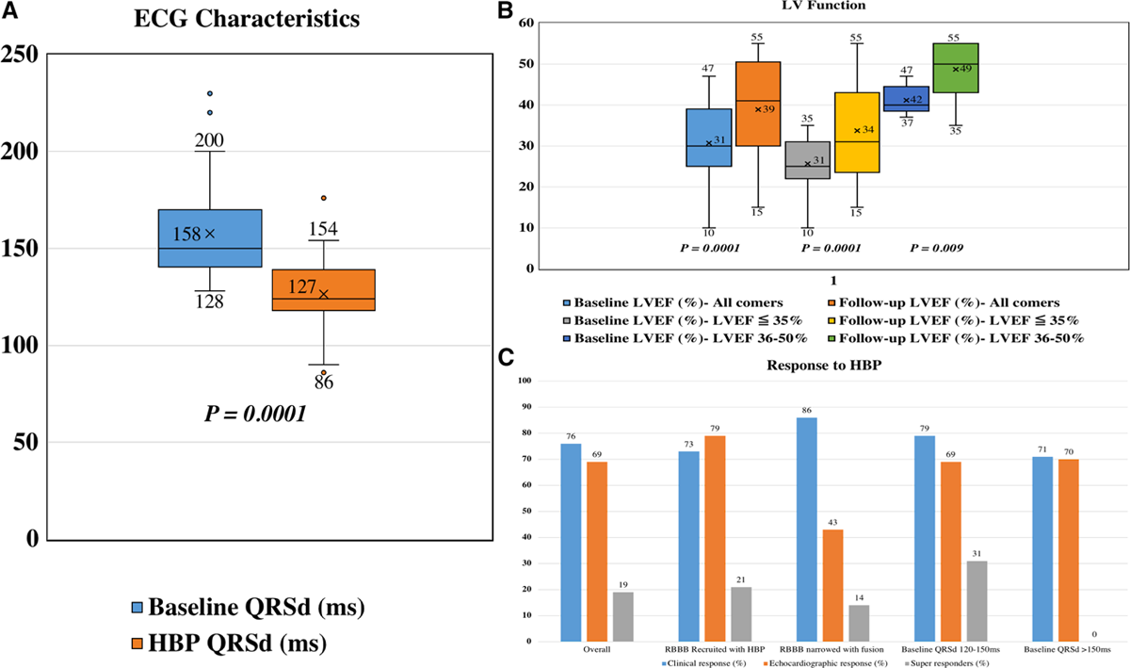
RBBB too…
QRS narrowing occurs
Permanent His Bundle Pacing for Cardiac Resynchronization Therapy in Patients With Heart Failure and Right Bundle Branch Block
CIRC EP 2018
Notes:
Where his bundle pacing in a series of 39 patients improves ventricular activation significantly

Slide 99
RBBB too…
LV function improves
Permanent His Bundle Pacing for Cardiac Resynchronization Therapy in Patients With Heart Failure and Right Bundle Branch Block
CIRC EP 2018
Notes:
Resulting again in improvements in LV function from 30% at baseline to 40%

Slide 100
And prolonged PR
Notes:
Another place where his bundle pacing may revolutionise things is in those with a long pr interval

Slide 101
And prolonged PR

Slide 102
Control Group – ICD only
P <0.001
Heart Failure / Death
Long PR interval
Normal PR interval
Years
MADIT CRT Subgroup analysis
Stockburger et al. Clin Res Cardiol (2016) 105:944–952
Notes:
We know from the control group of the madit crt data set, that a long - pathalogical av delay is not a benign state

Slide 103
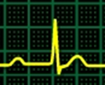
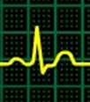
How about avoiding RV pacing?
Control Group – ICD only
PR prolongation is not benign
P <0.001
Heart Failure / Death
Long PR interval
Normal PR interval
Years
MADIT CRT Subgroup analysis
Stockburger et al. Clin Res Cardiol (2016) 105:944–952
Notes:
Infact it is associated with a significantly increased rate of heart failure and death,

Slide 104
Methods to Improve Pathological AV Delay in those with narrow QRS
Narrow QRS
Synchronous Ventricular Activation
Intrinsic
Pathological AV delay
Keene et al. ESC Heart Failure (2018) 5:965–976
Notes:
… and we know bad av dyssynchrony can be corrected with other pacing approaches

Slide 105
Methods to Improve Pathological AV Delay in those with narrow QRS
Narrow QRS
Synchronous Ventricular Activation
Intrinsic
Pathological AV delay
Paced
Optimised
AV delay
Keene et al. ESC Heart Failure (2018) 5:965–976
Notes:
but unfortunately comes at a cost

Slide 106
Methods to Improve Pathological AV Delay in those with narrow QRS
Narrow QRS
Synchronous Ventricular Activation
Broader QRS
Dyssynchronous Ventricular Activation
Intrinsic
Pathological AV delay
Paced
Optimised
AV delay
RV Pacing
Keene et al. ESC Heart Failure (2018) 5:965–976

Slide 107
Methods to Improve Pathological AV Delay in those with narrow QRS
Narrow QRS
Synchronous Ventricular Activation
Broader QRS
Dyssynchronous Ventricular Activation
Intrinsic
Pathological AV delay
Paced
Optimised
AV delay
BiV Pacing
RV Pacing
Keene et al. ESC Heart Failure (2018) 5:965–976
Notes:
as even with biv paced activation
the ventricular activation is prolonged
however his bundle pacing offers the best of both worlds

Slide 108
Methods to Improve Pathological AV Delay in those with narrow QRS
Narrow QRS
Synchronous Ventricular Activation
Broader QRS
Dyssynchronous Ventricular Activation
Intrinsic
Pathological AV delay
5.2 cm
Paced
Optimised
AV delay
His Pacing
BiV Pacing
RV Pacing
Keene et al. ESC Heart Failure (2018) 5:965–976
Notes:
as av dyssynchrony and all its bad effects on av filling can be corrected but without inducing any ventricular dysynchrony

Slide 109
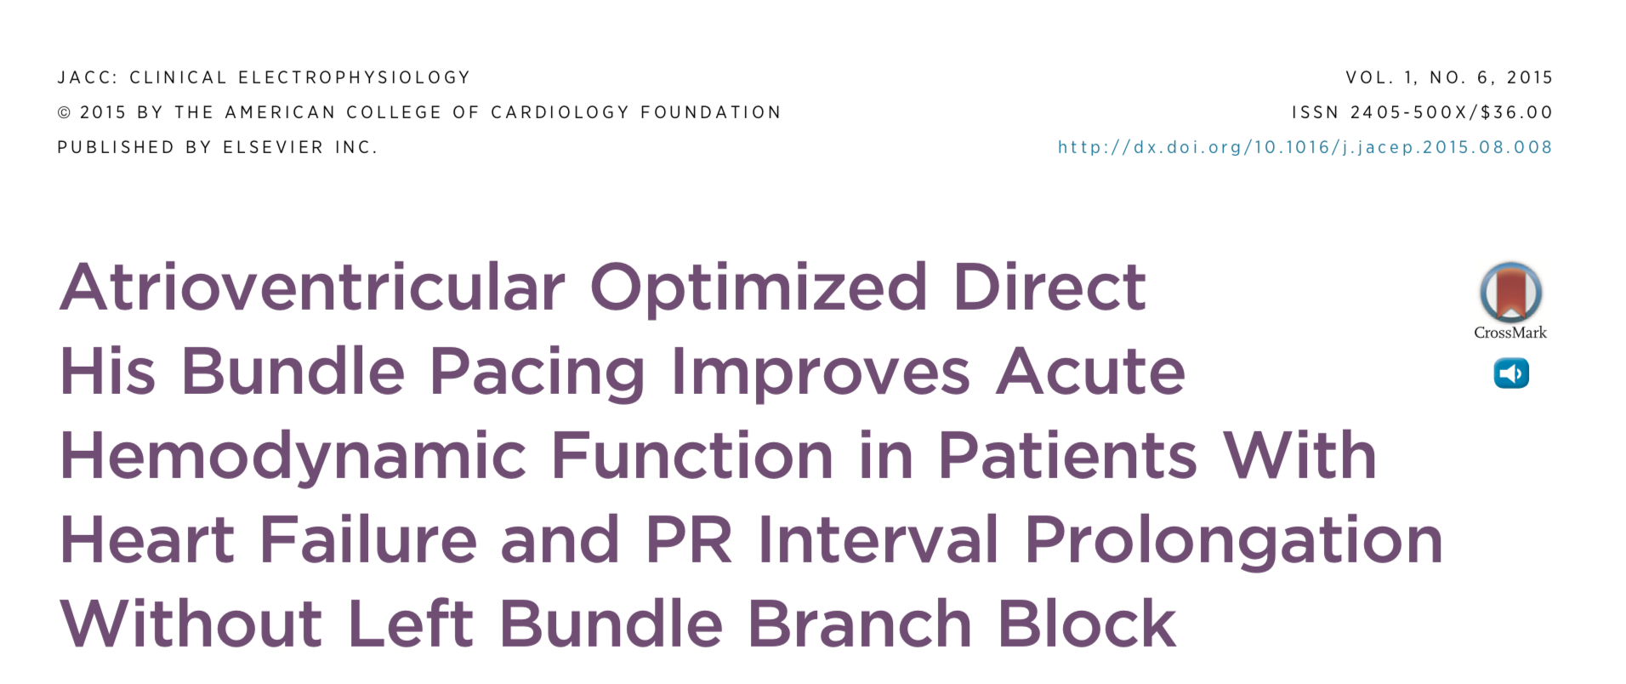
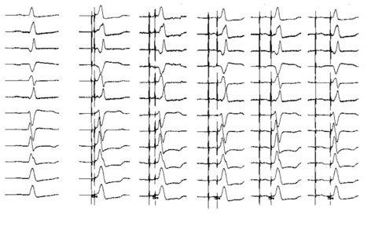
Results of an Acute Haemodynamic study: His pacing in patients with HF and long PR interval
JACC: Clinical Electrophysiology, Volume 1, Issue 6, 2015, 582–591
Notes:
and We have shown that this approach of isolated av delay optimisation produces dramatic acute haemodynamic benefits in heart failure patients

Slide 110


AV optimisation delivered with direct His bundle pacing, in patients with heart failure, long PR without left bundle branch block: randomised multi-centre clinical outcome study
The His Optimised Pacing Evaluated
for Heart Failure Trial
Notes:
and to test whether this haemodynamic improvement translates into true longer term benefits we are currently running a double blinded randomised multicentre cross over trial called hope hf –

Slide 111
Trial Flow Diagram
Keene et al. ESC Heart Failure (2018) 5:965–976
Notes:
We have just finished recruiting and are now well into the follow up period

Slide 112
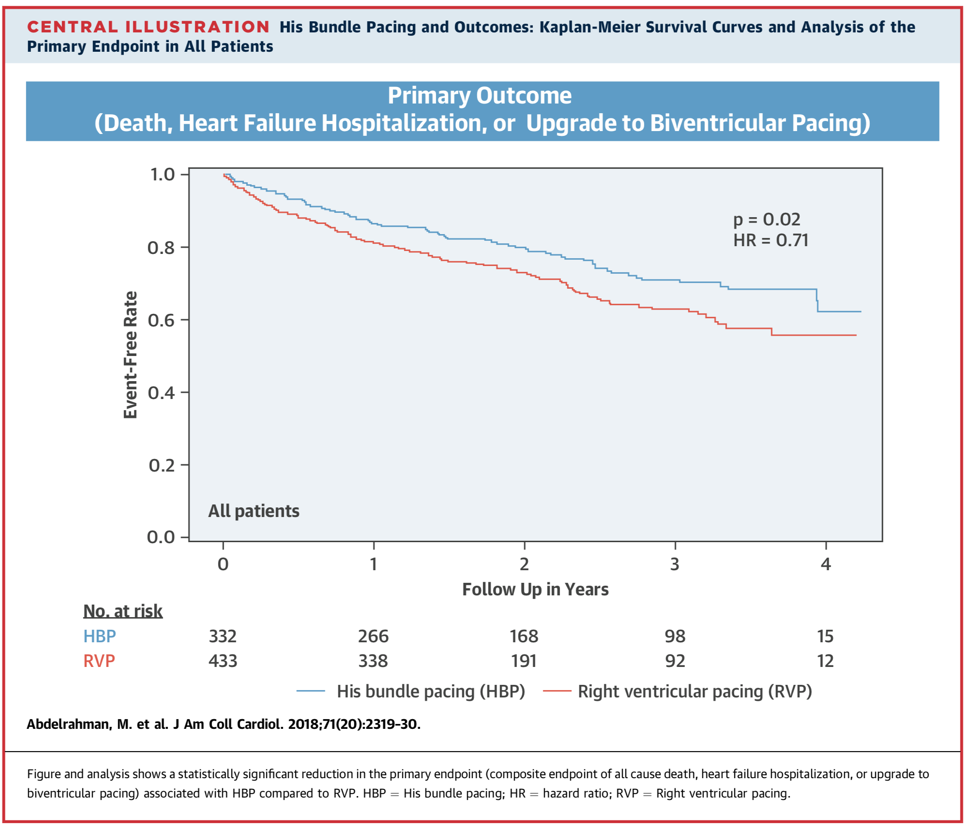
Preventing pacing induced cardiomyopathy
His pacing
RV pacing
Notes:
And finally his bundle pacing can even reduce pacing induced cardiomyopathy
in this 750 patient cohort
worsening ventricular activation with RV pacing is associated with a high incidence of death and heart failure but seemingly if we improve activation with his pacing this incidence is dramatically improved.

Slide 113
Probability of Survival Free
of Heart Failure
Notes:
So to sum up
Biventricular pacing leaves a lot to be desired EVEN in those with lbbb

Slide 114
Notes:
but we also need better solutions than biventricular pacing for those that will pace a lot as the alternative is horrible RV pacing

Slide 115
Notes:
And those with long pathological av dealys

Slide 116
Notes:
And those with RBBB

Slide 117
Notes:
We cannot afford to rest on our laurels with our mediocre treatment that just about works in broad lbbb

Slide 118
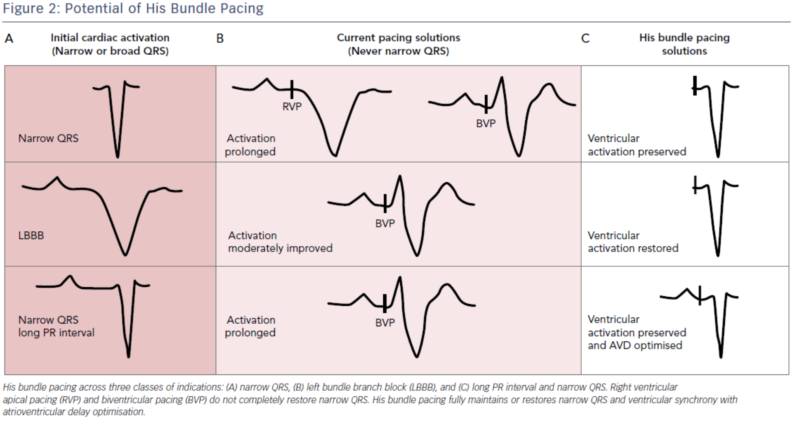
When to use His pacing?
Ali, Keene, et al. Arrhythmia & Electrophysiology Review 2018;7(2):103–10.
Notes:
with
his bundle pacing we can
maintain a normal narrow complex when needed
we can restore and improve ventricular activation whether we start with RBBB or LBBB in the majority of patients
or can restore normal av timing but without the harm of inducing ventricular dyssynchrony as the other methods would...

Slide 119
His bundle pacing?
Notes:
So I bet when the event counting RCTs are funded we will see superiority of his bundle pacing
But I reckon we only need to prove non-inferiorty

Slide 120
His bundle pacing?
No Contrast Needed
Notes:
Unlike biv pacing his pacing doesn’t need contrast

Slide 121
His bundle pacing?
No Contrast Needed
Less Leads
Less Complications
Notes:
Uses less leads and so may mean less complications

Slide 122
His bundle pacing?
No Contrast Needed
Less Leads
Less Complications
No phrenic Capture
Notes:
Doesn’t run the risk of phrenic capture

Slide 123
His bundle pacing?
No Contrast Needed
Less Leads
Less Complications
No phrenic Capture
Less Fluoro Time
Notes:
And uses less fluoricopy time as less hardware to implant

Slide 124
No Contrast Needed
Less Leads
Less Complications
No phrenic Capture
Less Fluoro Time
Notes:
Overall a better and safer approach

Slide 125


Slide 127
LBBB
HIS Bundle Pacing
LBBB
Lustgarten et al. Heart Rhythm 2015
Notes:
His bundle pacing does the opposite of flogging the heart
It makes life easier for the heart
Removing the inefficiency of incoordination
So it can do more useful work
using less energy

Slide 128
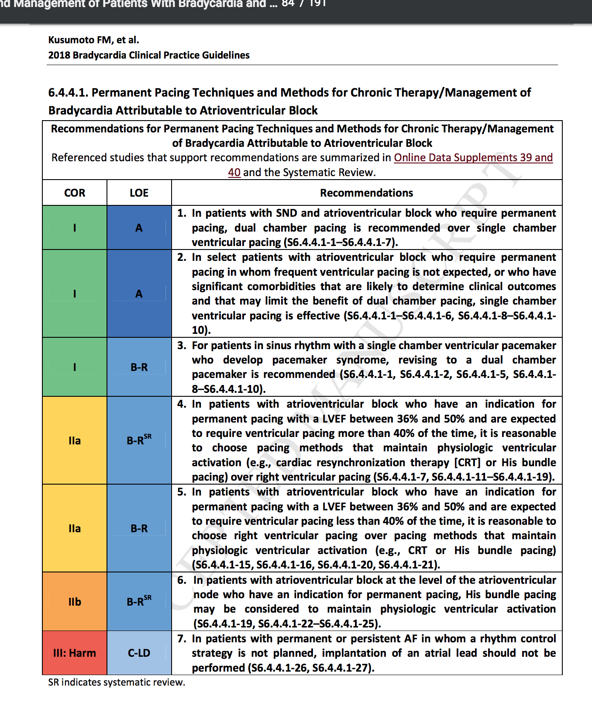
Notes:
On the other hand when we look at his bundle pacing
normally conservative guideline committess are now recommending His pacing with the same level of evidence as biventricular pacing
here you can see a recommendation for those patients with moderate LV impairment and a pacing need
Clearly demonstrating that his pacing is at least an alternative to CRT

Slide 129
The positive effect of normal ventricular activation
Lusgarten et al. Heart Rhythm 2015
Notes:
His bundle pacing though is different
His bundle pacing rather than making the heart work harder
It can increase its efficiency
It allows More useful work with less energy consumption
By improving the activation as you can seen here removing block

Slide 130
The positive effect of normal ventricular activation
Lusgarten et al. Heart Rhythm 2015
Notes:
Daniel Lusgarten was one individual who also deomstrated that hbp can cause electrical resynchronisation in over 80% of patients with bundle branch block, he wanted to explore the effect on outcomes
So he Performed a randomised control crossover trial of his versus BiV pacing in those with crt heart failure indications
29 patients (28 lbbb, 1 rbbb) all fulfilling crt criteria And of these 21/29 narrowed.
Patients underwent 6 months of his pacing and 6 months of biv pacing – but before I show you this
Here you can see some the Acute hemodynamic effect of His-bundle pacing with QRS normalization: if you look at the femoral arterial pressure tracing at the bottom. A: First 3 QRSs are from AAI pacing, rate 80 so intrinsic ventricular activation and then with the switch to DDD-HBP, 80 bpm. With normalisaiton of ventricualr activation the femoral arterial pressure increases, on average about 10 mm Hg
On the other side of the figure the opposite is true and results unsurprisingly in an equivalent decrease in femoral arterial pressure

Slide 131
The positive effect of normal ventricular activation
Lusgarten et al. Heart Rhythm 2015
Notes:
interms of longer outcomes both Biv and his bundle pacing were both significantly better than baseline with respect to improvements in EF, NYHA class, QOL and exercise capacity but in this study Differences between biventricular and His-bundle pacing were statistically not significant but at least show that his bundle pacing is a credible option but what did come about was that the his pacing implant time was shorter with shorter fluroscopy durations and no need for contrast

Slide 132
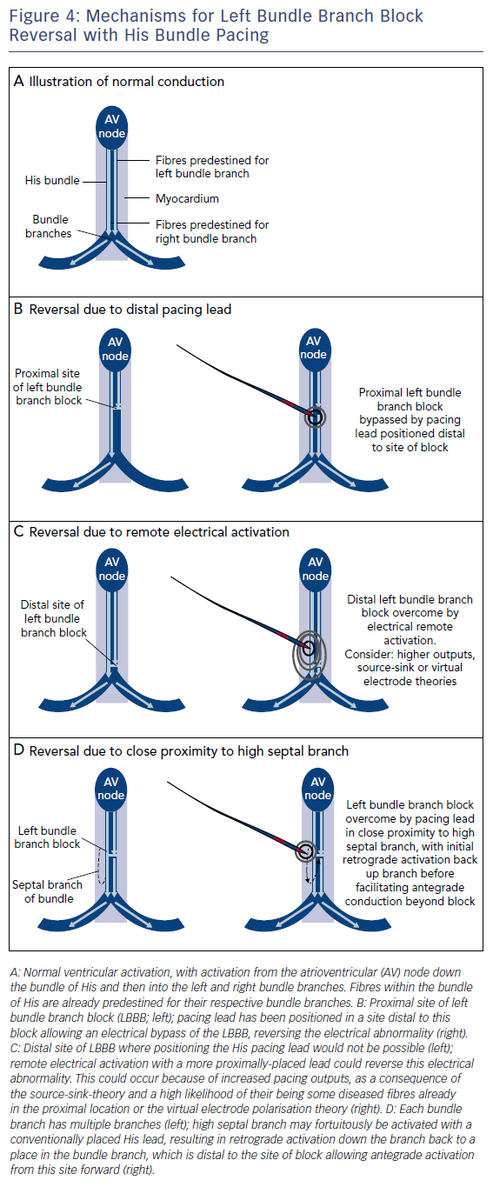
Ali, Keene, et al. Arrhythmia & Electrophysiology Review 2018;7(2):103–10
Notes:
So as we have said The most Simple explanation is somehow being able to position the pacing lead distal to the site of the block and thereby bypassing the site of the block

Slide 133
Ali, Keene, et al. Arrhythmia & Electrophysiology Review 2018;7(2):103–10
Notes:
The next theory relies on the premis that Higher output pacing can engage and reactivate diseased conduction tissue
this can result from simply higeher pacing outputs arriving distally either directly or from either the virtual electrode polarisation theory or source sink relationships

Slide 134
Ali, Keene, et al. Arrhythmia & Electrophysiology Review 2018;7(2):103–10
Notes:
A third suggested theory is that there could be fortuotous placement of the lead in relation to a branch of the conduction system allowing
Retrograde activation via a high septal branch and then onward antegrade activation down healthy parts of the his purkinjee system

Slide 135
Single alternation from AAI to His pacing with AV delay 80ms
Notes:
I now would like to show you some of our work, most of which is presently not in print
In our lab back home at imperial college in london we perform haemodynamic optimisation to maximise our pacing responses
We have a patented method whereby we alternate from intrinsic ventricular activation but at a controlled heart rate to a paced ventricular activated heart beat at exactly the same rate perfromed at set av delays
As you can see we start with aai pacing and transition to dual chamber his pacing here with an av delay programmed of 80ms

Slide 136
Single alternation from AAI to His pacing with AV delay 80ms
Change in Systolic Blood Pressure from reference AAI pacing (SBP_{rel} (mmHg)
Change in systolic BP at AV 80ms, from AAI, after one alternation
Notes:
We then plot the change in systolic bp at the starting av delay from aai to the paced one
Change scale on graph!!!!

Slide 137
Single alternation from AAI to His pacing with AV delay 80ms
Multiple alternation from AAI to His pacing with AV delay 80ms
Change in Systolic Blood Pressure from reference AAI pacing (SBP_{rel} (mmHg)
Change in systolic BP at AV 80ms, from AAI, after one alternation
Mean change in systolic BP after 6 alternations
Notes:
To ensure valid, reliable and robust data we then perfrom mulitple alternations to and for from aai to his apcing at this same av delay so we can calculate the mean change in systolic bp after a minimum of 8 alternations
This allows us a value with a very narrow error bar

