Slide 1
Atrial Fibrillation Ablation in Heart Failure
Avishag Laish-Farkash, MD, PhD
Director, EP and Pacing Unit,
Assuta Ashdod University MC
Ben-Gurion University of the Negev
Notes:
Due to lack of time- focus on HFrEF and not HFpEF

Slide 2
AF and HF – the related twin epidemics of CVD
AF is the most common cardiac arrhythmia
The lifetime risk of AF is 1:4 in individuals aged > 55Y
AF begets HF and HF begets AF
AF and HF share common pathophysiological mechanisms and underlying risk factors and independently predict each other
The prevalence of AF among HF: 10-57%
The rate of HF in patients with persistent/long standing persistent AF is 40-55%
Notes:
Atrial fibrillation (AF) is the most common cardiac arrhythmia with an estimated worldwide prevalence of 1.5–2.0% in the general population.
The incidence of AF is further predicted to increase twofold over the next decades owing mainly to a steadily aging population
with growing burden of cardiovascular comorbidities.1,2
The lifetime risk of AF is one in four individuals aged >55 years.3 This epidemiological
course needs strongly to be considered in the light of the fact that AF carries risk of significant morbidity and mortality.4 Of particular
importance,
AF is associated with the development and deterioration of left ventricular (LV) dysfunction and systolic and diastolic
heart failure (HF).5,6 Conversely, LV dysfunction promotes atrial structural and electrical changes that facilitate the occurrence and
maintenance of AF.7 Therefore, the concept of AF begets HF and HF begets AF has been well appreciated.8 Both conditions share common
pathophysiological mechanisms and underlying risk factors and independently predict each other.9,10
The prevalence of AF among patients with HF is in the range of 10–57% depending on age, onset and severity of HF,7,8 whereas the rate of HF ranges between 40% and 55% in patients with persistent and long-standing persistent AF.11

Slide 3
AF and HF – the related twin epidemics of CVD- (cont.)
AF and HF synergistically confer worse outcomes compared with either condition alone
It is of paramount importance to elaborate effective and safe treatment strategies to prevent/reverse AF in HF patients
Since most conventional AAD are CI/ineffective/not well tolerated in HFrEF patients, catheter ablation of AF provides an increasingly important option
Notes:
Not surprisingly, the related twin epidemics of cardiovascular disease with increased risk of mortality synergistically confer worse outcomes compared with either condition alone.
Given the poor prognosis associated with concomitant AF and HF, it is of paramount importance to elaborate effective and safe treatment strategies to prevent or reverse the occurrence of AF in patients with HF and

Slide 4
AF begets HF and HF begets AF
AF can promote development/progression of systolic/diastolic HF by several established mechanisms:
- Loss of atrial contraction and contribution to ventricular filling
- Persistent rapid ventricular contraction can impair myocardial contractility (directly or
through cellular and neurohormonal modulation)
- Rhythm irregularity may itself decrease CO, irrespective of ventricular rate
Santhanakrishnan R, Circulation 2016;133:484–92
Ferreira JP, Int J Mol Sci 2015;16:3133–47
Notes:
Concomitant AF and HF synergistically confer an adverse prognosis. Compared with sinus rhythm, the presence of AF is clearly
associated with poorer outcome in patients with LV systolic dysfunction.
Atrial fibrillation can promote the development or progression of systolic and diastolic HF by several established mechanisms.
Loss of atrial contraction and uncontrolled rapid and irregular ventricular conduction may contribute.
Lack of atrial contribution to ventricular filling worsens diastolic function and can reduce cardiac output by up to 25%.
Persistent rapid ventricular conduction can impair myocardial contractility, directly, or through cellular and neurohormonal alterations, lead to LV systolic
dysfunction, and may cause (reversible) tachycardia-induced cardiomyopathy in patients with or without structural heart disease.
Regardless of the ventricular rate, rhythm irregularity during AF may itself decrease cardiac output.
These observations do not only explain why many patients with severe HFrEF gain rapid haemodynamic improvement with immediate cardioversion,
but also why some patients are symptomatic during AF despite sufficient rate control and improve with restoration of sinus rhythm.

Slide 5
AF begets HF and HF begets AF- cont.
On the other hand, ventricular dysfunction promotes atrial structural and electrical changes by several hemodynamic, mechanical and neurohormonal mechanisms:
- Activation of RAAS- resulting in structural remodeling and anisotropic conduction
- Volume retention, increased ventricular filling pressures and functional MR can lead
to atrial stretch and fibrosis
- HF-associated alternations in calcium handling and overload may contribute to
arrhythmogenesis
Li D Circulation 2001;104:2608–14
Cha YM, Circulation 2004;109:2839–43.
Notes:
On the other hand, ventricular dysfunction promotes atrial structural and electrical changes by several hemodynamic, mechanical, and neurohormonal mechanisms including:
activation of the renin-angiotensin-aldosterone system (RAAS). direct effects of an activated RAAS on structural remodeling and anisotropic conduction,
increased ventricular filling pressures, and functional mitral regurgitation can lead to the development of atrial stretch and fibrosis
that facilitate initiation and maintenance of AF.
Moreover, HF associated alterations in calcium handling and calcium overload may also contribute to atrial arrhythmogenesis

Slide 6
AF-mediated tachycardiomyopathy
AF is the most common cause of TICMP in adults
These patients gain the greatest clinical benefit from restored SR and most likely recovers normal LV systolic function
It is of paramount importance to determine whether (or to what extent) AF contributes to ventricular dysfunction- by an attempt to strict rhythm control for at least 6-8 weeks- documented improved LVEF would confirm the association and Dx
Notes:
The hallmark of TCM is partial or complete reversibility once the culprit arrhythmia is controlled.
The arrhythmia can be solely causative or jointly responsible for ventricular dysfunction depending on the presence and severity of an underlying cardiomyopathy

Slide 7
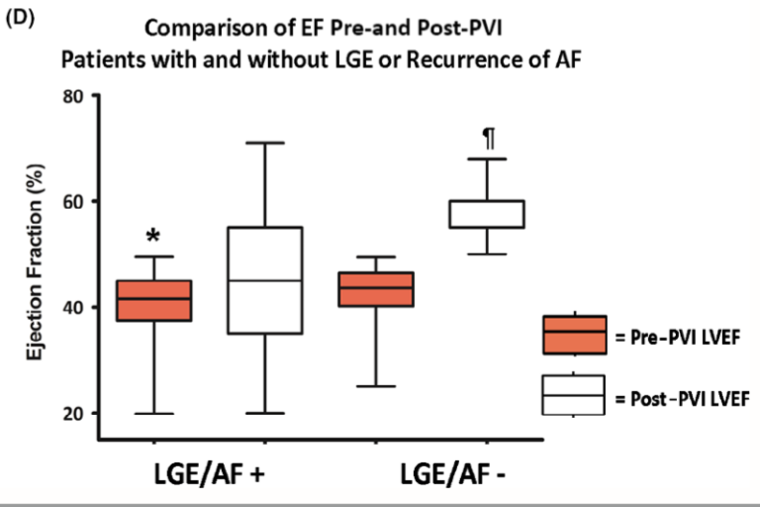
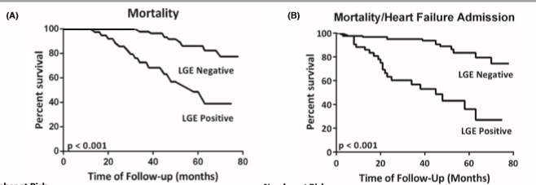
AF-mediated tachycardiomyopathy- (cont.)
Since not only rapid but also normal irregular ventricular response can lead to TICMP (alike frequent VPBS), pharmacologic rate control alone may not be sufficient for treating AF+HF
Recent studies show that freedom of AF recurrence and absence of
ventricular LGE on cMRI predict improvement of LV dysfunction
after AF ablation
Prabhu S, CAMERA-MRI, JACC 2017;70:1949-61 Addison D, JAHA 2016;5:e003570 Ling L-H, Heart Rhythm 2013;10:1334–9

Slide 8
Lessons learned from pharmacological rhythm control
Regardless of what begets what, tackling the arrhythmia in patients with AF and HFrEF is key to clinical and functional improvement
Rate control or rhythm control???- a question of debate
Rhythm control by AAD is limited to amiodarone and dofetilide These can be associated with adverse effects and toxicity
Hence, rhythm control may be preferred over rate control if SR maintenance can be achieved without AAD
Notes:
Regardless of what begets what, it stands to reason that tackling the arrhythmia in patients with AF and HFrEF is key to clinical and functional improvement. Whether this can be achieved by pharmacological rate or rhythm control has long been a question of debate, mainly driven by previous well-designed randomized controlled trials (RCTs) which failed to identify a significant benefit in favor of the rhythm-control strategy

Slide 9
Catheter ablation in patients with AF and HF
Notes:
The role of AF ablation is less well defined for patients with HF. Albeit challenging to manage this patient population is potentially the one that stands to gain the most from catheter ablation in terms of morbidity and perhaps mortality. Particularly in patients who suffer from symptomatic AF on amiodarone treatment, catheter ablation remains the only reasonable choice for rhythm control
several observational and randomized studies have provided substantial evidence that AF ablation in patients with HFrEF results in high rates of successful sinus rhythm maintenance along with significant clinical and LV functional improvements

Slide 10
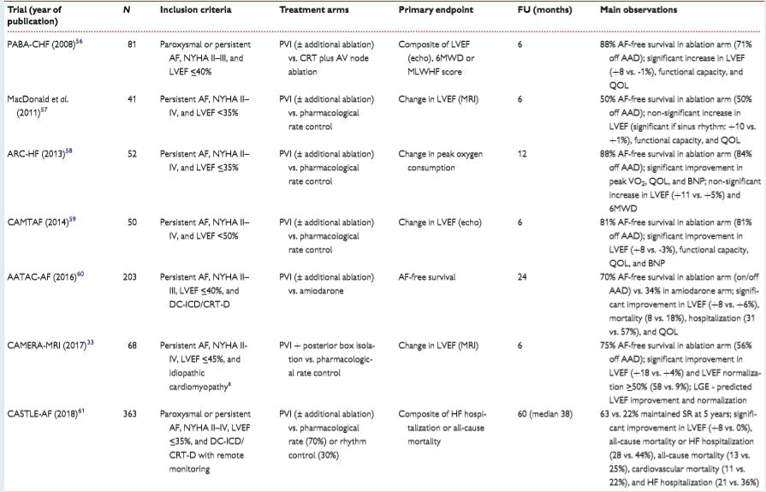
Randomized trial support for AF ablation in pts with HF and reduced EF
Notes:
Five smaller and two most recently published larger prospective RCTs have evaluated the role and efficacy of AF ablation in selected patients with HFrEF (Table 1). In line with several observational studies, the five smaller RCTs, including an overall of 292 enrolled patients, strongly indicate that catheter ablation for rhythm control is superior to pharmacological or pace-and-ablate-based rate control in terms of improvement in left ventricular ejection fraction (LVEF), exercise capacity, and quality of life (QOL)

Slide 11
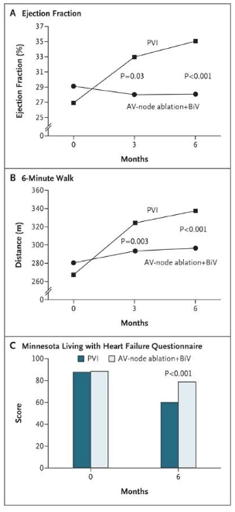
The PABA-CHF (Pulmonary Vein Antrum Isolation vs. AV Node Ablation with Bi-Ventricular Pacing for Congestive Heart Failure) trial
Showed that catheter ablation resulted in 88% AF-free survival (71% off AADs) and absolute increase in LVEF by 8% at 6 months of follow-up compared with no relevant change in LVEF (−1%) in the pace-and-ablate group (P < 0.001)
Functional capacity and QOL significantly improved in patients randomized to AF ablation
Limitations: relatively small number of patients (n=81), short follow-up (6 mo), and high probability of substantial selection bias
Khan MN et al. N Engl J Med 2008;359:1778–85
Notes:
Considering biventricular pacing plus atrioventricular (AV) junctional ablation (pace-and-ablate strategy) as the most effective approach to rate control, randomized comparison of the two ablative strategies would be most powerful to identify significant differences in efficacy outcomes between non-pharmacological rhythm and rate control. N=81 f/u=6 months

Slide 12
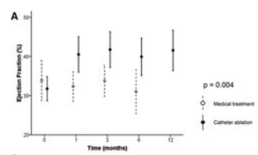
ARC-HF (A Randomized Trial to Assess Catheter Ablation vs. Rate-Control in the Management of Persistent Atrial Fibrillation in Chronic Heart Failure)
CAMTAF (Catheter Ablation vs. Medical Treatment of Atrial Fibrillation in Heart Failure)
prospectively compared ablation-based rhythm control with pharmacological rate control in patients with persistent AF and LV dysfunction
The two studies demonstrated >80% AF-free survival off AADs and significant increase in exercise capacity and QOL in the ablation group at 6–12 months
While the ARC-HF trial reported a trend towards LVEF improvement (+11% vs. +5%;P = 0.055), the CAMTAF trial showed a significant increase in LVEF (+8% vs. −3%; P < 0.001) in the ablation group
Jones DG et al. ARC-HF, J Am Coll Cardiol 2013 ;61:1894–1903
Hunter RJ et al. CAMTAF, Circ AE 2014;7:31–38
Notes:
Similar findings were reported from the ARC-HF and CAMTAF (N=52, 50) (f/u 12 and 6 mo) (88% and 81% AF free survival)

Slide 13
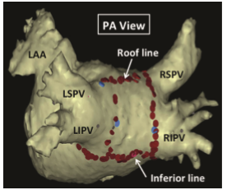
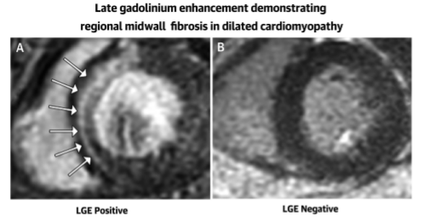
CAMERA-MRI (Catheter Ablation vs. Medical Rate Control in Atrial Fibrillation and Systolic Dysfunction) trial
(n=68) Ablation-based rhythm control (posterior box isolation) in persistent AF results in a significant improvement in LVEF and LVEF normalization ≥50% (58% vs. 9%, P = 0.0002), particularly in the absence of ventricular LGE on pre-procedural cardiac MRI
In the ablation group, the absence of LGE predicted greater improvements in LVEF and higher rates of LVEF normalization at 6 months [73% vs. 29%; mean difference 44.2% (95% CI 10.7–66.1%); P = 0.0093]
Prabhu S et al. J Am Coll Cardiol 2017;70:1949-1961
Notes:
N-68 pts PVI=posterior box isolation. The study showed that:………………
Background
Atrial fibrillation (AF) and left ventricular systolic dysfunction (LVSD) frequently co-exist despite adequate rate control. Existing randomized studies of AF and LVSD of varying etiologies have reported modest benefits with a rhythm control strategy.
Objectives
The goal of this study was to determine whether catheter ablation (CA) for AF could improve LVSD compared with medical rate control (MRC) where the etiology of the LVSD was unexplained, apart from the presence of AF.
Methods
This multicenter, randomized clinical trial enrolled patients with persistent AF and idiopathic cardiomyopathy (left ventricular ejection fraction [LVEF] ≤45%). After optimization of rate control, patients underwent cardiac magnetic resonance (CMR) to assess LVEF and late gadolinium enhancement, indicative of ventricular fibrosis, before randomization to either CA or ongoing MRC. CA included pulmonary vein isolation and posterior wall isolation. AF burden post-CA was assessed by using an implanted loop recorder, and adequacy of MRC was assessed by using serial Holter monitoring. The primary endpoint was change in LVEF on repeat CMR at 6 months.
Results
A total of 301 patients were screened; 68 patients were enrolled between November 2013 and October 2016 and randomized with 33 in each arm (accounting for 2 dropouts). The average AF burden post-CA was 1.6 ± 5.0% at 6 months. In the intention-to-treat analysis, absolute LVEF improved by 18 ± 13% in the CA group compared with 4.4 ± 13% in the MRC group (p < 0.0001) and normalized (LVEF ≥50%) in 58% versus 9% (p = 0.0002). In those undergoing CA, the absence of late gadolinium enhancement predicted greater improvements in absolute LVEF (10.7%; p = 0.0069) and normalization at 6 months (73% vs. 29%; p = 0.0093).
Conclusions
AF is an underappreciated reversible cause of LVSD in this population despite adequate rate control. The restoration of sinus rhythm with CA results in significant improvements in ventricular function, particularly in the absence of ventricular fibrosis on CMR. This outcome challenges the current treatment paradigm that rate control is the appropriate strategy in patients with AF and LVSD

Slide 14
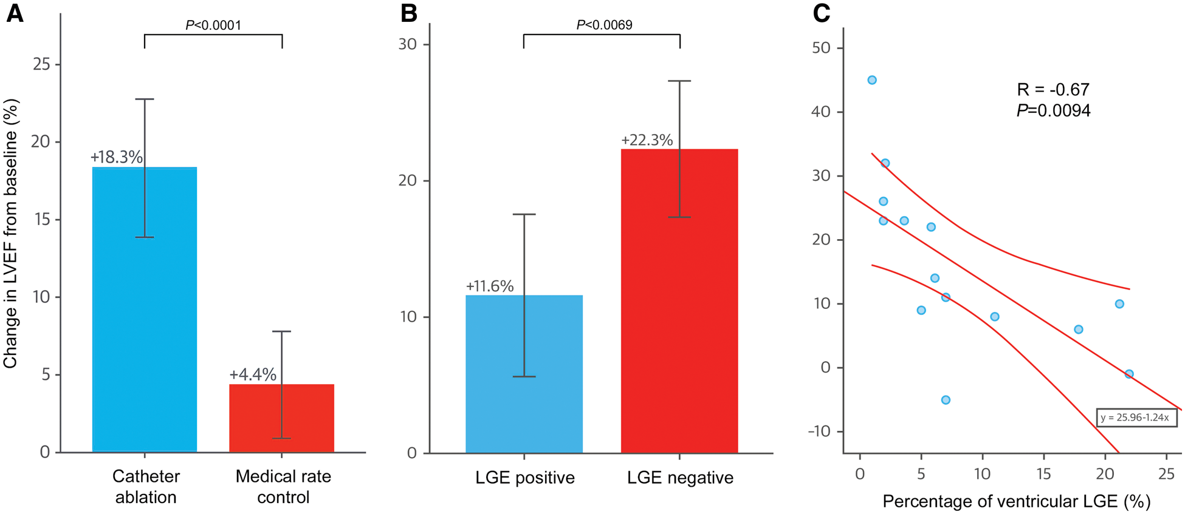
(A) Change in absolute left ventricular ejection fraction from baseline according to treatment arm
(B) % Ventricular LGE status in patients who underwent AF ablation
(C) Correlation between % of ventricular LGE and ΔLVEF following catheter ablation in CAMERA-AF:
Despite a relatively small cohort, this data adds a promising piece to the puzzle on how to identify and select good ablation candidates who most likely benefit from an AF ablation approach
Prabhu S et al. JACC 2017;70:1949-61
Notes:
Figure 1 Change in absolute left ventricular ejection fraction from baseline according to treatment arm (A) and ventricular late gadolinium enhancement status in patients who underwent atrial fibrillation ablation (B + C) in CAMERA-AF.<sup>33</sup> Bars represent 95% confidence intervals. (C) Correlation between the percentage of pre-ablation magnetic resonance imaging-derived ventricular late gadolinium enhancement and percent change in left ventricular ejection fraction from baseline. LGE, late gadolinium enhancement; LVEF, left ventricular ejection fraction.
C):Correlation Between % of Ventricular LGE and ΔLVEF Following Catheter Ablation

Slide 15
AATAC-AF (Ablation vs. Amiodaron for Treatment of Atrial Fibrillation in Patients with CHF and an Implanted ICD/CRT-D) trial
203 patients with persistent AF and HFrEF [NYHA class II–III; LVEF ≤40%] – randomized to either amiodarone or catheter ablation
At 2 years f/u: 70 % AF free survival in PVI group (± posterior wall isolation ± non-PV trigger ablation in 78%) vs. 34% in the amiodarone group (P < 0.001)
Amiodarone was a predictor of arrhythmia recurrence [HR 2.5 (95% CI 1.5–4.3), P < 0.001].
Di Biase L et al. Circulation 2016 ;133:1637–1644
Notes:
To date, two large(r) RCTs assessing the efficacy of AF ablation in patients with HFrEF have been completed, the AATAC-AF and the most recently published CASTLE-AF. Whereas the primary outcome in AATAC-AF was freedom from AF during mid-term follow-up, the CASTLE-AF trial was designed to assess the long-term effect of catheter ablation on the hard primary outcome of mortality or hospitalization for worsening HF. An important common strength of both RCTs was imposed by the fact that all participants had a dual-chamber or biventricular defibrillator implanted to provide optimal continuous atrial rhythm monitoring.
The AATAC-AF trial, which randomized 203 patients with persistent AF and HFrEF [New York Heart Association (NYHA) class II–III; LVEF <_40%] to either amiodarone or catheter ablation, proved that ablationissuperior to amiodarone intermsof rhythm controland improvement in LV dysfunction

Slide 16
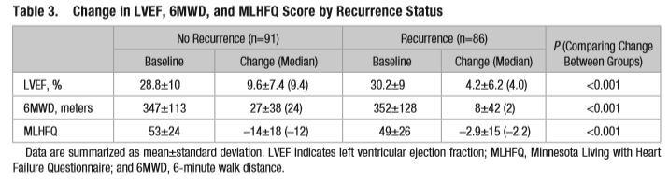
AATAC-AF (Cont.)
Improvement in LVEF was significantly higher in the ablation arm (8% vs. 6%, P = 0.02) and associated with freedom of AF recurrence
Secondary outcomes (small numbers): catheter ablation was better than amiodarone in reducing unscheduled hospitalization (31% vs. 57%, P < 0.001) and all-cause mortality (8% vs. 18%, P = 0.037)
Conclusion: AATAC-AF proved that ablation is superior to amiodarone in terms of rhythm control and improvement in LV dysfunction
Di Biase L et al. Circulation 2016 ;133:1637–1644
Notes:
Improvement in LVEF was significantly higher in the ablation arm (8% vs. 6%, P=0.02) and associated with freedom of AF recurrence. Moreover, catheter ablation performed also significantly better than amiodarone in reducing unscheduled hospitalization (31% vs. 57%, P<0.001) and even all-cause mortality (8% vs. 18%, P=0.037), though these were only secondary outcome measures with small numbers of events and its noted limitations

Slide 17
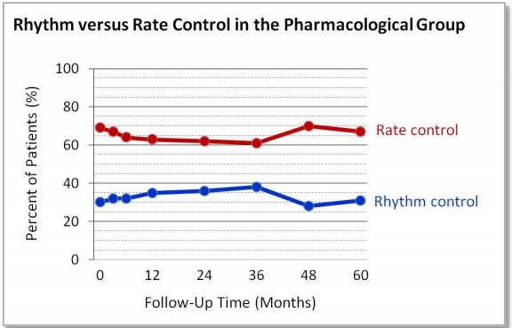
CASTLE-AF (Catheter Ablation vs. Standard Conventional Treatment in Patients with Left Ventricular Dysfunction and Atrial Fibrillation) trial
363 patients with PAF or persistent AF and HFrEF (NYHA II–IV; LVEF ≤35%), who were randomized to either catheter ablation or pharmacological Tx – 70% rate control and 30% rhytm control, predominantly amiodarone (in contrast to AATAC-AF!)
f/u up to 5 years (median 37.8 months)
Primary endpoint: all-cause mortality and hospitalization for worsening HF
Marrouche NF et al. N Engl J Med 2018 ;378:417-427
Notes:
The CASTLE-AF trial primarily evaluated all-cause mortality and hospitalization for worsening HF in 363 patients with paroxysmal or persistent AF and HFrEF (NYHA II–IV; LVEF <_35%), who were randomly assigned to either catheter ablation or pharmacological rate or rhythm control and followed for up to 5years (median 37.8months). In contrast to the AATAC-AF trial, 70% of CASTLEAF patients randomized to medical therapy opted for a rate control strategybasedontheoveralldiscouragingefficacyofAADsinthispatient population, the remaining 30% of patients were predominantly treated with amiodarone.

Slide 18
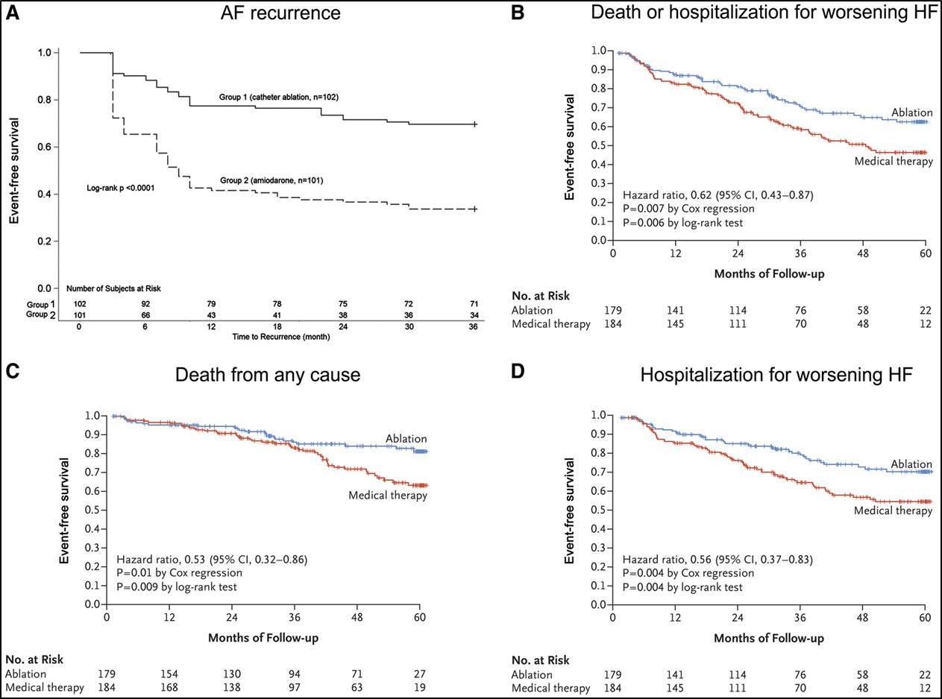
CASTLE-AF- results:
A significant reduction in the primary composite endpoint [28.5% vs 44.6%, HR 0.62 (95% CI 0.43-0.87), p=0.007]; NNT = 8.3
There was also benefit in all-cause mortality alone [13% vs. 25%, HR 0.53 (95% CI 0.32–0.86),P=0.01], mainly driven by a significantly lower rate of CV death in the ablation arm [11% vs. 22%, HR 0.49 (95% CI 0.29–0.84), P=0.009], However, the mortality benefit of AF ablation did not emerge until after 3y
Marrouche NF et al. N Engl J Med 2018 ;378:417-427
Notes:
The long-term results achieved by CA were impressive (Fig B-D)
……. However, the mortality benefit of AF ablation did not emerge until after 3y which highlights the importance of a sufficiently long follow-up to reach hard endpoints and makes the CASTLE-AF trial unique in this respect

Slide 19
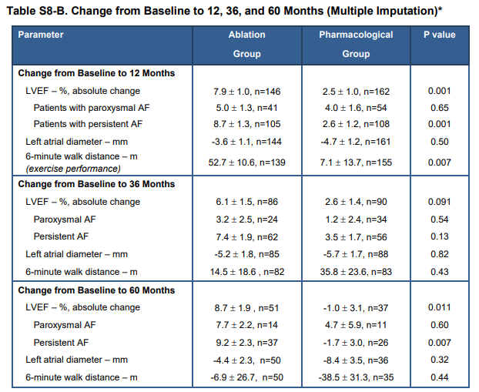
CASTLE-AF- results (Cont.):
Catheter ablation led to a significant improvement in LVEF at 5 years vs. meds (+8.0% vs. +0.2%,P=0.005), which was essentially driven by ablation of persistent (+10% vs. -2.5%, P=0.004) and not paroxysmal AF
68% of patients in the ablation group showed an increase in LVEF beyond the magical cut-off of 35% !!!

Slide 20
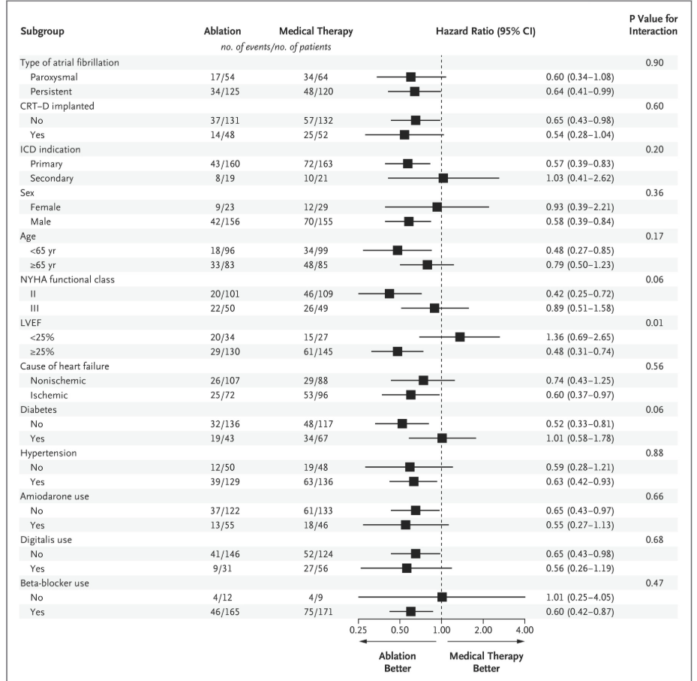
CASTLE-AF- results (Cont.):
Subgroup analysis
A significant interaction between LVEF and the primary endpoint:
Patients with LVEF ≥25% were more
likely to benefit from AF ablation
than patients with a LVEF<25%
Both paroxysmal and persistent AF groups benefited from catheter ablation, but in particular ablation of persistent AF was superior to medical therapy for the primary endpoint

Slide 21
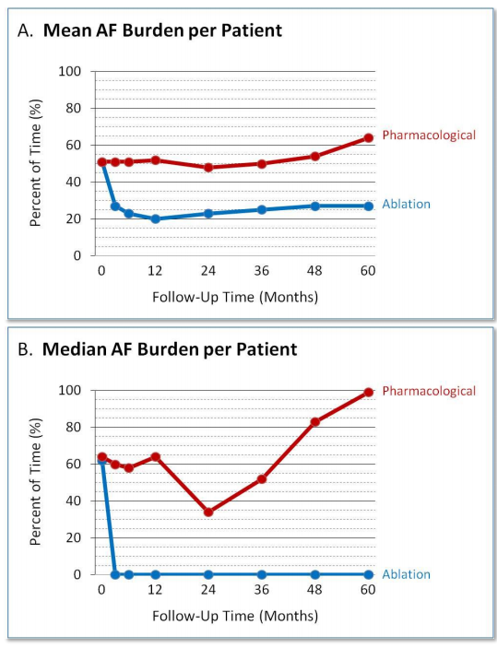
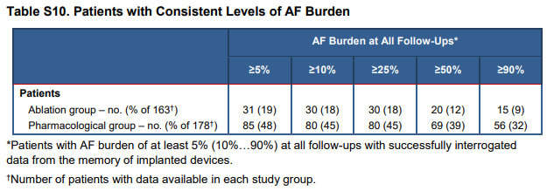
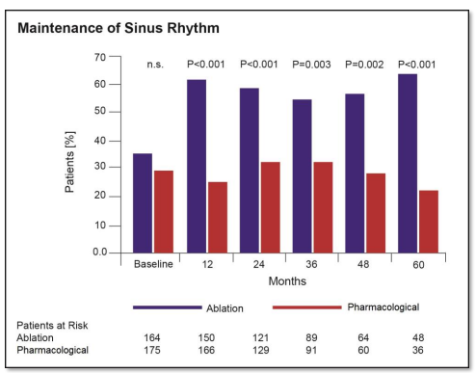
CASTLE-AF- results (Cont.):
Catheter ablation significantly reduced the AF burden and resulted in stable sinus rhythm in 63% of cases at 5y (vs 22% in the medical Tx group)
The adjusted rate of AF recurrence (patients who had actually undergone ablation and completed the 5y f/u) (75/151) was 50%, average of 1.3±0.5 procedures/patient
Suggests that maintenance of SR is beneficial when achieved without AAD and supports the widely used approach of extensive LA ablation in persistent AF
Notes:
In line with previous studies, catheter ablation significantly reduced the AF burden and resulted in stable sinus rhythm in 63% of cases at 5 years.
In the ablation group, 63% of patients were in sinus rhythm at 60 months versus 22% in the medical-therapy group, which suggests that maintenance of sinus rhythm is beneficial when achieved without the use of antiarrhythmic drugs.
In the light of the strong outcome data in favor of ablation, these findings should challenge the widely used approach to extensive LA ablation in persistent AF

Slide 22
Is one ablation strategy fits for all?
In CASTLE-AF - Additional LA lesions in only 53% of all AF ablation procedures, despite the fact that 70% of patients randomized to catheter ablation had persistent or long-standing persistent AF. This is in contrast to the other completed RCTs, in which the vast majority (78–98%) of patients with persistent AF received LA lesions in addition to PVI
The ongoing CONTRA-AF trial compares single shot cryoballoon ablation with pharmacological rate or rhythm control in patients with paroxysmal or persistent AF and HFrEF (NYHA II–IV;LVEF≤35%)
Taken all RCTs together, it remains unanswered which AF ablation strategy is optimal and should be recommended to achieve the reported favorable outcomes
Notes:
.A standardized one fits for all ablation strategy will certainly not apply for all the heterogenous HF populations with AF.

Slide 23
Is one ablation strategy fits for all?- (cont.)
In patient cohorts with severe HFrEF, advanced structural remodeling, or non-convertible AF following PVI, additional ablation is often needed first-line
Whether empirical linear lesions, targeted non-PV trigger ablation, LA appendage isolation, ablation of complex fractionated atrial electrograms (CFAE), or substrate (low voltage) modification ensure superior success is a controversial matter of opinion, and comparison of the different ablation strategies in patients with HF lacks evidence

Slide 24
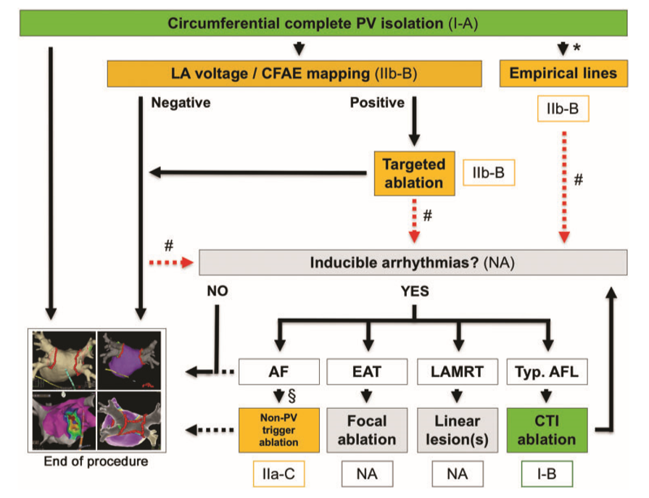
Proposed approach to individually tailored catheter ablation irrespective of the atrial fibrillation type and underlying heart disease (based on voltage mapping and inducibility of atrial arrhythmias)
*May be considered in cases of non-convertible AF after PVI or patients with persistent/long-standing persistent AF
Richter S, Di Biase L and Hindricks G, EHJ 2019;40:663-72
Notes:
An individually tailored ablation strategy based on understanding of the underlying arrhythmogenic substrate will likely be required in numerous patients with severe HFrEF in order to avoid unnecessary extensive ablation and improve procedural outcome
This is one proposed approach to individually tailored ablation regardless of the defined type of AF. The next lecture of Dr. Beruezzo will show his approach for these patients.
* May be considered in cases of non-convertible AF after PVI or patients with persistent/long-standing persistent AF.
# Our proposed approach to AF ablation based on left atrial voltage mapping and inducibility of atrial arrhythmias.
§ Should be considered in cases of reproducible non-PV-triggers
AF,atrial fibrillation; AFL, atrialflutter;CFAE, complexfractionatedatrial electrogram;CTI, cavotricuspid isthmus;EAT, ectopic atrial tachycardia;LAMRT, left atrial macro-reentrant tachycardia; LA,leftatrial;NA,notapplicable

Slide 25
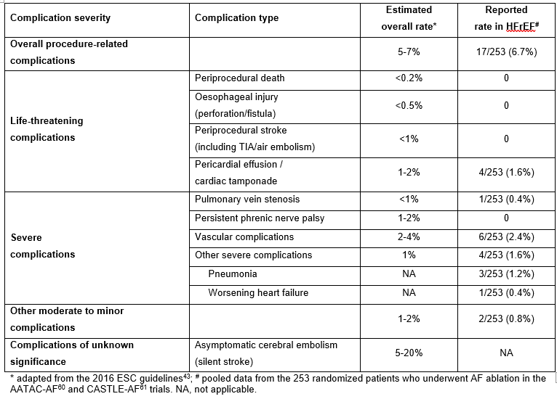
Complications related to AF ablation in HFrEF
Richter S, Di Biase L and Hindricks G, EHJ 2019;40:663-72
Notes:
The complication rates of AF ablation reported in the AATAC-AF and CASTLE-AF trials are reasonable (overall 6.7%) and compare well to those reported overall for patients undergoing AF catheter ablation
However, we must exercise caution in interpreting procedure-related outcomes and adverse events in large RCTs, since participating locations are usually experienced high-volume ablation centres with specialized multi-disciplinary HF units on site, and outcome results may therefore not be reproducible in many centers across the globe

Slide 26
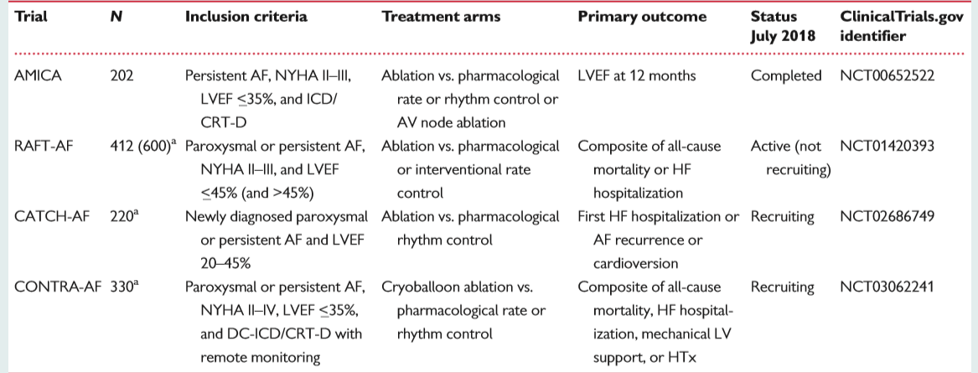
Ongoing large randomized controlled trials on AF ablation in patients with HFrEF
Notes:
In summary, the data derived from the AATAC-AF and CASTLEAF trials support and expand upon findings from several smaller observational and randomized studies, and strongly strengthen the proposed dogma that maintained rhythm control is beneficial and prognostic on long-term when achieved by catheter ablation and not Class III AADs.
Although there is now evidence and time for a shift in the paradigm in the treatment of AF in patients with HF, it is reasonable to await the outcomes of other large RCTs such as the upcoming RAFT-AF (A Randomized Ablation-based Atrial Fibrillation Rhythm Control vs. Rate Control Trial in Patients with Heart Failure and High Burden Atrial Fibrillation) and AMICA (Atrial Fibrillation Management in Congestive Heart Failure with Ablation) trials to confirm the striking benefits of AF ablation observed in CASTLE-AF.

Slide 27
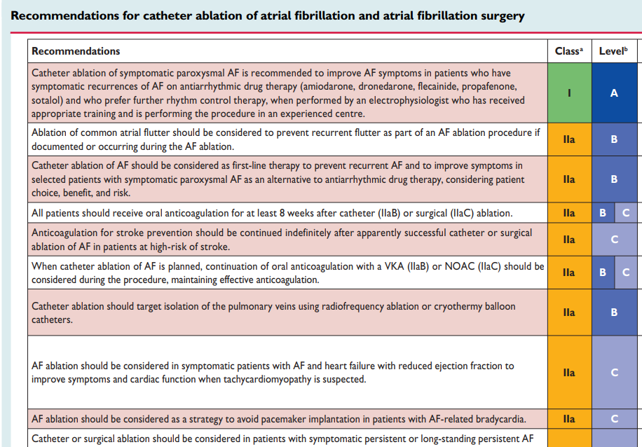
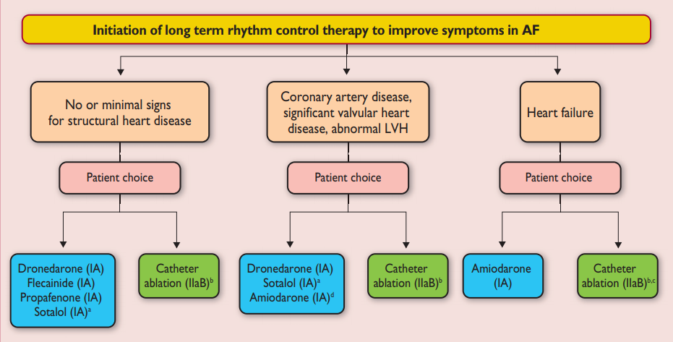
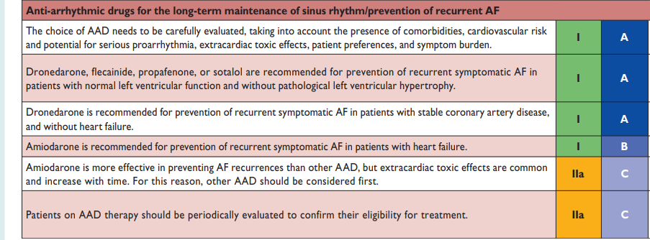
Current guideline recommendations on AF ablation in patients with HF
Kirchhof P et al. 2016 ESC guidelines for the management of atrial fibrillation developed in collaboration with EACTS. Eur Heart J 2016;37:2893–2962
Notes:
The current 2016 ESC guidelines for the management of AF provide for the first time an evidence-based recommendation for catheter ablation in patients with concomitant HF (Class IIa-B), which is based on the evidence on safety and superior efficacy of AF ablation in HF that has been generated in the last years.
Importantly, in contrast to previous guidelines, this new recommendation considers catheter ablation rather as first-line than as second-line treatment option for symptomatic paroxysmal or persistent AF and AF-mediated TCM in selected patients with HFrEF. However, AAD treatment with amiodarone remains a Class I-A indication in this setting

Slide 28
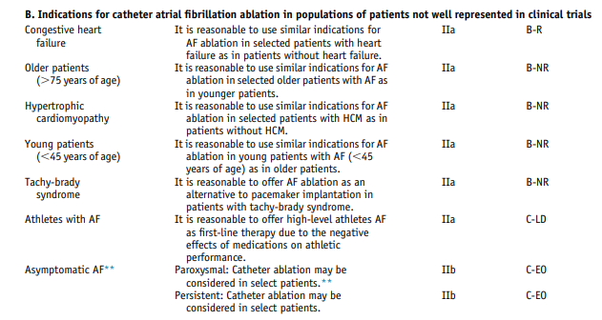
Current guideline recommendations on AF ablation in patients with HF (cont.)
Calkins H, Hindricks G, Cappato R, et al. 2017 HRS/EHRA/ECAS/APHRS/ SOLAECE expert consensus statement on catheter and surgical ablation of atrial fibrillation Europace 2018;20:e1–e160
Notes:
The most recently published 2017 HRS/EHRA expert consensus statement on catheter and surgical ablation of AF takes up this recommendation and states that it is reasonable to use similar indications for AF ablation in selected patients with HF as for patients without HF (Class IIa-B)
It is tempting to speculate, that future guidelines will update this recommendation to a Class I indication and implement prognostic indications for AF ablation in selected patients with severe HFrEF regardless of symptoms

Slide 29
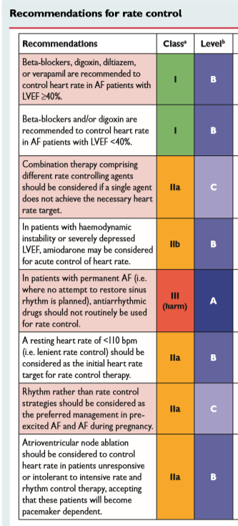
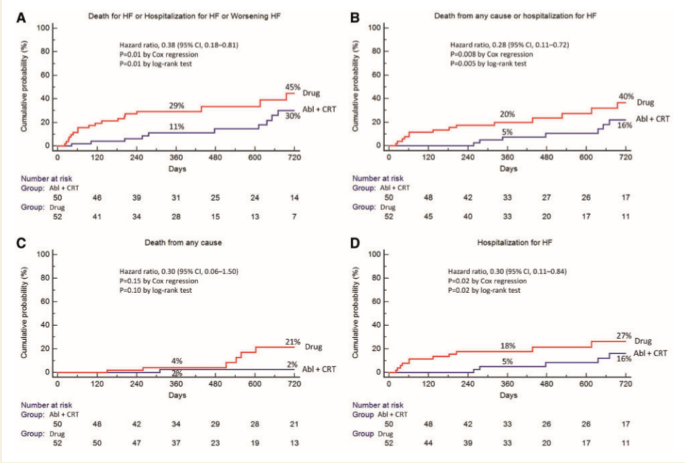
Current guideline recommendations on AF ablation in patients with HF (cont.)- Pace and ablate
-There is a legitimate role for AV junctional ablation with resynchronization therapy. In particular, elderly patients with HFrEF (LVEF ≤45%) and symptomatic persistent AF with uncontrolled ventricular rates, who are unsuitable candidates for AF ablation or had previously failed ablation attempt(s), should be considered for a biventricular pace-and-ablate strategy (Class IIa-B)
-The most recent APAF-CRT trial demonstrated a prognostic benefit of biventricular pace-and-ablate over pharmacological rate control also for patients with HFrEF and narrow QRS complex (QRS ≤110ms)
Brignole M et al. EHJ 2018; 39(45): 3999-4008
Notes:
Despite the enthusiasm for ablation-based rhythm control, we should not forget that there is a legitimate role for AV junctional ablation with resynchronization therapy. In particular, elderly patients with HFrEF (LVEF ≤45%) and symptomatic persistent AF with uncontrolled ventricular rates, who are unsuitable candidates for AF ablation or had previously failed ablation attempt(s), should be considered for a biventricular pace-and-ablate strategy (Class IIa-B)
APAF-CRT:. (A) The cumulative incidence of the primary composite outcome of death due to heart failure, or hospitalization due to heart failure, or worsening heart failure is shown. (B) The cumulative incidence of patients who died from heart failure or were hospitalized for heart failure is shown. (C) The cumulative incidence of patients who died from any cause is shown. The event rates at one at 2 years of follow-up are shown (D) The cumulative incidence of patients who were hospitalized for heart failure is shown..
Abstract
AIMS:
We tested the hypothesis that atrioventricular (AV) junction ablation in conjunction biventricular pacing [cardiac resynchronization (CRT)] pacing is superior to pharmacological rate-control therapy in reducing heart failure (HF) and hospitalization in patients with permanent atrial fibrillation (AF) and narrow QRS.
METHODS AND RESULTS:
We randomly assigned 102 patients (mean age 72 ± 10 years) with severely symptomatic permanent AF (>6 months), narrow QRS (≤110 ms), and at least one hospitalization for HF in the previous year to AV junction ablation and CRT (plus defibrillator according to guidelines) or to pharmacological rate-control therapy (plus defibrillator according to guidelines). After a median follow-up of 16 months, the primary composite outcome of death due to HF, or hospitalization due to HF, or worsening HF had occurred in 10 patients (20%) in the Ablation+CRT arm and in 20 patients (38%) in the Drug arm [hazard ratio (HR) 0.38; 95% confidence interval (CI) 0.18-0.81; P = 0.013]. Significantly fewer patients in the Ablation+CRT arm died from any cause or underwent hospitalization for HF [6 (12%) vs. 17 (33%); HR 0.28; 95% CI 0.11-0.72; P = 0.008], or were hospitalized for HF [5 (10%) vs. 13 (25%); HR 0.30; 95% CI 0.11-0.78; P = 0.024]. In comparison with the Drug arm, Ablation+CRT patients showed a 36% decrease in the specific symptoms and physical limitations of AF at 1 year follow-up (P = 0.004).
CONCLUSION:
Ablation+CRT was superior to pharmacological therapy in reducing HF and hospitalization and improving quality of life in elderly patients with permanent AF and narrow QRS.

Slide 30
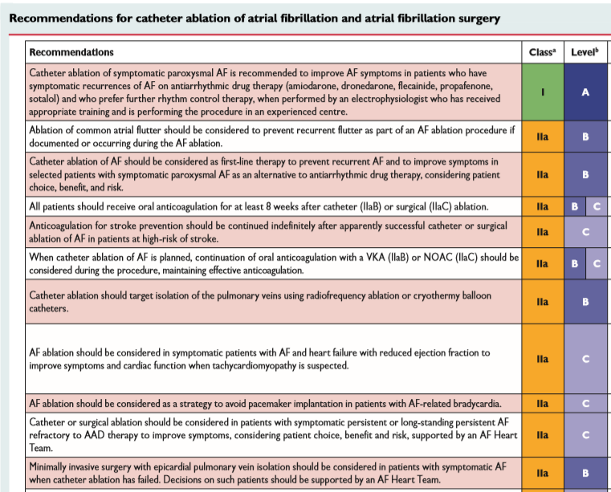
Current guideline recommendations on AF ablation in patients with HF (cont.)
Kirchhof P, 2016 ESC guidelines for the management of atrial fibrillation developed in collaboration with EACTS. Eur Heart J 2016;37:2893–2962
Notes:
- On the other hand, in patients with AF-related and drug-induced bradycardia, an attempt to ablation-based rhythm control should be considered as a strategy to improve symptoms and avoid cardiac pacing (Class IIa-C)
- The current guidelines also highly recommend that indications for AF ablation in HF should be carefully balanced on an individual basis and procedures performed by well-trained electrophysiologists in experienced centres
- The implementation of an AF Heart Team to support inter disciplinary decision making in patients with severe HFrEF has also been recommended

Slide 31
Proposed rhythm management strategy in patients with AF and HF based on recent evidence and current guideline recommendations
-Richter S, EHJ 2019;
40:663-72
-Prabhu S, CAMERA-MRI,
JACC 2017;70:1949-61
-Di-Biase L, AATAC study,
Circulation 2016; 133:
1637-44
-Marrouche NF, NEJM
2018; 378:417-27
Notes:
The figure depicts one of the proposed rhythm management strategy in patients with AF and HF published recently in the literature
*Other Class III antiarrhythmic drugs (sotalol or dofetilide) may be considered.
we encourage to consider early catheter ablation in selected patients when being performed in experienced centers
centres.

Slide 32
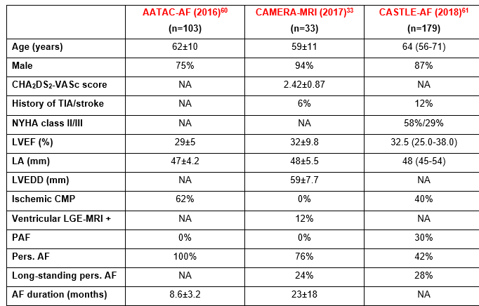
Considerations for appropriate patient selection for AF ablation in HF and reduced EF
Key clinical characteristics of the HF patients randomized to AF ablation in the 3 recent RCTs
There is no clear consensus on appropriate patient selection for catheter ablation or optimal ablation strategy in this setting
In the RCTs, there was a distinct selection bias towards younger and less severely affected patients with low(er) peri-procedural risk profile
Thus, careful patient selection for AF ablation is key important to achieve similar outcome benefits and should currently be geared to those HF populations included in previous RCTs
Notes:
The CASTLE-AF trial provides strong evidence in support of the current guideline recommendation to endorse catheter ablation as preferred treatment of AF in patients with HFrEF regardless of the type of AF. However, there is no clear consensus on appropriate patient selection for catheter ablation or optimal ablation strategy in this setting.
Not every patient will benefit from an approach to ablation-based rhythm control. Catheter ablation may not be appropriate in many patients with extensive atrial and/or ventricular remodeling, advanced congestive HF, poor functional status, or at advanced age. In fact, in CASTLE-AF and other RCTs, there was a distinct selection bias towards younger and less severely affected patients with low(er) peri-procedural risk profile
Thus, careful patient selection for AF ablation is key important to achieve similar outcome benefits and should currently be geared to those HF populations included in previous RCTs.

Slide 33
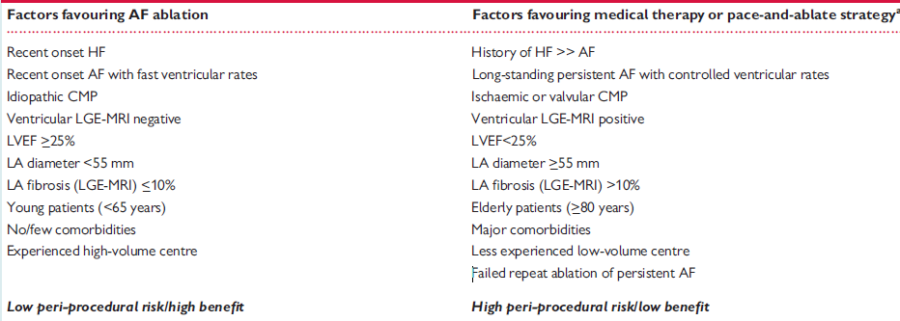
Clinical guidance to the choice of treatment in patients with AF and HFrEF
Richter S, Di Biase L and Hindricks G, EHJ 2019;40:663-72
Notes:
Table 3 depicts a proposed clinical guidance to the choice of treatment of AF in patients with HF

Slide 34
Treatment choices following rhythm control failure in patients with HFrEF
No evidence-based recommendation; The management of patients with HFrEF and recurrent AF (>3 months) after an initial ablation procedure should be individually tailored based on previous clinical outcome, updated risk benefit assessment, and patient choice (AF Heart Team)
Options:
Notes:
Early recurrences of atrial arrhythmias within the post-ablation blanking period are commonly treated by electrical cardioversion with or without AAD support.
1) The so-called hybrid rhythm control strategy increases the chance to maintain stable sinus rhythm due to possibly synergistic effects on different AF drivers and substrates, and should timely be considered when either therapy
alone has previously been ineffective (Class IIa-C). However, there is weak evidence in support of a first-line hybrid rhythm control strategy. Although concomitant AAD treatment significantly reduces early AF recurrences and related hospitalizations within the post-ablation blanking period, it does not prevent later arrhythmia relapses at 6 months and 12 months. Therefore, initiation or continuation of AAD therapy after catheter ablation in order to improve AF-free survival is arguable and may be considered (Class IIb-C) in patients with a predicted higher risk of recurrence including those with persistent AF and HF.
2) A repeat ablation procedure - is reasonable in particular for patients who have clinically benefited from previous catheter ablation, and for patients in whom concomitant amiodarone treatment is ineffective or contraindicated
3) However, these patients should also be discussed by an AF Heart Team and alternatively considered for a biventricular pace-and-ablate strategy (Class IIa-B) or
4) surgical ablation in case of an established indication for conventional cardiac surgery (ClassIIa-A)

Slide 35
Treatment choices following rhythm control failure in patients with HFrEF
No evidence-based recommendation; The management of patients with HFrEF and recurrent AF (>3 months) after an initial ablation procedure should be individually tailored based on previous clinical outcome, updated risk benefit assessment, and patient choice (AF Heart Team)
Options:
Hybrid rhythm control strategy - possible synergistic effects on different AF drivers and substrates. It may be considered when either therapy alone has previously been ineffective (Class IIa-C) or higher risk of recurrence (including persistent AF+HF); A weak evidence in support of first line strategy (Class IIb-C)
Notes:
Early recurrences of atrial arrhythmias within the post-ablation blanking period are commonly treated by electrical cardioversion with or without AAD support.
1) The so-called hybrid rhythm control strategy increases the chance to maintain stable sinus rhythm due to possibly synergistic effects on different AF drivers and substrates, and should timely be considered when either therapy
alone has previously been ineffective (Class IIa-C). However, there is weak evidence in support of a first-line hybrid rhythm control strategy. Although concomitant AAD treatment significantly reduces early AF recurrences and related hospitalizations within the post-ablation blanking period, it does not prevent later arrhythmia relapses at 6 months and 12 months. Therefore, initiation or continuation of AAD therapy after catheter ablation in order to improve AF-free survival is arguable and may be considered (Class IIb-C) in patients with a predicted higher risk of recurrence including those with persistent AF and HF.
2) A repeat ablation procedure - is reasonable in particular for patients who have clinically benefited from previous catheter ablation, and for patients in whom concomitant amiodarone treatment is ineffective or contraindicated
3) However, these patients should also be discussed by an AF Heart Team and alternatively considered for a biventricular pace-and-ablate strategy (Class IIa-B) or
4) surgical ablation in case of an established indication for conventional cardiac surgery (ClassIIa-A)

Slide 36
Treatment choices following rhythm control failure in patients with HFrEF
No evidence-based recommendation; The management of patients with HFrEF and recurrent AF (>3 months) after an initial ablation procedure should be individually tailored based on previous clinical outcome, updated risk benefit assessment, and patient choice (AF Heart Team)
Options:
Hybrid rhythm control strategy - possible synergistic effects on different AF drivers and substrates. It may be considered when either therapy alone has previously been ineffective (Class IIa-C) or higher risk of recurrence (including persistent AF+HF); A weak evidence in support of first line strategy (Class IIb-C)
A repeat ablation procedure - patients with previous clinical benefit from ablation or with failure/contraindication of amiodarone
Notes:
Early recurrences of atrial arrhythmias within the post-ablation blanking period are commonly treated by electrical cardioversion with or without AAD support.
1) The so-called hybrid rhythm control strategy increases the chance to maintain stable sinus rhythm due to possibly synergistic effects on different AF drivers and substrates, and should timely be considered when either therapy
alone has previously been ineffective (Class IIa-C). However, there is weak evidence in support of a first-line hybrid rhythm control strategy. Although concomitant AAD treatment significantly reduces early AF recurrences and related hospitalizations within the post-ablation blanking period, it does not prevent later arrhythmia relapses at 6 months and 12 months. Therefore, initiation or continuation of AAD therapy after catheter ablation in order to improve AF-free survival is arguable and may be considered (Class IIb-C) in patients with a predicted higher risk of recurrence including those with persistent AF and HF.
2) A repeat ablation procedure - is reasonable in particular for patients who have clinically benefited from previous catheter ablation, and for patients in whom concomitant amiodarone treatment is ineffective or contraindicated
3) However, these patients should also be discussed by an AF Heart Team and alternatively considered for a biventricular pace-and-ablate strategy (Class IIa-B) or
4) surgical ablation in case of an established indication for conventional cardiac surgery (ClassIIa-A)

Slide 37
Treatment choices following rhythm control failure in patients with HFrEF
No evidence-based recommendation; The management of patients with HFrEF and recurrent AF (>3 months) after an initial ablation procedure should be individually tailored based on previous clinical outcome, updated risk benefit assessment, and patient choice (AF Heart Team)
Options:
Hybrid rhythm control strategy - possible synergistic effects on different AF drivers and substrates. It may be considered when either therapy alone has previously been ineffective (Class IIa-C) or higher risk of recurrence (including persistent AF+HF); A weak evidence in support of first line strategy (Class IIb-C)
A repeat ablation procedure - patients with previous clinical benefit from ablation or with failure/contraindication of amiodarone
Biventricular pace-and-ablate strategy (Class IIa-B)
Notes:
Early recurrences of atrial arrhythmias within the post-ablation blanking period are commonly treated by electrical cardioversion with or without AAD support.
1) The so-called hybrid rhythm control strategy increases the chance to maintain stable sinus rhythm due to possibly synergistic effects on different AF drivers and substrates, and should timely be considered when either therapy
alone has previously been ineffective (Class IIa-C). However, there is weak evidence in support of a first-line hybrid rhythm control strategy. Although concomitant AAD treatment significantly reduces early AF recurrences and related hospitalizations within the post-ablation blanking period, it does not prevent later arrhythmia relapses at 6 months and 12 months. Therefore, initiation or continuation of AAD therapy after catheter ablation in order to improve AF-free survival is arguable and may be considered (Class IIb-C) in patients with a predicted higher risk of recurrence including those with persistent AF and HF.
2) A repeat ablation procedure - is reasonable in particular for patients who have clinically benefited from previous catheter ablation, and for patients in whom concomitant amiodarone treatment is ineffective or contraindicated
3) However, these patients should also be discussed by an AF Heart Team and alternatively considered for a biventricular pace-and-ablate strategy (Class IIa-B) or
4) surgical ablation in case of an established indication for conventional cardiac surgery (ClassIIa-A)

Slide 38
Treatment choices following rhythm control failure in patients with HFrEF
No evidence-based recommendation; The management of patients with HFrEF and recurrent AF (>3 months) after an initial ablation procedure should be individually tailored based on previous clinical outcome, updated risk benefit assessment, and patient choice (AF Heart Team)
Options:
Hybrid rhythm control strategy - possible synergistic effects on different AF drivers and substrates. It may be considered when either therapy alone has previously been ineffective (Class IIa-C) or higher risk of recurrence (including persistent AF+HF); A weak evidence in support of first line strategy (Class IIb-C)
A repeat ablation procedure - patients with previous clinical benefit from ablation or with failure/contraindication of amiodarone
Biventricular pace-and-ablate strategy (Class IIa-B)
Surgical ablation - in case of an established indication for conventional cardiac surgery (Class IIa-A)
Notes:
Early recurrences of atrial arrhythmias within the post-ablation blanking period are commonly treated by electrical cardioversion with or without AAD support.
1) The so-called hybrid rhythm control strategy increases the chance to maintain stable sinus rhythm due to possibly synergistic effects on different AF drivers and substrates, and should timely be considered when either therapy
alone has previously been ineffective (Class IIa-C). However, there is weak evidence in support of a first-line hybrid rhythm control strategy. Although concomitant AAD treatment significantly reduces early AF recurrences and related hospitalizations within the post-ablation blanking period, it does not prevent later arrhythmia relapses at 6 months and 12 months. Therefore, initiation or continuation of AAD therapy after catheter ablation in order to improve AF-free survival is arguable and may be considered (Class IIb-C) in patients with a predicted higher risk of recurrence including those with persistent AF and HF.
2) A repeat ablation procedure - is reasonable in particular for patients who have clinically benefited from previous catheter ablation, and for patients in whom concomitant amiodarone treatment is ineffective or contraindicated
3) However, these patients should also be discussed by an AF Heart Team and alternatively considered for a biventricular pace-and-ablate strategy (Class IIa-B) or
4) surgical ablation in case of an established indication for conventional cardiac surgery (ClassIIa-A)

Slide 39
Conclusions and future directions

Slide 40
Catheter ablation provides the superior approach to rhythm and symptom control compared with drug therapy and results in significant clinical and functional improvements
Notes:
Given the limited AF treatment options for the challenging population of patients with concomitant HF, catheter ablation provides the superior approach to rhythm and symptom control compared with drug therapy and results in significant clinical and functional improvements
AATAC-AF and CASTLE-AF trials indicate also improvement in prognostic surrogates for HF outcomes (including hospitalization for worsening HF and mortality). The outcomes of the upcoming RAFT-AF and AMICA trials will further extent our evidence base to the prognostic impact of AF ablation in patients with HF
5. Controversies still exist in how to ablate patients with persistent and long-standing persistent AF, who frequently present with advanced forms of what has been tagged fibrotic atrial cardiomyopathy. In these patients, PVI only may not be sufficient to maintain stable rhythm control and additional ablation is often needed first-line. We certainly need to establish more sophisticated strategies for electrophysiological substrate visualization and modification to improve ablation outcome, with development towards an individualized patient-tailored approach

Slide 41
Catheter ablation provides the superior approach to rhythm and symptom control compared with drug therapy and results in significant clinical and functional improvements
AATAC-AF and CASTLE-AF trials indicate also improvement in prognostic surrogates for HF outcomes (including hospitalization for worsening HF and mortality)
Notes:
2. AATAC-AF and CASTLE-AF trials indicate also improvement in prognostic surrogates for HF outcomes (including hospitalization for worsening HF and mortality). The outcomes of the upcoming RAFT-AF and AMICA trials will further extent our evidence base to the prognostic impact of AF ablation in patients with HF

Slide 42
Catheter ablation provides the superior approach to rhythm and symptom control compared with drug therapy and results in significant clinical and functional improvements
AATAC-AF and CASTLE-AF trials indicate also improvement in prognostic surrogates for HF outcomes (including hospitalization for worsening HF and mortality)
3) Catheter ablation can safely be performed with acceptable
complication rates in patients with HF

Slide 43
Catheter ablation provides the superior approach to rhythm and symptom control compared with drug therapy and results in significant clinical and functional improvements
AATAC-AF and CASTLE-AF trials indicate also improvement in prognostic surrogates for HF outcomes (including hospitalization for worsening HF and mortality)
3) Catheter ablation can safely be performed with acceptable
complication rates in patients with HF
4) However, long-term success rates of single and repeat ablation for
non-paroxysmal AF seem to be lower in patients with than without HF (*)
*) Cha YM, Circ AE 2011;4:724-32
*) Ullah W, Europace 2016;18:679-86

Slide 44
Catheter ablation provides the superior approach to rhythm and symptom control compared with drug therapy and results in significant clinical and functional improvements
AATAC-AF and CASTLE-AF trials indicate also improvement in prognostic surrogates for HF outcomes (including hospitalization for worsening HF and mortality)
3) Catheter ablation can safely be performed with acceptable
complication rates in patients with HF
4) However, long-term success rates of single and repeat ablation for
non-paroxysmal AF seem to be lower in patients with than without HF (*)
5) Controversies still exist in how to ablate patients with persistent and
long-standing persistent AF, who frequently present with advanced
forms of fibrotic atrial cardiomyopathy
*) Cha YM, Circ AE 2011;4:724-32
*) Ullah W, Europace 2016;18:679-86
Notes:
5. Controversies still exist in how to ablate patients with persistent and long-standing persistent AF, who frequently present with advanced forms of what has been tagged fibrotic atrial cardiomyopathy. In these patients, PVI only may not be sufficient to maintain stable rhythm control and additional ablation is often needed first-line.

Slide 45
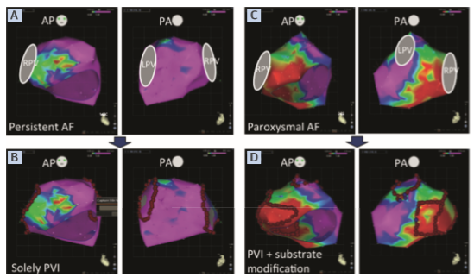
Future directions:
1) Sophisticated strategies for electrophysiological substrate visualization and modification to improve ablation outcome, with development towards an individualized patient-tailored approach
Kottkamp H, JACC 2015;65:196–206
Notes:
We certainly need to establish more sophisticated strategies for electrophysiological substrate visualization and modification to improve ablation outcome, with development towards an individualized patient-tailored approach:
Two examples of patients undergoing AF ablation with voltage mapping and individually tailored ablation according to the substrate rather than the “phenotype” (persistent vs. paroxysmal AF). (A) A patient with persistent AF showed completely normal voltages in most areas of the left atrium and only mildly reduced voltages in the anteroseptal region. (B) Accordingly, solely circumferential PVI was performed. (C) A patient with paroxysmal AF showed substantial areas of very low voltage in the anteroseptal and posteroinferior left atrium. (D) Additional substrate modiﬁcation was performed with speciﬁcally targeted box isolations. Abbreviations as in

Slide 46
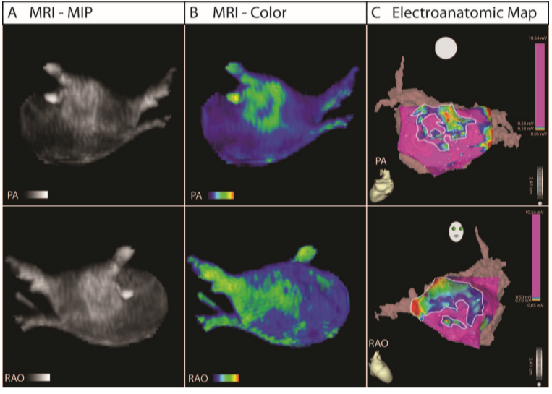
Future directions:
2) Advanced AF-trigger and substrate modification concepts should target precise localization and ablation of areas thought to be crucial for arrhythmia initiation and perpetuation (3D-EAM; focal impulse and rotor modulation techniques; but also pre-ablation MRI-derived LGE plays an increasing role in atrial tissue characterization and localization of atrial fibrosis)
Oakes RS, Circulation 2009;119:1758–1767

Slide 47
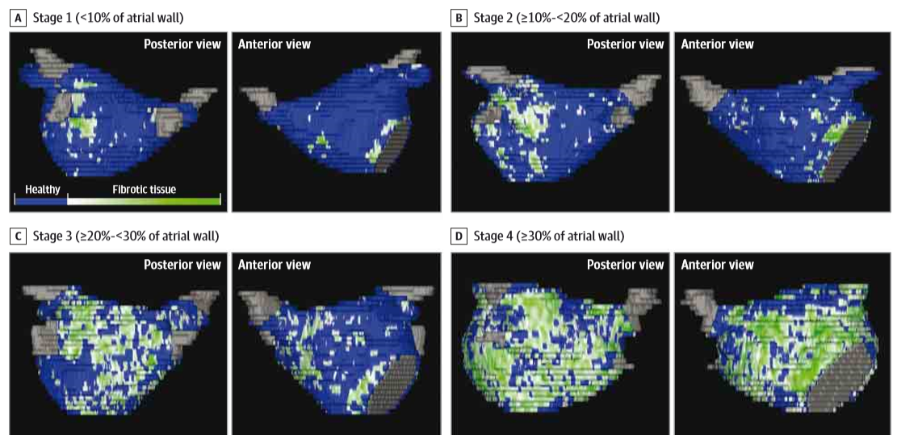
Future directions:
3) Image integration of electroanatomical (CFAE; low voltage) and structural (fibrosis) information fused on 3D anatomical MRI models of the atria
Marrouche NF, the DECAAF study. JAMA 2014; 311:498–506
Notes:
Four Stages of Left Atrial Tissue Fibrosis Based on 3D Delayed Enhancement Magnetic Resonance Imaging Scans

Slide 48
Real-time MRI -may possibly enable non-fluoroscopic MRI-guided catheter ablation of the patient’s individual AF substrate
Moreover, concomitant pre-ablation MRI screening for ventricular LGE has proven very useful to identify and select appropriate ablation candidates with HF who most likely benefit from an AF ablation approach (*)
Finding new markers and tools for risk/benefit assessment and patient selection for catheter ablation should be another step forward in the treatment of AF in patients with HF
*) Addison D, J Am Heart Assoc 2016;5:e003570
*) Prabhu S, CAMERA-MRI study. JACC 2017;70: 1949–1961
Notes:
This substrate visualization concept will logically pave the way for introducing real-time MRI into the clinical electrophysiological laboratory and may possibly enable non-fluoroscopic MRI-guided catheter ablation of the patient’s individual AF substrate

Slide 49

“The exciting journey of AF catheter ablation in HF has
already begun and it looks that we are getting far beyond the
first step…” (S. Richter)
Thank you!
avishagl@assuta.co.il

Slide 50
AF ablation in patients with HF and preserved LV systolic function (HFpEF)
AF and HFpEF likewise share common mechanisms and risk factors and jointly confer an adverse prognosis
AF occurs in >50% of patients with HFpEF
New-onset AF is prevalent in HFpEF and is associated with an increased mortality (HR 1.83 [95% CI 1.41 to 2.37], P<0.0001)
Maintenance of normal sinus rhythm and AV synchrony is key to improve diastolic function and clinical outcome in patients with HFpEF

Slide 51
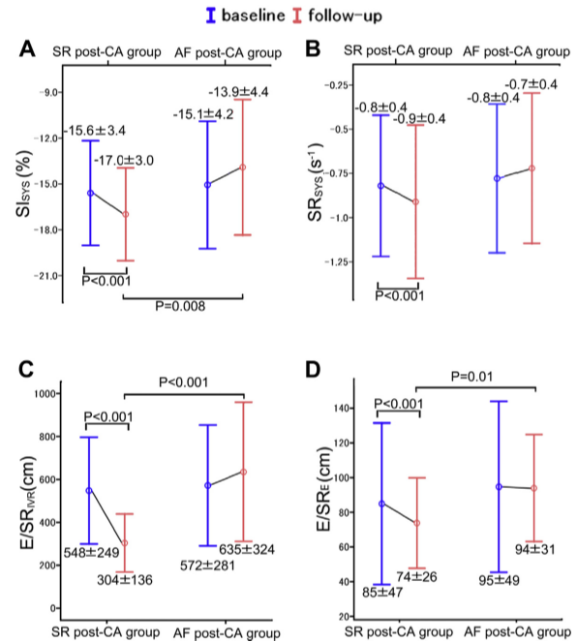
AF ablation in patients with HF and preserved LV systolic function (HFpEF) (cont.)
There is scarce evidence for AF ablation in this HF population
A small single-center study suggests that AF catheter ablation in patients with HFpEF frequently requires repeat and more extensive ablation (>60%) and concomitant AADs to achieve effective rhythm control.
Successful maintenance of sinus rhythm was associated with improvement in diastolic function
Machino-Ohtsuka T, JACC 2013;62:1857-65

Slide 52
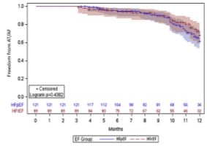
AF ablation in patients with HF and preserved LV systolic function (HFpEF) (cont.)
These findings were expanded by a retrospective study comparing the outcomes of AF ablation in patients with HFpEF and HFrEF:
AF ablation was equally safe and effective in HFpEF and HFrEF
Arrhythmia-free survival at 12 months was 66% in HFpEF and 67% in HFrEF, with only 6% and 3% repeat ablation, respectively.
Approximately 50% of patients with HFpEF and HFrEF received concomitant AADs
Additional LA lesions were frequently required and equally often performed in both groups
Rates of arrhythmia recurrence at 12 months remained similar between groups in patients with paroxysmal and persistent AF
Black-Maier E, Heart Rhythm 2018;15:651-7

Slide 53
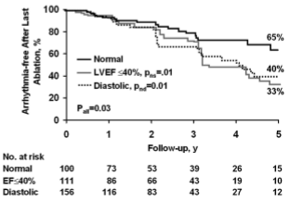
AF ablation in patients with HF and preserved LV systolic function (HFpEF) (cont.)
Effective treatment directed toward hypertension and LV diastolic dysfunction is an important adjunct to the ablation approach in achieving long-term rhythm control and preventing atrial remodeling progression (*)
- In a prior study from the Mayo Clinic including 157 patients with diastolic dysfunction, 1-year AF-free survival after catheter ablation in patients with HFpEF was excellent (75% off and 85% on AADs) and compared well to that in patients with normal LV function (**)
-However, 5-year freedom from AF recurrence was 29% off and 40% on AADs as compared to 46% and 65%, respectively, in control patients without HF (**)
*) Pathak RK, ARREST-AF study, JACC 2014;64:2222-31
**)Cha YM, Circ AE 2011;4:724-732

Slide 54
AF ablation in patients with HF and preserved LV systolic function (HFpEF) (cont.)
There is an urgent need for RCTs on AF ablation in HFpEF.
The upcoming EVENT-AF (Catheter Ablation for Atrial Fibrillation in Heart Failure with Preserved Ejection Fraction) trial, which is designed to assess the effect of catheter ablation on the primary outcome of HF hospitalization or mortality in patients with HFpEF, will provide further evidence on the efficacy and prognostic value of ablation-based rhythm control in this particular HF patient population

Slide 55
Rationale for rhythm control in patients with AF and HF

Slide 56
Lessons learned from pharmacological rhythm control
Regardless of what begets what, tackling the arrhythmia in patients with AF and HFrEF is key to clinical and functional improvement
Rate control or rhythm control???- a question of debate
Rhythm control by AAD is limited to amiodarone and dofetilide. These can be associated with adverse effects and toxicity
Notes:
Regardless of what begets what, it stands to reason that tackling the arrhythmia in patients with AF and HFrEF is key to clinical and functional improvement. Whether this can be achieved by pharmacological rate or rhythm control has long been a question of debate, mainly driven by previous well-designed randomized controlled trials (RCTs) which failed to identify a significant benefit in favor of the rhythm-control strategy

Slide 57
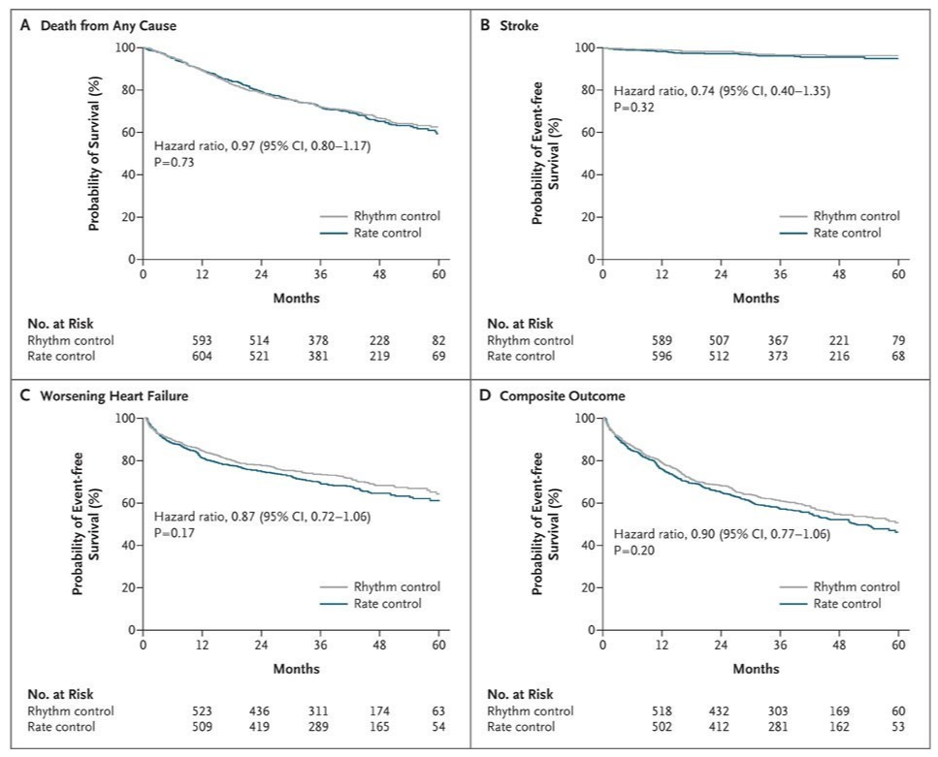
Lessons learned from pharmacological rhythm control (cont.)
The AF-CHF trial showed no differences in all-cause mortality and worsening HF between pharmacological rate and AAD-facilitated rhythm control (amiodarone + DCCV)
Roy D, NEJM 2008;358:2667-77
Notes:
Especially amiodarone is associated with significant toxicity and adverse effects, which likely offset the expected clinical benefits of maintained sinus rhythm. Not surprisingly, the AF-CHF (Atrial Fibrillation and Congestive Heart Failure) trial showed no differences in all-cause mortality and worsening HF between pharmacological rate and AAD-facilitated rhythm control (amiodarone with electrical cardioversion)

Slide 58
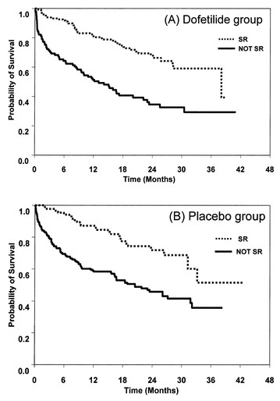
Lessons learned from pharmacological rhythm control- (cont.)
In the DIAMOND-CHF trial: dofetilide had no effect on all cause mortality (but increased probability of SR)
In contrast, restoration and maintenance of SR was associated with significant reduction in hospitalization and mortality
Hence, rhythm control may be preferred over rate control if SR maintenance can be achieved without AAD
Pedersen OD, Danish Investigators of Arrhythmia and Mortality on Dofetilide in CHF, Circulation 2001;104:292-6
Notes:
Abstract
Background In patients with left ventricular dysfunction, atrial fibrillation and flutter (AF and AFl, respectively) are common arrhythmias associated with increased morbidity and mortality. The present study investigated the potential of dofetilide in AF-AFl patients with left ventricular dysfunction to restore and maintain sinus rhythm, which might reduce mortality and hospitalizations.
Methods and Results In the Danish Investigations of Arrhythmia and Mortality ON Dofetilide (DIAMOND) studies, 506 patients were in AF-AFl at baseline. Over the course of study, cardioversion occurred in 148 (59%) dofetilide- and 86 (34%) placebo-treated patients. In these patients, the probability of maintaining sinus rhythm for 1 year was 79% with dofetilide versus 42% with placebo (P<0.001). Dofetilide had no effect on all-cause mortality, but restoration and maintenance of sinus rhythm was associated with significant reduction in mortality (risk ratio [RR], 0.44; 95% CI, 0.30 to 0.64; P<0.0001). In addition, dofetilide therapy was associated with a significantly lower risk ratio versus placebo for either all-cause (RR, 0.70; 95% CI, 0.56 to 0.89; P≤0.005) or congestive heart failure (RR, 0.69; 95% CI, 0.51 to 0.93; P≤0.02) rehospitalization.
Conclusions Dofetilide is safe and increases the probability of obtaining and maintaining sinus rhythm in patients with structural heart disease. The present study suggests that restoration of sinus rhythm is associated with improved survival.

Slide 59
Catheter ablation for non-pharmacological rhythm and symptom control
Catheter ablation (CA) is currently recommended in patients with PAF (class I-A) and persistent AF (class IIa-B) who remain symptomatic despite adequate attempts of meds (rate or rhythm control)
Emerging evidence shows that also first-line CA is more effective than AAD in achieving rhythm and symptom control, especially in younger pts with recurrent PAF (IIa-B) or persistent AF (IIa-C) and low-risk profile for procedure-related complications
Kirchhof P et al, 2016 ESC guidelines for the management of AF, EHJ 2016;37:2893-62
Notes:
Since safety and efficacy of invasive ablation procedure has well been established, ……..

Slide 60
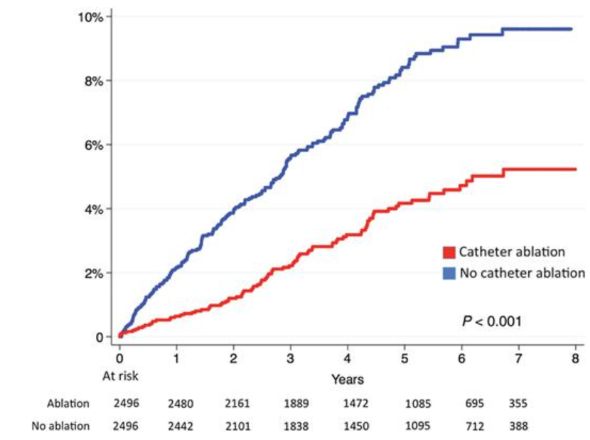
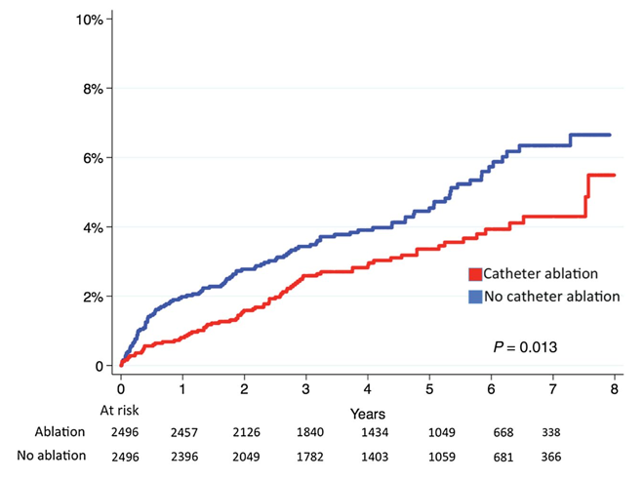
Catheter ablation for non-pharmacological rhythm and symptom control- (cont.)
Moreover, observational and non-randomized studies (including recent data from the Swedish AF Registry) even suggest that CA may be associated with lower risk of stroke and reduced morbidity and mortality
Friberg L, EHJ 2016;37:2478-87
Notes:
Abstract
Aim It is unclear if catheter ablation for atrial fibrillation (AF) affects the prognosis or merely is a symptomatic treatment. The aim is to study the association between ablation for AF, ischaemic stroke, and mortality.
Methods and results We identified all 361 913 patients with a diagnosis of AF in the Swedish Patient Register. During a 7-year period, 5176 AF ablations were performed among 4278 individuals. Patients who had undergone catheter ablation were younger (58.7 vs. 74.7 years, P < 0.001) and healthier (mean CHA ₂ DS ₂ -VASc scores 1.5 ± 1.4 vs. 3.6 ± 1.9, P < 0.001) than other patients with AF. Propensity score matching was used to construct two cohorts of equal size ( n = 2836) with similar characteristics in 51 dimensions. Mean follow-up was 4.4 ± 2.0 years (minimum 1 year). In the ablated group, 78 patients suffered ischaemic stroke compared with 112 in the non-ablated (annual rates 0.70 vs. 1.0%, P = 0.013). A total of 88 ablated and 184 non-ablated patients died (annual rates 0.77 vs. 1.62%, P < 0.001). After multivariable adjustments, catheter ablation was associated with lower risk of ischaemic stroke [hazard ratio (HR) 0.69, 95% confidence interval (CI) 0.51–0.93) and with lower mortality risk (HR 0.50, 95% CI 0.37–0.62). Stroke reduction was most pronounced among patients with CHA ₂ DS ₂ -VASc score ≥2 (HR 0.39, 95% CI 0.19–0.78) and among patients without new cardioversions beyond 6 months after the ablation (HR 0.68, 95% CI 0.48–0.97).
Conclusion Ablation may be associated with lower incidence of ischaemic stroke and death in patients with AF. This beneficial finding appears more pronounced in patients with higher thromboembolic risk.

Slide 61
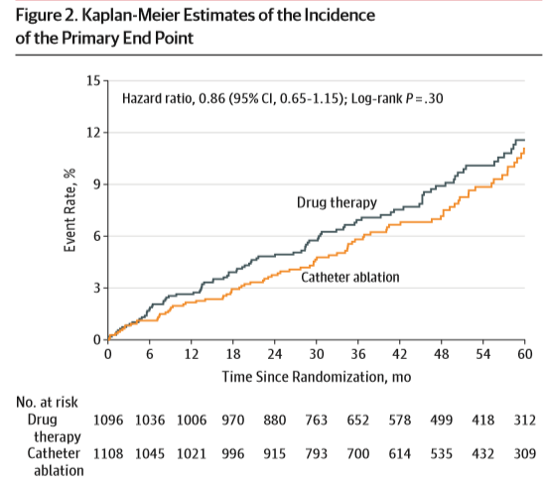
CABANA trial:
2204 pts with new-onset or untreated AF were randomly assigned to either CA or drug Tx
Failed to demonstrate that CA is superior to drug Tx for primary outcome (composite of all-cause mortality, disabling stroke, serious bleeding, cardiac arrest) at 5y based on conventional ITT analysis
Packer DL, CABANA trial, JAMA 2019, 321(13);1261-74

Slide 62
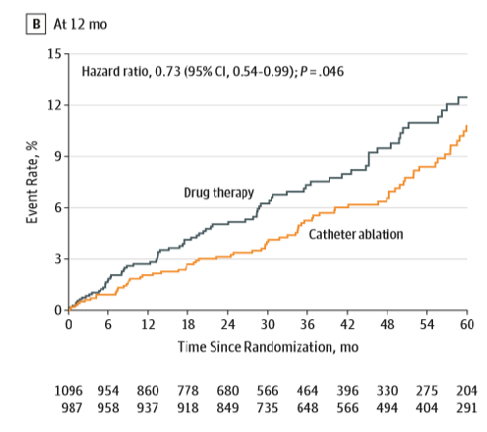
CABANA trial:
However, there was a highly significant reduction in primary and secondary (all-cause mortality; death or CV hospitalization) outcomes with CA based on an as-treated analysis, which has additionally been performed owing to the high cross-over rate between groups
Ongoing EAST trial (Early Treatment of AF for Stroke Prevention Trial)
Hence, the primary treatment goal of CA still remains achievement of symptomatic rather than prognostic improvement, until randomized trials prove beneficial effects on the outcome of stroke or mortality
Packer DL, CABANA trial, JAMA 2019, 321(13);1261-74
Kirchhof P, EAST trial- rationale and design, AHJ 2013;166:442-8

