Slide 1


DOACs in Atrial Fibrillation: What is New?
Moti Haim, MD
Cardiac Electrophysiology and Pacing
Cardiology Department
Soroka Medical Center

Slide 2



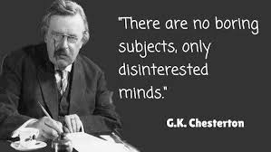
DOACs in Atrial Fibrillation: What is New?

Slide 3
DOACs in Atrial Fibrillation: What is New For Me?

Slide 4
DOACs in Atrial Fibrillation: What is Relatively New? And may not bore the Audience?
Few Data from Israel
Elderly and CKD Benefits and Risk
Minimally Interrupted vs. Un Interrupted DOACS in AF ablation
DOACS in Device Implantations
DOACS in PCI

Slide 5
DOACs in Atrial Fibrillation: What is Relatively New? And may not bore the Audience?
Few Data from Israel
Elderly and CKD Benefits and Risk
Minimally Interrupted vs. Un Interrupted DOACS in AF ablation
DOACS in Device Implantations
DOACS in PCI

Slide 6
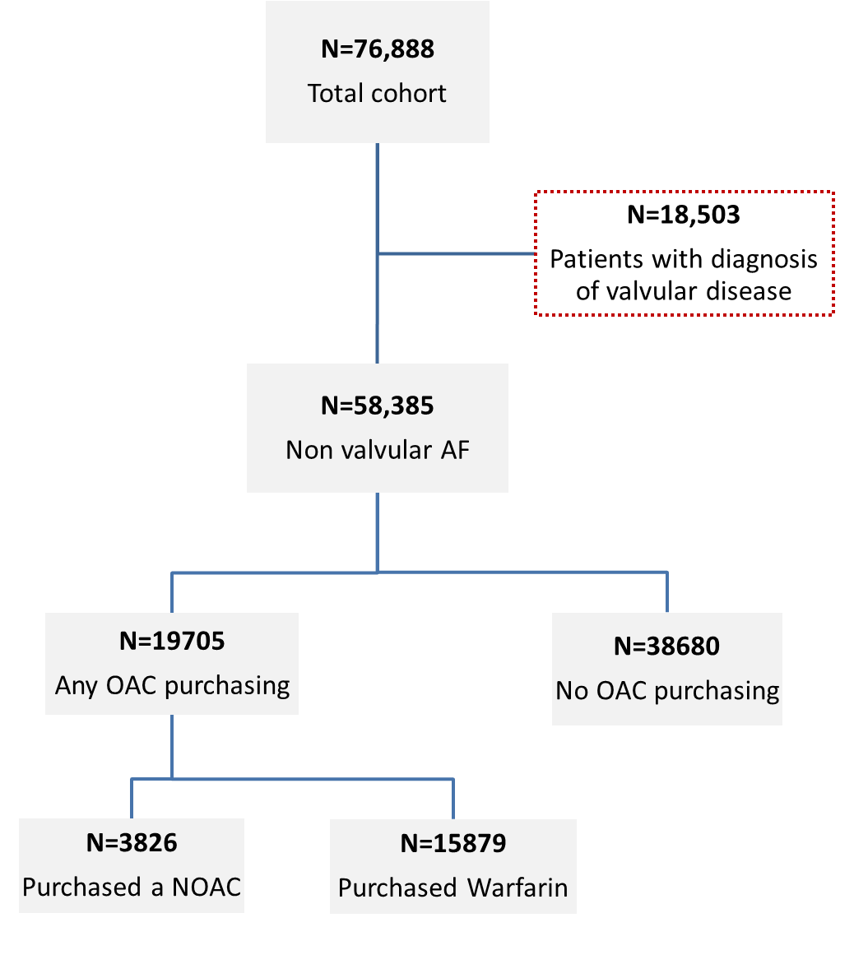
Epidemiology in Israel 2008-2015
Kezerle L… Haim M. JCE 2019 in press

Slide 7
Any Oral Anticoagulant Use 2004-2015

Slide 8
VKA and NOACS 2004-2015

Slide 11
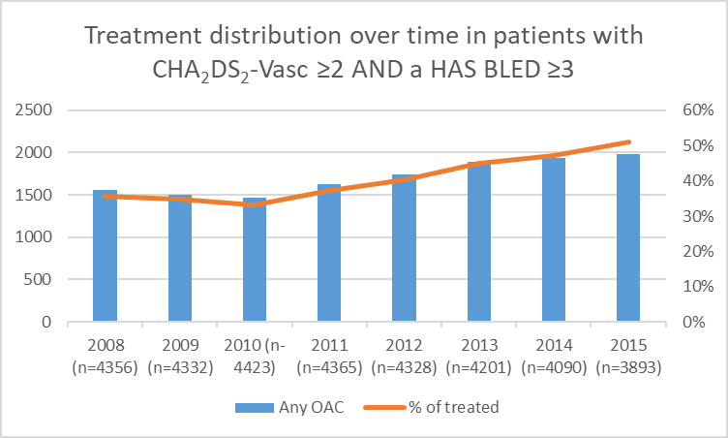
Epidemiology in Israel 2008-2015
Kezerle L… Haim M. JCE 2019 in press

Slide 12
DOACS in PCI and AF
AF is common- 12-15% of adults older than 65
40% of AF patients have concomitant CAD
Anticoagulants are used in AF to prevent thromboembolic complications
PCI dictates addition of dual antiplatelet agents to prevent stent thrombosis.
Concomitant use of dual antiplatelets and OAC (Triple Therapy) increases risk of bleeding
Haim et al. JAHA 2015

Slide 13
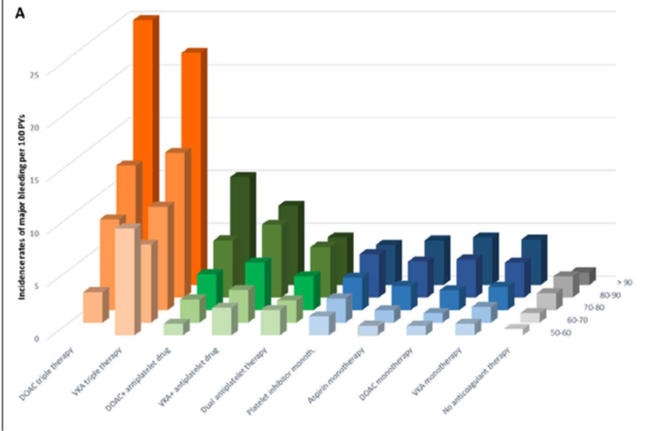

Slide 15
Circulation. 2019;139:775–786

Slide 16
Patients with atrial fibrillation on VKA and DOAC triple therapy experienced a high rate of major bleeding.
Patients >80 years of age and patients with a CHA2DS2-VASc of 7 to 9 and with a history of a major bleeding, had very high bleeding rates
suggesting that triple therapy should be carefully considered in these patients.
Circulation. 2019;139:775–786

Slide 17
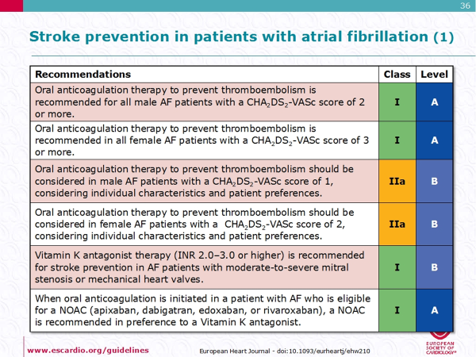
NOACS are preferred over VKAs

Slide 18
POST PCI
  DAPT
    ASA+Clopidogrel in Stable CAD (6-12 mnths)
    ASA+Ticagrelor or Prasugrel after ACS-PCI (12 months or less)
  short-term DAPT followed by P2Y12-inhibitor monotherapy may provide a safety benefit compared with standard DAPT in PCI patients receiving current-generation DES.

Slide 19
DOUBLE VERSUS TRIPLE THERAPY IN
AF-PCI PATIENTS VKA studies
WOEST
Early discontinuation of aspirin reduces bleeding in comparison to TAT, without any apparent increase in ischemic events
WOEST, Lancet, Vol 381 March 30, 2013

Slide 20
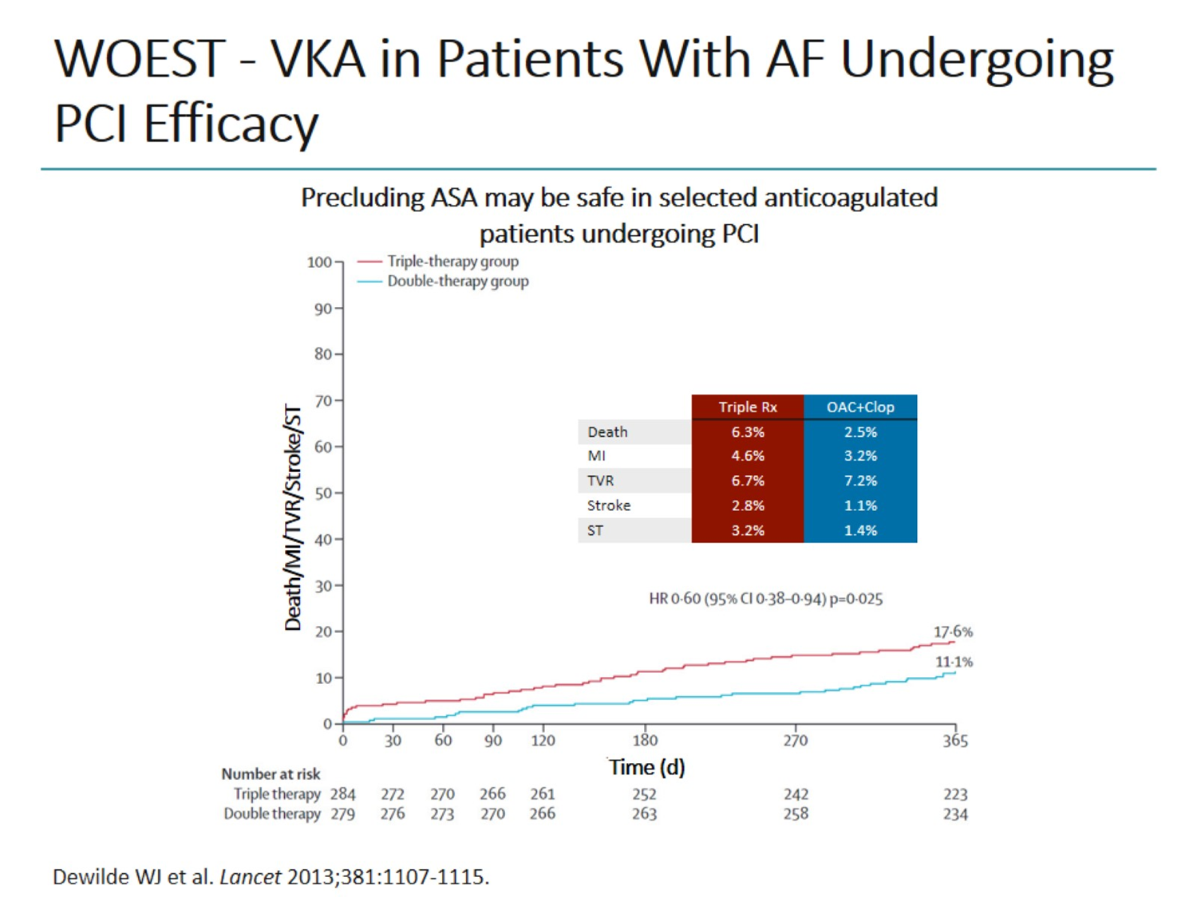
WOEST, Lancet, Vol 381 March 30, 2013

Slide 21
ISAR-TRIPLE
Randomized to 6 weeks vs 6 months of Clopidogrel
Both ISAR-TRIPLE as well as WOEST were under powered to assess differences in ischemic end points
J Am Coll Cardiol 2015;65:1619–29.

Slide 22
NOAC Trials

Slide 23
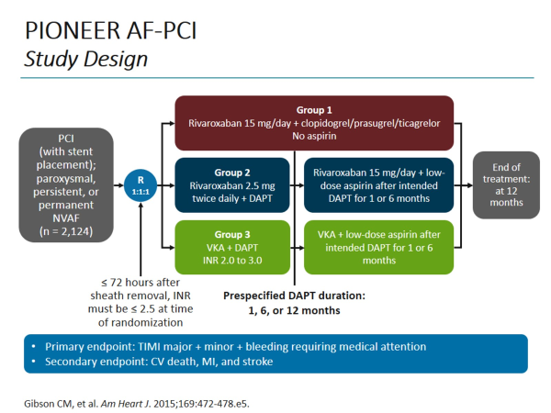
PIONEER AF PCI

Slide 24
PIONEER AF PCI

Slide 25
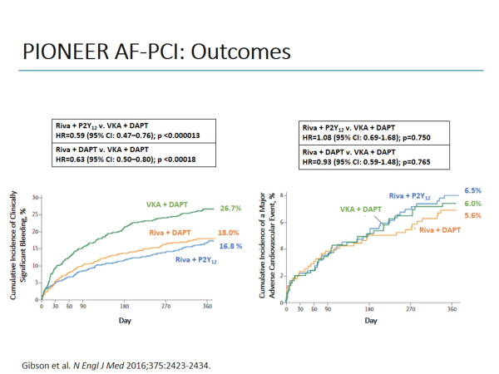

Slide 26
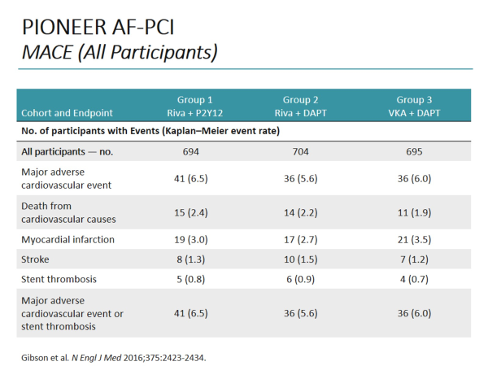

Slide 27
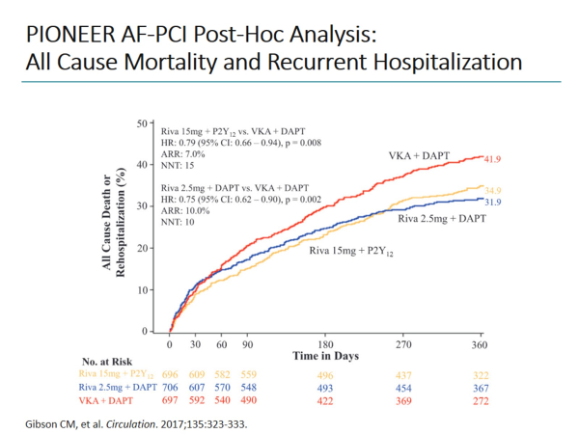
PIONEER AF PCI

Slide 28
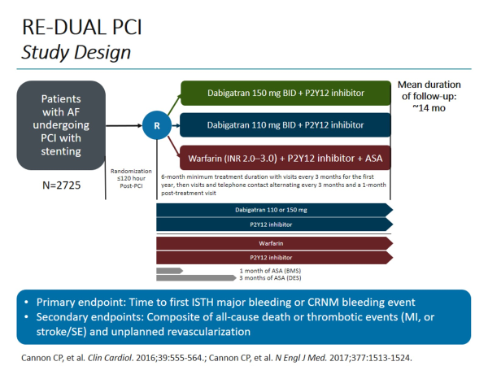
RE-DUAL PCI

Slide 29
RE-DUAL PCI

Slide 30
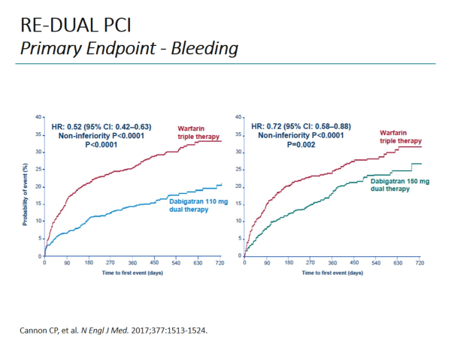

Slide 31
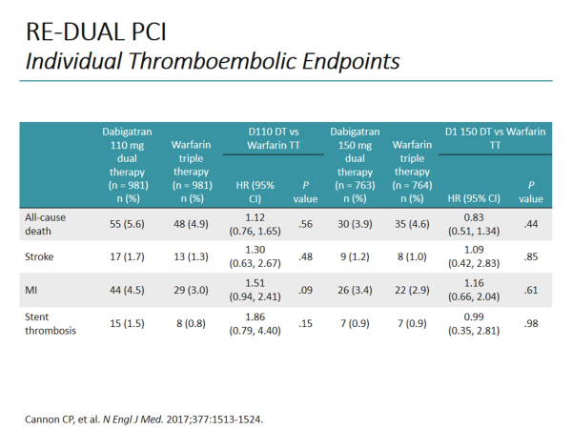
RE-DUAL PCI

Slide 32
RE- DUAL PCI and PIONEER AF- Reduction in Bleeding non inferior in Ischemic events
Reduction could be due to:
  DOACs vs. VKAs
  Dual Antithrombotic (omission of ASA) vs. Triple Therapy
  Both

Slide 33
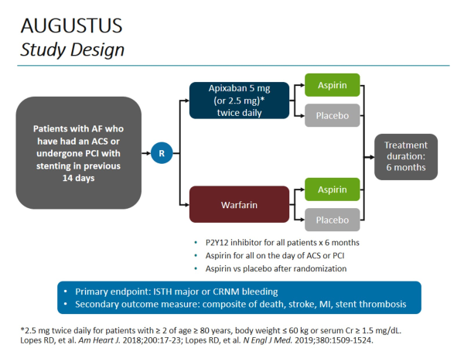

Slide 34

AUGUSTUS

Slide 35
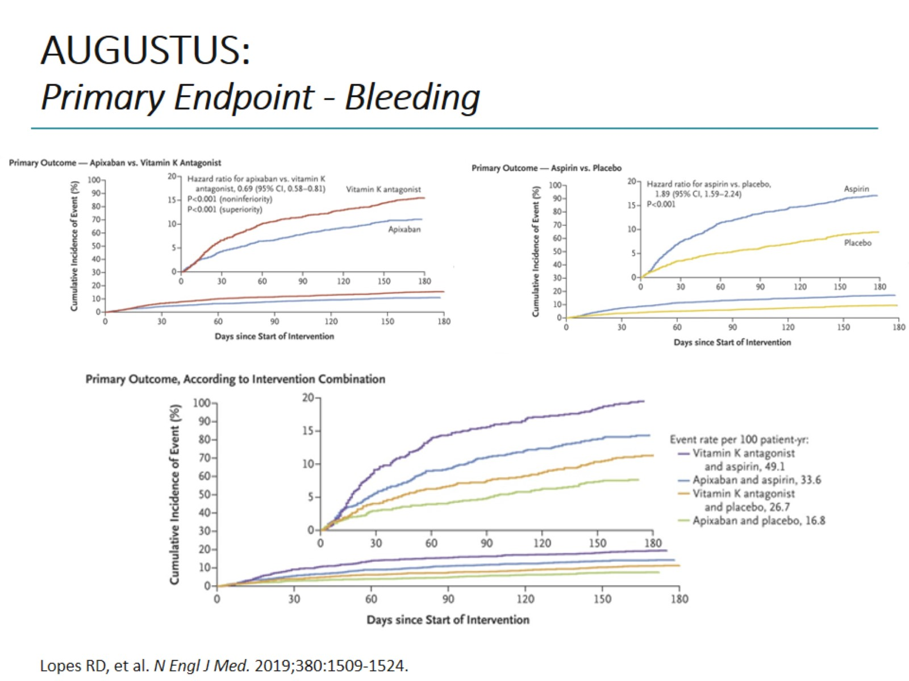
AUGUSTUS:
Primary Endpoint - Bleeding

Slide 36
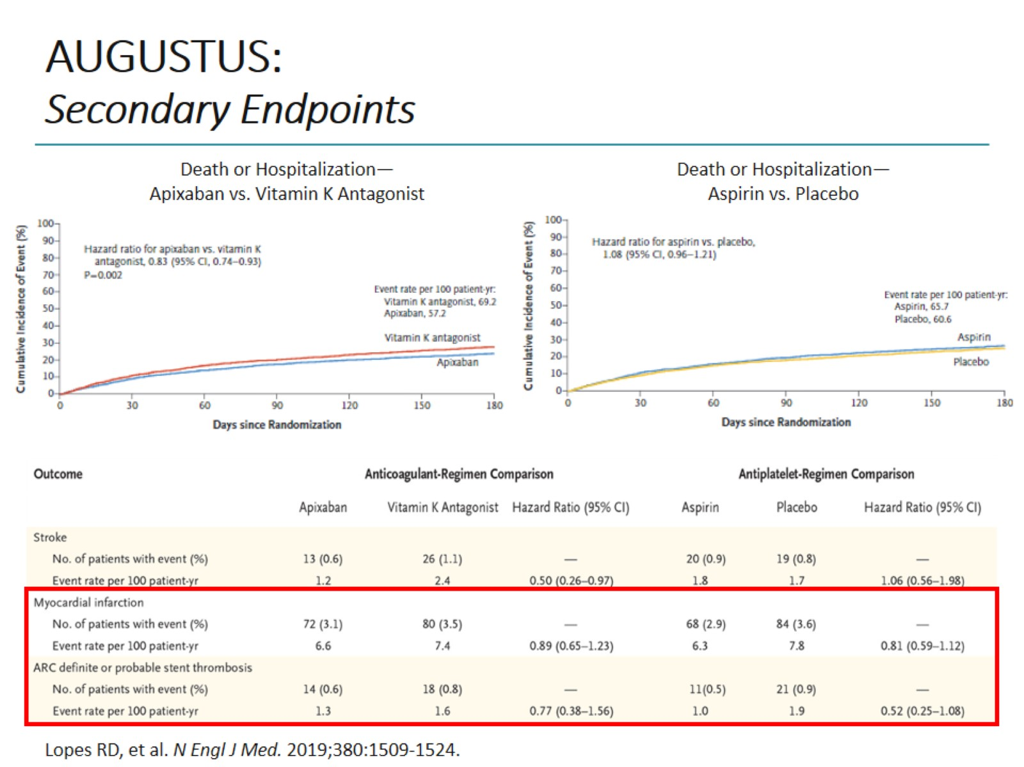
AUGUSTUS:
Secondary Endpoints

Slide 37
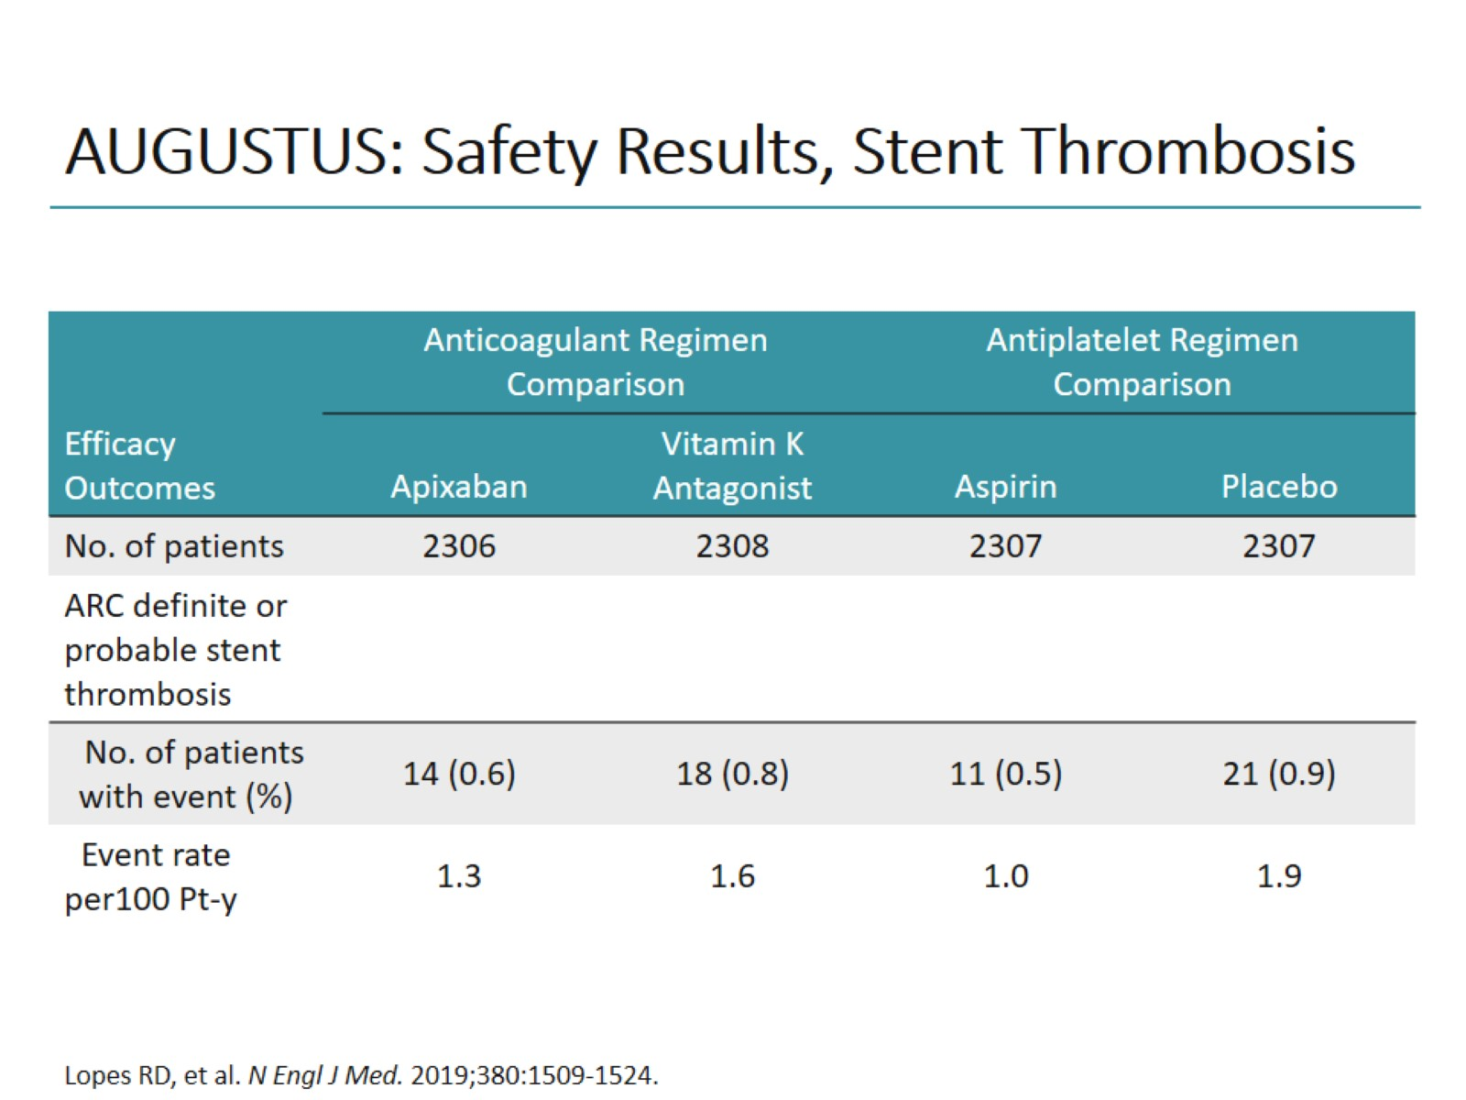
AUGUSTUS: Safety Results, Stent Thrombosis

Slide 38
MetaAnalyses

Slide 39
European Heart Journal (2019) 0, 1–11

Slide 40
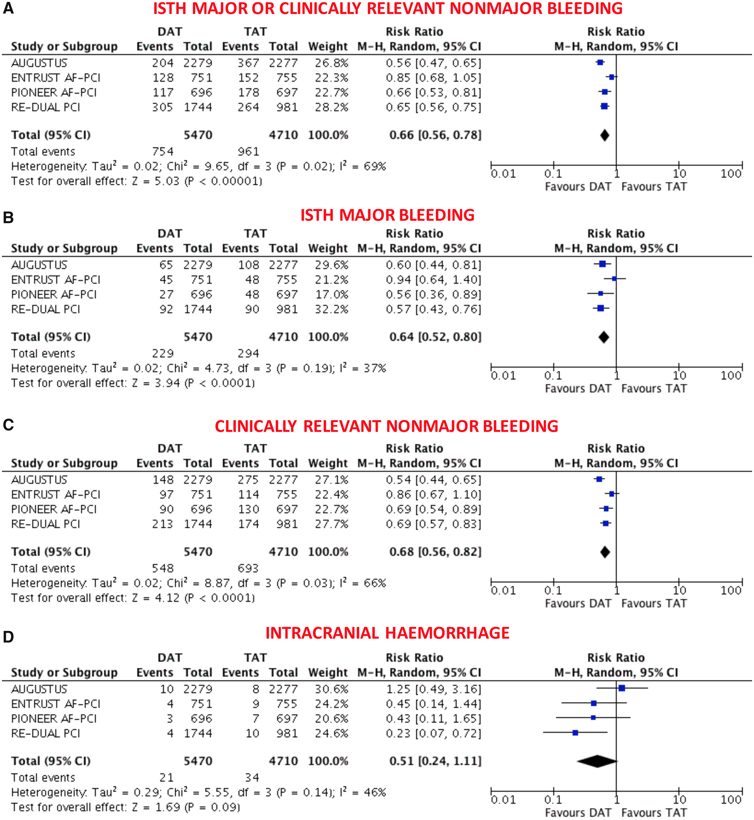
Figure 1 Main bleeding endpoints in double vs. triple antithrombotic therapy. (A) ISTH Major or clinically relevant ...
Notes:
Figure 1 Main bleeding endpoints in double vs. triple antithrombotic therapy. (A) ISTH Major or clinically relevant non-major bleeding; (B) ISTH major bleeding; (C) clinically relevant non-major bleeding; (D) intracranial haemorrhage. Random-effects risk ratios and 95% confidence intervals for main bleeding endpoints. CRNMB, clinically relevant non-major bleeding; DAT, double antithrombotic therapy; ISTH, International Society on Thrombosis and Haemostasis; M–H, Mantel–Haenszel; PCI, percutaneous coronary intervention; TAT, triple antithrombotic therapy. Note: PIONEER AF-PCI provided individual endpoints of ISTH major and CRNMB but not the composite that was derived by the sum of these two. Re-DUAL PCI did not provide CRNMB that was derived by subtracting ISTH major by the composite.
Unless provided in the caption above, the following copyright applies to the content of this slide: © The Author(s) 2019. Published by Oxford University Press on behalf of the European Society of Cardiology.This is an Open Access article distributed under the terms of the Creative Commons Attribution Non-Commercial License (http://creativecommons.org/licenses/by-nc/4.0/), which permits non-commercial re-use, distribution, and reproduction in any medium, provided the original work is properly cited. For commercial re-use, please contact journals.permissions@oup.com

Slide 41
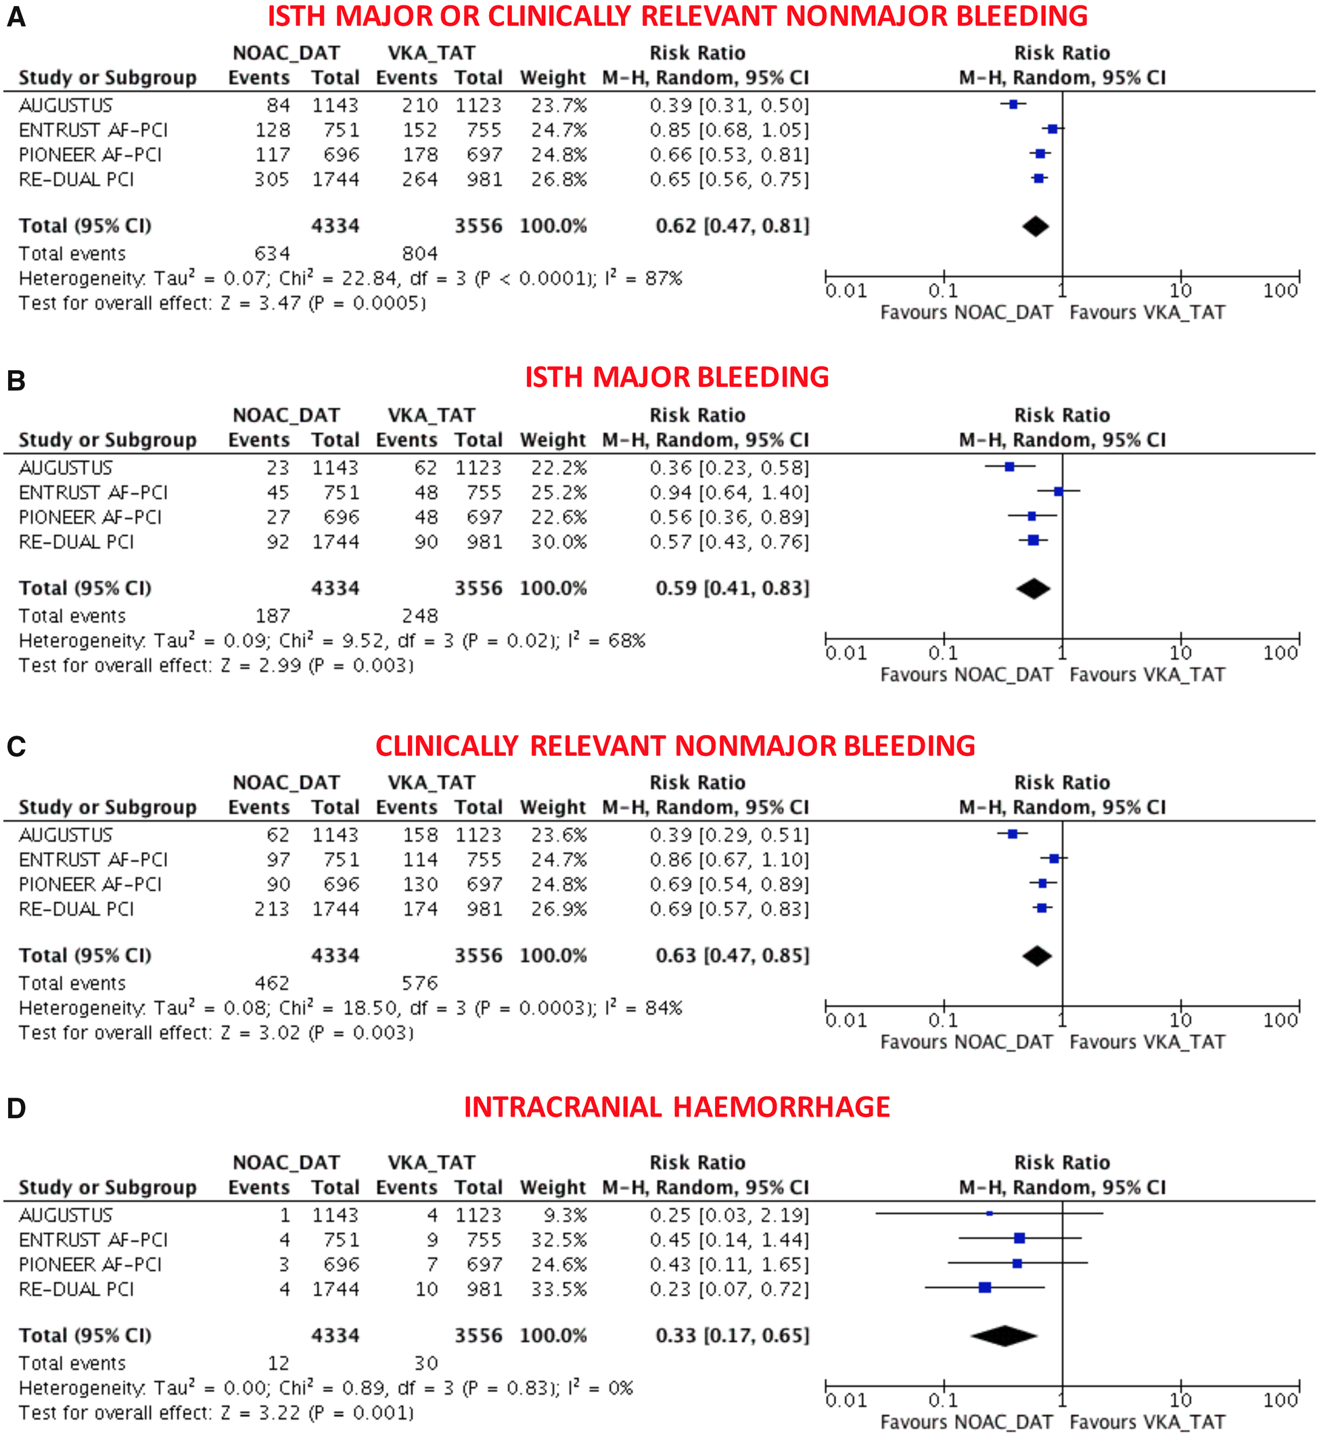
Figure 2 Main bleeding endpoints in non-vitamin K antagonist oral anticoagulant-based double antithrombotic therapy ...
Notes:
Figure 2 Main bleeding endpoints in non-vitamin K antagonist oral anticoagulant-based double antithrombotic therapy vs. vitamin K antagonist-based triple antithrombotic therapy. (A) ISTH Major or clinically relevant non-major bleeding; (B) ISTH major bleeding; (C) clinically relevant non-major bleeding; (D) intracranial haemorrhage. Random-effects risk ratios and 95% confidence intervals for main bleeding endpoints. DAT, double antithrombotic therapy; ISTH, International Society on Thrombosis and Haemostasis; M–H, Mantel–Haenszel; NOAC, non-vitamin K antagonist oral anticoagulant; PCI, percutaneous coronary intervention; TAT, triple antithrombotic therapy; VKA, vitamin K antagonist.
Unless provided in the caption above, the following copyright applies to the content of this slide: © The Author(s) 2019. Published by Oxford University Press on behalf of the European Society of Cardiology.This is an Open Access article distributed under the terms of the Creative Commons Attribution Non-Commercial License (http://creativecommons.org/licenses/by-nc/4.0/), which permits non-commercial re-use, distribution, and reproduction in any medium, provided the original work is properly cited. For commercial re-use, please contact journals.permissions@oup.com

Slide 42
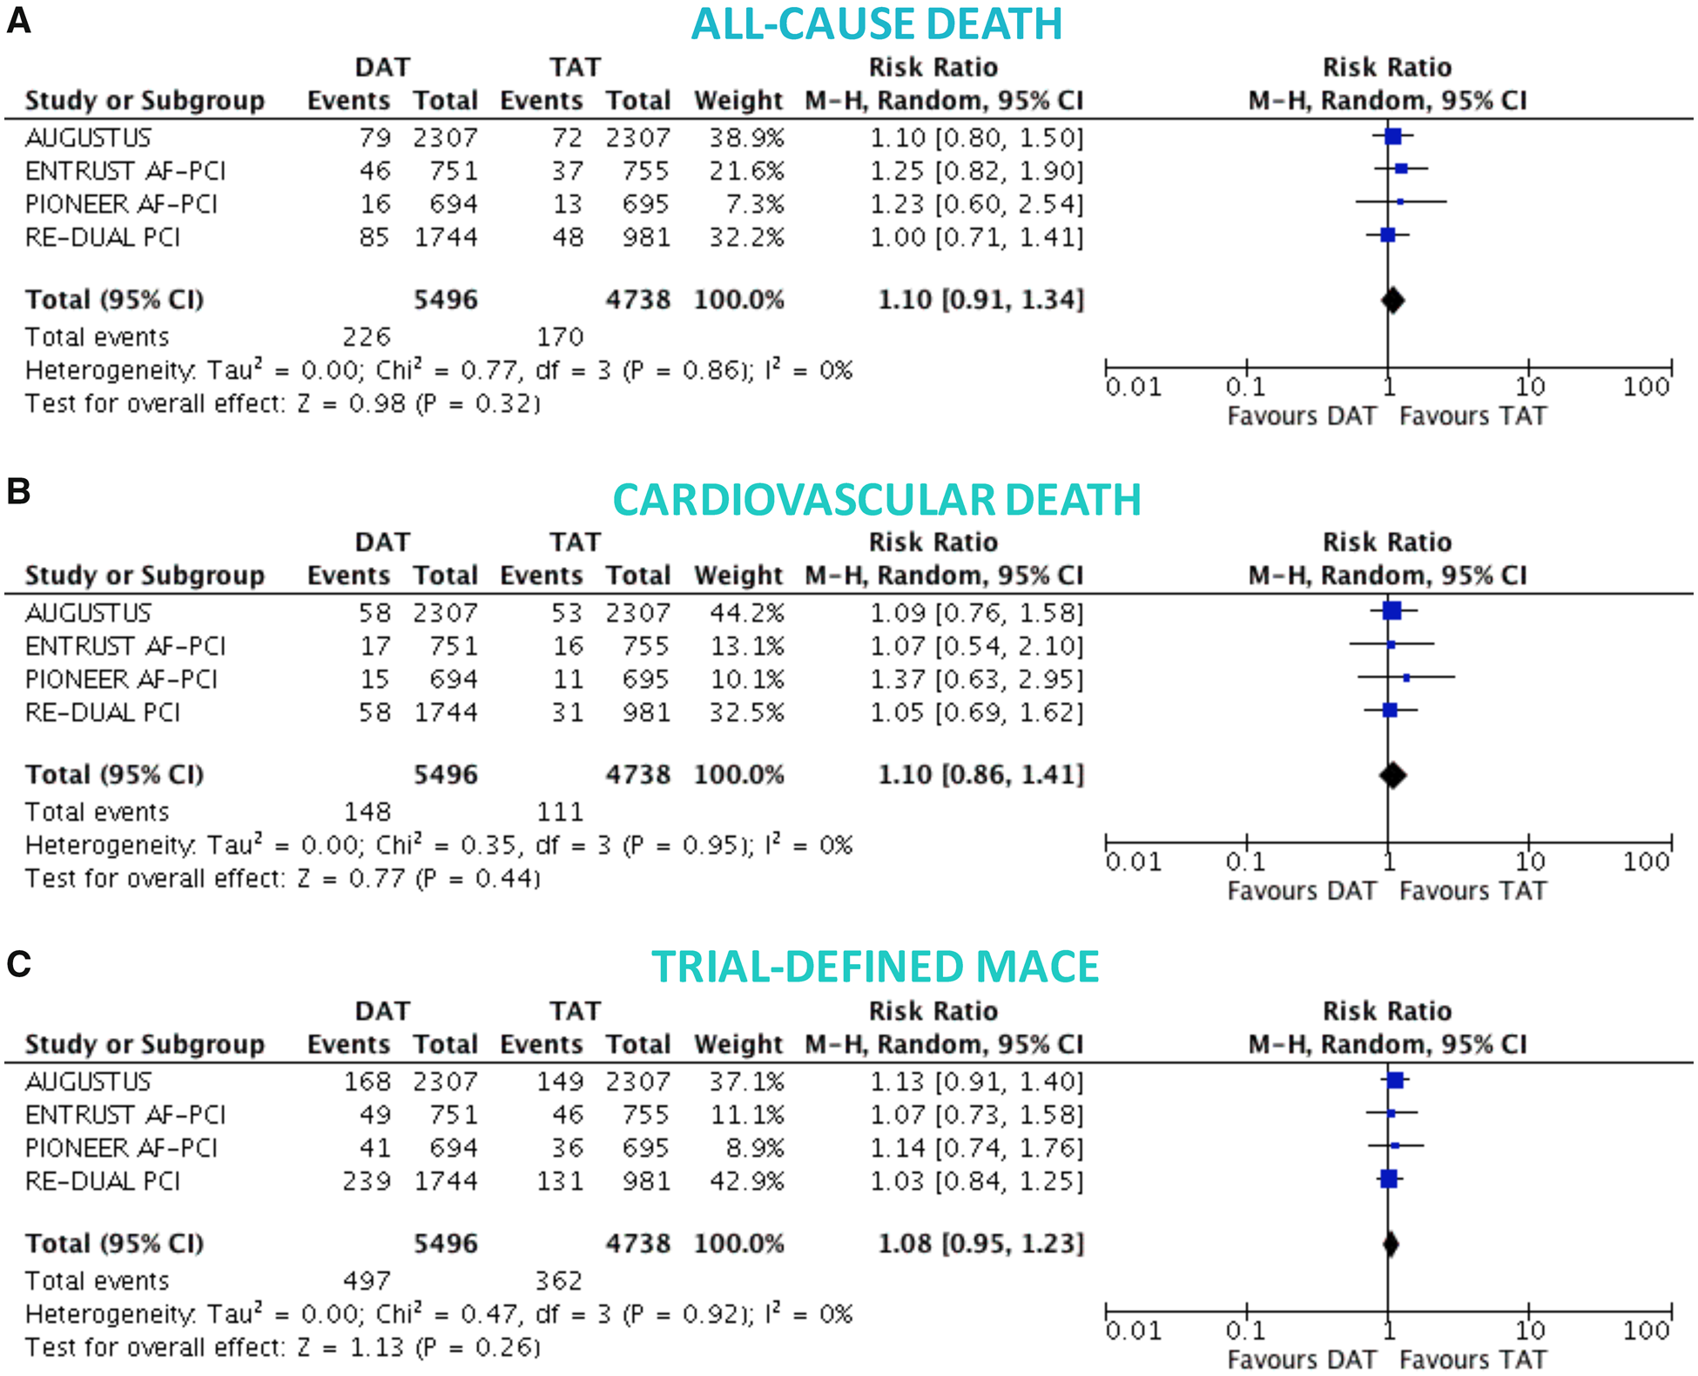
Figure 3 Death and major adverse cardiovascular events in double vs. triple antithrombotic therapy. Random-effects ...
Notes:
Figure 3 Death and major adverse cardiovascular events in double vs. triple antithrombotic therapy. Random-effects risk ratios and 95% confidence intervals for all-cause death (A), cardiovascular death (B), and major adverse cardiovascular events (C). Abbreviations as Figure1.
Unless provided in the caption above, the following copyright applies to the content of this slide: © The Author(s) 2019. Published by Oxford University Press on behalf of the European Society of Cardiology.This is an Open Access article distributed under the terms of the Creative Commons Attribution Non-Commercial License (http://creativecommons.org/licenses/by-nc/4.0/), which permits non-commercial re-use, distribution, and reproduction in any medium, provided the original work is properly cited. For commercial re-use, please contact journals.permissions@oup.com

Slide 43
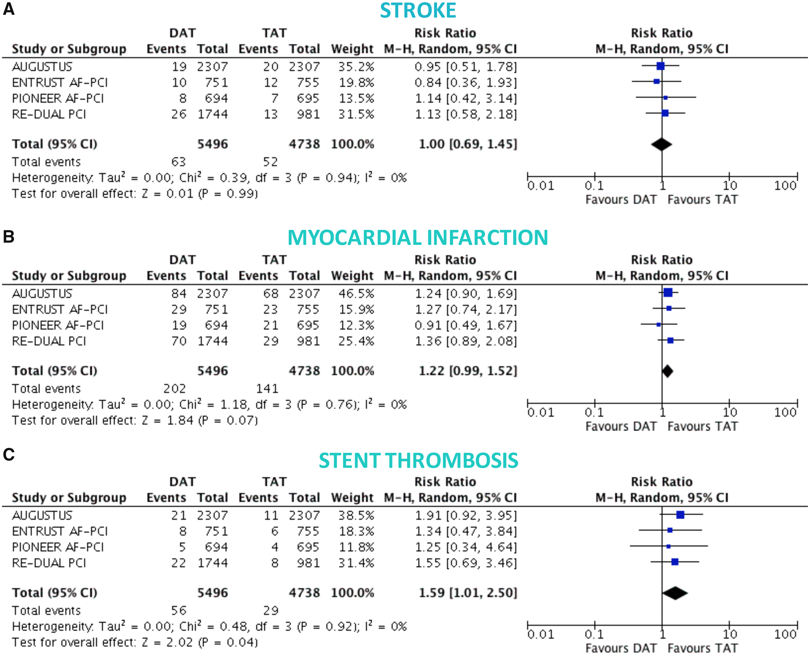
Figure 4 Ischaemic endpoints in double vs. triple antithrombotic therapy. Random-effects risk ratios and 95% ...
Notes:
Figure 4 Ischaemic endpoints in double vs. triple antithrombotic therapy. Random-effects risk ratios and 95% confidence intervals for stroke (A), myocardial infarction (B), and ST (C). Note: stent thrombosis definitions were not overlapping, and numbers refer to definite ST for the RE-DUAL PCI and ENTRUST AF-PCI trials, likely definite ST also for PIONEER-AF PCI (not clearly reported, but low numbers suggest this), and definite or probable ST for AUGUSTUS. Abbreviations as Figure1.
Unless provided in the caption above, the following copyright applies to the content of this slide: © The Author(s) 2019. Published by Oxford University Press on behalf of the European Society of Cardiology.This is an Open Access article distributed under the terms of the Creative Commons Attribution Non-Commercial License (http://creativecommons.org/licenses/by-nc/4.0/), which permits non-commercial re-use, distribution, and reproduction in any medium, provided the original work is properly cited. For commercial re-use, please contact journals.permissions@oup.com

Slide 44


Figure 4 Ischaemic endpoints in double vs. triple antithrombotic therapy. Random-effects risk ratios and 95% ...
Notes:
Figure 4 Ischaemic endpoints in double vs. triple antithrombotic therapy. Random-effects risk ratios and 95% confidence intervals for stroke (A), myocardial infarction (B), and ST (C). Note: stent thrombosis definitions were not overlapping, and numbers refer to definite ST for the RE-DUAL PCI and ENTRUST AF-PCI trials, likely definite ST also for PIONEER-AF PCI (not clearly reported, but low numbers suggest this), and definite or probable ST for AUGUSTUS. Abbreviations as Figure1.
Unless provided in the caption above, the following copyright applies to the content of this slide: © The Author(s) 2019. Published by Oxford University Press on behalf of the European Society of Cardiology.This is an Open Access article distributed under the terms of the Creative Commons Attribution Non-Commercial License (http://creativecommons.org/licenses/by-nc/4.0/), which permits non-commercial re-use, distribution, and reproduction in any medium, provided the original work is properly cited. For commercial re-use, please contact journals.permissions@oup.com

Slide 45
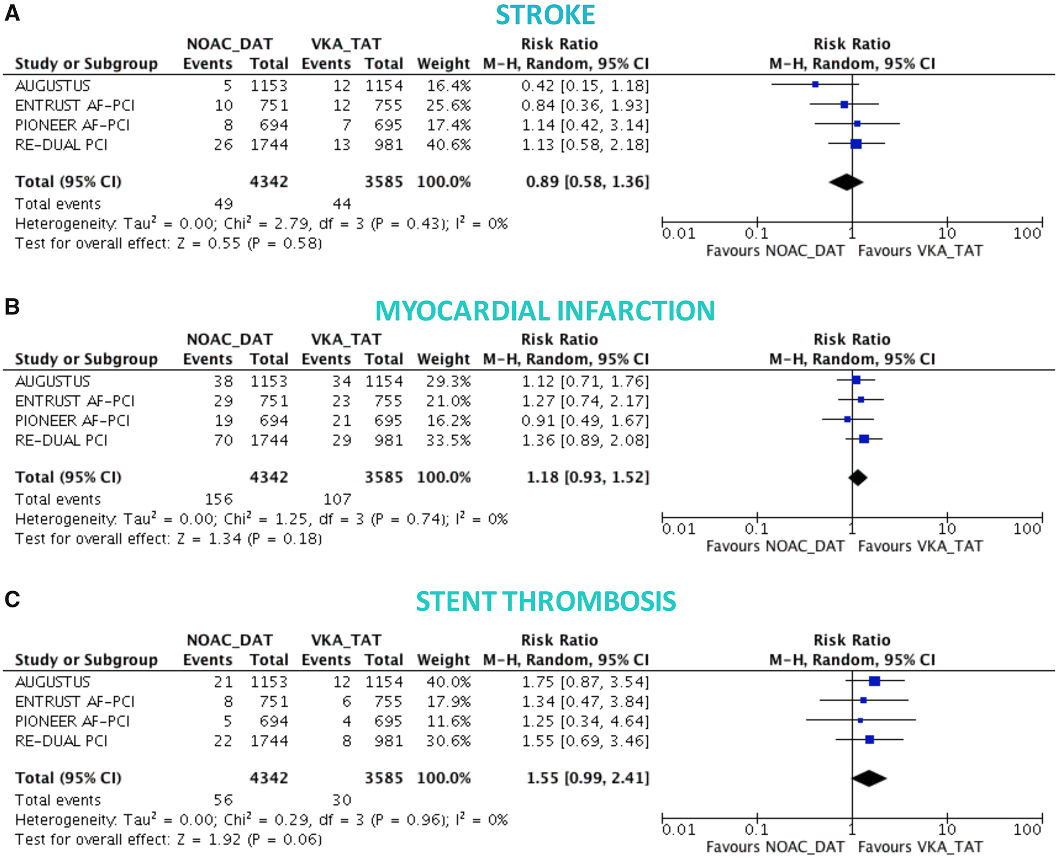
Figure 6 Ischaemic endpoints in non-vitamin K antagonist oral anticoagulant-based double antithrombotic therapy vs. ...
Notes:
Figure 6 Ischaemic endpoints in non-vitamin K antagonist oral anticoagulant-based double antithrombotic therapy vs. vitamin K antagonist-based triple antithrombotic therapy. Random-effects risk ratios and 95% confidence intervals for stroke (A), myocardial infarction (B), and stent thrombosis (C). Note: number of events of stent thrombosis stratified by NOAC-DAT vs. VKA-TAT for the AUGUSTUS come from a recent meta-analysis and likely correspond to definite or probable or possible ST.
Unless provided in the caption above, the following copyright applies to the content of this slide: © The Author(s) 2019. Published by Oxford University Press on behalf of the European Society of Cardiology.This is an Open Access article distributed under the terms of the Creative Commons Attribution Non-Commercial License (http://creativecommons.org/licenses/by-nc/4.0/), which permits non-commercial re-use, distribution, and reproduction in any medium, provided the original work is properly cited. For commercial re-use, please contact journals.permissions@oup.com

Slide 46
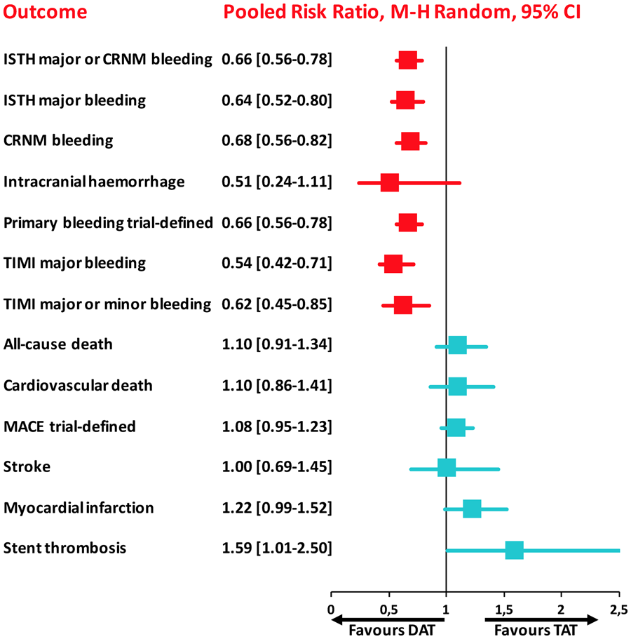
Take home figure The summary of safety and efficacy endpoints in double vs. triple antithrombotic therapy demonstrating that ...
Notes:
Take home figure The summary of safety and efficacy endpoints in double vs. triple antithrombotic therapy demonstrating that double antithrombotic therapy is associated with reduction of bleeding events but with a trade-off of cardiac ischaemic complications. Pooled random-effects risk ratios with 95% confidence intervals for safety and efficacy endpoints. CRNM, clinically relevant non-major; DAT, double antithrombotic therapy; ISTH, International Society on Thrombosis and Haemostasis; MACE, major adverse cardiovascular events; TAT, triple antithrombotic therapy; TIMI, thrombolysis in myocardial infarction.
Unless provided in the caption above, the following copyright applies to the content of this slide: © The Author(s) 2019. Published by Oxford University Press on behalf of the European Society of Cardiology.This is an Open Access article distributed under the terms of the Creative Commons Attribution Non-Commercial License (http://creativecommons.org/licenses/by-nc/4.0/), which permits non-commercial re-use, distribution, and reproduction in any medium, provided the original work is properly cited. For commercial re-use, please contact journals.permissions@oup.com

Slide 47
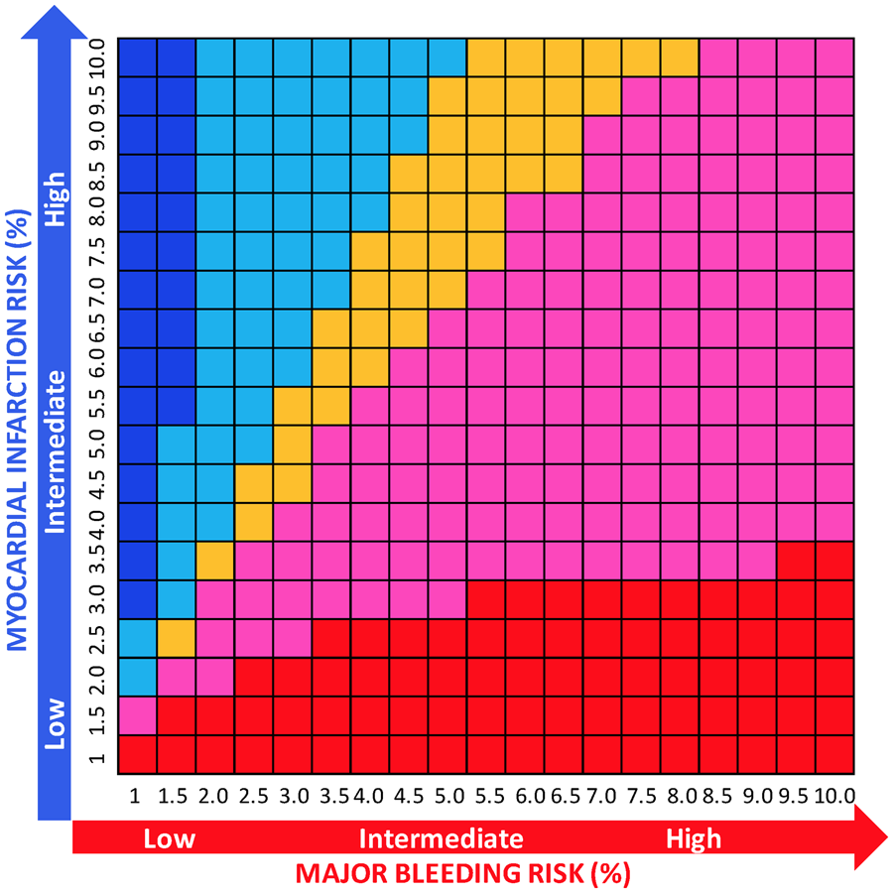
Figure 7 Number needed to treat for benefit or harm for double vs. triple antithrombotic therapy according to risk of ...
Notes:
Figure 7 Number needed to treat for benefit or harm for double vs. triple antithrombotic therapy according to risk of major bleeding and myocardial infarction. At each risk (%) ranging from 1% to 10% for both major bleeding and myocardial infarction, the difference between NNTB and NNTH was calculated. Red indicates that the net benefit of double vs. triple antithrombotic therapy is in favour of bleeding (NNTB < NNTH, thus reduction of bleeding is higher than the risk of myocardial infarction) and its intensity refers to greater (dark red) or lower (light red/pink) benefit (with the cut-off range selected arbitrarily to be −100 to 100), while blue indicates a net ischaemic harm (NNTB > NNTH, thus the reduction of bleeding is lower than the risk of myocardial infarction) and its intensity refers to greater (dark blue) or lower (light blue) harm (with the cut-off range selected arbitrarily to be −100 to 100). Orange indicates a neutral effect (NNTB = NNTH; we arbitrarily selected a range from −10 to 10 to consider the effect as neutral).
Unless provided in the caption above, the following copyright applies to the content of this slide: © The Author(s) 2019. Published by Oxford University Press on behalf of the European Society of Cardiology.This is an Open Access article distributed under the terms of the Creative Commons Attribution Non-Commercial License (http://creativecommons.org/licenses/by-nc/4.0/), which permits non-commercial re-use, distribution, and reproduction in any medium, provided the original work is properly cited. For commercial re-use, please contact journals.permissions@oup.com

Slide 48
European Heart Journal (2019) 0, 1–11

Slide 49
Double antithrombotic therapy, compared with TAT, significantly reduced major and CRNMB, but
only NOAC-based DAT was associated with a significant decrease of intracranial haemorrhage
Double antithrombotic therapy was associated with similar rates of MACE, all-cause or cardiovascular death and stroke when compared with TAT; however, it increased the risk of myocardial infarction and ST, with a statistical borderline and.
These risks appeared slightly greater when dabigatran 110 mg, but not dabigatran 150 mg, was separately appraised in the DAT group

Slide 50
Compared with TAT, DAT, particularly when based on
NOACs, is associated with a reduction in bleeding complications, including major and intracranial haemorrhages. However, this benefit is counterbalanced by a higher risk of ischaemic, mainly stent-related, events

Slide 51
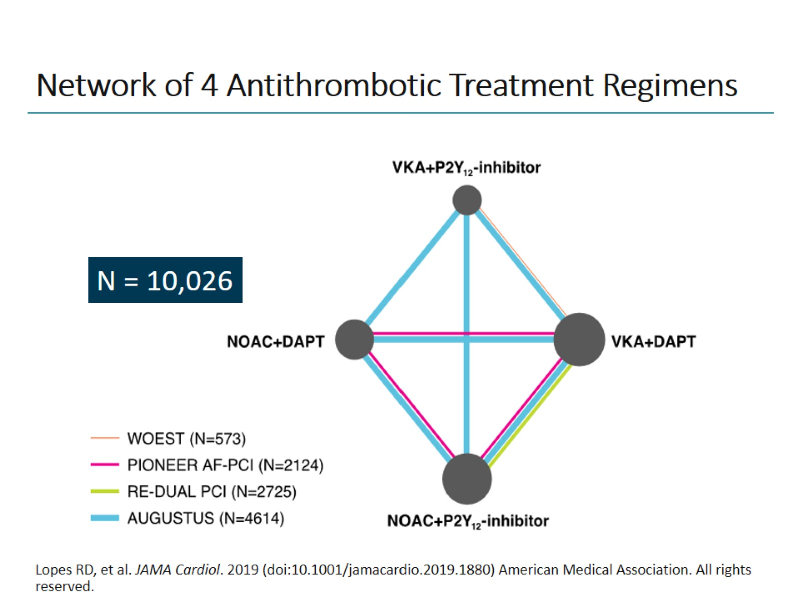
Network of 4 Antithrombotic Treatment Regimens

Slide 55
In patients with AF undergoing PCI, NOAC plus P2Y12 inhibitor was associated with fewer bleeding complications, including intracranial bleeding, without a significant difference in ischemic events compared with VKA plus DAPT
results support the use of an NOAC and P2Y12 inhibitor as the preferred treatment option for this high-risk patient population.
regimens that include a VKA plus a P2Y12 inhibitor plus aspirin should generally be avoided

Slide 56
Considerations
J Am Coll Cardiol 2019;74:83–99

Slide 57
Considerations
J Am Coll Cardiol 2019;74:83–99

Slide 59





Thank You תודה רבה

