Slide 1
Device programming for CRT optimization
David Luria, MD
Hadassah Medical Center

Slide 2
Conflict of interest
NONE

Slide 3
“What is your routine practice for CRT optimization?”
”Im not sure I remember what is it!”

Slide 4
Non responders- continue challenge

Slide 5
Optimization: concept
Patient selection
Medical therapy correction
Guarantee 100% pacing (to treat PVC, AF)
Intraoperative optimization (lead position )
Programming optimization (AV/VV, MPP)

Slide 6
Electrical or mechanical resynchronization?
Electrical Concept: “Electrical therapy for electric problem”
Solution: pace at the latest activation (q-LV interval) and target shortest pace QRS
Mechanical concept: Final result is contraction improve
Solution: use ECHO, dP/dt guidance and target best hemodynamic parameters

Slide 7
Lead placement
Lateral wall (postero-lateral, antero-lateral)
Non apical (MADIT CRT, REVERCE )
Latest activation (Q-LV or RV-LV)
Latest contraction (ECHO, speckle tracking)
Escape scared myocardium (ECHO, radial strain)
Multisite/multipolar pacing

Slide 8
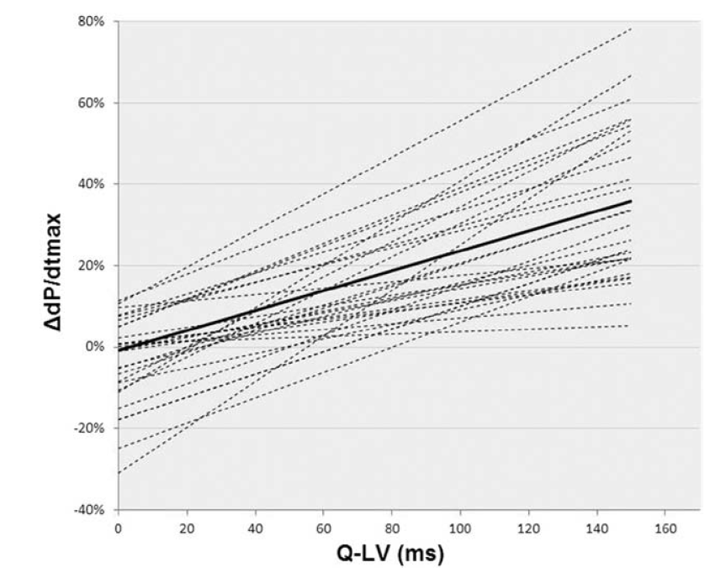
23 consecutive pts
All available veins
Acute electrical & hemodynamic measurements
Q-LV = 95 msec ensure > 10% increase of dP/dt in all pts

Slide 9
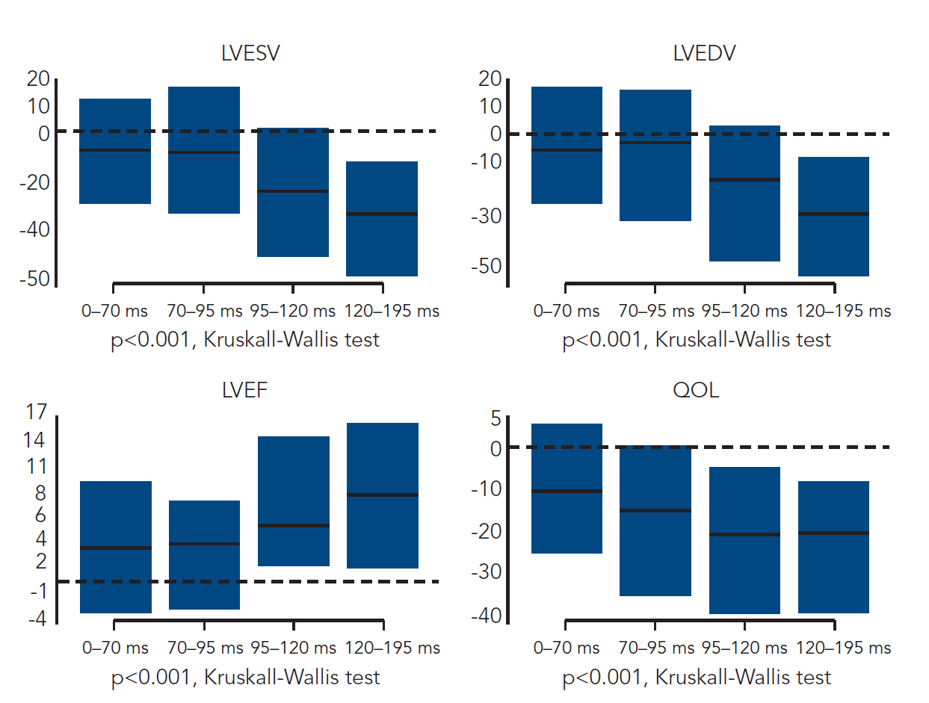
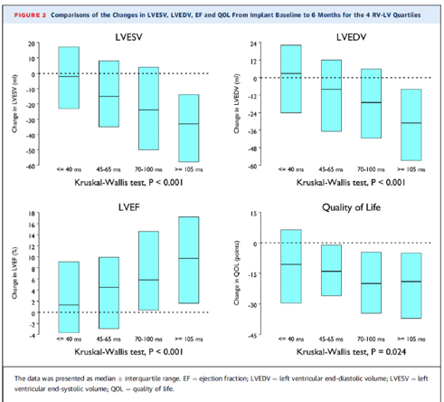
Q-LV & RV-LV intervals for prediction of CRT response

Slide 10
Speckle Tracking Radial Strain Imaging - guided
Lead Placement For Improving Response to CRT
In Patients With Ischemic CMP
- The Raise CRT Trial -
Michael Glikson(1), Gregory Golovchiner (2) , Moshe Swissa (3), Monther Boulus (4) Sami Viskin (5) Aharon Medina (1), Moti Haim (6) , Paul Friedman (7) , Vladimir Khalameizer (8), Ori Vatury (9 ) , Ito Saki (7), Nir Shlomo (10), Jae K. Oh (7), Ilan Goldenberg (10), Roy Beinart (9)

Slide 11
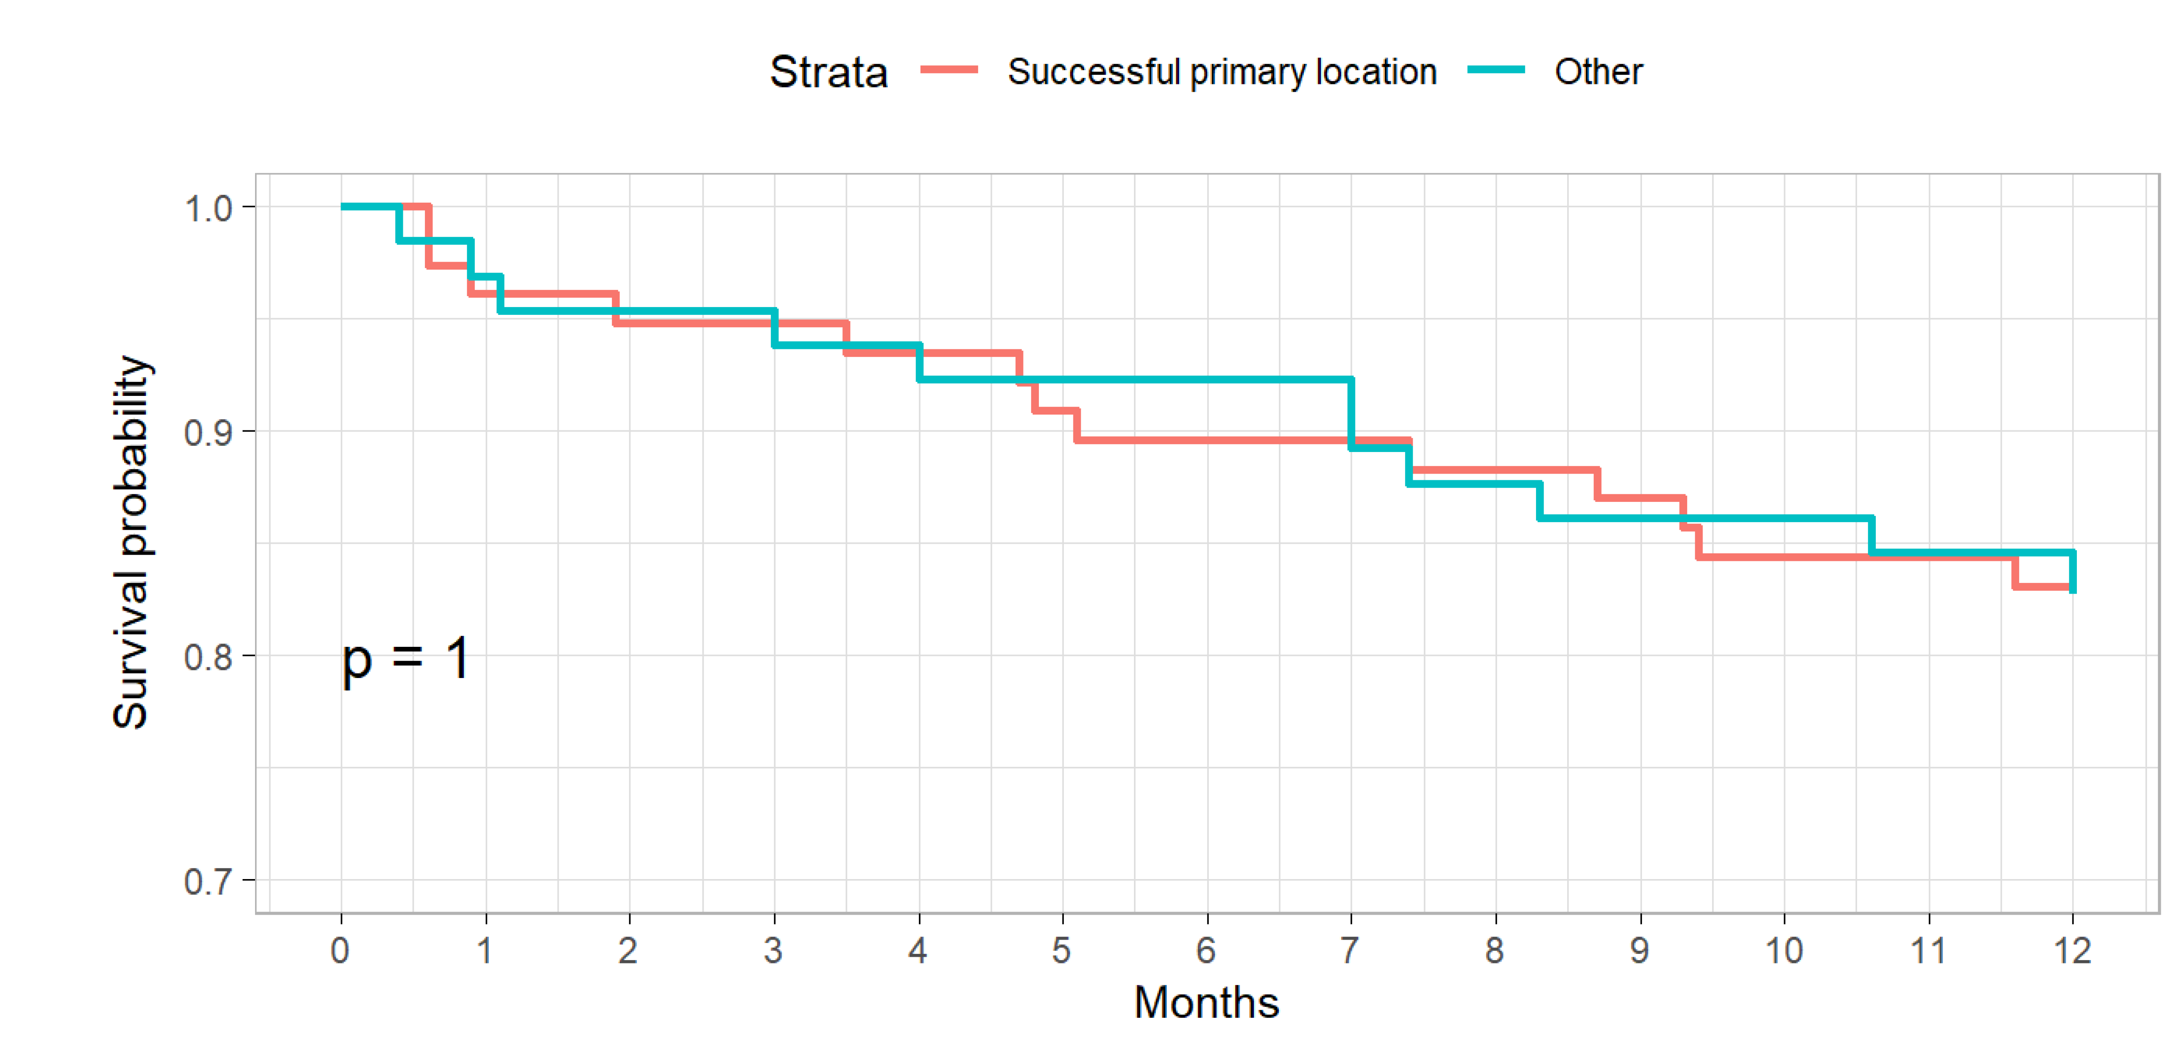
Combined outcome 12 m – MACE (death, CHF hospitalization )

Slide 12
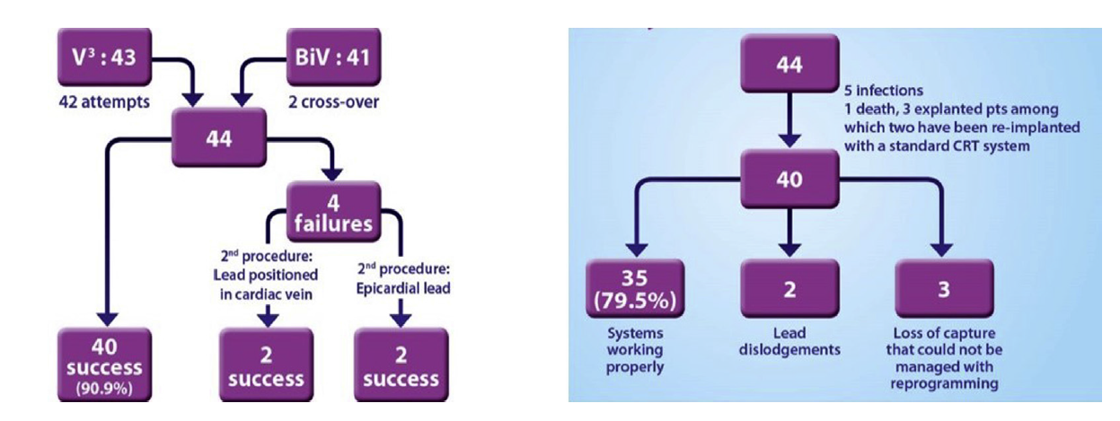
Results:
  20% procedure/system related complications
  At 12 and 24 months no difference in:
  - Hospitalizations
  - NYHA
  - EF

Slide 13
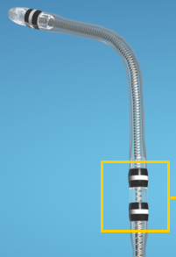
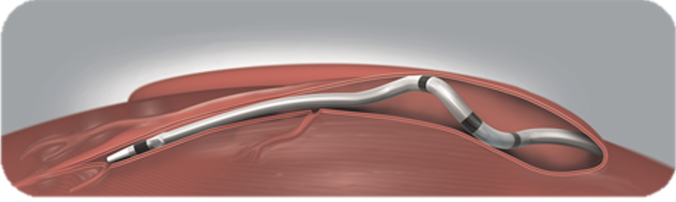
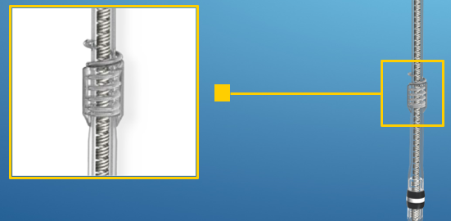
Lead’s advances
Quadripolar leads
Passive fixation
Active fixation

Slide 14
44 pts
1:1 randomization for MPP
12 months f/u

Slide 15
110 consecutive pts
Intraoperative lead position optimization by Q-LV and
dP/dt max
1 year follow up
“RESPONDER”
  - 15% ESV
  - I NYHA
  Packer’s score =0

Slide 16
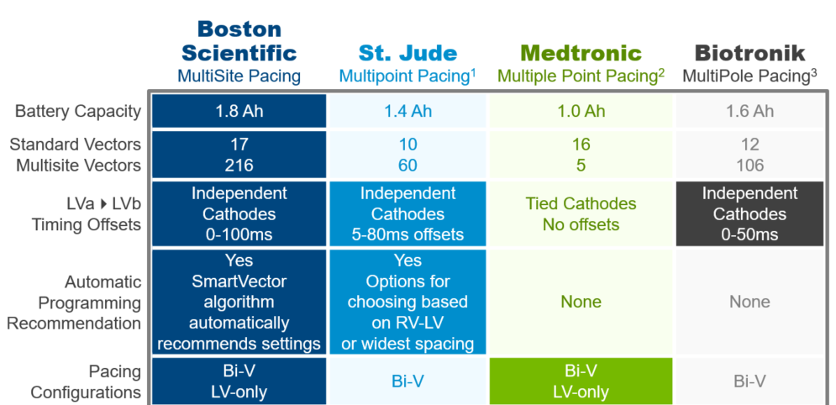

Slide 17
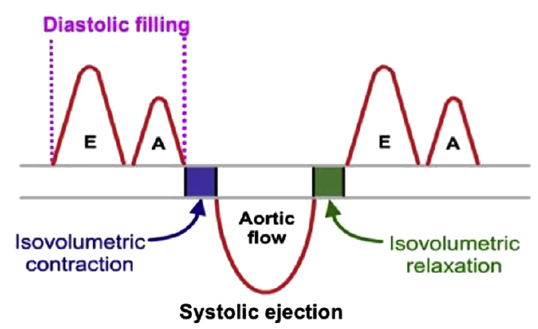
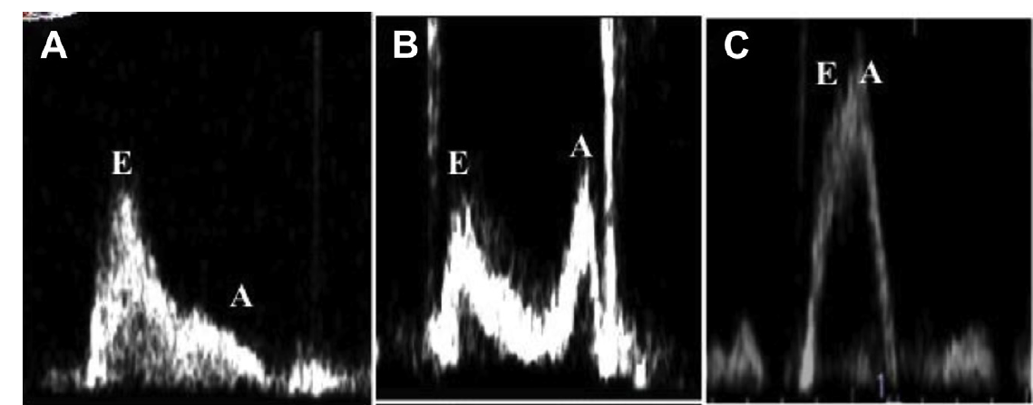
Timing programing optimization
AV delay – ventricular filling optimization
  Too long (early atrial contraction)– decrease atrial diastolic feeling
  Too short – decrease atrial kick
VV delay – synchronization optimization

Slide 18


Slide 19
Optimization: limitations
Not adapting to changing conditions:
  Orthostasis
  Exercise
  Loading conditions
  Drug regimen
Time and resource consuming
Clinical significance of observing hemodynamic changes are questionable

Slide 20
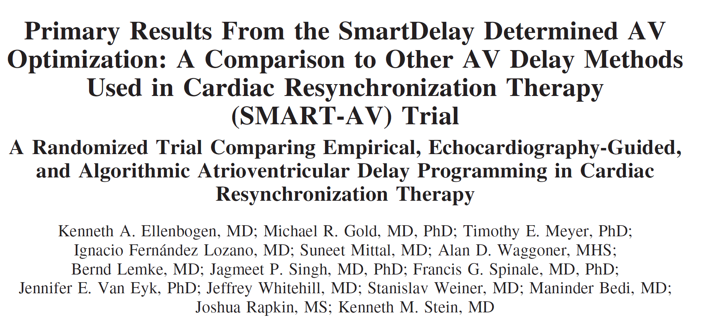
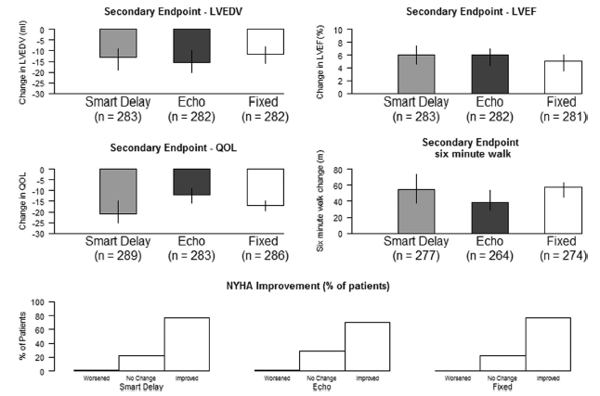
Prospective randomized 1:1:1
  FIXED AV delay = 120 ms
  ECHO optimization by mitral inflow
  BOSTON SC SmartDelayTM
6 month clinical/ECHO follow up
NO DIFFERENCE in any parameter

Slide 21
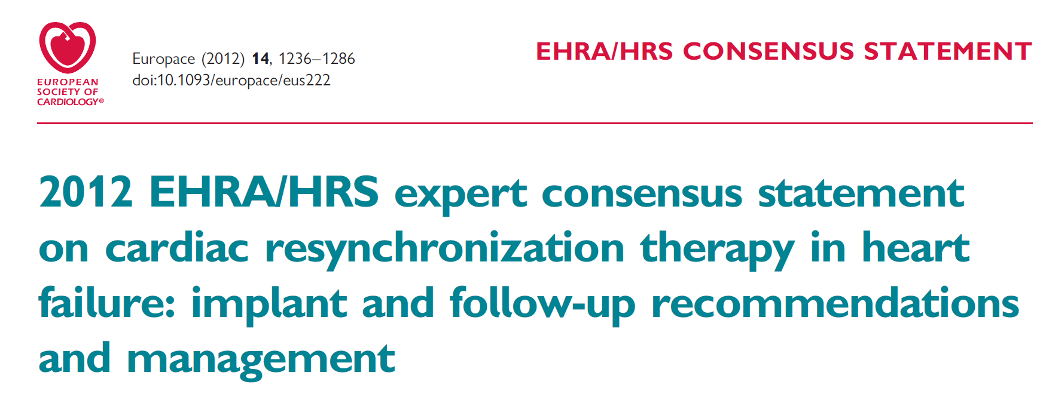
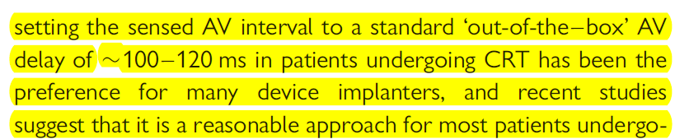
GUIDELINES citations

Slide 22
Device-based optimization algorithms

Slide 23
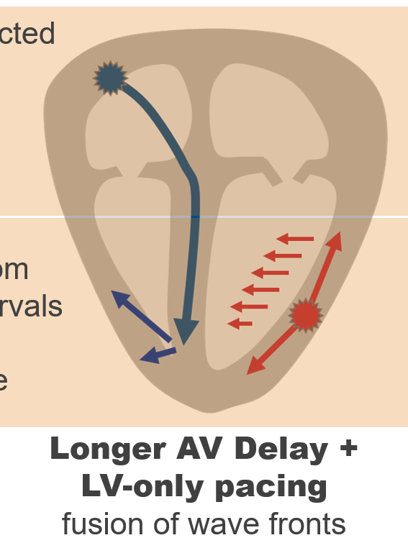
BOSTON SC – SmartDelayTM
Target: to allowed native septum activation
Method: paced/sensed AV and RV/LV conductions measurements (AV optimization only)
Programming: run of semi-automatic algorithm after implant
NOTE: frequent only LV pacing and long AV delay
DATA:
  Favorite small hemodynamic studies
  SMART AV prospective randomized clinical trial – NEGATIVE results
  Some advantage in subgroups of pts

Slide 24
SMART AV study sub-analysis
280 pts
Randomization
  Fixed AV 120
  SD (EG based algorithm)
End point: ESV reduction >15%

Slide 25
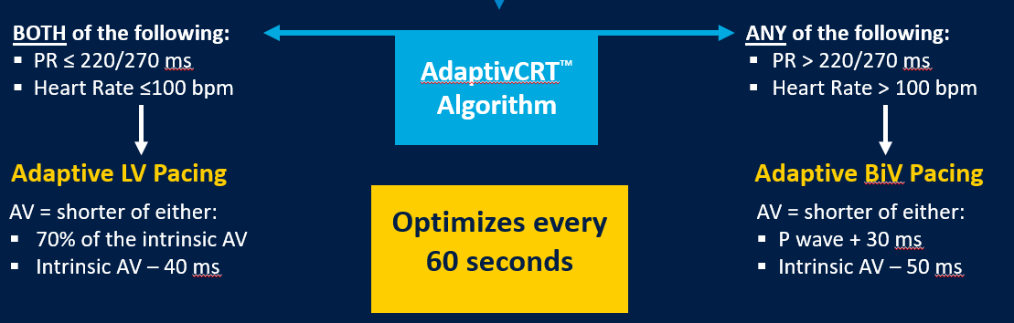
MEDTRONIC: AdaptiveCRT TM
BIOTRONIC : AutoAdaptTM
Target: to allowed native septum activation
Method: Dynamic every minute AV measurement
Programming: automatic AV/VV optimization

Slide 26
Prospecting randomized trial
2:1 aCRT to ECHO optimization
6 month follow up
Non-inferiority primary end points
  Clinical score (Packer)
  Echo AoVTI

Slide 27
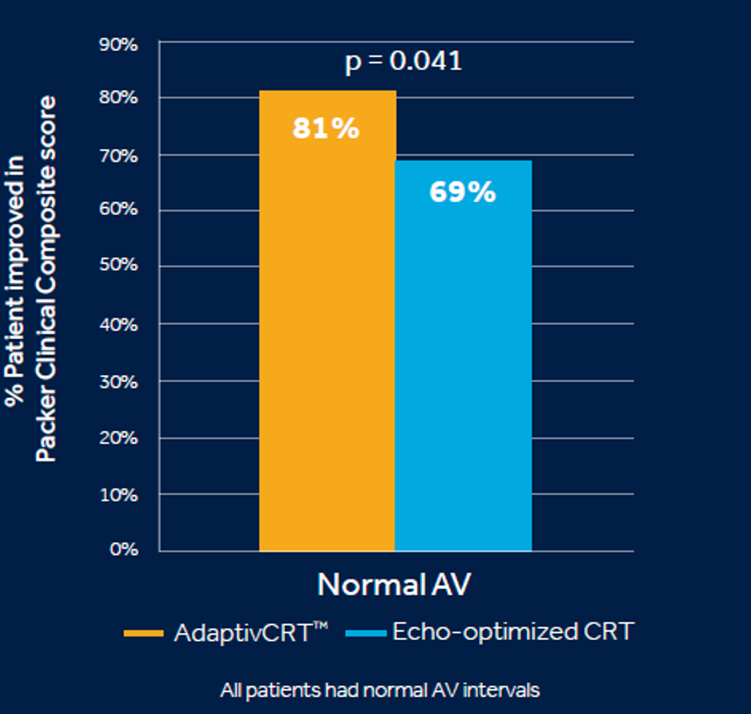
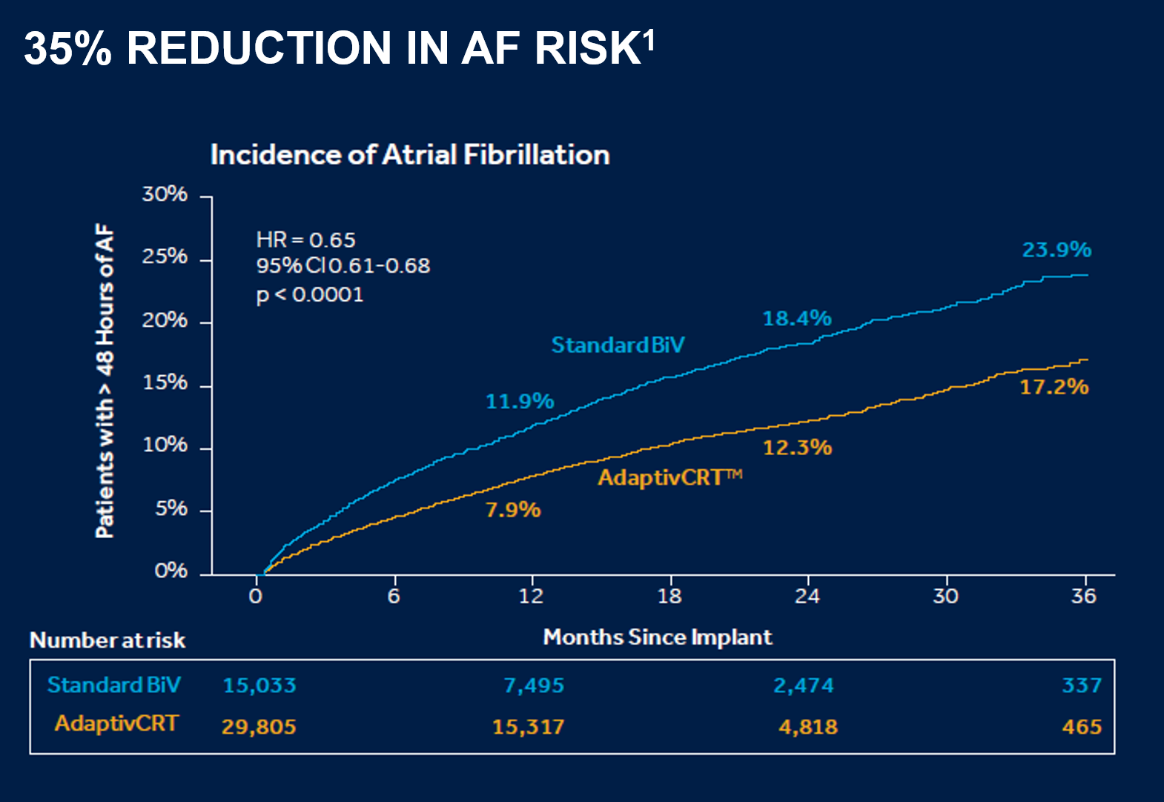
AdaptiveCRT TM
44,838 pts from CARE LINK data base Abstract from HRS 2017
Sub-analysis of “only LV pacing” group from Adaptive CRT trial. HR 2013 ; 10: 1368

Slide 28
ABBOT (SJM): Sync AV TM
Target: AV pacing by programmed offset
Method: Dynamic (every 256 beats) intrinsic AV measurement
Programming: automatic. AV offset programmable (-50 to -10)
Retrospective
Propensity matched
4:1
Abstarct, HRS 2019

Slide 29
CONCUSIONS
There are NO class I/IIA evidence/recommendations for intraoperative or programming optimization
Lead location selection for non apical area with latest
(more than 75-95 msec) Q-LV /RV-LV may be useful
Multipolar pacing from single quadripolar lead is promising
New automatic algorithms of AV/VV optimization demonstrated non inferiority as compared to ECHO guided optimization in randomized studies
LV pacing only/before RV may save buttery life and improve clinical results in subset of patients

Slide 30
Back up

Slide 31
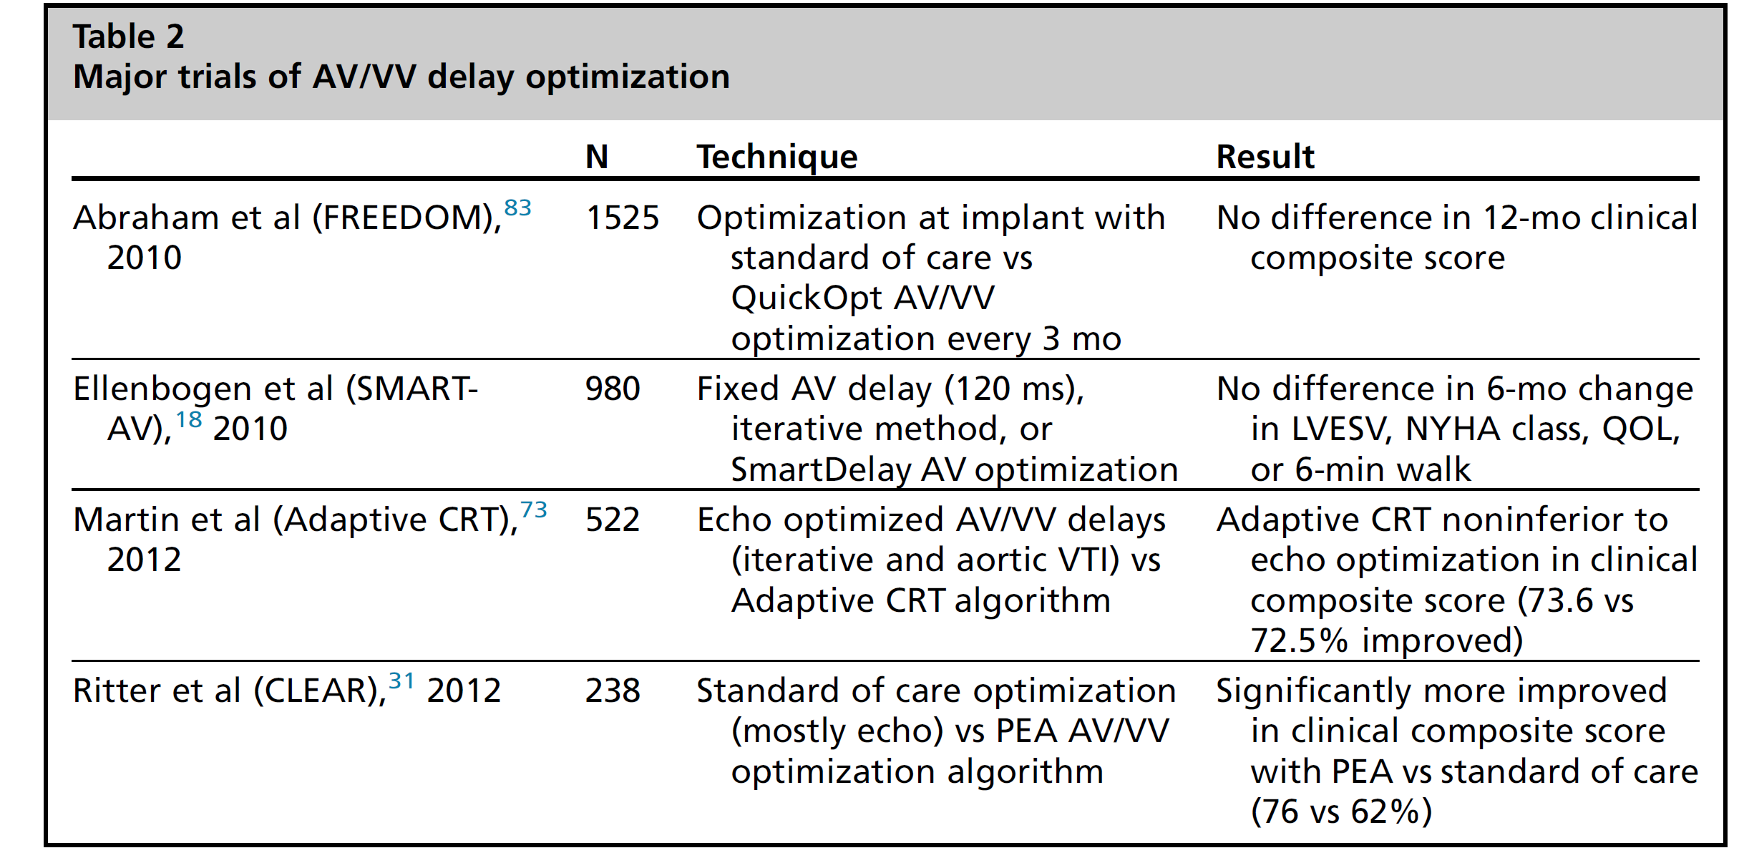

Slide 32
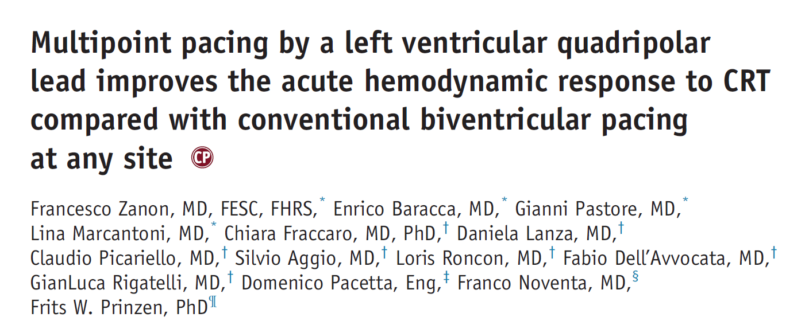

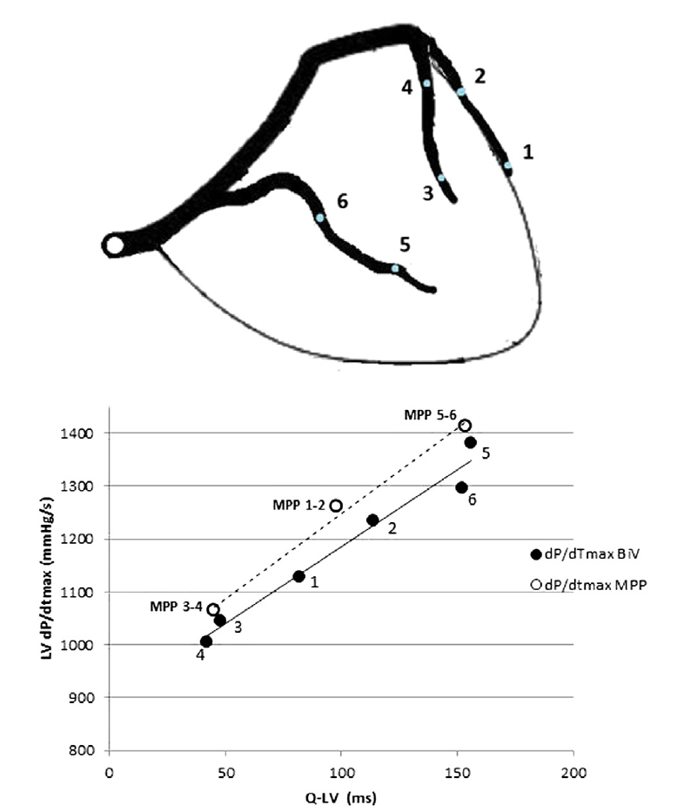
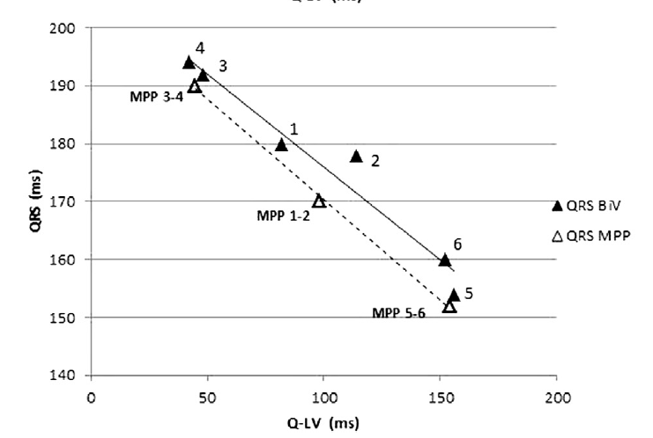

Slide 34
Reasons for insufficient response rate
Internal limitations –desynchronization is only part of the problem
  LBBB cardiomyopathy/pacing cardiomyopathy – very high responding rate
  Severe ischemic CMP – relatively low
Patient selection: RBBB vs LBBB, QRS width, AF, pt gender

Slide 35
Reasons for insufficient response rate
Absence of robust criteria for best lead position
Technical challenges in lead placing
  Limited choice of veins
  Low stability in proximal vein (basis LV)
  High threshold/diaphragmatic pacing
  Long procedure/Xray/contrast
Non physiological pacing
  epicardial
  partially synchronized

Slide 36



